Slide 1
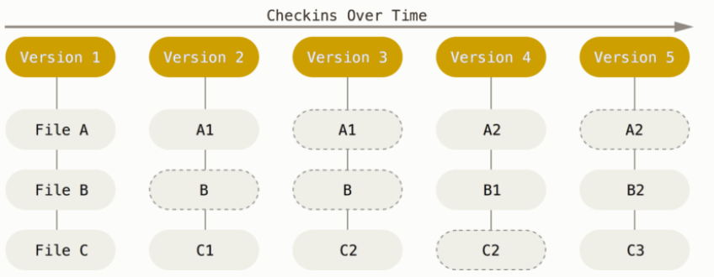
Git basically takes a picture of what all your files look like at that moment and stores a reference to that snapshot.

Slide 2
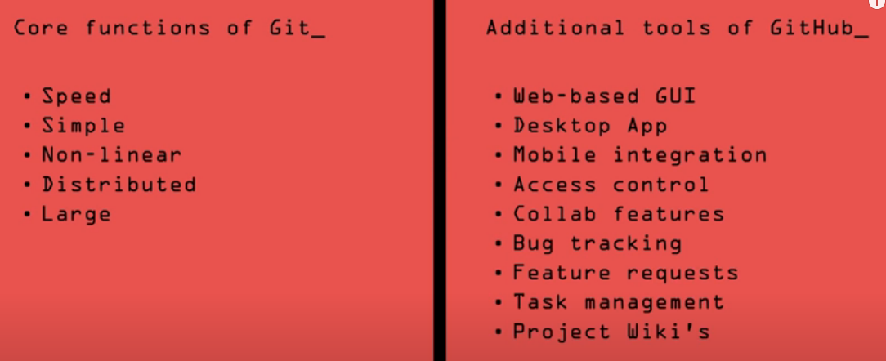
GitHub is a remote hosting system for sharing repos. You can use Git independently on your local machine and never share your work or use GitHub. Alternately, you can use Git to directly collaborate with others without using a shared hosting system like GitHub.

