Slide 1
ENPM808X Software Development for Robotics
Phase-1 Designing & Planning
Human Obstacle Detection and Tracking

Slide 2
Review
Aim: Design and develop the perception module for the AMCE Robotics’ AMR platform.
Perception Module: Human (N>=1) Obstacle Detector and Tracker
Requirements: Module must output location info directly usable in a robot's reference frame. Assume the use of only one monocular video camera. Must be able to obtain training/test data.

Slide 3
Phase 1: Planning
Following the Agile Development process we have done the following:
Created AIP Sheets for Product and Iteration Backlog.
Created Sprint Review notes for discussing the task execution and its approximate time allotment.

Slide 4
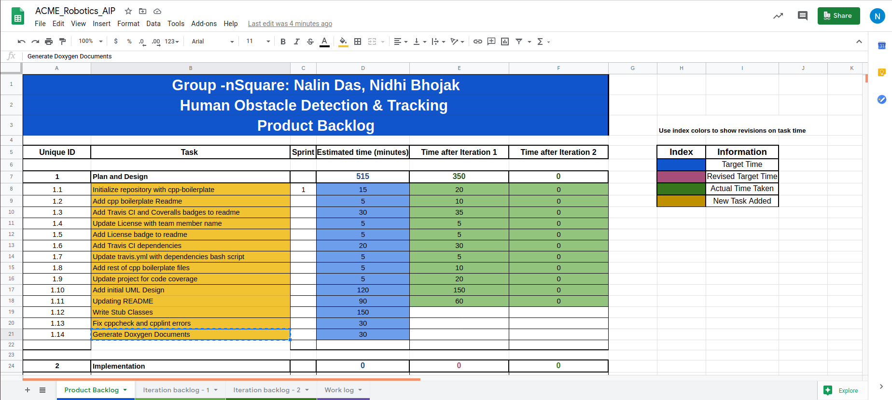
Tasks

Slide 5
Phase 1: Design

Slide 6
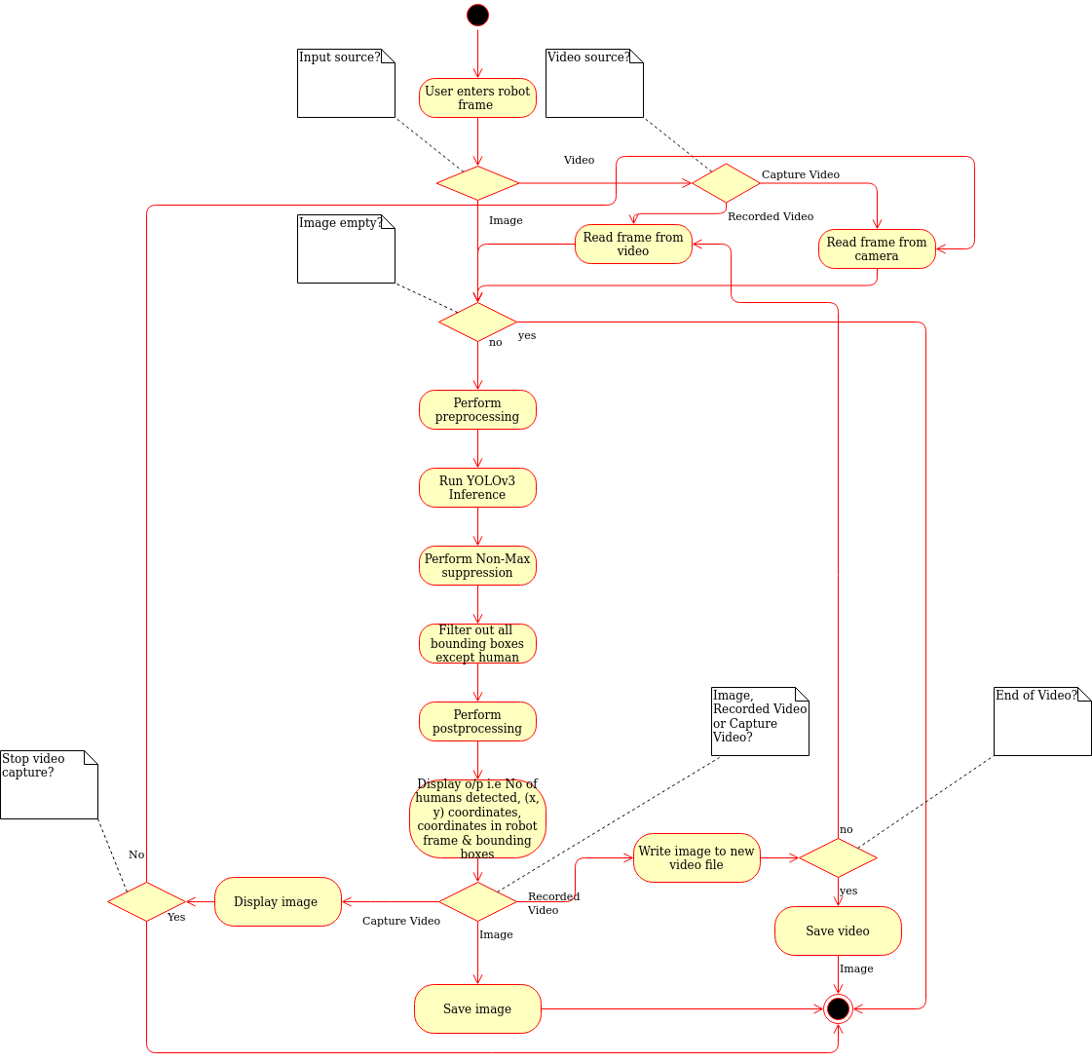
UML Diagrams
Activity Diagram

Slide 7
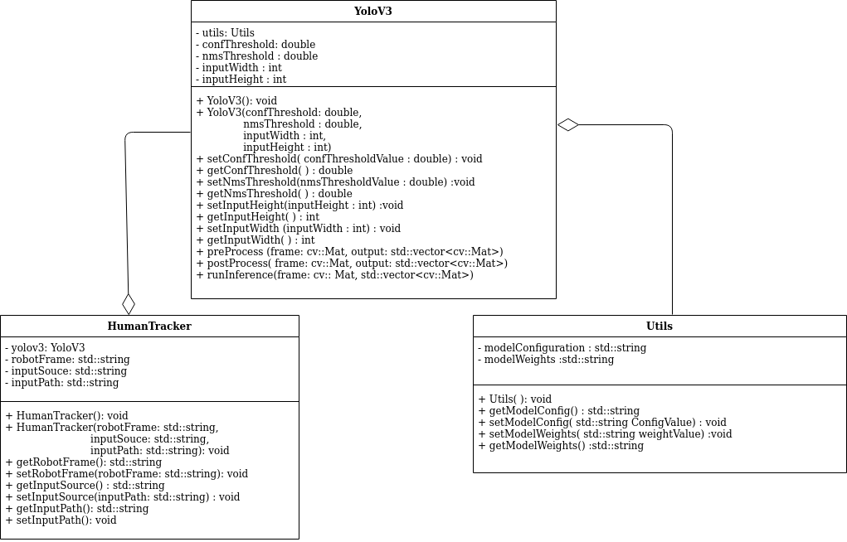
UML Diagrams
Class Diagram

Slide 8
Modifications added
Added selectable input source (i.e. Image, Video, Capture Video)
Option for choosing Robot Frame and automatically generating the transform
Updated README with all the necessary documentation

Slide 9
THANK YOU!!

