Slide 1


STREAMFLIX Analytics Dashboard
Team Members: Nalini, Bella, Rizwan, Matthew
Notes:
Good [morning/afternoon] everyone. We’re the Streamflix Analytics Team — Nalini, Bella, Rizwan and Matthew. Today, we’ll walk you through the insights we discovered from your platform data, and how it can shape strategic decisions moving forward.

Slide 2

Project Overview
Purpose: To understand user behavior and content preferences on Streamflix.
Scope: Viewership trends, genre popularity and user segmentation.
Goal: Present actionable insights to guide platform growth and user retention.
Notes:
Our goal was simple — to understand what your users love to watch, how they behave on the platform, and where your next big opportunities lie. We looked at viewer activity, genre trends, device usage, and subscriptions to craft a data story that’s easy to act on.

Slide 3
Objectives
Top 10 Movies by Ratings
Most Popular Genres
Age Group Segments
Subscription Status Distribution
Country-wise User Base
Device Usage Trends
Notes:
Our analysis focused on six key areas — top movies, popular genres, user demographics, subscription trends, device usage, and geographic insights. Let’s dive into what the data told us.

Slide 4

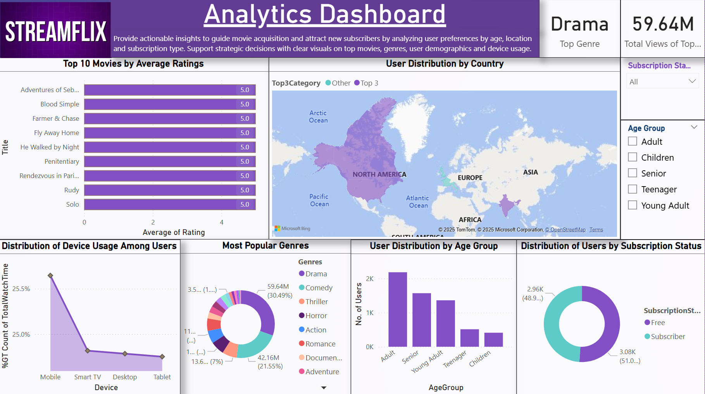
Notes:
The highest-rated content on Streamflix is drama-heavy. Movies with emotional storytelling like ‘The Shawshank Redemption’ and ‘The Godfather’ scored consistently above 4.5. It’s clear that your viewers value depth and substance in storytelling.

Slide 5
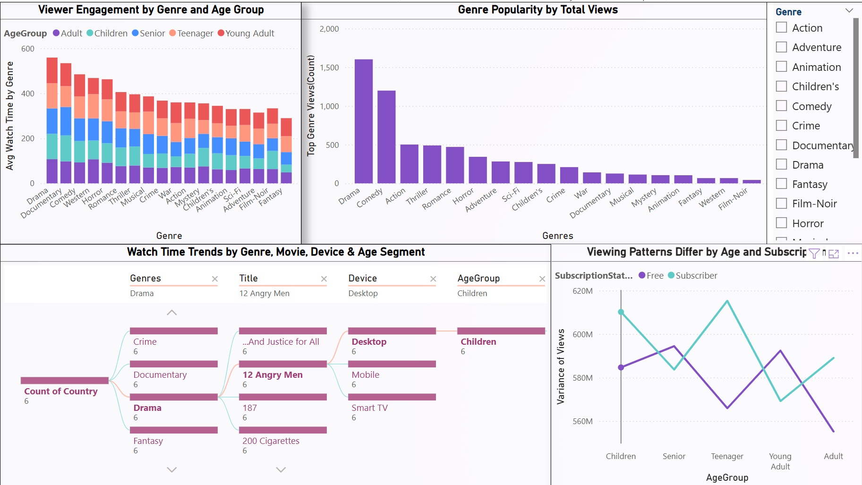
Notes:
Drama, Comedy and Action were the most viewed across countries. Interestingly, family and animated genres also performed well in specific regions — giving you a chance to tap into underserved but loyal audience groups.

Slide 6
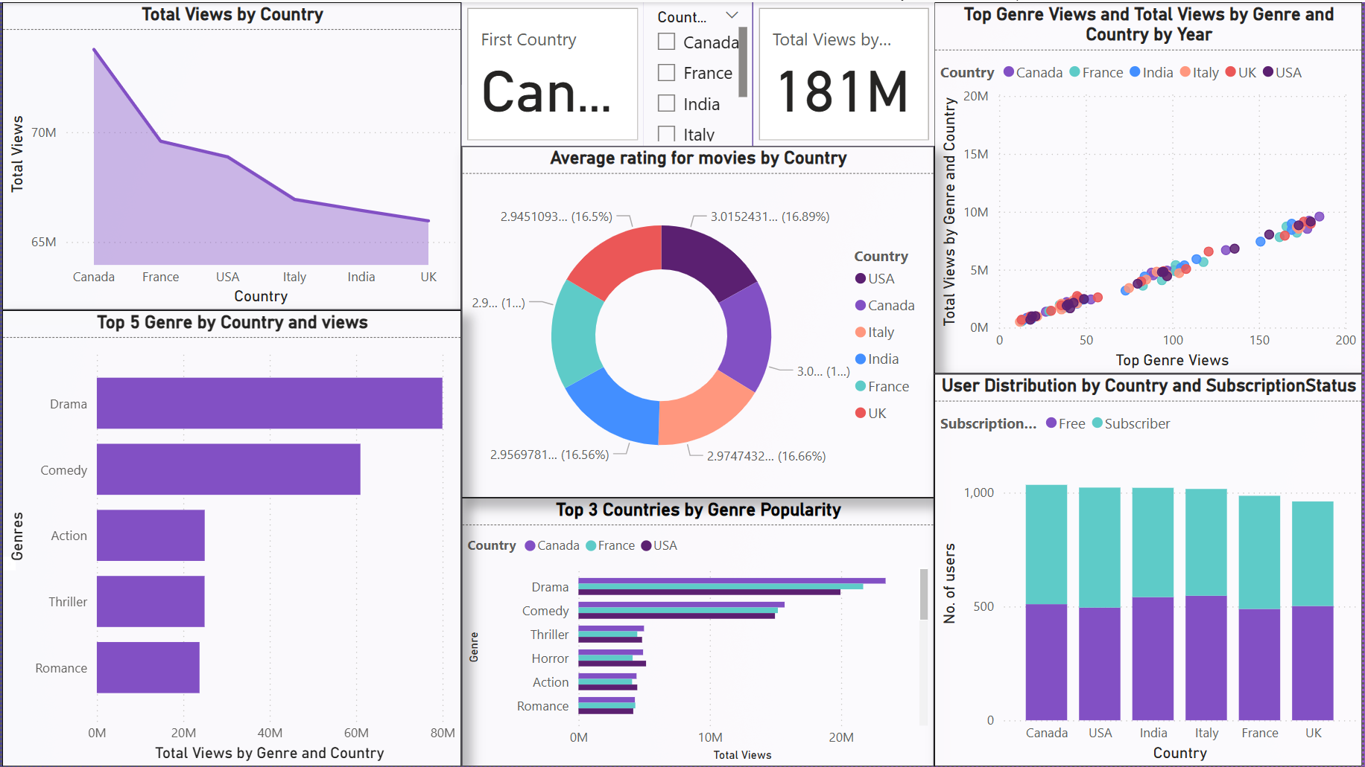
Notes:
Your most active users are aged 25 to 34 — tech-savvy and content-hungry. But mobile viewership is growing fast among users under 24, which is a great sign for future engagement from younger audiences.

Slide 7
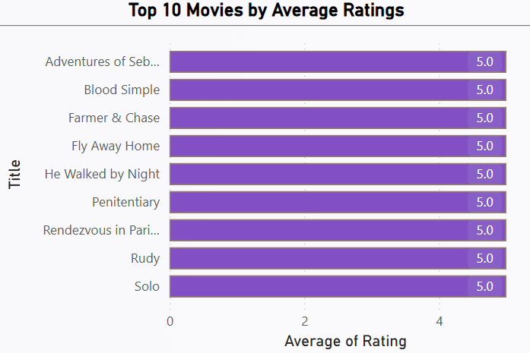
Top 10 Movies by Average Ratings
Users highly rate emotionally engaging and story-driven content. The top 10 list is dominated by drama genre with average ratings above 4.5.
Notes:
While free users form the largest base, your fastest-growing premium segment is 25–34. That tells us they’re willing to pay — but only if they see real value in exclusive content or features.

Slide 8
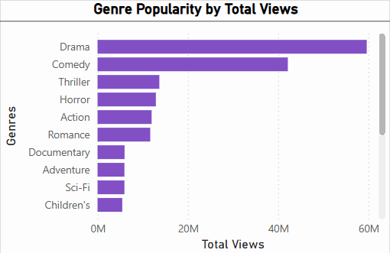
Most Popular Genres
Top 3 Most Popular Genre are Drama, Comedy and Thriller.
The above Genres are the most popular in every age group.

Slide 9
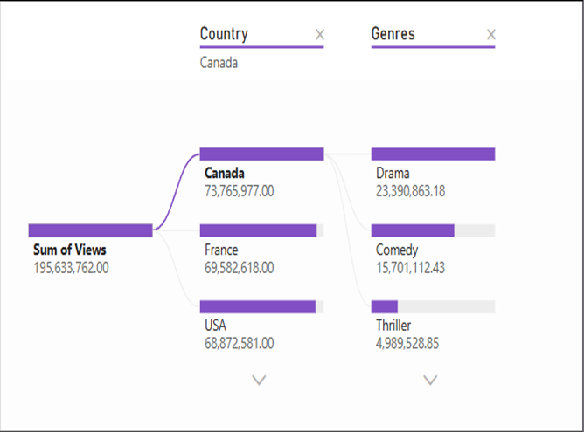
Top Genres by Country
All countries where Streamflix is watched the top 3 Genre are Drama , Comedy and Thriller except USA where the top2 are same but the 3rd one is Horror.

Slide 10
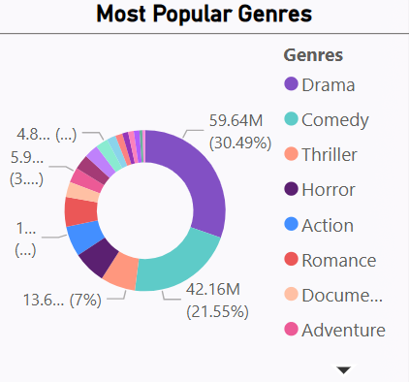
Most Popular Genres
Drama leads in both views and ratings, followed by Comedy, Action and Thriller. Family-friendly and animated content show strong performance in selected countries.
Notes:
Younger viewers prefer mobile, while older users tend to watch on Smart TVs. This split gives you a strong reason to tailor your user interface, push notifications and content format by age group.

Slide 11
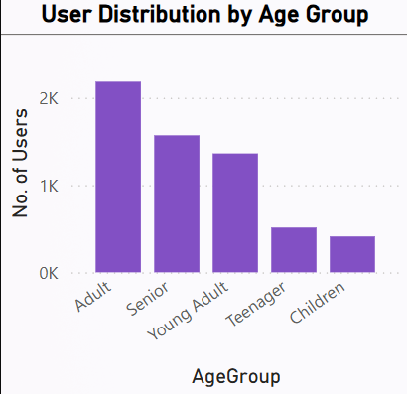
User Distribution by Age Group
Highest activity from 25–34 age group, followed by 35–44. Younger users (under 24) show rising trends in mobile viewership.
Notes:
Canada, India and the US are your top-performing regions. Genre preferences also vary — with Action trending in India, and Drama in North America. This is a great opportunity to regionalize your content licensing.

Slide 12
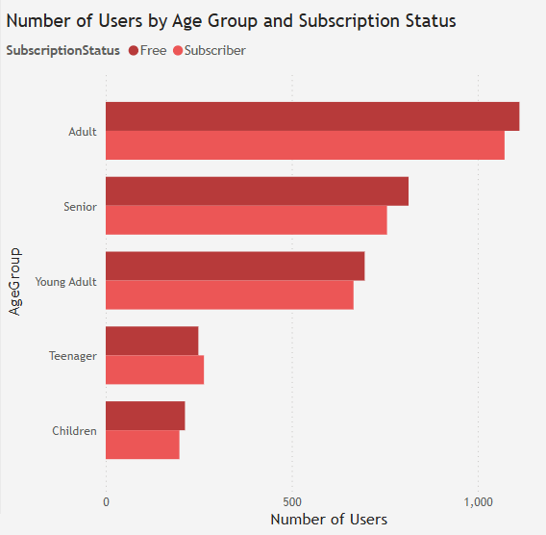
Number of users BY AGE GROUP AND SUBSCRIPTION STATUS

Slide 13
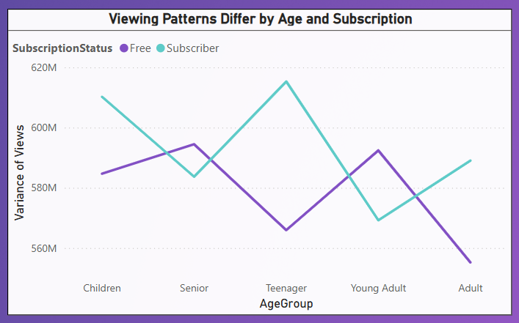
VIEWING PATTERNS BY AGE GROUP AND SUBSCRIPTION STATUS

Slide 14
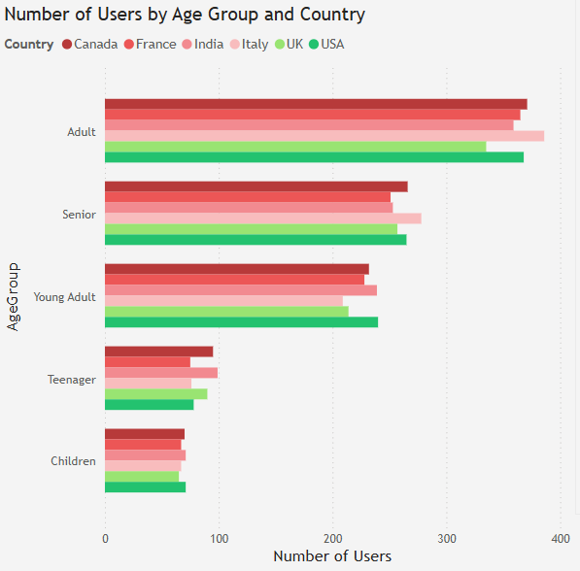
Number of users BY AGE GROUP AND Country

Slide 15
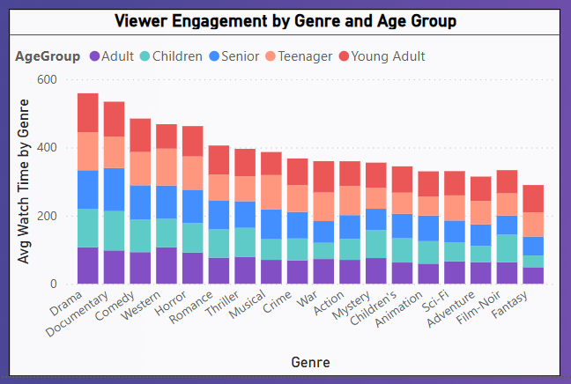
VIEWER WATCH TIME BY GENRE AND AGE GROUP

Slide 16
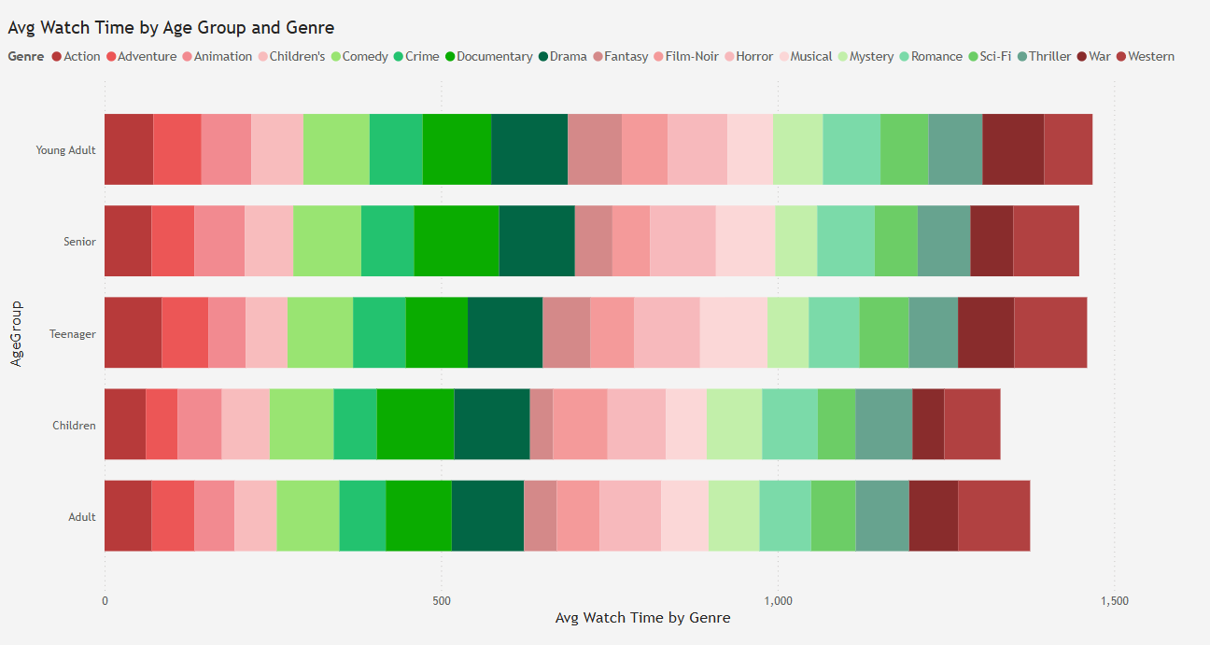
Average watch time by age group and genre

Slide 17
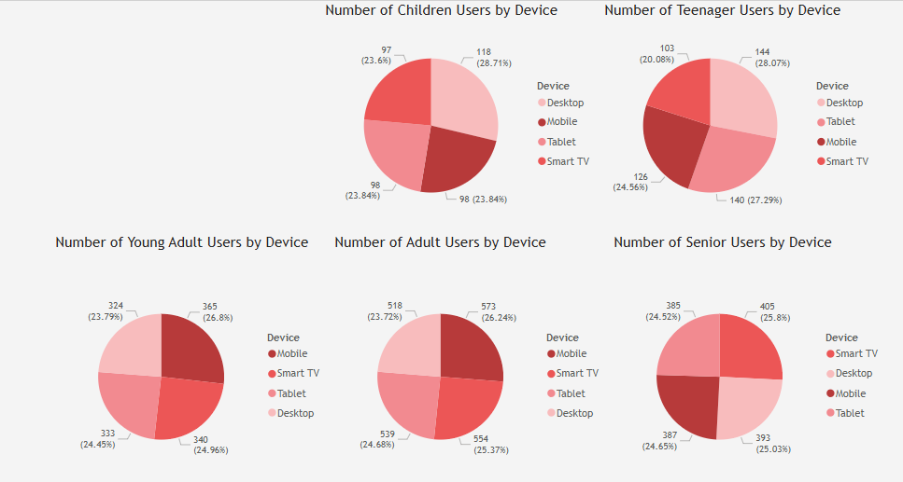
BREAKDOWN OF DEVICE TYPE USAGE BY AGE GROUP

Slide 18
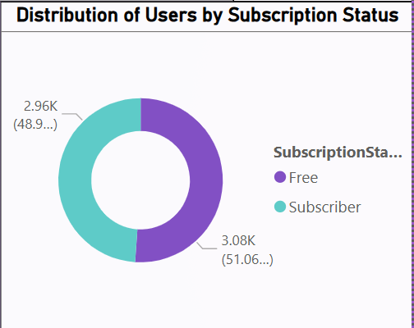
Distribution of Users by Subscription Status
Free users form a significant base, but premium subscriptions are rising fastest among 25–34 users. Opportunity lies in exclusive content offerings.
Notes:
We also broke down genre preferences by country. It revealed that while India leans towards Action, viewers in the US and Canada enjoy Drama and Thrillers more. This can help you build region-specific marketing and content plans.

Slide 19
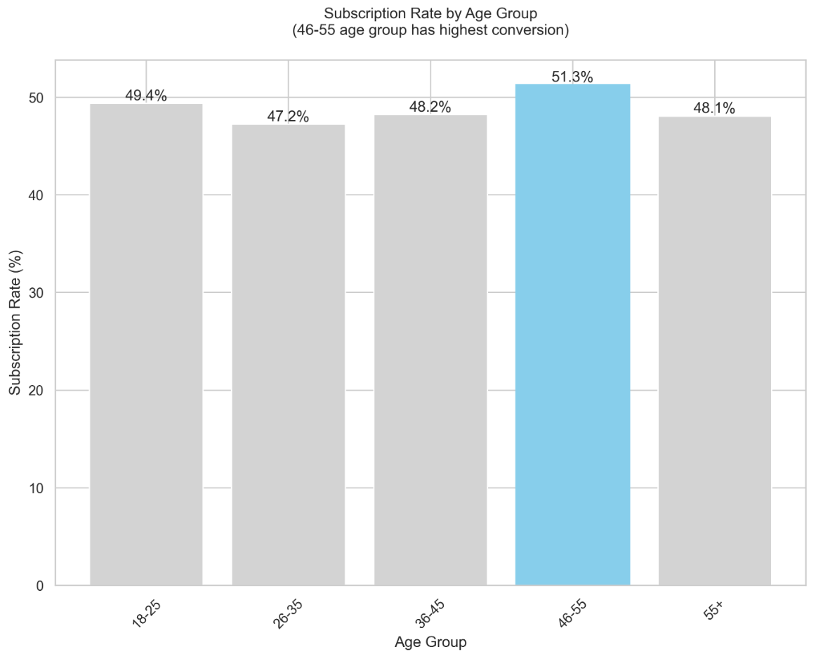
Subscription Rate by age group
The 46-55 age group shows the highest subscription rate at 51.3%
This demographic also has significant engagement with an average watch time of 252.4 minutes
Recommendation:
- Focus marketing efforts and content curation on this age group, as they demonstrate both high conversion and engagement rates

Slide 20
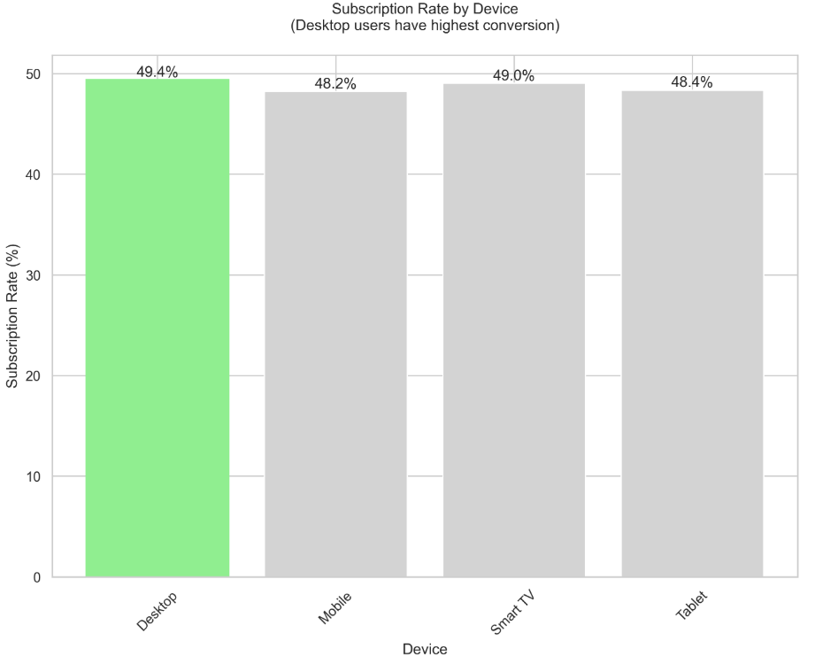
Subscription Rate by Device
Desktop users show the highest subscription rate at 49.4%
Recommendation:
- Optimize desktop experience further
- Consider implementing desktop-specific features

Slide 21
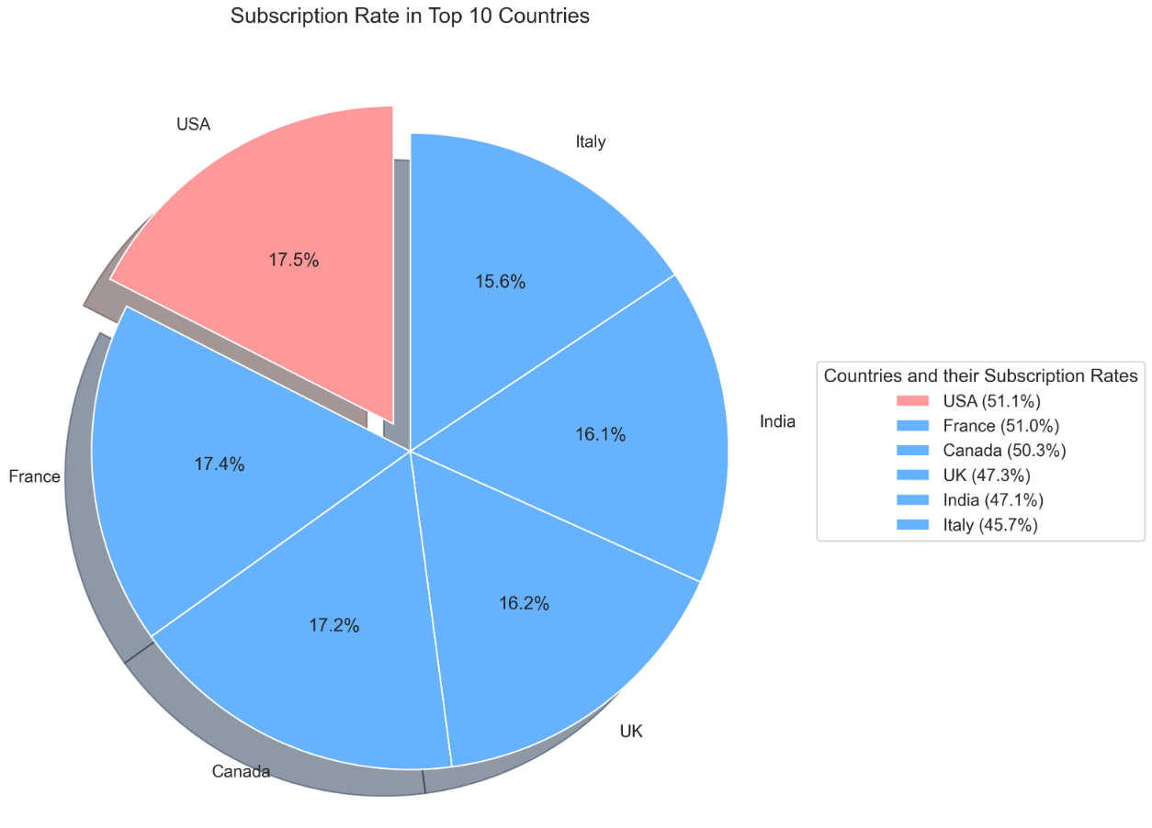
Subscription Rate in Top countries
USA leads in subscription rate at 51.1%, followed closely by France.
The market shows strong potential with 873 users in the top country
Recommendation:
- Develop USA specific marketing campaigns
- Consider localizing content for the US market
- Use successful US strategies as a template for other markets

Slide 22
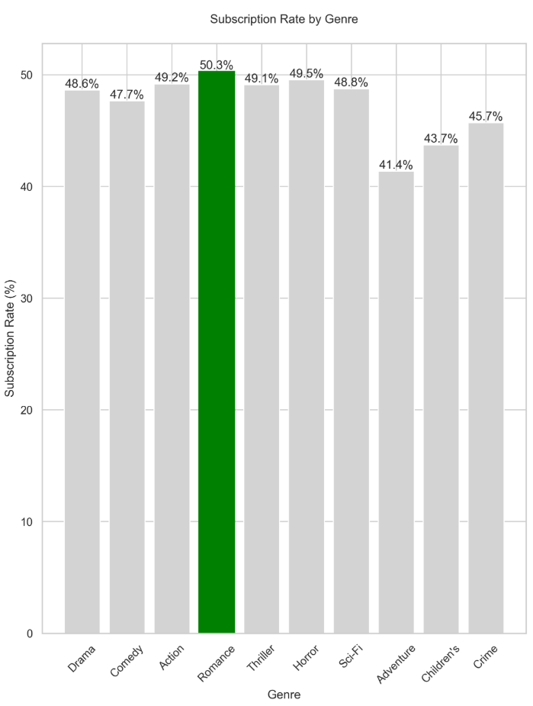
Subscription Rate by Genre
Romance shows the highest subscription rate at 50.3%, followed closely by Horror and Action
Recommendation:
Focus on expanding romance content library
Develop romance-specific subscription packages
Create targeted marketing campaigns for romance viewers
Adventure and Children's content show lower subscription rates at 41.4% and 43.7%
Recommendation:
Review pricing strategy for family-oriented content
Develop family subscription packages
Create more exclusive children's content to drive subscriptions

Slide 23
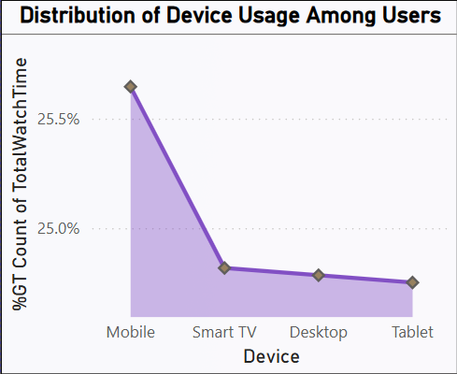
Distribution of Device Usage Among Users
Mobile is dominant for 18–34 users. Smart TVs are more popular among users aged 45+. Important for UX and content strategy.
Notes:
A surprising find — children spent over 1.5 hours watching ‘12 Angry Men’, mostly on desktops. It shows that even classic, serious content can engage young viewers — especially when accessed on larger screens in learning environments.

Slide 24
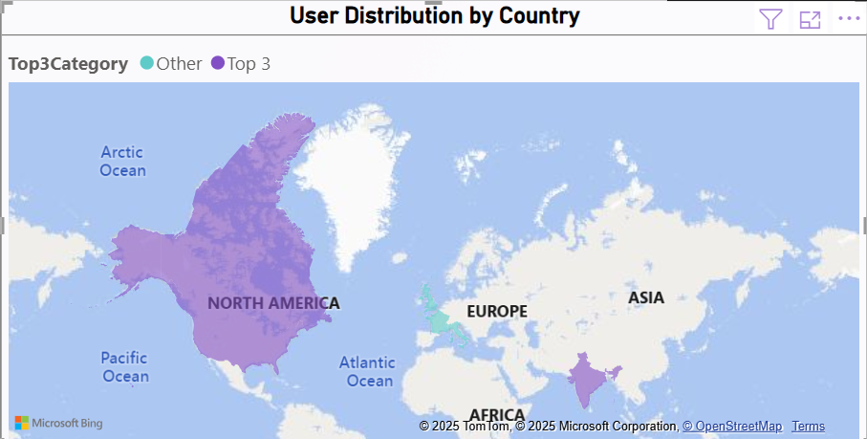
User Distribution by Country
Top 3 user bases: Canada, India and USA
Notes:
So, what should you do with these insights? We suggest four key actions:
1. Personalize recommendations by country and age.
2. License more content in trending genres like Drama and Comedy.
3. Create device-specific experiences — like short formats for mobile.
4. Use exclusive titles to convert free users to paid plans.

Slide 25
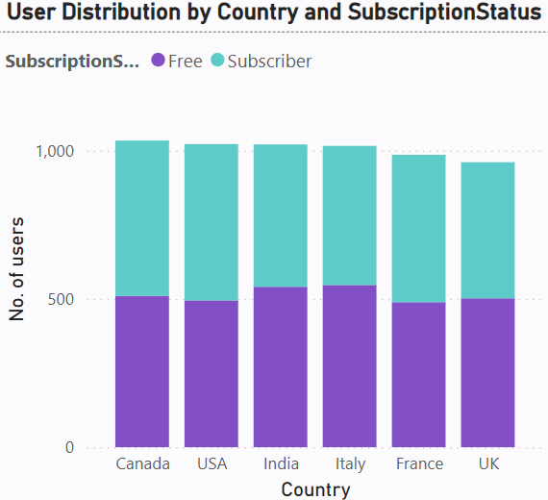
User Distribution by Country and subscription status

Slide 26
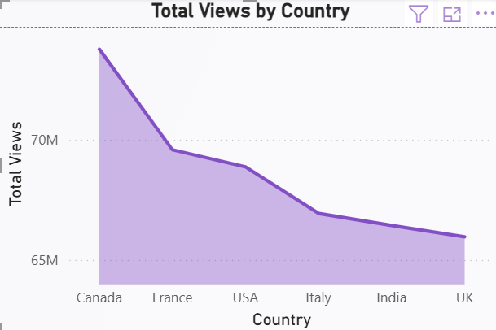
Total views by country
Notes:
We did face some blockers — mainly data gaps and limited time for predictive modelling. But we worked around them using strong descriptive analytics and suggest future steps for deeper integration and forecasting.

Slide 27
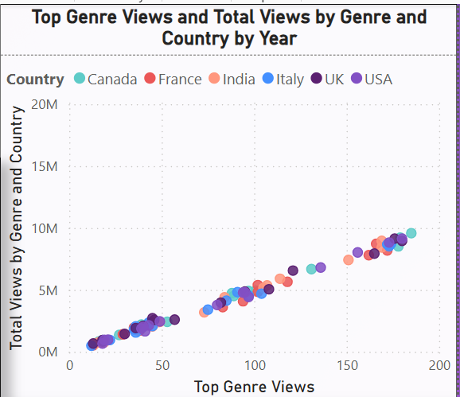
Top genre views and total view by genre and country by year
Genre preferences vary—Action dominates in India, Drama and thriller in the US and Canada.
Notes:
To wrap up — we believe these insights can help Streamflix grow smarter, not just bigger. With data-guided content choices, better user segmentation, and personalized engagement, you’re well-positioned to lead in the streaming space.
Thank you for your time — we’d love to hear your thoughts or questions, and explore how we can support your growth journey.

Slide 28
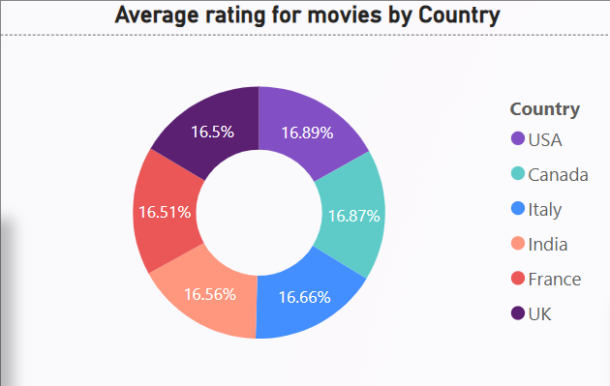
Average rating For movies by country

Slide 29
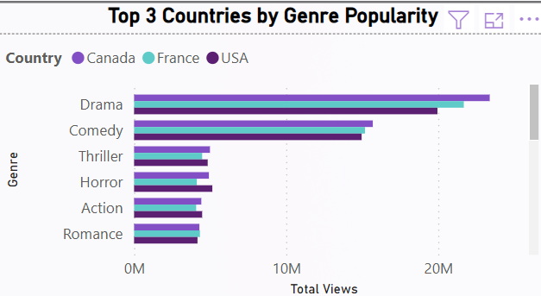
Top 3 countries by Genre popularity

Slide 30
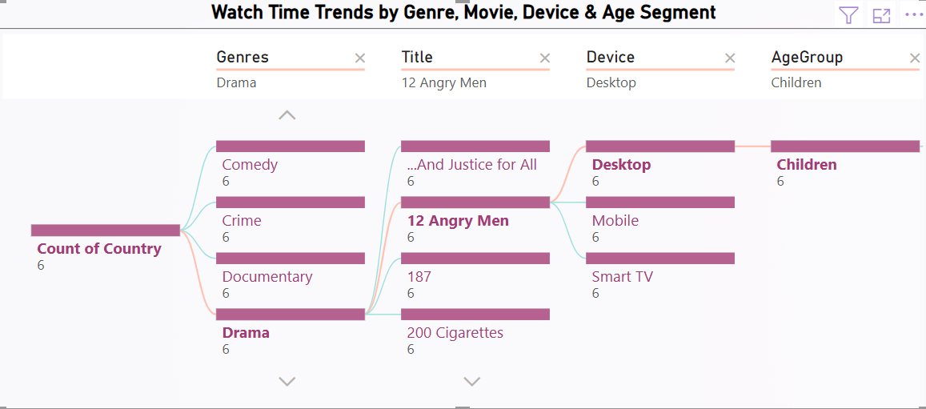
Watch Time by Genre, Movie, Device & Age Group
Children watched the drama 12 Angry Men for more than 1.5 hours, mostly on desktop. This shows that even young viewers enjoy classic movies when watching on bigger screens.

Slide 31
Recommendations
Personalize recommendations by user age and country.
License more content in trending genres (e.g., Drama, Comedy).
Target device-specific marketing strategies.
Encourage free users to upgrade by showcasing top-rated exclusive titles.

Slide 32
Blockers and Solutions
Blockers:
Data completeness – some user metadata missing.
Time constraints on deep predictive analysis.
Integration limitations between sources.
Solutions:
Propose future enhancements with fuller data.
Use descriptive analytics for current insights.
Recommend integration-friendly BI tools.

Slide 33
Thank YOU

