Slide 1
Alpine Update Interim Review JPSC Sri Rama Murthy Kotta Hammad Ahmed
August 12, 2024

Slide 2
Executive Summary
Project Objective
Achieve significant cost reduction by eliminating redundant cloud storage
Improve long-term product stability of Contour Diabetes App (CDA) by introducing a new lightweight technology platform integrated with GlucoContro.online (GCO)
Progress & Achievements
Wipro has been selected as the primary vendor for the Alpine project, with the Statement of Work (SOW) and all necessary amendments now completed.
High-level requirements have been completed, and the UX design is currently in progress.
Integration discussions with Wipro and GCO (SDN) are currently in progress.
Collaborated with SdNCenter and Wipro to identify a technical and legal solution to add Russia support to Alpine, initially approved by JPSC as out of scope
Proposed changes to the Alpine project scope.
Adding Arabic language support to the project scope due to changes in KSA regulatory requirements.
Modifications in Alpine and GCO to support operations in Russia due to the unavailability of Azure in Russia (Cost savings to Russia from Alpine compared to current CDA support).
Financial implications due to the proposed changes in the Alpine project scope
Decisions Requested
Approve Scope Change and Additional Cost
Item | Cost for 2024 | Cost for 2025 | After 2025
Russia Server Setup Cost | $15,000 | $7,000
Yearly Maintenance after 2025 (Russia P&I Budget) |  |  | $60,000
Addition of Arabic | $40,000 | $20,000
Total Extra Cost | $55,000 | $27,000

Slide 3
Planned & Incremental Alpine Budget
Item | Development $000 | Validation and Registration $000 | Maintenance $000
 | FY2024 | FY2025 | FY2026+
Alpine Project Expense (covered in CDA budget by reducing existing CDA to maintenance-only) | 690 | 500 | 350
Alpine translations (covered by Engineering Services budget) | 20 | 40
Additional Alpine Development Cost due to Scope change (Arabic and Russia support) (Can be covered within existing CPTS Budget) | 55 | 27
Ongoing Maintenance of Russia Server (currently Contour Cloud dedicated Russia server costs 80 k€/year, covered by Russia team) |  |  | 60

Slide 4
New CDA Global Program Team
* Laura Meyrich
PM
Sri Rama Kotta
Operations
Hammad Ahmed
Marketing
Tina Holly
Regulatory
Sri Rama Kotta Global Program Leader
Thomas Maier
Medical / Clinical Affairs
Lisa Pring
Quality
* Starke Moore
Cyber Security
* Newly added to the core team. We have confirmed the team members ability to support the Project.

Slide 5
New CDA App - Program Roadmap – No Changes
FY2024 | FY2025 | FY2026
New CDA App(Creation)
Alpine (Regulatory clearance)
CDA App Integration (CDA App and GCO Integration)
Architecture & Design Creation of Architecture for the New CDA App Design of Requirements and UI/UX | Regulatory Planning will start April ’24 Development of the App Communication to different Countries continues till end of FY’25 | Go Live by April (for first few countries)-FY’26 Region by region we will go live, so that we can eliminate production servers by region
Migration of CDA Servers data to GCO Cloud Server Phase 1 Review Oct 2024 | Regulatory Clearance - Completion by end of FY’25 Migration of CDA Servers data to GCO Cloud Server | Maintenance of the Existing Server will continue Decommission of old CDA App & CDA Server

Slide 6
Decisions Requested
NEW
Approve Scope Change and Additional Cost

Slide 7
Backup

Slide 8
CDA - Existing platform and FY2024 needs
Need to build new CDA and integrate with GCO Cloud platform
BGM
In the current connected age, increased use of technology by PWDs through various venues puts us in a position to offer those services just to compete in the Digital space [e.g.: Mobile apps, Digital Assistants, Augmented Reality, Web].
To support the current and future needs of PWDs and Payors, development of an Ascensia Universal Platform for BGM is essential for our data strategy.
Current CDA platform is not equipped to deal with these challenges. The need to develop an Ascensia Universal platform is now more prominent than ever. New platform will deliver better services, quicker digital trends adoption [features], broader digital space penetration [apps], third party integrations, serve BGM patients, reduced software maintenance overhead, reduced costs.

Slide 9
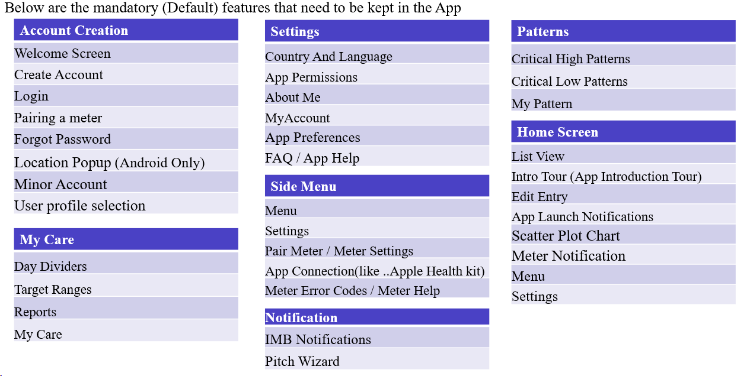
Mandatory Features
NEW

Slide 10
Decommission of Old CDA App & Contour Cloud – No Change
NEW
Milestone | Due Date
Initial Launch of New CDA App | June 2026
Old CDA App & Cloud Decommission in SG | July 2026
Old CDA App & Cloud Decommission in EU | July 2026
Old CDA App & Cloud Decommission in US | July 2026

Slide 11
Approved Budget Details
Item | Merge/Dev | Validation/Reg | Maintenance
 | FY2024 | FY2025 | FY2026+
"Alpine" development (year 1), validation and bug fixes (year 2), and maintenance and enhancements (year 3+) Based on Wipro proposal | 550 | 305 | 350
"Alpine" cybersecurity | 90 | 25 | -
"Alpine" usability | 50 | 125 | -
"Alpine" clinical validation | - | - | -
"Alpine" translations Assume this is covered by Packaging Services | 20 | 40

Slide 12
Total Digital Solutions (CDA+GCO) Budget
Item | Baseline $000 | Development $000 | Validation and Registration $000 | Maintenance $000
 | FY2023 | FY2024 | FY2025 | FY2026+
CC Hosting + GCO Hosting | 1017 | 1017 | 1083 | 300
CDA Dev + GCO Dev | 3288 | 2618 | 2618 | 1543
Alpine approved project budget | n/a | 690 | 500 | 350
Total approved budget | 4305 | 4325 | 4305 | 2268
Total approved budget including Russia ($87K/year paid by Russia country budget) | 4392 | 4412 | 4392 | n/a (CDA discontinued in Russia)
Incremental development cost for Arabic and Russia |  | 55 | 27
Incremental maintenance cost for Russia dedicated server |  |  |  | 60 (27K savings compared to FY2024)
Total budget including incremental Arabic/Russia added scope |  | 4467 | 4419 | 2328

