Slide 1
UDACITY DATA VISUALIZATION NANODEGREE Build a data story midterm project
By: NALINI SHARMA

Slide 2
Problem Statement:
Which genre, release date, revenue, run time of movies that had the lowest 10% of popularity in the past 10 years.

Slide 3
Issue Tree:
What is the genre, run time and release date of movies that had the lowest 10% of popularity in the past 10 years.
Is it determined by genre?
Is it determined by release month?
Is it determined by run time?
Documentary
TV Movie
Months when people have more holidays
Less than 90 minutes
More than 90 minutes
Western
Months in which people have less holidays

Slide 4
Ghost Deck
Synthesis: The genre of the movie drives the popularity and revenue. The release month of movies can also determine the popularity of movies. Our recommendation is to make fewer movies of the genre’s TV movie and musical. Our recommendation is to release more movies in the months when people have more time to watch movies (holidays) like the summer months, November and December and not months like January and October. | Overview of analysis: Genre by popularity Release Date and month Run time. | Genre by popularity: The least popular genres of movies in the past 10 years are Fantasy, Adventure, TV Movie, Music and Western. The most popular genres are Animation, Adventure, Western and Fantasy. The least popular on this list are TV movie, Documentary and Music.. | Release Date: A larger number of bottom 10 percent movies were released in January and October
Run Time: The average run time of the bottom 10 movies in the past 10 years was around 82 minutes while the average run time of the top 10 movies is about 108 minutes. The run time of a movie does not really impact the popularity or revenue. | Limitation 1: We only considered one genre of a movie for movies that can be multiple genres. Some movie can be of two genres, for example ,Spider Man is an action and an adventure movie. | Limitation 2: The analysis does not take into account the fact that the audience preference’s keeps changing. For example, even if documentary movies are not popular now, they could become popular in the future. We cannot always use historical data to predict future audience preference. | Review of next steps: Include all genres of a movie in the analysis for movies that can be multiple genres. Use data for the past 15 years instead of 10 years. This could provide more insight and could help in the analysis.

Slide 5
Synthesis
The genre of the movie drives the popularity and revenue.
The release month of movies can also determine the popularity of movies.
Our recommendation is to make fewer movies of the genre’s TV movie and Musical.
Our recommendation is to release more movies in the months when people have more time to watch movies (holidays) like the summer months, November and December and not months like January and October

Slide 6
Overview of analysis:
Genre by popularity
Release Date and month
Run time

Slide 7
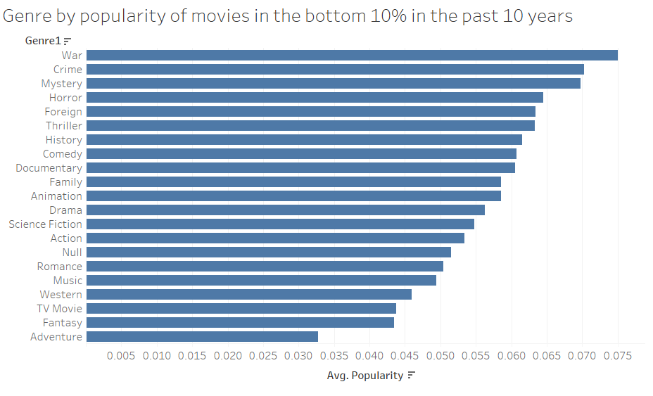
Genre by popularity – Bottom 10% movies in the past 10 years :
The least popular genres of movies in the past 10 years are Fantasy, Adventure, TV Movie, Music and Western.

Slide 8
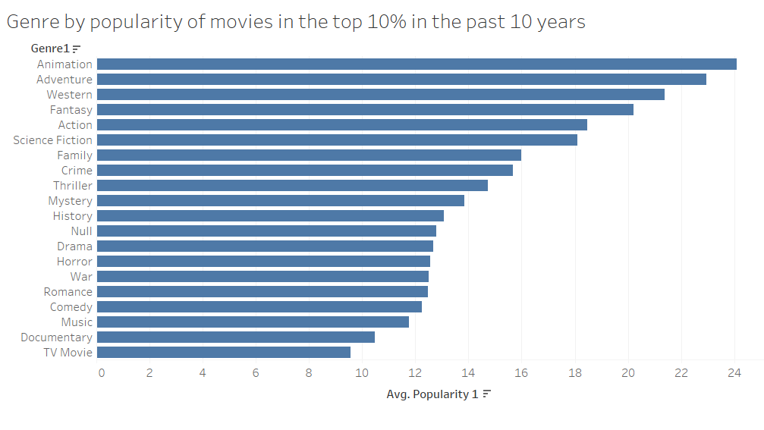
Genre by popularity for the top 10% movies in the past 10 years:
The most popular genres are Animation, Adventure, Western and Fantasy. The least popular on this list are TV movie, Documentary and Music.

Slide 9
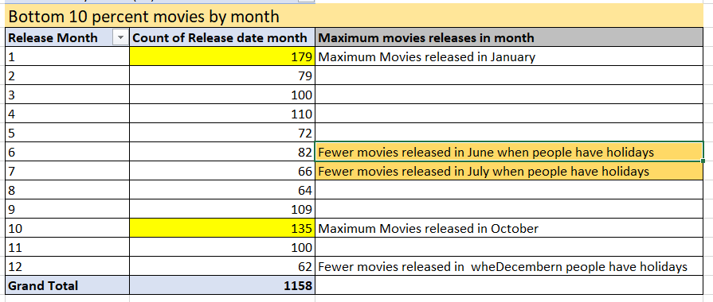
Release Date/Month:
A larger number of bottom 10 percent movies were released in January and October, Months when people don’t have enough holidays to take time off to watch movies.

Slide 10
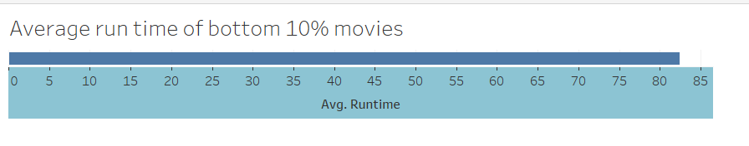
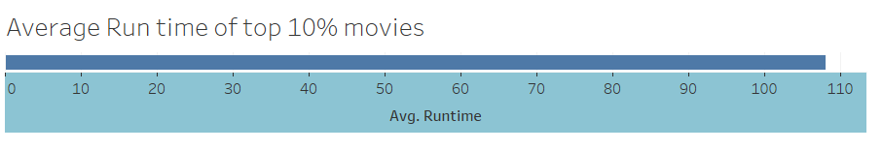
Run Time:
The average run time of the bottom 10 movies in the past 10 years was around 82 minutes while the average run time of the top 10 movies is about 108 minutes. Our analysis determined that the run time of a movie does not really impact the popularity or revenue.

Slide 11

Limitation 1:
We only considered one genre of a movie for movies that can be multiple genres. Some movie can be of two genres, for example ,Spider Man is an Action and a Fantasy movie.

Slide 12
Limitation 2:
The analysis does not take into account the fact that the audience preference’s keeps changing. For example, even if documentary movies are not popular now, they could become popular in the future. We cannot always use historical data to predict future audience preference.

Slide 13
Review of next steps:
Include all genres of a movie in the analysis for movies that are multiple genres.
Use data for the past 15 years instead of 10 years. This could provide more insight and could help in the analysis.

