Slide 1
UDACITY DATA VISUALIZATION NANODEGREE Build a data story final project
By: NALINI SHARMA

Slide 2
Problem Statement:
What is the genre, release date and budget of movies that had the lowest 10% of popularity in the past 15 years.
Notes:
We wanted to review movies that had a low popularity so that we could help make informed decisions regarding what types of movies to release, review the month of movies released and also compare the low and high popularity movies.

Slide 3
Issue Tree:
What is the genre, release date and budget of movies that had the lowest 10% of popularity in the past 15 years.
Is it determined by genre?
Is it determined by release month?
Is it determined by budget?
Documentary
TV Movie
Any other?
Months when people have more holidays
Months in which people have less holidays
Are the less popular movies lower budget movies?
Did the more popular movies have a higher budget?
Western
Notes:
We decided to review three parameters – Genre, release date and budget.
Genre: Since the audience uses Genre as one of the criteria for watching movies, it made sense to review genre by popularity.
Release month: There are certain months in which the audience has more time to got to theatres to watch movies, like the winter months. We wanted to review the months when the low popularity movies were released to allow us to make a decision regarding release dates.
Budget: We wanted to also research if a lower budget impacted the popularity of a movie and wanted to compare it with the budget of the more popular movies.

Slide 4
Synthesis
The genre of the movie drives the popularity and revenue.
The release month of movies can also determine the popularity of movies.
Our recommendation is to make fewer movies of the genre’s TV movie and Western.
Our recommendation is to release more movies in the months when people have more time to watch movies (holidays) like the summer months, November and December and not months like January and September
The budget of the top 10% movies was a lot higher than the bottom 10%. Our recommendation is to consider having a larger budget for movies.
Notes:
The Genre of a movie does impact the popularity. The least popular genre’s were TV movie, Western, History and Mystery. TV movies and Westerns had the lowest popularity when we looked at the lowest 10% popularity movies.
The release month also impacted the popularity of the movies as we found that many of the movies were released in the months when people have less time to go to theatres to watch movies. This finding could generate a discussion regarding what month is best to release movies that could potentially be less popular.
Budget: When we compared the budget of the lowest popularity and highest popularity movies, we found a significant difference. We would recommend, as you will see in subsequent slides, to have a higher budget for movies if they belong to a genre that is generally lower in popularity.

Slide 5
Overview of analysis:
Genre by popularity
Release Date and month
Budget
Notes:
We can use this slide to explain what is coming up in subsequent slides.

Slide 6
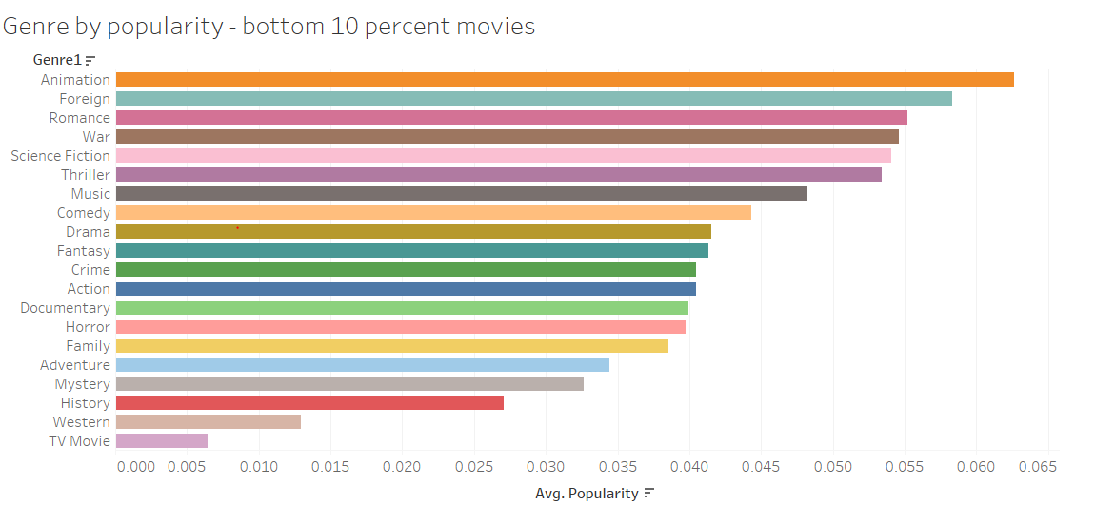
Genre by popularity – Bottom 10% movies in the past 15 years :
Takeaways:
The least popular genres of movies in the past 15 years are TV movie, Western, History and Mystery
Notes:
The Genre of a movie does impact the popularity. The least popular genre’s were TV movie, Western, History and Mystery. TV movies and Westerns had the lowest popularity when we looked at the lowest 10% popularity movies.
The past 15 years data was used because we felt that more recent 15 year data would be more accurate and would have more information.
Once we cleaned up the data, we used Tableau to create the chart and used a bar chart because it allows us to clearly see the differences in popularity between the genres.

Slide 7
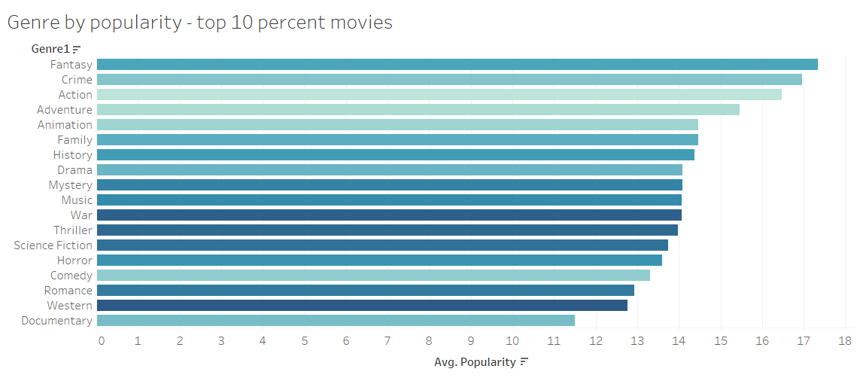
Genre by popularity for the top 10% movies in the past 15 years:
Takeaways:
The most popular genres are Fantasy, Crime, Action and Adventure. The least popular on this list are documentary, western and romance.
Notes:
The most popular genres are Fantasy, Crime, Action and Adventure. We would like to recommend releasing more movies of this genre. The fantasy Genre had the highest popularity and other than the 4 top genres, the remaining genres had a somewhat similar popularity.
We used Tableau to create the chart and used a bar chart because it allows us to clearly see the differences in popularity between the genres.
We can also clearly see the difference in popularity between the top 10% (highest popularity around – 18) and the popularity of the least popular movies in the earlier chart (between 0 and .065).

Slide 8
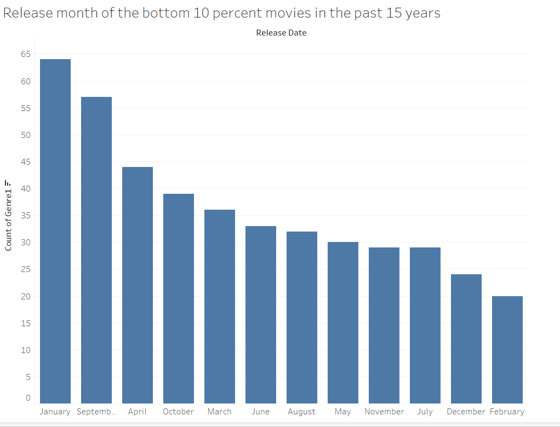
Release Date-Month of bottom 10 percent movies in the past 15 years:
Takeaways:
A larger number of bottom 10 percent movies were released in January, September and April, months when people don’t have enough holidays to take time off to watch movies.
Notes:
From this slide we could see that most of the least popular movies were released in January, September and April which are months when people don’t have enough holidays to go to theatres to watch movies, People are more likely to watch movies when they have more time – as in holidays.
This chart was created using Tableau and the release month and count of movies were used to create the chart. We took the bottom 10 percent movies and generated a chart of the count of the movies released by release month. A bar chart was used to clearly view the count and to see the count difference between the months.

Slide 9
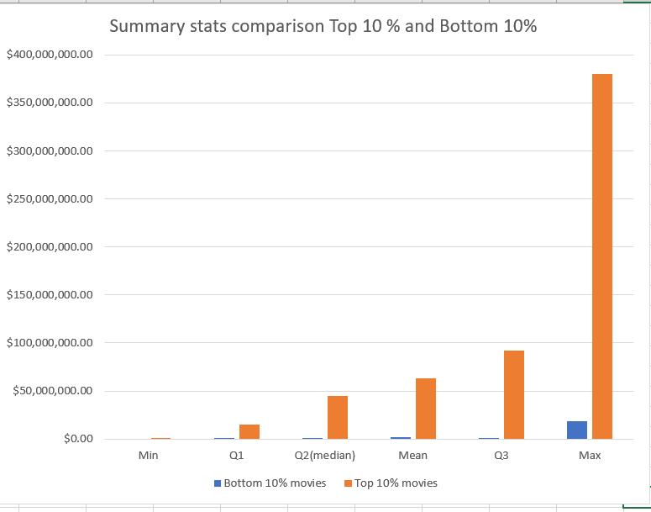
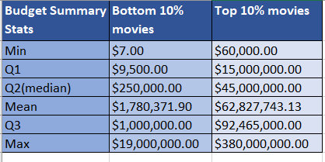
Summary Stats comparison (Budget) Top 10% and Bottom 10%
Takeaways:
The budget of the top 10% movies is a lot higher compared to the bottom 10%.
Notes:
We decided to compare the budget of the top and bottom 10 percent movies. We first created separate datasets of the top and bottom 10% movies, then we calculated the summary stats and placed them side by side. We also decided to create a bar chart showing the comparison of Minimum, Maximum, the mean and the quartiles. The lower quartile value (Q1) is the median of the lower half of the data. The upper quartile (Q3) value is the median of the upper half of the data.
We found a significant difference between the budgets of the top 10% and bottom 10% movies. The top 10% movies had a significantly larger budget compared to the bottom 10% and this allows us to make a recommendation that a higher budget helps increase the popularity of the movies.

Slide 10

Limitation 1:
We only considered one genre of a movie for movies that can be multiple genres. Some movie can be of two genres, for example ,Spider Man is an Action and a Fantasy movie.
Notes:
We noticed that in the dataset, many movie’s had multiple genres. For the purposes of this analysis, we considered one genre only, however, in the dataset, some movies have multiple genres. In the future, a more detailed analysis could be done by considering multiple genres of a movie.
Data Pipeline stages – Bias:
Considering only one Genre of a movie (Processing Bias): Considering only one genre of a movie for movies that have two or multiple genres is a processing bias and will affect our decision making process.

Slide 11
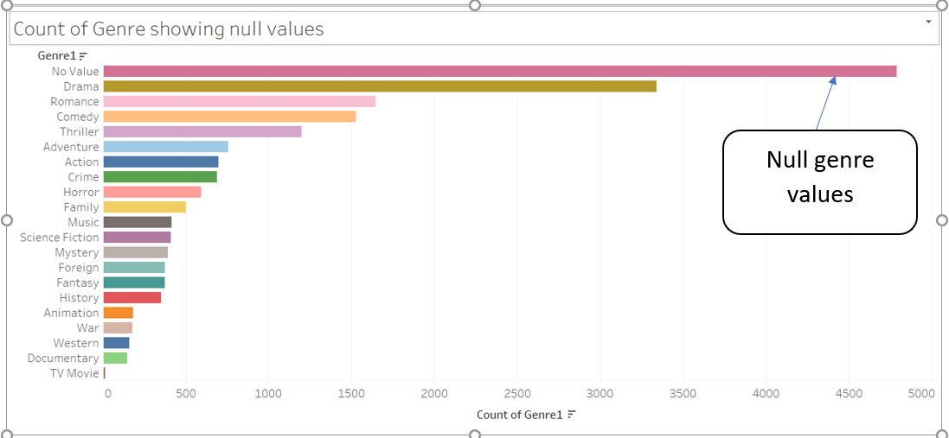
Limitation 2:
There are a significant number of movies that have null values in the genre column. These rows were not included as part of the analysis and could have impacted the analysis.
Notes:
When we were working on the analysis for genre, we found several null values which means that the genre was not recorded for these movies. We decided to create a bar chart to show the count of the null values and the other genres. There were a large numbers of null values in the dataset and this could impact our analysis. For this reason, this was included as a limitation for the analysis since for our analysis, we did not include the movies will null genre values.
Data Pipeline Stages – Bias:
Not considering null values (Processing Bias): Not considering the null values is a processing bias and impacts our analysis and affects a decision making process.
Having null values for Genre (Collection Bias): Movies having Null values for “Genre”, is also a collection bias and will affect our decision making process. If the values were not null we could have provided better analysis regarding the Genre.

Slide 12
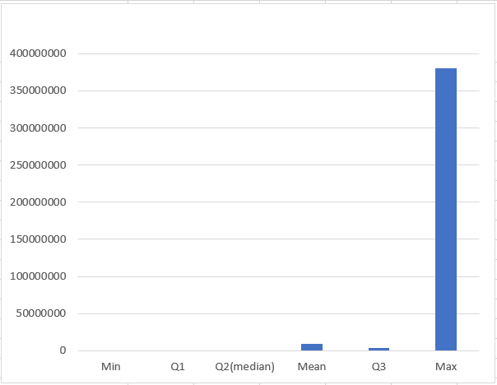
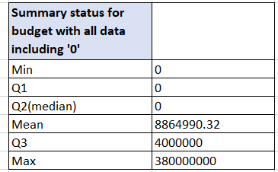
Limitation 3:
There are a lot of movies in which the budget has a value of ‘0’, which could mean that the budget of these movies was not recorded. For this analysis, the ‘0’ values were removed. Since several rows had to be removed, this impacted the analysis.
Notes:
We decided to do a full analysis of the budget for all the movies and found that there are many movies that have a budget value of ‘0’. This means that the budget of these movies was not recorded. The ‘0’ values were removed as part of this analysis and that could have impacted the analysis. We created a chart showing the summary stats and that clearly shows that there is a significant difference between the minimum and maximum values.
Data pipeline stages – Bias:
Value of ‘0’ for Budget (Collection Bias): Having a value of ‘0’ for budget is a collection bias and it impacted our analysis. If there was a recorded value for the budget it would have allowed us to provide better analysis.
Not including ‘0’ budget movies in the analysis (Processing bias): Not including the ‘0’ budget movies impacted our analysis, if there was a value for Budget for these movies, we could have provided better analysis.

Slide 13
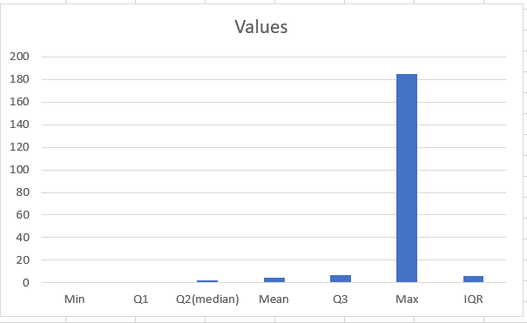
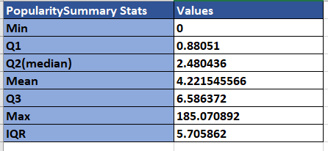
Limitation 4:
There are a lot of movies in which the popularity has a value of ‘0’, which could mean that the popularity of these movies was not recorded. For this analysis, the ‘0’ values were removed. Since several rows had to be removed, this impacted the analysis.
Notes:
Another limitation of our analysis is that the popularity data also has ‘0’ values and that could have impacted our analysis as well. We created a summary stats chart of popularity as well which shows outliers (Max = 185) and a minimum value of ‘0’. For the analysis, we included the max value but removed the ‘0’ values and this was another limitation of the analysis.
Data pipeline stages – Bias:
Value of ‘0’ for popularity(Collection Bias): Having a value of ‘0’ for popularity is a collection bias and it impacted our analysis. If there was a recorded value for the popularity it would have allowed us to provide better analysis.
Not including ‘0’ popularity movies in the analysis (Processing bias): Not including the ‘0’ popularity movies impacted our analysis, if there was a value for popularity for these movies, we could have provided better analysis.

Slide 14
Review of next steps:
Include all genres of a movie in the analysis for movies that are multiple genres.
Find another comprehensive source of data which has budget and popularity values for all movies.
Analyze the entire dataset and not just the last 15 years.
Notes:
As a next step, we could include all genres of a movie and not just the genre value in one column which could create a more comprehensive list. We can also use or find another comprehensive source of data which does not have a large number of ‘0’ values in the ‘budget’ and ‘popularity’ columns. Another improvement could be to include the entire dataset in the analysis or at least the past 20-25 years instead of 15 years. We could also potentially compare popularity between movies released in the past decade and the decade before that to analyze audience preference changes over the years.

