Slide 1


ONLINE FACULTY ORIENTATION PROGRAM ON
Data Science and Big Data Analytics Theory and Laboratory
(TEIT2019 Course)
ORGANIZED BY
Department of Information Technology
Pune Institute Of Computer Technology,Pune
IN ASSOCIATION WITH
BoS-IT, Savitribai Phule Pune University (SPPU), Pune
RESOURCE PERSON
Prof.Yogita Fatangare
PES’s Modern College of Engineering,Pune
yogita.fatangare@moderncoe.edu.in

Slide 2
PARTB:ASSIGNMENT NO5
Course Objective
To understand different data visualization techniques for Big Data
Course Outcome
Visualize the Big Data using Tableau

Slide 3
Problem Statement
Perform the following data visualization operations using Tableau on Adult and Iris datasets.
a. 1D (Linear) Data visualization
b. 2D (Planar) Data Visualization
c. 3D (Volumetric) Data Visualization
d. Temporal Data Visualization
e. Multidimensional Data Visualization
f. Tree/ Hierarchical Data visualization
g. Network Data visualization

Slide 4
Tableau Installation
Install Tableau Desktop.
Link to download tableau :
https://www.tableau.com

Slide 5
dataset download
Adult dataset and IRIS Dataset
Download it from UCI repository or kaggle.com
https://archive.ics.uci.edu/ml/datasets/adult
https://www.kaggle.com/wenruliu/adult-income-dataset
https://archive.ics.uci.edu/ml/datasets/iris
https://www.kaggle.com/arshid/iris-flower-dataset

Slide 6
The Adult dataset is from the Census Bureau and the task is to predict whether a given adult makes more than $50,000 a year based attributes such as education, hours of work per week, etc.

Slide 7
Adult Dataset
The dataset provides 14 input variables that are a mixture of categorical, ordinal, and numerical data types. The complete list of variables is as follows:
Age.
Workclass.
Final Weight.
Education.
Education Number of Years.
Marital-status.
Occupation.
Relationship.
Race.
Sex.
Capital-gain.
Capital-loss.
Hours-per-week.
Native-country
There are a total of 48,842 rows of data

Slide 8
Iris Dataset
Anderson collected the data to quantify the morphologic variation of Iris flowers of three related species.
The data set consists of 50 samples from each of three species of Iris (Iris Setosa, Iris virginica, and Iris versicolor).
Four features were measured from each sample: the length and the width of the sepals and petals, in centimeters.
This dataset became a typical test case for many statistical classification techniques in machine learning such as support vector machines

Slide 9
The dataset contains a set of 150 records under 5 attributes - Petal Length, Petal Width, Sepal Length, Sepal width and Class(Species).
This dataset is free and is publicly available at the UCI Machine Learning Repository

Slide 10
INTRODUCTION TO TABLEAU
What is Tableau?
Tableau Product Suite
Dimensions and Measures
Charts in Tableau
Why to Use Tableau

Slide 11
How to Connect to data source from Tableau Desktop
Open Tableau Desktop and begin
The first thing you see after you open Tableau Desktop is the start page. Here, you select the connector (how you will connect to your data) that you want to use.

Slide 12
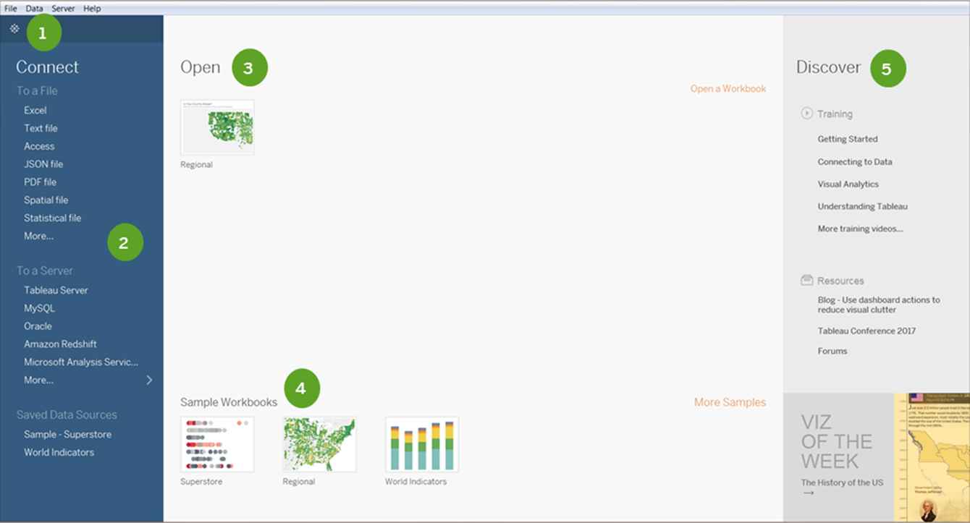
How to Connect to data source from Tableau Desktop

Slide 13
1D (Linear) Data visualization
1D/Linear Data Visualization
Lists of data items, organized by a single
feature (e.g., alphabetical order) (not commonly visualized)
Display one parameter of your data
Example:
Find total sales of United States.

Slide 14
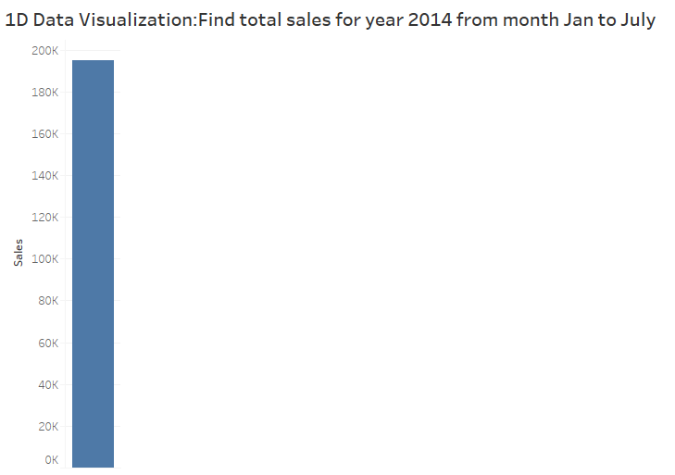
1D Example: Find total sales for year 2014 from Jan to July(Samplesuperstore dataset)

Slide 15
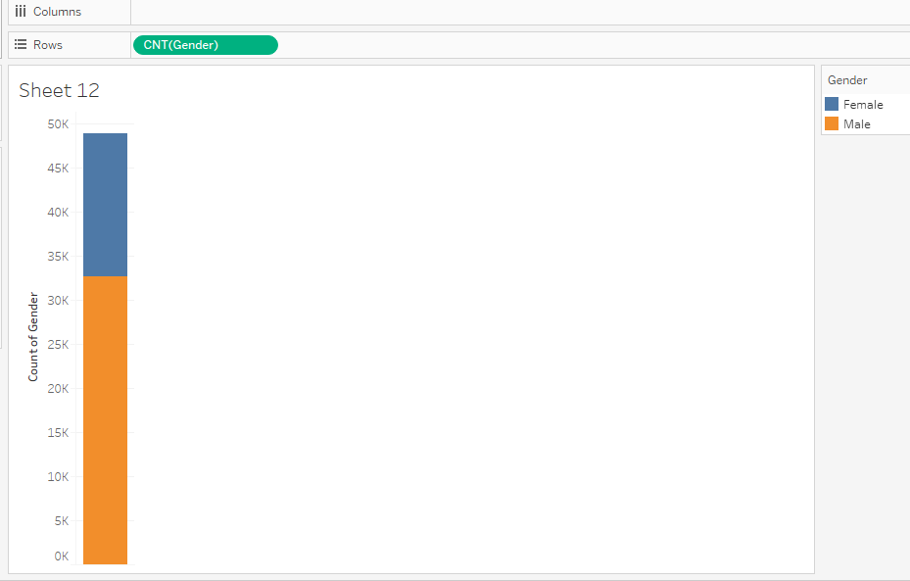
1D/Linear Data Visualization Example: Count of number of Male and Females (ADULT Dataset)

Slide 16
2D/Planner Data Visualization
Geospatial or spatial data visualizations relate to real life physical locations, overlaying familiar maps with different data points.
These types of data visualizations are commonly used to display sales or acquisitions over time, and can be most recognizable for their use in political campaigns or to display market penetration in multinational corporations.
Example:
Plot state wise sales distribution.

Slide 17
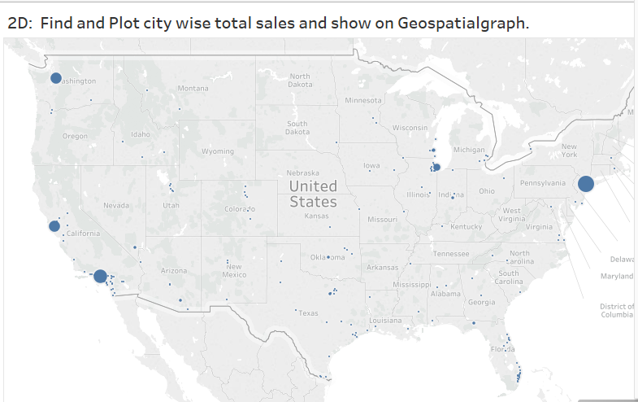
2d example1: superstore dataset

Slide 18
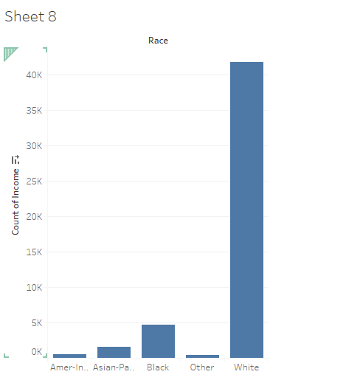
2D Example2: income based on Race(Adult dataset)

Slide 19
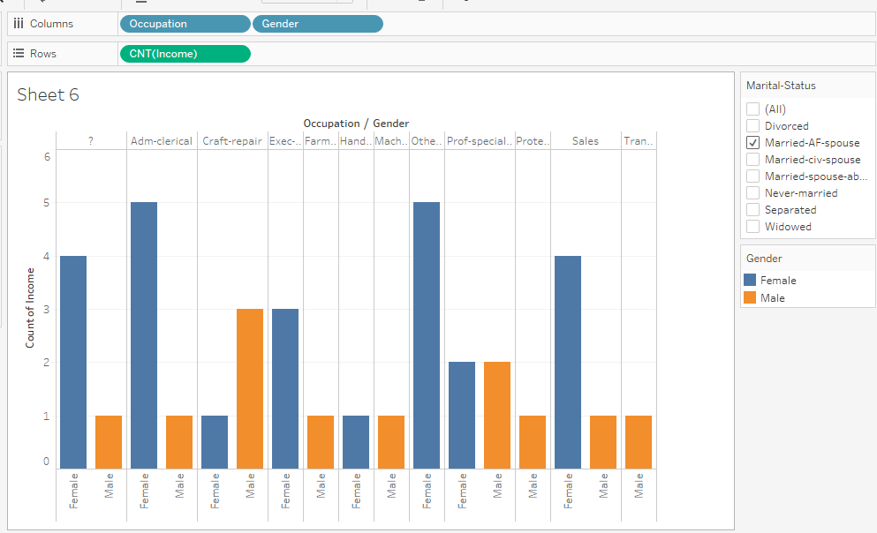
3D Example:Ocuupation wise Income of Male and Female(ADULT dataset)

Slide 20
Multidimensional Visualization
Here we analyze multiple data dimensions or attributes (2 or more)
multidimensional simply means to add additional aspects or variables for consideration.
Multidimensional visualization is not only involves just checking out distributions but also potential relationships, patterns and correlations amongst these attributes

Slide 21
Types of Multidimensional Visualization
Examples of visualizations that show category proportions or counts:
pie chart,
Wordles,
bar chart,
histogram,
rank plot,
tree map
Examples of visualizations that show relationships between variables:
scatter plot,
line chart,
step chart,
area chart,
heat map,
matrices,
parallel coordinates/sets,
radar/spider chart,
box and whisper plots, mosaic display, waterfall chart, pixel bar chart, tabular comparison of charts

Slide 22
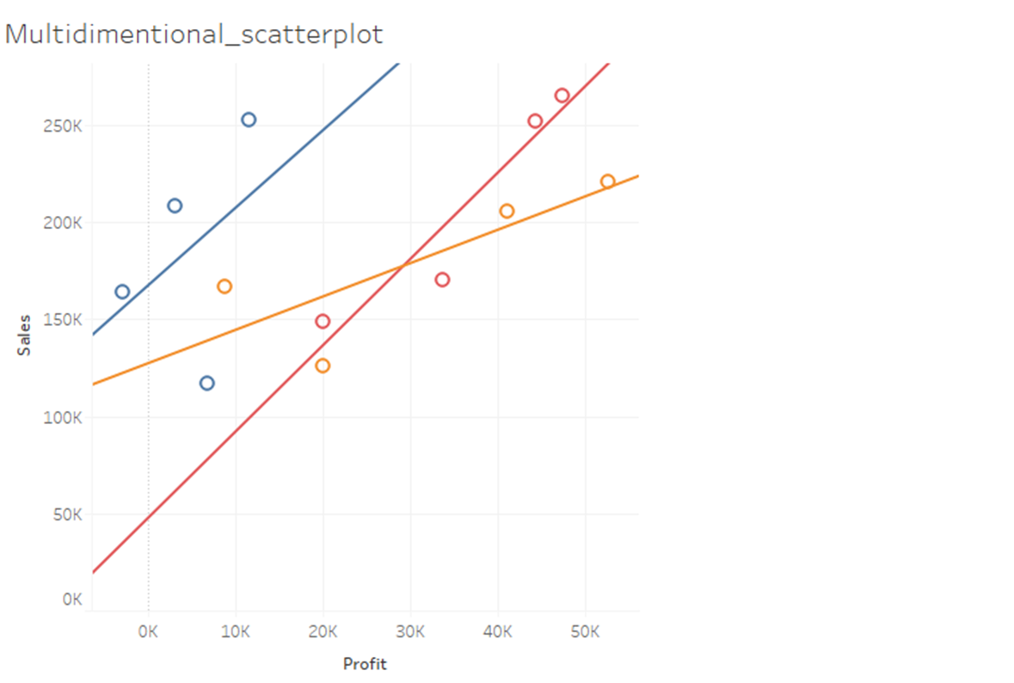
Multidimenstional Example:suersore dataset
Category
Region
Sales
Profit

Slide 23
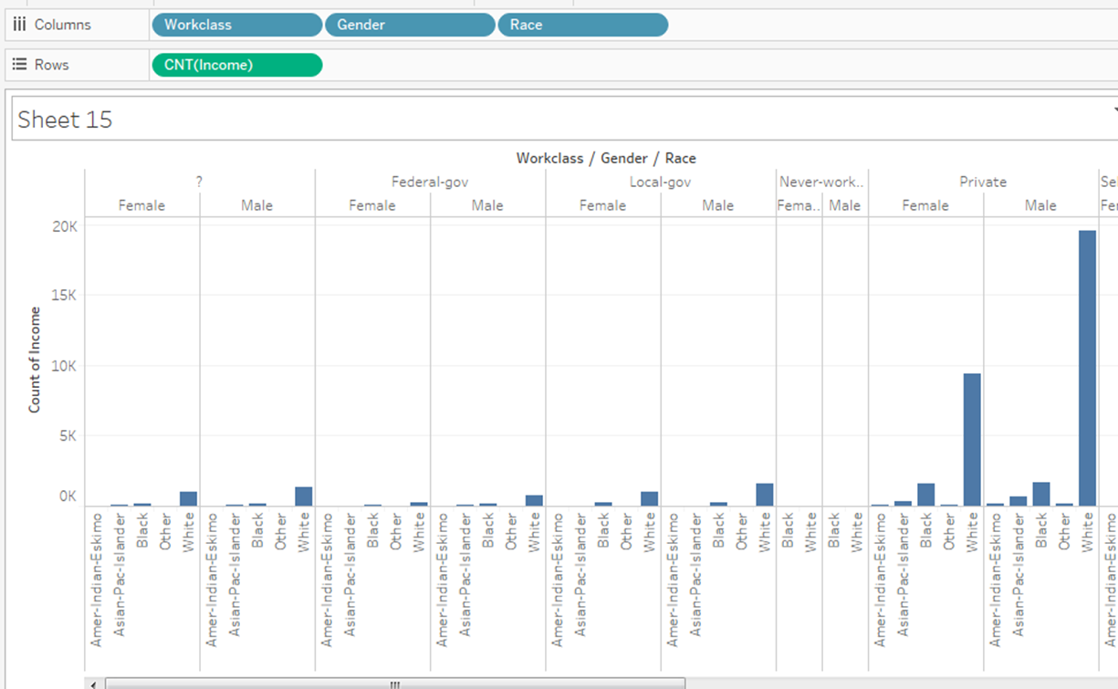
Multidimenstional Example:adult dataset
Income
Gender
Occupation
Workclass

Slide 24
Hierarchical Data Visualizations/Trees
Hierarchical Visualizations or Trees are collections of items with each item having a link to one parent item (except the root).
Items and the links between parent and child can have multiple attributes.

Slide 25
Hierarchical Data Visualizations/Trees
A tree map is a visualization that nests rectangles in hierarchies so you can compare different dimension combinations across one or two measures (one for size; one for color) and quickly interpret their respective contributions to the whole.
When used poorly, tree maps are not much more than an alternative pie chart.
When used well, they provide at least two big benefits:
Depending on the analysis, some portions of the tree map will be composed of large rectangles where additional context can be added as labels. This is beneficial when the visualization will not be interactive and you still want the written information represented.
In addition to the scatter plot, tree maps are one of the only visualization types that allow you to reasonably communicate and consume hundreds of marks on a single view. This makes it easier to spot patterns and relationships that you would not otherwise be able to

Slide 26
Hierarchical Data Visualizations/Trees
Examples include:
dendrogram,
phylogenetic tree,
radial tree,
hyperbolic tree,
tree map,
cone tree,
radial hierarchy,
decision tree/flow chart

Slide 27
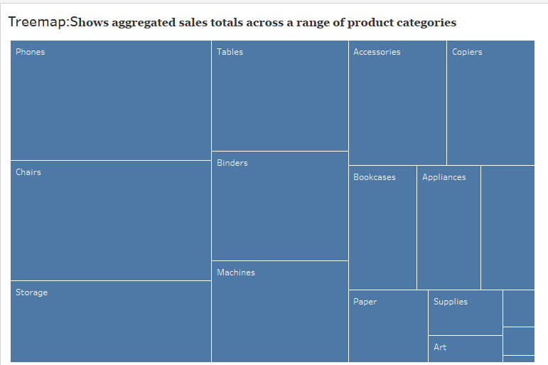
Treemap example:superstore dataset

Slide 28
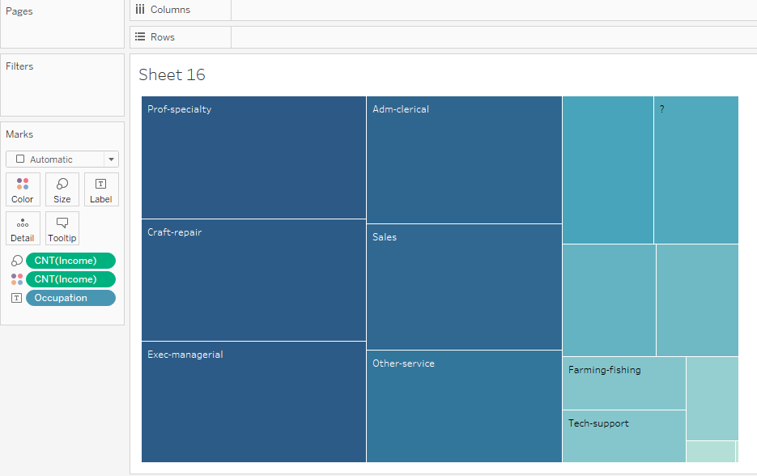
TreeMap Example : Income Generated based on Occupation(adult dataset)

Slide 29
Temporal Data visulization
Temporal data refers to time.
Temporal data is data that represents a state in time such as
Land use pattern of Hong-Cong in 1990
Total rainfall in US on Jul 1,2009
Temporal data is collected to analyze
weather patterns
other environmental variables
monitor traffic condition and so on

Slide 30
Temporal Data visulization
Temporal data is data in which values You see in dataset depends on time.
Example:
Business sales
Natural Phenomenon
Behavior/Movement
Traffic/Mobility
Medical/Healthcare
Finance

Slide 31
Types of Temporal data
Event Data
Measurement Data

Slide 32
Event Data
Every object in dataset represent one single event.
Something happened at time T
Example:
Let say any message on social media at some time can be an event.
Message on facebook

Slide 33
Measurement Data
Time+measure
This is the value at time T
Example
From sensor temperature
From finance reveneu, stock value

Slide 34
Examples of temporal data visualization
Time series
Time line
Scatterplot
Line graphs

Slide 35
Time Series Visualization
Time series analysis is a statistical technique used to record and analyze data points over a period of time, such as daily, monthly, yearly, etc.
A time series chart is the graphical representation of the time series data across the interval period.

Slide 36
Time Series Visualization
Provides the flexibility to reflect on historical data and analyze trends and seasonal components.
It also helps to compare
multiple dimensions over time
spot trends,
and identify seasonal patterns in the data.
Examples include
stock market analysis,
population trend analysis using a census,
sales and profit trends over time.

Slide 37
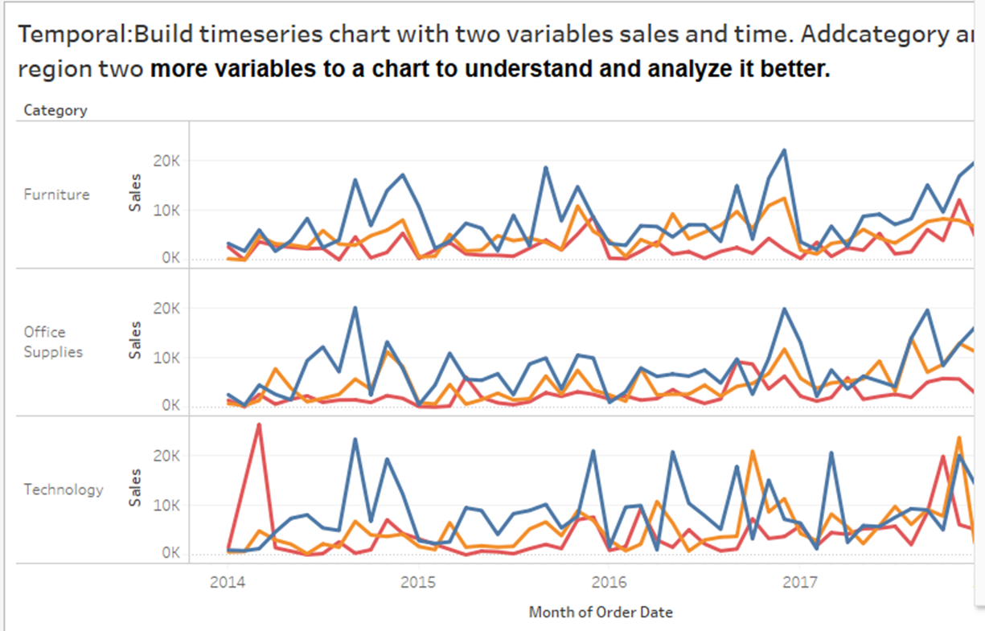
Timeseries Example:Superstore dataset

Slide 38
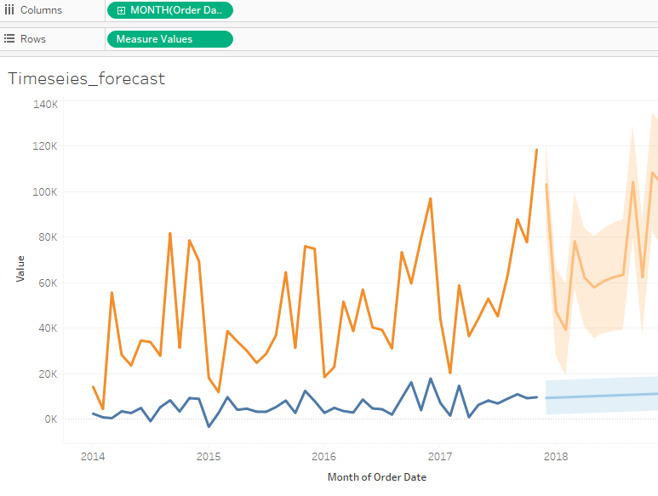
Timeseries forecast:superstore dataset

Slide 39
Network data visualization
Network visualizations display relationships between elements by linking nodes with common characteristics.
User can visualize clusters quickly and determine relationships.
Unfortunately, the development process in Tableau isn’t as straightforward.
To get the data into a Tableau-friendly format for network visualization, we’ll first do some data preparation then bring it into Gephi to produce spatial coordinates.

Slide 40
Network data visualization
A network graph is a data visualization method that allows users to easily understand relationships in data.
Network graphs are composed of nodes and edges.
Nodes are singular data points which are connected to other nodes through edges.
Edges show the relationship between two or more nodes.

Slide 41
Example
Consider an organization with three employee types: directors, managers, and associates.
A network graph would show each employee type as a node, and the relationship between those individual employees as edges.

Slide 42
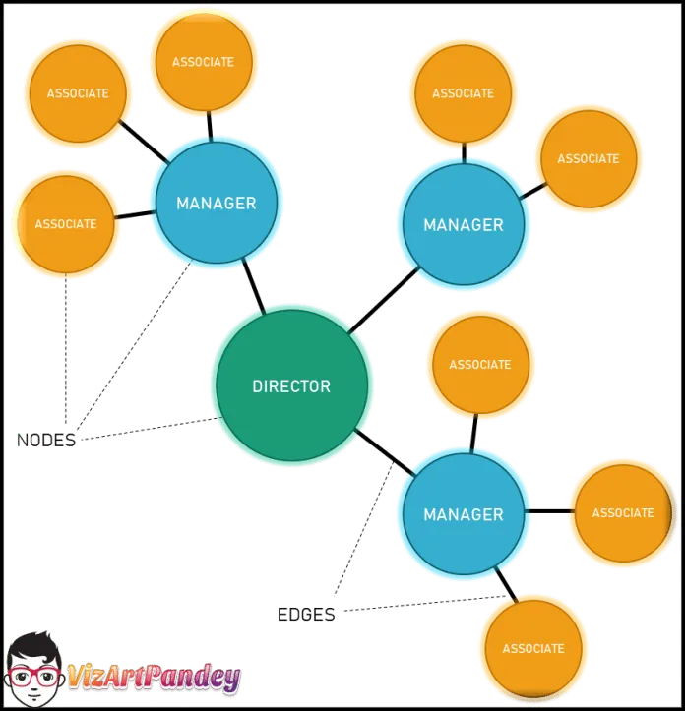

Slide 43
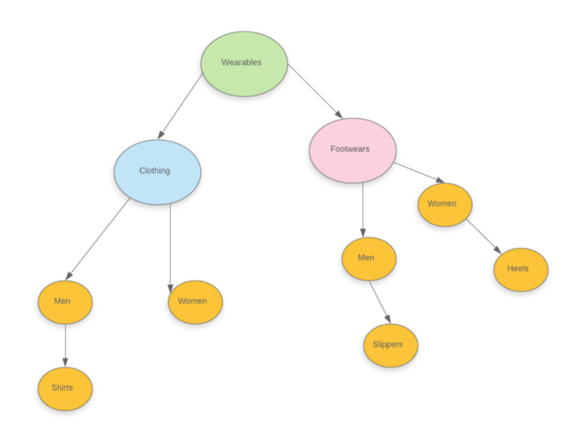
Suppose you are opening a departmental store. You can create a network chart for all items.
A small scale graph would be as follows.

Slide 44
HOW TO CREATE NETWORK DATA VISUALIZATION IN TABLEAU
Prepare a Dataset Capable of Creating Network Visualizations
Add LineX to columns
Add LineY and CircleY to rows
Note both the X and Y variables must be continuous dimensions
Right-click on the CircelY variable and select “Dual Axis”
Right-click on either CircleY-axis and select “Synchronize Axis”
Set the first value on the Marks card, LineY, to Line
Set the second value on the Marks card, CircleY to Circle

Slide 45
Drag and drop Node on CircleY’s Lable
Drag and drop ID on LineY’s Details
Drag relationship on LineY’s ID
Drag ID on CircleY’s colour
Finish

Slide 46
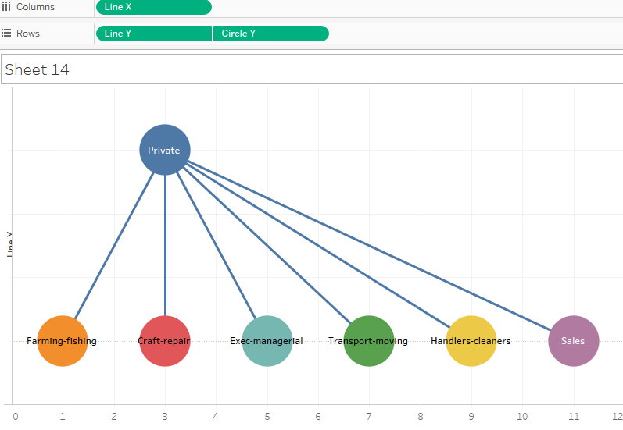
Network data visualization example

Slide 47
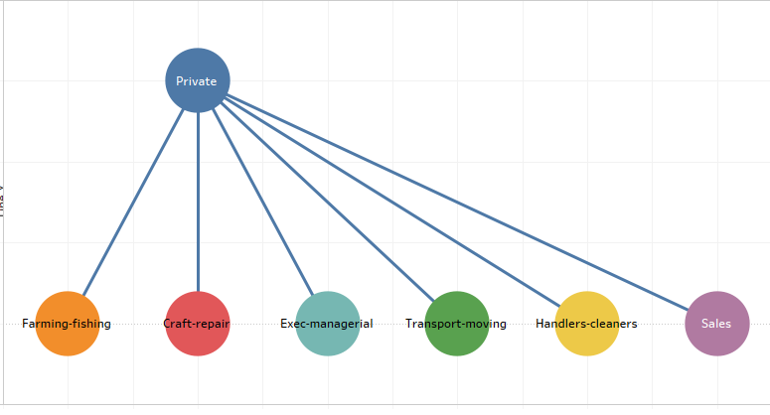

Slide 48
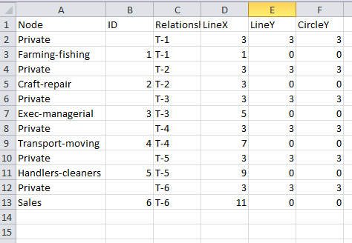
Dataset for network data visualization(adult dataset)

Slide 49
THANK YOU

