Slide 1
Log File Agent
27th May 2020

Slide 2
Introduction
It is an agent which can be configured to monitor the log files using regular expressions.
We define 2 files while setting up the monitoring configuration and format file which has the regular expression details.
The agent can either be configured to send events to TEMS or to the EIF probe directly.
Product code is LO
Agent Capabilities
Agent uses the file system to monitor the following log file types:
Application Log Files
Windows Event Logs
Unix System Logs
AIX error report command log
Monitor alerts/errors on the system that you are managing using predefined or custom situation.
Establish your own performance threshold.
Trace the causes leading to an alert.
Gather comprehensive data about system conditions.
Use policies to take action, schedule work or automate manual tasks.

Slide 3
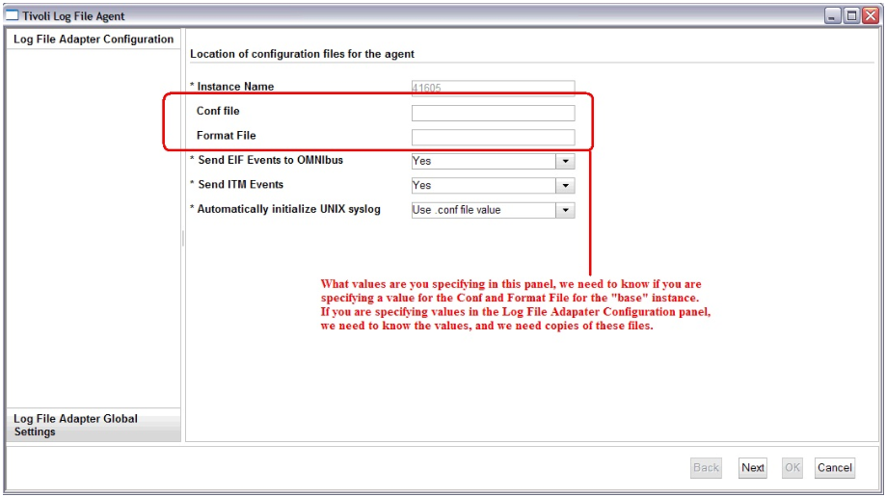
Installation and Configuration
Manual Method
Download the agent package and install using install.sh on AIX/Linux, setup.exe on Windows.
Configuration on Windows

Slide 4
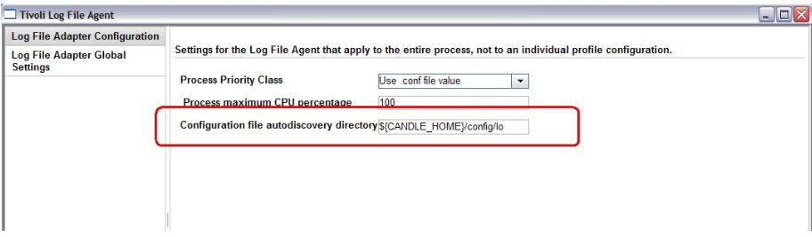

Slide 5
Configuration on UNIX/Linux
# ./itmcmd config -A lo Agent configuration started... Enter instance name (default is: ): 51494LO <--- LO agent instance name Edit "Tivoli Log File Agent" settings? [ 1=Yes, 2=No ] (default is: 1): 1 Edit 'Log File Adapter Configuration' settings? [ 1=Yes, 2=No ] (default is: 1): 1 Conf file (default is: ): <--- Conf file for the "base" instance - KLO_CONF_FILE. This value can be left blank if relying on sub nodes and auto discovery. Format File (default is: ): <--- Format file for the "base" instance - KLO_FORMAT_FILE. This value can be left blank if relying on sub nodes and auto discovery. Send EIF Events to Omnibus [ 1=Yes, 2=No ] (default is: 1): 2 Send ITM Events [ 1=Yes, 2=No ] (default is: 1): 1 Automatically initialize UNIX syslog [ 1=Yes, 2=No, 3=Use .conf file value ] (default is: 3): 3 Edit 'Log File Adapter Global Settings' settings? [ 1=Yes, 2=No ] (default is: 1): 1 Process Priority Class [ 1=A, 2=B, 3=C, 4=D, 5=E, 6=F, 7=Use .conf file value ] (default is: 7): 7 Process maximum CPU percentage (default is: 100): Configuration file auto discovery directory (default is: ${CANDLE_HOME}/config/lo): <-- The auto discovery directory to search for .conf / .fmt pairs - KLO_FILE_DISCOVERY_DIR.

Slide 6
Will this agent connect to a TEMS? [1=YES, 2=NO] (Default is: 1): 1 TEMS Host Name (Default is: NMP136): test.system.ibm.com Network Protocol [ip, sna, ip.pipe or ip.spipe] (Default is: ip.pipe): Now choose the next protocol from one of these: - ip - sna - ip.spipe - 0 for none
Network Protocol 2 (Default is: 0): IP.PIPE Port Number (Default is: 1918): Enter name of KDC_PARTITION (Default is: null): Configure connection for a secondary TEMS? [1=YES, 2=NO] (Default is: 2): Enter Optional Primary Network Name or 0 for "none" (Default is: 0): Agent configuration completed...

Slide 7
Remote Installation (Using AddSystems)
Command Line mode- Using tacmd command
tacmd addSystem {-t|--type} pc {-n|--node} managed-os {-p|--property} section.name=value ...
where:
-t|--type product code
-n|--node managed-os
-p|--property section.name=value...
tacmd addSystem -t LO -n sample.node.name:KUX -p LOG_FILE_ADAPTER_CONFIGURATION.KLO_AUTO_INIT_SYSLOG=No LOG_FILE_ADAPTER_CONFIGURATION.KLO_SEND_EIF_EVENTS=No LOG_FILE_ADAPTER_CONFIGURATION.KLO_SEND_ITM_EVENTS=Yes LOG_FILE_ADAPTER_GLOBAL_SETTINGS.KLO_FILE_DISCOVERY_DIR=/opt/IBM/ITM/FIS/KLO/AppLog LOG_FILE_ADAPTER_GLOBAL_SETTINGS.KLO_PROCESS_MAX_CPU_PCT=100 INSTANCE="inst2”
./tacmd putfile -m Primary:WINDOWS:NT -s /nfs/app1/KLO_distributions/<file_name> -d <destination> -t text
where destination can be C:/IBM/ITM/FIS/KLO/AppLog/AppLog.conf or /opt/IBM/ITM/FIS/KLO/AppLog/AppLog.conf

Slide 8
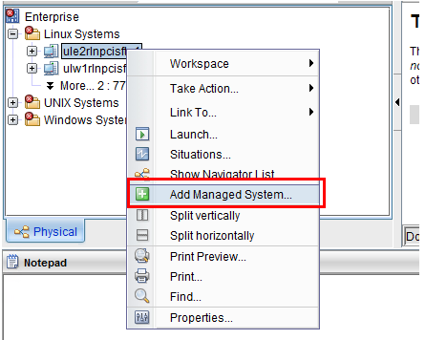
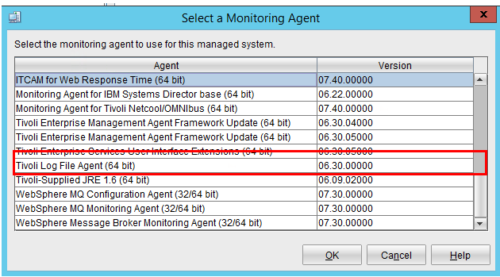
GUI- From TEPS

Slide 9
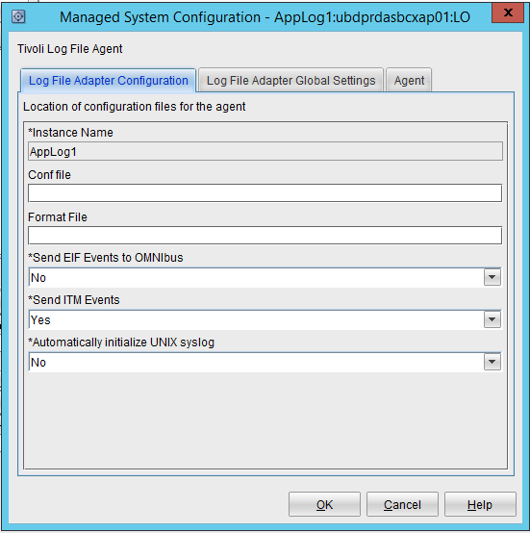
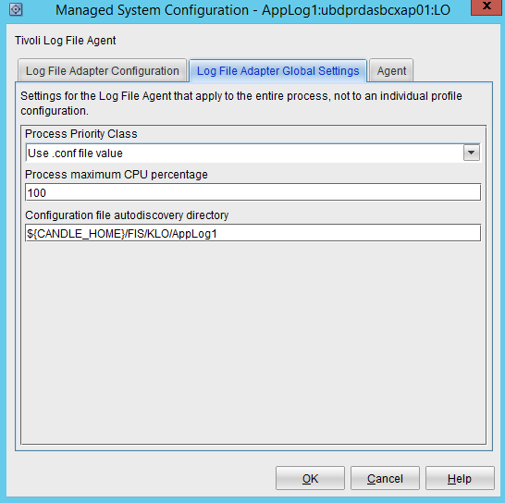
Configurations

Slide 10
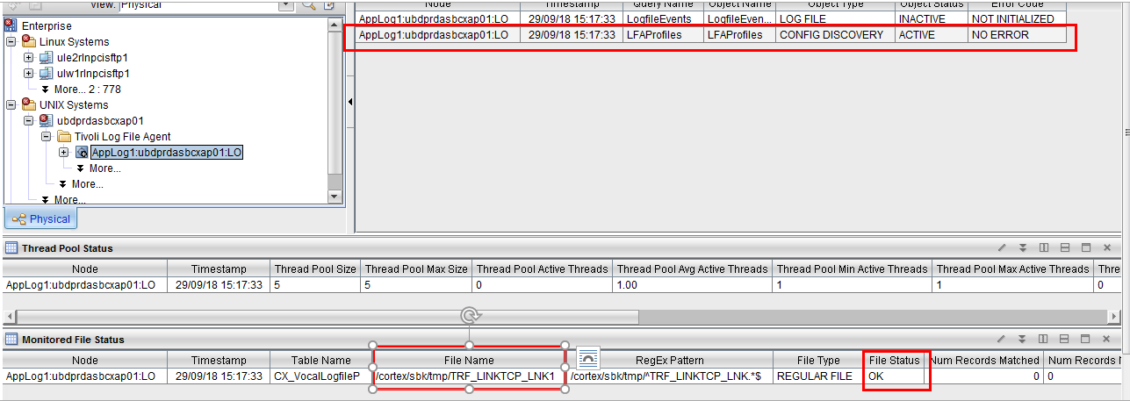
Review the "Data Collection Status" workspace view in the TEP Confirm if the desired log to monitor is found and has Object Status "ACTIVE" and File Status "OK".

Slide 11
Confirm that log entries are being parsed from the monitored log.
If logs are being monitored, and the status is OK, but log entries as not showing up as expected, confirm if log entries are being written to the unmatch log, and whether the values in the "Monitored File Status" workspace are being updated for the log.
The values for Number of Records Matched / Number of Records Not Matched / Number of Records Processed / Current File Position should be changing if the LO agent is detecting newly written data and is processing those log entries against the stanzas in the FORMAT (.fmt) file.
Initially there is no "new" data to process since the LO agent has been started as the number of records processed / matched / not matched are all zero.
For debugging, it is always recommended that an unmatch log be specified using UnmatchLog parameter in the CONF (.conf) file.

Slide 12
Log File Agent Work Flow
When log file agent is started, it monitors the log files as mentioned in the conf file. If Log file is not available in the defined path, agent starts monitoring the same as soon the file is available.
When an entry is written in the monitored logs i.e a match is found, it is read into a “record” and is evaluated against the REGEX defined in the format file.
If the record matches against a stanza, it is parsed into the attribute values matching the stanza.
If the parsed values, matches the filter criteria it is passed to the TEMS by the TEMA layer for evaluation against the situation formula.
The data collection ("matched" records in this case) rows are passed to TEMS for display of attribute data in TEP workspace view. At the TEMS, the "matched" records are displayed in the workspace for the LO agent in response to SQL query from TEPS for populating the LogfileEvents (or LogfileProfileEvents) workspace.
The TEMS evaluates the values that passed filters against the situation definition and if "TRUE" the situation fires, creating a situation alert in the TEP navigator if the situation is associated to a navigator icon.
If the situation is being forwarded to an event receiver, the TEMS forwards the details to the event receiver.

Slide 13
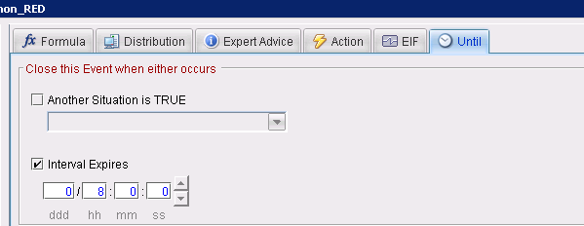
When you click on the alert icon chain link, it opens the Situation Event Console and displays the "Initial Situation Values" as you see above. The values highlighted in the same color code / severity as the alert icon are those fields that are used as part of the situation formula, and the rest of the details would be the attribute values that would be used in any attribute substitution
Situation alerts are either "pure" or "polling" based on the situation definition. For LO agent, the situations are "pure" alerts that are evaluated when the log entry is parsed and sent to the TEMS. A "pure" alert will remain open until acknowledged / closed manually, or IF you are using "UNTIL" clause, the alert will be closed automatically when the UNTIL clause is met. An UNTIL clause can be a Time To Live (TTL) so that the pure events close automatically after a set specific time, or the "UNTIL" clause can be another situation evaluating to True, so the pure event could be closed when some other condition is met.

Slide 14
Configuration File
The configuration file is read by the agent when it starts, and is monitored for changes to its timestamp every 60 seconds thereafter. If the timestamp of the file changes, the agent reinitializes its configuration dynamically, without requiring a restart.
The .conf file for the Log File agent accepts these options:
LogSources
Specifies the text log files to poll for messages. Complete path name to each file must be mentioned and they must be separated by commas.
Within each file name wildcards like (*) which represents any sequence of character or (?) to represent a single character, can be used.
These wildcards are supported only within the filename, the path must be specified explicitly.
A log file source is not required to exist when the agent is started, it is polled when the same is created.

Slide 15
RegexLogSources
Specifies the text log files to poll for messages.
It differs from log sources option, in that regular meta characters can be used in the base name portion of the file name and at most one subdirectory of the file name. This provides the greater flexibility.
For example, specifying /var/log/mylog* for the LogSources statement is identical to using the dot (.) meta character followed by an asterisk (*) meta character to form /var/log/mylog.* in the RegexLogSources statement. This type of qualifier results in polling all log files in the /var/log directory whose base names begin with mylog and are followed by zero or more characters. A /var/log/mylog.+ qualifier results in polling all log files in the /var/log directory whose names begin with mylog and are followed by one or more characters.
- Similar to LogSources, the complete path to each file must be specified and the file names must be separated by commas.
- However, the comma is also a valid character inside a regular expression. In order to distinguish between a comma that is used as part of a regular expression and one used to separate file names, commas that are used as part of a regular expression must be escaped with the backslash (\) character.
- If more than one subdirectory contains meta characters, a trace message is also issued. For example, c:/[0-9\.]*/temp.files/mylog.* has two subdirectories with meta characters. [0-9\.]* is the first subdirectory with meta characters and temp.files is the second subdirectory that used a dot (.) meta character. In this case, the agent assumes that the first subdirectory with the meta character is used and the subsequent directories with meta characters are ignored.

Slide 16
LognameIsBasename
When set to Y, the value of the Log name attribute in ITM is the base name of the log file in which the event was found. Example: /data/logs/mylog.log becomes mylog.log.
If this value is set to n, then we get the full path name. However this attribute is limited to 64 characters and hence name gets truncated if it is longer.
To see full path name in a longer attribute, we can specify in the mapping section of the format file. Like filename FILENAME CustomSlot1. CustomSlot1 can accommodate 256 characters.
NumEventsToCatchUp
Specifies the event in the log the agent starts with. This option provides some flexibility if the source that is being monitored is new or the agent is stopped for an extended time.
For text files , values 0 and -1 apply. For Windows event log, values 0, 1 and n applies
0 – starts with the next event in the log, this is the default value.
-1 – The agent saves a place where the file is being monitored, so that when the agent is stopped and restarted later it can process any events which were written when the agent was stopped. If not mentioned, when the agent is started the search is done from the initiated from the end of the file. This setting doesn’t apply to any pipes, or syslog monitoring in Unix and Linux.
n – Set to a positive integer. Starts with the n’th event from the most current event in the event logs. It is applied only for windows event log.

Slide 17
PollInterval
Specifies the frequency in seconds, to poll each log file mentioned. The default value is 5 seconds.
DupDetectionKeyAttributes
A comma-separated list of IBM Tivoli Monitoring that are used to determine which events are duplicates and which are not. If all the named attributes are same in two events, then those 2 events are considered to be duplicates.
The attributes are case sensitive and you must enter the names exactly as described.
If you do not provide a list of attributes, the values are defaulted to Class and Logname
UnmatchLog
Specifies a file to log discarded events that cannot be parsed into an event class by the agent.
The discarded events can then be analyzed to determine whether modifications are needed to the agent format file.
Events that match a pattern that uses *DISCARD* do not appear in the unmatch log because they did match a pattern.

Slide 18
EventSummaryInterval
Specifies the number of seconds the agent searches for duplicate events to suppress.
Need to set to a positive integer.
EventFloodThreshold
Specifies which events are sent when duplicates are detected.
Set to send_none, send_all, send_first or a positive integer.
FileComparisonMode
Specifies which log files are monitored when more than one matches a wildcard pattern.
CompareByAllMatches- This value is a default behavior. All Files that match the wildcard pattern that is specified in log sources are monitored.
CompareByLastUpdate- Of the files that match the wildcard pattern that is specified in log sources, the file with the most recent last update timestamp is monitored.

Slide 19
CompareBySize- Of the two or more files that match the name pattern criteria, the bigger file is selected for monitoring. It is advised not to use this parameter in cases with multiple matching files that are updated at the same time and increasing their file sizes. If the largest file subjected to frequent change, monitoring might continually restart at the beginning of the newly selected file. Use this parameter when there is a set of matching files but only one file is getting updated at any specific time.
CompareByCreationTime- Of the files that match the wildcard pattern that is specified in the Log Sources, the file with the most recent time stamp is monitored.
The CompareByLastUpdate, CompareBySize, and CompareByCreationTime values can all be used for rolling log files. CompareByLastUpdate is normally used for these files.
The CompareByCreationTime value:
Is applicable only to Windows Operating systems as Unix and Linux servers don’t store a true creation time for files
Is not supported by remote files that you monitor by using ssh protocol.
Of the files that match the wildcard pattern that is specified in the Log Sources, the file with the most recent time stamp is monitored.

Slide 20
The following options apply only where events are being forwarded to EIF:
BufferEvents
Specifies how event buffering is enabled. The possible values are:
YES - Stores events in the file that is specified by the BufEvtPath option (This value is the default).
MEMORY_ONLY - Buffers events in memory.
NO - Does not store or buffer events.
BufEvtPath Specifies the full path name of the agent cache file. If this path is not mentioned the default is: UNIX systems: For more information/etc/Tivoli/tec/cache Windows systems: \etc\Tivoli\tec\cache If events are being forwarded to more than one server, a BufEvtPath value must be specified for each forwarding channel. An index number is appended to the BufEvtPath name for each additional entry. For example, use BufEvtPath1 to indicate the path name of the agent cache file for forwarding to the first additional server. The value that is set in each BufEvtPath must be unique.

Slide 21
BufEvtMaxSize
Specifies the maximum size, in KB, of the agent cache file. The default value is 64. The cache file stores events on disk when the BufferEvents option is set to Yes. The minimum size for the file is 8 KB. File sizes specified less that this level is ignored, and 8 KB is used. There is no upper limit to the value you specify for the maximum file size.
SubnodeName
A string value that can be used to override the default name that is assigned to a monitoring profile subnode. By default the subnode name that is assigned to a monitoring profile corresponds to the base name of the configuration file that is used for that profile. Using this setting a different subnode name can be assigned.
https://www.ibm.com/support/knowledgecenter/SS4EKN_7.2.0/com.ibm.itm.doc_6.3/logfile/klo_conffile.htm

Slide 22
Log File Attributes
The following list contains information about each attribute in the LogfileEvents attribute group:
Node attribute: This attribute is a key attribute.
Description
The managed system name of the agent.
Type
String
Source
The source for this attribute is the agent.
Timestamp attribute
Description
The local time at the agent when the data was collected.
Type
String
Source
The source for this attribute is the agent.

Slide 23
Class attribute: This attribute is a key attribute. Description The Class name of the log file event, as defined in the configured format (.fmt) file. Type String Source The source for this attribute is Log File Data.
Logname attribute: This attribute is a key attribute.
Description
The name of the log in which the matching record was found.
Type
String
Source
The source for this attribute is Log File Data.

Slide 24
CustomSlot1-10 attribute Description User-defined slot from the EIF event. Type String Source The source for this attribute is Log File Data.
Occurrence Count attribute
Description
The number of times this event occurred over the current flood control summary interval.
Type
Integer (32-bit gauge) with enumerated values. The strings are displayed in the Tivoli Enterprise Portal. The warehouse and queries return the values that are shown in parentheses. The following values are defined:
Value Exceeds Maximum (2147483647)
Value Exceeds Minimum (-2147483648)
Any other value is the value that is returned by the agent in the Tivoli Enterprise Portal.
Source
The source for this attribute is derived: occurrenceCount().

Slide 25
Event Type attribute Description A flag indicating whether the current event is a flood control summary event. Type Integer (32-bit numeric property) with enumerated values. The strings are displayed in the Tivoli Enterprise Portal. The warehouse and queries return the values that are shown in parentheses. The following values are defined: Event (0) Summary Event (1) Any other value is the value that is returned by the agent in the Tivoli Enterprise Portal. Source The source for this attribute is derived: isSummaryEvent().
CustomInteger1-3 attribute
Description
User-defined slot with integral type from the EIF event.
Type
Integer (64-bit gauge) with enumerated values. The strings are displayed in the Tivoli Enterprise Portal. The warehouse and queries return the values that are shown in parentheses.

Slide 26
Value Exceeds Maximum (9223372036854775807) and Value Exceeds Minimum (-9223372036854775808) Any other value is the value that is returned by the agent in the Tivoli Enterprise Portal. Source The source for this attribute is Log File Data.
https://www.ibm.com/support/knowledgecenter/SS4EKN_7.2.0/com.ibm.itm.doc_6.3/logfile/fac_attributes_descriptions.htm#attr_group_KLOLOGEVTS

Slide 27
Format File
The Tivoli Log File Agent extracts information from system log messages and then matches different log messages to event classes. A format file serves as a lookup file for matching log messages to event classes, telling the event class what to read, what to match, and how to format the data.
When the format file is used as a lookup file, all format specifications in the file are compared from the beginning to the end of the file. When two classes match or there are multiple matching classes for a message, the first expression from the end that matches is used. If no match is found, the event is discarded. A discarded event is written to the unmatch log if it is defined in the .conf file.
Format file specifications
The format file describes the patterns that the agent looks for to match events in the monitored logs. The format file consists one or more format specifications.
If we change the format file while an agent instance is running. The file is read by the agent when it starts, and is monitored for changes to its timestamp every 60 seconds thereafter. If the timestamp of the file changes, the agent reinitializes its configuration dynamically, without requiring a restart.

Slide 28
To create new patterns to match an event, use the new regular expression syntax that consists of the following parts: Format header Regular expression Slot mappings End statement
Format Header
It contains the keyword REGEX, this informs the agent that a regular expression is used to match a pattern in log file.
We assign this regular expression to an event class as shown in the following example:
REGEX REExample
If you use the special predefined event class *DISCARD* as your event class, any log records matching the associated pattern are discarded, and no events are generated for them. For example:
REGEX *DISCARD*
You can assign multiple event definitions to either the same event class or to different event classes. The class name is arbitrary and you can use it to indicate the type of event or to group events in various ways.

Slide 29
The format content consists of a regular expression on the first line, followed by mappings. Each mapping is shown on a separate line and these mappings
Regular Expression
All lines that match the regular expressions are selected and sent to the monitoring server as events.
The regular expression contains sub expressions. You can use the sub expressions to match specific parts of these lines that match, to a variable called a 'slot' in the Event Integration Facility.
Slot Mappings
The regular expression must match the lines that begin with Error: and also include a sub expression. The sub expression is denoted by parentheses and it must match only the input text that you want to assign to the msg slot. The value of $1 to the msg slot, will assign the value of the first sub expression.
The Tivoli Log File agent includes the following 13 predefined attributes:
10 string type attributes ranging from CustomSlot1 to CustomSlot10.
Three integer type attributes ranging from CustomInteger1 to CustomInteger3.
Using these attribute names in the format file populates IBM Tivoli Monitoring attributes of the same name

Slide 30
End Statement
The END keyword completes the format specification. The format header, regular expression, and the END keyword must each begin on a new line.
REGEX REExample

Slide 31
Inheritance
Format file uses inheritance to derive slot definitions from a previously defined format specification.
Use the FOLLOWS relationship to build specific format specifications from generic format specifications by using inheritance.
First, you define a base class and call it DiskFailure, for example, as shown here:
REGEX DiskFailure
Disk Failure on device (.*)
device $1 CustomSlot1
END
This regular expression matches the Disk Failure on device/dev/sd0 errors in the monitoring log so that the /dev/sd0 value is assigned to the device slot.
Consider the below error:
Disk Failure on device /dev/sd0, error code: 13 error message.

Slide 32
REGEX DiskFailureError FOLLOWS DiskFailure Disk Failure on device (.*), error code: ([0-9]*) errcode $2 CustomSlot2 END
Now, the event includes the device slot and the errcode slot. As the DiskFailure event class defined a slot for the device name already, you allow the subclass to inherit that slot, and this inheritance saves you from declaring it a second time. The slot is defined as $1 so the first sub expression in the regular expression is assigned to that slot.
the DiskFailureError class also defines a second sub expression. You can assign this sub expression to a new slot called errcode and define it as $2 to refer to the second sub expression in the regular expression.
MultiLine
Multi-line syntax is used to match records that span more than one line to patterns in the log that you are monitoring.
We specify the \n newline character as part of the regular expression to indicate where the line breaks occur in the monitoring log.
On Windows, you specify a \r\n carriage-return and newline combination.

Slide 33
If the following error messages are reported in the log text, the REMultiLine event is created:
Log errors
REGEX REMultiLine
Line1:(.*)\nLine2(.*)
msg $1
second_msg $2
END
The msg slot is assigned the value of An error occurred and the second_msg slot is assigned the value of The error was "disk error".
Line1: An error occurred
Line2: The error was "disk error"copy to clipboard

Slide 34
Mappings
The Tivoli Log File Agent uses mappings to determine the event class for a system log message. The agent determines the event class by matching the message to a pattern in the format file.
The agent translates log messages in to event class instances that contain attribute name=value pairs.
Attribute values come from various sources, such as:
Default values provided by the agent.
Log text that matches specific sub expressions in regular expressions.
Value specifiers
The mapping part of a format specification consists of the following types of value specifiers:
$i
String constant
PRINTF statement
$i
The i indicates the position of a sub expression in a format string. Each sub expression is numbered from 1 to the maximum number of sub expressions in the format string.

Slide 35
The value of a $i value specifier (also known as a variable, slot, or attribute) is the portion of the system log message that is matched by the corresponding sub expression.
string constant
The string constant declares that the value of the attribute is the specified string. If the attribute value is a single constant without any spaces, you specify it without surrounding double quotation marks (" ")
PRINTF statement
The PRINTF statement creates more complex attribute values from other attribute values. The PRINTF statement consists of the keyword PRINTF followed by a printf() C-style format string and one or more attribute names.
The format string supports only the %s component specifier. The values of the attributes that are used in the PRINTF statement must be derived from either a $i value specification or a constant string value specification.
To use an integer slot in a PRINTF statement, you still identify it with “%s”, not “%d”
Keywords
Following keywords expand at run time:
DEFAULT
FILENAME
LABEL
REGEX

Slide 36
FILENAME
The FILENAME keyword indicates the fully qualified file name (including the path) of the log file that contains the message.
If you use a single agent to monitor multiple log files, and you need to identify the source of the event, use this keyword to populate an event attribute with the file name.
If the message comes from the system log, then mapping is set to EventLog for Windows agents and SysLogD for UNIX logfile agents.
LABEL
The LABEL keyword indicates the host name of the system where the agent is currently running.
REGEX
The REGEX keyword expands to the regular expression that matched the message and caused the event.

Slide 37
Maximum Message length
This value is the maximum message length that the Log File agent can receive without truncating the message.
Tivoli Monitoring
For events sent to IBM® Tivoli Monitoring, the msg attribute is limited to 2048 bytes. Messages greater in length are truncated.
Tivoli Netcool/OMNIbus
For events sent through the Probe for Tivoli EIF to Netcool/OMNIbus, the total size of the event, including the class name and all slots and their values cannot exceed 4096 bytes

Slide 38
This example illustrates the use of a custom integer attribute:
2018-08-15 03:00:00,ukbiprdjblx04,RAP-WS-2_46_0,GRG,909,26
2018-08-15 03:00:00,ukbiprdjblx04,RAP-WS-2_46_0,GRG,909,26
2018-08-15 03:00:00,ukbiprdjblx04,RAP-WS-2_46_0,GRG,909,26
2018-08-15 03:00:00,ukbiprdjblx04,RAP-WS-2_46_0,GRG,909,26
2018-08-15 03:00:00,ukbiprdjblx04,RAP-WS-2_46_0,GRG,909,26
REGEX DPP_WS_Malfunction
^([0-9]{4}-[0-9]{2}-[0-9]{2}) ([0-9]{2}:[0-9]{2}:[0-9]{2}),(.*?),(.*?),(.*?),909,([0-9]*)$
Date $1 CustomSlot1
Time $2 CustomSlot2
Host $3 CustomSlot3
Service $4 CustomSlot4
Client $5 CustomSlot5
Errors $6 CustomInteger1
msg PRINTF("DPP Web-Services - System Malfunction detected for %s in service %s on host %s (occurrences: %s, code: 909)", Client, Service, Host, Errors)
END

Slide 39
Event filtering and summarization
Use the event filtering and summarization options that you set in the configuration (.conf) file to control how duplicate events are handled by the Tivoli Log File Agent.
Detecting and filtering duplicate events
It is done by DupDetectionKeyAttributes
Summary interval
The duplication detection procedure operates over a time period known as the Summary Interval.
Duplicate events are counted during this interval and then reset when the interval expires. The counter starts the count again beginning at 0 at the start of each new summary interval.
The agent sends a summary event for each event set that it monitors during the interval. The summary event contains the attribute values of the first event that matched. The summary event also contains a count that indicates how many duplicates of that event occurred during the summary interval.
The value assigned to the summary interval is in seconds, so in this example, the summary interval is 5 minutes.
EventSummaryInterval=300

Slide 40
Filtering events
If filtering of events is running, the EventFloodThreshold setting in the configuration (.conf) file informs the agent when to send an event.
EventFloodThreshold values | Description
send_all | The send_all value is the default value. All events are sent even if these events are duplicate events.
send_none | The send_none value means that no individual events are sent. Only the summary events are sent.
send_first | Use the send_first value to send the first event as soon as it is encountered. If duplicates of that first event occur within a specified time, then subsequent duplicates of this first event are not sent. For more information, see Summary interval.
n integer | Use the n integer value to send only every n occurrence of an event (for example every fifth duplicate) during a specific time. For more information, see Summary interval.

Slide 41
Summarization attributes
The Event Type and Occurrence Count attributes are used to help summarize events.
When event summarization is enabled, the Event Type and Occurrence Count attributes become meaningful. The Event Type attribute indicates the type of the event, being either an Event or a Summary Event.
General events that correspond to records found in the log on a one-to-one basis are tagged as Event.
Summary events that are sent at the end of the Summary Interval, are tagged as Summary Event.
The Occurrence Count attribute indicates the total amount of duplicate records found in the log for the event. Summary events include this count as it shows the number of events received that matched the summary event during the previous summary interval.
Regardless of the filter value as described in Filtering events, you always get the summary events at the end of each summary interval, for any event that occurred at least once during that interval. If you are not expecting the summary events your situations can be accidentally triggered. To avoid this accidental triggering of a situation, include a clause in the situation for Event Type== Event or Event Type!= Summary Event.
Viewing event filtering and summarization in the Tivoli Enterprise Portal
https://www.ibm.com/support/knowledgecenter/SS4EKN_7.2.0/com.ibm.itm.doc_6.3/logfile/klo_viewing_filtering.htm

