Slide 1
M2 Practical Challenge: Cross Validating a Linear Regression Model
Naveen Chowdary aliveli

Slide 2
1.Introduction
In this assignment, I am going to predict the curb weight of a passenger vehicles by constructing a cross validated linear regression model cars considering curb-weight variable as response variable and explanatory variables as height, width, length, wheel-base,engine-size, horsepower, peak-rpm, and city-mpg.
Steps involved are as follows:
Exploratory Data Analysis (EDA): In this step we will examine the quality of the data like examining the missing values or any outliers and also will try to find the relationships among the variables if any.
Regression Model Construction & Evaluation: In this step we will split the data and fed and then construct a linear regression model and evaluate the model using the K fold crossvalidation method.
Conclusions: Finally we will conclude the predicted curb-weight of a passenger vehicle and examine the performance scores of the models.

Slide 3
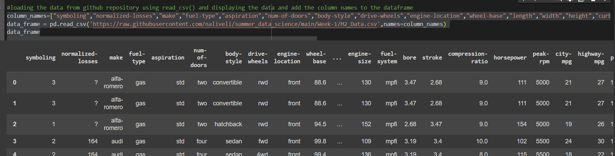
2. Exploratory Data Analysis (EDA)
Load the data from GitHub:

Slide 4
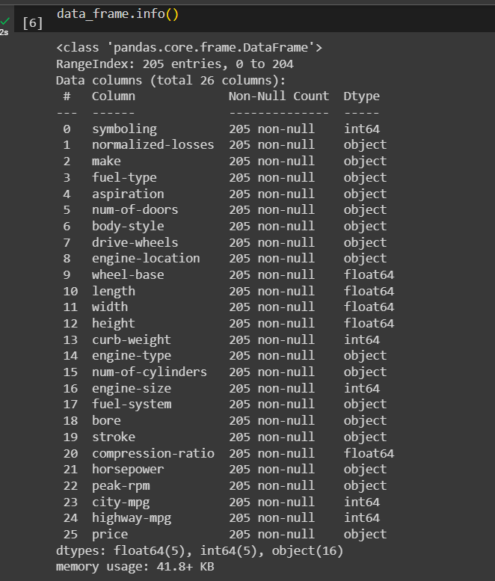
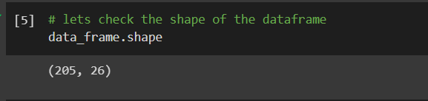
Continue..
Shape of a Data set
Data types of the attributes

Slide 5
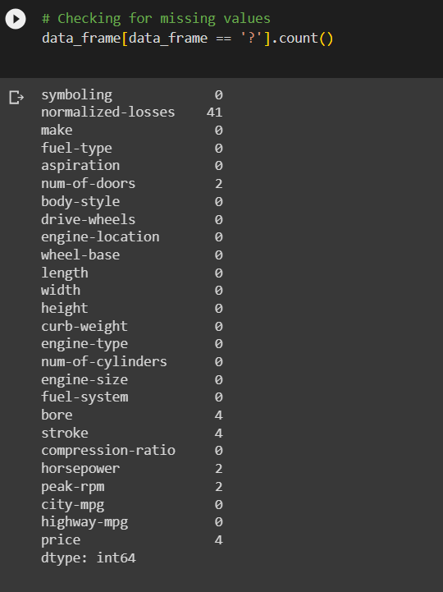
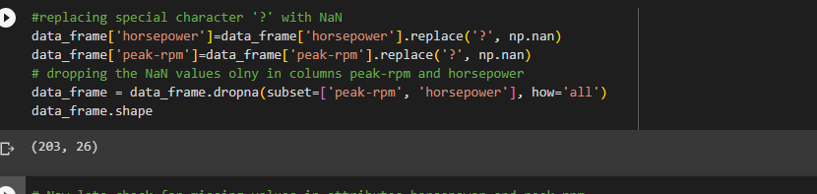
Cleaning the data

Slide 6
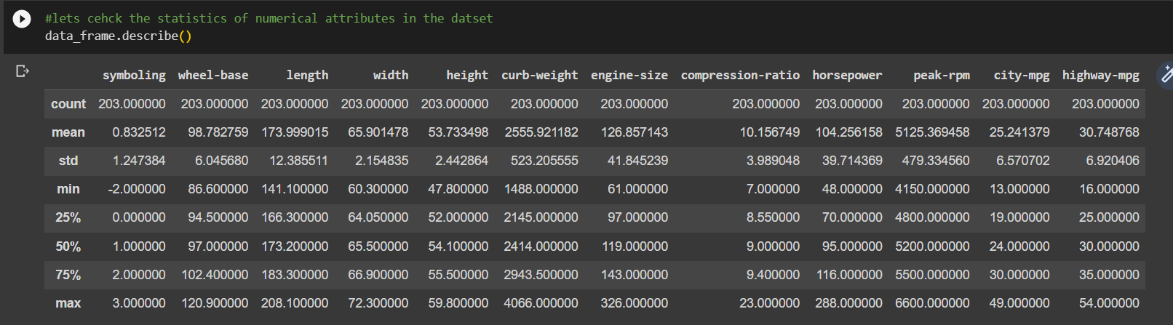
Statistics of Numerical attributes

Slide 7
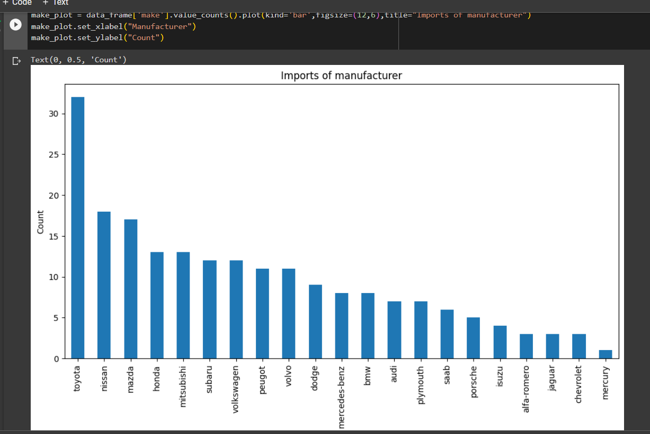
Car make frequency

Slide 8
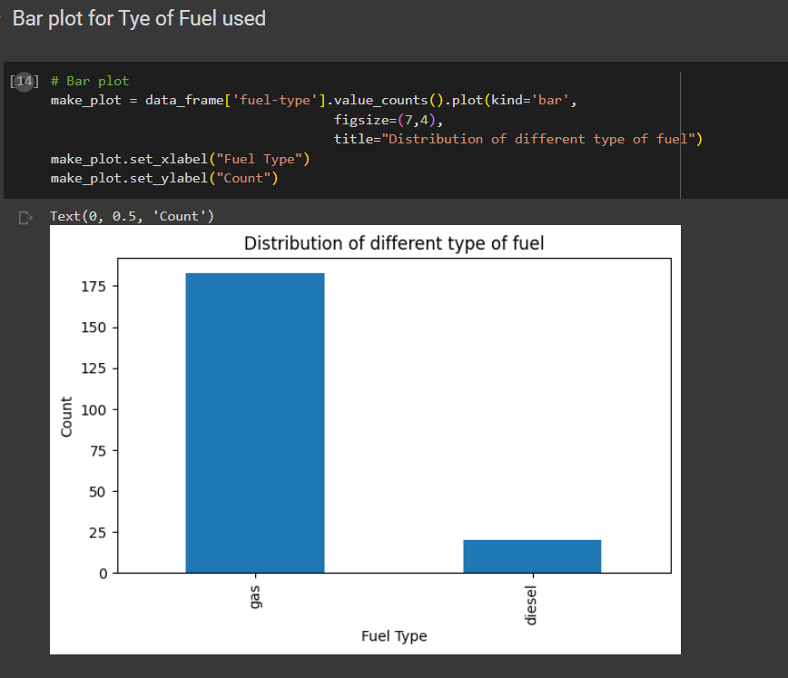
Distribution of different type of fuel

Slide 9
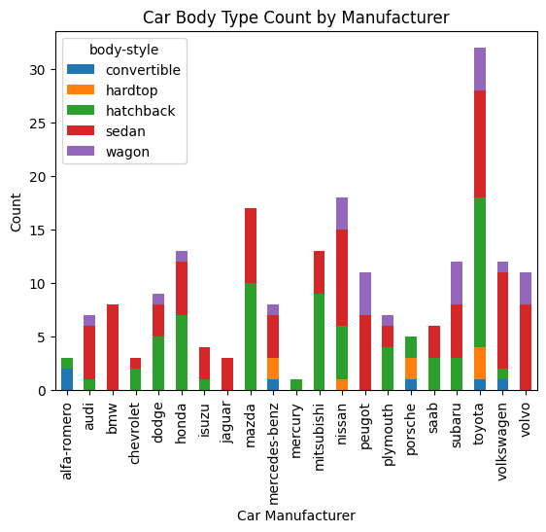
Car body style grouped by manufacturer

Slide 10
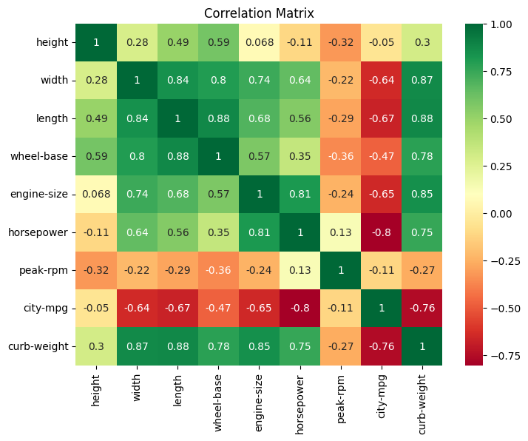
Correlation Matrix

Slide 11
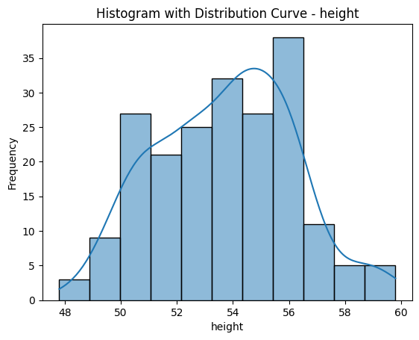
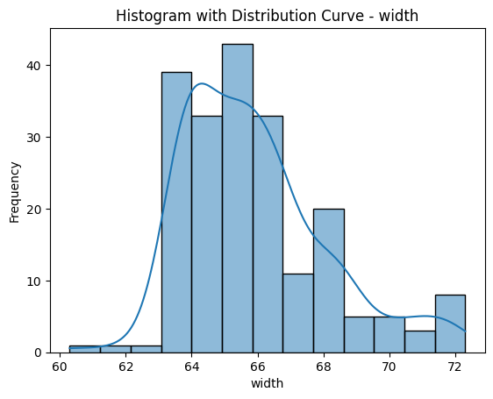
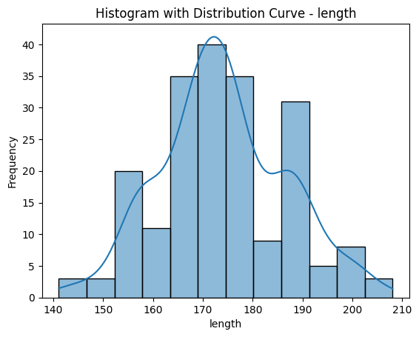
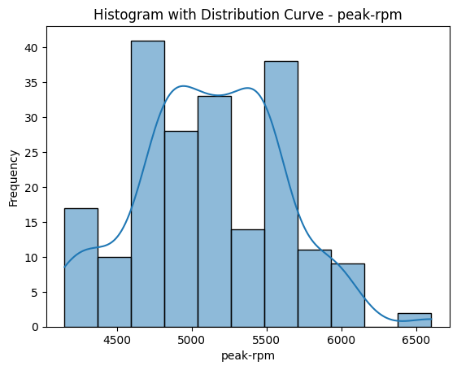
Histogram with distribution curve

Slide 12
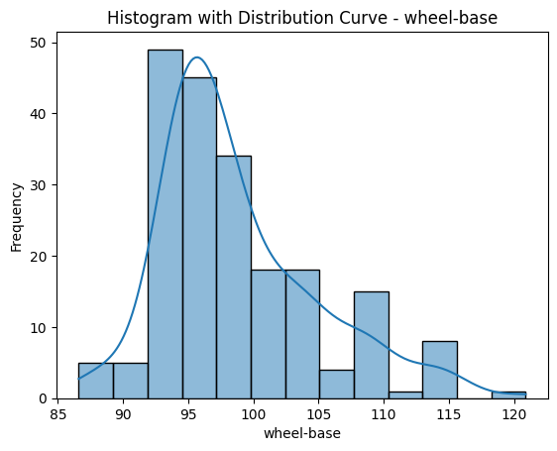
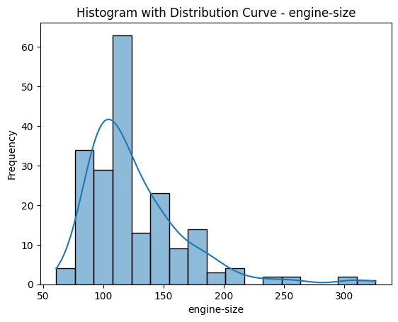
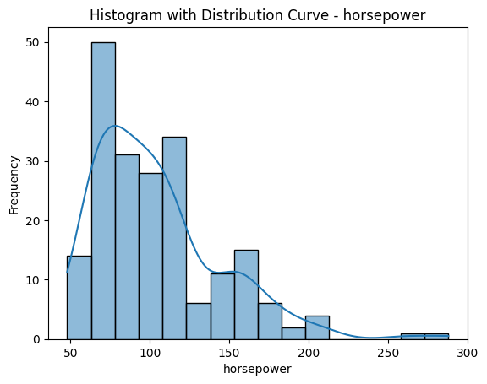
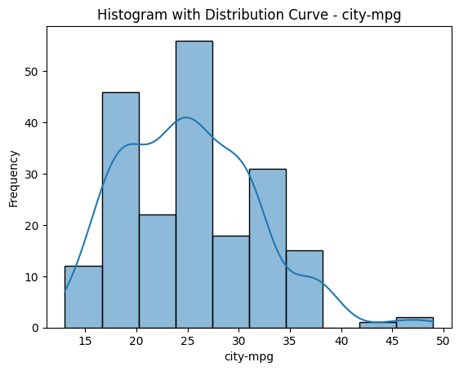

Slide 13
3. Regression Model Construction & Evaluation
Response Variable : curb-weight
Exploratory variables : height,
width,
length,
wheel-base,
engine-size,
horsepower,
peak-rpm, and city-mpg
So now create a new data frame by removing the responsive variable .

Slide 14
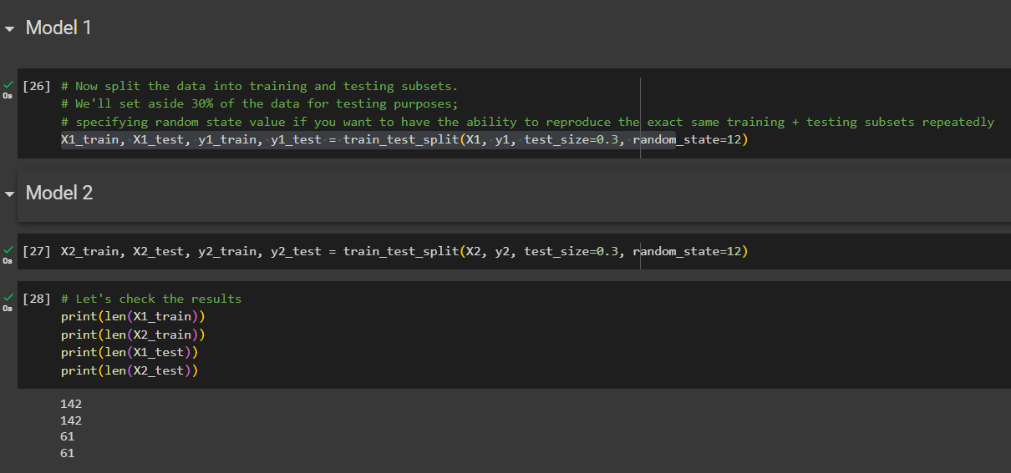
Continue…
Split the data into test and train data subsets for two models.
30% of data set for testing and 70% for training

Slide 15
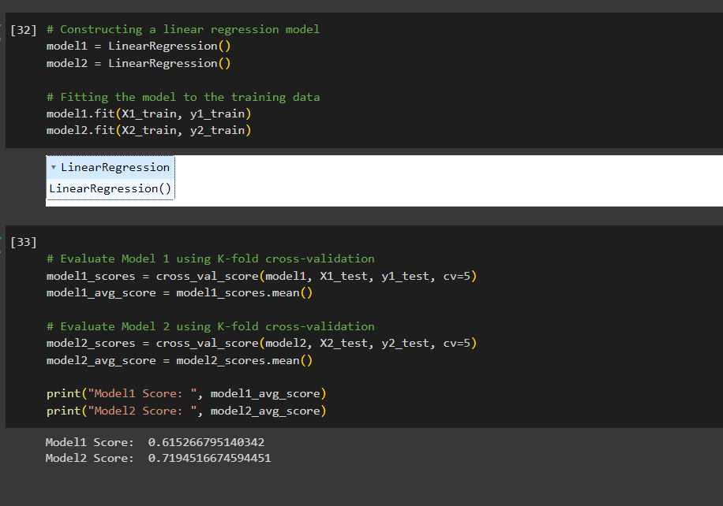
Linear regression model and evaluation

Slide 16
4. Conclusion
Hence we developed a twolinear regression models to predict a curb weight with average scores of 0.61 and 0.71 from which shows that model 2 has better performance than model 1.
And also found that there is strong positive correlation of 0.88, 0.87, 8.85 between the curb-weight and length, width, engine-size respectively.

Slide 17
Thanks!

