Slide 1
ATM PROJECT

Slide 2
INTRODUCTION
. Javatechnology is;
. A programming languge ,devdlopementenvironment.
. A application environment

Slide 3
GOALS OF JAVA TECHNOLOGY
. A language that is easy to program.
. A means of ensuring security by checking loaded code modules.
. Java technology architecture uses.
. The jvm
. Garbage collection
. The jre
. Jvm tool kit

Slide 4
REQUIREMENTS
. Providing provision FOR BALANCE CHeck in account withdraw money from account desposit money in account transfer money from one account to another and change password

Slide 5
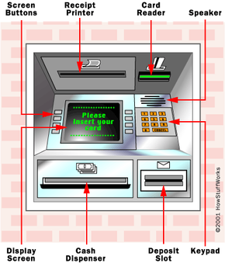

Slide 6
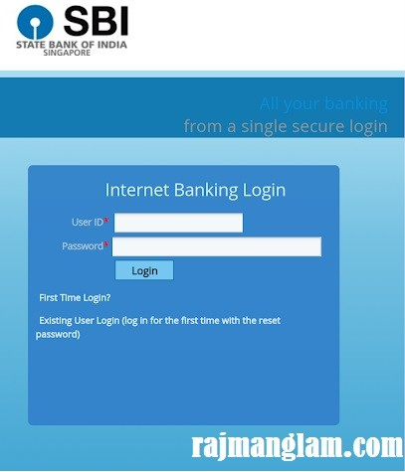
CHANGE PASSWORD

Slide 7


