Slide 1
WorkshopPLUS - Windows Server: Vital Signs Part 1
Notes:
Version: 12/21/2018 18:22:55

Slide 2
Disclaimer

Slide 3
Processor

Slide 4
Learnings Units covered in this Module
Measure Processor Ussage
Processor Privileged Mode
Processor User Mode
Processor Power management

Slide 5
Measure Processor Ussage

Slide 6
Learnings covered in this Unit
Processes and Threads
Processor Time
Real Time Tools
Processor Advanced

Slide 7
Processes and Threads

Slide 8
Processes and Threads
Process: A container for a set of resources that are used when running an instance of the program such as:
Private virtual memory address space
Executable
Security Context
ID
Thread(s)
Thread: An entity within a process that the Operating System (OS) schedules to run work in a specific order or priority. Can be individual or several at once
Notes:
A process is a container for resources used to execute a program. The threads of the process are the worker bees of the process that execute code.

Slide 9
Idle Process
All CPU clock cycles are consumed by the OS
When no runnable thread exists on a CPU, the OS dispatches the per-CPU idle thread
It shows up as System Idle Process, but it is not a real process
\Process(Idle)\% Processor Time measures the total idle time of all processors
Notes:
Every processor (CPU) of a computer has an idle thread that executes on the processor when there is no other work to do. These threads run under the System process, and they are collectively called the System Idle Process, which show up in Performance Monitor and many other tools as the idle process, but no process is actually exists. This fake process can be viewed as an instance of the Process counter object.
Runs KiIdleLoop instruction per CPU, and its responsible for consuming clock cycles when no other threads are scheduled to run, or in other words when the CPU as no real work.

Slide 10
Processor vs. Processor Information
Processor counter object:
Displays up to 32 logical processors on 32-bit Windows and Windows Server
Displays up to 64 logical processors on 64-bit Windows and Windows Server
Processor Information counter object:
Introduced in Windows 7 and Windows 2008 R2
Displays all logical processors information accurately—more than 64 logical processors
Notes:
Systems with more than one physical processor or systems with physical processors that have multiple cores provide the Operating System (OS) with many logical processors.
A logical processor is one logical computing engine from the perspective of the OS, application or driver
A core is one processor unit, which can consist of one or more logical processors
A physical processor can consist of one or more cores
A physical processor is the same as a processor package, a socket, or a CPU
Prior to Windows 7 and Windows Server 2008 R2, the number of logical processors, that Windows and Windows Server can recognize is limited to the architecture of the OS such as 32-bit and 64-bit. One of the bits represents each processor. This means that earlier versions of Windows and Windows Server can only recognize logical processor less than or equal to the architecture of the OS, 32 logical processors on 32-bit and 64 logical processors on 64-bit
Support for systems that have more than 64 logical processors is based on the concept of a processor group, which is a static set of up to 64 logical processors that is treated as a single scheduling entity. Processor groups are numbered starting with 0. Systems with fewer than 64 logical processors always have a single group, Group 0
Processor groups are not supported on Windows Server 2008, Windows Vista, Windows Server 2003, Windows XP and earlier versions of Windows and Windows Server
Windows Server 2008 R2 supports up to 4 processor groups where each processor group can recognize up to 64 logical processors allowing it to recognize up to 256 logical processors
Windows Server 2012 supports up to 10 processor groups allowing it to recognize up to 640 logical processors

Slide 11
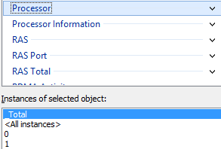
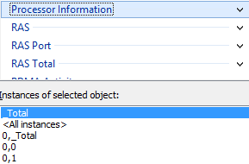
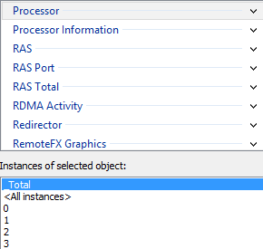
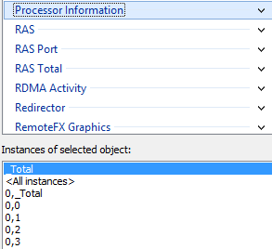
Processor vs. Processor Information
Processor with HT disabled
Processor Information HT disabled
Processor with HT enabled
Processor Information HT enabled
Notes:
The processor groups recognized by the OS might seem very similar to the NUMA nodes, but they are different. Processor groups are logical processors grouped by Windows and Windows Server while NUMA nodes are based on the physical hardware
Getting back to the counter objects, the key difference between the Processor counter object and the Processor Information counter object is the awareness of the processor groups.
The Processor object is not processor group aware, so it is limited to the original number of processors that Windows Server 2003 and earlier could address. The Processor Information counter object is aware of processor groups, so it is able to recognize all of the logical processors that are offered by the hardware
Consider using the Processor Information counter object instead of the Processor counter object or when analyzing systems with more than 32 logical processors
For more information on processor groups, see:
Processor Groups (Windows)
http://msdn.microsoft.com/en-us/library/windows/desktop/dd405503(v=vs.85).aspx
For more information on the differences between the Processor and Processor Information counter objects, see:
Windows 2008 R2 Performance Monitor – Processor Information Counters have replaced Processor Counters http://blogs.msdn.com/b/saponsqlserver/archive/2010/09/24/windows-2008-r2-performance-monitor-processor-information-counters-have-replaced-processor-counters.aspx
Windows Server and Processor Cores http://blogs.technet.com/b/askpfeplat/archive/2012/07/30/windows-server-and-processor-cores.aspx

Slide 12
Privileged Mode and User Mode
A thread can be in one of two modes:
Privileged mode: Synonymous with Kernel mode. Code runs on a processor in which all memory is accessible and all CPU instructions can be issued. OS code (such as system services and device drivers) runs in Kernel mode
Measured by \Processor Information(*)\% Privileged Time
User mode: The non-privileged processor mode in which applications run. A limited set of interfaces is available in this mode, and the access to system data is limited. This is the mode where application code is executed
Measured by \Processor Information(*)\% User Time
Notes:
A processor can run only one thread at a time. The thread can run in one of two modes:
User mode
Privileged mode
This workshop uses Kernel mode and Privileged mode synonymously.
User mode is code that runs in the memory space for the application. When the application code needs to write to a file, it must transition into Kernel mode. The counters % Privileged Time and % User Time measure Privileged mode and User mode processing time respectively. Both of these counters are part of the Processor Information and Processor counter objects.

Slide 13
Privileged Mode and User Mode
For each of these activities, which processor mode would you expect them to be in most often? (Kernel, User, or both):
Backup software
Database server executing complex calculations
Database server scanning large amounts of file system data
3D games
Browsing the Internet

Slide 14
Privileged Mode and User Mode (Answers)
For each of these activities, which processor mode would you expect them to be in most often? (Kernel, User, or both):
Backup software: Kernel
Database server executing complex calculations: User
Database server scanning large amounts of file system data: Kernel
3D games: Both
Browsing the Internet: User
Notes:
Backup software typically uses more Kernel mode CPU simply because it must often access disk and network resources
A database service is an application like any other, so when it does complex calculations it uses the User mode application code of the database software
Whenever physical resources are needed, such as network and disk, this has to go to Privileged mode. Therefore, it does not matter which application is accessing the disk. In this case, lots of file-system data use a lot of kernel mode CPU
Graphically intensive 3D games can use both User mode and Kernel mode, but they likely use Kernel mode more because of the 3D rendering with the video card driver
Browsing the Internet uses network resources, which means Kernel mode, but modern Websites often do client-side processing to render animations and such, so in this case they likely use more User mode

Slide 16
Processor Time

Slide 17
% Processor Time Formula
% Processor Time: All the time spent executing everything else other than the idle threads (1 per CPU)
What is everything else?
% User Time + % Privileged Time
Under normal conditions* processors spend their time running User and Privileged mode threads.
Example:
If % Processor Time is 50 and % Privileged Time is 5, % User Time should be 45
*: Under some conditions, DPC’s and interrupts can consume processor time (discussed later)
Notes:
% Processor Time is the percentage of elapsed time that the processor spends to execute a non-idle thread. It is calculated by measuring the percentage of time that the processor spends executing the idle thread and then subtracting that value from 100%.

Slide 18
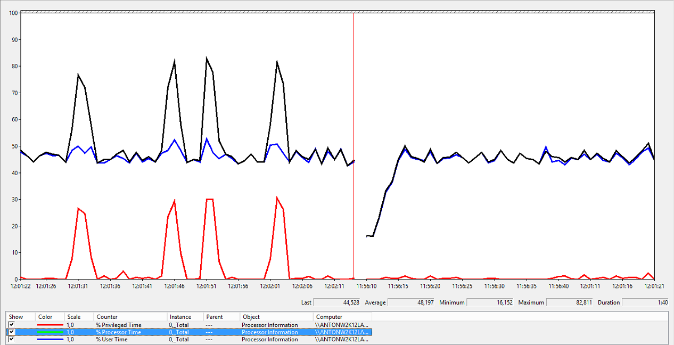
% Processor Time Formula (continued)
% Processor Time = % User Time + % Privileged Time
% Processor Time: 80
% User Time: 50
% Privileged Time: 30
Notes:
In the figure shown on the slide, you can see that the % Processor Time is 56, the % User Time is 46, and the % Privileged Time is 10. If you add up % User Time and % Privileged Time, the total is 56.
Under normal circumstances, this formula adds up correctly, but if you look closely, you might see that % Processor Time is 100 when % User Time and % Privileged Time are 0. This is a case where Deferred Procedure Calls (DPCs) and hardware interrupts have consumed 100% of all of the processors.

Slide 19
Thresholds for % Processor Time
Monitor the \Processor Information(*)\% Processor Time counter for all processor instances
Common next steps:
Identify the processes that are consuming high CPU
Identify which is higher: Privileged time or user time
Threshold | Effect
Less than 50% | Informational Normal usage
> 50% | Warning Monitor the processor time
> 80% | Critical The system might seem sluggish
Notes:
If % Processor Time has a sustained average of 80% or more, it likely reflects a high processor condition. Spikes of CPU usage are common, so look for sustained values only.

Slide 20
The \Process(*)\% Processor Time Counter
Each process can potentially consume up to 100% CPU times the number of processors, if it has enough active threads
A single threaded application can consume only up to 100% CPU
Example (Demo 004_Cpustres):
1 thread at maximum activity = \Process(cpustres)\% Processor Time of 100
With eight logical processors, any process can consume up to 800% CPU, assuming it has at least eight active threads
Notes:
If \Processor Information(*)\% Processor Time is exceeding the thresholds, look at the \Process(*)\% Processor Time counters. Note the difference between the counter objects of Processor vs. Process. When you are looking at the \Process(*)\% Processor Time counters, any process has the potential of using more than 100% CPU on multi-processor computers.
For example, the cprstres.exe tool might use 400% CPU. This can happen if at least four threads are consuming high amounts of CPU and if there are at least four logical processors.

Slide 21
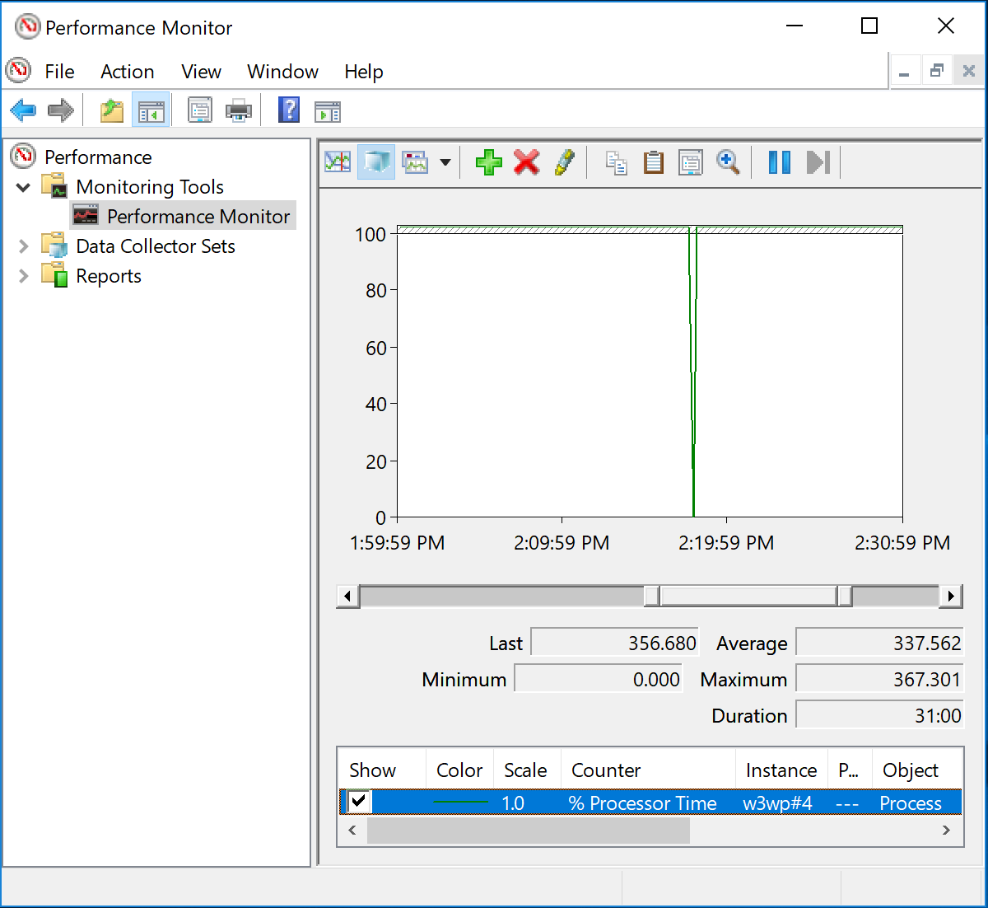
The \Process\% Processor Time counter (continued)
In this example, \Process(w3wp#4)\% Processor Time is consuming up to 367% CPU
This server has 4 logical processors, so any process can potentially consume up to 400% CPU
This process consumes up to 367% CPU
Notes:
In this slide, an IIS worker process (w3wp.exe) is consuming about 367% CPU. This is only possible if the computer has at least four logical processors and if the process has at least four threads consuming high CPU.

Slide 23
Real Time Tools

Slide 24
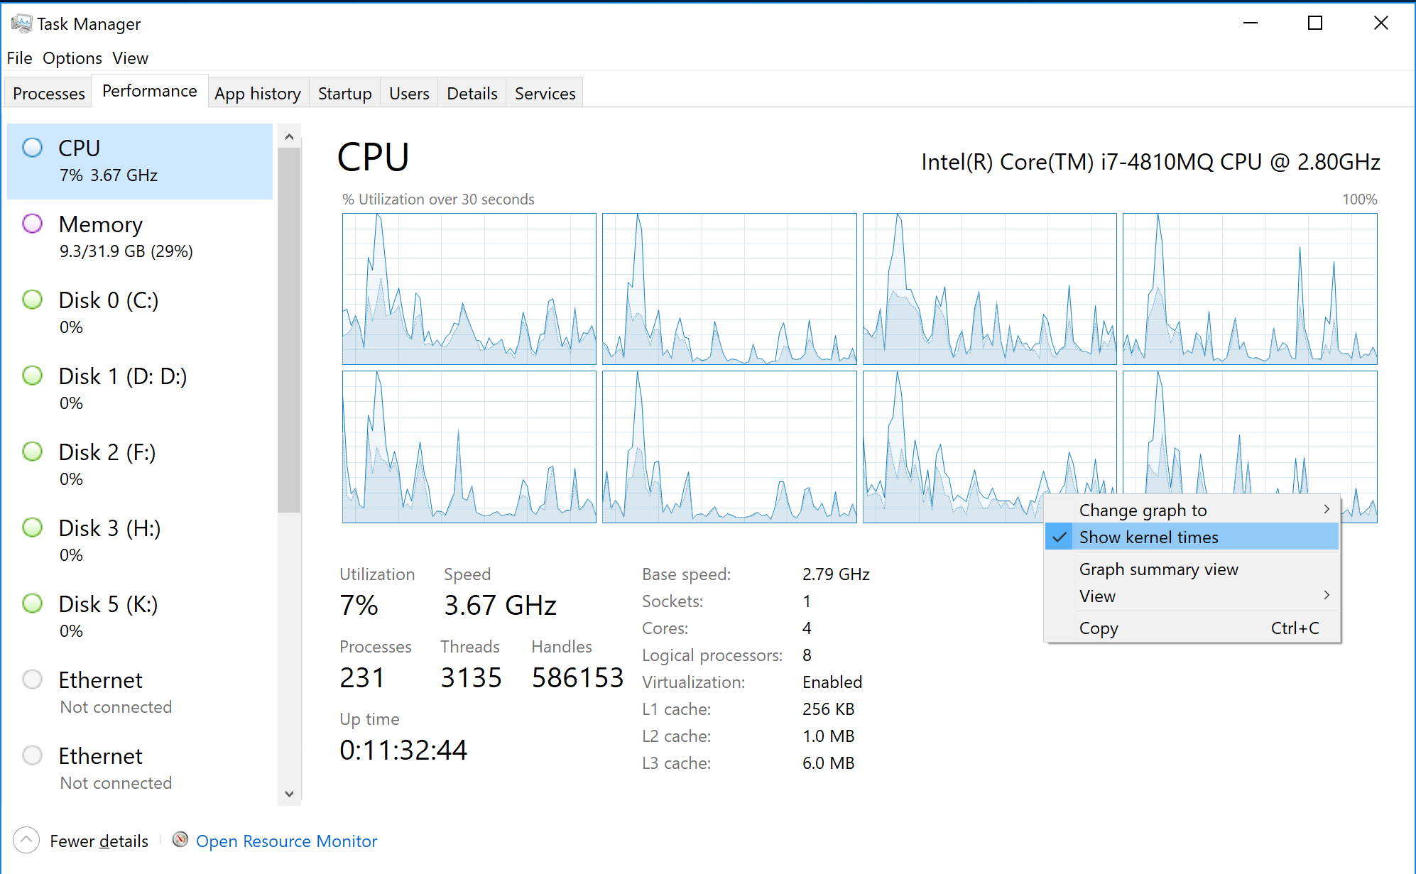
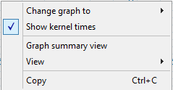
Real-time Tools: Using Task Manager
To measure overall processor usage, use the Performance tab of Task Manager
The light blue line indicates overall usage, and the darker blue line indicates privileged/kernel mode usage
To show privileged mode usage right click the graph area, and select Show kernel times. Not enabled by default
Generally, high CPU usage on average = poor performance
Notes:
Task Manager is a part of Windows and Windows Server. It has a feature called Show kernel times that shows the amount of privileged time. It displays privileged time in red and overall CPU usage in green. This is handy for a quick view of the ratio of User mode to Privileged mode CPU usage with live data.

Slide 25
Real-time Tools: Resource Monitor
Provides live processor usage information
Resource Monitor is built in to Windows 8 and Windows Server 2012, but is available since Windows Vista/2008
Can be launched from the Performance tab in Task Manager or by typing resmon
Notes:
Resource Monitor was first introduced in Windows Vista and Windows Server 2008, but has even more details in Windows 7/8 and Windows Server 2008 R2/2012. This tool can show live processor usage and the processes that are using the most CPU. If you select a process, it shows up as an orange line.

Slide 26
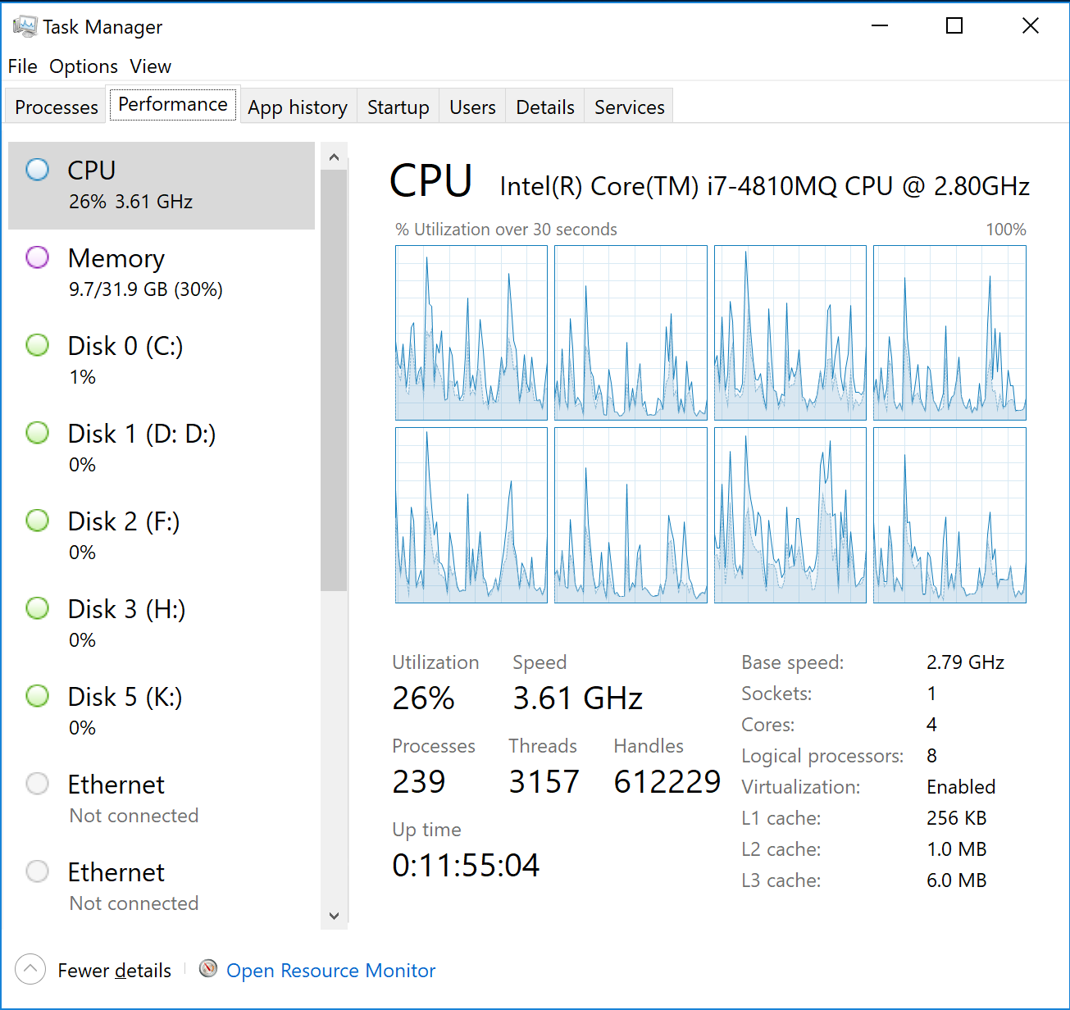
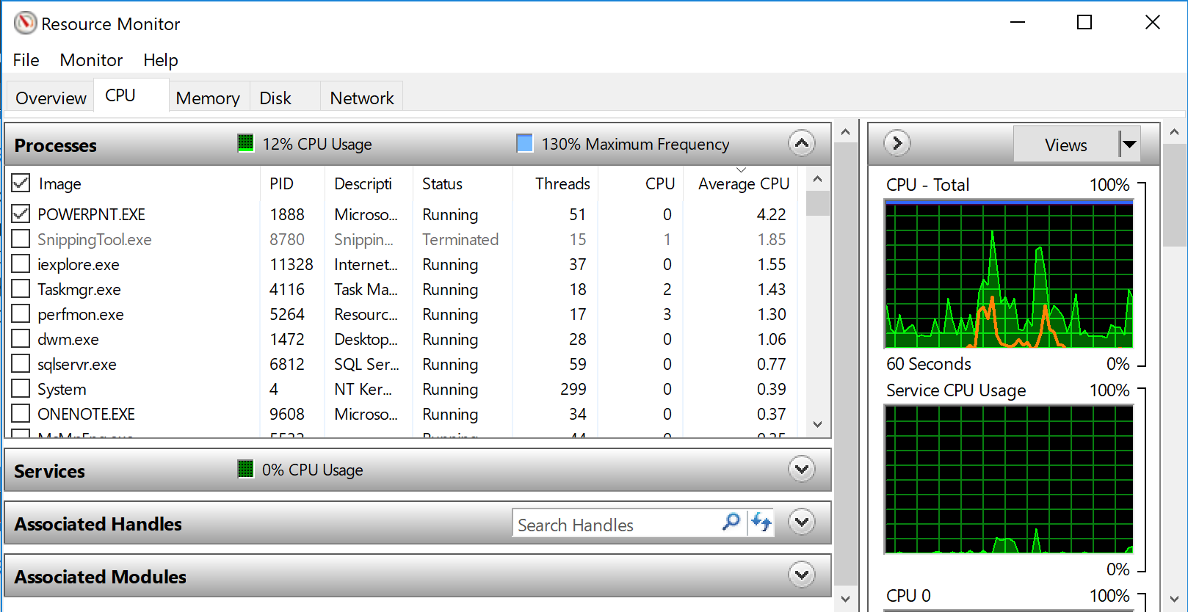
Real-time Tools: Resource Monitor (continued)
Launch Resource Monitor
Average CPU shows % utilization by the process in the last 60sec
Process selection displayed in orange

Slide 27
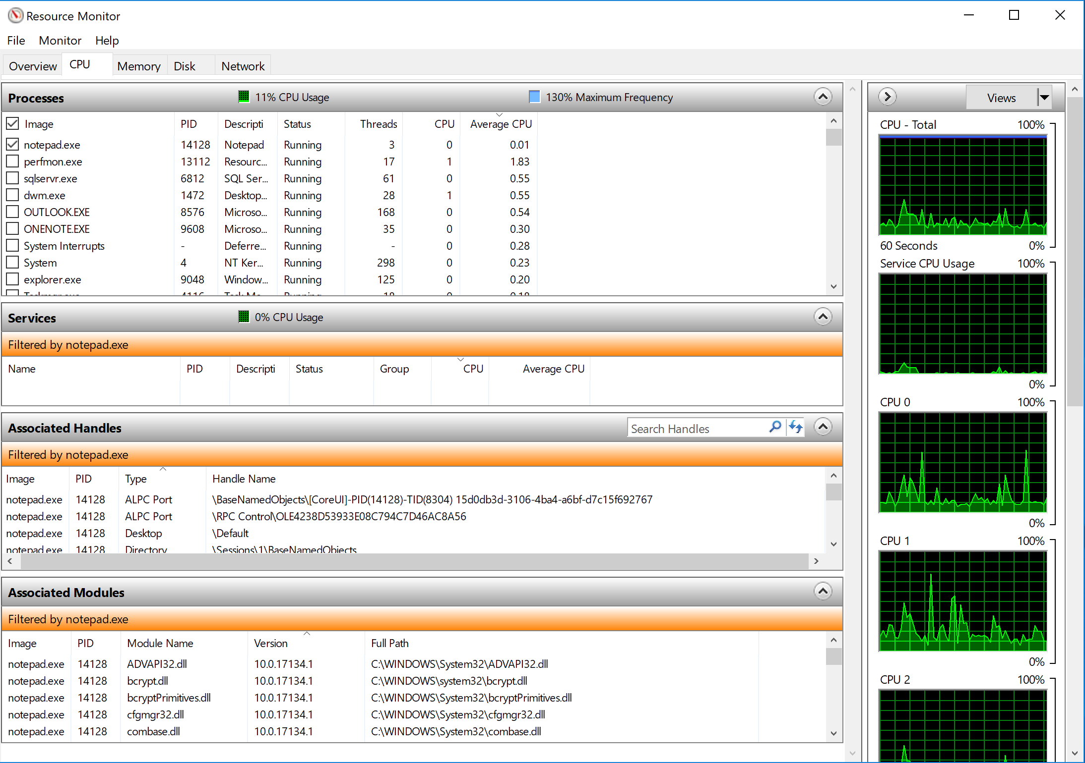
Real-time Tools: Resource Monitor (continued)
Processes
Services
Graphical view of processor activity
Handles
Modules
Notes:
In addition to general information about processor usage, Resource Monitor can show the handles and modules (.dlls and .exes) that the process has open. This is helpful especially if you need to ensure that an application has a hotfix update by looking at the version numbers of the modules.

Slide 28
Process Lifetime Management
Windows Store applications are new in Windows 8 and Windows Server 2012
Applications that are not in the foreground will be suspended or terminated to conserve resources
Applications in a suspended state retain the used memory, but consume no CPU cycles
In a low memory condition, suspended applications might be terminated
Notes:
Windows and Windows Server allow users to decide when to close and suspend applications to help conserve resources.
Windows Store applications are new in Windows 8 and Windows Server 2012.
When a user launches a Windows Store application, the application enters a running state. When the user launches another modern UI-style application, the previously launched application enters a suspended state. When the user switches back to a suspended application, then the application enters into the running state and resumes. This experience should be seamless to the user. This gives the processors more opportunities to go into a low power state.
If Windows 8 or Windows Server 2012 is under memory pressure, then suspended applications might be terminated to free up memory as needed.

Slide 29
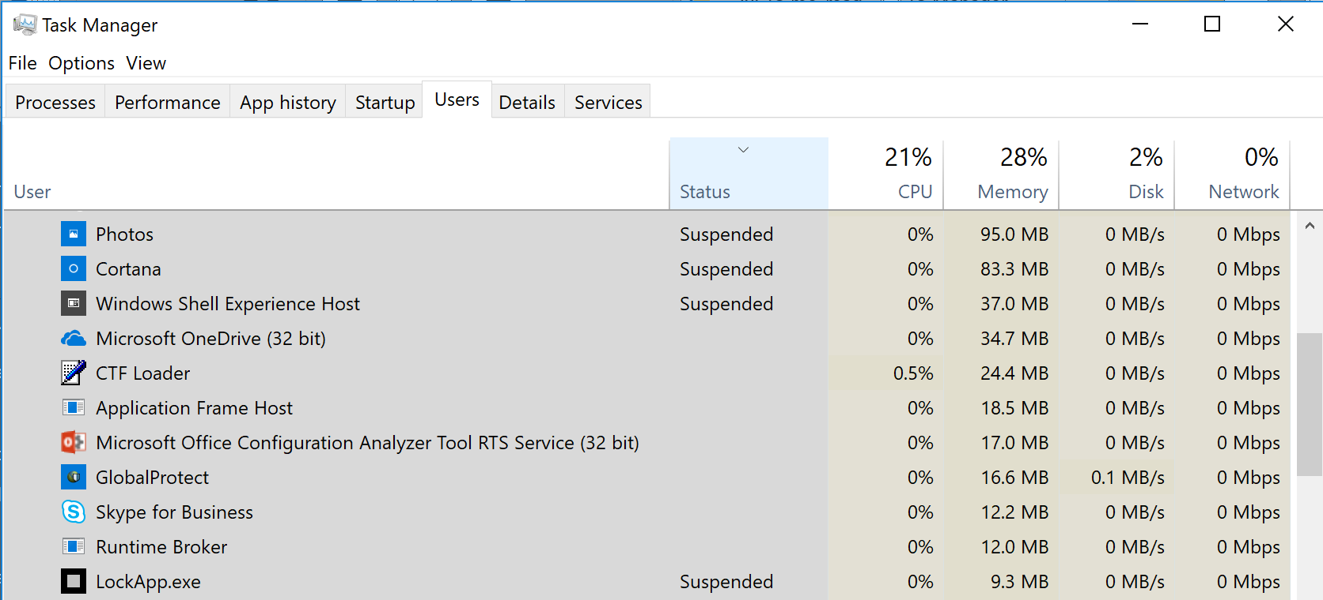
Process Lifetime Management in Task Manager
The Users (and Processes) tab of Task Manager shows the status of Windows Store applications

Slide 31
Processor Advanced

Slide 32
Processor Advanced
Processor instances
Processor queue length
Processor affinity and thread priority

Slide 33
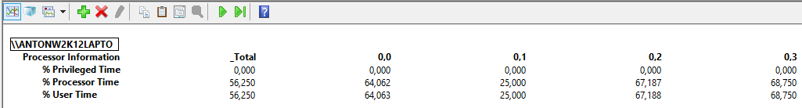
Processor Instances
A thread can run on only one processor at a time and threads might have affinity to a single processor
Single-threaded applications cannot take advantage of multiple processors
The _Total instance is an average, so look at all processor instances
_Total shows 56% usage
CPU 0 is at 64% usage
Notes:
When you look at the Processor counter instances, look at all of the individual instances for high values, because the _Total instance is an average of all of the instances. For example, on a system with two logical processors, if CPU0 is near 100% and CPU1 is near 0%, _Total is about 50%, which masks the problem.
If one processor is near 100% usage while other processors are at relatively low usage, this might indicate a CPU bottleneck for a single-threaded application. The application’s single thread cannot run on more than one processor at a time. If a single-threaded application needs more than one processor, the developer of the application must make the application multi-threaded. Applications must be developed to take advantage of multiple processors.

Slide 34
Processor Queue Length
\System\Processor Queue Length is the total number of threads in all of the processor queues
Unlike the disk counters, this counter shows ready threads only, not threads that are running
Each processor has its own thread queue, which is sorted by priority
A high processor queue length might not indicate a problem, but it might contribute to high context switching (discussed later)
Virtual guest computers commonly report high processor queue lengths incorrectly
Processor
Processor
Queue
Queue
Thread Dispatcher
Notes:
Each processor has its own queue. Each queue contains ready threads only, which are threads that are ready for execution. The \System\Processor Queue Length performance counter measures the total number of ready threads across all of the processor queues.
Virtual computers (such as computers running Microsoft Hyper-V or other virtual-computer host technologies) commonly report a high Processor Queue Length counter value with relatively low % Processor Time. Due to the nature of virtualization of computers and how threads are scheduled on physical processors, the Processor Queue Length counter reports higher values on virtual computers than on non-virtual computers.

Slide 35
Processor Queue Length (continued)
No real threshold as it depends on the workload and the effect may vary
A User mode application may suffer from UI responsiveness with a high queue length, but a File Server may not exhibit any user perceived symptoms
On multiprocessor systems, divide the queue by the number of logical processors
If the queue length rises at the same time as % Processor Time and results in performance degradation, you can determine what is an acceptable queue for your workload
Notes:
To determine which running threads might be causing a processor starvation condition, use the \Thread(*)\Thread State counter. Look for a value of 2 (running).
Performance Monitor Counter Description:
A sustained processor queue of less than 10 threads per processor is normally acceptable, dependent of the workload
For more information, see: Chapter 13 - Detecting Processor Bottlenecks
http://technet.microsoft.com/en-us/library/cc750967.aspx

Slide 36
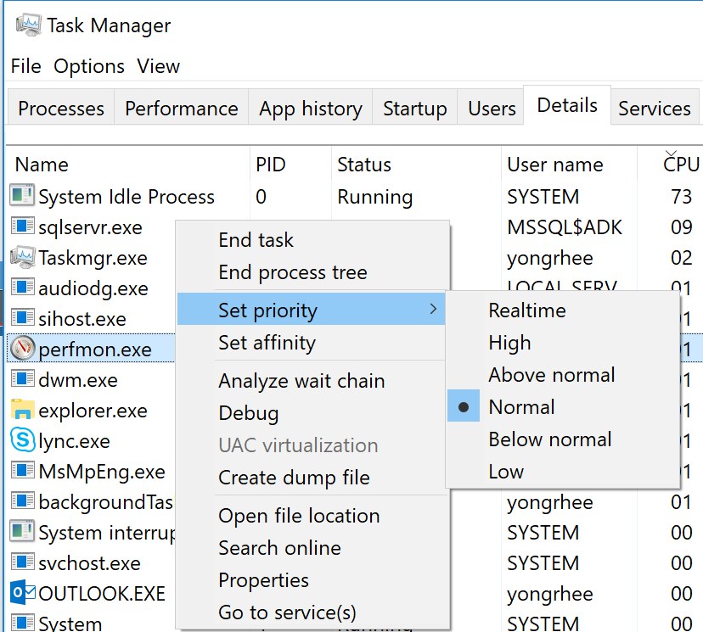
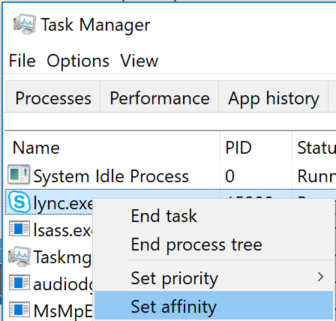
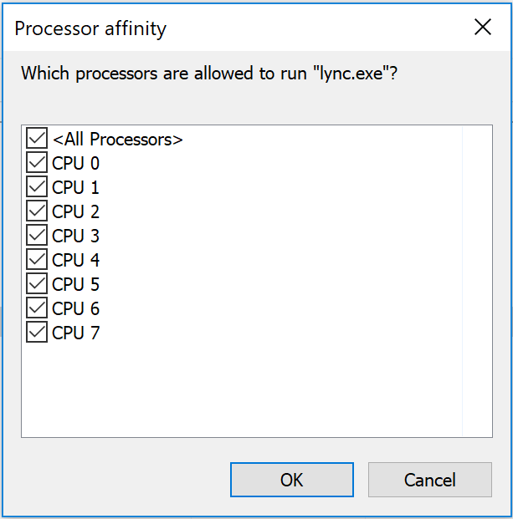
Processor Affinity and Thread Priority
You can use Task Manager to adjust the base thread priority for a process although not recommended as a permanent solution
A process can be assigned affinity to one or more processors
Thread priority and processor affinity can both greatly affect the performance of an application
Assign base priority
Assign processor affinity
Notes:
In Task Manager, you can change the base priority of a process from the normal (default) priority to a higher or lower one. The threads of the process inherit the process base priority as their default thread priority. This feature tells Windows and Windows Server how to prioritize the thread scheduling in the processor queues
A process can be assigned (affinity) to specific processors, forcing the threads to run only on the specified processors. This can help with applications that might have resource-locking problems by forcing the process to a single processor
These features can help minimize the resource impact of applications that require large amount of CPU but that are not time–sensitive, by setting the applications to a low priority or by assigning them to specific processors
Changing priorities might destabilize the system. Increasing the priority of a process might prevent other processes, including system services, from running. Decreasing the priority of a process might prevent it from running, not merely force it to run less frequently. In addition, lowering priority does not necessarily reduce the amount of processor time a thread receives; this happens only if it is no longer the highest-priority thread
Adjusting thread priority is not recommended as a permanent solution but might be useful as a troubleshooting method to check if a given application could improve the UI response with increase priority in its threads
Do not use Task Manager for CPU Affinity if the application already supports CPU Affinity in its code (example: SQL), as it may cause a racing condition

Slide 37
NUMA Computer Systems
Processors are grouped together in smaller units called nodes
Each node has its own processors and memory, and is connected to the larger system through a cache-coherent interchange bus
Although any processor in any node can access all of the memory, node-local memory is much faster to access
For efficiency and speed, Windows and Windows Server try to keep a thread on the same processor or node
Node 0
Node 1
P
P
P
P
Slow
P
P
P
P
Node-local memory is
fast
Bus
Bus
Cache-coherent interchange bus
RAM
RAM
Notes:
NUMA is a hardware architecture where the hardware is segregated into nodes. You can think of it as multiple computers running within a computer from a hardware perspective. Every processor can access the RAM across all of the nodes. However, if a processor needs to access RAM in another node, it must cross the cache-coherent interchange bus, which can be significantly slower than the RAM that is local to the node.
No performance counters measure Processor Information NUMA node performance. The point of this concept is to point out one of the reasons why Windows to schedule threads on the same processor or the same NUMA node that it previously ran.

Slide 38
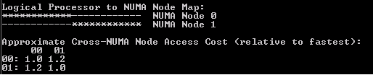
NUMA Computer Systems (continued)
SQL Server and Hyper-V are examples of NUMA aware products and can take advantage to schedule workloads to specific NUMA Nodes for better performance
Cross NUMA access cost will vary from hardware provider and server model/configuration
Coreinfo is a Sysinternals tool that performs NUMA Memory Access Latency tests
Notes:
Cross NUMA access cost will vary from hardware provider and server model/configuration, but using as an example a 2 NUMA Node server, the cost (latency) of accessing local memory vs. remote is 1.2x superior, or 20% slower. That could be the difference of accessing memory at 80 ns or 100 ns.
A nanosecond (ns) is one billionth of a second (10⁻⁹ or ¹/_{1,000,000,000} s). One nanosecond is to one second as one second is to 31.7 years.
http://en.wikipedia.org/wiki/Nanosecond
Note: The memory latency test in Coreinfo can yield different results depending on the load of the CPU’s and should be only be run with the system idle.

Slide 40
Knowledge Check
What is the difference between Privileged mode and User mode?
If % Processor Time is 75 and % Privileged Time is 10, what is the value of % User Time?
What tools can you use to analyze the CPU load in real time?
Why is it more efficient to keep a thread on the same processor?
Notes:
Privileged mode processes OS code, and User mode processes application code.
If % Processor Time is 75 and % Privileged Time is 10, % User Time should be 65.
You can use Task Manager and Resource Monitor to analyze the CPU load in real time.
It is often less efficient to frequently move a thread between processors than to leave it on the same processor, because of loading of the thread stack and accessing memory on other NUMA nodes.

Slide 41
Processor Privileged Mode

Slide 42
Learnings covered in this Unit
CPU Ussage
Privileged Time and Usage

Slide 43
CPU Ussage

Slide 44
Identifying Privileged Mode CPU Usage
\Processor Information(*)\% Privileged Time is the percentage of time that an individual CPU (or all CPUs) has run in Kernel mode during a specified interval
A high amount of % Privileged Time may warrant more investigation into kernel-related processor usage
Common causes:
Poorly written drivers or faulty hardware
High amounts of driver-related tasks, such as file and network I/O
High amounts of context switching
Notes:
High values of % Privileged Time might occur on systems that are doing a lot of network or file I/O. To help troubleshoot these conditions, ensure that the computer system is running the latest device drivers for the hardware, and check the performance counters related to disks and network that the previous modules cover.
If you cannot identify the root cause of high privileged mode CPU, consider using tools like Microsoft WPR to capture and analyze this condition.

Slide 45
Thresholds for % Privileged Time
The following thresholds apply to \Processor Information(*)\% Privileged Time
Common next steps:
Investigate disk and network related I/O
Investigate % DPC Time and % Interrupt Time
Investigate Context Switches/sec
Threshold | Effect
Less than 30% | Informational Normal usage
> 30% | Warning Monitor I/O and thread counts
> 50% | Critical High processor usage is likely, with too much time servicing hardware interrupts
Notes:
It is common for backup software and other high I/O related applications to spend a lot of time using Privileged mode CPU. With that said, sustained averages above 50% specifically in privileged mode CPU warrant more investigation.

Slide 46
Interrupts
Asynchronous events (that can occur at any time) that are unrelated to what the processor is currently running
The active thread on a processor is interrupted. In some cases under heavy interrupt load, the application’s threads that execute sampling may return skewed values due to constant interruption of their work. For this reason the preferred tool to see Interrupt activity is WPR, which also allows to map it to a culprit
Interrupts are generated primarily by hardware I/O devices, processor clocks, or timers, and they can be enabled or disabled
\Processor Information(*)\% Interrupt Time is the time the processor spends receiving and servicing hardware interrupts during sample intervals
Notes:
Interrupts do exactly what they say, they interrupt the processor and then execute code r to service the hardware that interrupted the processor. The \Processor Information(*)\% Interrupt Time counter measures the amount of time spent servicing hardware interrupts.

Slide 47
Deferred Procedure Calls (DPCs)
Routines that perform most of the work involved in handling a device interrupt after the interrupt service routine (ISR) runs
The DPC routine executes at a lower interrupt request level (IRQL) than standard interrupts, in order to avoid unnecessary blocking
\Processor Information(*)\% DPC Time is the percentage of time that the processor spends receiving and servicing DPCs during the sample interval
DPCs are tasks or activities for later processing
Notes:
DPCs are effectively low-priority interrupts. To measure them, use the \Processor Information(*)\% DPC Time counter.
For example, you visit an ATM center for some cash withdrawal. When the card is inserted or swiped, you get prompted for secret PIN, next you select option for Cash Withdrawal. You specify the amount and then the cash is dispensed. During this transaction, no one else can use it. Hence, this should be completed as quickly as possible. Until then, others have to wait in the queue.
Interrupts are similar to the above activity, where a request needs an immediate attention and should be serviced as soon as possible.
Continuing with the above example, a banking service may also provide a text message as an alert on mobile device for all transactions. However, the text may not be necessarily sent when the cash is being withdrawn.The activity of sending a text message to mobile can be sent a little later. Basically, the task can be deferred for later processing, and others willing to use the ATM machine need not wait until the text message is sent.
DPC's are similar to the above activities where the execution can be deferred and processed later.

Slide 48
Thresholds for % Interrupt Time and % DPC Time
The following thresholds apply to % Interrupt Time or % DPC Time only if there is high % Privileged Time
Common next steps:
Investigate I/O that is related to disk and network
Update device drivers
Remove faulty hardware
Profile the kernel to determine CPU usage by the driver
Threshold | Effect
Less than 10% | Informational Normal usage
> 10% | Warning Monitor I/O and thread counts
> 20% | Critical High processor usage likely with too much time servicing hardware interrupts
Notes:
A computer system should be spending very little time servicing hardware interrupts. If % Privileged Time is taking up more than 30% of processor usage on any processor and if % DPC Time or % Interrupt Time and are taking up more than 20% of processor usage on the same processor, you should investigate the hardware conditions. As a first step toward resolution, consider updating device drivers. If you need to do any troubleshooting beyond updating the device drivers, you need tools such as Microsoft WPR.
Note: This workshop does not cover how to use Microsoft WPR, but the tool is available free from Microsoft.

Slide 49
Context Switches and Transitions
Context switch: The procedure of saving the state of a running thread, loading another thread’s state, and starting the new thread’s execution
\System\Context Switches/sec is the combined rate at which all processors on the computer are switched from one thread to another
High context switching can be caused by high disk or network I/O, too many active threads, and other causes
Transition: The act of a thread moving to or from User mode or kernel mode
\System\System Calls/sec for example a busy terminal server with many users accessing it, is expected to display a high number
Quantum: The time a thread is allowed to run before another thread at the same priority level is given a turn to run
Notes:
Context switches and system calls are often assumed to be the same thing, but they are technically different:
A context switch occurs when a thread running on a processor is switched with another thread
A system call occurs when a thread executing in User mode address space transitions into Kernel mode
For example, this happens when an application writes to the disk; the thread must transition from User mode to Kernel mode to write to the disk. The transition from User mode to Kernel mode is not a context switch; it is simply a system call. With that, the disk subsystem is a relatively slow resource and can take a significant amount of time to return, so the processor might context switch to another thread while the thread is waiting on the disk to signal it that the data is ready.
Every process running in a windows computer needs to consume services from the underlying OS or the kernel. This counter displays the total number of requests received by the OS per second in a given machine. On a highly utilized machine, for example a busy terminal server with many knowledge workers accessing it, this counter would be expected to display a high number.
Do you like?

Slide 50
Thresholds for Context Switches/Sec
The following thresholds apply only if there is high % Privileged Time
Common next steps:
Investigate I/O related to disk and network
Identify and reduce active threads by using \Process(*)\Thread Count and \Process(*)\% Privileged Time
Adjust for best performance of background services—longer quantums (more clock cycles before switching)
Threshold | Effect
Less than 5,000 | Informational Normal usage
> 2,500 x NumOfProcs | Warning Monitor I/O and thread counts
5,000 x NumOfProcs or > 20,000 | Critical High processor usage is likely, with too much time switching between threads
Notes:
A high amount of context switches per second might indicate that the system has too many active threads running. This is similar to many people trying to get your attention at the same time via email, instant messaging, phone calls, and so on. In order for the processor to be more efficient, consider reducing the number of active threads (a common server-application setting), or consider increasing the number of processor clock cycles that threads get on the processor. The number of clock cycles that a thread runs on a processor is known as a quantum.
You can change the quantum by using the Adjust for best performance of background services feature in the My Computer performance settings. If it is set to background services, threads can have large quantum, which means more can be done per quantum (more efficient), but switches out threads less often. This can result in a less responsive user interface. This is why workstation computers, such as computers running Windows 7, are set to Programs, which has smaller quantum that swap out threads more often, providing for a more responsive user interface.
Generally, if there is a high amount of % Privileged Time and if \System\Context Switches/sec is greater than 5,000 times the number of processors or greater than 20,000, you should investigate the context switching.

Slide 52
Privileged Time and Usage

Slide 53
\Process(*)\% Privileged Time
\Process(*)\% Privileged Time is the percentage of elapsed time that the threads of a process spend executing code in privileged (kernel) mode
Helps identify which processes are consuming the most privileged time
The system process has only kernel-based threads and is exclusive to % Privileged Time
Processes using privileged time
Notes:
If \Processor(*)\% Privileged Time is high, you can identify which processes are consuming the most privileged time by using the \Process(*)\% Privileged Time performance counter. Notice the slight difference in the names of the counter objects.
In the example on this slide, several processes are consuming a relatively high amount of privileged mode processor usage. These processes happen to be Microsoft BizTalk Server processes, but they could be any process

Slide 54
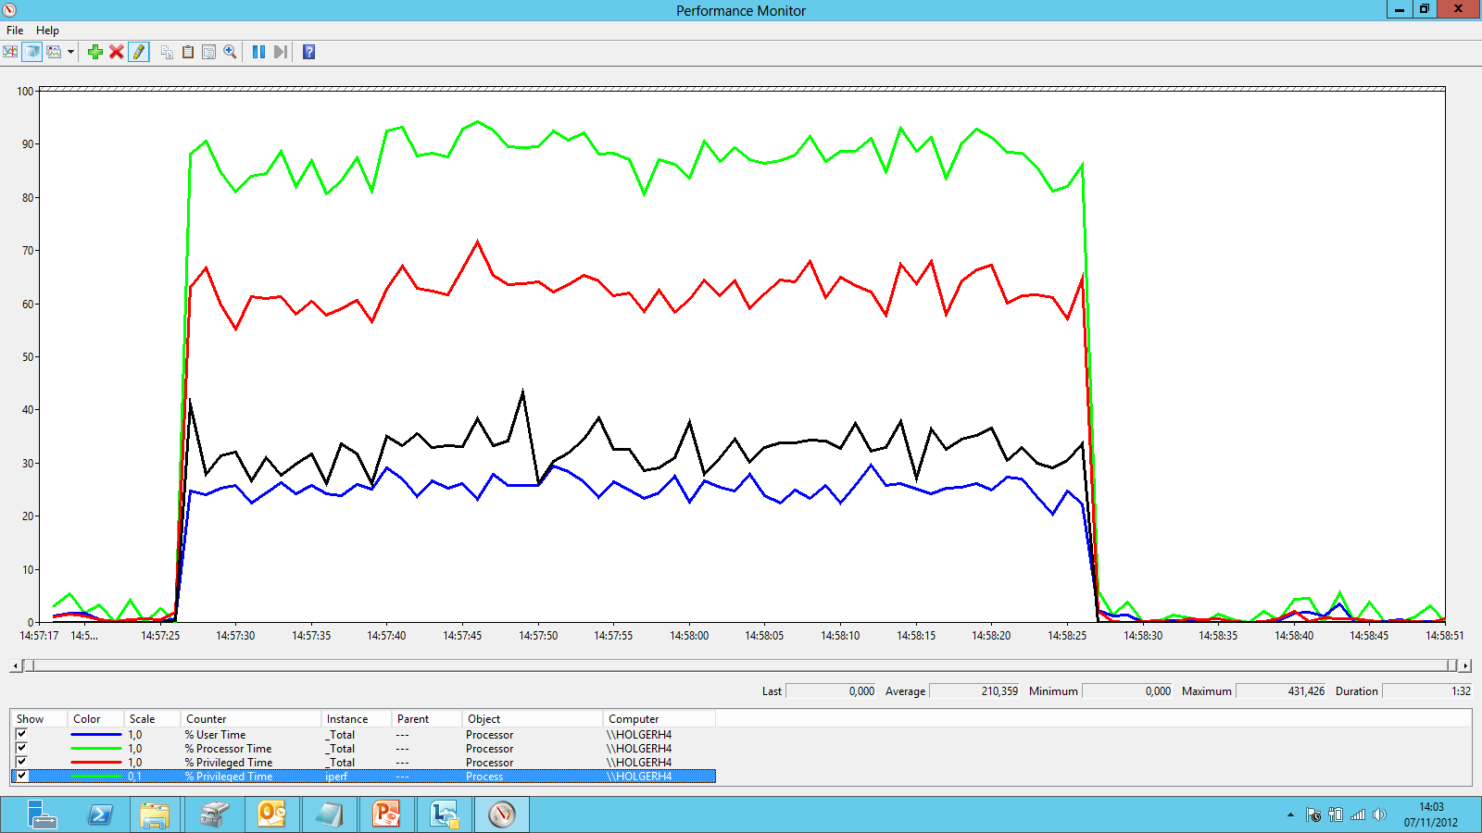
Unexpected High Privileged Mode Usage
Unexpected % Privileged Time from a single process can starve other applications running on the same OS and cause performance issues
% Processor Time
90%
% Privileged Time
65%
% User Time
25%
Notes:
The example on this slide shows a high amount of % Privileged Time CPU usage from a single process, with up to 431% of Process\% Privileged Time, which in a server with 8 Processors, means 4 were being used fully by this process.
Total Processor utilization is around 90% and approximately 65% is % Privileged time.

Slide 55
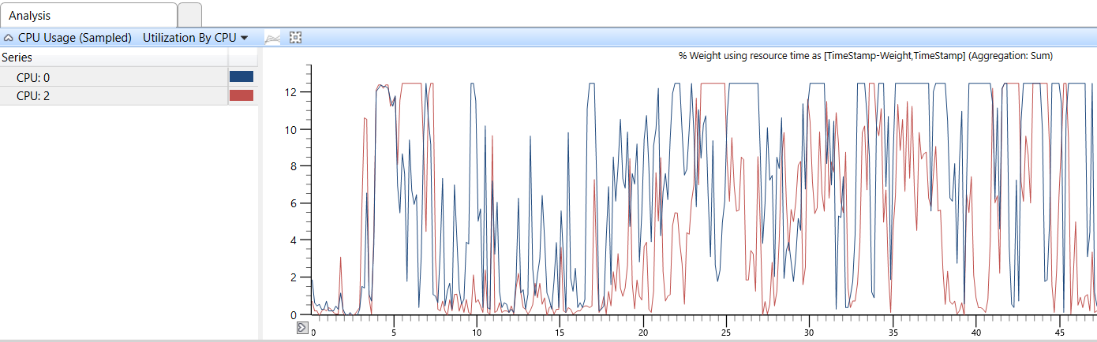
Using WPA for High Privileged CPU
Microsoft Windows Performance Analyzer (WPA) is a tool based on Event Tracing for Windows (ETW) that can identify processes and drivers using the most Privileged mode CPU
Notes:
Microsoft WPR captures Event Tracing for Windows (ETW) events and displays the data graphically in the WPA tool. You can use WPR to quickly capture and analyze processor usage in both Privileged mode CPU and User mode CPU.

Slide 56
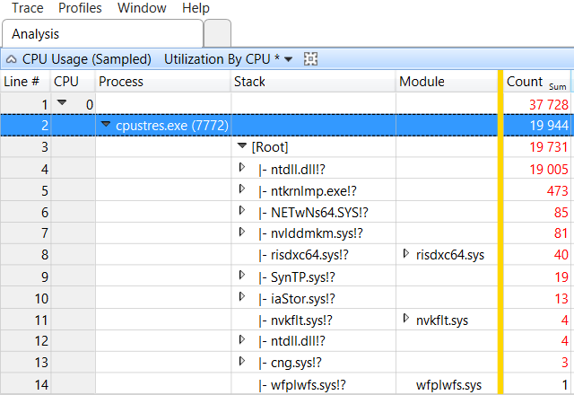
Using WPA for High Privileged CPU
Part of the Windows Performance Toolkit included in ADK and SDK
For more information, see Windows Performance Analysis Developer Center:
http://msdn.microsoft.com/performance/default.aspx

Slide 58
The Case of the Over-privileged Processor

Slide 59
Knowledge Check
What counter can you use to identify kernel-mode CPU usage?
What can cause high privileged mode CPU usage?
What can cause frequent context switching?
Notes:
\Processor Information(*)\% Privileged Time can help identify kernel-mode CPU usage.
High privileged mode CPU usage can be caused by poorly written drivers, high amounts of I/O, hardware usage, and high context switching.
High context switching can be caused by a large number of active threads.

Slide 60
Processor User Mode

Slide 61
Learnings covered in this Unit
User Mode Ussage

Slide 62
User Mode Ussage

Slide 63
Identifying User Mode CPU Usage
\Processor Information(*)\% User Time is the percentage of elapsed time the processor spends in the User mode
A high amount of \Processor Information(*)\% User Time might warrant more investigation into process application code
\Process(*)\% User Time is the percentage of elapsed time that the threads of a process spend executing code in User mode
Common causes:
Poorly written or heavily used application code
High amounts calculations, object sorting, and any other tasks that use non-privileged resources
Notes:
High User mode CPU usage means that one or more applications are executing application code. To learn why User mode CPU is high, look at the call stacks of the active threads and consult with the application developer.
You can measure the amount of User mode processor usage on all processors by using the \Processor Information(*)\% User Time performance counter. You can measure the amount of User mode processor usage for each process by using \Process(*)\% User Time. Notice the slight difference in the names of the counter objects.

Slide 64
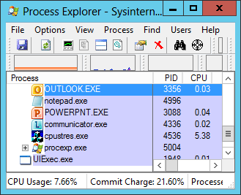
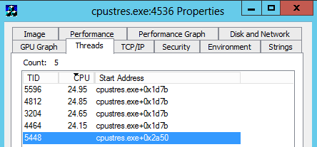
Process Explorer for Thread Activity per CPU
Process Explorer (Sysinternals) can show the modules and functions (symbols needed) of threads that are actively using CPU
Shows only native and .NET Framework v4.0 or later modules and functions
http://live.sysinternals.com/procexp.exe
Tools like Process Explorer can show active thread modules and functions (symbols needed)
Notes:
You can use Process Explorer to visually sort by CPU and to identify which process or processes are consuming the most CPU. In addition, if you go to Properties > Threads, you can see which threads are consuming the most CPU within the process. The active module and function are shown. Finally, click Stack to see a full call stack of the thread.
The example in this slide shows only the call stack for native applications or for Microsoft .NET Framework 4.0 or later applications. This means that Process Explorer cannot show the .NET call stacks of applications running the .NET Framework earlier than version 4.0.
Process Explorer is part of the Sysinternals Suite of tools from Microsoft.

Slide 65
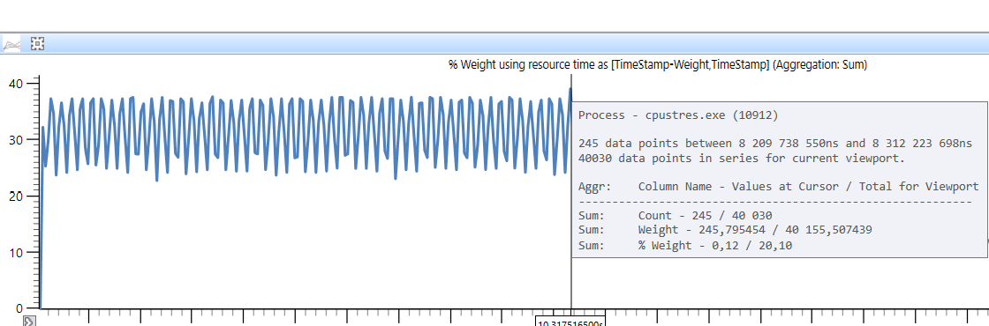
Microsoft WPA on Process Profiling
Microsoft WPA shows the processes, threads, and functions of high processor usage
Requires .NET 4.0 or above to show call stacks
Notes:
Consider using Microsoft WPR for high CPU issues. It can show the modules and functions that are consuming the most CPU for both high privilege and high user mode CPU issues.

Slide 66
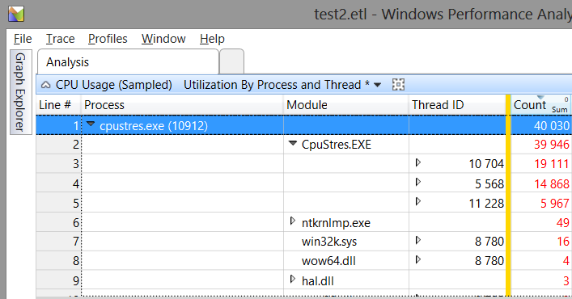
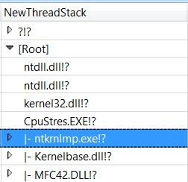
Microsoft WPA on Process Profiling (continued)
Symbols are required to see the functions calls, and if the symbols are not public, the software vendor must be engaged for further analysis
WPA can show modules and functions consuming the most CPU
Notes:
The Thread Stack column would show functions if Symbols were configured/available.
As they are not, the modules (DLL’s and EXE’s) show a !? and makes it not possible to see exactly what they are running.
Stack Walking: WPA allows capturing and viewing of the functions executed in a specific period and see which ones were consuming the most processor. It can map the function back to a path of execution.
Example: Imagine you find a lot of time being consumed when accessing a temp file, and then back trace the function to see which component called it. Every time the temp file is accessed, it causes a file system lookup for all temp files by another module. (AV for example).

Slide 68
The Case of the Busy App Server

Slide 69
Knowledge Check
What counter can you use to identify user-mode CPU usage?
What can cause high user-mode CPU usage?
What tools can you use to identify modules and functions found most often on active thread stacks?
Notes:
\Processor Information(*)\% User Time can be used to identify high user-mode CPU conditions
High user-mode CPU conditions can be caused by application code
Tools such as Process Explorer, Microsoft WPR, and the Visual Studio Profiler can identify modules and function found most often on active thread stacks

Slide 70
Processor Power management

Slide 71
Learnings covered in this Unit
States

Slide 72
States

Slide 73
Processor C-States
To save power when the OS scheduler has no operations for the processors to execute, it can move them to an idle state also called low power mode
Those states are named C-States and can be observed in Performance Monitor under the counter \Processor Information(*)\% Cx Time
C0 – Active (Not displayed in performance monitor)
C1 – Clock signal Stopped (Software based). Enables the processor to maintain its entire context and quickly return to the running state
C2 – Clock signal Stopped (Hardware based). A lower power and higher exit latency state than C1
C3 – Sleep mode
Notes:
The % C1 Time, % C2 Time, and % C3 Time counters measure the power states of each of the processors. The higher the Cx number, the lower the power state that the processor is in.
As an example, the C-1E State in Intel is entirely different from the same state name in AMD.
Note: Not all C-states are displayed in performance monitor as they depend on the CPU model and generation from different hardware vendors (Intel/AMD).

Slide 74
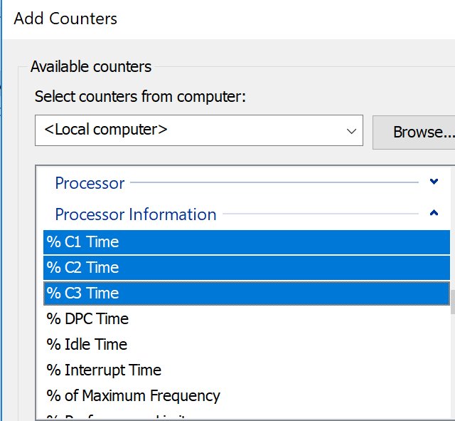
\Processor Information(*)\% Cx Time
\Processor Information(*)\% Cx Time is the percentage of time that the processor spends in the Cx low-power idle state
% C1 Time, % C2 Time, and % C3 Time are subsets of the total processor idle time

Slide 75
Processor Frequency and Core Parking
Starting in Windows Server 2008 performance monitor include counters for processor clock speed
\Processor Information(*)\% of Maximum Frequency is the percentage of the maximum frequency of the current processor
Helps determine the load and power efficiency of the processor
Notes:
Windows Vista and Windows Server 2008 introduce a way to measure the percentage of the maximum frequency of a processor by using the \Processor Information(*)\% of Maximum Frequency performance counter.
Windows 7 and Windows Server 2008 R2 introduces a feature, which effectively puts processors into a very low power state, called core parking. If the processor workload is less than the number of processor cores that are needed to service the workload, the system might put the core into a parked state. The \Processor Information(*)\Parking Status performance counter measures the parking status of each processor. A value of 1 means that the processor is parked.

Slide 76
Processor Frequency and Core Parking (continued)
Windows Server 2008 first introduced support for core parking
Consolidates processing onto the fewest number of possible processor cores, and suspends inactive ones
Further improvements to the core parking logic mechanism have been made in Windows 8 and Server 2012
\Processor Information(*)\Parking Status represents whether a processor is parked or not
0 = Not parked
1 = Parked
Note: Demanding workloads with little delay/latency tolerance and with sudden bursts of activity across CPU’s it may be necessary to disable core parking for maximum performance
Notes:
In Windows 8 and Windows Server 2012, further improvements have been made to the Core Parking feature, with improved logic to park cores with less impact on different workloads.
A new Dynamic Ticker was also implemented to detect more accurately when the system is periodically awaked by interrupts that result in longer idle states and less power consumption.
For most servers, the default core-parking behavior provides a reasonable balance of throughput and energy efficiency. On processors where core parking may not show as much benefit on generic workloads, it can be disabled by default. If your server has specific core parking requirements, you can control the number of cores that are available to park by using the Processor Performance Core Parking Maximum Cores parameter or the Processor Performance Core Parking Minimum Cores parameter in Windows Server 2012.
For more information, please see the whitepaper: Performance Tuning Guidelines for Windows Server 2012
http://msdn.microsoft.com/en-us/library/windows/hardware/jj248719.aspx

Slide 77
Processor Frequency and Core Parking (continued)
In Windows and Windows Server, processor power state changes based on load
Low-intensity tasks like text editing will require less CPU cycles than heavy I/O for example
Low load
Core parked
High load
Not core parked
Notes:
The examples in this slide show the Parking Status and the % of Maximum Frequency performance counters when the system is has a high CPU workload and when it has a low CPU workload.
This behavior is the same in Windows and Windows Server.
Key point:
2 threads @ 100% utilization and 50% of rated frequency is not equal to the same 2 threads @ 100% utilization and 100% of rated frequency. The number of processor cycles consumed will be double.
Reference: Interpreting CPU Utilization for Performance Analysis
http://blogs.technet.com/b/winserverperformance/archive/2009/08/06/interpreting-cpu-utilization-for-performance-analysis.aspx

Slide 78
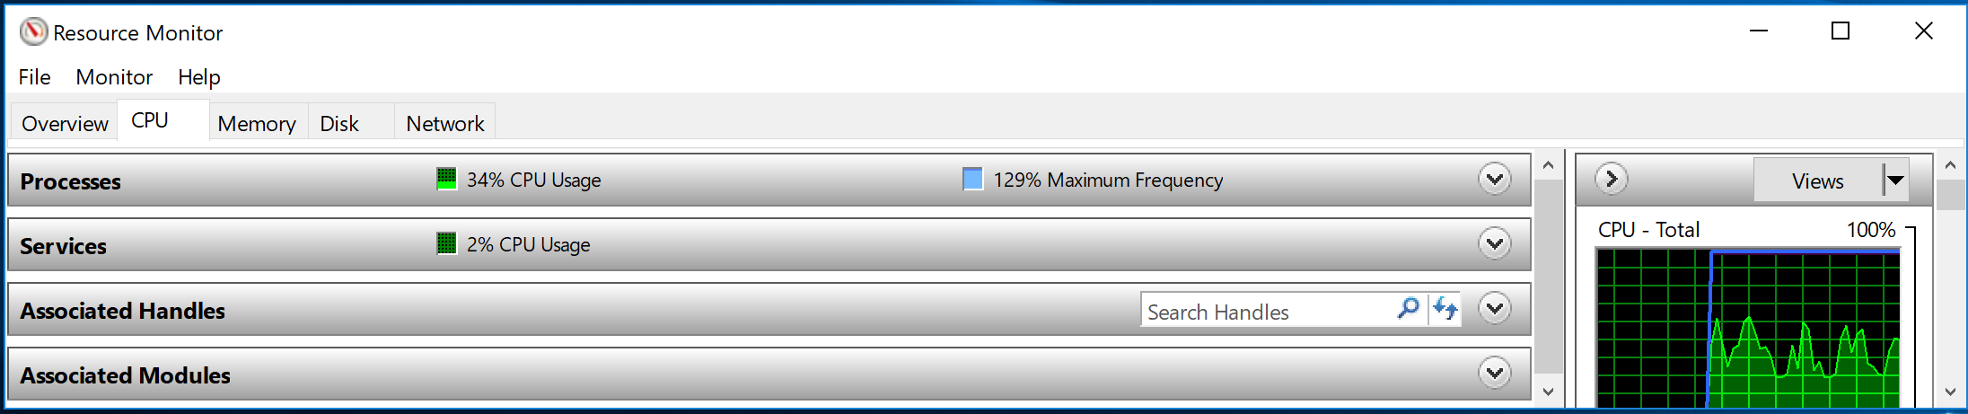
Resource Monitor and Processor Frequency
Microsoft Resource Monitor shows the average percentage of maximum frequency of all the processors
Processor frequency changes based on load (blue line)
Notes:
Resource Monitor shows the percentage of maximum frequency of the processors on the CPU tab. The blue line in the chart shows the percentage of maximum frequency on the CPU usage chart.
Take in consideration that % Maximum Frequency are instant samples which can change many times over one second. To see more accurately the processor frequency, consider using a ETW trace.

Slide 80
Knowledge Check
If % C3 Time has a high value, what might this indicate?
Why is adjusting the clock frequency or power state of idle processors helpful?
Notes:
If % C3 Time has a high value, it indicates that the processor is in a low power state
Adjusting the clock frequency or power state of idle processors reduces the electrical power that the server uses, which saves money while trying not to sacrifice performance

Slide 81
Microsoft

