Slide 1
WorkshopPLUS - Windows Server: Vital Signs Part 1
Notes:
Version: 12/21/2018 18:22:55

Slide 2
Disclaimer

Slide 3
Network

Slide 4
Introduction to networking

Slide 5
Learnings covered in this Unit
Packets
Routing
Vlans
TCP & UDP
Network Bandwith
Packet Loss
Port Exhaustion
Receive Side Scaling

Slide 6
Packets

Slide 7
Introduction to networking
The operating system simplifies network access for applications
Data is broken down into smaller chunks to be sent over the network
A variety of protocols are used to transfer data, depending on the application
Network components, devices and software can introduce latency due to congestion and load
Notes:
Networking components include source computer, software, network card, routers, switches, modems, cabling, Internet Service Providers (ISPs), web servers

Slide 8

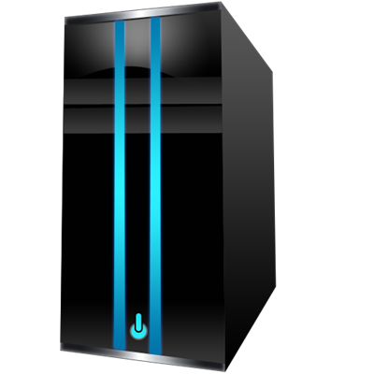
Using packet based networking
Application
Application
Application
Application data is broken down into messages
Messages are broken down in to segments
Segments are encapsulated in IP packets
Packets are transmitted as frames on the wire
The receiving host re-assembles the data in order to deliver the messages to an application
Presentation
Presentation
Presentation
Session
Session
Session
Transport
Transport
Transport
Network
Network
Network
Data Link
Data Link
Data Link
Physical
Physical
Physical

Slide 9
Browsing through the layers to a secure website
Application
HTTP
Application
Presentation
HTML
Presentation
Session
TLS/SSL
Session
Transport
TCP
Transport
Network
IP
Network
Data Link
MAC
Data Link
Physical
Ethernet
Physical

Slide 10
Simplifying the network stack
Application
Application
Web Service URL
Presentation
Session
Windows
Transport
Transport
TCP/UDP Ports
Network
Internet
IP Address
Data Link
Network Access
MAC Address
Physical
NIC & Cabling
OSI Model
TCP/IP Model
Real world example

Slide 12
Routing

Slide 13

Transferring data across a simple route/switch environment
Switches function at layer 2 and use MAC addresses to switch packets between their ports
Routers function at layer 3 and use IP addresses to route packets between interfaces
Switches may have layer 3 routing capabilities
Application
Application
Presentation
Presentation
Session
Session
Transport
Transport
Network
IP
IP
Network
Data Link
MAC
MAC
MAC
MAC
Data Link
Physical
Physical
Physical
Physical
Physical
Physical

Slide 14


Connecting through proxy servers and firewalls
Users URL Allow?
All users https://outlook.office.com Yes
Source IP Destination IP Port Allow?
* 10.10.10.10 443 Yes
Edge Browser
URL filtering
Web Server
Source IP Destination IP Port Allow?
* * 443 Yes
HTML
HTML
HTML
SSL
SSL
SSL
Port
Port
Port
Port
Port Number
IP
IP
IP
IP
IP Address
MAC
MAC
MAC
MAC
MAC
NIC
NIC
NIC
NIC
NIC

Slide 15
Routing IP packets across the network
2 ms
10 ms
4 ms
9 ms
7 ms
7 ms
20 ms
3 ms
4 ms
Notes:
Everything is local from a layer 2 perspective
A single network limits the number of hosts
Routers move packets from one network to another network
Routers and network segments can add latency due to distance or congestion
Slide timings based on actual tracert data:
C:\>tracert outlook.office365.com
Tracing route to outlook.ms-acdc.office.com [40.97.132.210]
over a maximum of 30 hops:
1 2 ms 7 ms 1 ms 192.168.0.1
2 2 ms 2 ms 1 ms isp-dhcp-address [redacted]
3 3 ms 2 ms 3 ms ae8---0.car01.evrt.wa.frontiernet.net [74.40.70.57]
4 4 ms 3 ms 4 ms ae3---0.cor02.sttl.wa.frontiernet.net [74.40.1.101]
5 20 ms 3 ms 3 ms ae1---0.cbr01.sttl.wa.frontiernet.net [74.40.5.126]
6 4 ms 3 ms 4 ms static-74-43-96-217.fnd.frontiernet.net [74.43.96.217]
7 9 ms 8 ms 10 ms be-71-0.ibr02.stb.ntwk.msn.net [104.44.8.68]
8 10 ms 9 ms 9 ms be-6-0.ibr01.cnr03.mwh01.ntwk.msn.net [104.44.4.102]
9 * * * Request timed out.
10 * * * Request timed out.
11 * * * Request timed out.
12 * * * Request timed out.
13 * * * Request timed out.
14 * * * Request timed out.
15 7 ms 8 ms 7 ms 40.97.132.210

Slide 16
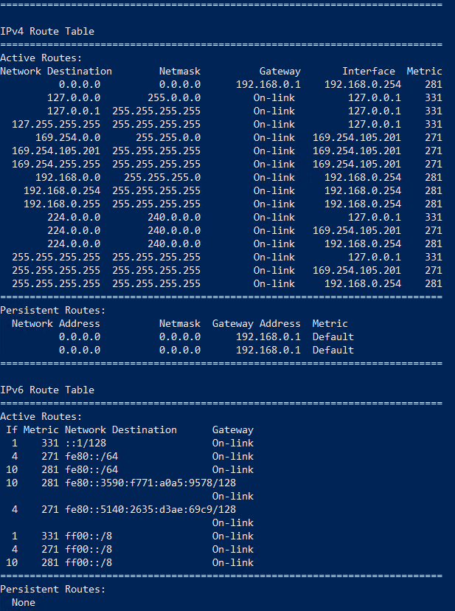
Deciding how to route IP packets
Each host on an IP network has a routing table
Routing tables describe the local network and how to reach other networks
Use Route Print or Get-NetRoute to display the routing table
Destination Subnet Mask for the Router to use for Local NIC Priority
Network or IP address destination network destination network to send packets of route
Notes:
Arrow to something in the box to explain an example – what do they need to understand

Slide 17
Layering the network for speed, scalability and isolation
Core: Network backbone with fast switching
Distribution: Routers and L3 switches
Access: Switches, Wireless APs, hubs
Notes:
Networks can be described in a layered model. The layered model provides benefits including:
High performance: Traffic is switched to the correct port, all LAN traffic is kept to the local network, and inter-lan traffic is passed via a high speed dedicated layer of devices.
Filtering and Policies: Filtering and policies can be applied in multiple points within the network/internetwork for efficiency. Scalability and Redundancy: This model scales well as each layer is abstracted from the next and it provides multiple paths for redundancy.
Troubleshooting: Troubleshooting can be isolated to a layer or specific devices with greater ease.
Core layer: This is the backbone of the network. It includes high performance switches and routers connected by high-speed interconnects such as fibre. This layer does not route packets on the LAN, rather it provides high speed/low latency access between LANs. Distribution layer: This is composed of LAN routers and layer 3 switches and connects subnets within a LAN. This layer may include some type of packet manipulation, such as port based filtering (firewalls) and QoS. This layer defines network boundaries and provides access to the core layer.
Access layer: This layer is composed of hubs, switches, and wireless access points. This layer connects servers and clients other hosts on the same subnet and with other hosts on the same network or other network via the distribution layer. Port security and access policies can be managed at this layer.

Slide 19
Vlans

Slide 20
Using VLANS to control the network
Virtual LANs are logical groups of devices that can communicate as if they are on the same physical wire
VLANs are broadcast domains created by switches rather than routers
Individual switch ports are associated with a specific VLAN
Advantages include:
Improve network performance
Logical separation for management or security
Bridge disparate LANs into one logical LAN

Slide 21
Using VLANS to manage the network
Accounting
HR
Finance
Notes:
Virtual LANs are logical groups of devices that can communicate as if they are on the same physical wire
VLANs are broadcast domains created by switches rather than routers
Individual switch ports are associated with a specific VLAN
Advantages include:
Improve network performance
Logical separation for management or security
Bridge disparate LANs into one logical LAN

Slide 22
TCP & UDP

Slide 23
Examining the main transport protocols
Transmission Control Protocol (TCP)
Unicast and connection oriented
Favors reliability over speed
Data is sequenced and ordered
Reliability is built in to the protocol
More overhead, with session setup, session management and session tear down
Includes error checking, error recovery mechanisms, and flow control
User Datagram Protocol (UDP)
Unicast, multicast, connectionless
Favors speed over reliability
Data is not ordered and segments may be independent
Applications are responsible for reliability
Light weight “send and forget” approach
Does not perform error checking, error recovery, or flow control

Slide 24





TCP or UDP? That is the question…
User Datagram Protocol (Unreliable)
Transmission Control Protocol (Reliable)
Notes:
UDP
Online media streaming
Internet games
DNS queries (<512 bytes)
Skype for Business audio and video (preferred protocol)
TCP
HTTP(S), FTP, SMTP
Outlook connections
DNS queries (>512 bytes) and zone transfers
Skype for Business audio and video (if UDP is blocked)

Slide 25
Network Bandwith

Slide 26
What is bandwidth and throughput?
Bandwidth is the rate that a device or link can process, measured in bits per second
Expressed in multiples of bits per second (Kbps, Mbps, Gbps)
Actual throughput may be significantly less than expected
Network throughput is only as fast as the slowest link or slowest device
Statistics from a single computer might not reveal network congestion
Throughput bottleneck
Site A
Site B
100% utilization: CPU
100% utilization: Network
Throughput bottleneck
Notes:
The formulas for calculating the percentage of network utilization by a network adapter assume that your network adapter is the slowest connection on the network. If your system communicates with other networks, the network throughput is only as fast as the slowest link.
In the example on this slide, computers at Site A communicate with computers at Site B. Both sites have connection speed of 1 gigabit per second, but they must cross over a bridge or router that has a connection speed of only 100 megabits per second, which might quickly be saturated by usage. This is common when connecting to internet resources, yet the percentage of network utilization is very low from the perspective of your computer.

Slide 27
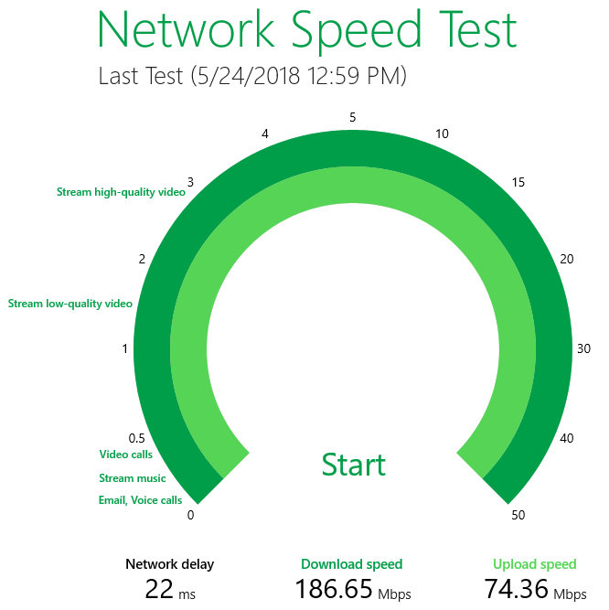
Measuring available bandwidth
Throughput may be less than provisioned bandwidth
Use Microsoft Research Network Speed Test Store app to measure internet connection speeds
Use third party tools such as Wireshark or iPerf for host to host network bandwidth testing

Slide 28
Bandwidth counters in perfmon
\Network Adapter(*)\Current Bandwidth is the current bandwidth of the network interface in bits per second (bps)
\Network Adapter(*)\Bytes Total/sec is the rate at which bytes are sent and received over a network adapter, including framing characters
\Network Adapter\Bytes Total/Sec is equal to
\Network Adapter(*)\Bytes Sent/sec + \Network Adapter(*)\Bytes Received/sec
Notes:
Here are a few performance counters that are commonly used as initial indicators of bandwidth related conditions.

Slide 29
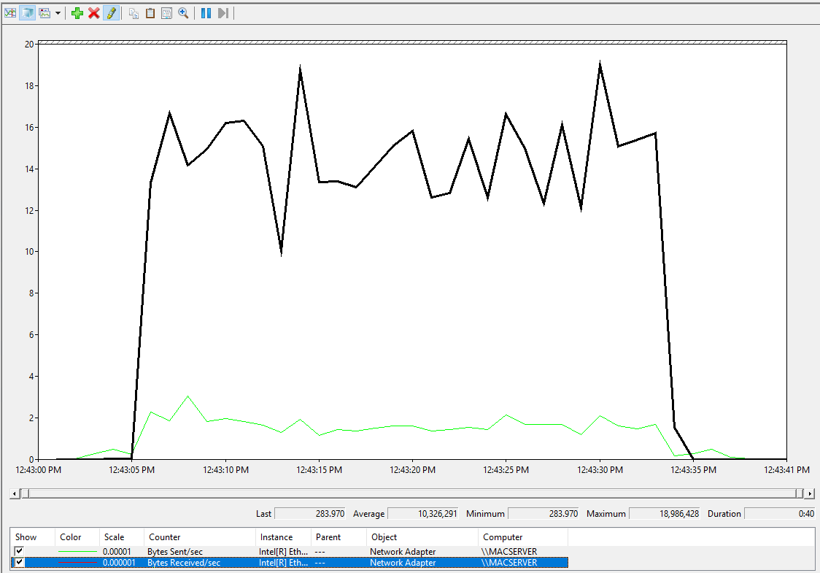
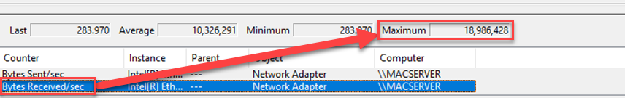
Calculating throughput
Byte per sec * 8 = bits per second
In this example:
(18986428 * 8) / 1000 / 1000 = 18.98Mbps
Notes:
This test was conducted on the same machine as the network speed test from the previous slide. The download was a 385MB video file from OneDrive. The available bandwidth was 186Mbps, but the maximum throughput was 18.98Mbps.
Kbps = bps / 1000
Mbps = Kbps / 1000
Gbps = Mbps / 1000

Slide 30
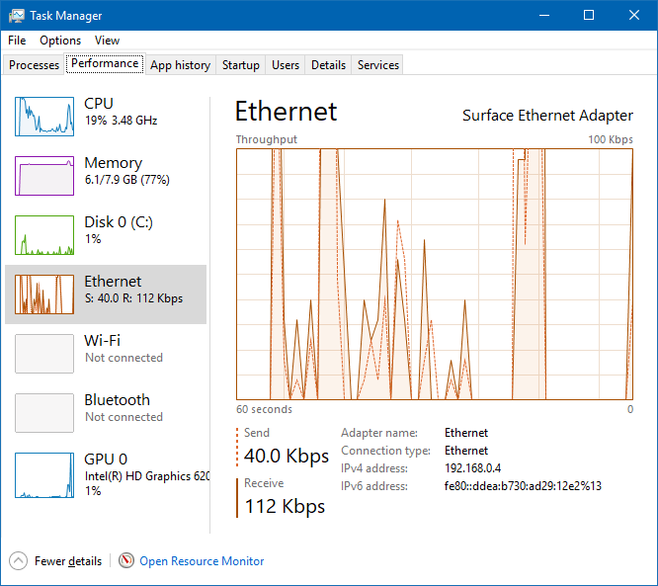
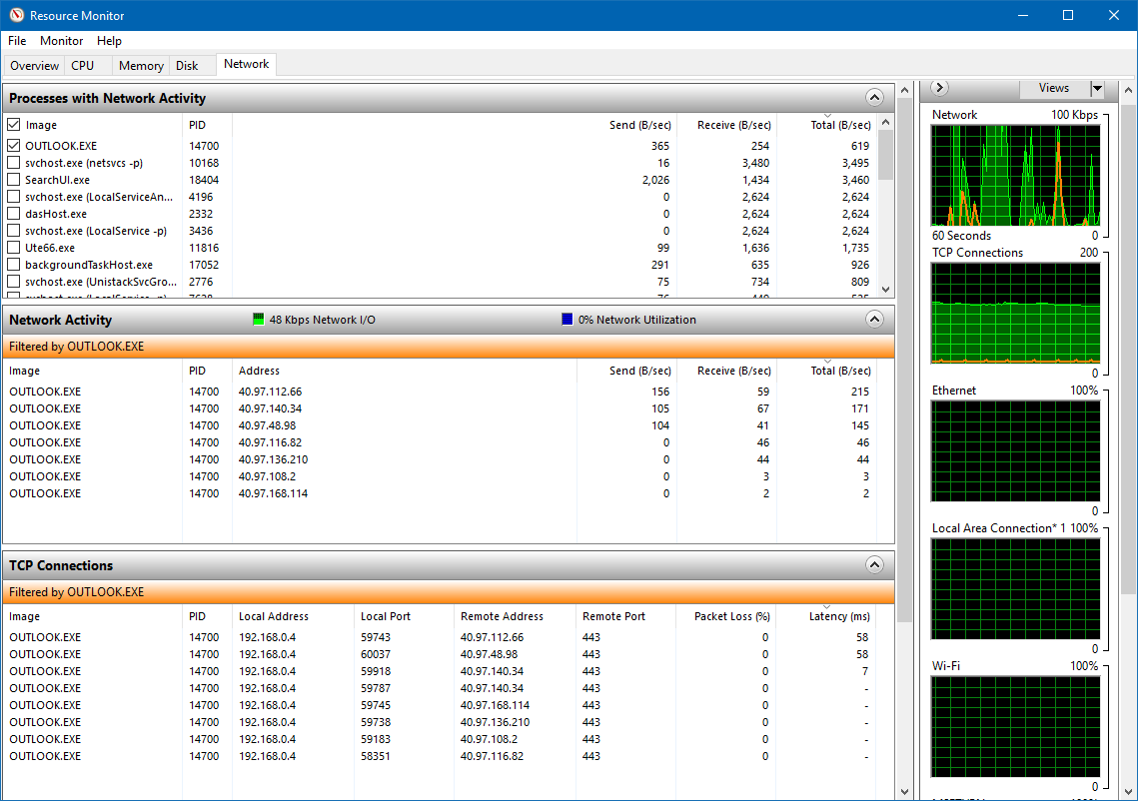
Capturing real time network statistics
Notes:
Play with some animation
Legend for orange versus green

Slide 31
Monitoring throughput by process
Total bytes per second for selected process, highlighted in orange

Slide 32
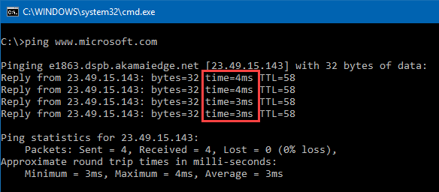
Troubleshooting latency
Latency is the time to get from the source to the destination
Measured in milliseconds (ms) and typically expressed as round trip time (RTT)
Common causes:
Line speed and distance
Queuing at devices
Processing delays by devices
Buffer bloat

Slide 33
Test example of how latency affects throughput
File transfer time in ms
Network latency between hosts, in milliseconds
Link capacity in bits = bandwidth (in bits per second) * round-trip time (RTT) (in seconds)
Notes:
Transfer between two machines attached to the same switch that had no utilization.

Slide 35
Packet Loss

Slide 36
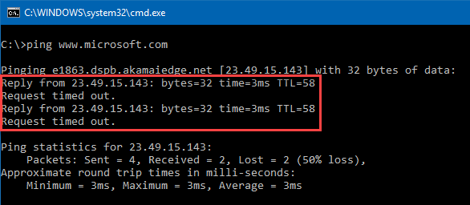
Troubleshooting packet loss?
The number of packets that do not arrive at the destination
Typically measured as a percentage of the packets that failed to reach their destination
Common causes:
Congestion at network devices and network segments
Degraded signal (signal strength and attenuation)
Faulty networking hardware
Faulty network drivers
Notes:
Other tools and URL to Psping

Slide 37
Checking latency and packet loss in real time
Notes:
Remote address – latency is only valid to proxy

Slide 38
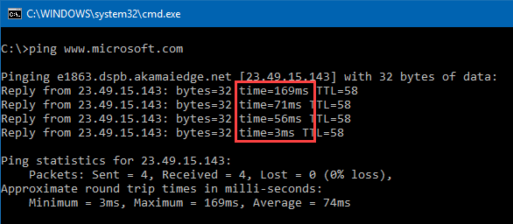
Jitter
The variability of latency in the arrival of packets at the destination
Measured in milliseconds and typically expressed as an average value for a connection or by a tool
Common causes:
Burstiness of transmission
Network congestion
Queueing on network devices
Notes:
Graphic

Slide 39
Command line tools
Latency and packet loss
Ping command uses ICMP to measure latency and loss
PSPing.exe from Sysinternals can measure latency over ICMP and TCP ports – not blocked like ping
Test-Connection cmdlet provides round trip latency
Test-NetConnection cmdlet can measure latency on specified ports
Routing and latency
PathPing
Tracert
Test-NetConnection cmdlet has a –TraceRoute switch
Notes:
ICMP ping packets may not follow same route as TCP or UDP packets

Slide 41
Port Exhaustion

Slide 42
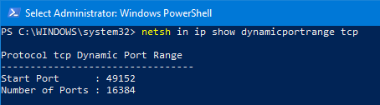
Port Exhaustion
This occurs when ephemeral (outbound) TCP ports are used due to a high number of outbound connections
Port exhaustion resulting in unpredictable network behavior
This is much more likely to happen on a proxy or firewall when a large number of clients connect to cloud services

Slide 43
Port Exhaustion example to O365
192.168.0.23
192.168.0.15
Office clients will make multiple connections to Office 365 services
A proxy or firewall will use Network Address Translation to map all of these connections to a single external IP address
The external IP must use a unique port per connection
If ports are not available, random connections failures occur
192.168.0.94

Slide 44
Receive Side Scaling

Slide 45

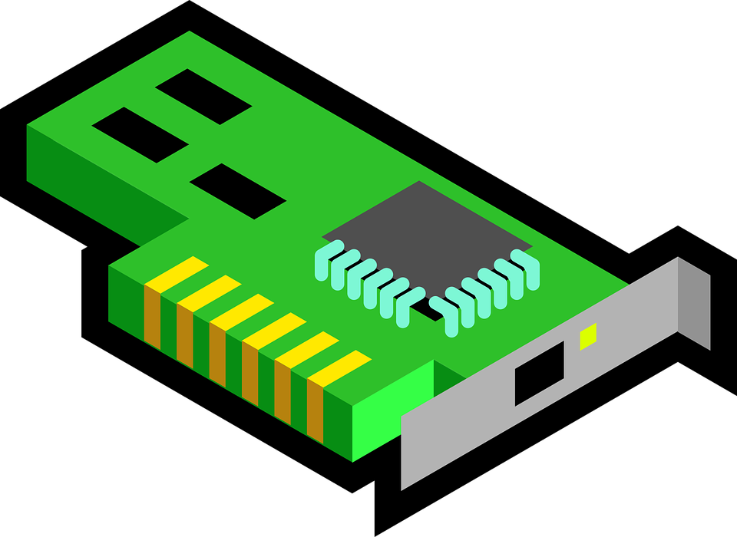
How network can impact CPU
Network cards need CPU time to process incoming packets
RSS distributes incoming network I/O packets among logical processors
RSS improves the scalability and performance for network intensive workloads
Load balances TCP and UDP traffic
RSS uses one logical processor per core
78%
7%
5%
6%
26%
24%
25%
23%

Slide 46
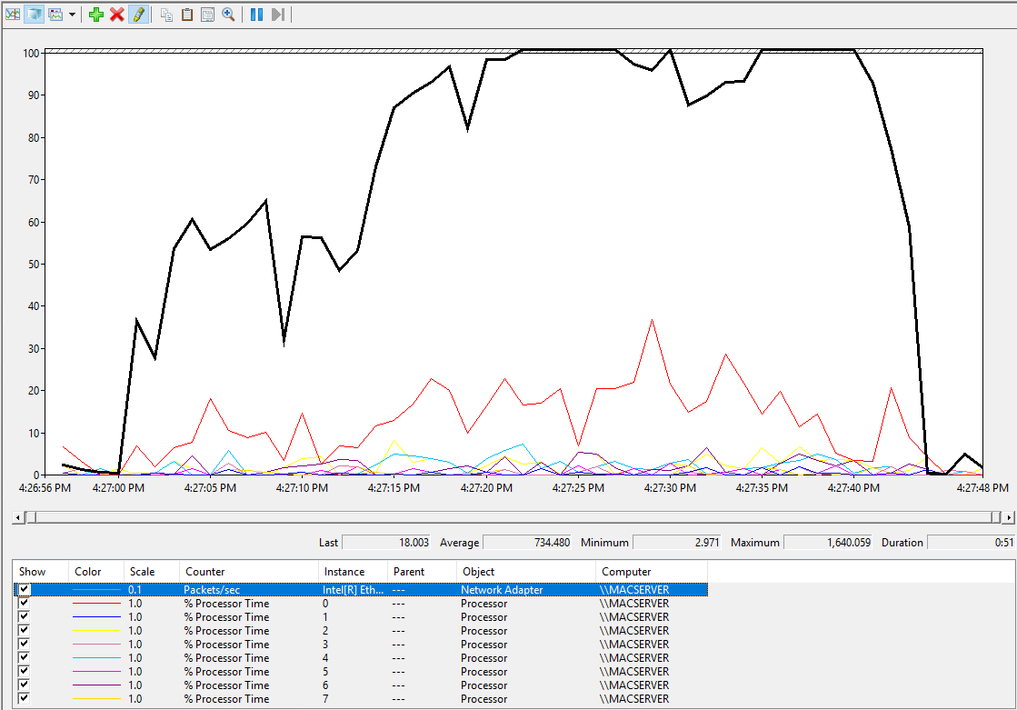
CPU performance when RSS is disabled

Slide 47
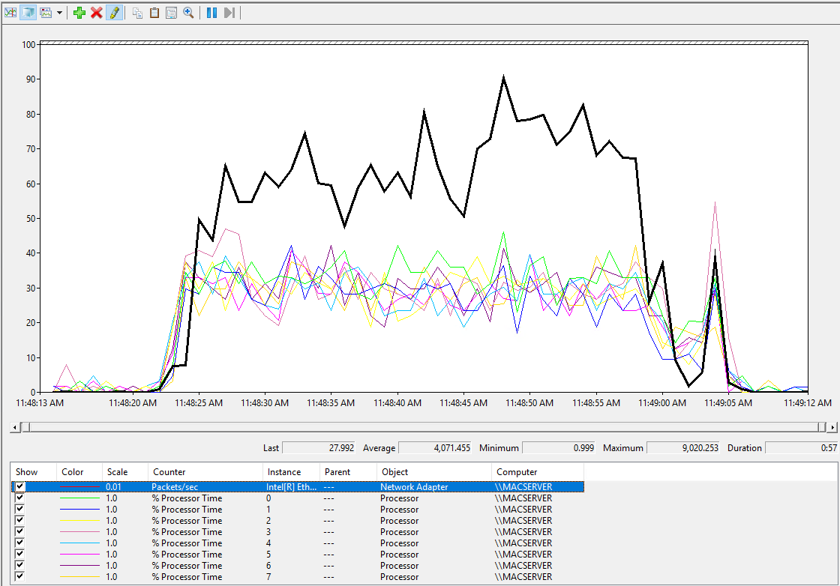
CPU performance when RSS is enabled

Slide 48
vRSS on Hyper-V hosts
Physical network adapters must support Virtual Machine Queue (VMQ). If VMQ is disabled or is not supported, then vRSS is disabled for the Hyper-V host and for any VMs that are configured on the host.
Network adapters must have a link speed of 10 Gbps or more.
Hyper-V hosts must be configured with multiple processors or at least one multi-core processor to use vRSS.
Virtual machines (VMs) must be configured to use two or more logical processors.
Notes:
https://docs.microsoft.com/en-us/windows-server/networking/technologies/vrss/vrss-top

Slide 50
The Case Of Instable Network

Slide 51
Microsoft

