Slide 1
HR ANALYTICS
HR Analytics Dashboard Project
An End-to-End Employee Attrition Analysis Across Tableau, Excel, Power BI & SQL
Tableau
Excel
Power BI
SQL
ExcelR Data Analytics Program • Capstone Presentation • Group 3

Slide 2
PRESENTATION ROADMAP
Agenda
01
Project Overview & Objective
05
Power BI Dashboard
Why this HR analytics project matters
KPI card-based reporting
02
Tools & Methodology
06
SQL KPI Queries
Four-tool BI stack across the project lifecycle
The analytical logic behind every metric
03
Tableau Dashboard
07
Key Insights
Executive-style attrition storytelling
What the data is telling us
04
Excel Dashboard
08
Recommendations
Interactive slicers & pivot-driven analysis
Actionable next steps for HR
HR Analytics Dashboard Project | ExcelR
2

Slide 3
THE BUSINESS PROBLEM
Project Overview & Objective
Objective
Tableau
T
Analyze employee attrition patterns using a company-wide HR dataset — examining department, compensation, job role, tenure, work-life balance and promotion history — to uncover the factors most strongly linked to employees leaving the organization.
Executive storytelling
Excel
E
Slicer-driven analysis
Scope of Work
Built the same set of 6 core HR KPIs across four platforms
Queried and validated metrics directly in SQL
Designed interactive dashboards in Tableau, Excel & Power BI
Compared attrition drivers across department, income & tenure
Power BI
P
KPI card reporting
SQL
S
Query-level logic
HR Analytics Dashboard Project | ExcelR
3

Slide 4
HOW THE PROJECT WAS BUILT
Tools & Methodology
1
2
3
4
SQL
Excel
Power BI
Tableau
Cleaned the HR dataset and wrote 6 grouped/aggregated queries to define each KPI at the source of truth.
Built a slicer-driven pivot dashboard (Gender, JobRole, Department, Age) for flexible ad-hoc analysis.
Converted the KPIs into a clean, card-based report for at-a-glance monitoring.
Assembled an executive dashboard combining all 6 KPIs into one visual narrative.
→
→
→
Same 6 KPIs, four lenses — a consistent single source of truth reported four different ways.
HR Analytics Dashboard Project | ExcelR
4

Slide 5
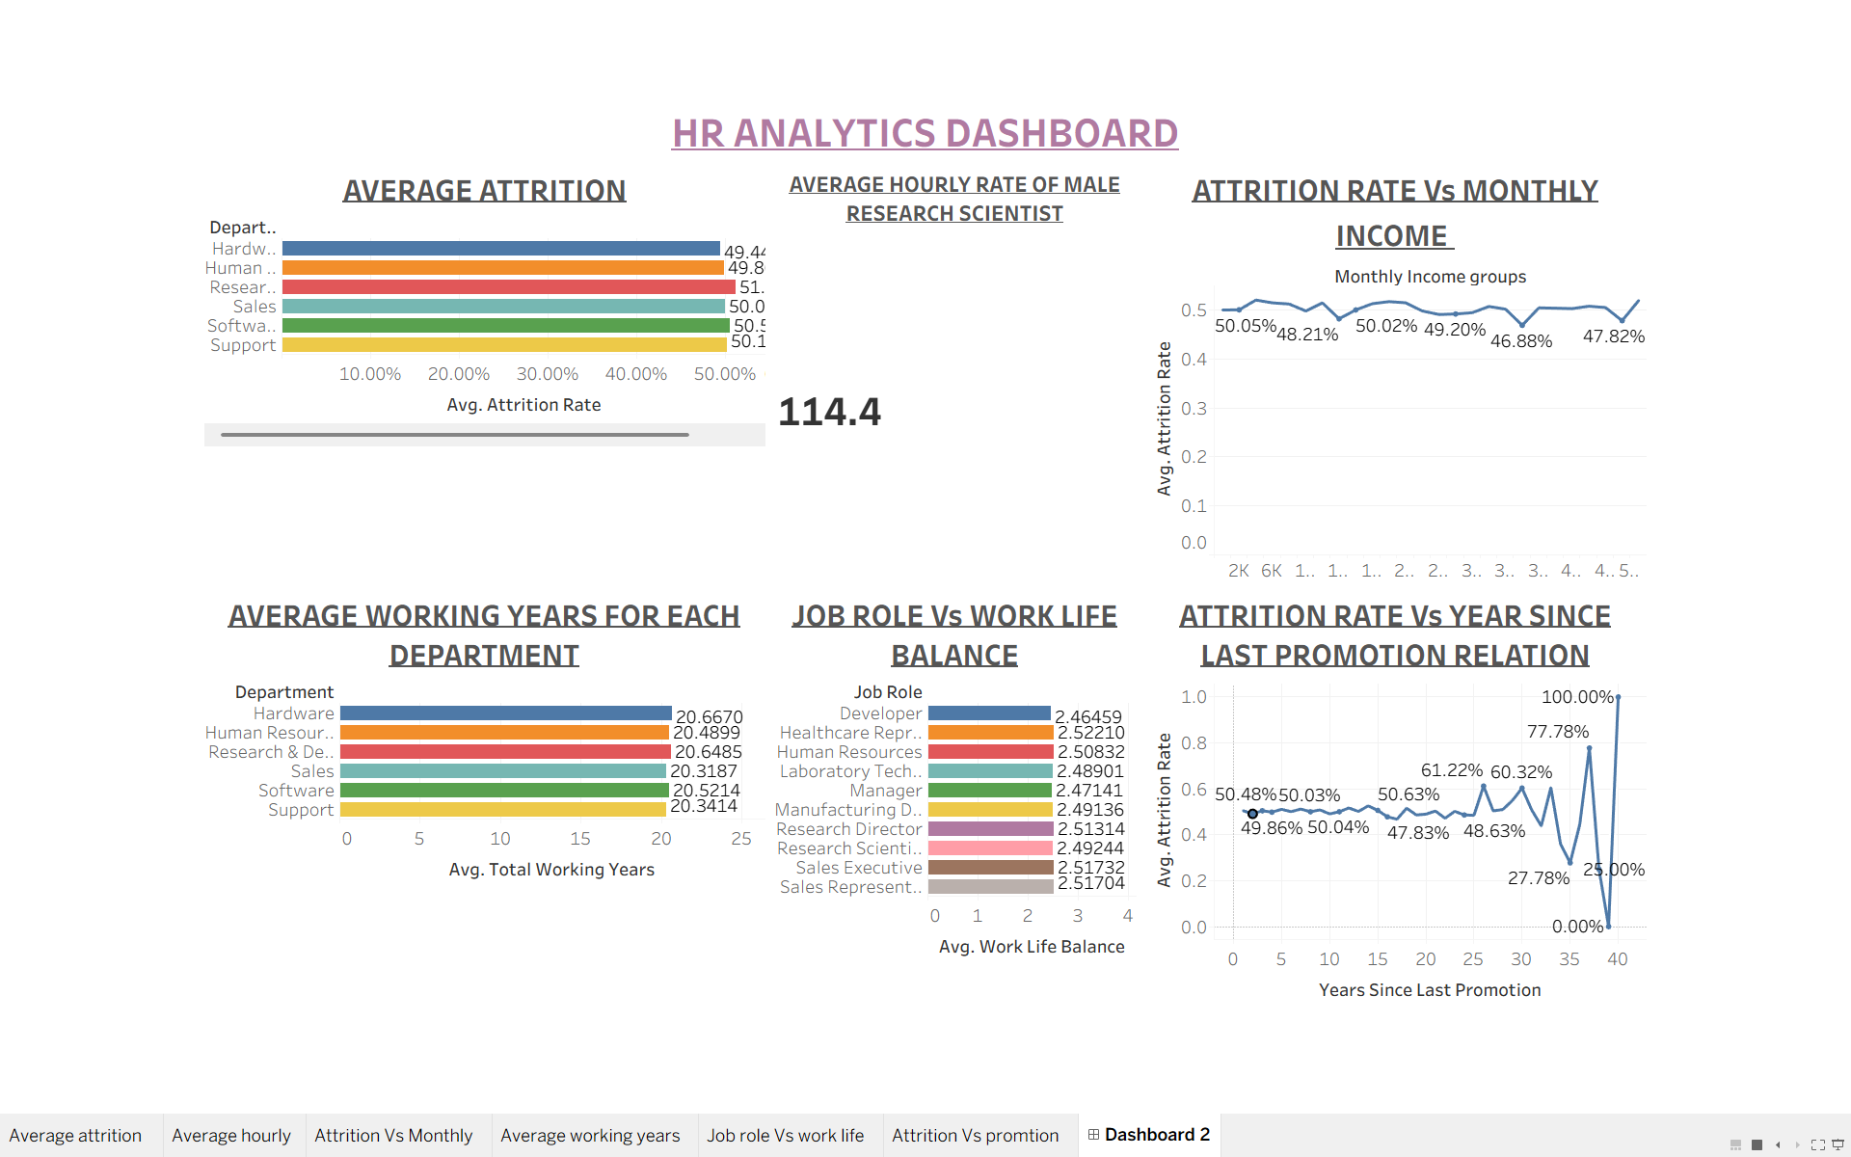
MODULE 1 · TABLEAU
Tableau Dashboard
TOOL: TABLEAU
Highlights
Six linked views in one executive dashboard
Attrition rate compared across department, income band & job role
Line chart reveals attrition spikes at long promotion gaps
Built for leadership storytelling & drill-down
HR Analytics Dashboard Project | ExcelR
5

Slide 6
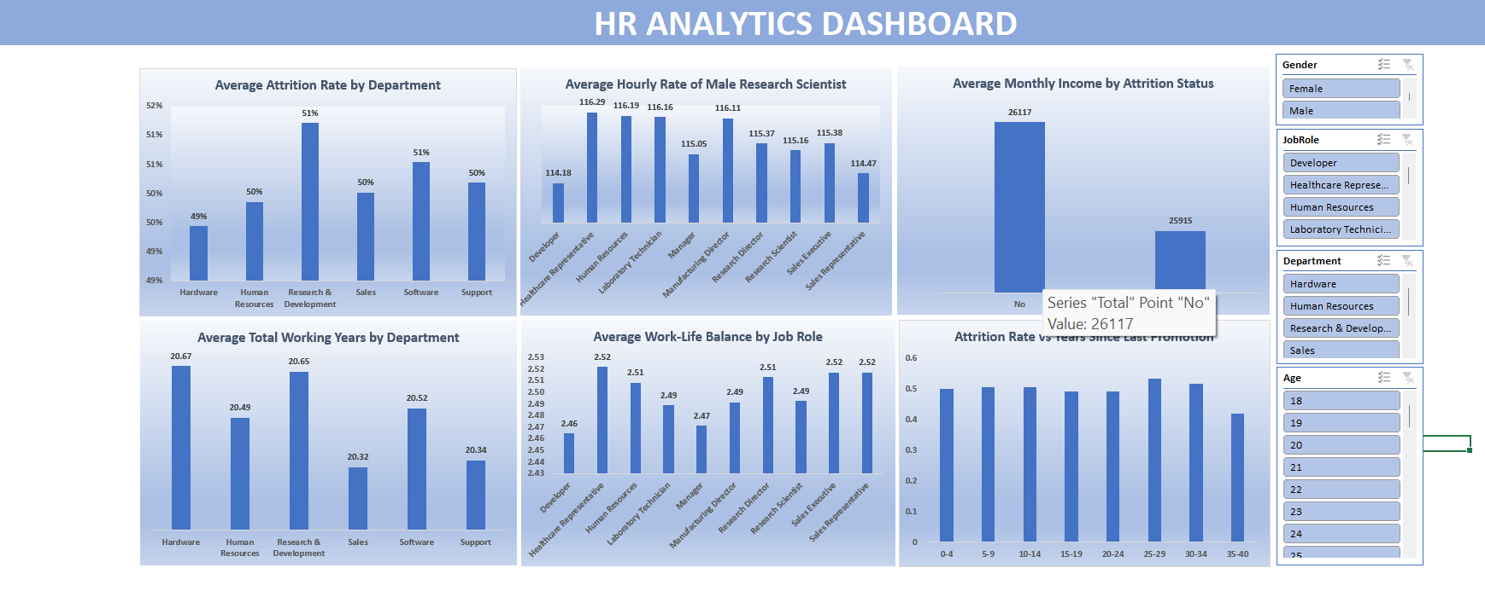
MODULE 2 · EXCEL
Excel Dashboard
TOOL: EXCEL
Highlights
Pivot-chart dashboard with live slicers
Filters: Gender, Job Role, Department, Age
Attrition rate ranges 49%–51% across departments
Fully interactive for ad-hoc HR analysis
HR Analytics Dashboard Project | ExcelR
6

Slide 7
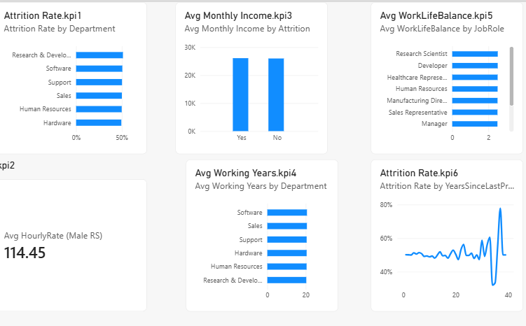
MODULE 3 · POWER BI
Power BI Dashboard
TOOL: POWER BI
Highlights
Compact, card-based KPI report
Avg. Hourly Rate (Male Research Scientist): 114.45
Monthly income nearly identical for leavers vs. stayers
Designed for quick, at-a-glance monitoring
HR Analytics Dashboard Project | ExcelR
7

Slide 8
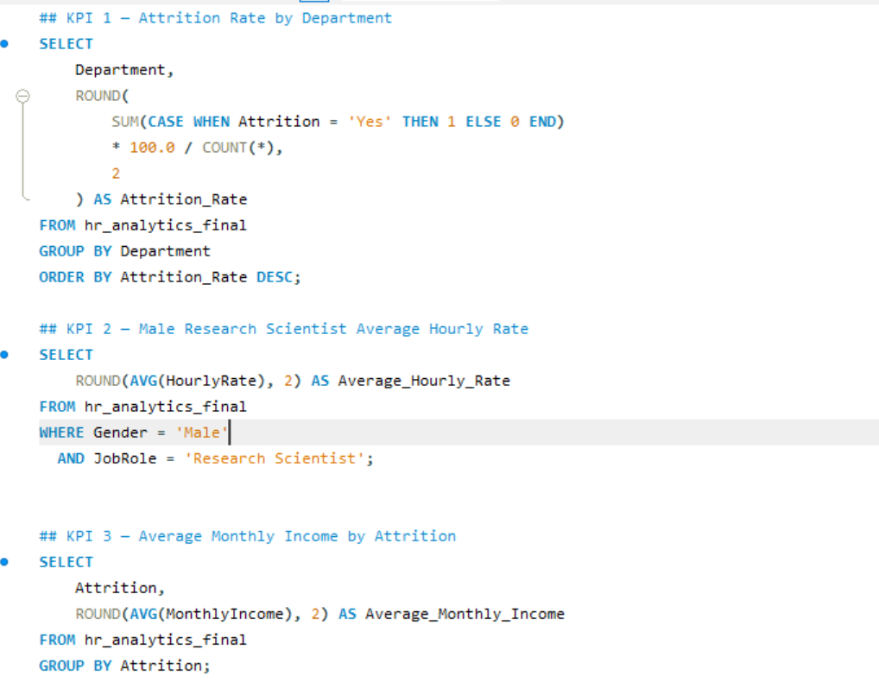
MODULE 4 · SQL
SQL KPI Queries — Part 1
KPI Definitions
KPI 1 · Attrition Rate by Department
% of employees who left, grouped by department — the foundation metric of the project.
KPI 2 · Male Research Scientist Hourly Rate
Average hourly pay filtered to Gender = Male and JobRole = Research Scientist.
KPI 3 · Avg. Monthly Income by Attrition
Compares average pay between employees who stayed vs. left.
HR Analytics Dashboard Project | ExcelR
8

Slide 9
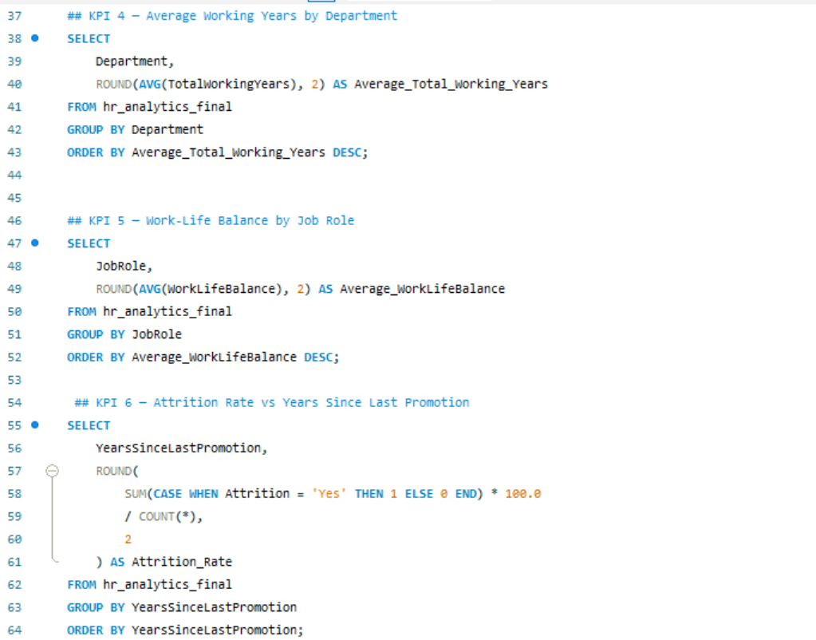
MODULE 4 · SQL
SQL KPI Queries — Part 2
KPI Definitions
KPI 4 · Avg. Working Years by Department
Average total tenure per department, ranked highest to lowest.
KPI 5 · Work-Life Balance by Job Role
Average work-life balance score, grouped by job role.
KPI 6 · Attrition Rate vs. Years Since Promotion
Attrition % calculated for every value of years since last promotion.
HR Analytics Dashboard Project | ExcelR
9

Slide 10
WHAT THE DATA TELLS US
Key Insights
1
Attrition is broadly uniform across departments
2
Promotion stagnation is the clearest red flag
Rates sit in a tight 49%–51% band, with Research & Development slightly the highest — department alone is not a strong differentiator.
Attrition swings wildly — up to 100% — once years since last promotion stretches past ~30 years, far more volatile than any other single factor.
3
Compensation shows only a small gap
4
Work-life balance is consistently moderate
Avg. monthly income is nearly identical for leavers (≈ 26,117) and stayers (≈ 25,915) — pay alone doesn't explain attrition.
Scores cluster tightly around 2.46–2.52 (out of a higher scale) across every job role — no role stands out as notably better or worse.
HR Analytics Dashboard Project | ExcelR
10

Slide 11
ACTIONABLE NEXT STEPS
Recommendations
1
Fix the promotion pipeline first
Introduce structured promotion / career-conversation checkpoints once an employee crosses 3–5 years without advancement — the single strongest attrition signal found.
2
Run a Research & Development retention review
Investigate workload, management span and role satisfaction in R&D specifically, since it edges out other departments on attrition.
3
Invest in work-life balance programs company-wide
Scores are moderate everywhere, not just in one role — flexible hours, wellness benefits and workload audits would lift the baseline across the board.
4
Look beyond pay for retention levers
Since income differs little between leavers and stayers, prioritize non-monetary levers — recognition, growth paths and manager quality — over compensation-only fixes.
5
Operationalize the 4-tool BI stack
Use SQL for source-of-truth metrics, Power BI for daily KPI monitoring, Excel for ad-hoc HR deep-dives, and Tableau for leadership storytelling.
HR Analytics Dashboard Project | ExcelR
11

Slide 12
Thank You
Questions & Discussion
HR Analytics Dashboard Project — Tableau · Excel · Power BI · SQL
ExcelR Data Analytics Program

