Slide 1
PROJECT PRESENTATION
HOSPITALITY ANALYTICS
Hotel Booking & Revenue Analytics Project
End-to-End Data Analytics using
Excel • SQL • Power BI • Tableau
Data Preparation • SQL • KPIs • Dashboards • Business Insights
MICROSOFT EXCEL
POWER BI
SQL
TABLEAU
GROUP 4
Hospitality Analytics | Project Presentation | Group 4
1

Slide 2
PROJECT TEAM MEMBERS
Edit names & IDs
PROJECT TEAM MEMBERS
GROUP - 2
G NANDINI
Nikitha Nallamalli
Prateek Gupta
Soubhagyalaxmi M Asangi
Ashutosh Biswal
Velunguri Venkata Mukesh
Bhati Dhruv
Hospitality Analytics | Project Presentation | Group 4
2

Slide 3
PROJECT OVERVIEW
Excel + Power BI
Hospitality Analytics • Excel • SQL • Power BI • Tableau
This project analyzes hotel bookings, realized revenue, room capacity, booking platforms, channels, room classes and hotel performance using Excel, SQL, Power BI and Tableau.
DATA PREPARATION
SQL ANALYSIS
VISUALIZATION
POWER QUERY
Prepared booking-level and aggregated-booking data with hotel, room and date dimensions.
Created the hospitality analytics database and inspected fact and dimension tables.
Built KPI dashboards and interactive visuals for revenue, bookings, occupancy, status and channel analysis.
Workbook preparation, pivot analysis, calculated KPIs and dashboard formatting.
PROJECT WORKFLOW
Booking Data
→
Data Preparation
→
KPI Calculations
→
Data Model
→
Dashboard
→
Insights
DATA MODEL : Fact_Bookings + Fact_Aggregated_Bookings → DimHotels | DimRooms | DimDate
Hospitality Analytics | Project Presentation | Group 4
3

Slide 4
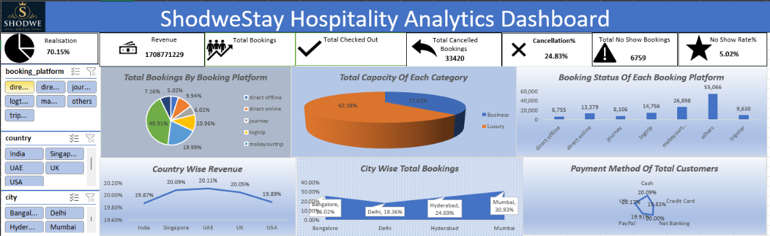
EXCEL DASHBOARD
Microsoft Excel | Pivot Tables | Charts | Slicers
HOSPITALITY DASHBOARD SCREENSHOT
Pivot Tables
Hotel, city, room-class, platform and booking-status analysis.
KPI Cards
Revenue Realized, Total Bookings, Occupancy, Average Rating and booking KPIs.
Interactive Slicers
City, Room Class, Booking Status and Platform filters for focused analysis.
Charts
Bar and comparison charts for city revenue, booking status, platforms and room classes.
Excel Work Completed_x000B_Data preparation • KPI calculations • pivot analysis • dashboard formatting
Hospitality Analytics | Project Presentation | Group 4
4

Slide 5
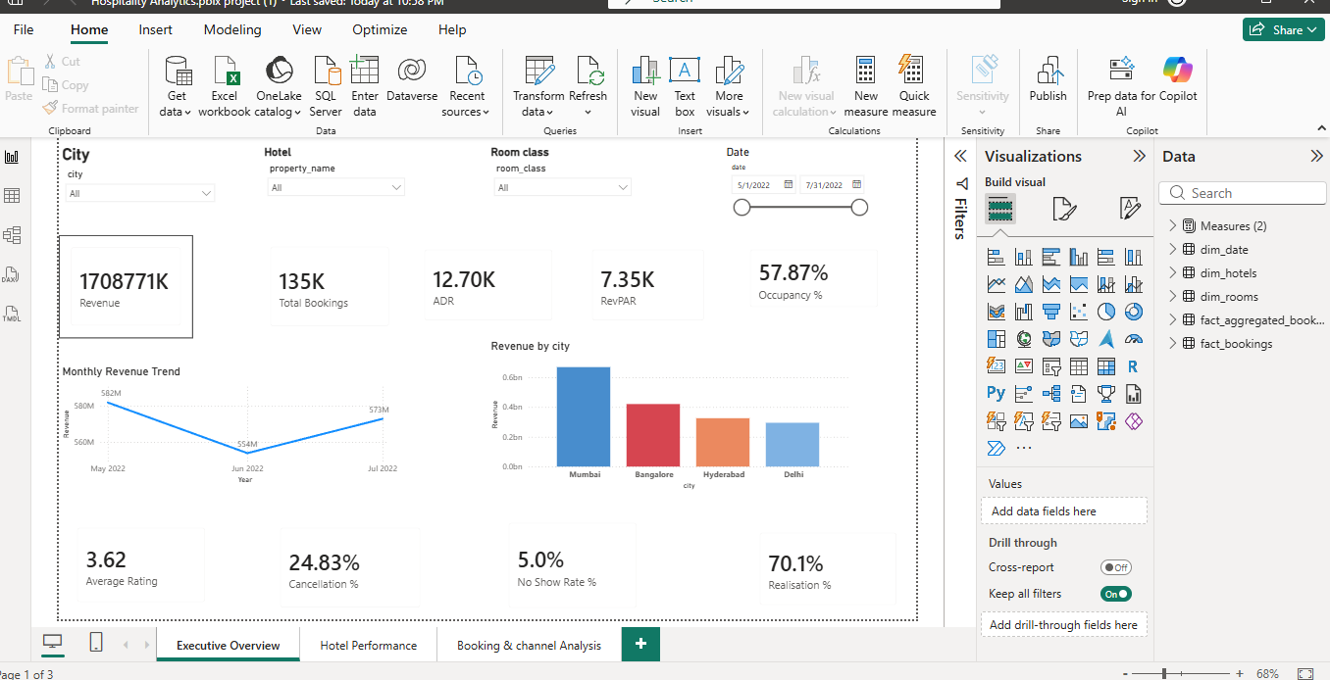
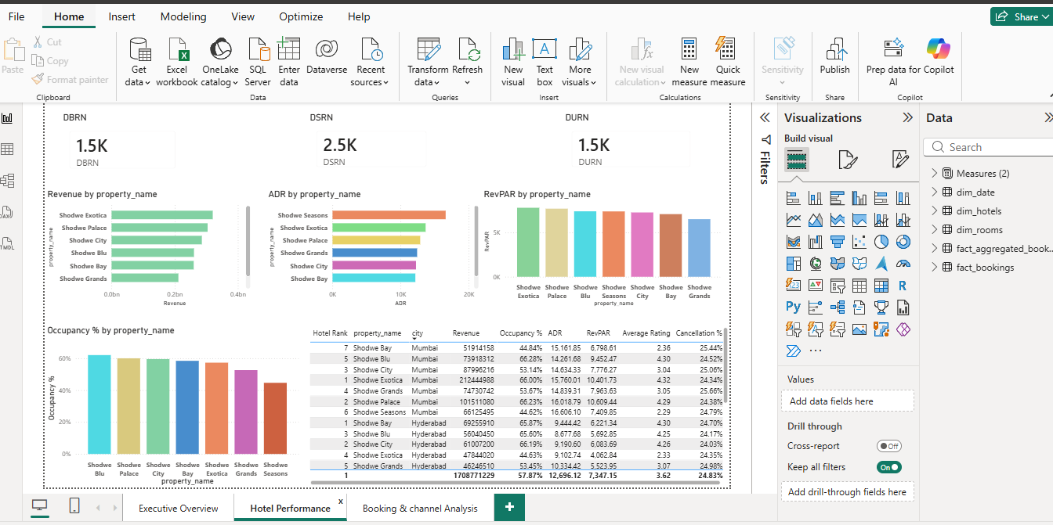
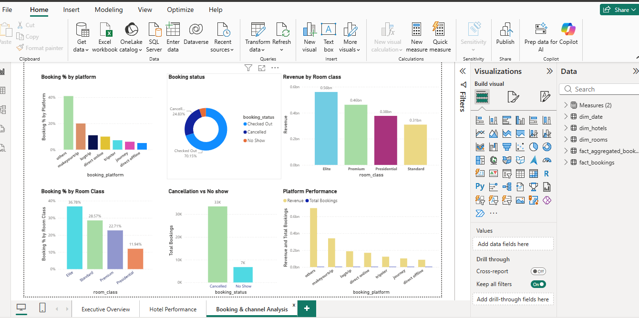
POWER BI DASHBOARD
Power Query | Data Model | DAX | Interactive Visuals
HOSPITALITY DASHBOARD SCREENSHOT
Data Model
Booking facts linked with hotel, room and date dimensions; aggregated bookings support capacity and occupancy analysis.
Power Query
Prepared booking and aggregated-booking data for the analytical model.
DAX & KPIs
Revenue, ADR, RevPAR, Occupancy, Realisation, Cancellation and No Show KPIs.
Interactive Dashboard
City, Hotel, Room Class and Date filters with hotel, booking and channel analysis.
Power BI Work Completed_x000B_Modeling • DAX measures • KPI cards • interactive visual storytelling
Hospitality Analytics | Project Presentation | Group 4
5

Slide 6
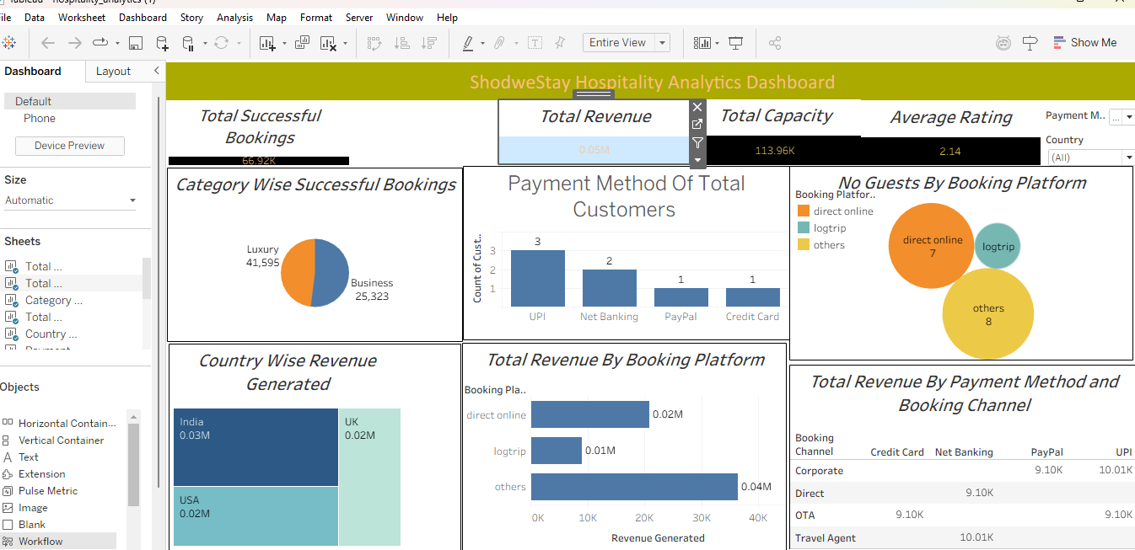
TABLEAU DASHBOARD
Tableau | Calculated Fields • Filters • Interactive Visualizations
TABLEAU DASHBOARD SCREENSHOT
DATA CONNECTION & PREPARATION
Connected the hospitality analytics MySQL database and prepared fact/dimension data for Tableau analysis.
DATA MODELING
Used fact bookings, aggregated bookings, hotel, room and date tables for hospitality analysis.
CALCULATED FIELDS & KPIs
Created analytical views for bookings, revenue, room class, platform, payment method and channel.
Interactive Dashboard
Interactive filters and visualizations for hotel, room class, booking platform, payment method and revenue.
Tableau Work Completed_x000B_Data Connection • Calculated Fields • KPI Analysis • Interactive Visual Storytelling
Hospitality Analytics | Project Presentation | Group 4
5

Slide 7
SQL DATABASE SETUP & DATA LOADING
SQL SCRIPT — DATABASE SETUP & FACT TABLE LOADING
01 — DATABASE & SETTINGS
02 — CREATE fact_bookings
03 — LOAD fact_bookings
CREATE DATABASE shodwe_hotels;
USE shodwe_hotels;
-- To off Safe updates
SET SQL_SAFE_UPDATES = 0;
-- Enable Load local data
SET GLOBAL local_infile = 1;
CREATE TABLE fact_bookings (
booking_id VARCHAR(50),
property_id INT,
booking_date DATE,
check_in_date DATE,
checkout_date DATE,
no_guests INT,
room_category VARCHAR(10),
booking_platform VARCHAR(50),
ratings_given DECIMAL(3,1),
booking_status VARCHAR(30),
revenue_generated DECIMAL(15,2),
revenue_realized DECIMAL(15,2),
customer_id VARCHAR(50),
payment_method VARCHAR(50),
stay_duration INT,
cancellation_reason VARCHAR(255),
is_loyalty_member VARCHAR(10),
country VARCHAR(100),
customer_age INT,
special_requests INT,
discount_applied DECIMAL(10,2),
booking_channel VARCHAR(50)
);
-- loaded required files using import wizard
-- importing fact_bookings
LOAD DATA LOCAL INFILE 'C:/Users/gnana/Downloads/1789015204028_Hospitality Data/Hospitality Data/Data/fact_bookings.csv'
INTO TABLE fact_bookings
FIELDS TERMINATED BY ','
OPTIONALLY ENCLOSED BY '"'
LINES TERMINATED BY '\r\n'
IGNORE 1 ROWS
(
booking_id, property_id, booking_date, check_in_date,
checkout_date, no_guests, room_category, booking_platform,
ratings_given, booking_status, revenue_generated, revenue_realized,
customer_id, payment_method, stay_duration, cancellation_reason,
is_loyalty_member, country, customer_age, special_requests,
discount_applied, booking_channel
);
Hospitality Analytics | SQL Analysis | Group 02

Slide 8
SQL — DATE RELATIONSHIPS
Hospitality Analytics | SQL Analysis | Date → Fact relationships
02 — Date → fact_aggregated_bookings
01 — Date → fact_bookings
-- Date → fact_aggregated_bookings
DESCRIBE fact_aggregated_bookings;
ALTER TABLE fact_aggregated_bookings
ADD COLUMN check_in_date_new DATE;
UPDATE fact_aggregated_bookings
SET check_in_date_new = STR_TO_DATE(check_in_date, '%d-%b-%y');
SELECT check_in_date, check_in_date_new
FROM fact_aggregated_bookings
LIMIT 10;
ALTER TABLE fact_aggregated_bookings
DROP COLUMN check_in_date;
ALTER TABLE fact_aggregated_bookings
CHANGE COLUMN check_in_date_new check_in_date DATE;
ALTER TABLE fact_aggregated_bookings
ADD CONSTRAINT fk_agg_date
FOREIGN KEY (check_in_date)
REFERENCES dim_date(`date`);
-- Date → fact_bookings
ALTER TABLE dim_date
ADD COLUMN date_new DATE;
UPDATE dim_date
SET date_new = STR_TO_DATE(`date`, '%d-%b-%y');
SELECT `date`, date_new
FROM dim_date
LIMIT 10;
ALTER TABLE dim_date
ADD PRIMARY KEY (`date`);
ALTER TABLE fact_bookings
ADD CONSTRAINT fk_booking_date
FOREIGN KEY (check_in_date)
REFERENCES dim_date(`date`);
Hospitality Analytics | SQL Analysis | Group 02

Slide 9
SQL — HOTEL & ROOM RELATIONSHIPS
03 — dim_hotels → fact_bookings
-- dim_hotels → fact_bookings
SELECT TABLE_NAME, COLUMN_NAME, DATA_TYPE, COLUMN_TYPE
FROM INFORMATION_SCHEMA.COLUMNS
WHERE TABLE_SCHEMA = 'shodwe_hotels'
AND TABLE_NAME IN ('dim_hotels', 'fact_bookings')
AND COLUMN_NAME = 'property_id';
SELECT TABLE_NAME, COLUMN_NAME, DATA_TYPE, COLUMN_TYPE
FROM INFORMATION_SCHEMA.COLUMNS
WHERE TABLE_SCHEMA = 'shodwe_hotels'
AND TABLE_NAME IN ('dim_hotels', 'fact_bookings')
AND COLUMN_NAME = 'property_id';
ALTER TABLE dim_hotels
ADD PRIMARY KEY (property_id);
ALTER TABLE fact_bookings
ADD CONSTRAINT fk_booking_hotel
FOREIGN KEY (property_id)
REFERENCES dim_hotels(property_id);
04 — dim_hotels → fact_aggregated_bookings
-- dim_hotels → fact_aggregated_bookings
SELECT TABLE_NAME, COLUMN_NAME, DATA_TYPE, COLUMN_TYPE
FROM INFORMATION_SCHEMA.COLUMNS
WHERE TABLE_SCHEMA = 'shodwe_hotels'
AND TABLE_NAME IN ('dim_hotels', 'fact_aggregated_bookings')
AND COLUMN_NAME = 'property_id';
ALTER TABLE fact_aggregated_bookings
ADD CONSTRAINT fk_agg_hotel
FOREIGN KEY (property_id)
REFERENCES dim_hotels(property_id);
05 — dim_rooms → fact_bookings
06 — dim_rooms → fact_aggregated_bookings
-- dim_rooms → fact_bookings
SELECT TABLE_NAME, COLUMN_NAME, DATA_TYPE, COLUMN_TYPE
FROM INFORMATION_SCHEMA.COLUMNS
WHERE TABLE_SCHEMA = 'shodwe_hotels'
AND TABLE_NAME IN ('dim_rooms', 'fact_bookings')
AND COLUMN_NAME IN ('room_id', 'room_category');
ALTER TABLE dim_rooms
MODIFY COLUMN room_id VARCHAR(10) NOT NULL;
ALTER TABLE dim_rooms
ADD PRIMARY KEY (room_id);
ALTER TABLE fact_bookings
ADD CONSTRAINT fk_booking_room
FOREIGN KEY (room_category)
REFERENCES dim_rooms(room_id);
-- dim_rooms → fact_aggregated_bookings
SELECT TABLE_NAME, COLUMN_NAME, DATA_TYPE, COLUMN_TYPE
FROM INFORMATION_SCHEMA.COLUMNS
WHERE TABLE_SCHEMA = 'shodwe_hotels'
AND TABLE_NAME IN ('dim_rooms', 'fact_aggregated_bookings')
AND COLUMN_NAME IN ('room_id', 'room_category');
ALTER TABLE fact_aggregated_bookings
MODIFY COLUMN room_category VARCHAR(10);
ALTER TABLE fact_aggregated_bookings
ADD CONSTRAINT fk_agg_room
FOREIGN KEY (room_category)
REFERENCES dim_rooms(room_id);
Hospitality Analytics | Project Presentation
9

Slide 10
SQL — TABLEAU VIEWS & VALIDATION
Hospitality Analytics | SQL Analysis | Tableau-ready views
01 — tableau_bookings VIEW
02 — tableau_occupancy VIEW
CREATE OR REPLACE VIEW tableau_bookings AS
SELECT
f.booking_id, f.property_id, h.property_name,
h.category, h.city, f.booking_date, f.check_in_date,
f.checkout_date, d.`mmm yy`, d.`week no`, d.day_type,
f.room_category, r.room_class, f.no_guests,
f.booking_platform, f.ratings_given, f.booking_status,
f.revenue_generated, f.revenue_realized, f.customer_id,
f.payment_method, f.stay_duration, f.cancellation_reason,
f.is_loyalty_member, f.country, f.customer_age,
f.special_requests, f.discount_applied, f.booking_channel
FROM fact_bookings f
LEFT JOIN dim_hotels h ON f.property_id = h.property_id
LEFT JOIN dim_rooms r ON f.room_category = r.room_id
LEFT JOIN dim_date d ON f.check_in_date = d.date;
SELECT COUNT(*) FROM tableau_bookings;
SELECT * FROM tableau_bookings;
CREATE OR REPLACE VIEW tableau_occupancy AS
SELECT
a.property_id, h.property_name, h.category, h.city,
a.check_in_date, d.`mmm yy`, d.`week no`, d.day_type,
a.room_category, r.room_class,
a.successful_bookings, a.capacity
FROM fact_aggregated_bookings a
LEFT JOIN dim_hotels h ON a.property_id = h.property_id
LEFT JOIN dim_rooms r ON a.room_category = r.room_id
LEFT JOIN dim_date d ON a.check_in_date = d.date;
SELECT COUNT(*) FROM tableau_occupancy;
SELECT * FROM tableau_occupancy;
Hospitality Analytics | Project Presentation
10

Slide 11
EXCEL DATA PREPARATION
Workbook Structure & KPI Preparation
01 - BOOKING FACT
Sheet1 (2) / fact_bookings
134,590 booking records
02 - AGGREGATED FACT
fact_aggregated_bookings
9,200 records for capacity analysis
03 - DIMENSIONS
dim_hotels • dim_rooms • dim_date
Hotel, room and calendar context
04 - KPI CALCULATIONS
Revenue Realized • Bookings • Occupancy
ADR • RevPAR • Realisation
05 - BOOKING METRICS
Cancellation % • No Show %
Status and platform analysis
06 - ANALYSIS OUTPUT
Dashboard + Pivot tables & charts
Interactive business reporting
Hospitality Analytics | Excel Analysis | Group 04

Slide 12
KEY INSIGHTS
Hospitality Analytics | Hotel Booking Analysis
₹1.71B
₹2.01B
57.87%
3.62 / 5
Revenue Realized
Revenue Generated
Occupancy
Average Rating
1
Highest Revenue City: Mumbai
2
Largest Booking Platform: Others
3
Most Booked Room Class: Elite
Mumbai generated ₹668.64M of realized revenue in the uploaded booking data.
The Others platform category recorded 55,066 bookings, the largest platform count.
Elite rooms recorded 49,505 bookings, ahead of the other room classes.
4
Booking Status Mix
5
Highest Revenue Property: Shodwe Exotica | Mumbai
6
Revenue & Utilization
94,411 checked-out bookings, 33,420 cancellations and 6,759 no-shows are recorded.
The property recorded ₹212.44M of realized revenue in the project data.
Realisation is 70.16%, cancellation is 24.83%, no-show is 5.02%, and occupancy is 57.87%.
Hospitality Analytics | Project Presentation | Group 4
6

Slide 13
THANK YOU
Adventure Works Sales Analysis
Excel + Power BI
EXCEL
POWER BI
TABLEAU
SQL
Hospitality Analytics | Project Presentation | Group 4

