Slide 1
RETINAL NERVE FIBER SEGMENTATION IN FUNDUS IMAGES
Presented by: Sasidhar Nallapaneni
Raghuram Boineni
Manjukesh Pnguluru

Slide 2
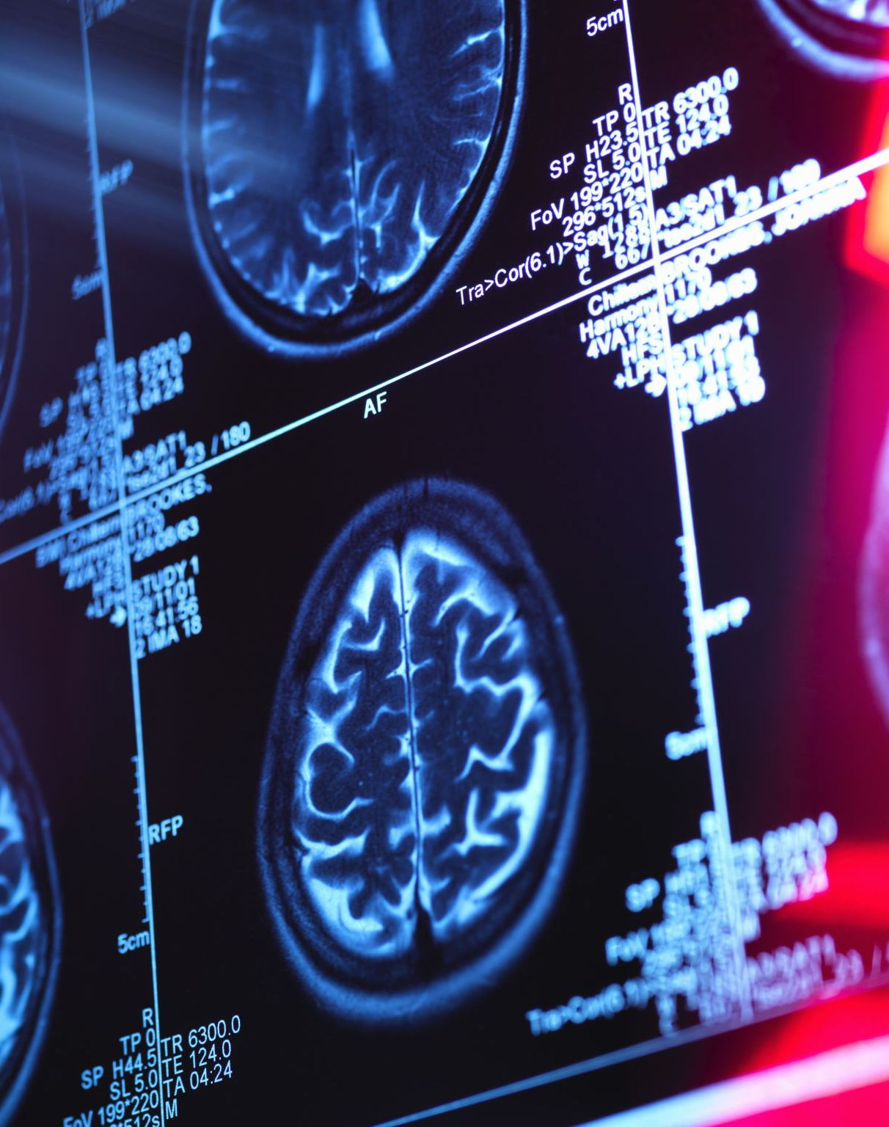
Project Overview
Objective: Develop a neural network model to segment retinal images, enhancing diagnostic processes.
Approach: Utilize state-of-the-art deep learning architectures, including EfficientNet and MobileNet, to compare performance.
Impact: Improve accuracy and speed of retinal image analysis for medical diagnostics.

Slide 3

Data Sources
DRIVE Dataset: A collection of digital images for vessel extraction, utilized in training segmentation models.
High-Resolution Fundus (HRF) Image Database: Supplies high-resolution retinal images for comprehensive analysis.

Slide 4

Methodology
Preprocessing:
Image Preparation: Input images are resized to 256x256 pixels and normalized to a range of 0-1, ensuring consistency across the dataset.
Model Architectures:
EfficientNet: Serves as the backbone for extracting deep and meaningful features from images.
MobileNet: Used as a benchmark for performance comparison.
Training:
Optimizer: Adam optimizer is employed for efficient gradient-based optimization.
Loss Function: Binary crossentropy is utilized to assess pixel-wise classification accuracy during segmentation.
Callbacks: Incorporates model checkpointing for saving the best-performing models and dynamic learning rate scheduling to prevent overfitting and facilitate convergence.

Slide 5

Evaluation Metrics
Accuracy: Represents the proportion of pixels accurately segmented by the model, serving as a key metric for performance evaluation.
Binary Crossentropy Loss: Measures the model's effectiveness in predicting segmentation boundaries by comparing its predictions to the true labels.
Visualization: Plots of training and validation loss over epochs are generated to monitor learning progress and identify potential issues, such as overfitting or underfitting.

Slide 6
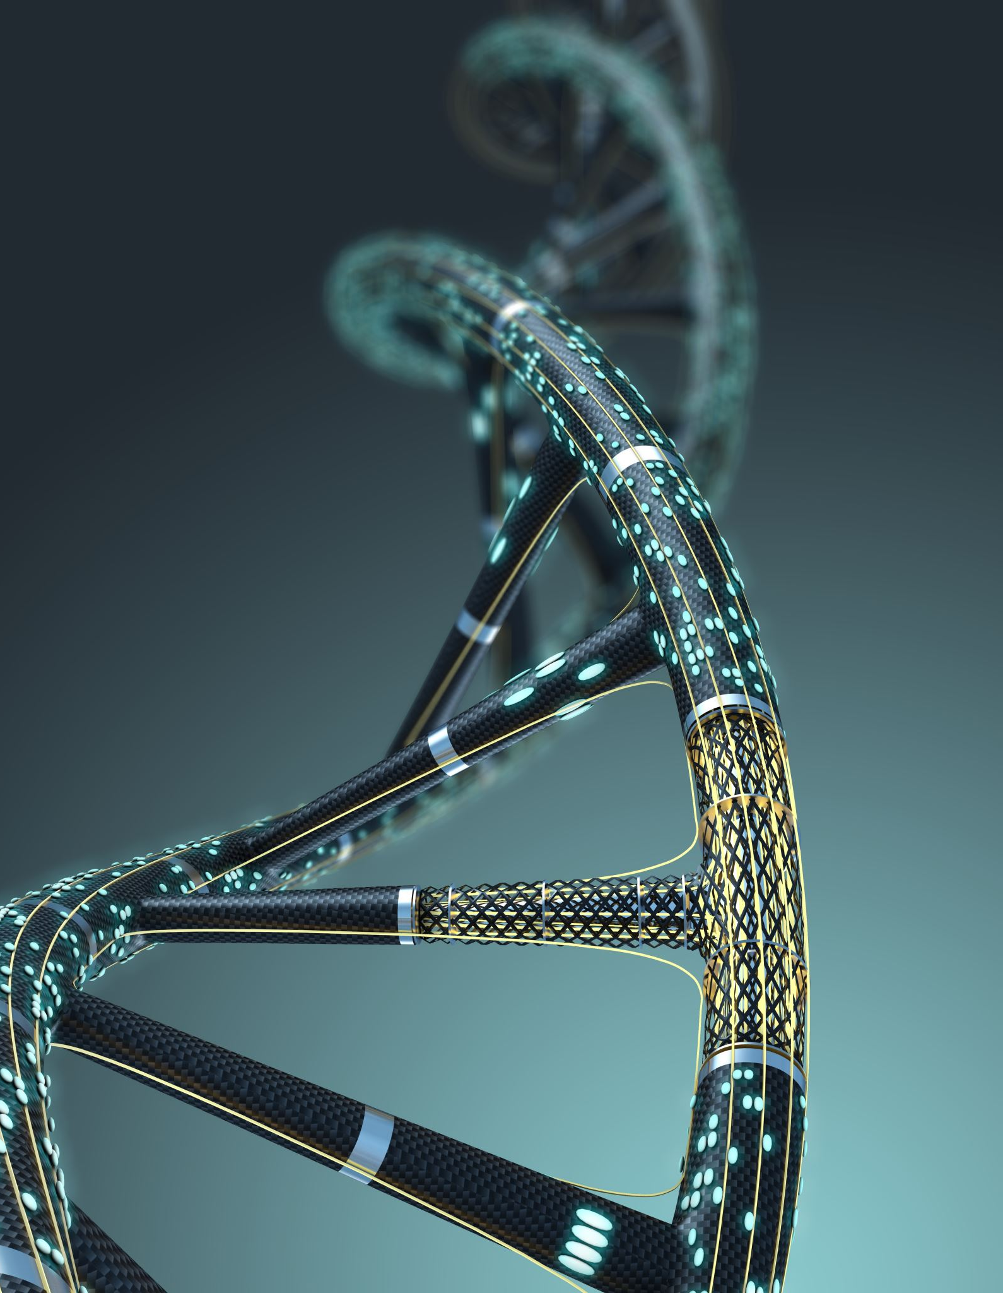
Results - Quantitative Analysis
Model Performance:
EfficientNet: Attained an accuracy of 92% on the validation dataset.
MobileNet: Achieved a comparable accuracy of 92%.
Performance Summary:The hybrid model integrated with an attention mechanism surpassed the others, showcasing superior ability to manage complex image details effectively.

Slide 7
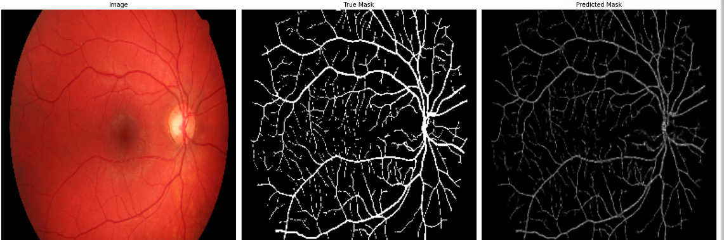
Visual Outputs - Sample Prediction
Image Displays:
Side-by-side comparison of original images, ground truth masks, and predicted masks generated by each model for a clear evaluation.
.

Slide 8

Conclusion
Model Efficacy:EfficientNet emerged as the most effective architecture for achieving precise and detailed segmentation of retinal images.

