Slide 1
HACKATHON PROJECT PRESENTATION
ResQAgent
Intelligent Emergency Response & Coordination Platform
Citizen SOS
Emergency Intake
ResQAgent Triage
Smart Dispatch
Field Responder
➔
➔
➔
➔
Team: ResQAgent Development Team | Track: Agentic AI & Autonomous Systems
GitHub: github.com/nallapremteja04/resqagent | Live Deployment: http://localhost:8000

Slide 2
THE REALITY OF EMERGENCY RESPONSE
During an Emergency, Every Minute Matters
TRADITIONAL 911 DISPATCH WORKFLOW (MANUAL & SEQUENTIAL):
Citizen Call ➔ Manual Intake ➔ Operator Verifies ➔ Radio Voice Search ➔ Unconfirmed Dispatch ➔ Delayed Response
PROBLEM 01
Incomplete & Panicked Information
Callers under extreme stress often omit critical medical details or exact addresses, forcing operators to spend 2-4 minutes probing before dispatching.
PROBLEM 02
Unmonitored Responder Dropouts
If an assigned ambulance gets stuck in traffic, has radio failure, or declines, traditional systems stay idle until someone notices minutes later.
PROBLEM 03
Operator Cognitive Overload
During storms or mass accidents, dispatchers face dozens of simultaneous calls, causing manual triage mistakes and prioritization delays.
PROBLEM 04
Siloed Communications
Citizens wait in panic with zero status updates, while receiving trauma centers get no pre-arrival casualty heads-up.
ResQAgent — Emergency Response & Coordination Platform
02 / 23

Slide 3
THE SOLUTION
Our Approach: One Coordinated Response Workflow
01. INTAKE
02. TRIAGE
03. DISPATCH
04. COMMUNICATION
Collect Emergency Report
Accepts structured distress forms or raw distress text. Automatically binds caller identity, coordinates, and emergency description into an active incident.
Understand & Prioritize
Extracts incident classification (Accident, Fire, Medical, Crime, Rescue) and clinical urgency (P1-Critical to P4-Low) in milliseconds using LLM & fallback logic.
Select Best Responder
Evaluates field units using a proximity and specialization matching formula. Excludes busy/offline responders and picks the optimal unit instantly.
Coordinate All Stakeholders
Dispatches simultaneous targeted alerts: push notification to responder, reassuring SMS to caller, radio log to dispatch, and trauma alert to hospital.
“From reporting an emergency to tracking the response in one coordinated workflow.”
ResQAgent — Emergency Response & Coordination Platform
03 / 23

Slide 4
END-TO-END WORKFLOW
From SOS to Response: Complete Operational Pipeline
01
02
03
04
1. Report SOS
Citizen submits distress call via app or 1-touch SOS button
2. Incident Created
FastAPI validates & commits new record to database
3. AI Triage
Clinical urgency classified into P1-Critical to P4-Low
4. Fleet Search
Available responders ranked by distance & specialty
05
06
07
08
5. Unit Dispatched
Primary unit assigned; notifications sent to all parties
6. 30s SLA Monitor
Monitors acknowledgment; triggers failover if unaccepted
7. Mission Active
Responder updates progress: En Route ➔ On Scene
8. Debrief Report
System synthesizes AI postmortem & audit timeline
ResQAgent — Emergency Response & Coordination Platform
04 / 23

Slide 5
MULTI-AGENT SYSTEM ARCHITECTURE
How the 6 Specialized Agents Coordinate
EmergencyAnalysisAgent (PERCEIVE & REASON)
Intake & Clinical Triage: Extracts medical emergency type, severity, and urgency. Determines priority P1-P4.
MonitoringAgent (OBSERVE)
SLA Sentinel: Enforces 30-second acknowledgment window. Detects unresponsive units.
AGENT ORCHESTRATOR
State Machine & Cognitive Trace Logger
ResponderSelectionAgent (DECIDE)
Fleet Matchmaker: Evaluates field units using distance and medical skill specialization bonus.
EscalationAgent (ADAPT)
Self-Healing Failover: Blacklists dropped units, recalculates candidates, and re-routes mission.
CommunicationAgent (ACT)
Stakeholder Broadcast: Dispatches tailored notifications to Citizen, Responder, Dispatcher, and Trauma Centers.
AIIncidentReportAgent (REPORT)
Debrief Synthesizer: Generates postmortem incident dossier from timeline actions and response metrics.
ResQAgent — Emergency Response & Coordination Platform
05 / 23

Slide 6
EMERGENCY ANALYSIS LOGIC
How Triage Decides Priority: Clinical Urgency Scoring
P1 - CRITICAL — Trauma, cardiac arrest, severe bleeding, unconsciousness
Action: Immediate dispatch (<1 min). Trauma hospital notified.
REAL-WORLD TRIAGE EXECUTION
Incoming Distress Call:
“Major car crash on highway, smoke rising, passenger trapped and bleeding heavily.”
• 1. Classification: Accident (Extracted from 'car crash', 'collision')
• 2. Severity: Critical (Triggered by 'trapped', 'bleeding heavily')
• 3. Urgency: Immediate (Life threat apparent)
• 4. Assigned Priority: P1-Critical
• 5. Clinical Rationale: Critical trauma or life-threatening symptoms identified; immediate paramedic extraction required.
P2 - HIGH — Highway collisions, active flames, major fractures, robbery
Action: Rapid response (<3 min). Priority dispatch queue.
P3 - MEDIUM — Moderate pain, minor burns, localized sprains
Action: Standard response (<8 min). First available local unit.
P4 - LOW — Property theft, non-injury disputes, general inquiry
Action: Routine queue. Scheduled dispatch when units free.
ResQAgent — Emergency Response & Coordination Platform
06 / 23

Slide 7
DISPATCH DECISION LOGIC
Dispatcher: Turning Priority into Optimized Action
DISPATCH EXECUTION SEQUENCE:
1. Query Candidate Pool:
Filters database for responders with status AVAILABLE
2. Apply Incident Blacklist:
Excludes responders who previously timed out or declined this incident
3. Determine Optimal Specialization:
Accident ➔ Medical/Rescue | Fire ➔ Fire/Rescue | Crime ➔ Police
4. Calculate Suitability Score:
Score = (10 / Distance_km) * Specialization_Bonus (1.5x)
5. Rank & Select Winner:
Unit with highest score assigned immediately
6. Start 30s SLA Clock:
State set to WAITING_FOR_RESPONSE; timer starts
MATHEMATICAL SCORING ENGINE
Implemented in ResponderSelectionAgent.py:
Suitability Score = (10 / Distance) × Spec_Bonus
(Bonus = 1.5x if Specialization matches Emergency Type)
Example Ranking for Accident (#28):
• 1. Suresh (Medical, 0.8 km) ➔ Score: 18.75 [SELECTED]
• 2. Ravi (Rescue, 1.5 km) ➔ Score: 10.00 [STANDBY]
• 3. Priya (General, 1.2 km) ➔ Score: 8.33 [STANDBY]
ResQAgent — Emergency Response & Coordination Platform
07 / 23

Slide 8
END-TO-END WALKTHROUGH
Example: Medical Emergency & SLA Failover
STEP 1: REPORT
Distress call received: 'Car crash, trapped & bleeding heavily' ➔ Incident #28 initialized in status NEW
STEP 2: TRIAGE
EmergencyAnalysisAgent evaluates clinical text ➔ Classified: P1-Critical | Emergency: Accident
STEP 3: DISPATCH
ResponderSelectionAgent scores available fleet ➔ Assigned Unit: Suresh (Paramedic, 0.8 km away)
STEP 4: SLA TIMEOUT
Suresh fails to acknowledge within 30-second window ➔ MonitoringAgent triggers SLA breach
STEP 5: FAILOVER
EscalationAgent blacklists Suresh & searches pool ➔ Reassigned: Ravi (Rescue Squad, 1.5 km away)
STEP 6: RESOLUTION
Ravi accepts call, arrives on scene, assists victim ➔ Incident marked COMPLETED ➔ RESOLVED
STEP 7: POSTMORTEM
AIIncidentReportAgent synthesizes debrief dossier ➔ Report #10 generated with 95/100 score
ResQAgent — Emergency Response & Coordination Platform
08 / 23

Slide 9
TECHNICAL DESIGN
System Architecture: 5 Decoupled Layers
LAYER 1: USER ACCESS & CLIENTS
Citizen Web App (SOS) | Responder Field Terminal | Dispatcher Command Center | Admin Panel
LAYER 2: APPLICATION & FRONTEND
Vanilla CSS Design System | ES6 JavaScript Modules (api.js, app.js) | Web Audio API Sound Engine
LAYER 3: API & SECURITY GATEWAY
FastAPI REST Server (8 Routers) | bcrypt Password Hashing (12 Rounds) | JWT Bearer Authentication
LAYER 4: AGENT ORCHESTRATION
Orchestrator | Analysis Agent | Selection Agent | Comm Agent | Monitoring Agent | Escalation Agent | Report Agent
LAYER 5: DATA & EXTERNAL SERVICES
SQLAlchemy ORM | SQLite Database (resqagent.db) | Google Gemini 1.5 Flash REST API | Deterministic Fallback Engine
ResQAgent — Emergency Response & Coordination Platform
09 / 23

Slide 10
DATABASE ARCHITECTURE
Data Behind the Response: 8 Relational Models
TABLE: User
Authentication & RBAC
Attributes:
id, email, password_hash, role (citizen/responder/dispatch/admin), location, is_active
TABLE: Incident
Distress Records
Attributes:
id, reporter_name, emergency_type, severity, priority, status, location, description
TABLE: Responder
Field Fleet
Attributes:
id, name, role, specialization (Medical/Fire/Rescue/Police), distance, availability
TABLE: Assignment
Mission Dispatches
Attributes:
id, incident_id, responder_id, assignment_status (PENDING/ACCEPTED/COMPLETED), attempt_number
TABLE: Notification
Omnichannel Alerts
Attributes:
id, incident_id, recipient_type, channel (PUSH/SMS/RADIO/SECURE_NET), message
TABLE: IncidentTimeline
Event Milestones
Attributes:
id, incident_id, event_type, actor (Analysis Agent/Orchestrator), description, timestamp
TABLE: AgentAction
Cognitive Trace Log
Attributes:
id, incident_id, agent_name, action_type, reasoning, input_data, output_data
TABLE: Report
Postmortem Synthesis
Attributes:
id, incident_id, summary, initial_responder, final_responder, escalation_count, full_report_json
ResQAgent — Emergency Response & Coordination Platform
10 / 23

Slide 11
BACKEND DATA FLOW
How Data Moves Through the System: API Flow
REQUEST LIFECYCLE (SOS INTAKE):
1. Client Form Submission:
Citizen submits POST /api/incidents/ with description & location
2. JWT Authentication & Rate Check:
FastAPI verifies Bearer token & active user session
3. Pydantic Model Validation:
Validates incident payload against IncidentCreate schema
4. Database Record Creation:
SessionLocal writes incident with initial status NEW
5. Agent Orchestrator Trigger:
Synchronously kicks off EmergencyAnalysisAgent triage
6. Selection & Notification Loop:
Dispatches to closest responder and writes timeline logs
7. JSON Response to Client:
Returns incident object with assigned responder & priority
8 REST ROUTERS (FASTAPI BACKEND)
• /api/auth:
Login, register, /me profile, password management
• /api/admin:
User account provisioning, system stats, role management
• /api/incidents:
Incident creation, role-isolated filtering, status updates
• /api/responders:
Fleet roster, availability query, location tracking
• /api/assignments:
Responder accept/decline, operational progress toggles
• /api/simulation:
SLA timeout triggers, automated failover testing
• /api/reports:
AI debrief postmortem generation and export
• /api/users:
User directory and profile updates
ResQAgent — Emergency Response & Coordination Platform
11 / 23

Slide 12
RELIABILITY ENGINEERING
When Connectivity Is Limited: Dual-Engine Fallback
IMPLEMENTED: DUAL-ENGINE TRIAGE
In mission-critical emergencies, cloud AI API outages cannot be allowed to halt 911 dispatch. ResQAgent implements a two-tier cognitive architecture:
✓ Tier 1: Cloud LLM (Gemini 1.5 Flash):
Used when online for nuanced clinical understanding and semantic priority reasoning.
✓ Tier 2: Deterministic Fallback Engine:
Instantly triggers if Gemini times out, returns HTTP errors, or if API key is absent.
✓ Zero Dropped Calls:
Evaluates trauma keywords ('unconscious', 'bleeding', 'trapped') locally in 2ms without internet access.
✓ Session Token Persistence:
Signed JWT tokens stored in localStorage enable offline interface continuity.
PLANNED: LOW-CONNECTIVITY ENHANCEMENTS
To scale beyond prototype stage into extreme catastrophe zones (earthquakes, cellular grid collapse), we have designed the following extensions:
➔ IndexedDB Local Outbox Queue (Planned):
Allows citizens to submit distress reports with zero signal; automatically syncs via background service worker upon reconnection.
➔ SMS-to-API Gateway (Planned):
Enables emergency reporting via standard 2G GSM cellular SMS when 4G/5G data networks fail.
➔ Peer-to-Peer Bluetooth Mesh (Planned):
Responders relay mission coordinates unit-to-unit when cellular cell towers are down.
ResQAgent — Emergency Response & Coordination Platform
12 / 23

Slide 13
IMPLEMENTED STACK
Technology Stack: Modular, Modern & Reliable
FRONTEND
Single-Page Application
• Vanilla HTML5 & Semantic Elements
• Vanilla CSS3 Design System
• Vanilla ES6 JavaScript (No bloat)
• Web Audio API Synthesizer (Sirens/Tones)
BACKEND API
High-Performance ASGI
• Python 3.12 Runtime
• FastAPI Framework
• Uvicorn ASGI Server
• Pydantic V2 Data Validation
DATABASE & ORM
Relational Persistence
• SQLAlchemy 2.0 ORM Engine
• SQLite (Local Development)
• PostgreSQL Compatible Driver (psycopg2)
• Declarative Base Migrations
AGENT COGNITION
AI Triage & Reasoning
• Google Gemini 1.5 Flash REST API
• Deterministic Clinical Keyword Engine
• Multi-Agent State Machine
• Audit Action Logging
SECURITY & AUTH
Cryptographic RBAC
• bcrypt (12 Salt Rounds Hashing)
• PyJWT (HS256 Session Tokens)
• Role-Based Route Guards
• Database Query Data Scoping
TESTING & QUALITY
Automated Test Suites
• Auth & RBAC Suite (17 Tests)
• API Integration Suite
• Agent Flow & SLA Escalation Suite
• Zero Mocking of Core Logic
ResQAgent — Emergency Response & Coordination Platform
13 / 23

Slide 14
FEATURE MATRIX
What We Built: Core Implemented Features
One-Touch Citizen SOS
Quick-preset distress buttons (Accident, Medical, Fire, Crime) and instant GPS location binding.
Autonomous Clinical Triage
Semantic extraction of severity (Critical/High/Med/Low) and urgency into structured priority P1-P4.
Proximity & Skill Dispatch
Mathematical scoring engine that matches responder specialization to emergency type and distance.
SLA Sentinel Monitoring
30-second automated acknowledgment timer tracks responder health and flags stalled missions.
Self-Healing Escalation
Automatically blacklists dropped responders and assigns the next best unit with citizen reassurance.
Multi-Party Broadcast
Simultaneously alerts responders via push, citizens via SMS, dispatch via radio, and hospitals via secure net.
Post-Incident AI Dossier
Synthesizes comprehensive debrief report, timeline events, and agent performance score (95/100).
Cryptographic RBAC Security
4 distinct roles (Citizen, Responder, Dispatcher, Admin) with bcrypt hashing and token auth.
ResQAgent — Emergency Response & Coordination Platform
14 / 23

Slide 15
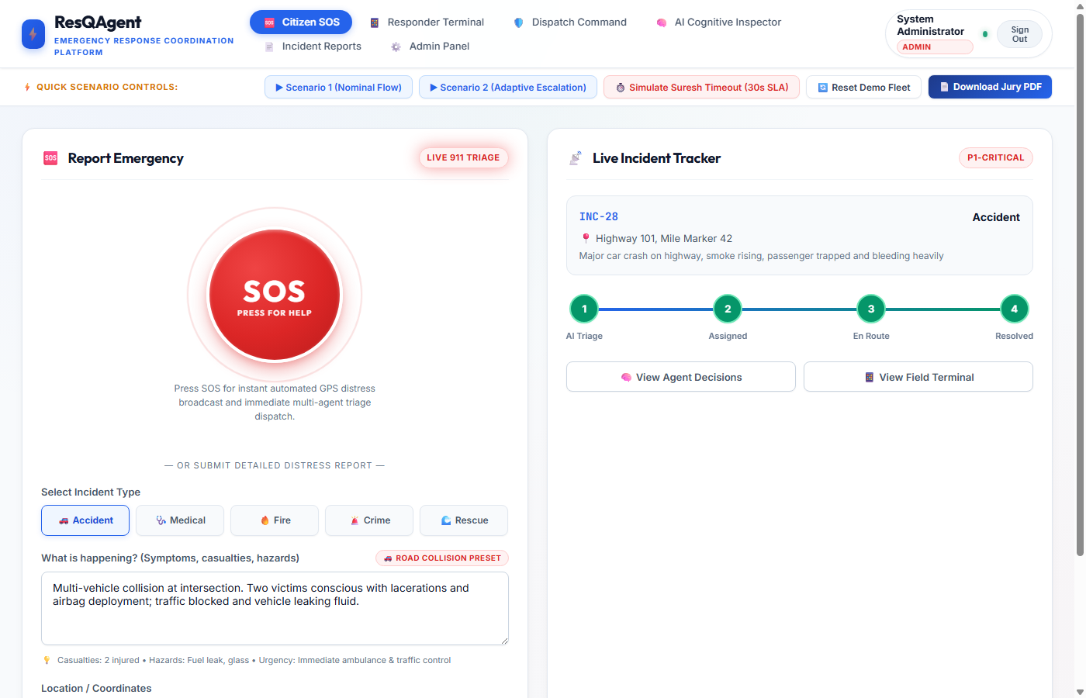
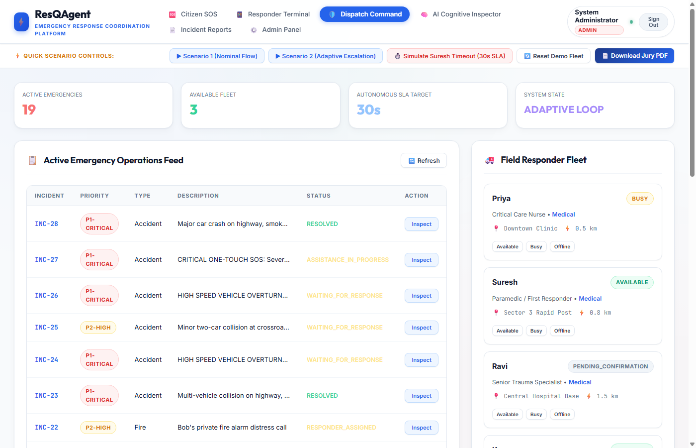
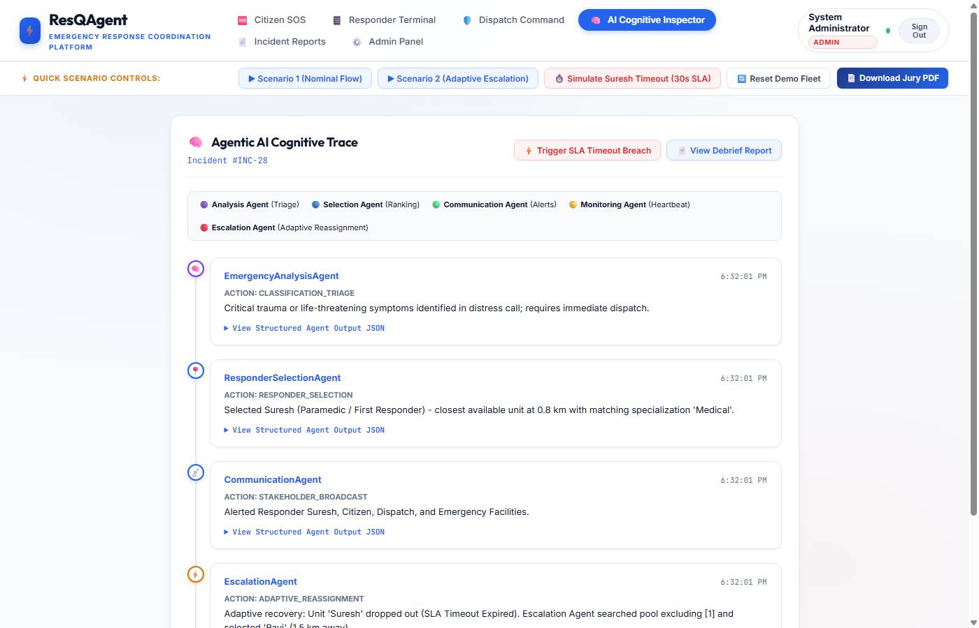
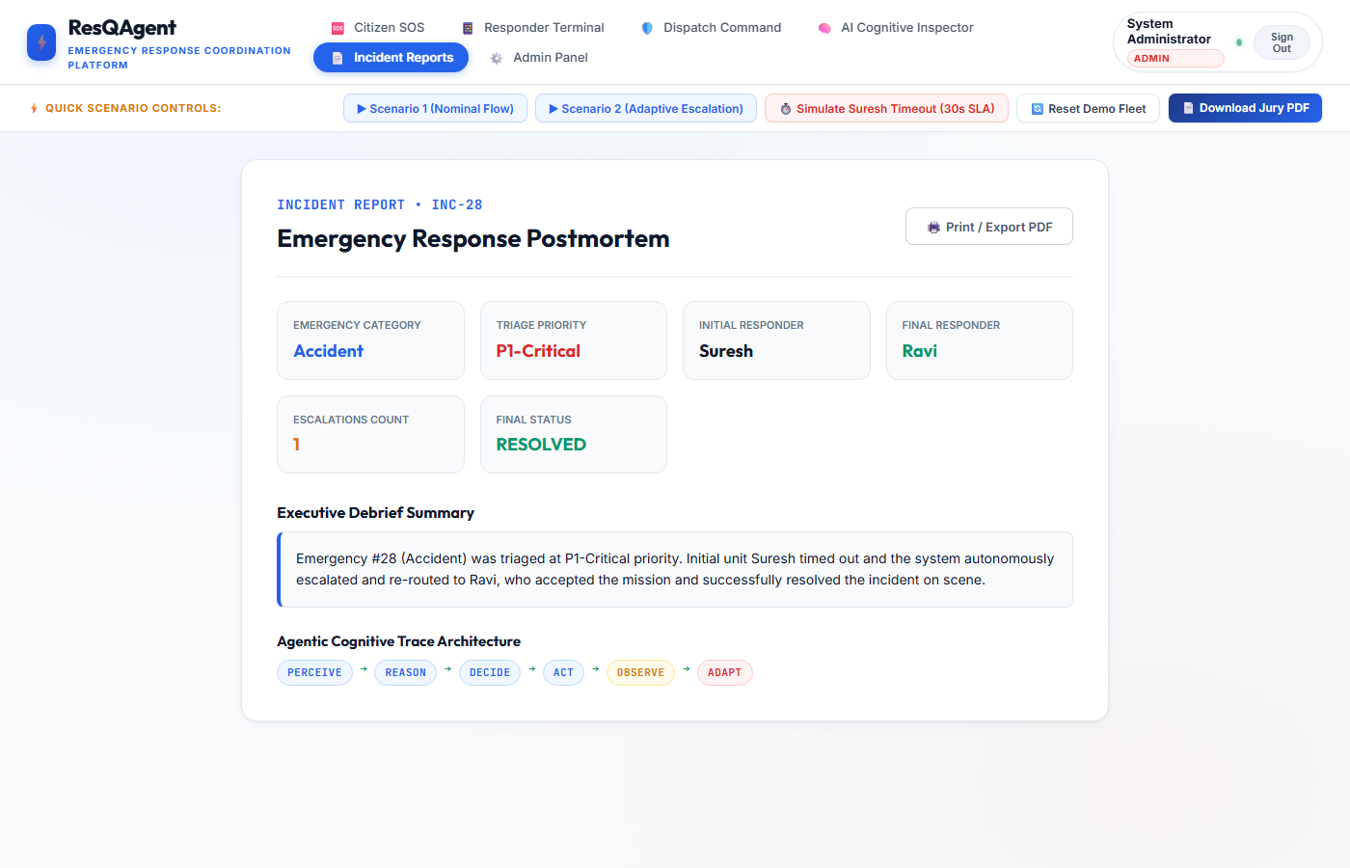
USER INTERFACE SHOWCASE
Application Screens: Real Working Prototype
Citizen SOS Screen
One-touch distress button & live incident tracking
Dispatch Command Center
Active city fleet roster, incident table & SLA simulation
AI Cognitive Inspector
Real-time agent reasoning traces & decision log
AI Incident Report
Post-incident debrief dossier & performance score
ResQAgent — Emergency Response & Coordination Platform
15 / 23

Slide 16
ROLE-BASED ACCESS CONTROL
Who Uses the System: 4 Strict Role Boundaries
CITIZEN
Route: /citizen
• Self-registers account
• Submits one-touch or detailed SOS
• Receives live arrival ETA & reassurance
• Strictly isolated: cannot see other citizens
RESPONDER
Route: /responder
• Assigned calls push to terminal
• Acknowledges (Accept / Decline)
• Updates progress: En Route ➔ Completed
• Bound strictly to assigned incident ID
DISPATCHER
Route: /dispatch
• Full city-wide incident visibility
• Live responder fleet tracking
• Manual assignment override controls
• Interactive SLA timeout simulation trigger
ADMINISTRATOR
Route: /admin
• Provisions Dispatchers & Responders
• Activates / deactivates system accounts
• Inspects system audit statistics
• 1-click demo fleet reset mechanism
ResQAgent — Emergency Response & Coordination Platform
16 / 23

Slide 17
TECHNICAL PROBLEM SOLVING
What We Had to Solve: Engineering Challenges
Challenge: Unstructured Distress Descriptions
Citizens submit frantic, ungrammatical descriptions with mixed symptoms.
Solution: Gemini 1.5 Flash Prompt + Deterministic Fallback
Configured structured JSON output schema. Backed by clinical keyword rules that triage critical cases in 2ms if the LLM drops.
Challenge: Unmonitored Responder Dropouts
In traditional systems, an unresponsive unit leaves the caller stranded.
Solution: 30s SLA Countdown + Autonomous EscalationAgent
Detects SLA breaches automatically, blacklists the unresponsive unit, recalculates the next closest responder, and re-routes the mission.
Challenge: Suboptimal Unit Dispatching
Sending general police to cardiac arrest or fire trucks to minor theft.
Solution: Proximity + Specialization Utility Scoring
Engine scores candidates by distance weighted with a 1.5x bonus for matching medical/fire/rescue expertise.
Challenge: Privilege Escalation & Data Leaks
Unauthorized users accessing dispatch controls or other citizens' data.
Solution: Cryptographic RBAC & Query-Level Isolation
Bcrypt 12-round password hashing, HS256 signed JWT tokens, and database query filters verified by 17 automated tests.
ResQAgent — Emergency Response & Coordination Platform
17 / 23

Slide 18
VALUE PROPOSITION
Why This Matters: Practical Real-World Utility
01
FASTER DISPATCH
Eliminates phone queue delays. Triage occurs in milliseconds instead of 3-5 minutes of manual interrogation.
02
CLEAR PRIORITY
Severe life-threats (P1-Critical) are automatically distinguished from non-urgent calls, preventing triage mistakes.
03
SMARTER ALLOCATION
Field responders are matched based on both proximity and specialized skill, sending the right care the first time.
04
LIVE VISIBILITY
Citizens receive automated arrival updates; dispatchers monitor the fleet; receiving hospitals prepare trauma bays early.
05
FULL AUDITABILITY
Every agent decision, reassignment, and timeline event is stored in an explainable cognitive log for postmortem review.
ResQAgent — Emergency Response & Coordination Platform
18 / 23

Slide 19
DEVELOPMENT ROADMAP
What We Would Build Next: Product Roadmap
STAGE 1: CURRENT PROTOTYPE (COMPLETED)
• 6-Agent Autonomous Cognitive Loop
• FastAPI REST Backend with 8 Routers
• 4-Role Cryptographic RBAC (bcrypt + JWT)
• 30s SLA Monitoring & Autonomous Escalation
• AI Incident Report Postmortem Generator
• 17 Automated Verification Security Tests
STAGE 2: NEAR-TERM IMPROVEMENTS (NEXT)
• Native Mobile App (React Native / Flutter)
• Live GPS Telemetry with Mapbox / Leaflet
• IndexedDB Offline Queue & Background Sync
• SMS-to-API Gateway for 2G Emergency Areas
• Automated Voice-to-Text Audio Call Ingestion
STAGE 3: PRODUCTION SCALE (FUTURE)
• Trauma Hospital EHR System Integration
• Drone Reconnaissance Automated Dispatch
• Multi-City Federated Dispatch Network
• Real-time Traffic Routing Engine (Google Maps API)
• Automated Resource Inventory Tracking
ResQAgent — Emergency Response & Coordination Platform
19 / 23

Slide 20
DEMONSTRATION SEQUENCE
Live Demonstration Playbook
01
02
03
04
Open Application
Navigate to http://localhost:8000 and view Citizen SOS interface
Report Emergency
Submit distress call: 'Highway crash, car smoking, driver trapped'
Observe Triage
Watch AI categorize as Accident / P1-Critical urgency in real time
Review Dispatch
Show Suresh (Paramedic, 0.8 km) assigned by selection algorithm
05
06
07
08
Simulate SLA Timeout
Click 'Simulate Suresh Timeout' to trigger 30s deadline breach
Watch Escalation
EscalationAgent blacklists Suresh & auto-reassigns Ravi (1.5 km)
Accept & Complete
Ravi accepts mission, marks En Route, and completes assistance
Generate Debrief
Click 'Incident Reports' to view AI-synthesized postmortem dossier
ResQAgent — Emergency Response & Coordination Platform
20 / 23

Slide 21
SOCIAL & OPERATIONAL IMPACT
Expected Impact: Saving Critical Minutes in Emergency Care
Faster Coordination
Replaces manual telephone chasing with autonomous multi-agent handoffs in milliseconds.
Smarter Care Matching
Specialization scoring sends trauma paramedics to cardiac calls, not general units.
EMERGENCY
COORDINATION
Protecting the Golden Hour
Zero Lost Emergencies
SLA monitoring ensures no responder dropout goes unnoticed or unhandled.
Complete Accountability
Every action, clinical justification, and reassignment is auditable in code.
ResQAgent — Emergency Response & Coordination Platform
21 / 23

Slide 22
CONCLUSION
From Emergency Report to Coordinated Response
REPORT ➔ UNDERSTAND ➔ PRIORITIZE ➔ DISPATCH ➔ RESPOND ➔ TRACK ➔ DEBRIEF
CONCLUSION & SUMMARY:
ResQAgent brings emergency reporting, clinical triage, dispatch optimization, SLA monitoring, and response tracking into one unified, transparent workflow.
Rather than relying on a single conversational chatbot, we built an autonomous multi-agent architecture where each agent handles a dedicated task with mathematical precision, strict state management, and safety guardrails.
Our focus is simple: make emergency coordination faster, clearer, and more reliable when every second counts.
ResQAgent — Emergency Response & Coordination Platform
22 / 23

Slide 23
Thank You
Questions & Discussion
ResQAgent — Intelligent Emergency Response & Coordination Platform
• GitHub Repository: https://github.com/nallapremteja04/resqagent
• Live Deployment: http://localhost:8000 (Running on Uvicorn ASGI Server)
• API Documentation: http://localhost:8000/docs (Interactive Swagger UI)
• Jury Evaluation Dossier: http://localhost:8000/ResQAgent_Jury_Presentation_Dossier.pdf
• Student Team: ResQAgent Development Team

