Slide 1

HOSPITAL MANAGEMENT SYSTEM
Student Name Register Number Section
GOPARAJU S R K AKSHITH 2510030365 S-8
ABHILASH 2510030320 S-8
N RUTHVIK 2510030348 S-8
YESHWANTH 2510030357 S-8
GUIDED BY : DR. MAHESH BABU ARRAMA
KONERU LAKSHMAIAH EDUCATION FOUNDATION

Slide 2

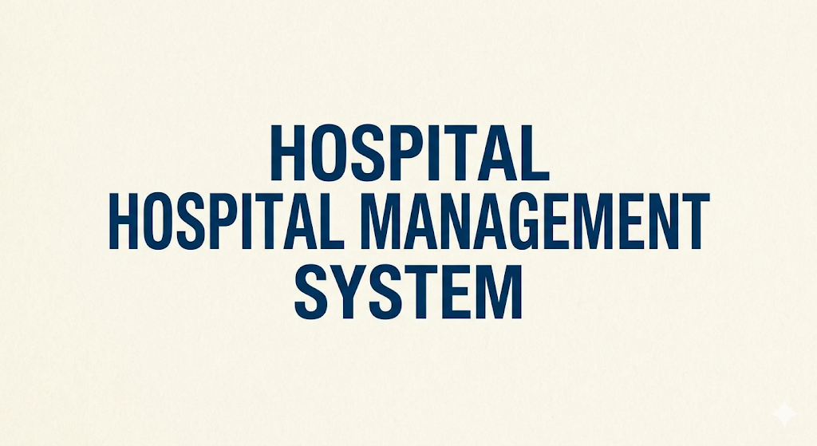
OBJECTIVE
HOSPITAL MANAGEMENT SYSTEM
The objective of this project is to design and develop a Hospital Management System using Java that efficiently organizes and manages patient and doctor records through an interactive console-based interface. The system aims to implement core data structures and algorithms such as doubly linked lists, stacks, queues, arrays, and sorting mechanisms to handle complex hospital operations like queueing admissions, tracking visit history, validating prescriptions, and securely saving data to local files.
Additionally, the project focuses on providing features such as maintaining patient admission and discharge histories, managing a real-time waiting room queue, and sorting medical staff based on their experience. It also integrates file handling to ensure persistent storage of hospital data and prescription validation functionality for an enhanced administrative experience.
Overall, this project demonstrates the practical application of data structures and object-oriented programming concepts in building a real-world software application with robust backend logic and an interactive console-based interface.

Slide 3
PROJECT DESCRIPTION
Hospital Management System
This project is a Java-based application developed to manage and organize patient and doctor records efficiently.
It provides an interactive console-based dashboard for easy and seamless administrative interaction.
Users can perform operations like queueing, admitting, and discharging patients, as well as searching and sorting medical staff.
The system also supports persistent data storage through file handling and stack-based prescription validation.
Goal : To demonstrate the practical use of core data structures, sorting algorithms, and object-oriented programming in building a real-world administrative application.

Slide 4
Working of the System
Patients and visit histories are stored using a Doubly Linked List for dynamic management.
Stack is used to validate complex medical prescription formulas (LIFO).
Queue is used to manage the patient waiting room admissions (FIFO).
Array is used to maintain and organize the staff of doctors.
Additional Features:
File handling to persistently save hospital records and data.
Sorting & Searching algorithms (Quick Sort and Binary Search) for highly efficient doctor lookup.

Slide 5
Key Features
Add, delete (discharge), search, and display patients and doctors
Admit patients and maintain a continuous visit history
Queue system for waiting room admissions
Doctors displayed and sorted by experience
Simple and interactive console-based dashboard
Conclusion
This project combines advanced data structures, sorting algorithms, and file handling to create a functional hospital management system, showcasing the real-world application of Java programming concepts.

Slide 6

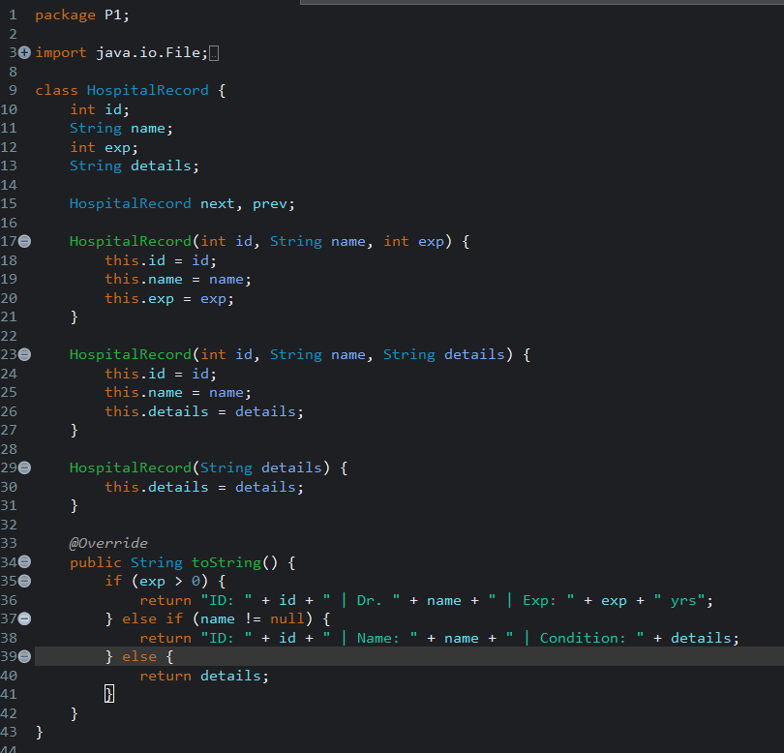
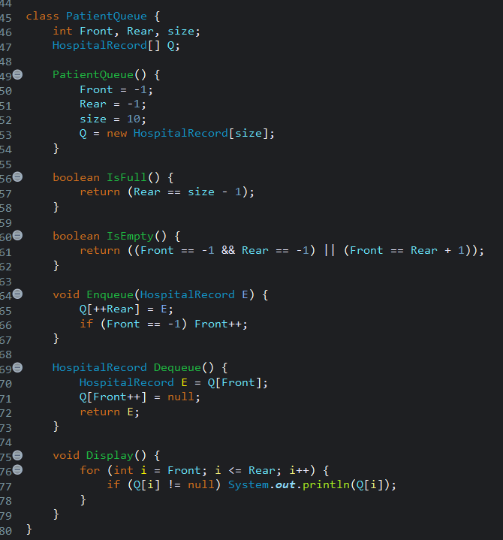
PROGRAM :
"Implementation of a Doubly Linked Node and insertion method for tracking Patient History."
"Custom FIFO Queue implementation using an Array for the Patient Waiting Room."

Slide 7
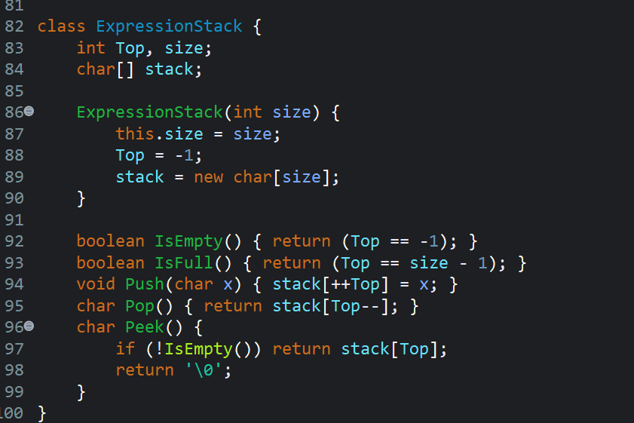
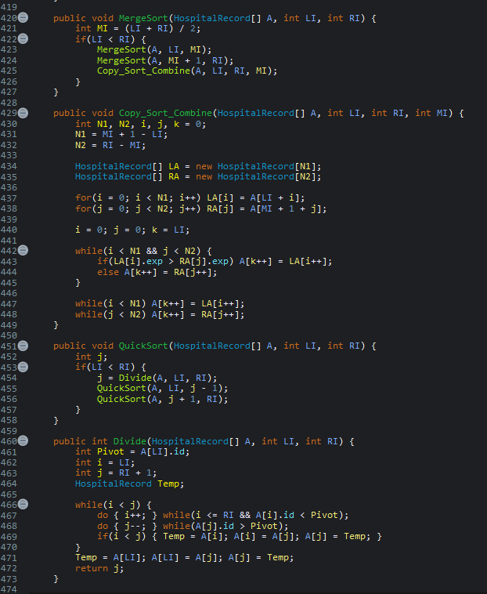
"Custom LIFO Stack implementation used to validate bracket matching in medical formulas."
"Merge Sort (sorting doctors by experience) and Quick Sort (sorting doctors by ID)."

Slide 8
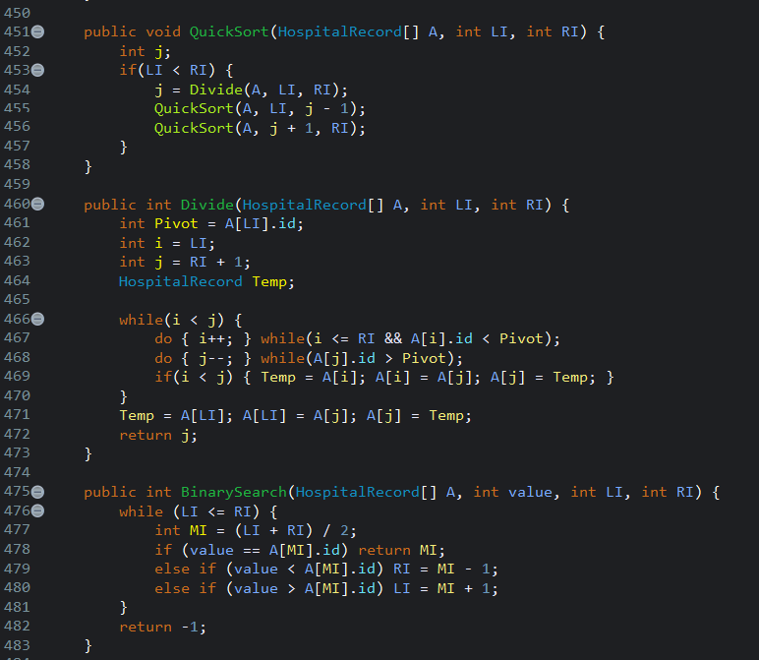
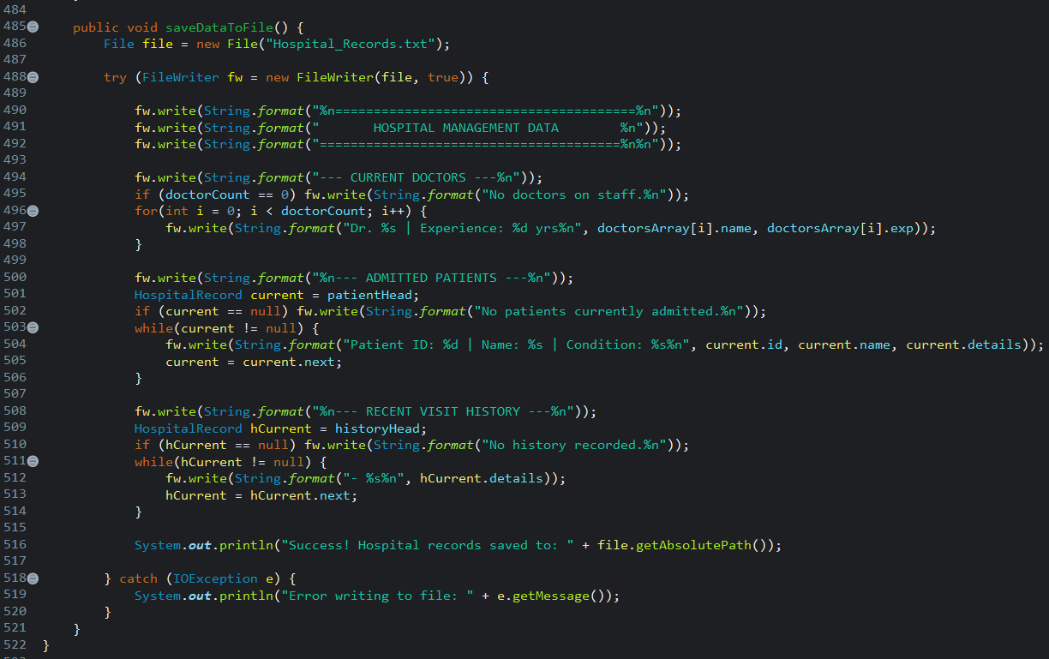
"Binary Search implementation (O(log n) time complexity) for efficient Doctor ID lookup."
"Persistent data storage using Java FileWriter, wrapped in Exception Handling to prevent system crashes."

Slide 9
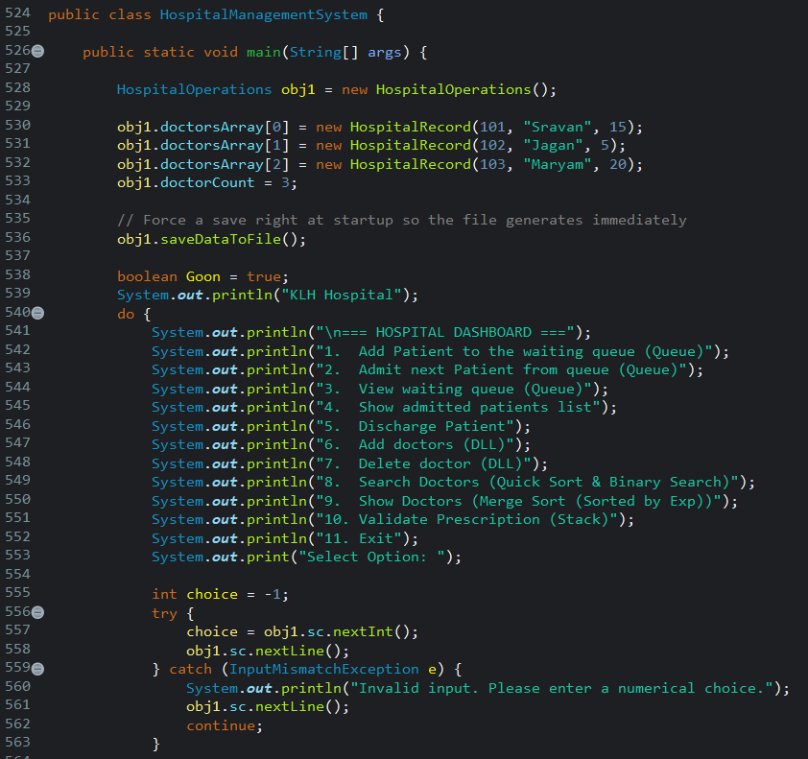
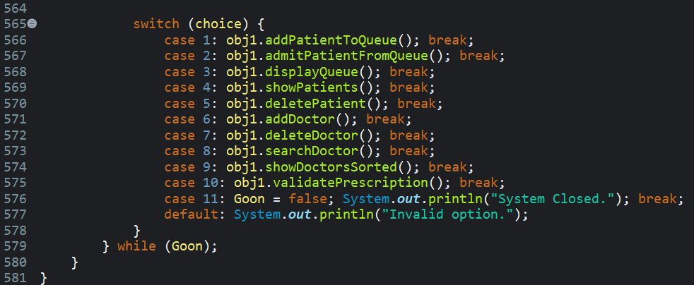

Slide 10
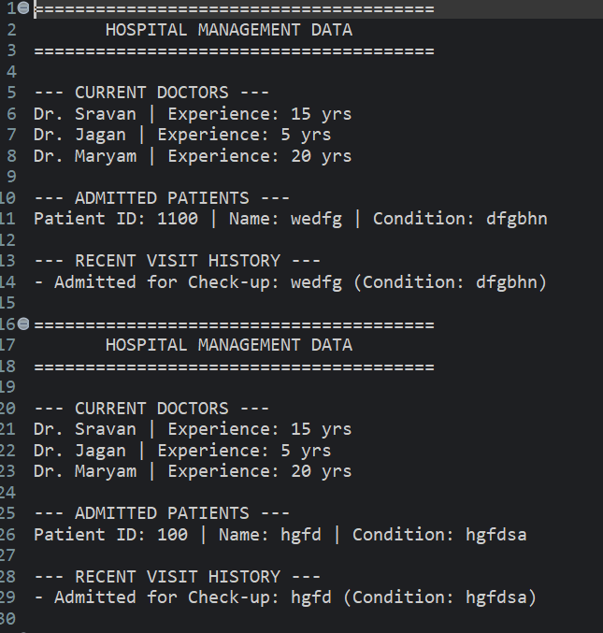
OUTPUTS :
"Demonstrating FIFO Queue management and automated DLL history logging."

Slide 11
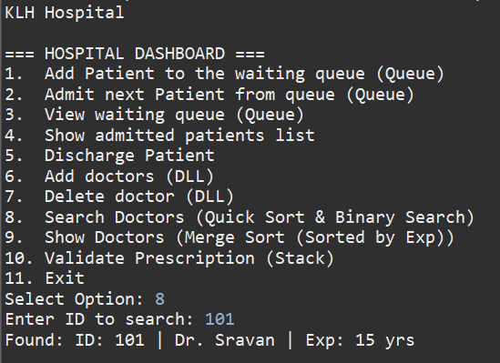
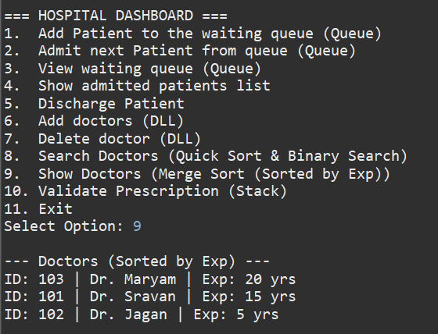
"Successful execution of Merge Sort for display and Binary Search for lookup."

Slide 12
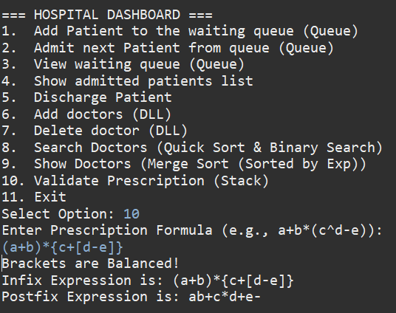
"Stack-based bracket validation and Infix-to-Postfix conversion."

Slide 13
THANK YOU

