Slide 1
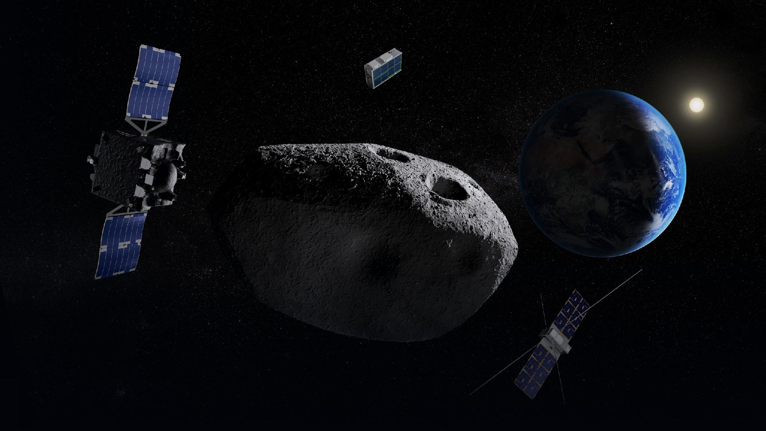

SSA SUMMER TRAINING | JULY - AUGUST 2026
Noora AlQuaydhib Summer Training Summary
Scientific Gap Assessment and Payload Recommendation for RAMSES Mission for Asteroid (99942) Apophis
Supervised by Najla AlAhmadi & Rawan AlRayes

Slide 2
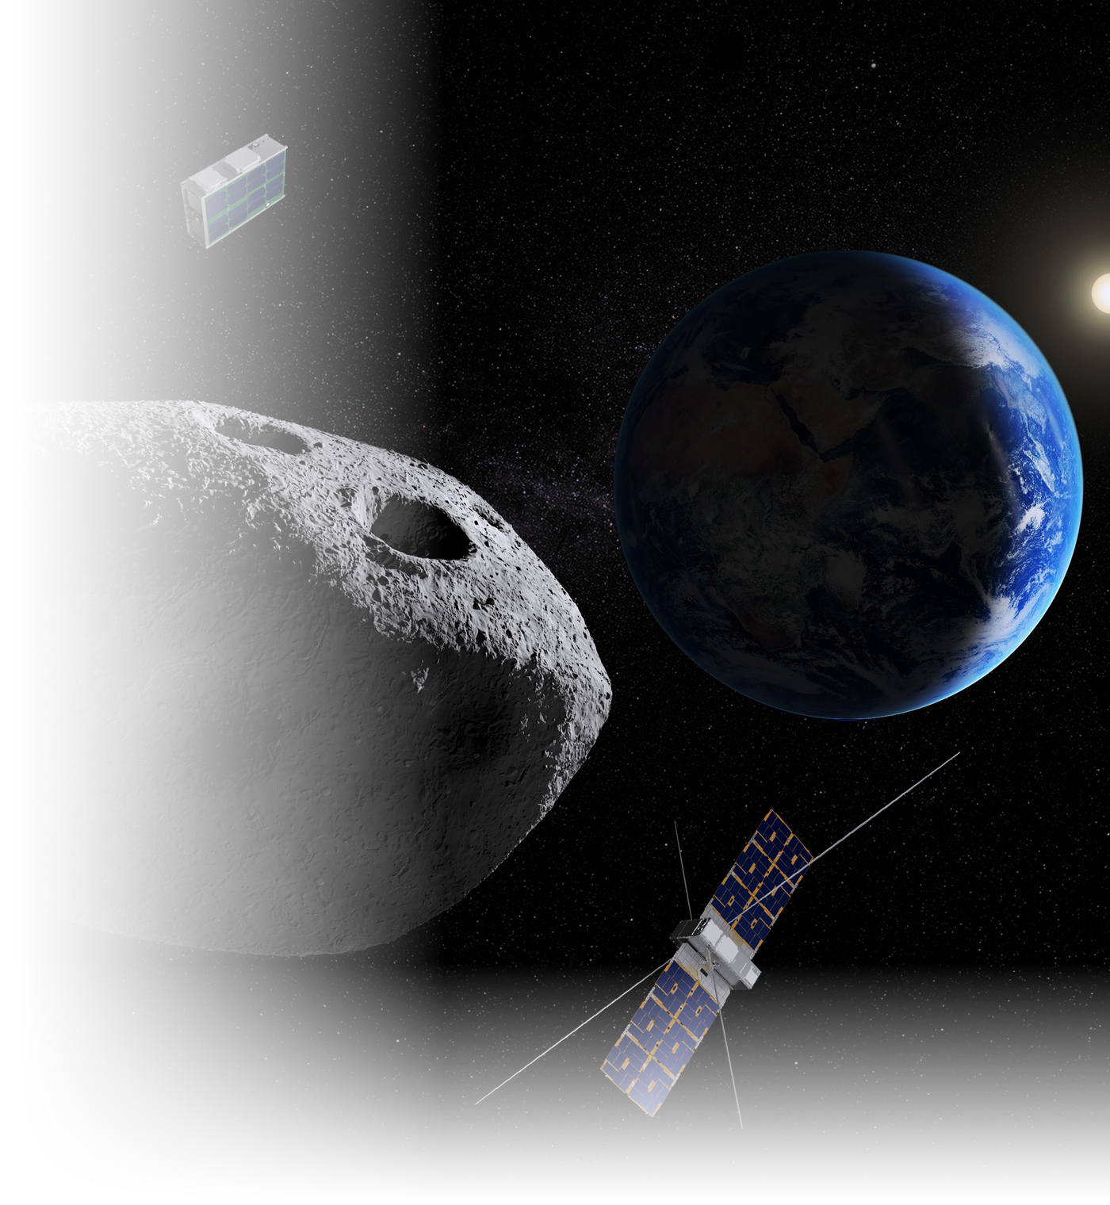
Context
01
The Event
On 13 April 2029. Apophis passes within ~32,000 km from earth, closer than geostationary satellites, visible to the naked eye.
02
The RAMSES Mission
An international collaboration between ESA and JAXA. Currently under development and planned to launch in spring 2028, to arrive to Apophis in February 2029.
03
The Goal
An SSA instrument converts observer status into participant status on a joint ESA–JAXA mission.
1

Slide 3


Study Objective & Scope
The second phase of a two-part study. The first selected the mission; this one determines the contribution.
WHERE THIS STUDY SITS
PHASE 1 — COMPLETED
OBJECTIVE
Asteroid Mission Study
Identify the knowledge gap where an additional payload would most increase the scientific return of RAMSES
11 missions benchmarked → 2 prioritized → RAMSES selected.
SCOPE
PHASE 2 — THIS STUDY
Assess the RAMSES baseline → identify an additional scientific gap → select one priority contribution → evaluate candidate payloads → define a credible implementation route.
Payload Study
What payload to put on the mission?
The question is no longer whether to participate
Phase 1 settled the mission. What remains is to put a specific technically credible contribution on the table while the build phase can still accommodate it.
2

Slide 4

RAMSES Mission Overview
Rapid Apophis Mission for Space Safety , joint ESA–JAXA planetary defense mission.
TARGET & TIMELINE
MISSION PUBLISHED OBJECTIVES
Designation
Asteroid (99942) Apophis
O1
Shape, orbit and rotation
Size
~375 m across
Before-and-after survey of shape, surface, orbit, rotation and orientation.
O2
Composition and interior
Taxonomy
Sq type, LL chondrite analogue
Composition, interior structure, cohesion, mass, density and porosity.
Launch
Spring 2028, H3 Rocket, Tanegashima
O3
Tidal response
Arrival
February 2029
How the asteroid responds to Earth's tidal forces.
O4
Solar System science
Close flyby
13 April 2029, ~32,000 km
Insight into the formation and evolution of the Solar System.
Payload architecture: three platforms, twelve confirmed instruments
Main Orbiter
Farinella: orbiter CubeSat
Don Quijote: lander CubeSat
6 INSTRUMENTS
3 INSTRUMENTS
3 INSTRUMENTS
AFC (×2) · CHANCES · HAMLET · TIRI · RSE · RPS
HORUS · Low-frequency radar · VISTA
SIA · Gravimeter · MARIE
3

Slide 5
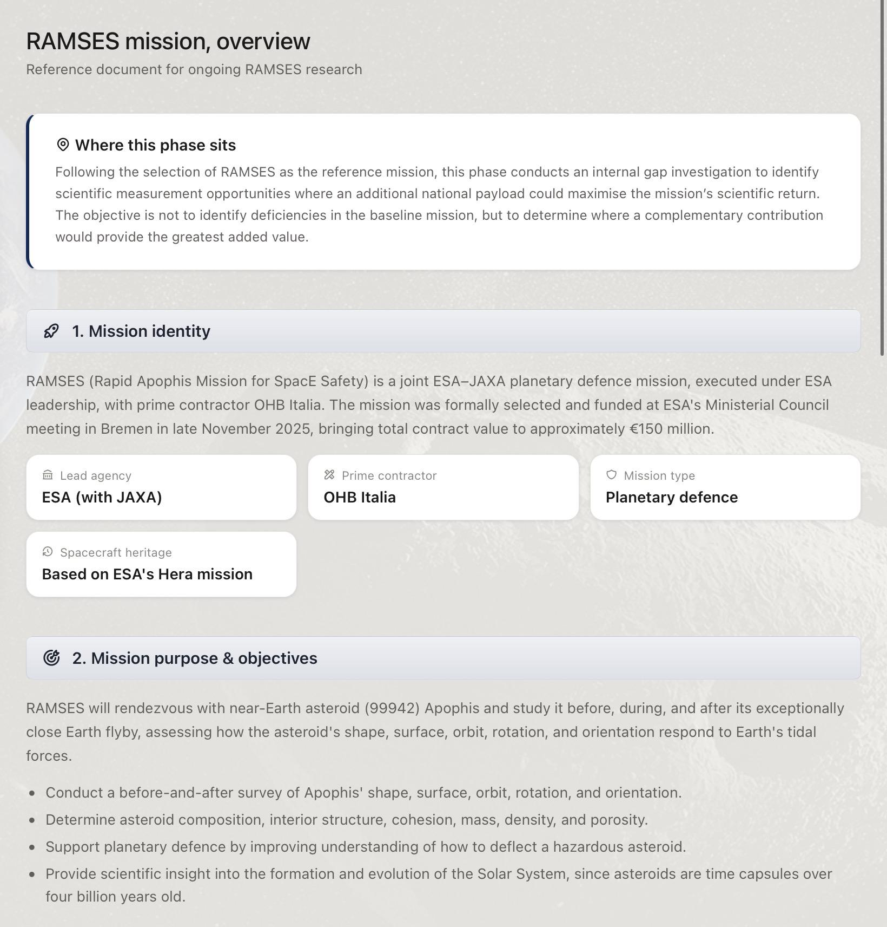
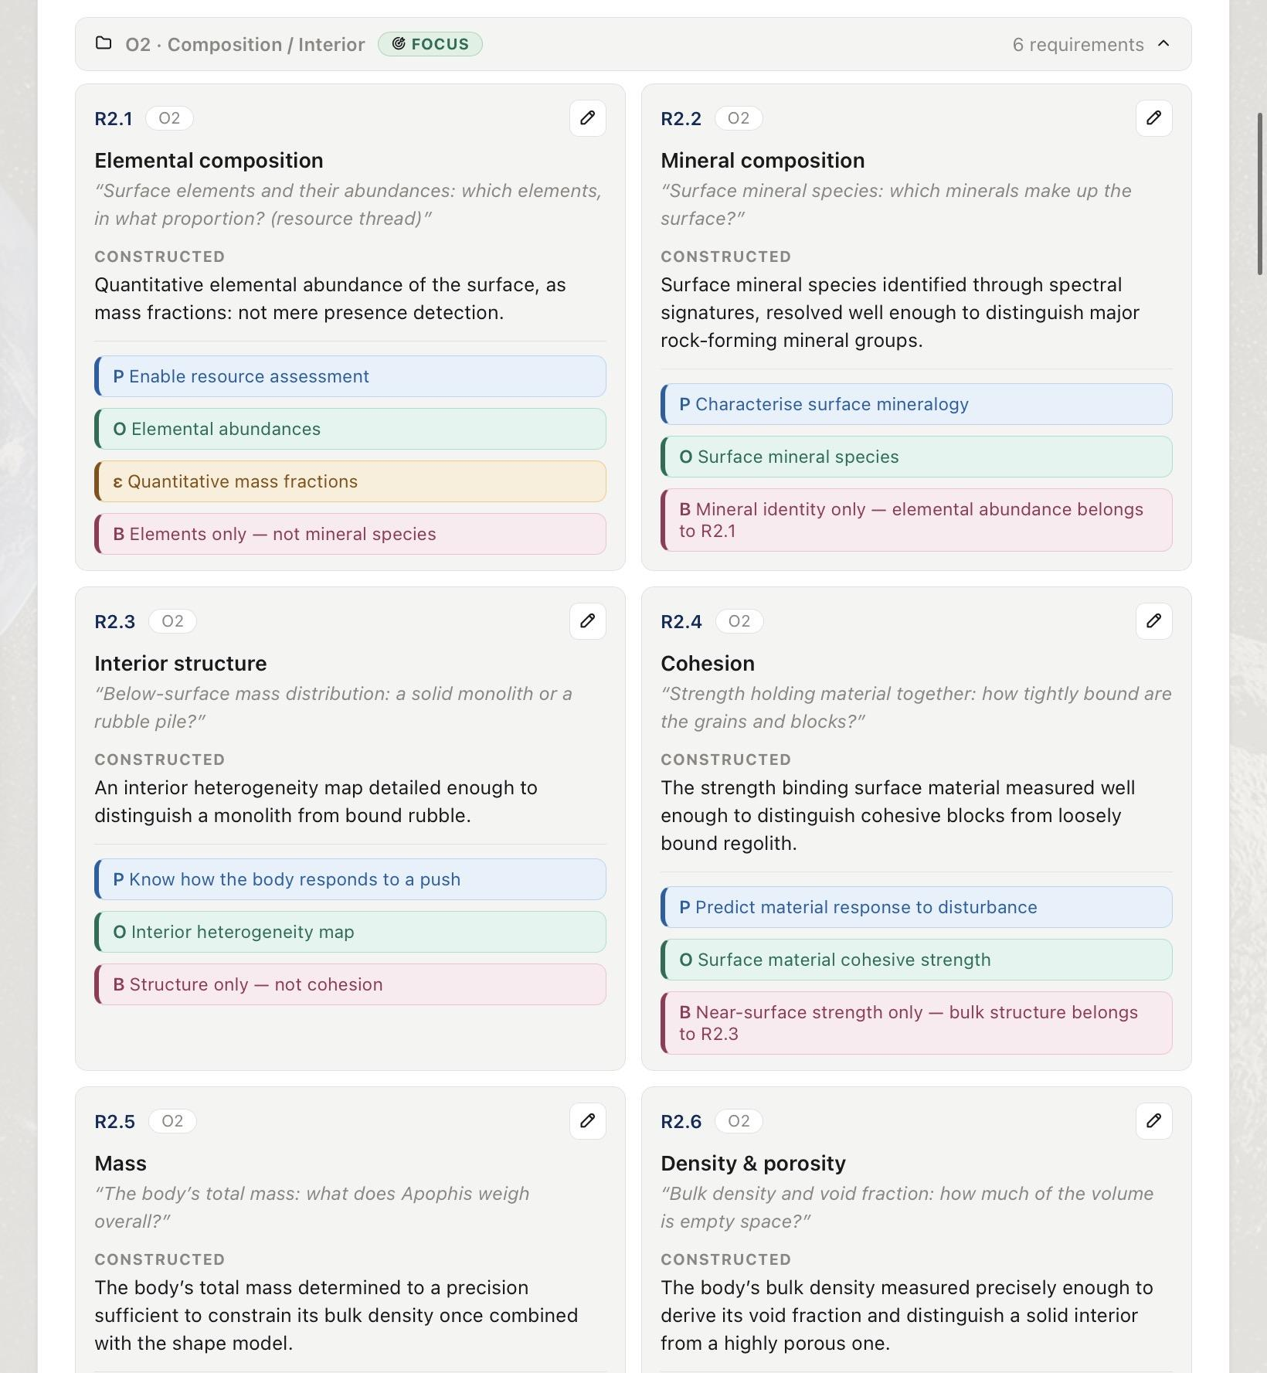
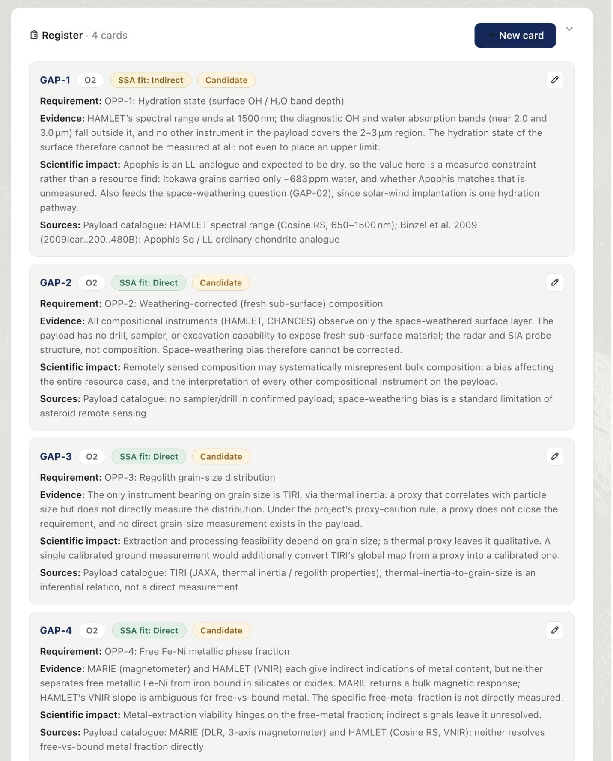
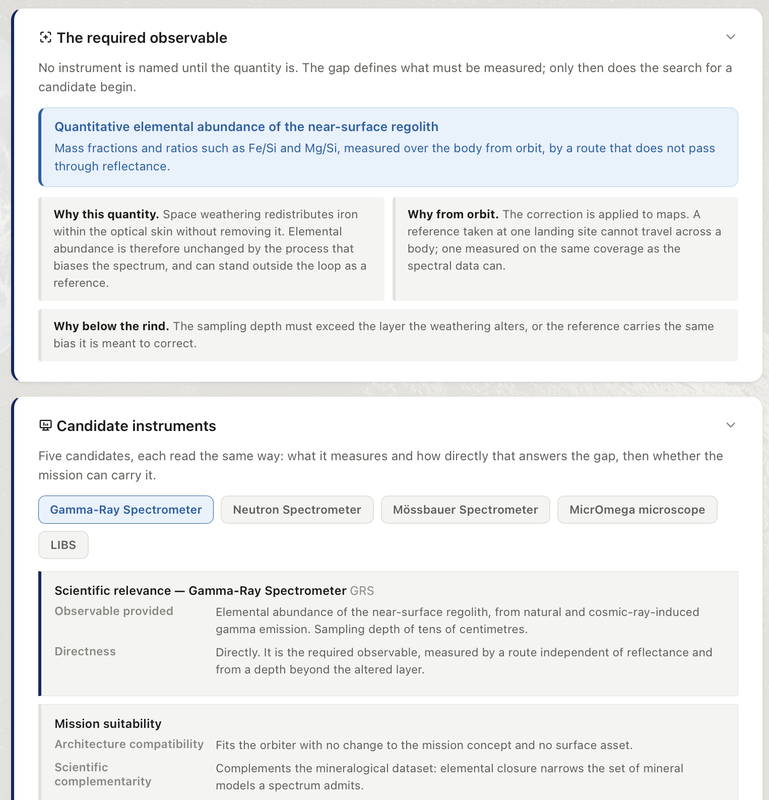
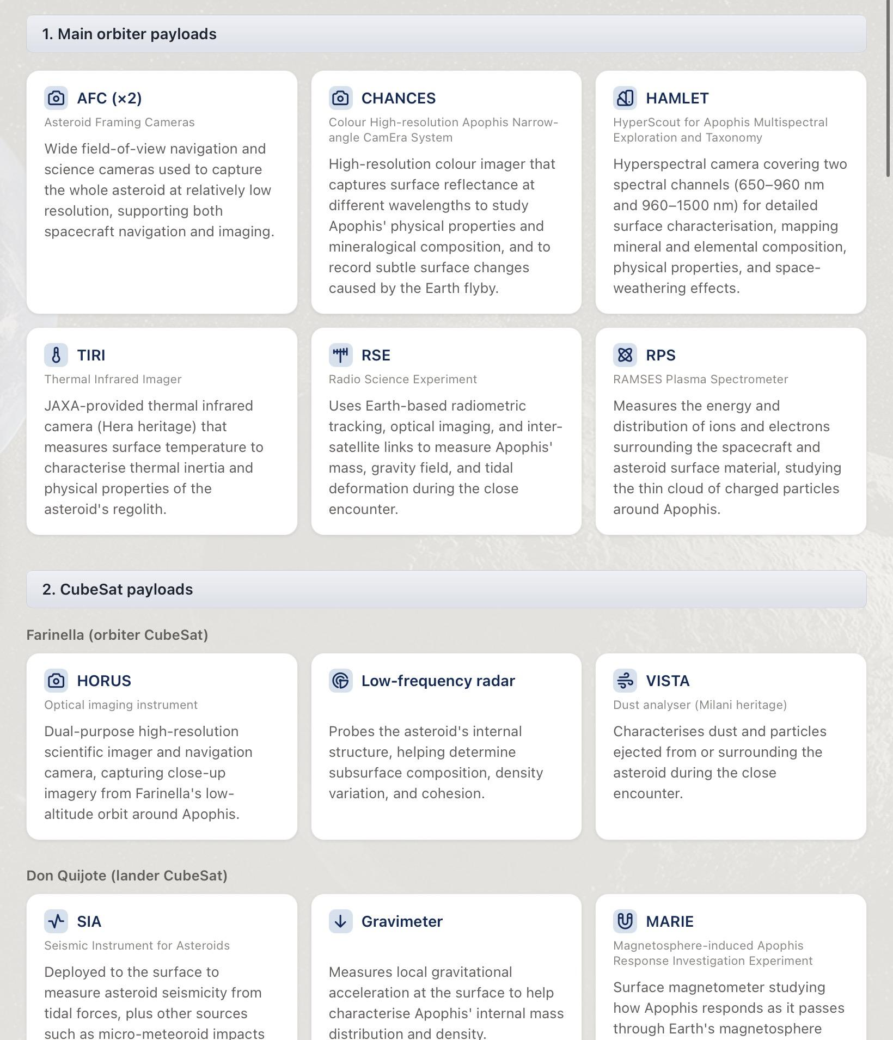
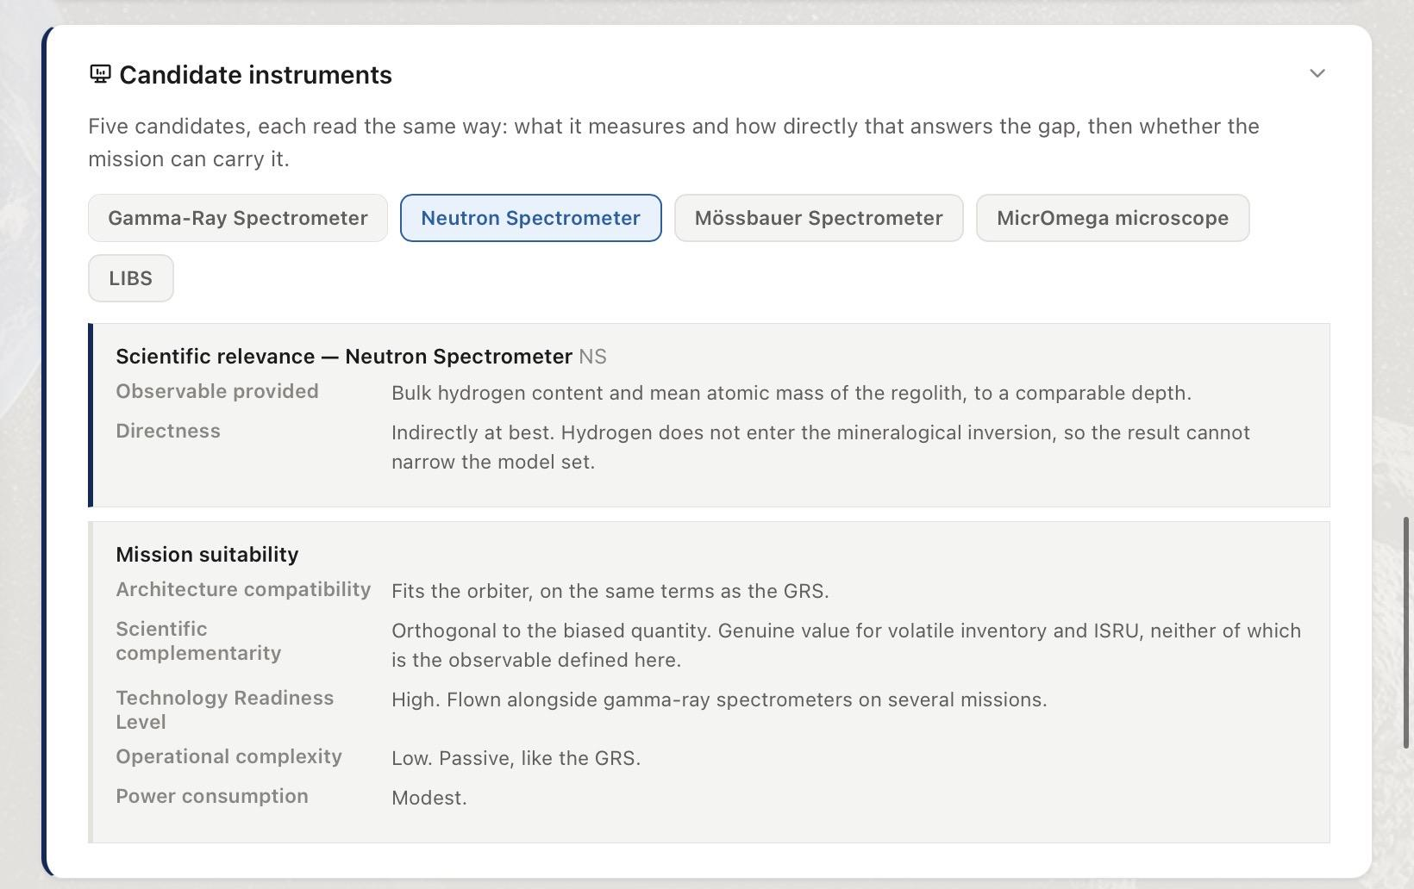
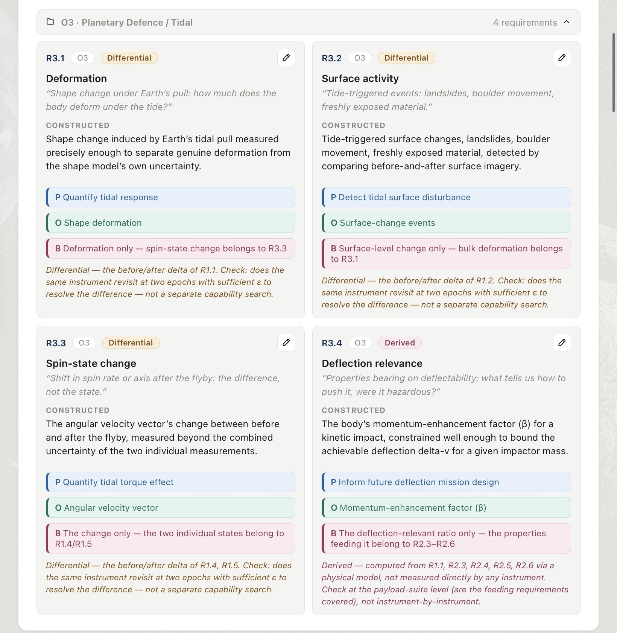
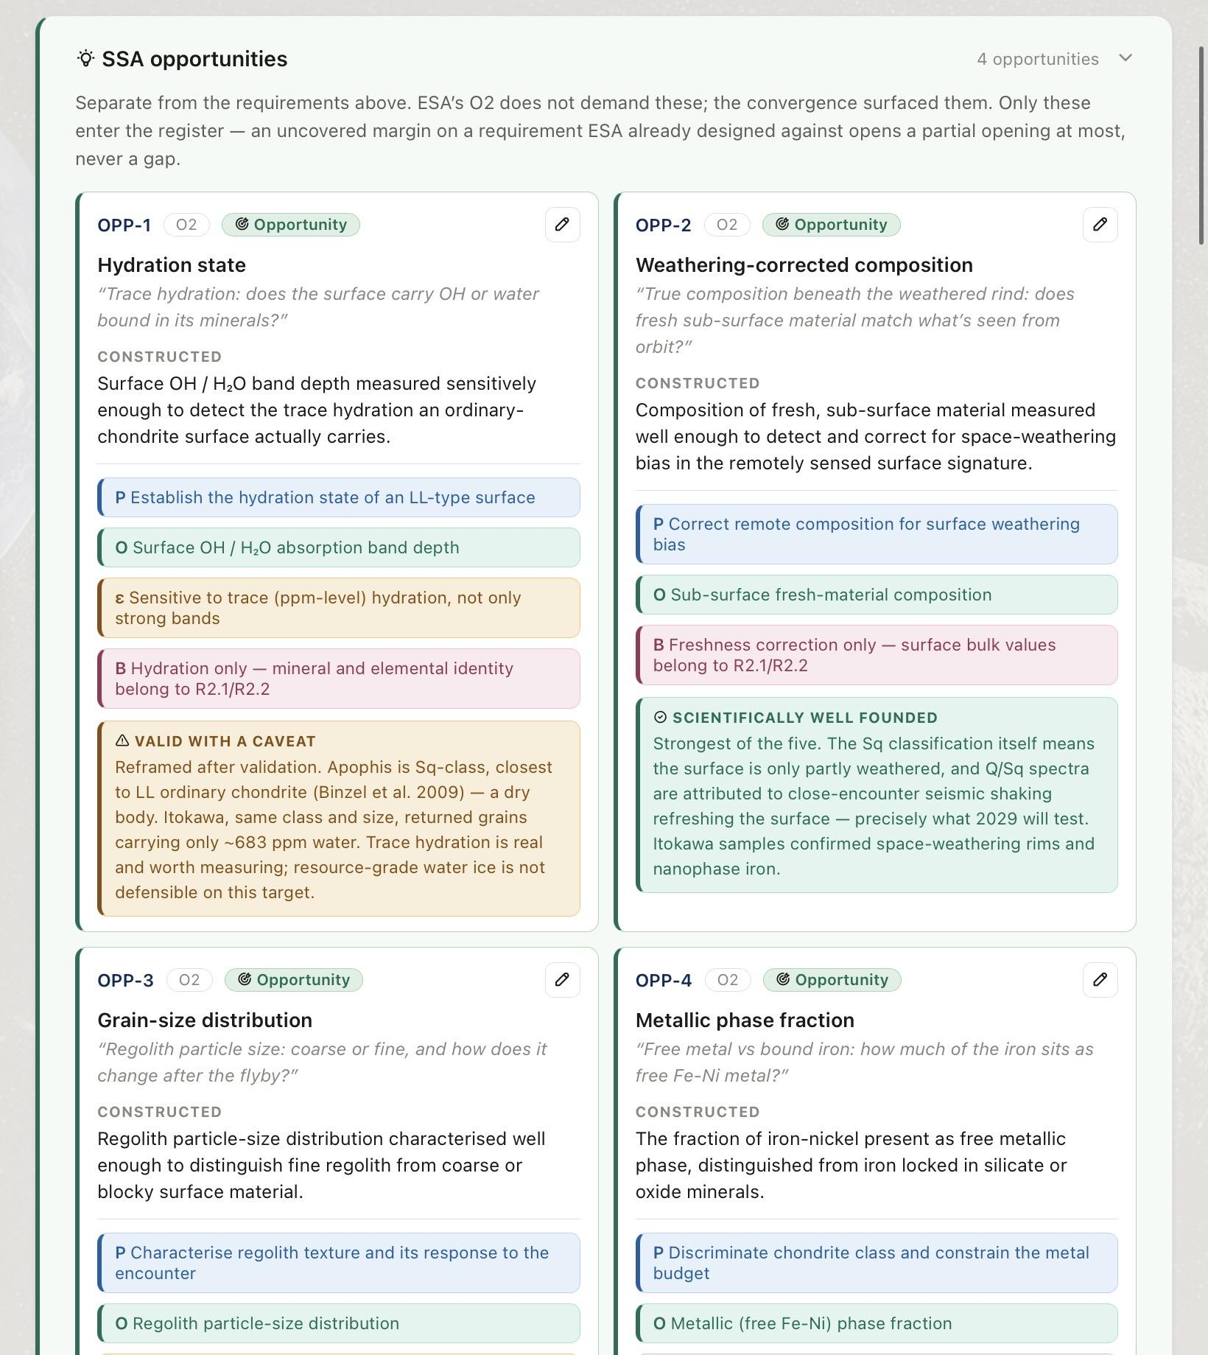
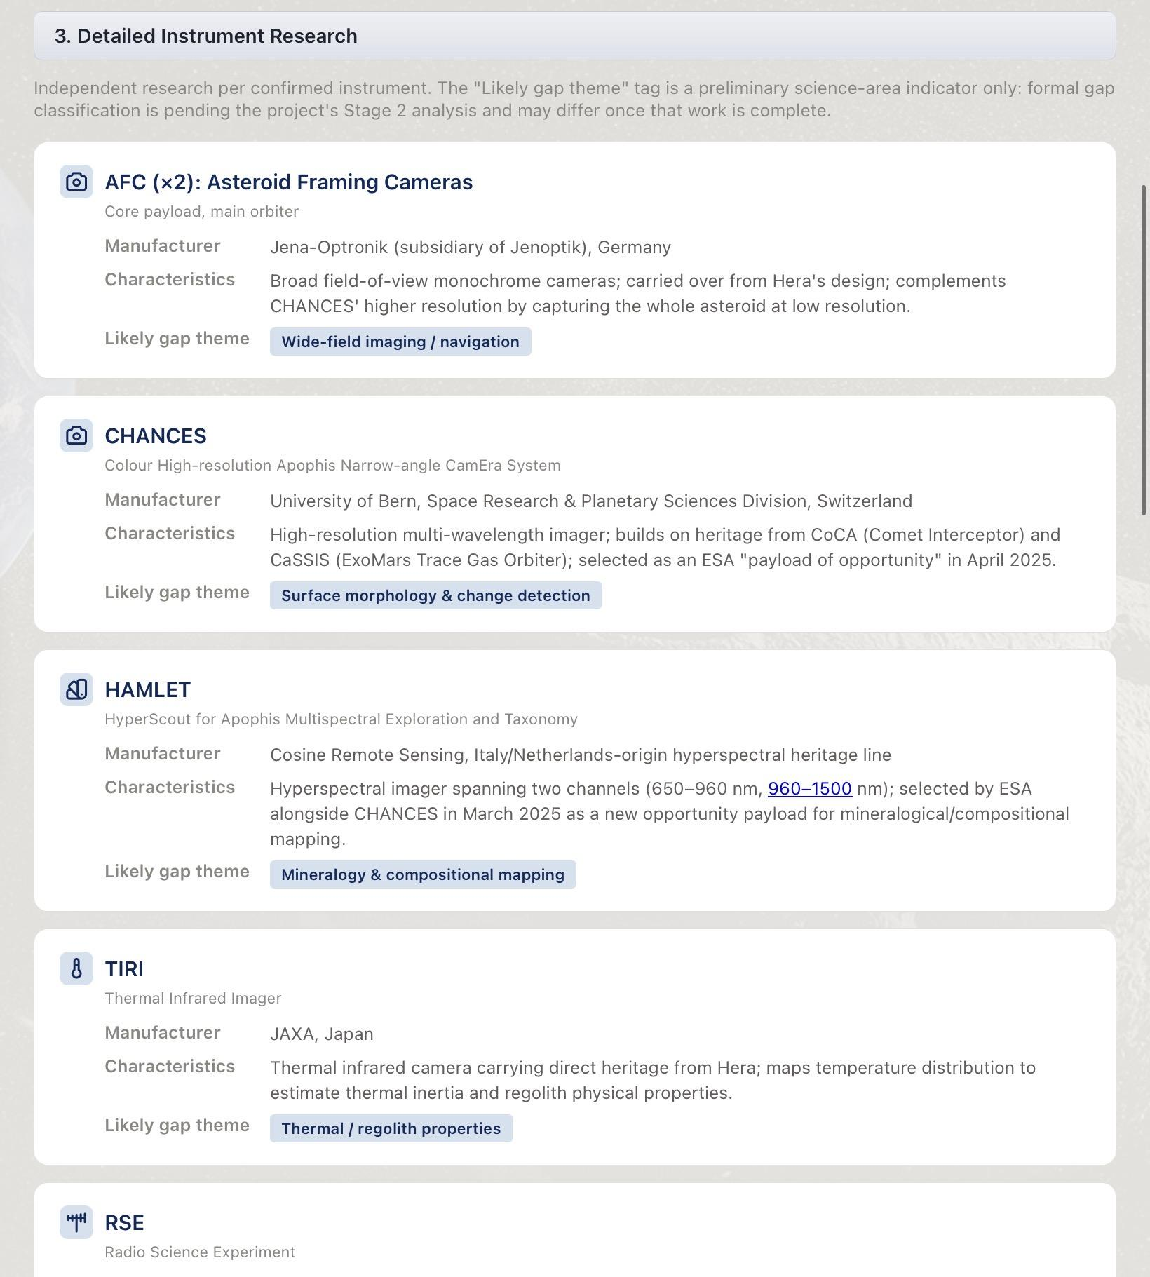
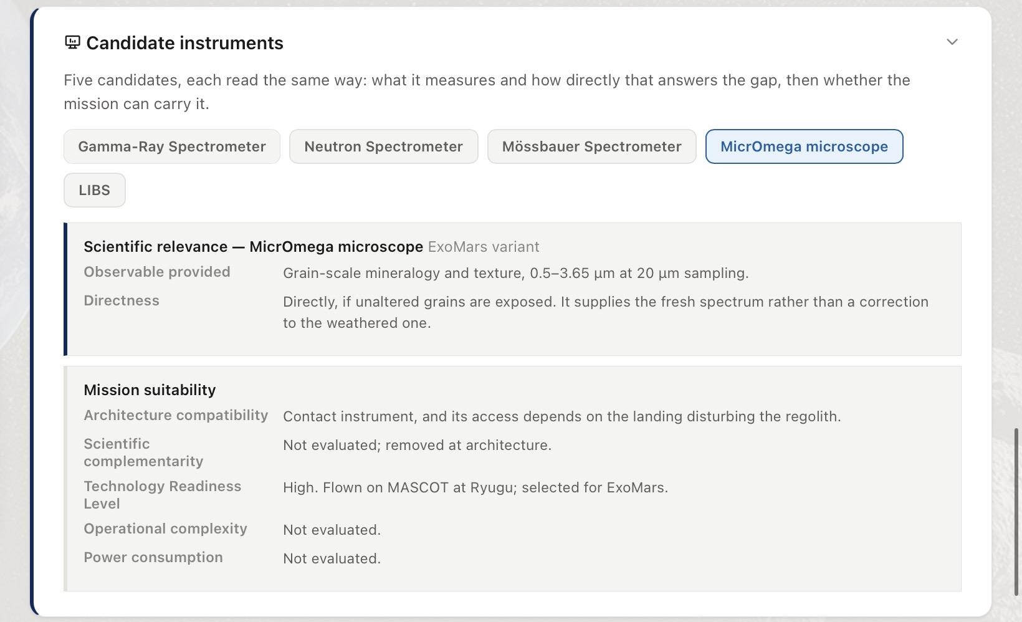
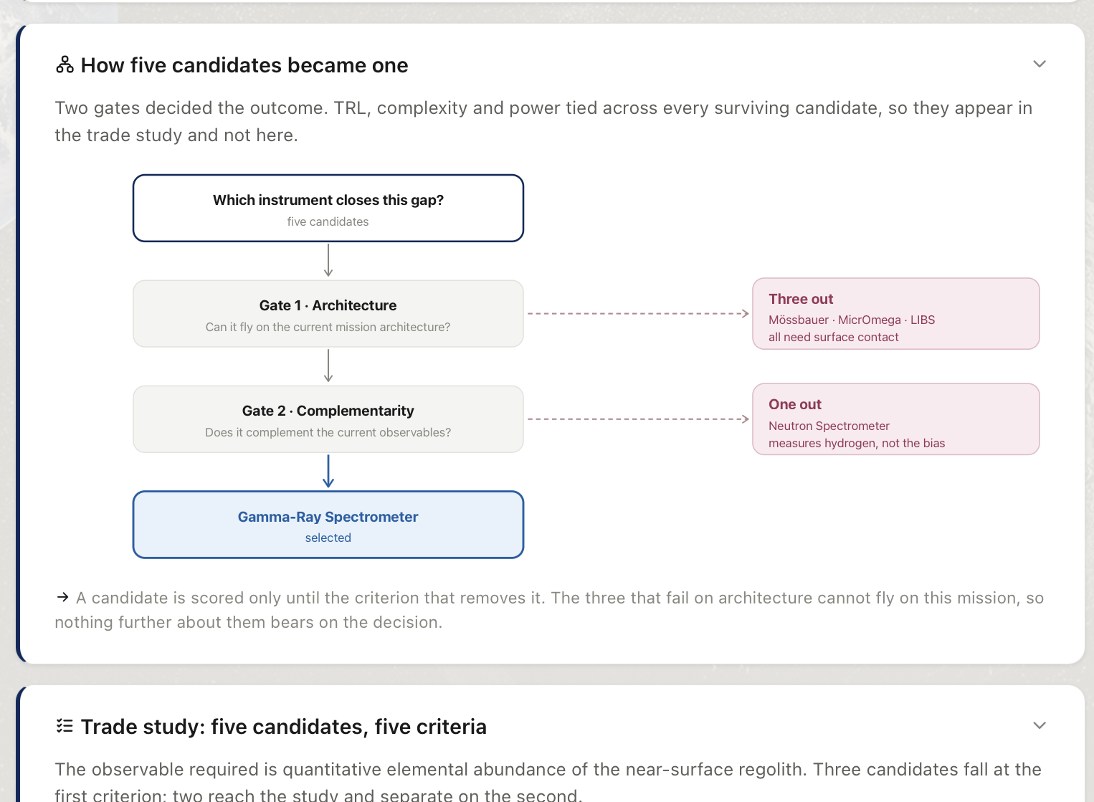
Methodology
A structured analysis narrowed four knowledge gaps to one payload
RAMSES baseline
Mission Measurements
Knowledge gaps
Payload trade study
Studied the mission objectives, platforms and payloads
Broke the 4 mission objectives into 19 scientific measurements, mapped the 19 measurements into the 12 instruments of the mission
Determined 4 knowledge gaps by identifying the non measured measurements and prioritized 1 knowledge gap
Identified multiple instruments that can measure the knowledge gap
One recommended payload
4

Slide 6

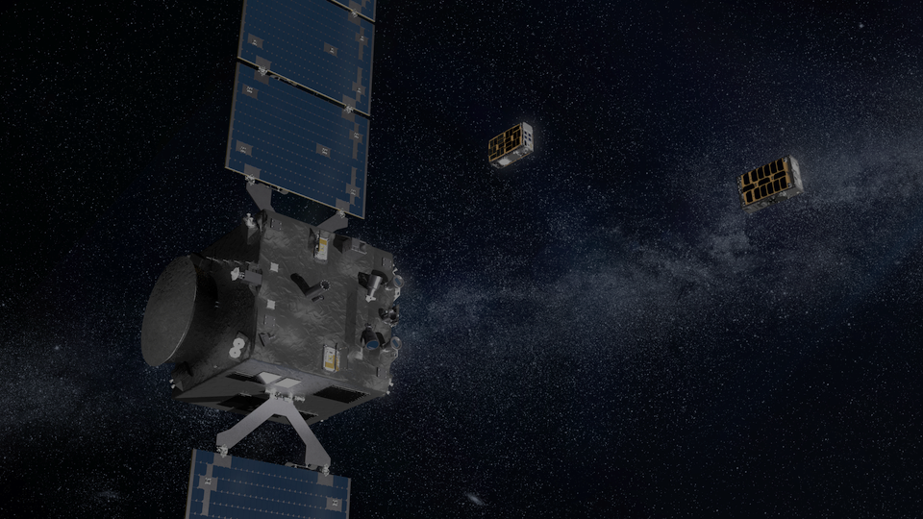
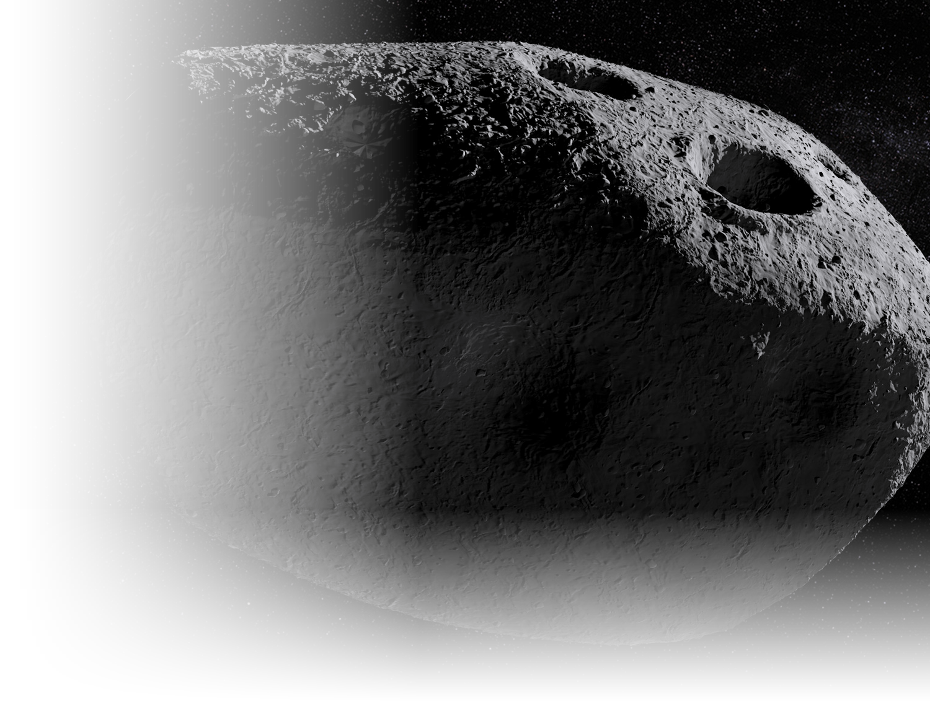
What RAMSES Measures
Confirmed payload by platform
Main Orbiter
Farinella · Orbiter CubeSat
Don Quijote · Lander CubeSat
AFC (×2)
HORUS
SIA
Wide-field navigation imaging and shape mapping
Close-range imaging beyond orbiter resolution
Seismic response to tidal stress and cracking
CHANCES
Radar
Gravimeter
High-resolution color imaging of surface change
Interior structure via dielectric sounding
Local density from gravitational acceleration
HAMLET
VISTA
MARIE
Composition and space weathering, 650–1500 nm
Volatile and organic content of captured dust
Magnetic response during the Earth flyby
TIRI
Surface temperature, thermal inertia, grain size
RSE
Radio tracking; gravity, spin state and tidal response
RPS
Ion and electron energy near the spacecraft
BASELINE KNOWLEDGE GAPS SELECTION RECOMMENDATION VALUE
5

Slide 7
What the Mission Must Measure
The four objectives were decomposed into 19 measurements. Those 15 are already measured by the confirmed payloads
Read the objectives
Split into raw demands
Write the requirement
Classify the type
1
ESA's four published aims, verbatim
2
one question per demand, no instrument named
3
purpose, observable, threshold, boundary
4
direct, differential, or derived
O1
Shape, orbit and rotation
O2
Composition and interior
O3
Tidal response
5 MEASUREMENTS
6 MEASUREMENTS
4 MEASUREMENTS
M1.1
Shape
M2.1
Elemental composition
M3.1
Deformation
M1.2
Surface
M2.2
Mineral composition
M3.2
Surface activity
M1.3
Orbit
M2.3
Interior structure
M3.3
Spin-state change
M1.4
Rotation
M2.4
Cohesion
M3.4
Deflection relevance
M1.5
Orientation
M2.5
Mass
M2.6
Density and porosity
15 of the 19 measurements are already covered by the mission. The four that are not measured are the knowledge gaps.
BASELINE KNOWLEDGE GAPS SELECTION RECOMMENDATION VALUE
6

Slide 8
Four Knowledge Gaps
Measurement openings the mission never set out to address, registered only where no confirmed instrument meets them.
GAP-1
GAP-2
GAP-3
GAP-4
Hydration state
Weathering-corrected composition
Regolith grain-size distribution
Free Fe–Ni metallic phase fraction
How much water and hydroxyl sit bound in the surface minerals: a record of whether water ever altered this body, and the basis of any volatile-resource case.
What the material is made of, beneath the thin rind that space alters. Every composition read from reflected light is biased until this is known.
How the loose surface material divides across particle sizes, from dust to boulders. It governs how regolith responds to disturbance and whether it can be processed.
How much of the iron is free metal rather than bound inside silicates. Only the free fraction separates magnetically, so it carries the metal-resource case.
BASELINE KNOWLEDGE GAPS SELECTION RECOMMENDATION VALUE
7

Slide 9
Priority Selection
Two criteria. A knowledge gap must verify both to be carried forward.
1
Scientific value
2
Mission compatibility
Does the measurement return something scientifically unique and not predictable?
Can the orbiter already flying carry it, and does it add to the baseline rather than repeat it?
GAP-1
GAP-2
GAP-3
GAP-4
Hydration state
Weathering-corrected composition
Regolith grain-size distribution
Free Fe–Ni metallic phase fraction
OUT · SCIENTIFIC VALUE
CARRIED FORWARD
OUT · MISSION COMPATIBILITY
OUT · SCIENTIFIC VALUE
Apophis is an LL analogue, and LL chondrites are dry. The likely result is an upper limit, which confirms the taxonomy instead of testing it.
Nothing on board supplies an unweathered reference, the answer is not set by taxonomy, and the 2029 encounter may reset the maturity clock.
TIRI already maps grain size through thermal inertia. Measuring the distribution itself needs surface contact, which an orbiter payload cannot give.
LL is the lowest-metal ordinary chondrite class, so the answer is largely set in advance. The quantity is static too: anybody would serve.
ONE PRIORITY
Weathering-corrected composition
BASELINE KNOWLEDGE GAPS SELECTION RECOMMENDATION VALUE
8

Slide 10

The Scientific Problem
Space weathering changes what we see without changing the bulk composition.
Fresh material
Space weathering
Altered optical spectrum
Biased mineralogical interpretation
RAMSES can measure the spectrum,
BUT it cannot independently measure the reference needed to correct it.
The correction lacks an independent compositional reference.
Why it matters at Apophis
HAMLET's maturity map is derived from the spectrum it would correct, which makes it verifiable only against its source
Sq type: a surface partly but not wholly refreshed. The 2029 encounter may reset the maturity clock, a natural experiment that will not recur.
BASELINE KNOWLEDGE GAPS SELECTION RECOMMENDATION VALUE
9
Public عام

Slide 11
The Required Observable
What measurement would fill the gap?
Independent elemental abundance
of the near-surface regolith
1
From orbit
2
Below the weathered surface
A specific reference from a single landing cannot travel across a body, so the measurement will be observed from the orbit.
Sampling depth must exceed the altered layer, or the reference carries the bias it was meant to remove.
BASELINE KNOWLEDGE GAPS SELECTION RECOMMENDATION VALUE
10
Public عام

Slide 12
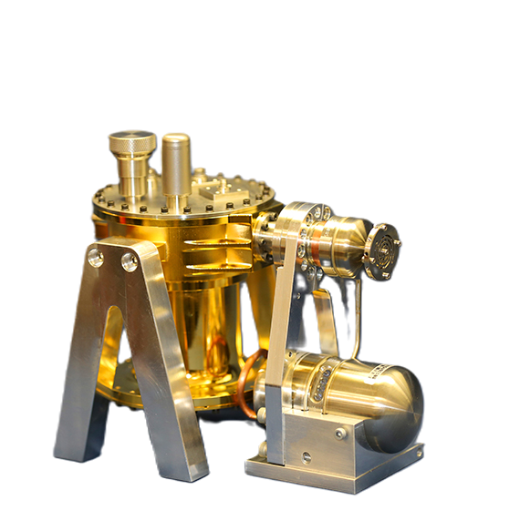
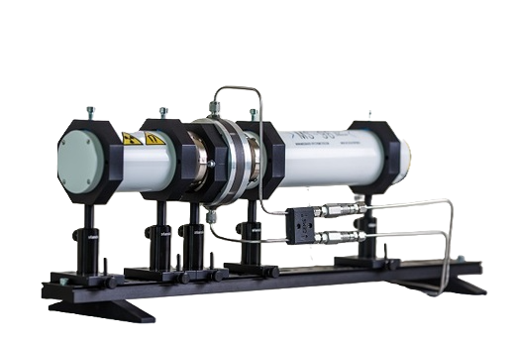
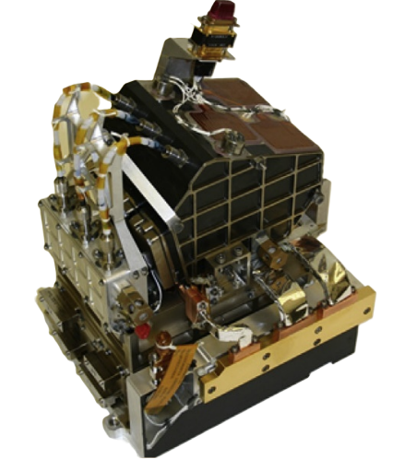
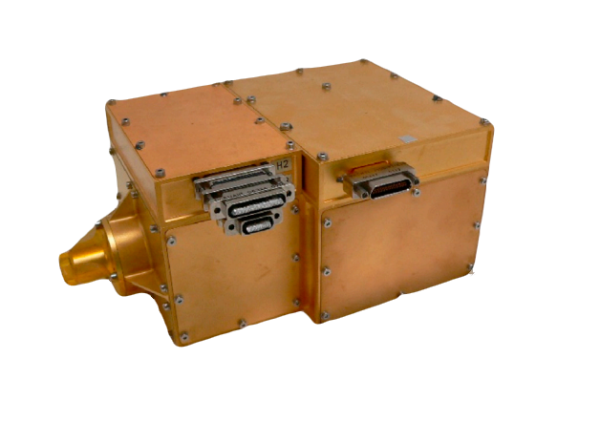
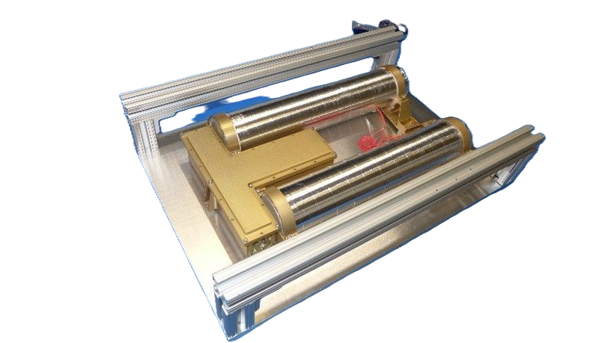
Candidate Payload Assessment
5 candidate payloads, screened against the required observable and the orbital compatibility
Mössbauer Spectrometer
MicrOmega Microscope
Neutron Spectrometer
LIBS, ChemCam class
Gamma-Ray Spectrometer
Reads iron specifically, separating oxidation state from mineral phase to about 200 µm. A contact instrument, held against the regolith, with no moving parts needed to select depth.
A near-infrared imaging microscope, 0.99–3.65 µm at 25 µm per pixel. It resolves mineralogy grain by grain rather than as an average, working within millimeters of the surface.
Counts neutrons that cosmic rays knock out of the regolith, giving bulk hydrogen and mean atomic mass from tens of centimeters down. Passive and continuous, operating from orbit.
A laser strips a spot of surface, and a spectrometer reads the plasma, giving elemental composition and how it varies with depth to about a millimeter. Needs close range and precise pointing.
Detects gamma rays from radioactive elements and from nuclei excited by cosmic rays, giving elemental abundance from tens of centimeters down. Operates passively from orbit with a cooled sensor.
BASELINE KNOWLEDGE GAPS SELECTION RECOMMENDATION VALUE
Full five-criteria assessment in appendix.
11
Public عام

Slide 13

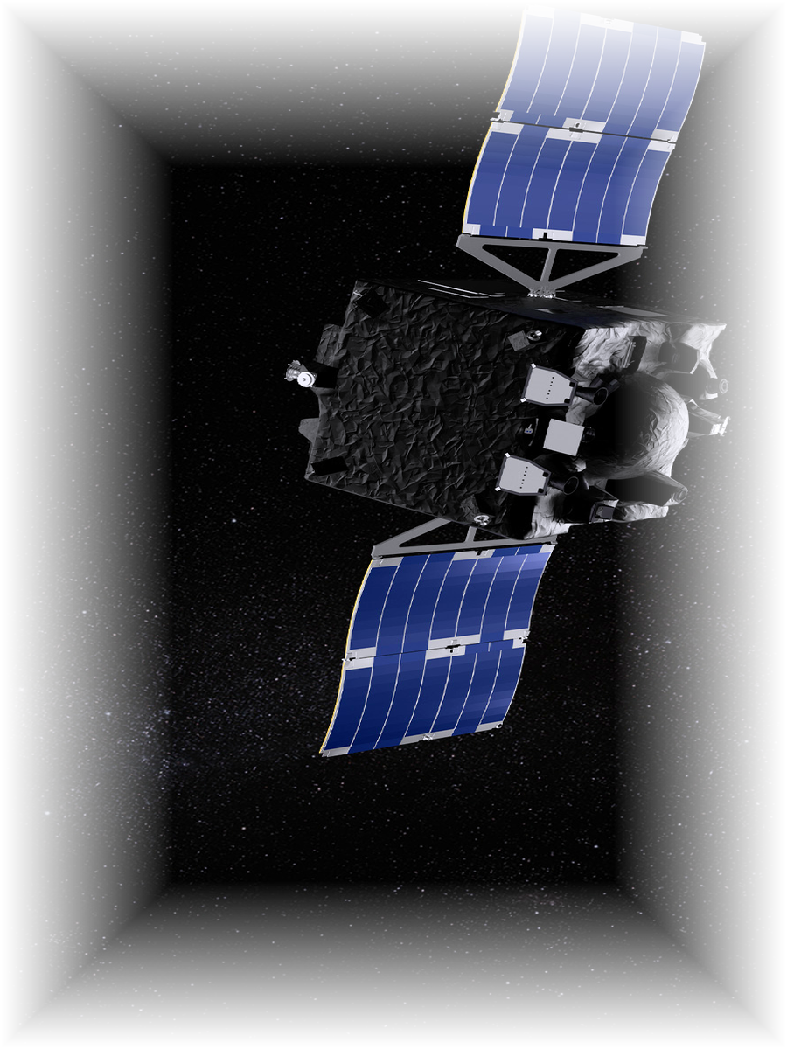
Recommendation
RECOMMENDED PAYLOAD ENHANCEMENT
Gamma-Ray Spectrometer
RAMSES Main Orbiter
WHY
01
02
03
04
05
Independent of reflected light
Measures elemental abundance
Samples below the weathered layer
Strengthens HAMLET's interpretation
Fits the existing mission architecture
HAMLET
+
GRS
Better constrained composition interpretation
Mineralogy
Elements
BASELINE KNOWLEDGE GAPS SELECTION RECOMMENDATION VALUE
12
Public عام

Slide 14
Implementation Route
A proven implementation route exists
APL
LLNL
Heritage-based GRS
Johns Hopkins Applied Physics Laboratory
Lawrence Livermore National Laboratory
A flight spare, engineering model,
or repeat of the Psyche design
Instrument build & integration
High-purity germanium detector
2
Previous Missions: MEGANE·MESSENGER·Psyche one agency contributing a gamma-ray spectrometer to another agency's small-body mission.
WHAT’S NEXT?
01
Leadership approval
02
ESA / JAXA accommodation discussion
03
APL / LLNL technical engagement
01
Authorise engagement on a payload contribution.
Confirm the route and the mission-of-opportunity mechanism.
Open the first technical exchange.
BASELINE KNOWLEDGE GAPS SELECTION RECOMMENDATION VALUE
Accommodation detail, open technical items and export-control considerations in appendix.
13
Public عام

Slide 15
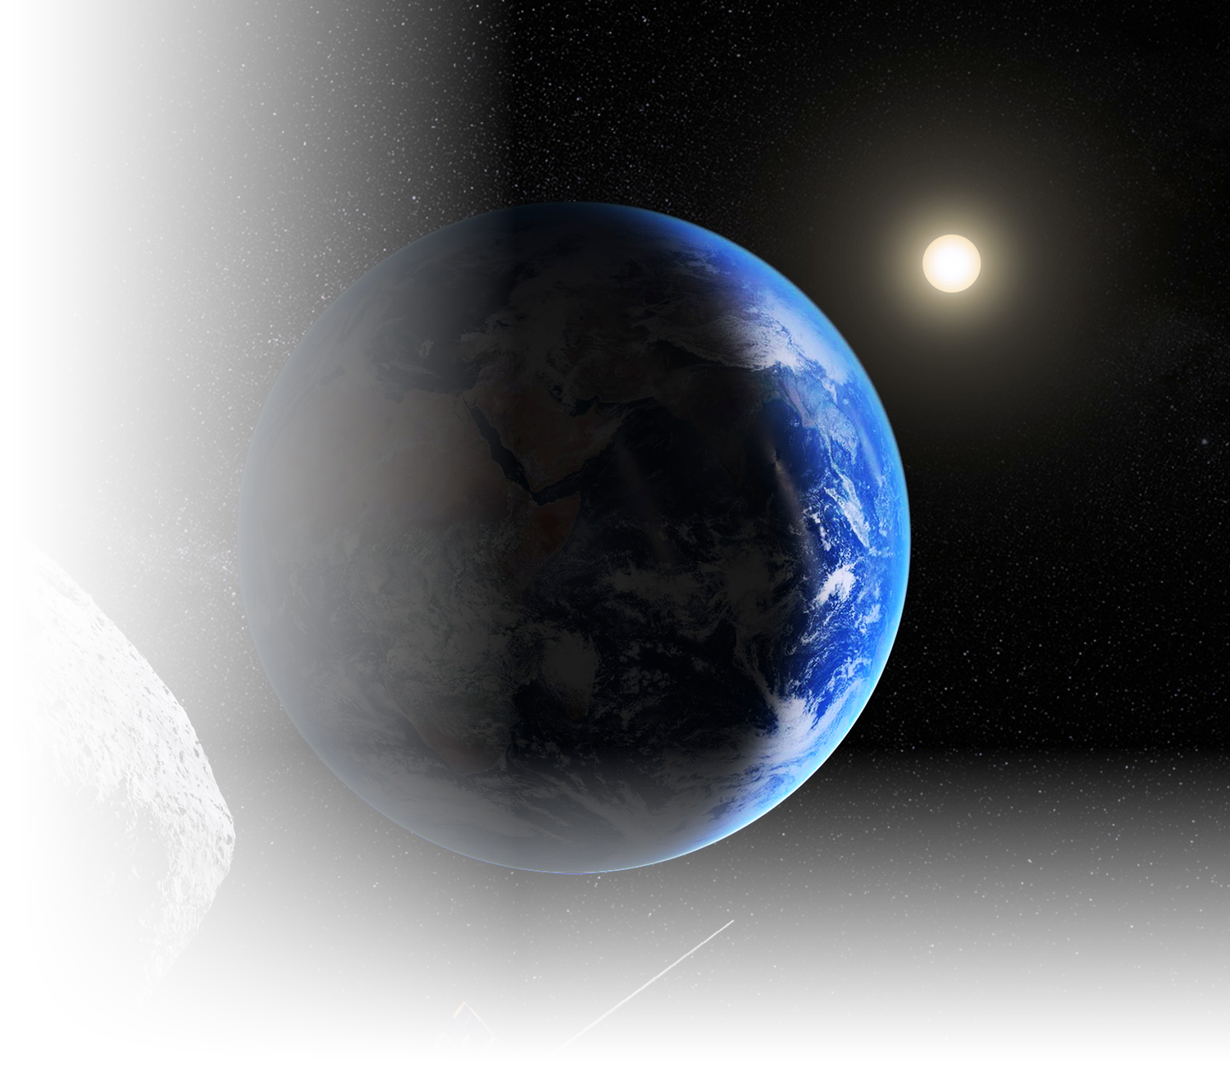
Why This Matters to SSA
01
Scientific
Adds a dataset RAMSES cannot generate independently.
02
Strategic
Moves SSA from observer to contributor on a flagship mission.
03
Programmatic
Uses a proven instrument and a proven partnership model.
04
Actionable
A credible acquisition route exists now.
BASELINE KNOWLEDGE GAPS SELECTION RECOMMENDATION VALUE
Public عام

Slide 16
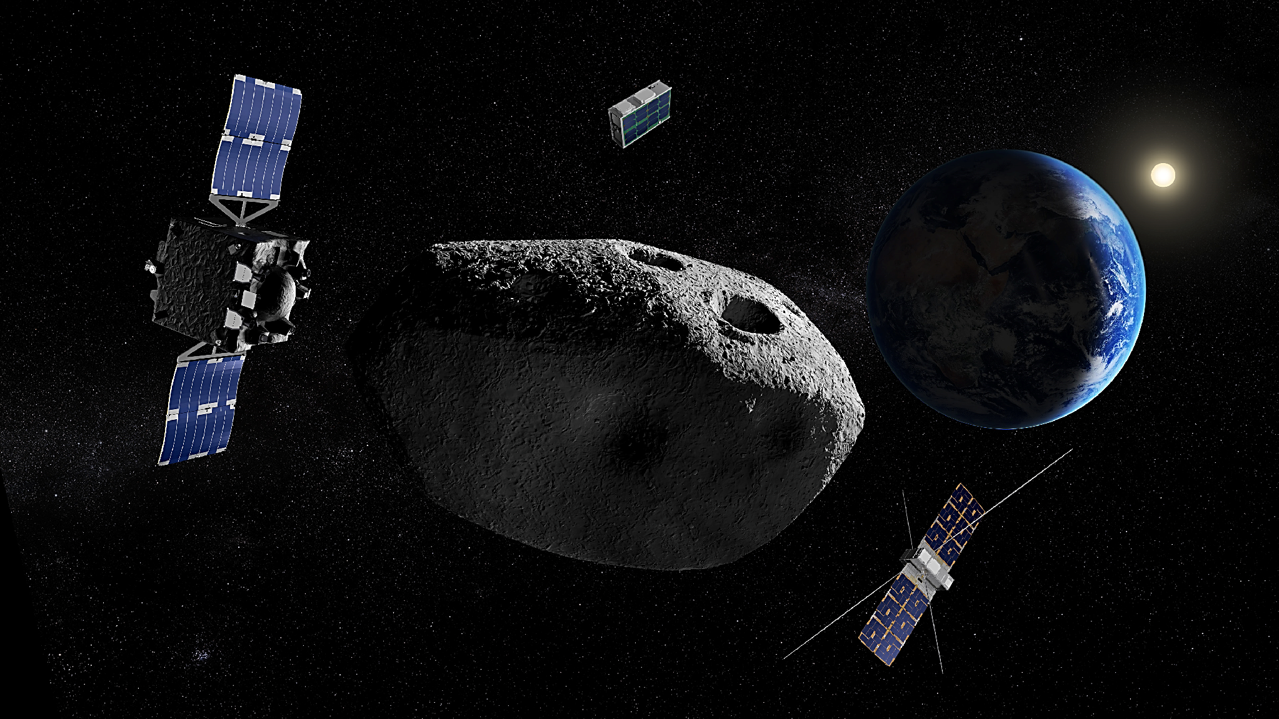
Thank you!
Public عام

Slide 17

APPENDIX
Candidate Trade Study — Full Assessment
Architecture is a screening criterion, not a differentiator. A candidate is scored only until the criterion that removes it.
Candidate | Architecture | Scientific complementarity | TRL | Operational complexity | Power
Gamma-Ray Spectrometer | Fits orbiter | Complements | High | Low | Modest
Neutron Spectrometer | Fits orbiter | Partial | High | Low | Modest
Mössbauer Spectrometer | Requires lander | — | High | — | —
MicrOmega Microscope | Requires lander | — | High | — | —
LIBS, ChemCam class | Requires close range | — | High | — | —
Incompatible with an orbiter-only contribution
Separated on scientific complementarity
The wrong quantity, well accessed
Mössbauer and MicrOmega are contact instruments requiring a landed platform; LIBS is close-range and requires high pointing precision. Establishing that sub-surface observation does not require a landing removed the premise beneath all three.
Neutron spectroscopy primarily constrains hydrogen and volatile abundance, which does not enter the mineralogical inversion. Resolving this gap requires multi-element ratios such as Mg/Si and Fe/Si.
LIBS solves access better than any other candidate and still returns the wrong quantity. Bulk elemental abundance barely moves under weathering, so profiling elements through the rind would most likely return no difference.
Public عام

Slide 18
APPENDIX
Accommodation & Open Technical Items
Detail supporting the recommendation and the first technical exchange.
Platform: main orbiter, not Farinella
Spatial resolution
Integration time
The cooled germanium sensor exceeds what a 6U-XL CubeSat carries in mass and standing power, and the measurement needs an accumulation window of months. It also belongs beside HAMLET: a shared platform means shared observation geometry and coverage, which is what permits one map to be subtracted from the other.
Reads a broad patch, tens to hundreds of metres. The mission already maps in detail; this supplies the calibrated value that map is read against.
Gamma emission is faint, so precision accumulates over hours and days. The instrument is passive — no laser, no mechanism, no pointing — and gathers while the spacecraft works.
PARTNERSHIP — GAMMA-RAY SPECTROMETERS BUILT
OPEN FOR THE FIRST TECHNICAL EXCHANGE
Laboratory | Role | Instruments built
Johns Hopkins APL | Instrument lead and integrator | NEAR Shoemaker, MESSENGER, MEGANE, Psyche, Dragonfly
Lawrence Livermore NL | High-purity germanium sensor | MESSENGER, MEGANE, Psyche
Footprint achievable at the planned operating altitude.
Boom against body mounting — spacecraft materials generate the same background the instrument measures.
Export control and technology transfer: both laboratories are United States national laboratories.
Public عام

Slide 19
APPENDIX
Knowledge Gap Register — Evidence
Why no confirmed instrument meets each registered gap.
ID | Knowledge gap | Why no confirmed instrument meets it | Outcome
GAP-1 | Hydration state | HAMLET's range ends at 1500 nm. The diagnostic OH and water bands near 2.0 and 3.0 µm fall outside it, and no other instrument covers that region. | Removed — scientific value
GAP-2 | Weathering-corrected composition | All compositional instruments observe only the space-weathered surface layer. No independent reference exists against which the correction can be established. | SELECTED
GAP-3 | Regolith grain-size distribution | TIRI already bears on grain size through thermal inertia. It is a proxy rather than a direct measurement, but it is one the mission already returns, and measuring the distribution itself needs surface contact an orbiter payload cannot give. | Removed — mission compatibility
GAP-4 | Free Fe–Ni metallic phase fraction | MARIE and HAMLET each give indirect indications of metal content, but neither separates free metallic iron from iron bound in silicates or oxides. | Removed — scientific value
HOW THE CONFIRMED PAYLOAD BEARS ON EACH GAP
HAMLET
TIRI
Radar
CHANCES / AFC
Closed inference, maturity map derived from the spectrum it would correct
Supplies grain size already, so this study need not measure it
Unrelated, dielectric measurement is blind to nanophase iron
No overlap, locates where fresh material may be, never quantifies it
Public عام

