Slide 1
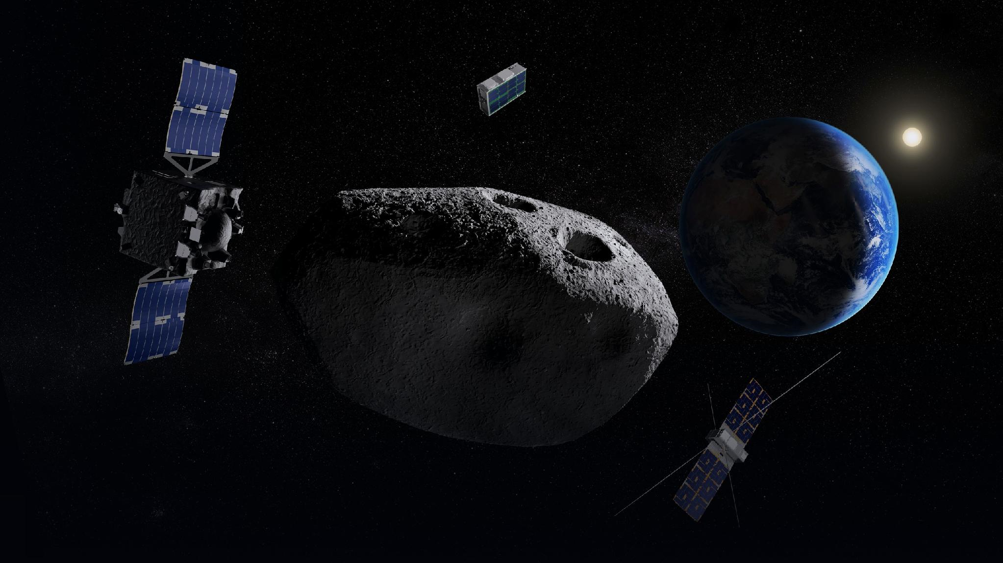

EXPLORATION TECHNOLOGY | JUNE - AUGUST 2026
Noora AlQuaydhib Summer Training Summary
01
Public عام

Slide 2
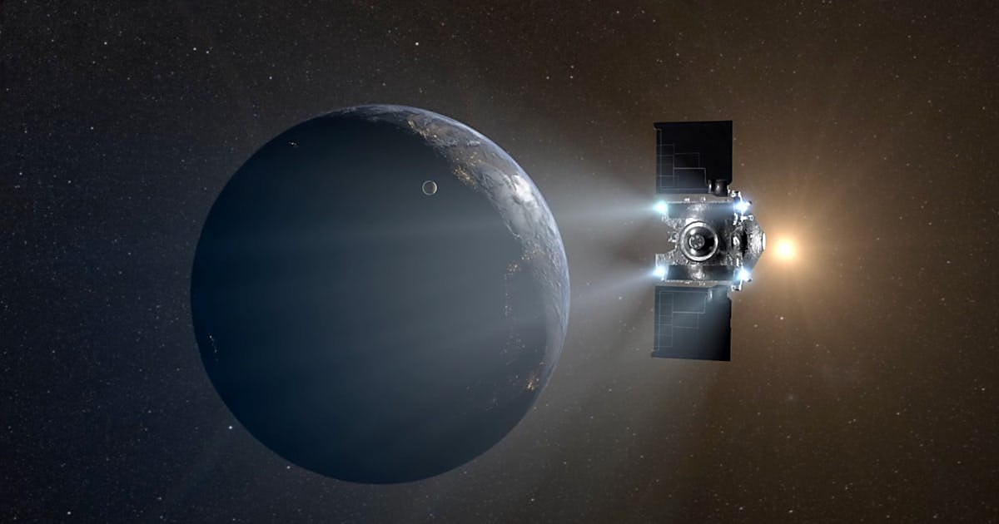
SUMMER TRAINING | FULL SCOPE
Summer Training Journey
# | Project | Key Outcomes
01 | RAMSES Mission ★ | • Identified and evaluated scientific knowledge gaps • Prioritized a single knowledge gap • Derived the required observable and evaluated candidate instruments • Recommended the payload and investigated its instrumental heritage
02 | Artemis IV & V Mission — NEO Survey in HEO | • Defined the scientific questions for NEO surveying in HEO • Derived the corresponding scientific objectives • Developed objective-to-payload traceability • Progressed toward defining the required payload
02
Public عام

Slide 3
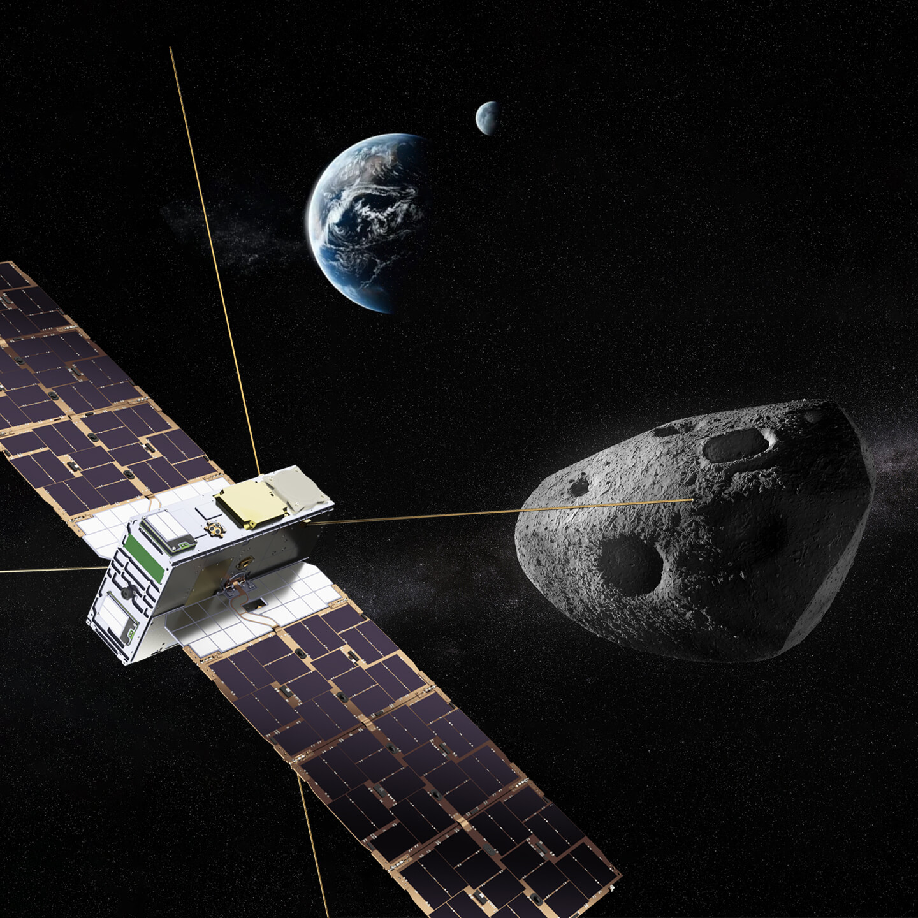
Context
01
The Event
On 13 April 2029. Apophis passes within ~32,000 km away from earth, closer than geostationary satellites, visible to the naked eye.
02
The RAMSES Mission
An international collaboration between ESA and JAXA. Currently under development and planned to launch in spring 2028, to arrive to Apophis in February 2029.
03
The Goal
An SSA recommended payload converts observer status into participant status on a joint ESA–JAXA mission.
03
Public عام

Slide 4


Study Objective & Scope
The second phase of a two-part study. The first selected the mission; this one determines the contribution.
WHERE THIS STUDY SITS
PHASE 1 — COMPLETED
OBJECTIVE
Asteroid Mission Study
Identify the knowledge gap where an additional payload would most increase the scientific return of RAMSES
11 missions benchmarked → 2 prioritized → RAMSES selected.
SCOPE
PHASE 2 — THIS STUDY
Assess the RAMSES baseline → identify a scientific gap → select one priority contribution → evaluate candidate payloads → define the engagement route
Payload Study
What payload to put on the mission?
The question is no longer whether to participate
Phase 1 settled the mission. What remains is to put a specific contribution on the table while the build phase can still accommodate it.
BASELINE KNOWLEDGE GAPS SELECTION RECOMMENDATION VALUE
04
Public عام

Slide 5
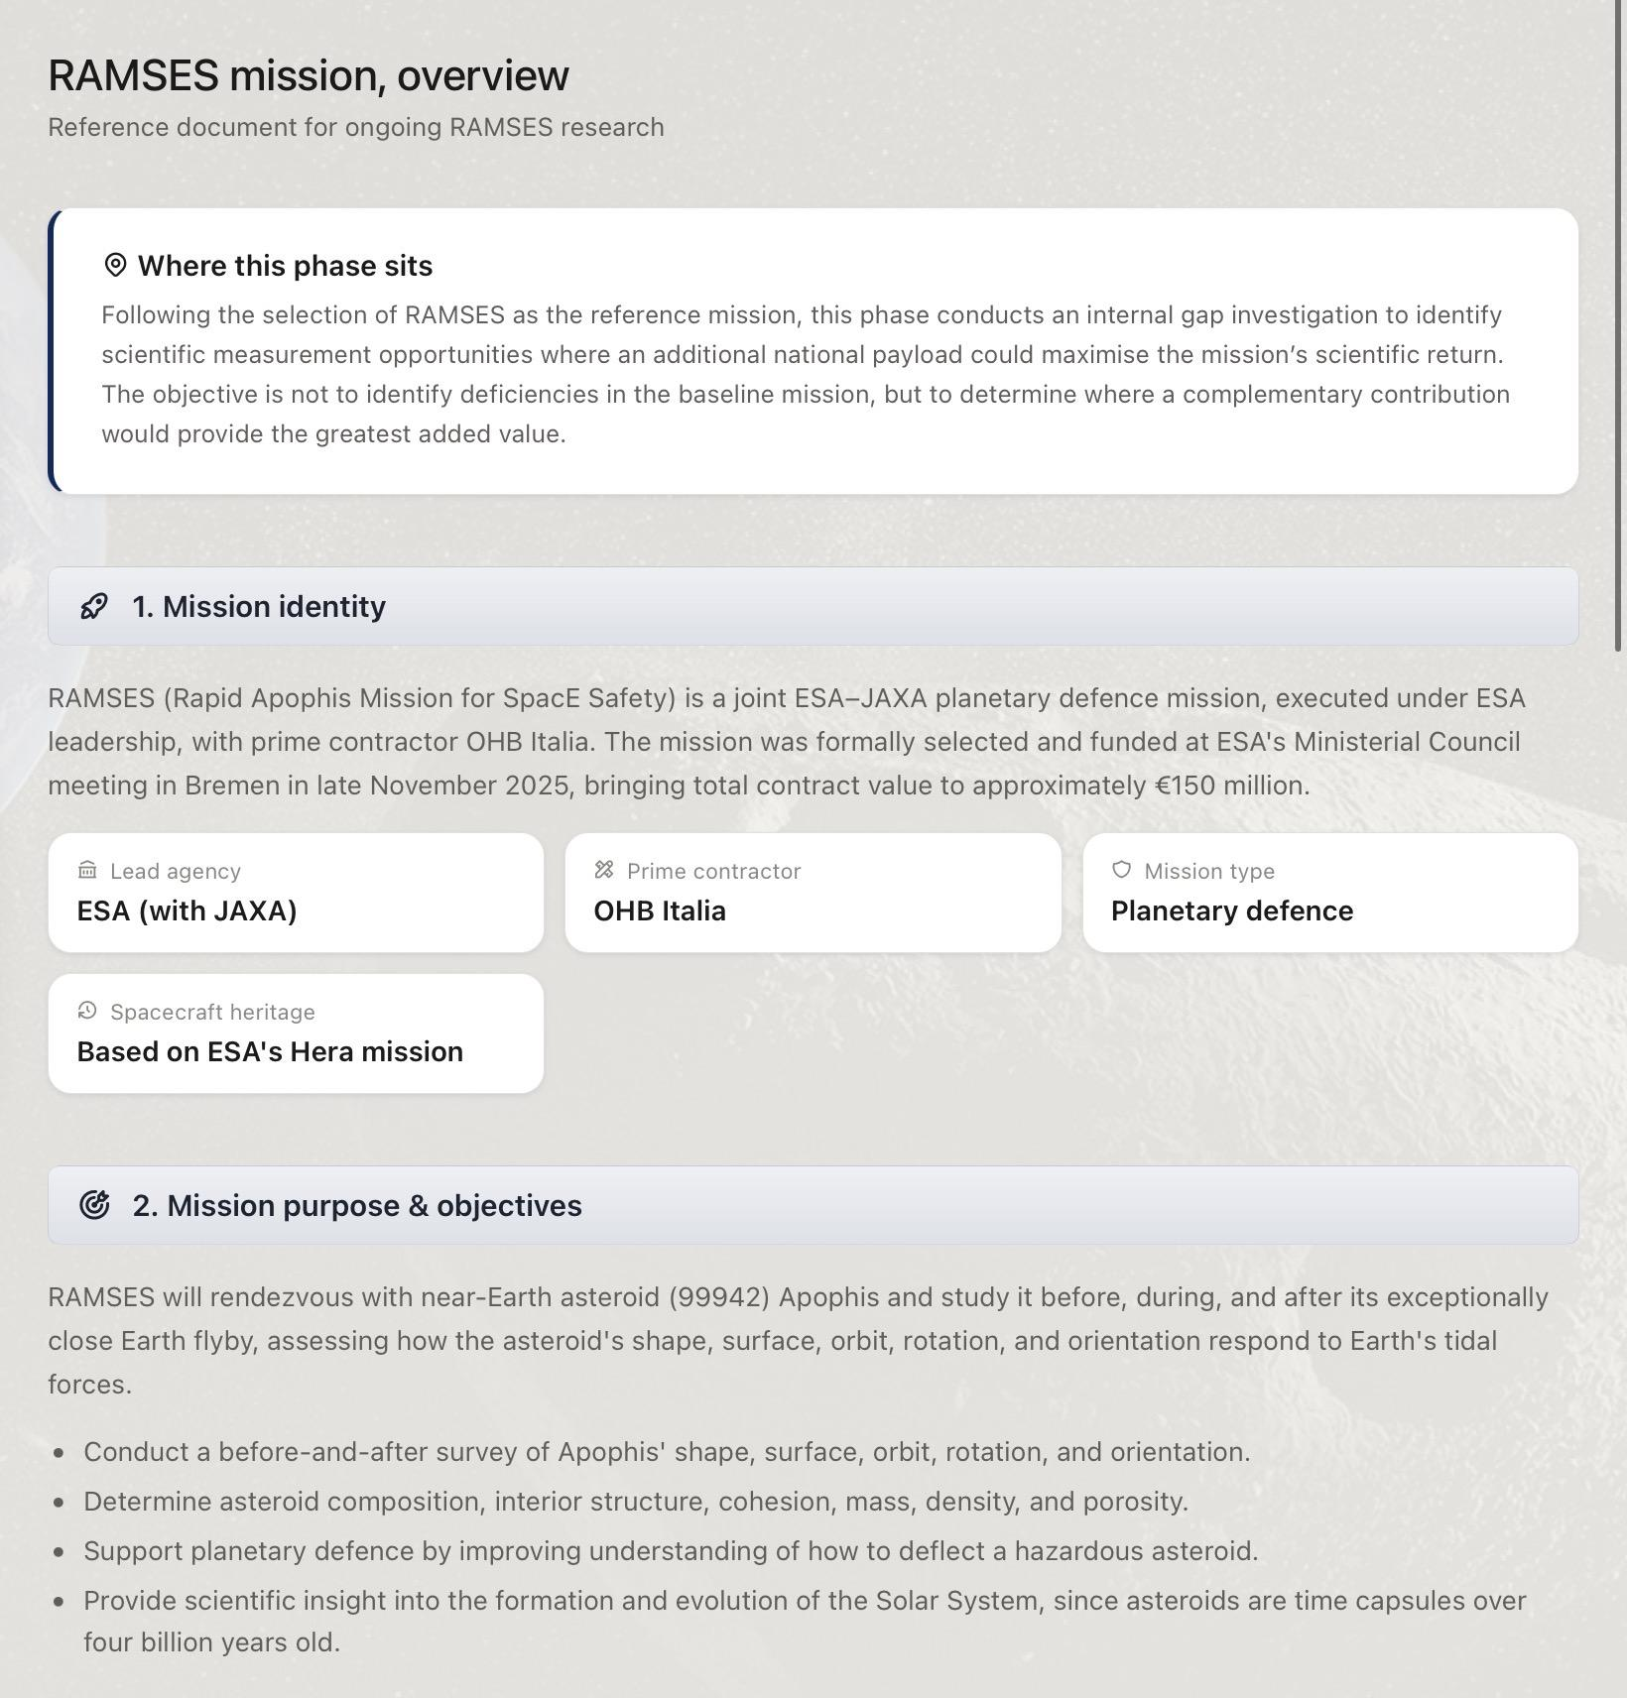
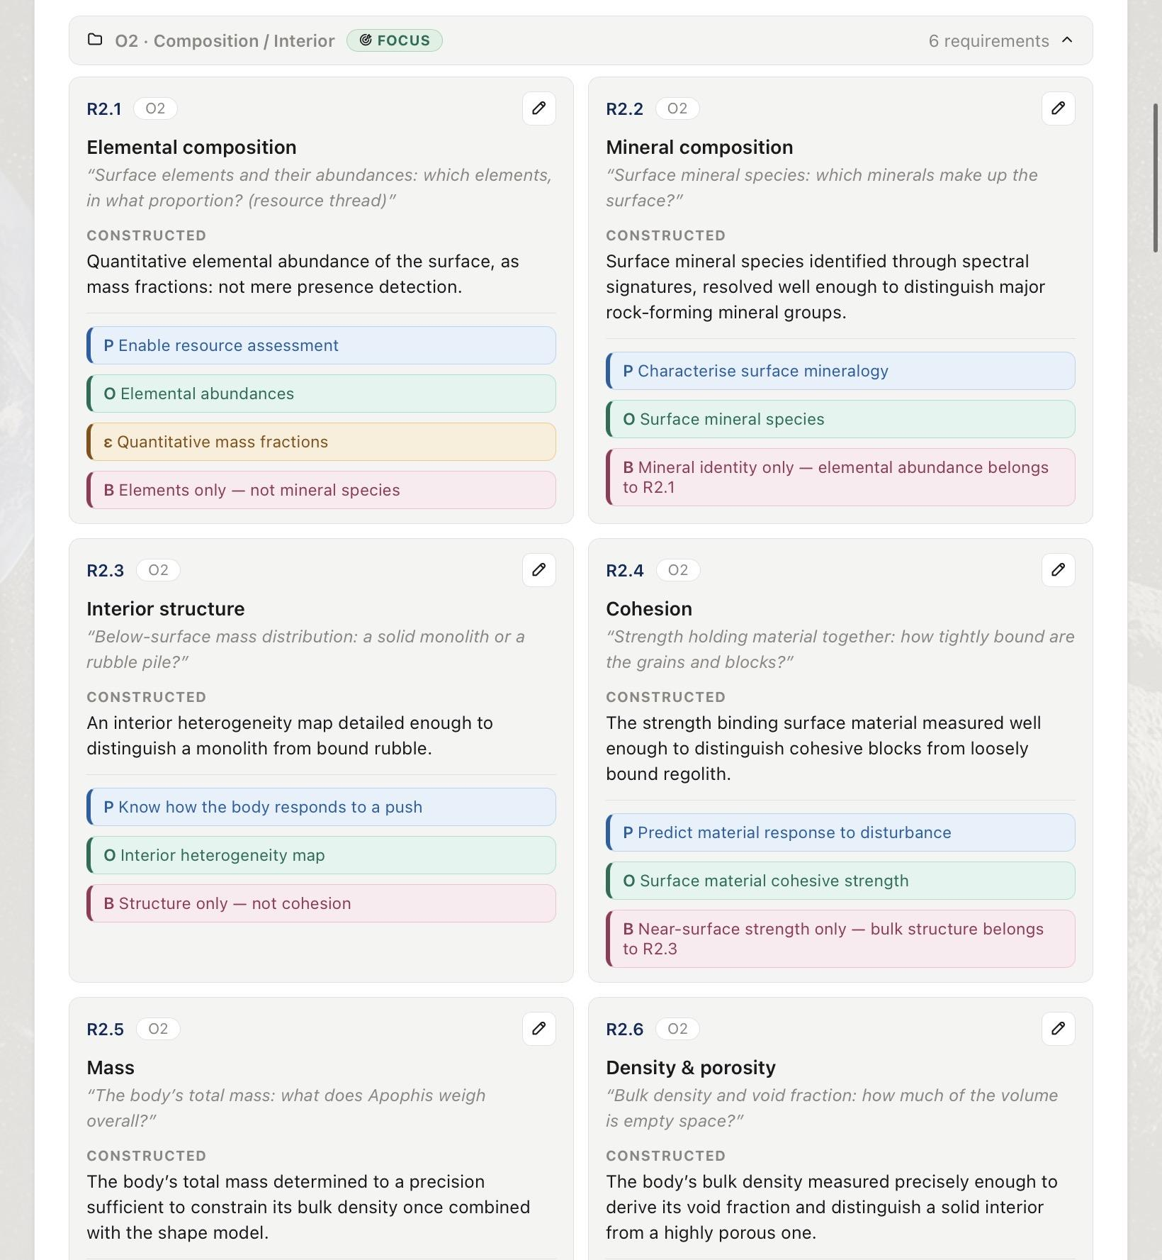
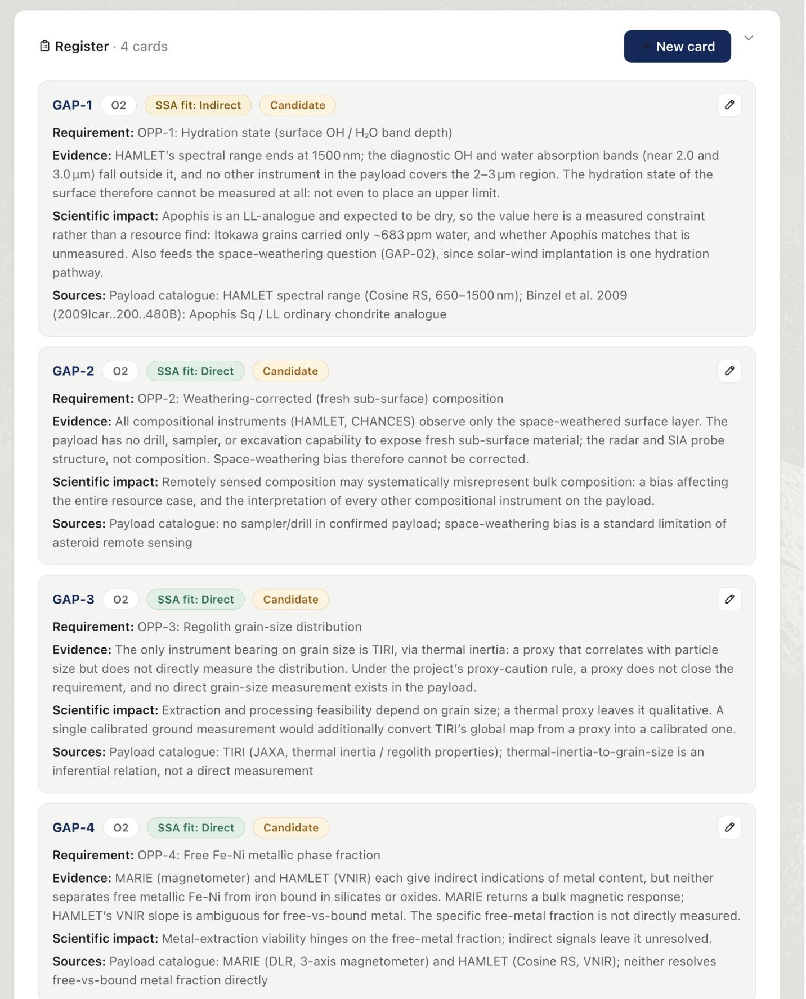
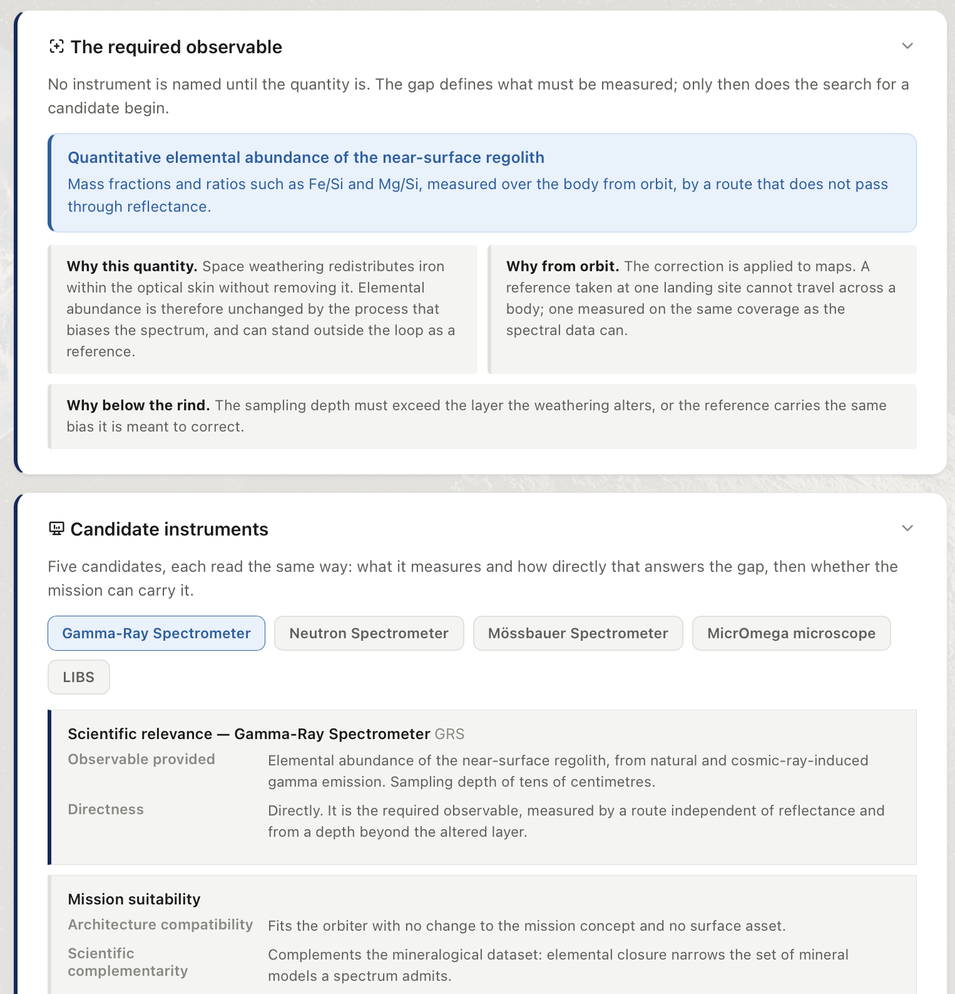
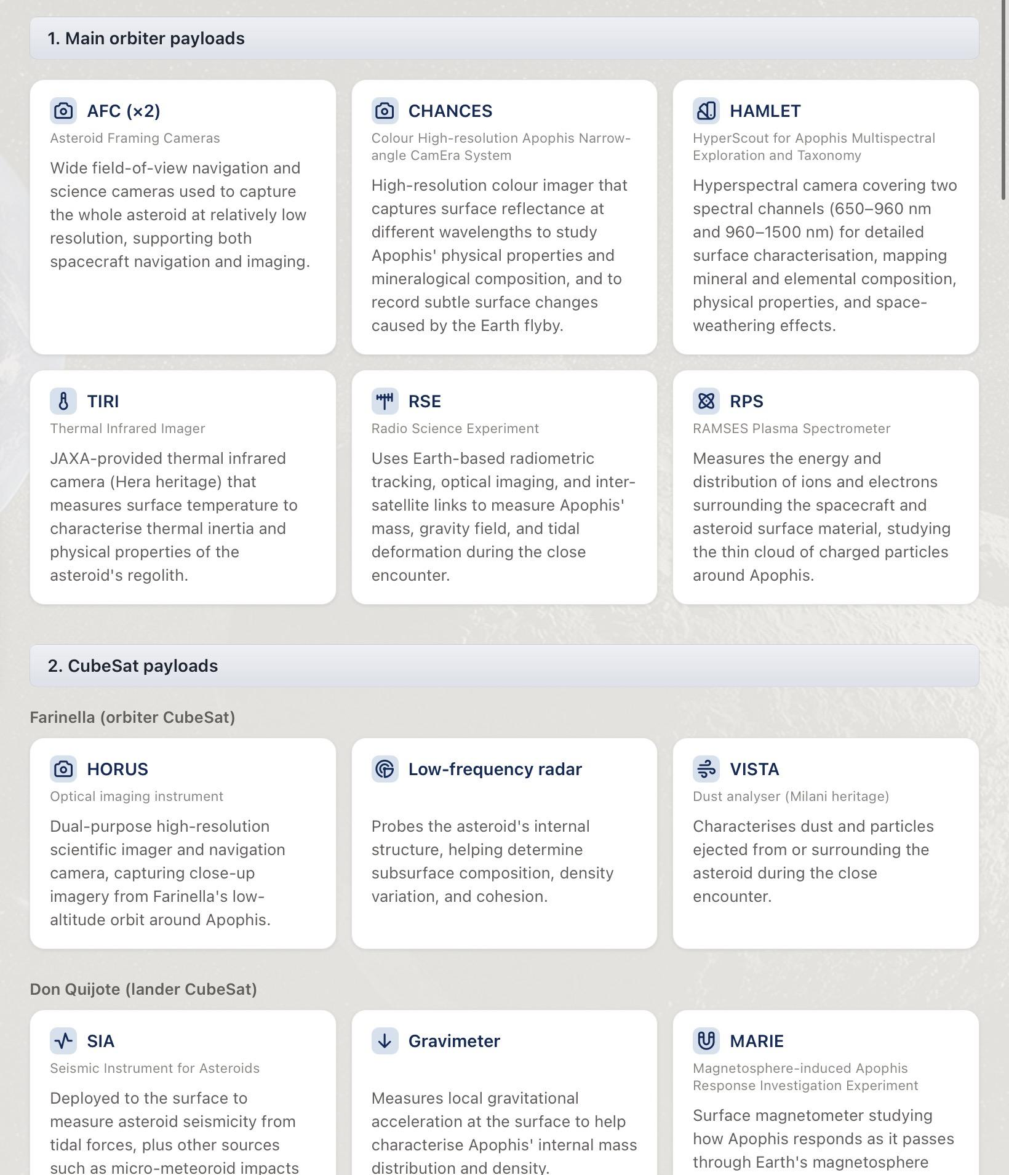
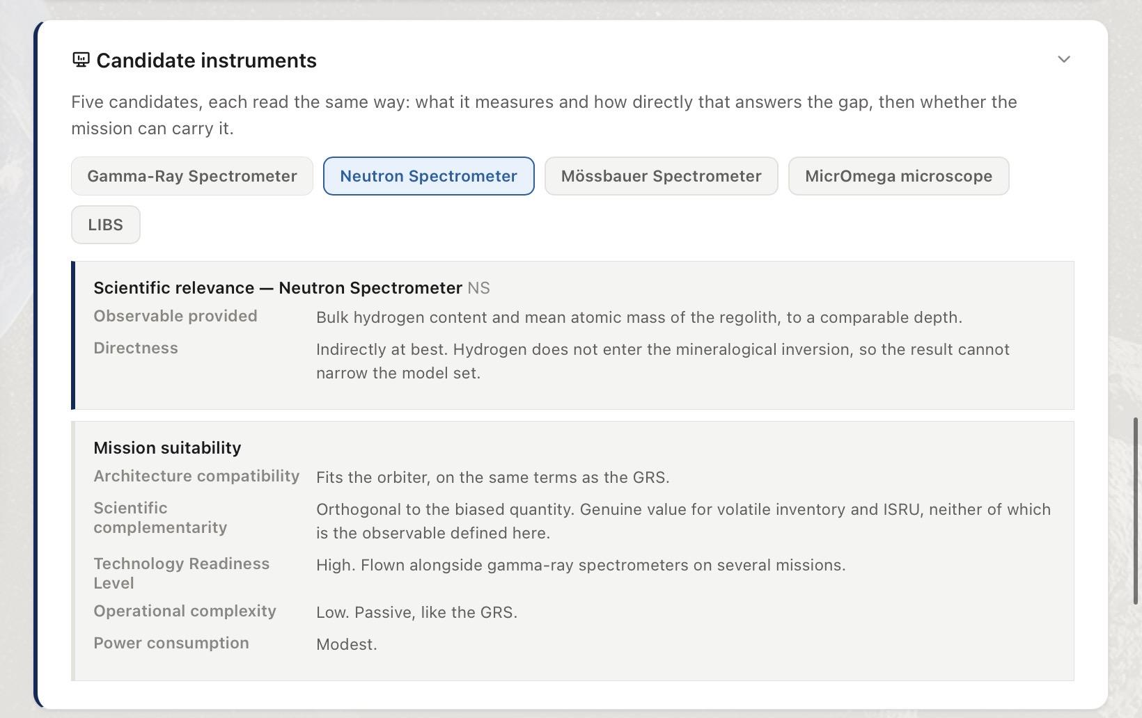
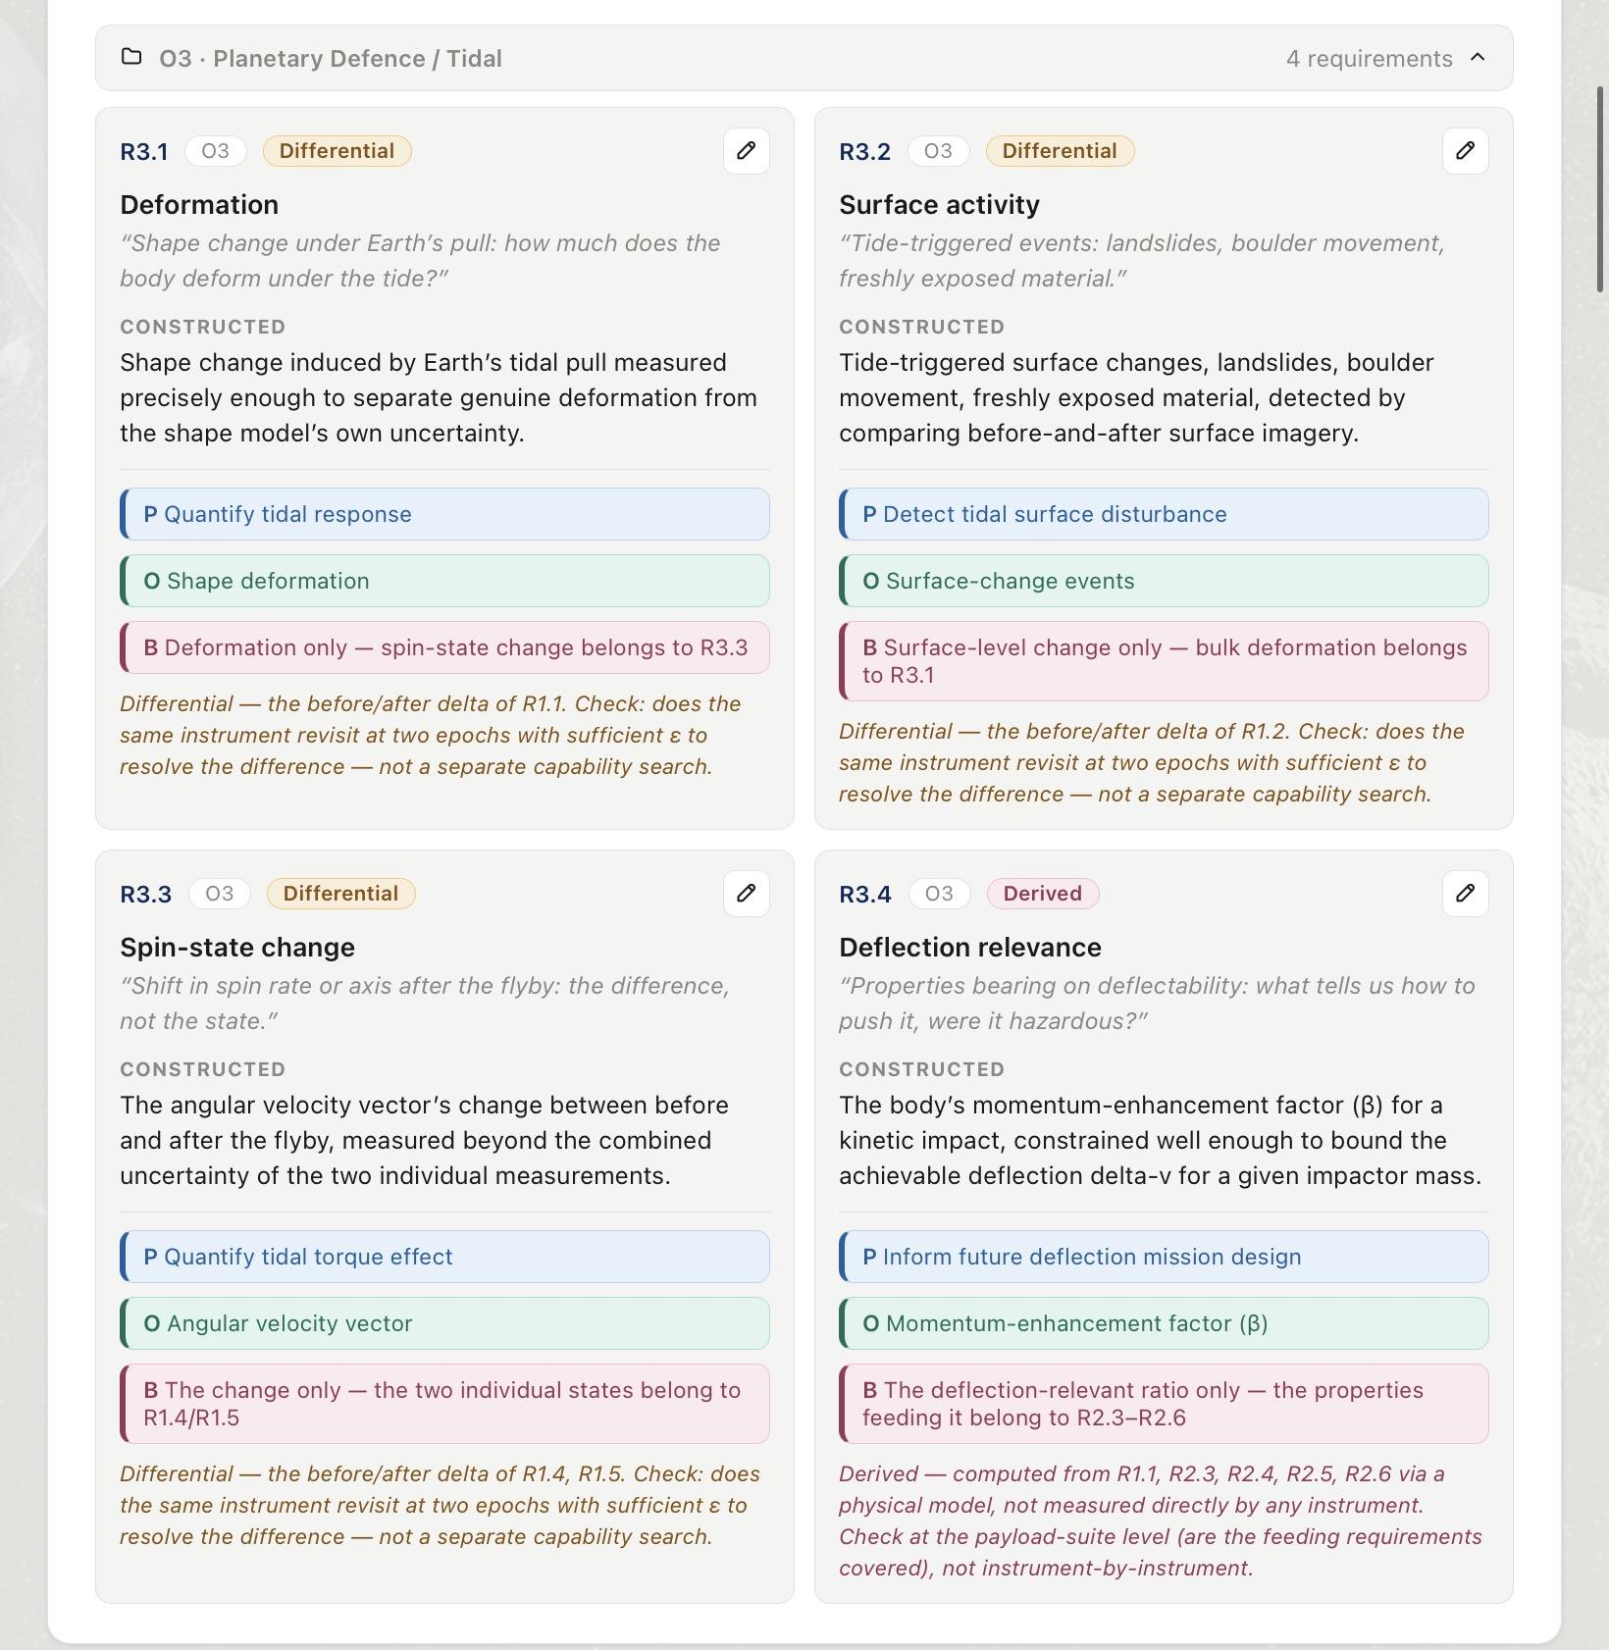
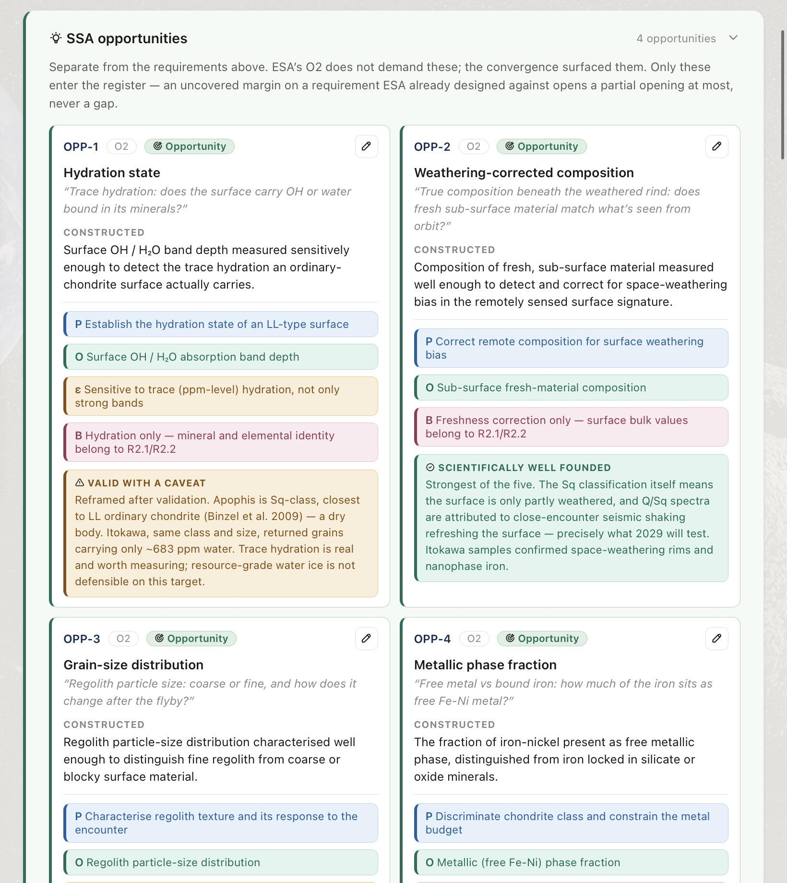
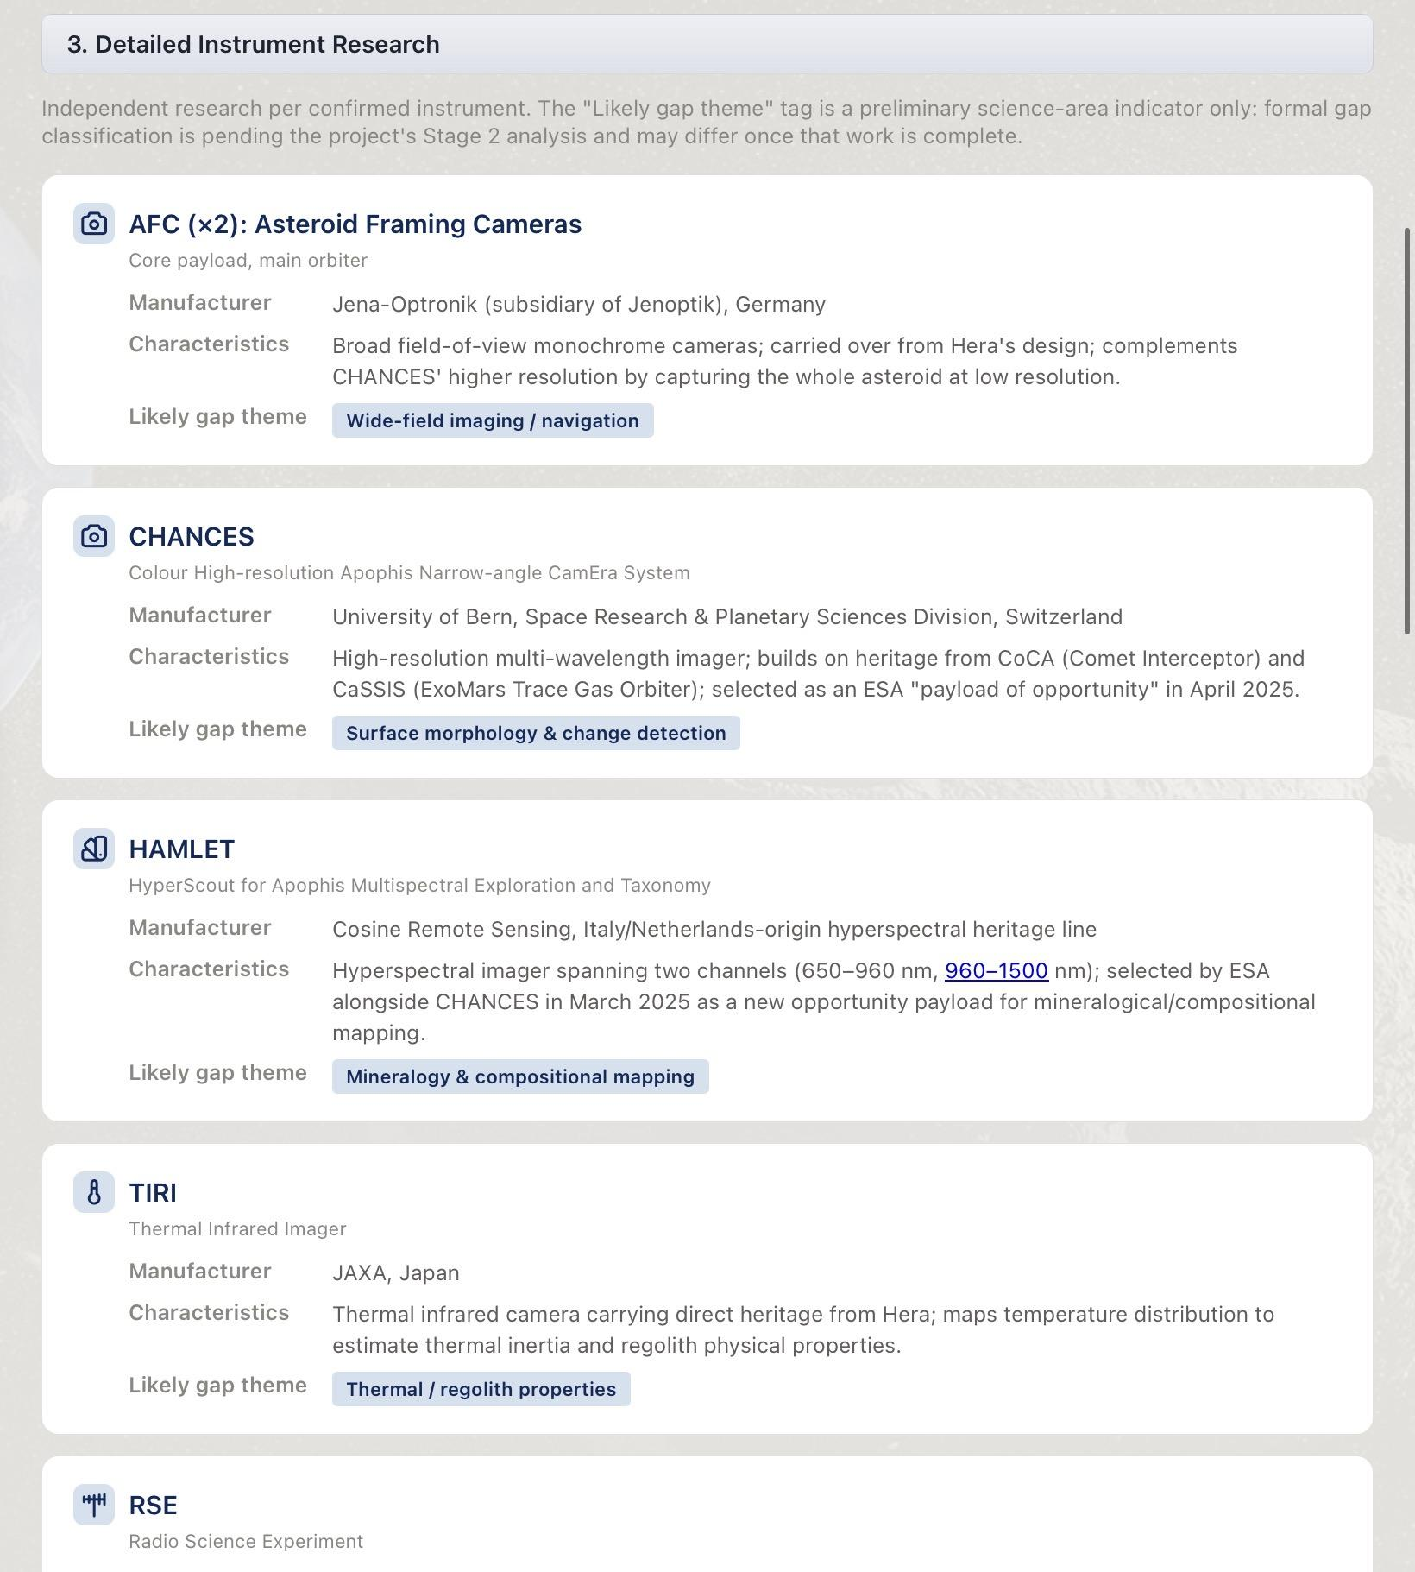
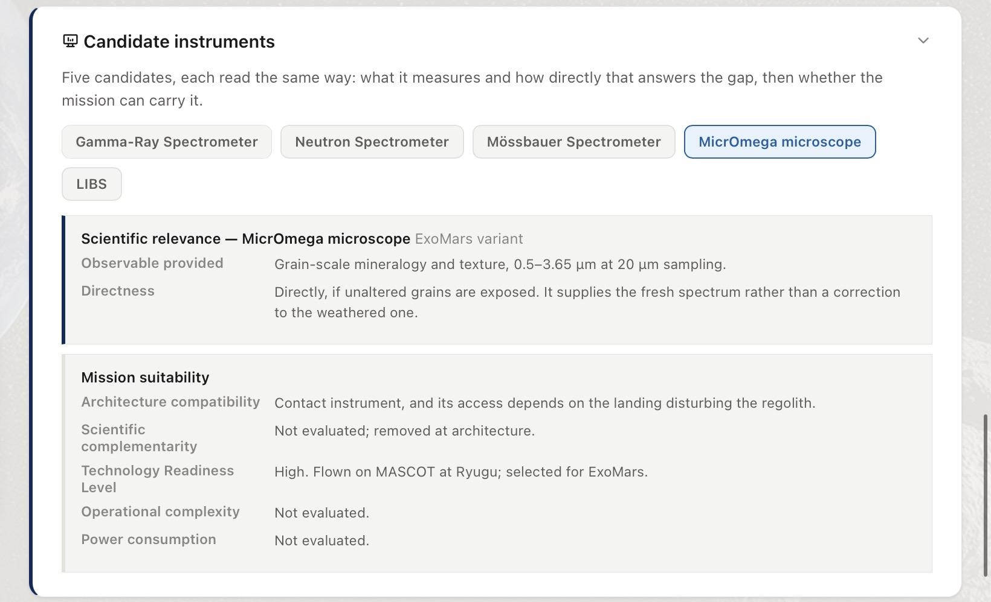
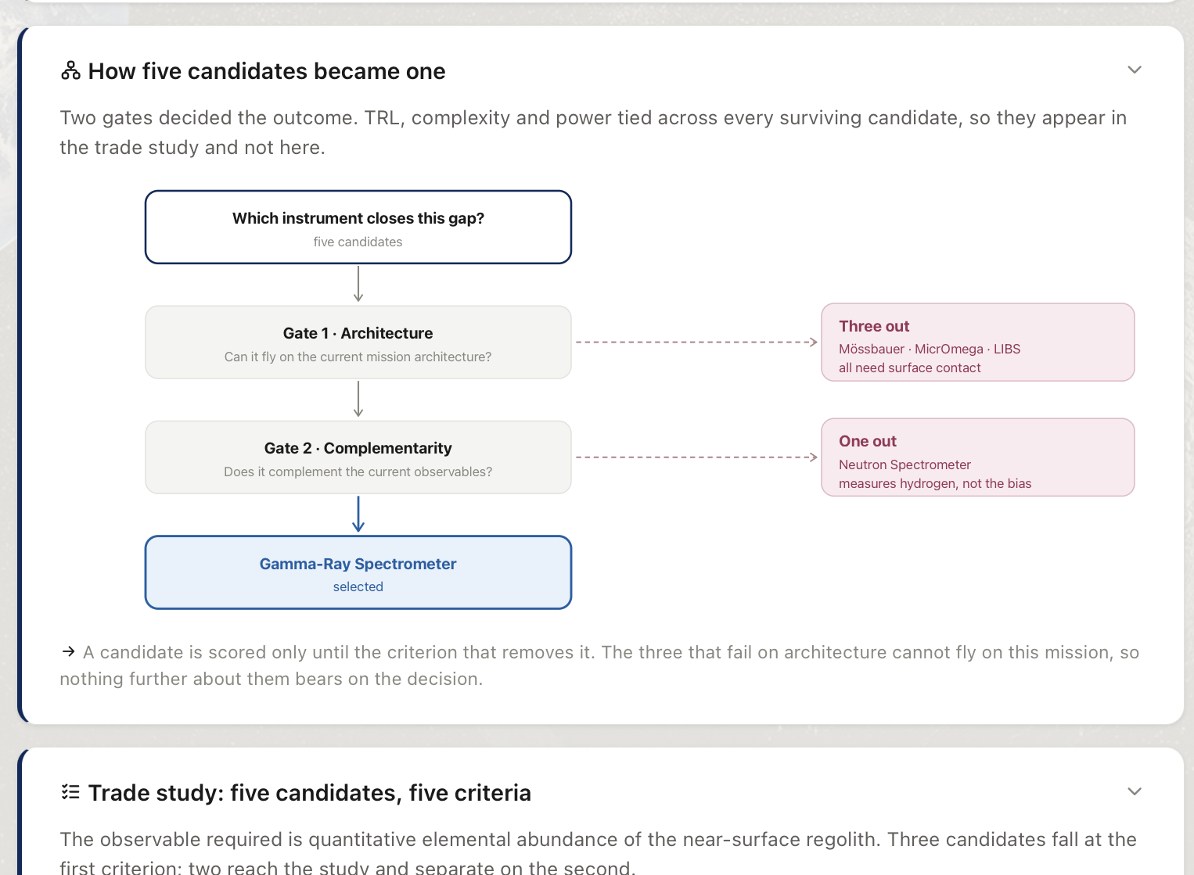
Methodology
A structured analysis narrowed four knowledge gaps to one payload
RAMSES baseline
Mission Measurements
Knowledge gaps
Payload trade-off
Studied the mission objectives, platforms and payloads
Broke the 4 mission objectives into 19 scientific measurements, mapped the 19 measurements into the 12 instruments of the mission
Determined 4 knowledge gaps by identifying the non measured measurements and prioritized 1 knowledge gap
Identified multiple instruments that can measure the knowledge gap
One recommended payload
BASELINE KNOWLEDGE GAPS SELECTION RECOMMENDATION VALUE
06
Public عام

Slide 6


RAMSES Mission Overview
Rapid Apophis Mission for Space Safety , joint ESA–JAXA planetary defense mission.
TARGET & TIMELINE
MISSION PUBLISHED OBJECTIVES
Designation
Asteroid (99942) Apophis
O1
Shape, orbit and rotation
Size
~375 m across
Before-and-after survey of shape, surface, orbit, rotation and orientation.
O2
Composition and interior
Taxonomy
Sq type, LL chondrite analogue
Composition, interior structure, cohesion, mass, density and porosity.
Launch
Spring 2028, H3 Rocket, Tanegashima
O3
Tidal response
Arrival
February 2029
How the asteroid responds to Earth's tidal forces.
O4
Solar System science
Close flyby
13 April 2029, ~32,000 km
Insight into the formation and evolution of the Solar System.
Mission architecture:
Main Orbiter
Farinella: orbiter CubeSat
Don Quijote: lander CubeSat
6 INSTRUMENTS
3 INSTRUMENTS
3 INSTRUMENTS
AFC (×2) · CHANCES · HAMLET · TIRI · RSE · RPS
HORUS · Low-frequency radar · VISTA
SIA · Gravimeter · MARIE
BASELINE KNOWLEDGE GAPS SELECTION RECOMMENDATION VALUE
05
Public عام

Slide 7

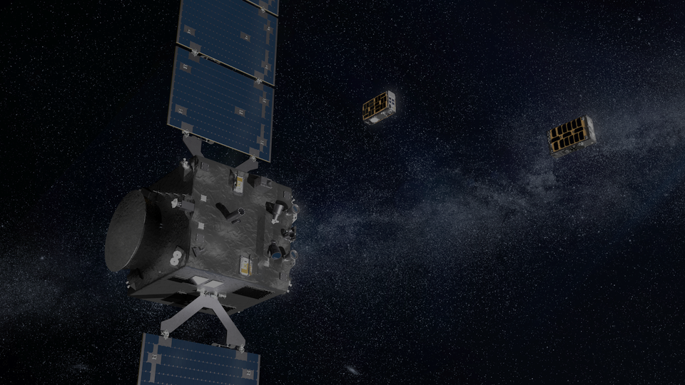
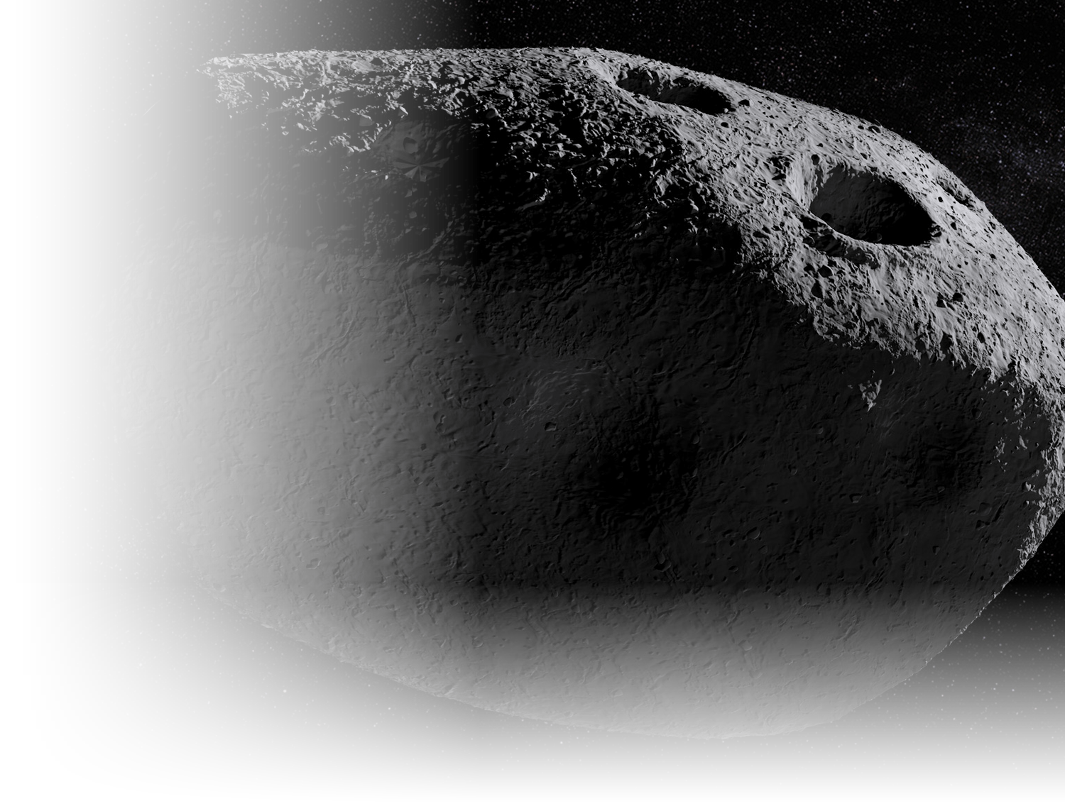
What RAMSES Measures
Confirmed payload by platform
Main Orbiter
Farinella · Orbiter CubeSat
Don Quijote · Lander CubeSat
AFC (×2)
HORUS
SIA
Wide-field navigation imaging and shape mapping
Close-range imaging beyond orbiter resolution
Seismic response to tidal stress and cracking
CHANCES
Radar
Gravimeter
High-resolution color imaging of surface change
Interior structure via dielectric sounding
Local density from gravitational acceleration
HAMLET
VISTA
MARIE
Composition and space weathering, 650–1500 nm
Volatile and organic content of captured dust
Magnetic response during the Earth flyby
TIRI
Surface temperature, thermal inertia, grain size
RSE
Radio tracking; gravity, spin state and tidal response
RPS
Ion and electron energy near the spacecraft
BASELINE KNOWLEDGE GAPS SELECTION RECOMMENDATION VALUE
07
Public عام

Slide 8
What the Mission Must Measure
The four objectives were decomposed into 19 measurements. Those 15 are already measured by the confirmed payloads
Read the objectives
Split into raw demands
Write the requirement
Classify the type
1
ESA's four published aims,
2
one question per demand, no instrument named
3
purpose, observable, threshold, boundary
4
direct, differential, or derived
O1
Shape, orbit and rotation
O2
Composition and interior
O3
Tidal response
5 MEASUREMENTS
6 MEASUREMENTS
4 MEASUREMENTS
M1.1
Shape
M2.1
Elemental composition
M3.1
Deformation
M1.2
Surface
M2.2
Mineral composition
M3.2
Surface activity
M1.3
Orbit
M2.3
Interior structure
M3.3
Spin-state change
M1.4
Rotation
M2.4
Cohesion
M3.4
Deflection relevance
M1.5
Orientation
M2.5
Mass
M2.6
Density and porosity
15 of the 19 measurements are already covered by the mission. The four that are not measured are the knowledge gaps.
BASELINE KNOWLEDGE GAPS SELECTION RECOMMENDATION VALUE
08
Public عام

Slide 9
Four Knowledge Gaps
Measurement openings the mission never set out to address, registered only where no confirmed instrument meets them.
GAP-1
GAP-2
GAP-3
GAP-4
Weathering-corrected composition
Regolith grain-size distribution
Free Fe–Ni metallic phase fraction
Hydration state
The abundance and mineralogical binding of surface water and hydroxyl remain uncertain, limiting our ability to determine whether the body experienced aqueous alteration and to assess its volatile-resource potential.
What the regolith is made of beneath the surface layer altered by space weathering. An independent composition measurement is needed to distinguish the underlying composition from weathering effects.
How the loose surface material divides across particle sizes, from dust to boulders. It governs how regolith responds to disturbance and whether it can be processed.
How much of the iron is free metal rather than bound inside silicates. Only the free fraction separates magnetically, so it carries the metal-resource case.
BASELINE KNOWLEDGE GAPS SELECTION RECOMMENDATION VALUE
09
Public عام

Slide 10
Priority Selection
Two criteria. A knowledge gap must verify both to be carried forward.
1
Scientific value
2
Mission compatibility
Does the gap provide a scientifically unique measurement that cannot be reliably inferred from existing knowledge?
Can the measurement be performed from the existing orbiter without duplicating the confirmed payload?
GAP-1
GAP-2
GAP-3
GAP-4
Hydration state
Weathering-corrected composition
Regolith grain-size distribution
Free Fe-Ni phase fraction
DISQUALIFIED · SCIENTIFIC VALUE
RECOMMENDED
DISQUALIFIED · MISSION COMPABILITY
DISQUALIFIED · SCIENTIFIC VALUE
Apophis is an LL analogue, and LL chondrites are dry. The likely result is an upper limit, which confirms the taxonomy instead of testing it.
RAMSES has no independent measurement of the unweathered composition. The result cannot be inferred from taxonomy, and the 2029 encounter may provide a unique opportunity to observe changes in surface maturity.
TIRI estimates grain size through thermal inertia but does not directly measure the grain-size distribution. Direct measurement requires contact with the regolith, which is not compatible with an orbiter payload.
For an LL-chondrite analogue, the expected free-metal fraction is low and largely constrained by the known meteorite class. The measurement would therefore provide limited new information and is not unique to the Apophis encounter.
ONE PRIORITY
Weathering-corrected composition
BASELINE KNOWLEDGE GAPS SELECTION RECOMMENDATION VALUE
10
Public عام

Slide 11
The Scientific Problem
Space weathering alters the surface spectrum without changing the asteroid's bulk composition.
Fresh surface composition
Space weathering alters the surface
Observed optical spectrum is altered
Biased mineralogical interpretation
RAMSES can measure the weathered spectrum,
but it has no independent measurement of the underlying elemental composition needed to correct it.
No independent compositional reference.
Why Apophis makes this important
HAMLET derives mineralogical information from the same weathered spectrum affected by space weathering. Without an independent elemental measurement, the correction cannot be independently validated.
Apophis is an Sq-type asteroid with a partially refreshed surface. The 2029 Earth encounter may alter the surface maturity, creating a rare opportunity to observe how space weathering changes the measured spectrum.
BASELINE KNOWLEDGE GAPS SELECTION RECOMMENDATION VALUE
11
Public عام

Slide 12
The Required Observable
What measurement would fill the gap?
Subsurface elemental abundance
of regolith beneath the weathered surface
1
Orbital
2
Below the weathered surface
The measurement will be observed from the orbit, since a single landing-site measurement cannot represent the entire asteroid surface.
Must sense below the space-weathered layer so the reference reflects underlying composition rather than the altered surface.
BASELINE KNOWLEDGE GAPS SELECTION RECOMMENDATION VALUE
12
Public عام

Slide 13
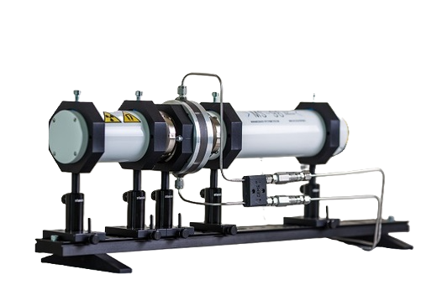
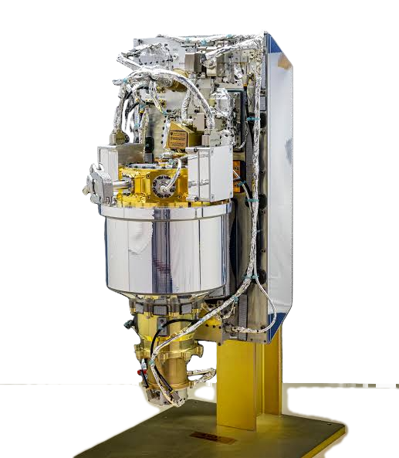
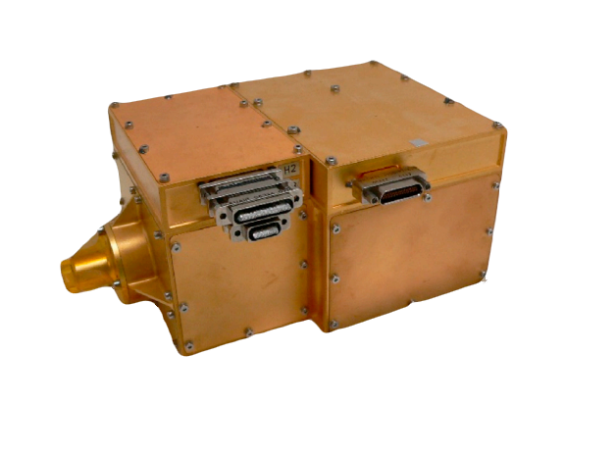
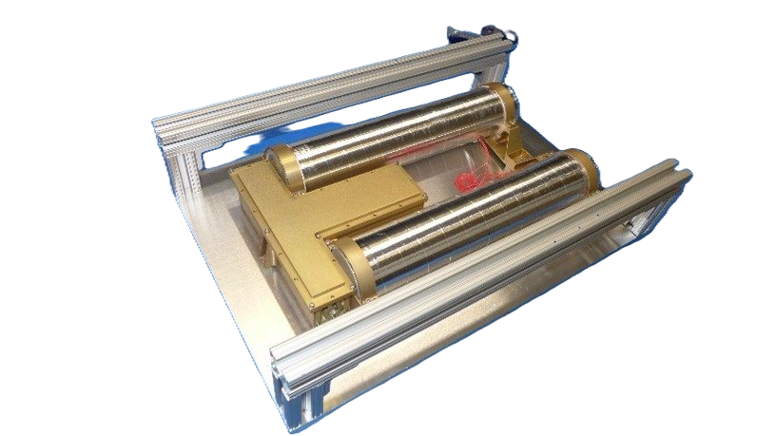
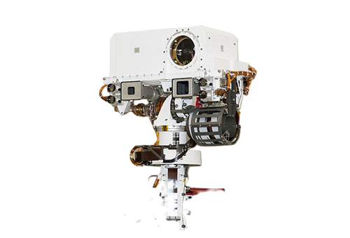
Candidate Payload Assessment
5 candidate payloads, screened against the required observable and the orbital compatibility
Mössbauer Spectrometer
MicrOmega Microscope
Neutron Spectrometer
LIBS, ChemCam class
Gamma-Ray Spectrometer
Measures: Fe oxidation state / Fe-bearing phases
Depth: ~0.2–3 mm
Strength: direct iron-phase information
Limitation: requires surface contact
Architecture: Not compatible
Measures: grain-scale mineralogy
Depth: Surface / grain-scale
Strength: detailed mineral identification
Limitation: requires contact with sampled material
Architecture: Not compatible
Measures: hydrogen / neutron moderation
Depth: bulk / subsurface sensitivity
Strength: independent of reflected light
Limitation: does not provide the required multi-element ratios
Architecture: Orbiter-compatible
Measures: elemental composition
Depth: Sub-mm to ~1 mm, depending on material
Strength: depth-resolved surface analysis
Limitation: close-range / high-pointing-precision operation
Architecture: Not compatible
Measures: elemental abundance
Depth: tens of cm scale
Strength: independent of reflected light
Architecture: Orbiter-compatible
Eliminated
Eliminated
Eliminated
Eliminated
RECOMMENDED
BASELINE KNOWLEDGE GAPS SELECTION RECOMMENDATION VALUE
13
Public عام

Slide 14

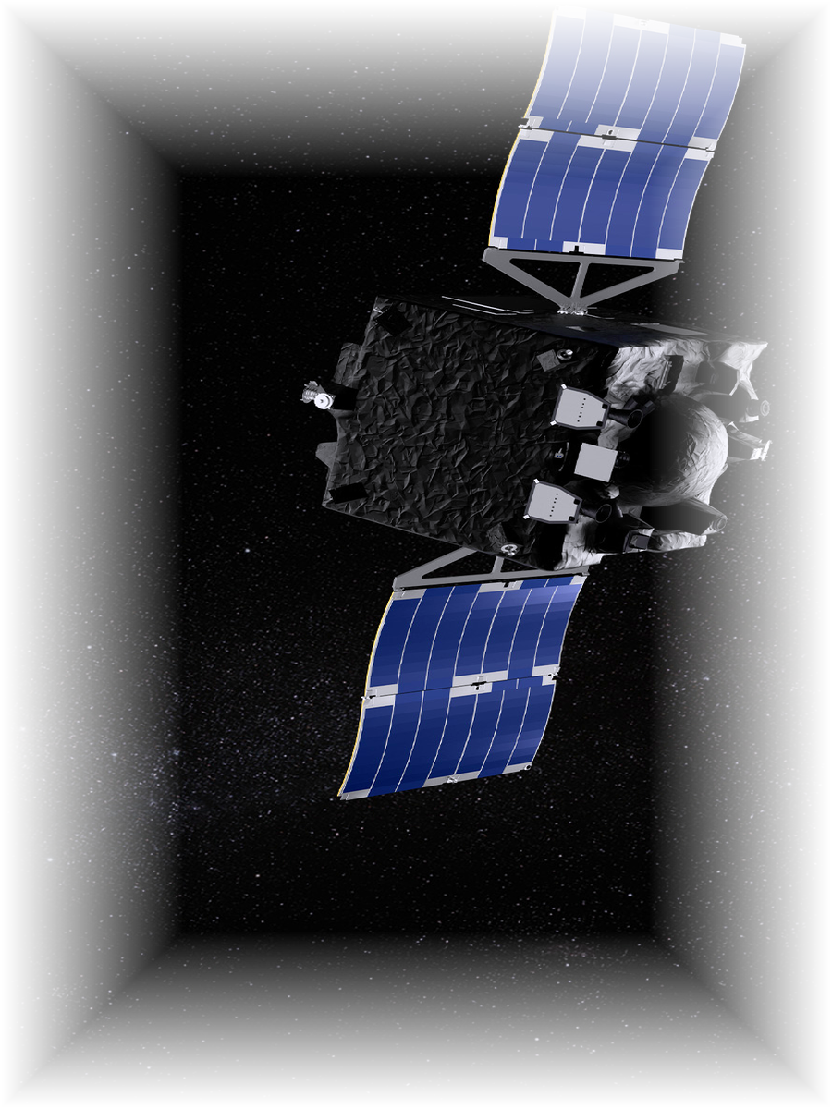
Recommendation
RECOMMENDED PAYLOAD ENHANCEMENT
Gamma-Ray Spectrometer
RAMSES Main Orbiter
WHY
01
02
03
04
05
Independent of reflected light
Measures elemental abundance
Samples below the weathered layer
Strengthens HAMLET's interpretation
Fits the existing mission architecture
HAMLET
+
Gamma-Ray Spectrometer
Better composition interpretation
Mineralogy
Elements
BASELINE KNOWLEDGE GAPS SELECTION RECOMMENDATION VALUE
14
Public عام

Slide 15
Next Steps
Psyche is the closest heritage mission: the same measurement — orbital elemental composition of an asteroid — is central to our proposed GRS. We therefore use its flight-proven architecture as the reference point, while targeting a smaller implementation compatible with RAMSES.
APL
LLNL
Johns Hopkins Applied Physics Laboratory
Lawrence Livermore National Laboratory
Instrument build & integration
High-purity germanium detector technology
Instrument Heritage: MEGANE·MESSENGER·Psyche
WHAT’S NEXT?
01
ESA / JAXA Engagement
02
APL / LLNL Engagement
Confirm the status of the mission and the possibility of collaboration.
Discuss the gamma ray payload specifications and availability.
BASELINE KNOWLEDGE GAPS SELECTION RECOMMENDATION VALUE
15
Public عام

Slide 16
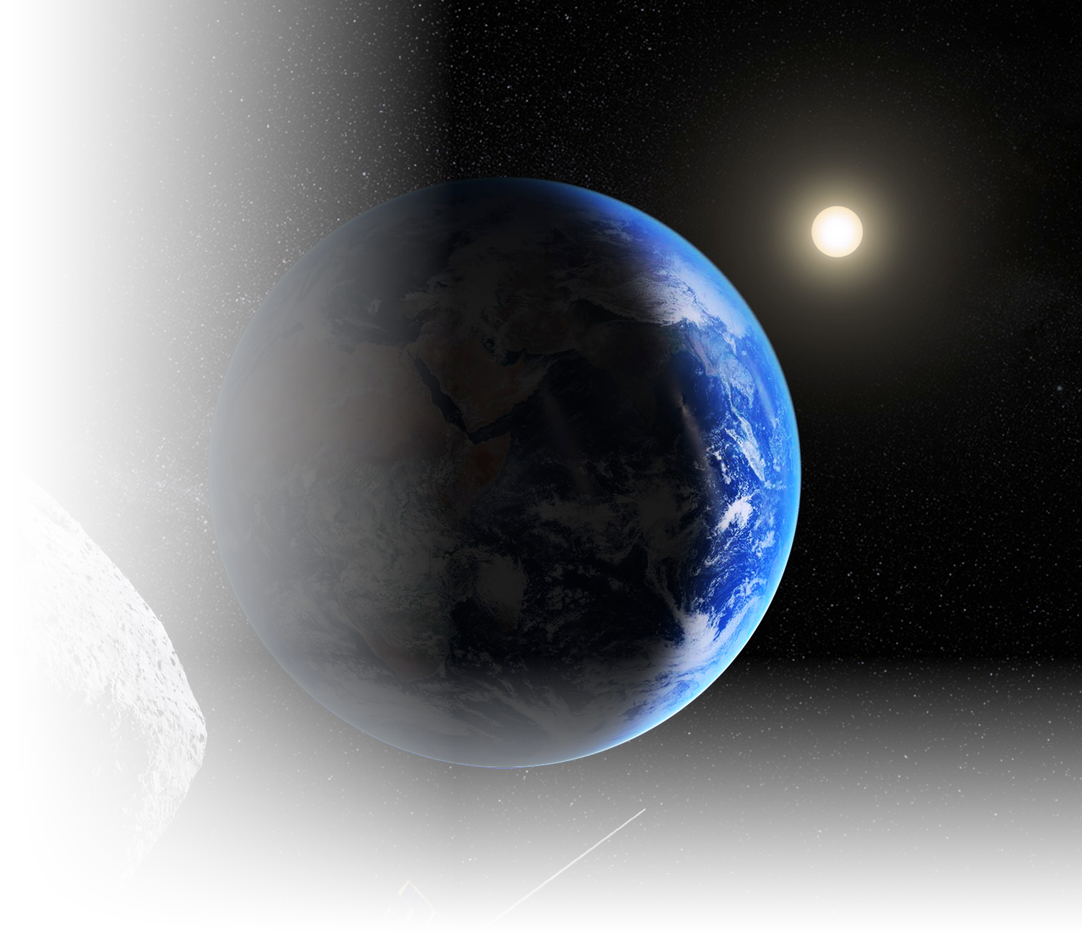
Why This Matters to SSA
01
Scientific
Adds a dataset RAMSES cannot generate independently.
02
Strategic
Moves SSA from observer to contributor on a flagship mission.
03
Programmatic
Uses a proven instrument and a proven partnership model.
BASELINE KNOWLEDGE GAPS SELECTION RECOMMENDATION VALUE
16
Public عام

Slide 17
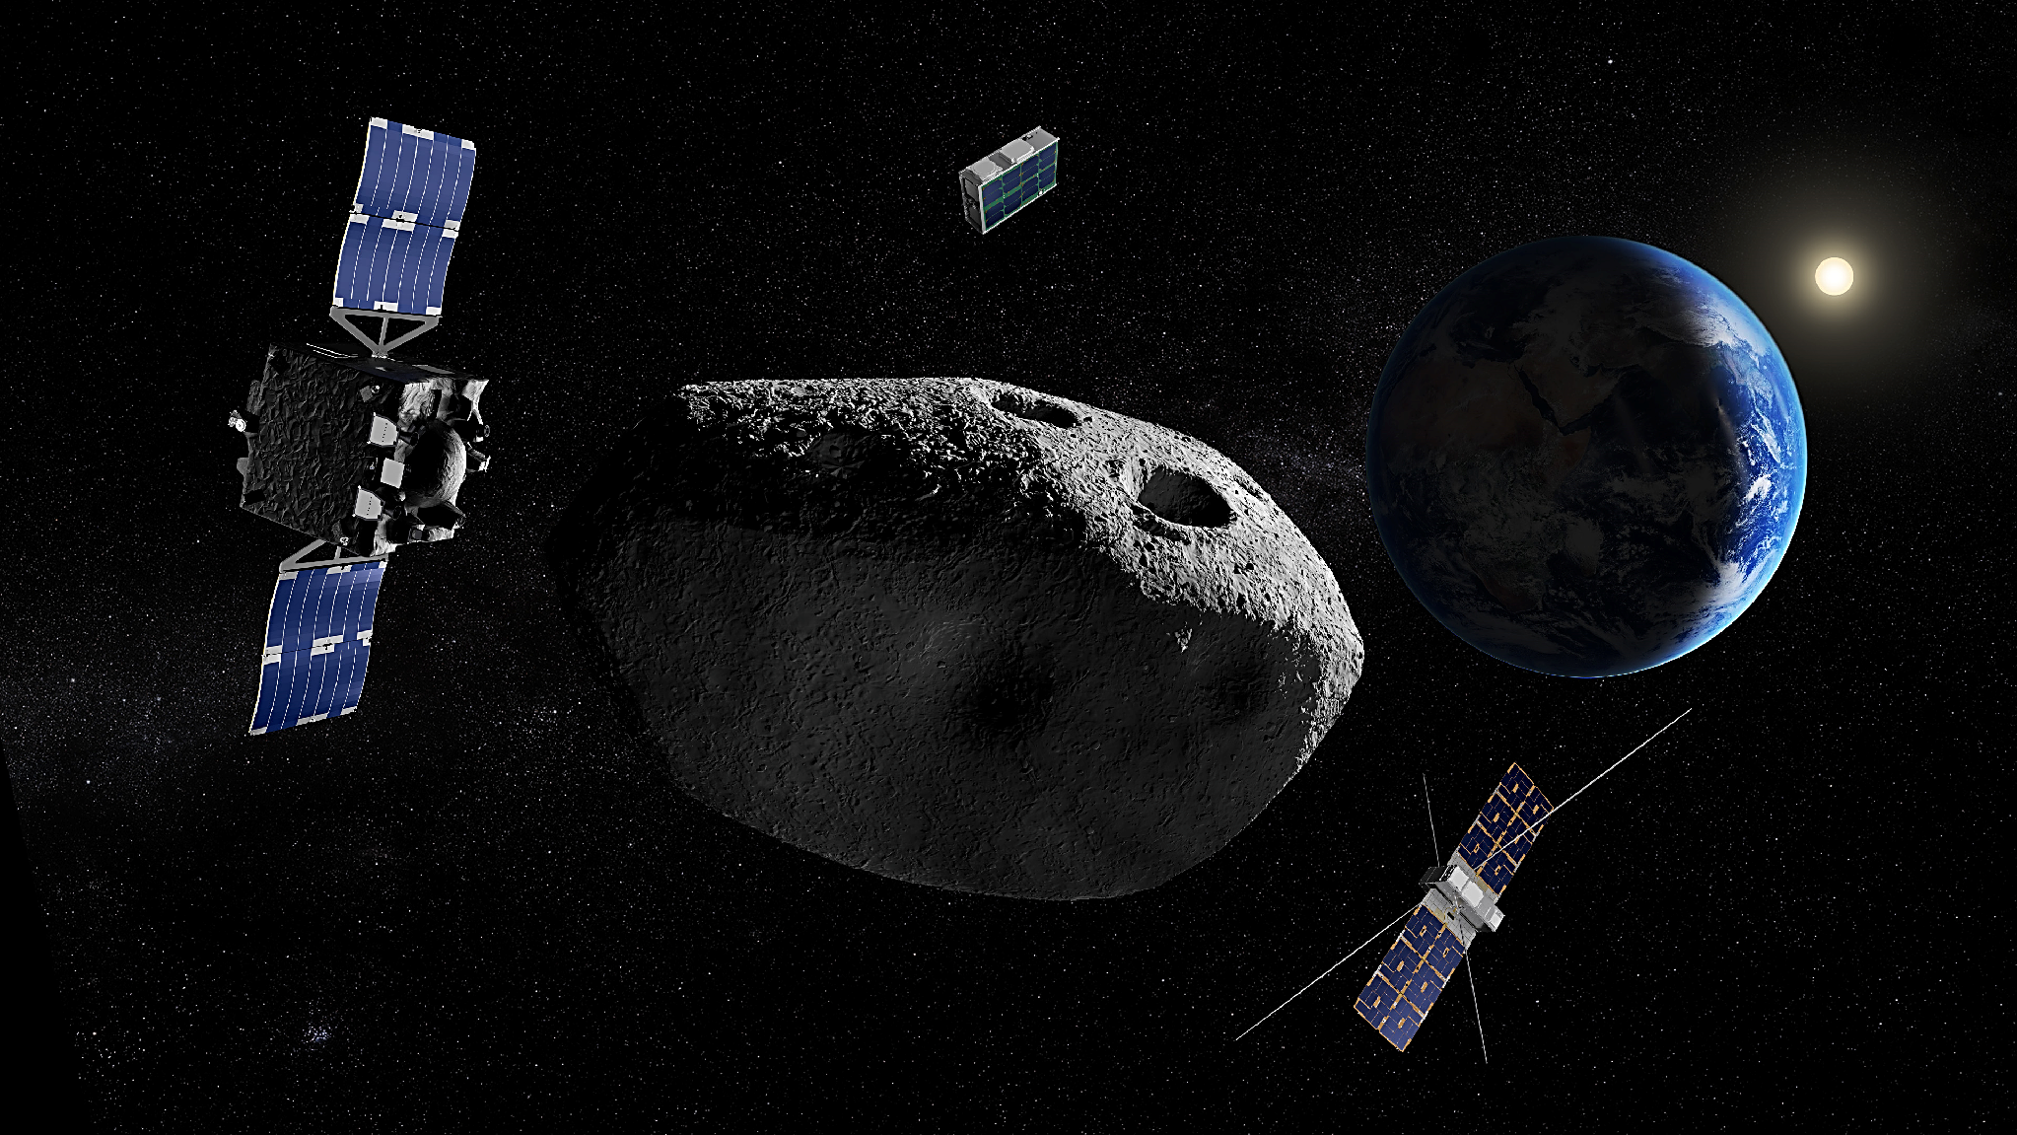
Thank you!
17
Public عام

