Slide 1
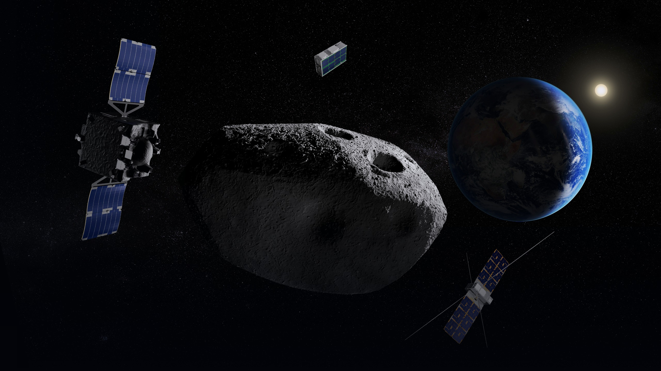

SSA SUMMER TRAINING | JULY - AUGUST 2026
Noora AlQuaydhib Summer Training Journey
Scientific Gap Assessment and Payload Recommendation for RAMSES Mission for Asteroid (99942) Apophis
Supervised by Najla AlAhmadi & Rawan AlRayes
Public عام

Slide 2

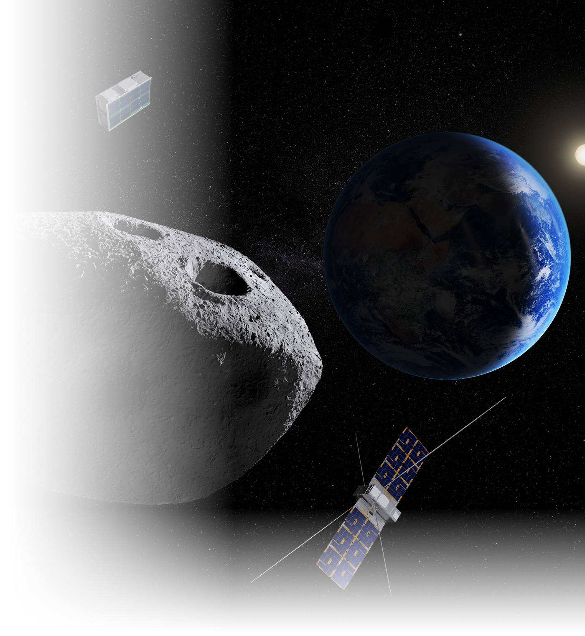
Context & Strategic Rationale
01
The Event
On 13 April 2029. Apophis passes within ~32,000 km, closer than geostationary satellites, visible to the naked eye.
02
The Mission
ESA has committed. ~EUR 150 million with OHB Italia. Now in build. Launch spring 2028, arrival February 2029.
03
The Platform
A spacecraft in build still accepts payload conversations. The encounter will not recur.
04
The Goal
An SSA instrument converts observer status into participant status on a joint ESA–JAXA mission.
The question is no longer whether to participate.
Phase 1 settled the mission. What remains is to put a specific, technically credible contribution on the table while the build phase can still accommodate it.
1
Public عام

Slide 3


Study Objective & Scope
The second phase of a two-part programme. The first selected the mission; this one determines the contribution.
WHERE THIS STUDY SITS
OBJECTIVE
Identify the single measurement opportunity where an additional national payload would most increase the scientific return of RAMSES and carry it to a named instrument and a named route to obtaining it.
PHASE 1 — COMPLETED
Asteroid Mission Study
11 missions benchmarked → 2 prioritized → RAMSES selected.
SCOPE BOUNDARIES
PHASE 2 — THIS STUDY
Confirmed payload by ESA only.
Payload Study
Must fit the existing architecture: no new spacecraft, stage or surface asset.
What does SSA put on the mission?
Methodology self-contained; heritage missions are context, not evidence.
2
Public عام

Slide 4
RAMSES Mission Overview
Rapid Apophis Mission for Space Safety , joint ESA–JAXA planetary defence mission.
TARGET & TIMELINE
MISSION PUBLISHED OBJECTIVES
Designation
Asteroid (99942) Apophis
O1
Shape, orbit and rotation
Size
~375 m across
Before-and-after survey of shape, surface, orbit, rotation and orientation.
O2
Composition and interior
Taxonomy
Sq type, LL chondrite analogue
Composition, interior structure, cohesion, mass, density and porosity.
Launch
Spring 2028, H3 Rocket, Tanegashima
O3
Tidal response
Arrival
February 2029
How the asteroid responds to Earth's tidal forces.
O4
Solar System science
Close flyby
13 April 2029, ~32,000 km
Insight into the formation and evolution of the Solar System.
Payload architecture: three platforms, twelve confirmed instruments
Main Orbiter
Farinella: orbiter CubeSat
Don Quijote: lander CubeSat
6 INSTRUMENTS
3 INSTRUMENTS
3 INSTRUMENTS
AFC (×2) · CHANCES · HAMLET · TIRI · RSE · RPS
HORUS · Low-frequency radar · VISTA
SIA · Gravimeter · MARIE
3
Public عام

Slide 5
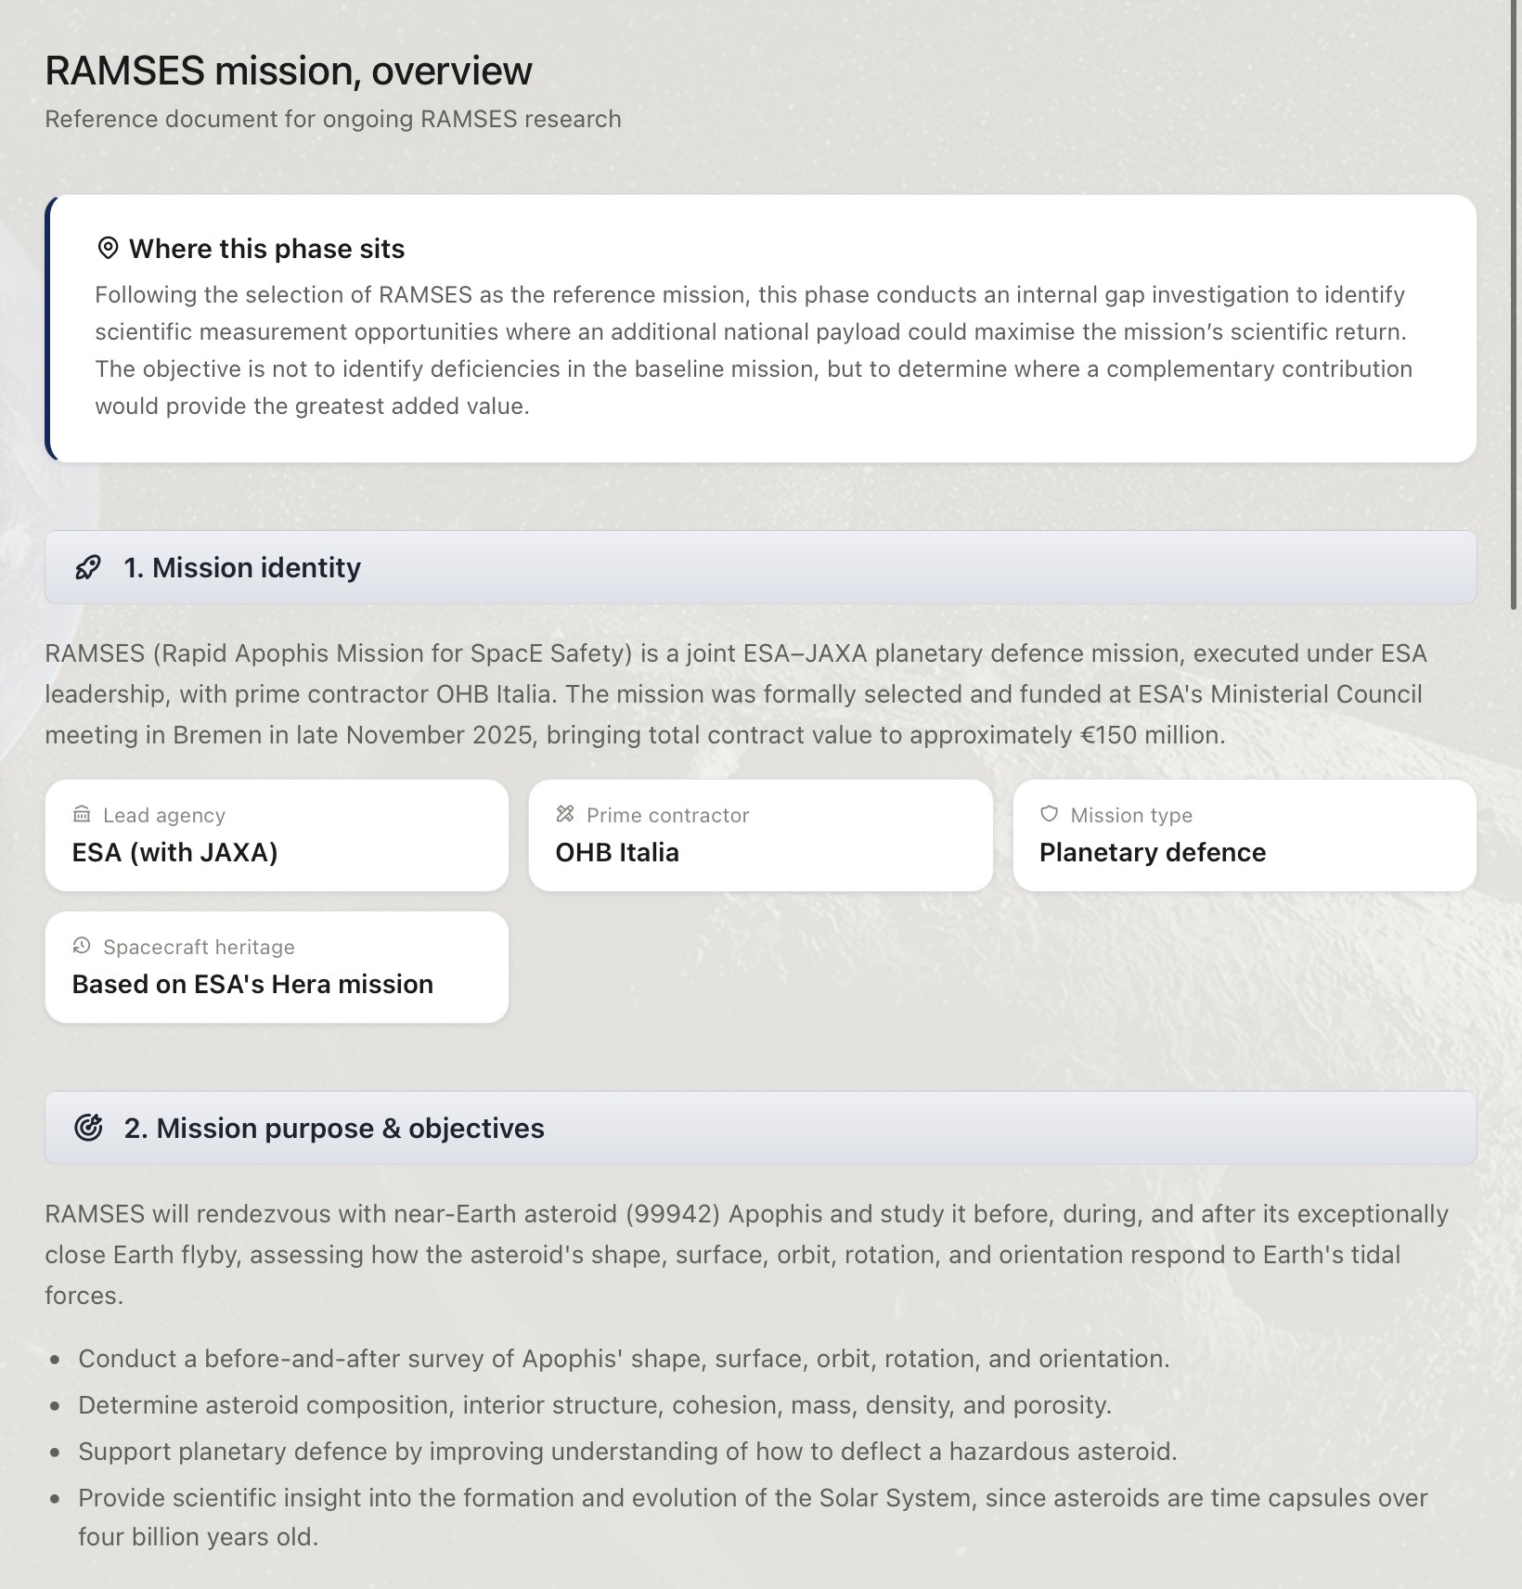
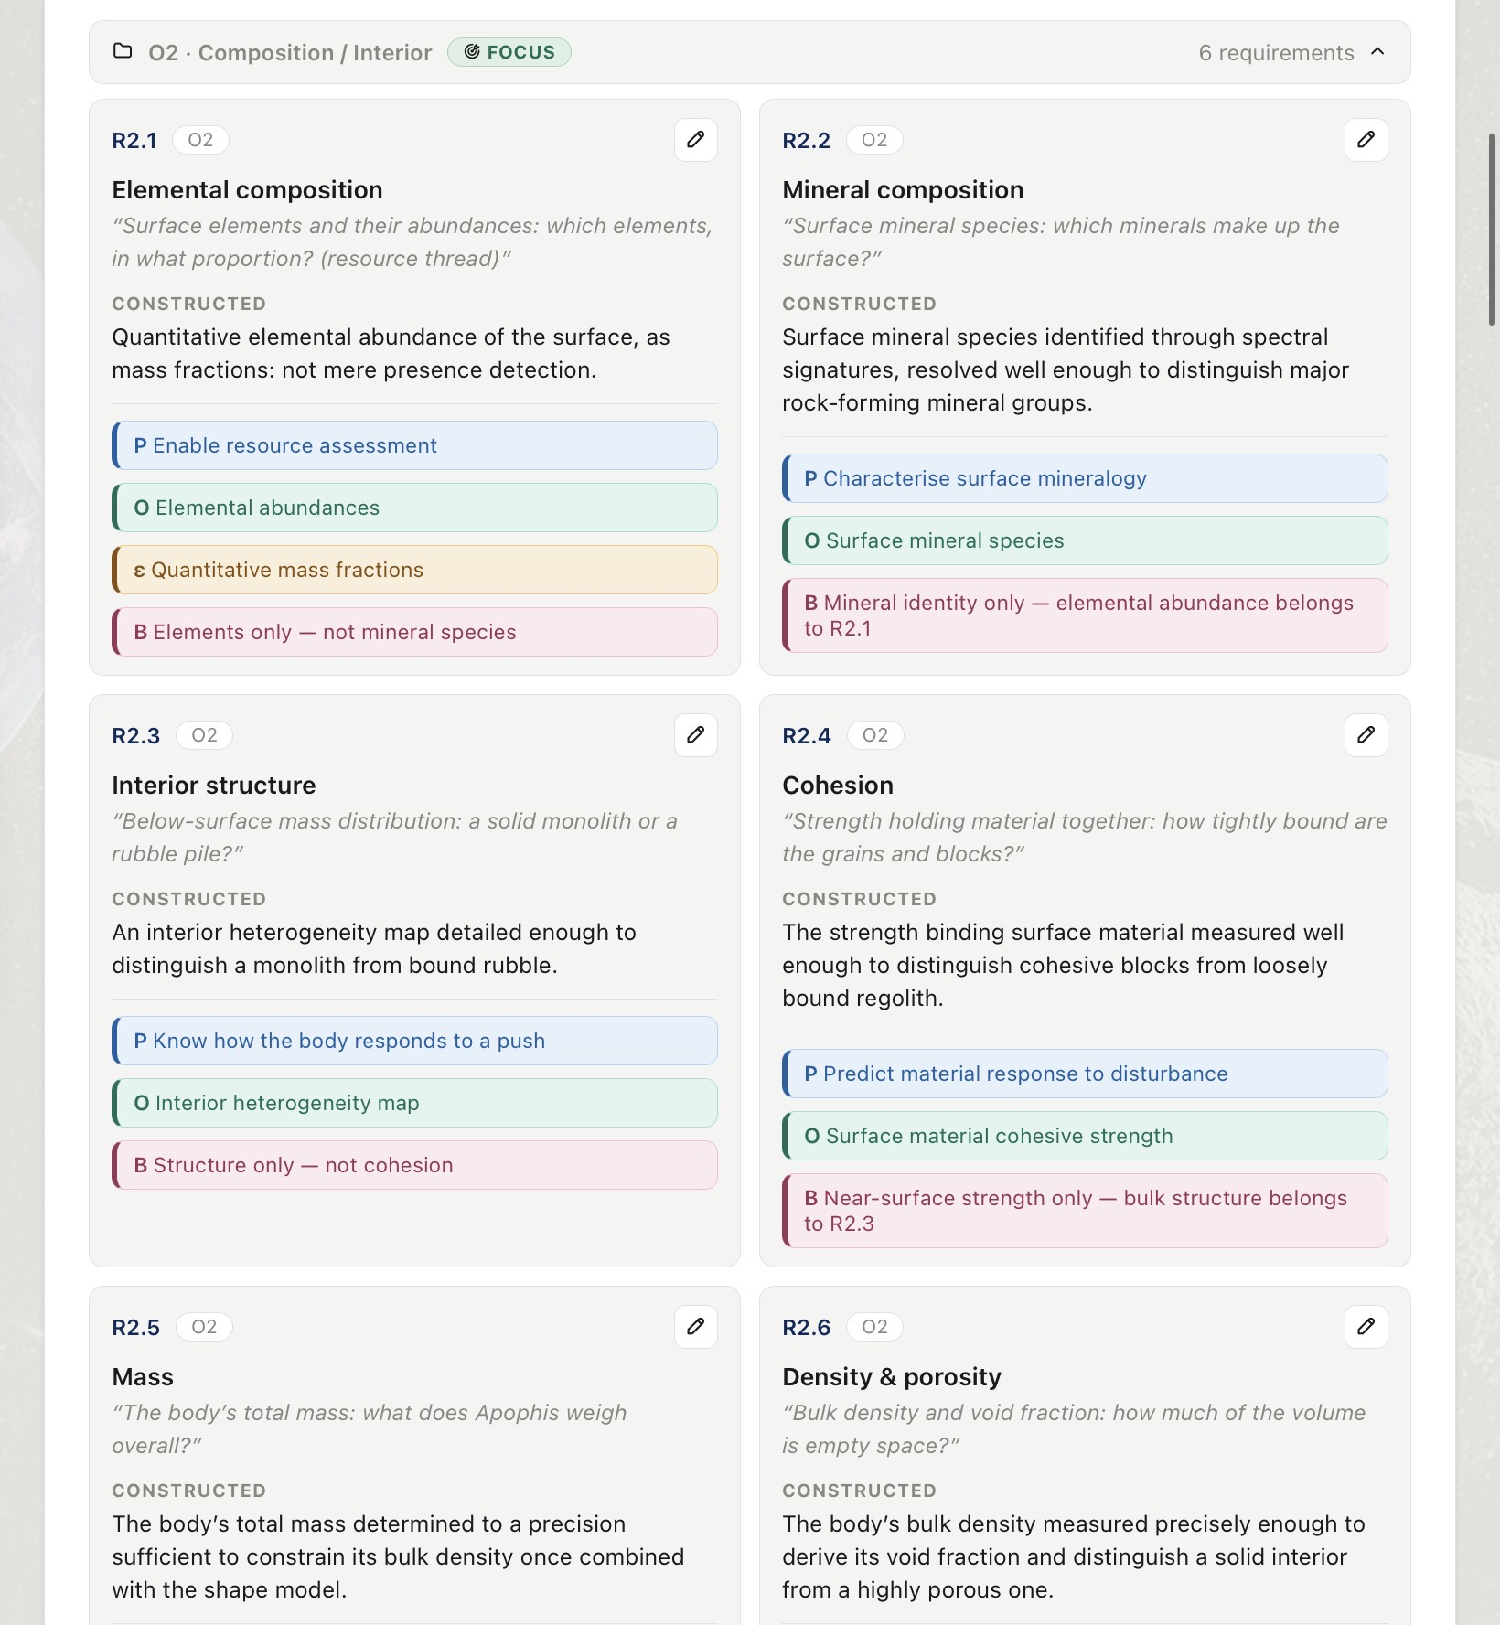
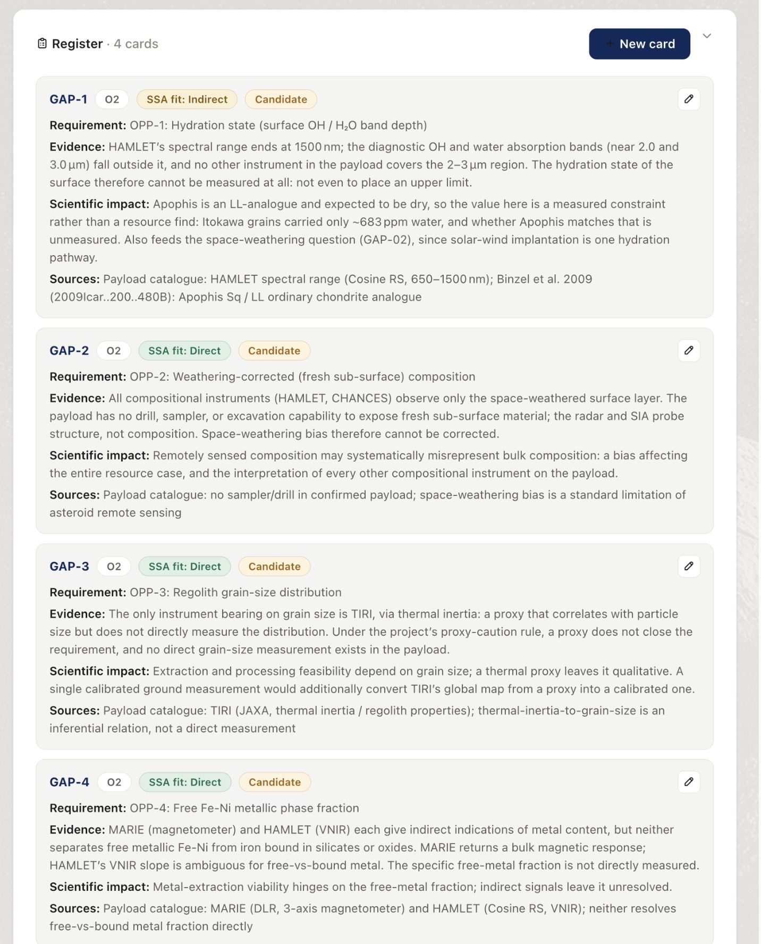
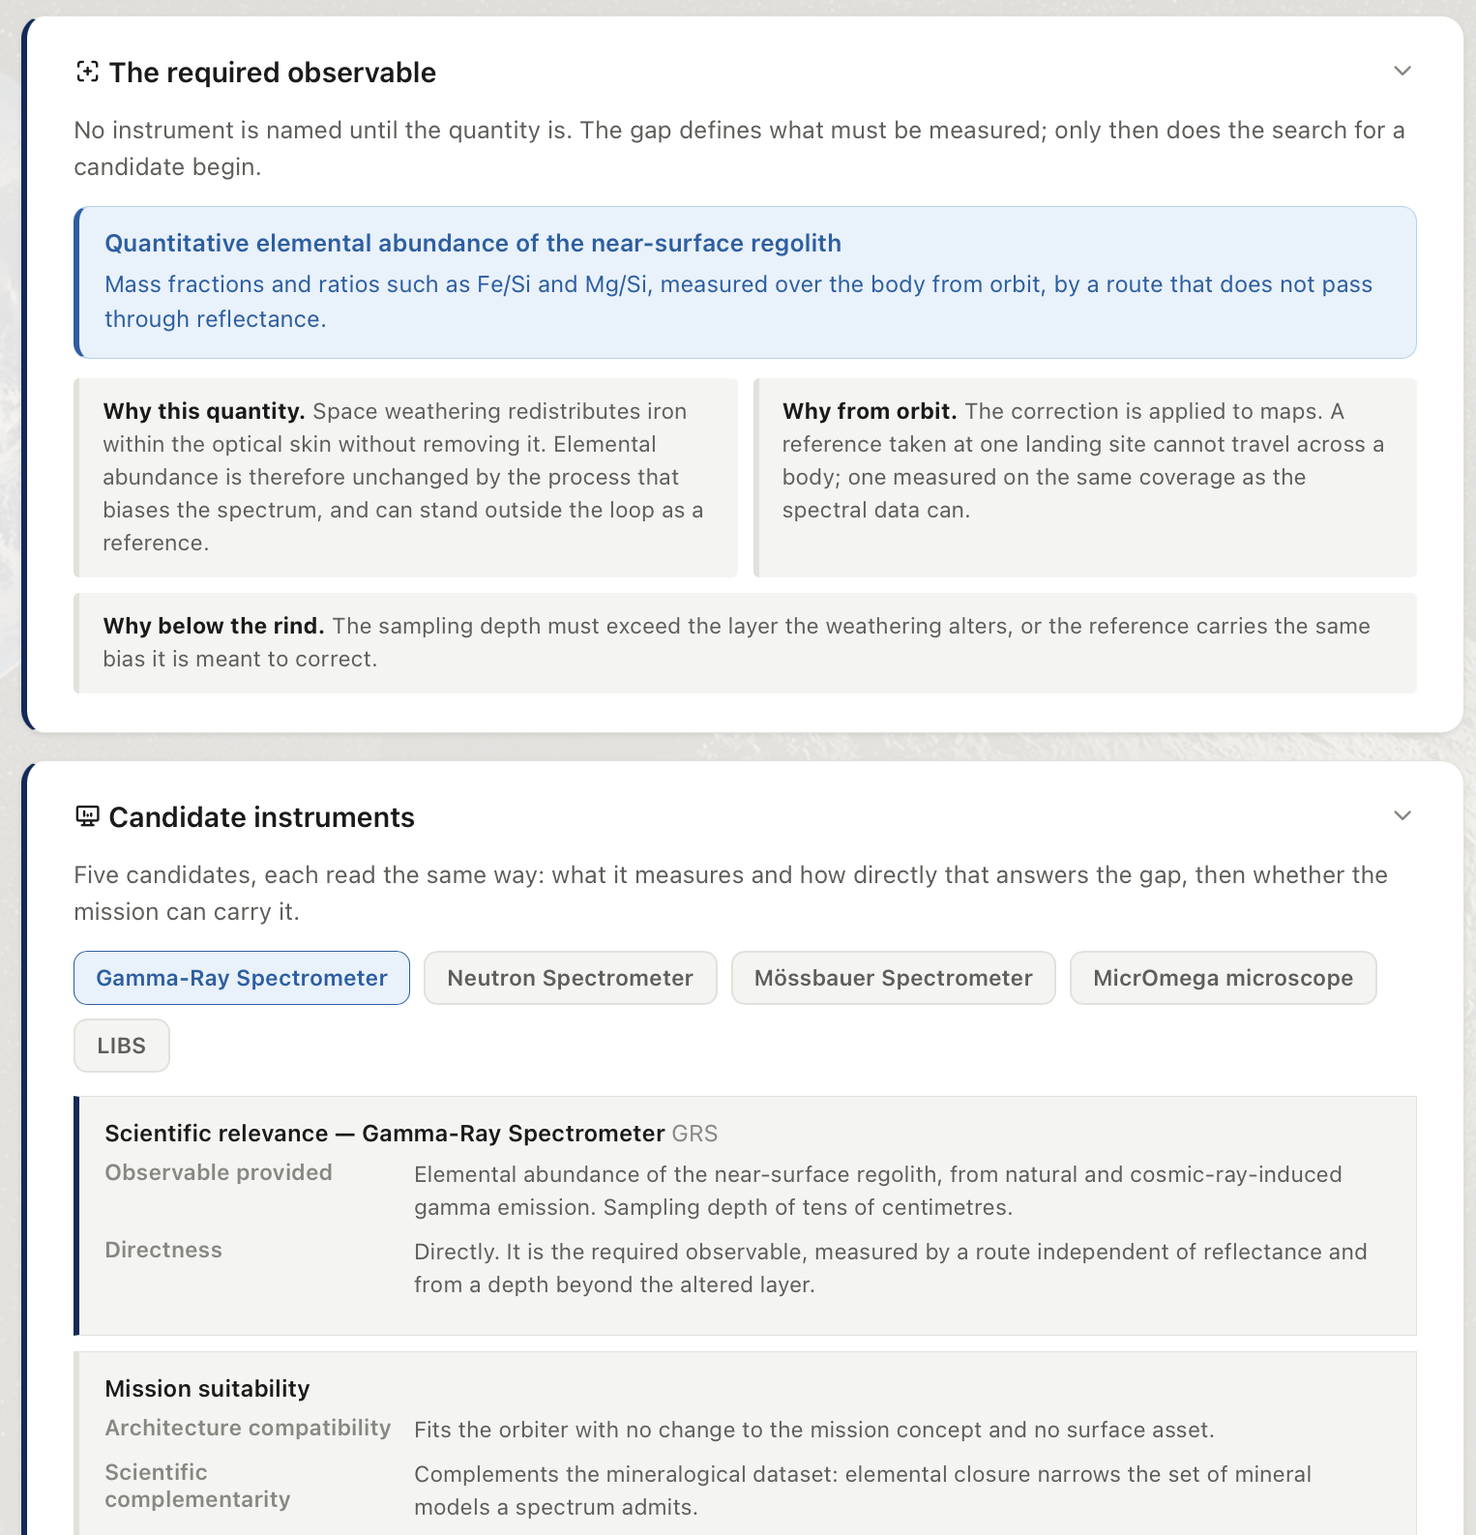
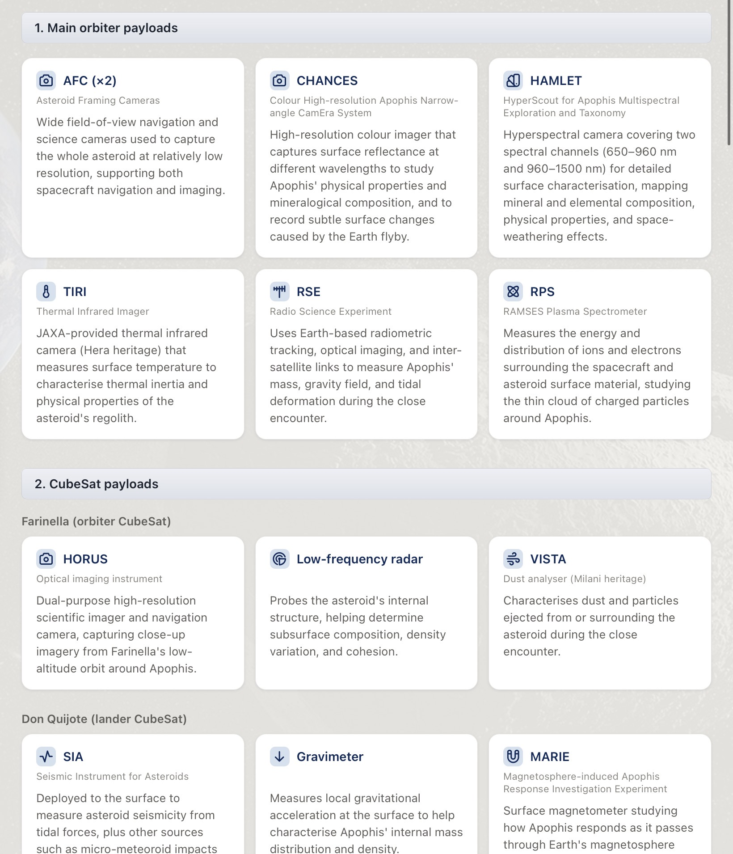
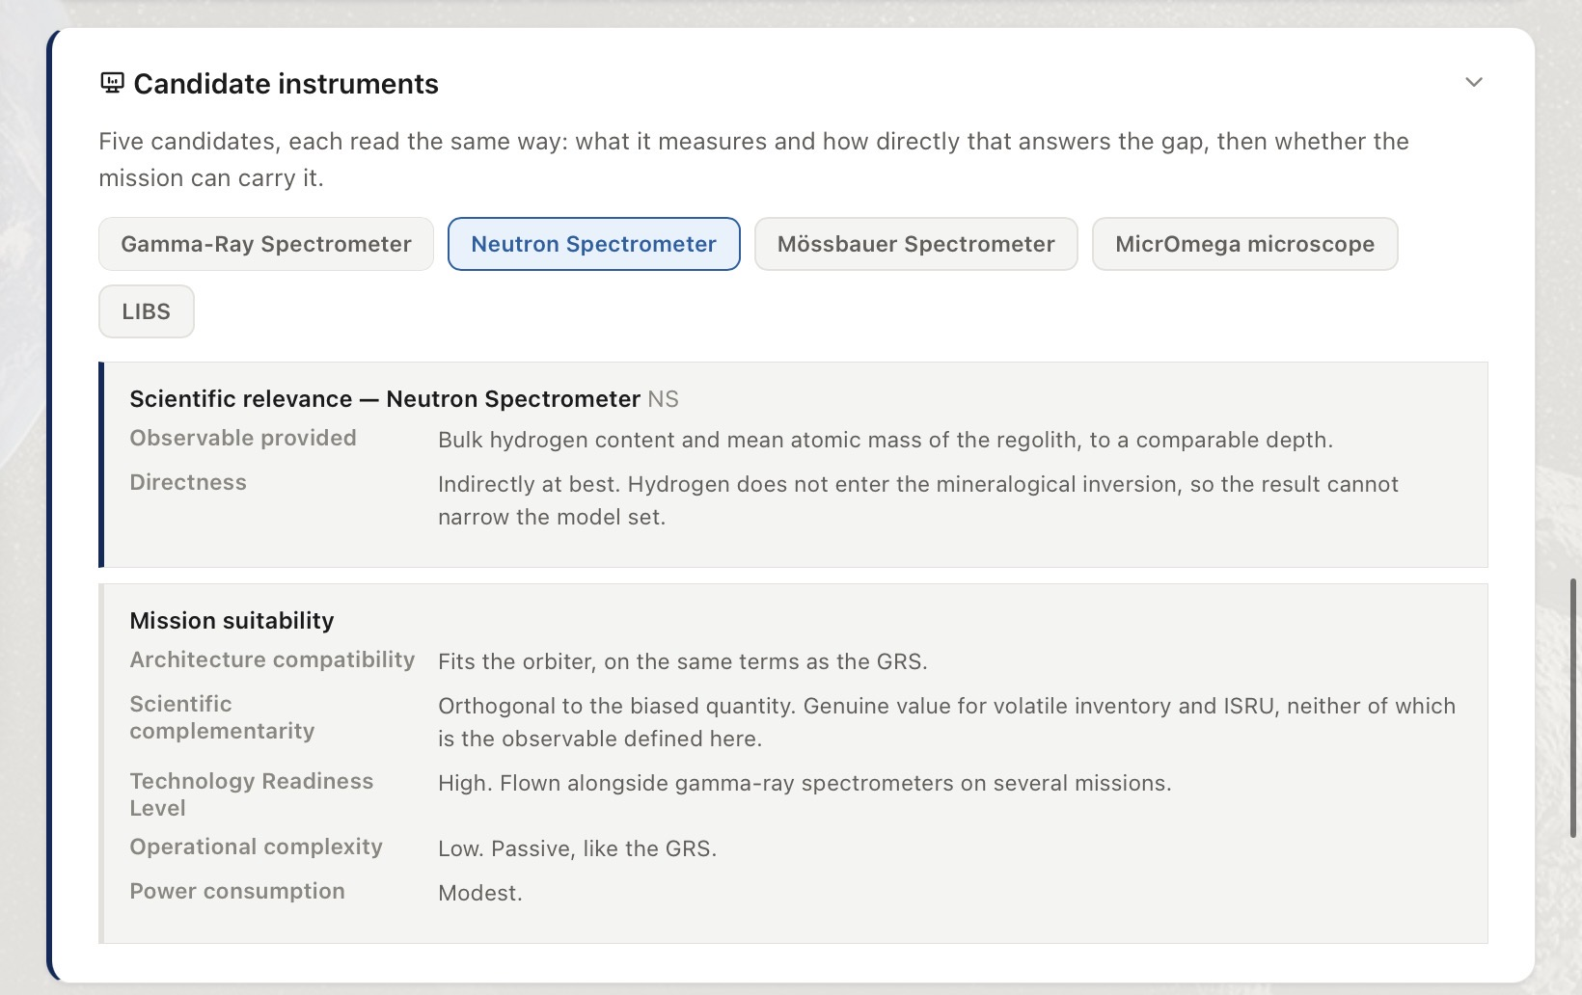
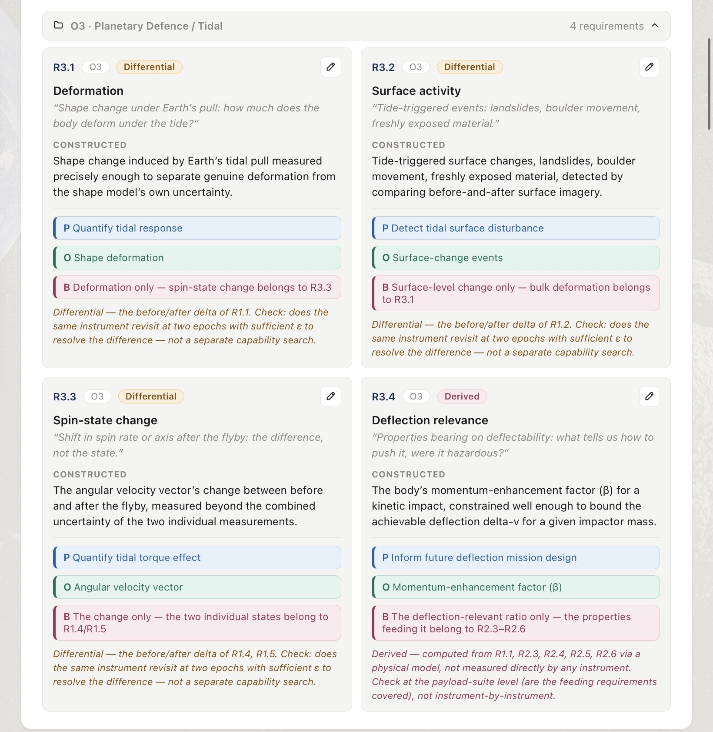
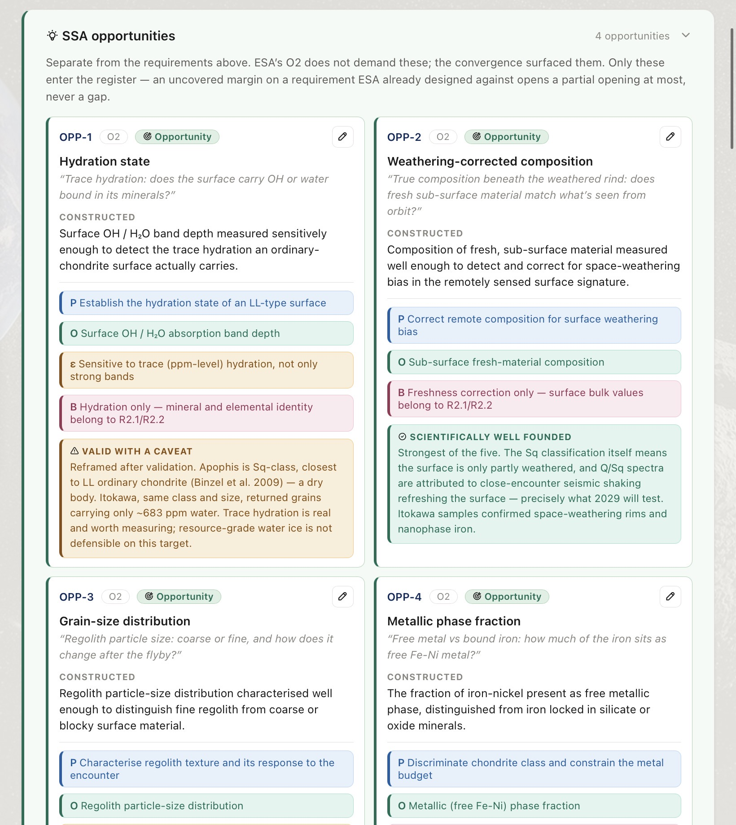
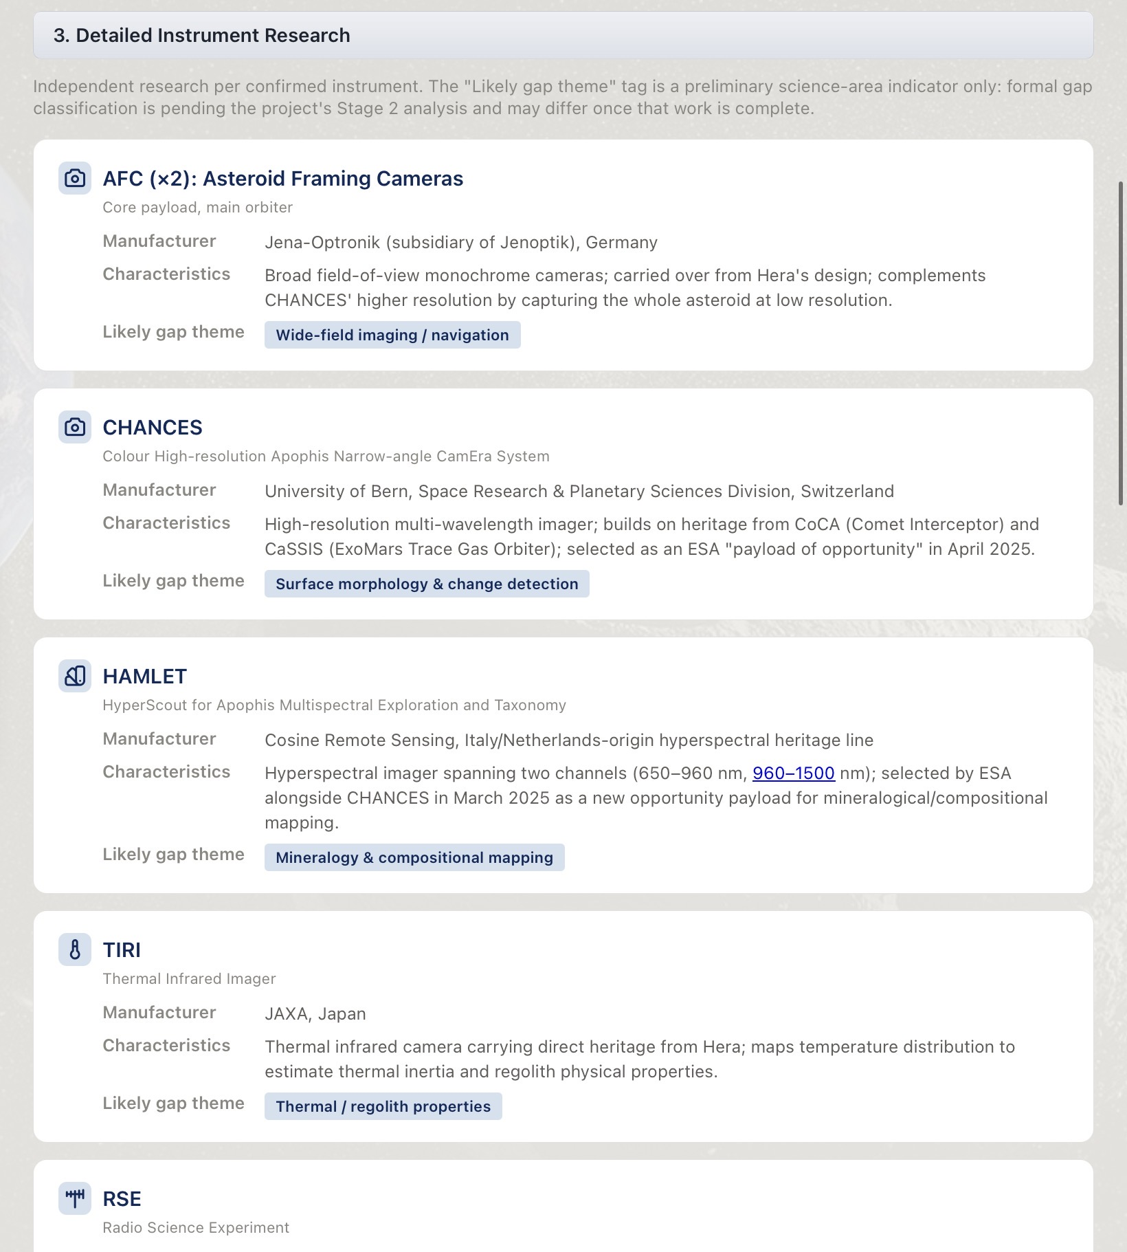
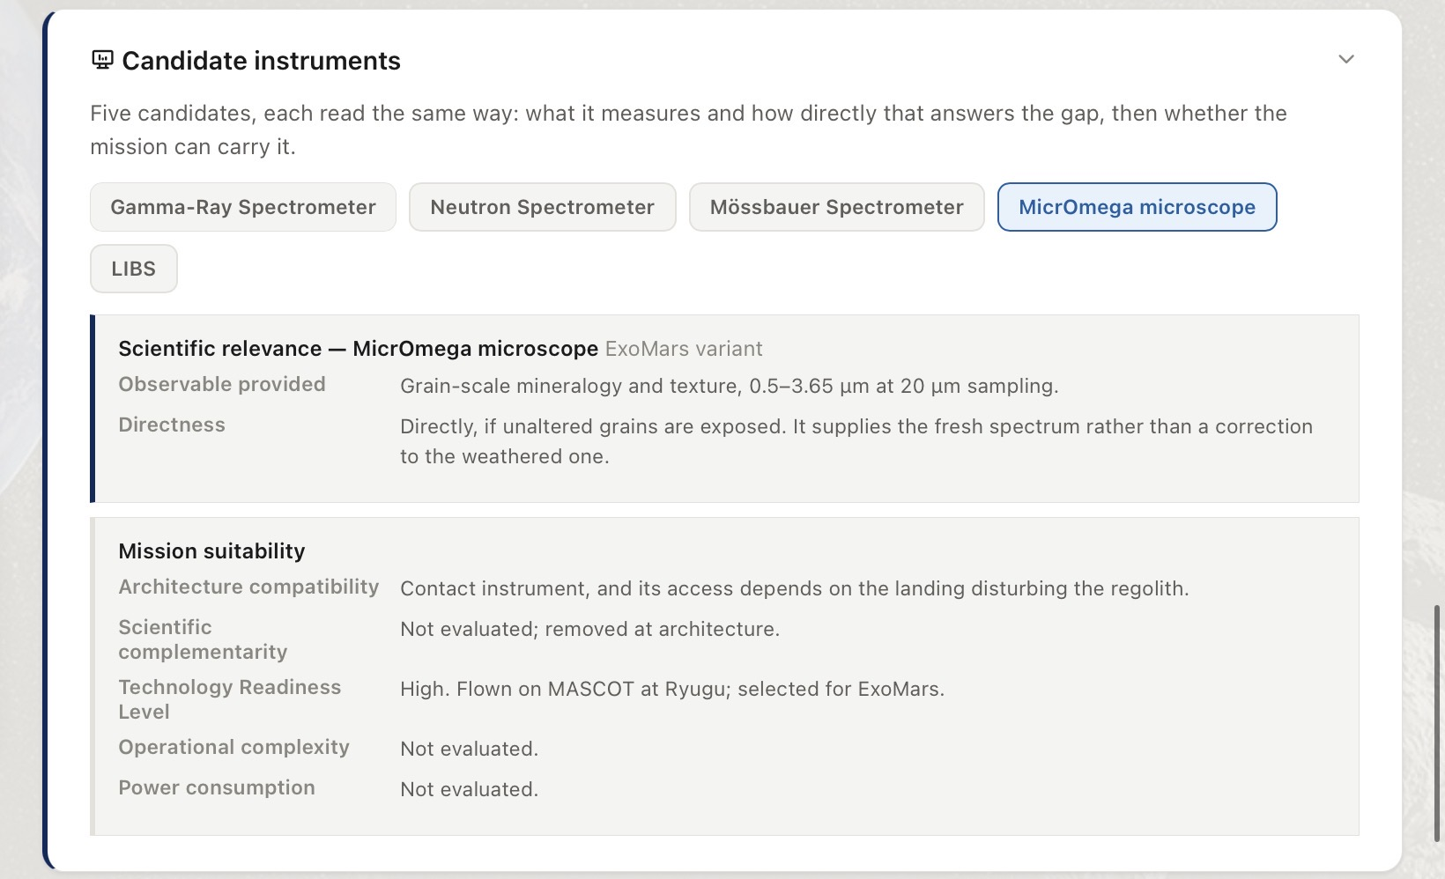
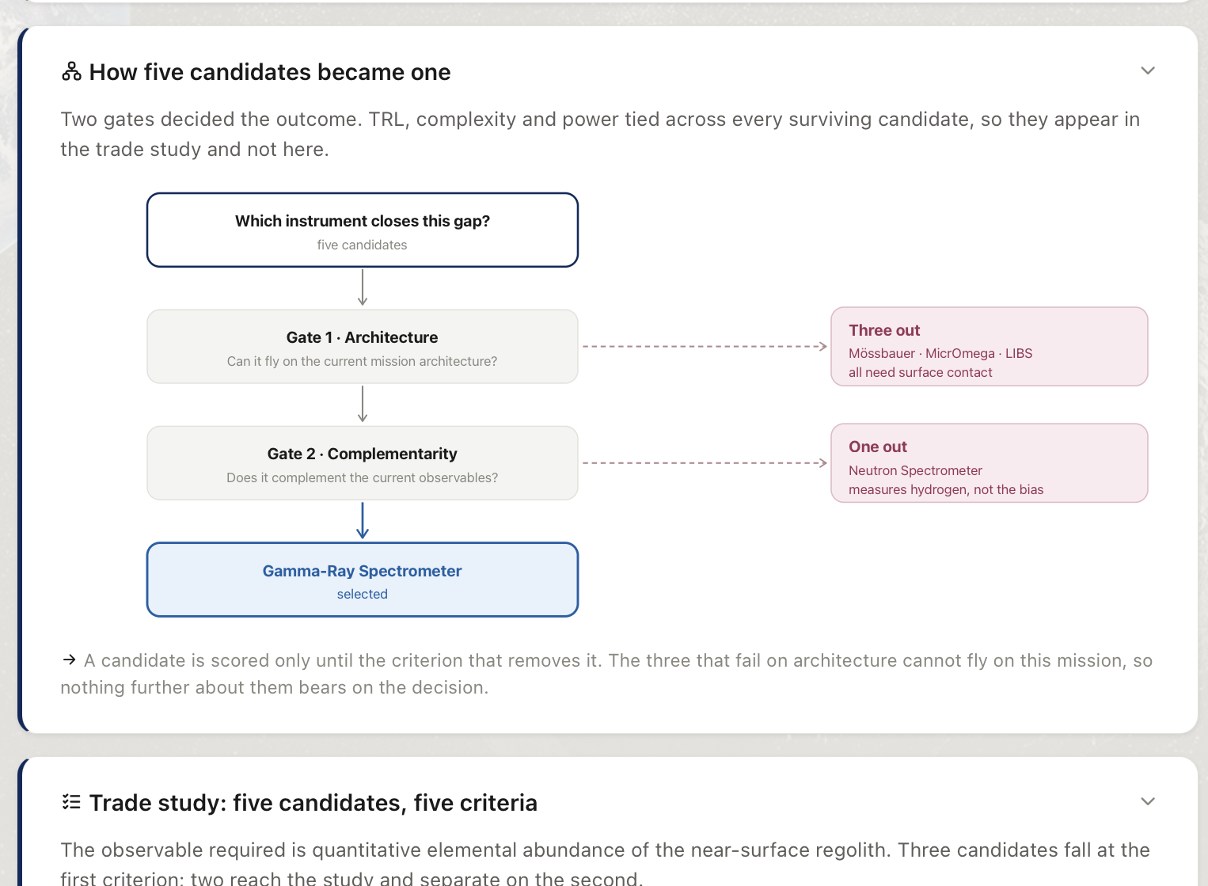
Analysis Methodology
A structured analysis narrowed the opportunity to one payload
RAMSES baseline
Mission Measurements
Knowledge gaps
Payload trade study
One recommended payload
Studied the mission objectives, platforms and payloads
Analysed the measurements against objectives, then constructed them through a framework of multi-variables
Determined knowledge gaps by extracting the non measured measurements
Searched for a set of compatible payloads
4
Public عام

Slide 6

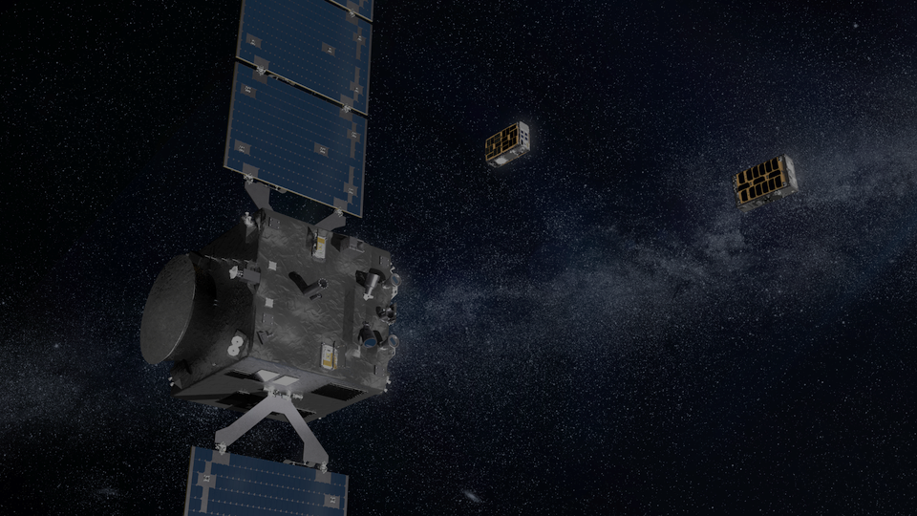
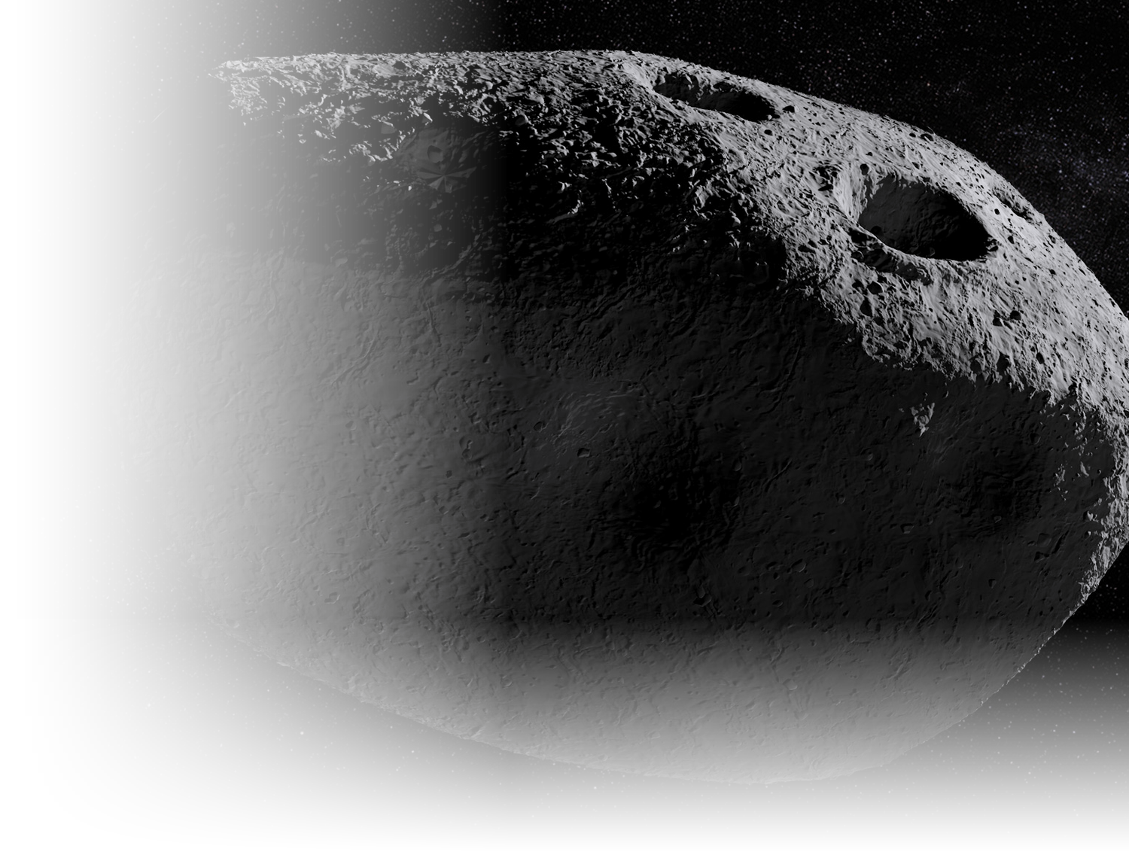
What RAMSES Already Measures
Confirmed payload by platform
Main Orbiter
Farinella · Orbiter CubeSat
Don Quijote · Lander CubeSat
AFC (×2)
HORUS
SIA
Wide-field imaging, shape
Close-range imaging
Surface seismometry
CHANCES
Radar
Gravimeter
Colour imaging, change detection
Interior structure, metre scale
Local density distribution
HAMLET
VISTA
MARIE
Hyperspectral, 650–1500 nm
Dust volatiles and organics
Surface magnetometry
TIRI
Thermal infrared, grain size
RSE
Radio science, gravity, tides
RPS
Charged-particle environment
BASELINE OPPORTUNITIES SELECTION RECOMMENDATION VALUE
5
Public عام

Slide 7
Four Scientific Opportunities
Measurement openings the mission never set out to address, registered only where no confirmed instrument meets them.
GAP-1
GAP-2
GAP-3
GAP-4
Hydration state
Weathering-corrected composition
Regolith grain-size distribution
Free Fe–Ni metallic phase fraction
Weathering-corrected composition was the only opportunity that was both scientifically differentiated and complementary to the existing payload.
BASELINE OPPORTUNITIES SELECTION RECOMMENDATION VALUE
6
Public عام

Slide 8
Priority Selection
Four opportunities passed through three lenses in fixed order, plus an overlap test against the existing requirement set.
Four identified knowledge gaps
GAP-1
GAP-2
GAP-3
GAP-4
1
Strategic fit
2
Scientific value
3
Mission compatibility
Unique to the 2029 encounter and compatible with the architecture
Not an answer already known before the mission flies
Not already addressed by the existing requirement set
GAP-4, GAP-1 out
Both confirmed out
GAP-3 out
ONE PRIORITY
Touched by no requirement and
by no confirmed instrument.
Weathering-corrected composition
BASELINE OPPORTUNITIES SELECTION RECOMMENDATION VALUE
7
Public عام

Slide 9

The Scientific Problem
Space weathering changes what we see without changing the bulk composition.
Fresh material
Space weathering
Altered optical spectrum
Biased mineralogical interpretation
RAMSES can measure the spectrum.
BUT it cannot independently measure the reference needed to correct it.
The correction closes on itself
Why it matters at Apophis
HAMLET's maturity map is derived from the spectrum it would correct, which makes it verifiable only against its source
Sq type: a surface partly but not wholly refreshed. The 2029 encounter may reset the maturity clock, a natural experiment that will not recur.
BASELINE OPPORTUNITIES SELECTION RECOMMENDATION VALUE
8
Public عام

Slide 10
The Required Observable
What measurement would close the opportunity?
Independent elemental abundance
of the near-surface regolith
1
From orbit
2
Below the weathered surface
3
Independent of reflected light
The correction is applied to maps. A reference from a single landing site cannot travel across a body.
Sampling depth must exceed the altered layer, or the reference carries the bias it was meant to remove.
A route through the spectrum would inherit the bias it exists to correct.
This defines the instrument requirement before any instrument is selected.
BASELINE OPPORTUNITIES SELECTION RECOMMENDATION VALUE
9
Public عام

Slide 11
Candidate Payload Assessment
Five candidate payloads were assessed against the required observable and the orbiter, only architecture.
Mössbauer Spectrometer
Landing required
✕
MicrOmega Microscope
Landing required
✕
LIBS, ChemCam class
Close-range operation required
✕
Neutron Spectrometer
Partial scientific match
!
Gamma-Ray Spectrometer
Direct match
✓
GRS is the only candidate that directly measures the required observable from the existing mission architecture.
BASELINE OPPORTUNITIES SELECTION RECOMMENDATION VALUE
Full five-criteria assessment in appendix.
10
Public عام

Slide 12
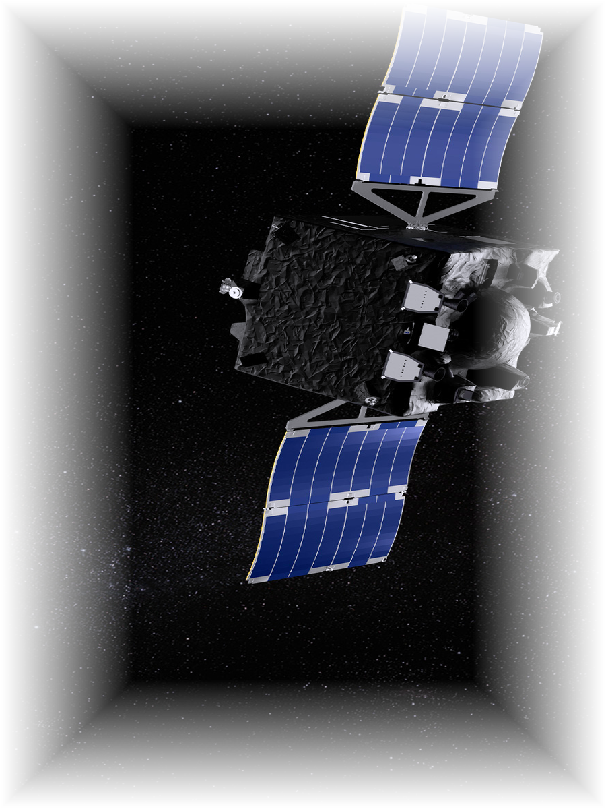
Recommendation
RECOMMENDED PAYLOAD ENHANCEMENT
Gamma-Ray Spectrometer
RAMSES Main Orbiter
WHY
01
02
03
04
05
Independent of reflected light
Measures elemental abundance
Samples below the weathered layer
Strengthens HAMLET's interpretation
Fits the existing mission architecture
+
More effecient
composition
HAMLET
GRS
Mineralogy
Elements
BASELINE OPPORTUNITIES SELECTION RECOMMENDATION VALUE
11
Public عام

Slide 13
Implementation Route
A proven implementation route exists
APL
LLNL
Heritage-based GRS
Johns Hopkins Applied Physics Laboratory
Lawrence Livermore National Laboratory
A flight spare, engineering model,
or repeat of the Psyche design
Instrument lead & integration
High-purity germanium detector
Precedent: MEGANE · MESSENGER · Psyche one agency contributing a gamma-ray spectrometer to another agency's small-body mission.
WHAT’S NEXT?
01
Leadership approval
02
ESA / JAXA accommodation discussion
03
APL / LLNL technical engagement
Authorise engagement on a payload contribution.
Confirm the route and the mission-of-opportunity mechanism.
Open the first technical exchange.
BASELINE OPPORTUNITIES SELECTION RECOMMENDATION VALUE
Accommodation detail, open technical items and export-control considerations in appendix.
12
Public عام

Slide 14

Why This Matters to SSA
01
Scientific
Adds a dataset RAMSES cannot generate independently.
02
Strategic
Moves SSA from observer to contributor on a flagship mission.
03
Programmatic
Uses a proven instrument and a proven partnership model.
04
Actionable
A credible acquisition route exists now.
BASELINE OPPORTUNITIES SELECTION RECOMMENDATION VALUE
Public عام

Slide 15
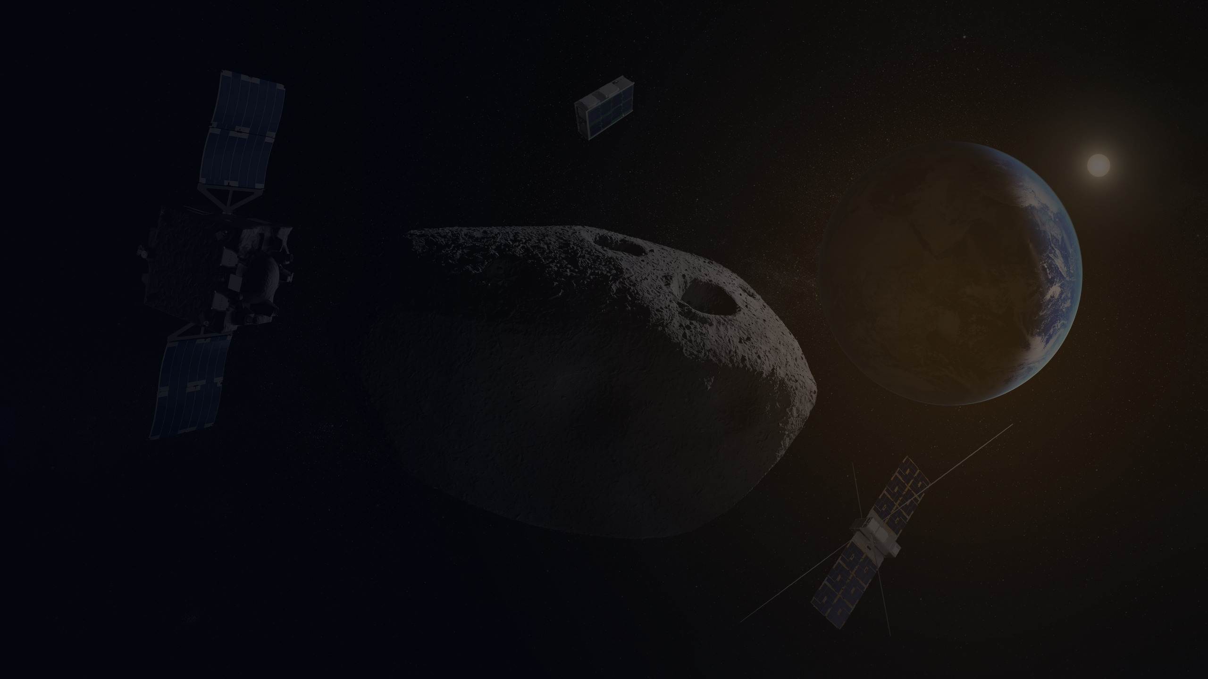
Thank you!
Public عام

Slide 16
APPENDIX
Candidate Trade Study — Full Assessment
Architecture is a screening criterion, not a differentiator. A candidate is scored only until the criterion that removes it.
Candidate | Architecture | Scientific complementarity | TRL | Operational complexity | Power
Gamma-Ray Spectrometer | Fits orbiter | Complements | High | Low | Modest
Neutron Spectrometer | Fits orbiter | Partial | High | Low | Modest
Mössbauer Spectrometer | Requires lander | — | High | — | —
MicrOmega Microscope | Requires lander | — | High | — | —
LIBS, ChemCam class | Requires close range | — | High | — | —
Incompatible with an orbiter-only contribution
Separated on scientific complementarity
The wrong quantity, well accessed
Mössbauer and MicrOmega are contact instruments requiring a landed platform; LIBS is close-range and requires high pointing precision. Establishing that sub-surface observation does not require a landing removed the premise beneath all three.
Neutron spectroscopy primarily constrains hydrogen and volatile abundance, which does not enter the mineralogical inversion. Resolving this gap requires multi-element ratios such as Mg/Si and Fe/Si.
LIBS solves access better than any other candidate and still returns the wrong quantity. Bulk elemental abundance barely moves under weathering, so profiling elements through the rind would most likely return no difference.
Public عام

Slide 17
APPENDIX
Accommodation & Open Technical Items
Detail supporting the recommendation and the first technical exchange.
Platform: main orbiter, not Farinella
Spatial resolution
Integration time
The cooled germanium sensor exceeds what a 6U-XL CubeSat carries in mass and standing power, and the measurement needs an accumulation window of months. It also belongs beside HAMLET: a shared platform means shared observation geometry and coverage, which is what permits one map to be subtracted from the other.
Reads a broad patch, tens to hundreds of metres. The mission already maps in detail; this supplies the calibrated value that map is read against.
Gamma emission is faint, so precision accumulates over hours and days. The instrument is passive — no laser, no mechanism, no pointing — and gathers while the spacecraft works.
PARTNERSHIP — GAMMA-RAY SPECTROMETERS BUILT
OPEN FOR THE FIRST TECHNICAL EXCHANGE
Laboratory | Role | Instruments built
Johns Hopkins APL | Instrument lead and integrator | NEAR Shoemaker, MESSENGER, MEGANE, Psyche, Dragonfly
Lawrence Livermore NL | High-purity germanium sensor | MESSENGER, MEGANE, Psyche
Footprint achievable at the planned operating altitude.
Boom against body mounting — spacecraft materials generate the same background the instrument measures.
Export control and technology transfer: both laboratories are United States national laboratories.
Public عام

Slide 18
APPENDIX
Opportunity Register — Evidence
Why no confirmed instrument meets each registered opportunity.
ID | Opportunity | Why no confirmed instrument meets it | Outcome
GAP-1 | Hydration state | HAMLET's range ends at 1500 nm. The diagnostic OH and water bands near 2.0 and 3.0 µm fall outside it, and no other instrument covers that region. | Removed — strategist / scientist
GAP-2 | Weathering-corrected composition | All compositional instruments observe only the space-weathered surface layer. No independent reference exists against which the correction can be established. | SELECTED
GAP-3 | Regolith grain-size distribution | Only TIRI bears on grain size, through thermal inertia, which is a proxy. Under the study's proxy rule a proxy does not close a requirement. | Removed — overlap test
GAP-4 | Free Fe–Ni metallic phase fraction | MARIE and HAMLET each give indirect indications of metal content, but neither separates free metallic iron from iron bound in silicates or oxides. | Removed — strategist / scientist
OVERLAP CHECK AGAINST THE CONFIRMED PAYLOAD
HAMLET
TIRI
Radar
CHANCES / AFC
Closed inference, maturity map derived from the spectrum it would correct
Useful, supplies grain size, so this study need not measure it
Unrelated, dielectric measurement is blind to nanophase iron
No overlap, locates where fresh material may be, never quantifies it
Public عام

