Slide 1
Limits to Arbitrage and stock market anomalies in the Korean Stock Market
Kyoungjin Choi
June 16th. 2017

Slide 2
Overview
Motivation
Previous studies
Sample
Empirical result
Conclusion
Further studies
Q & A

Slide 3
Motivation
Inspired by Ali, Hwang, and Trombley(2003) which asserts that B/M effect is better explained by persistent market-mispricing rather than by compensation for the systematic risk, we are interested in whether it is possible to expand the story to other well-known stock market anomalies.
If B/M effect, which fueled the development of the famous Fama-French 3 factor model, can be thought of as market-mispricing, what about momentum effects and standardized unexpected earnings(SUE) which have been suspected by quite a few scholars as delayed response phenomena?
On the other hand, if risk-based explanations are good enough for these effects, what risk factors might be behind them? (Although some what bold at this point, we postulate that if these anomalies can be explained by any classical risk factors, profitability(RMW) in the Fama-French 5 factor model should be the first candidate.)

Slide 4
Research Question
[Research Question]
Which one is better explanation for post earnings announcement drift and Momentum?
A1) Risk factor
→ test using CAPM, FF3, FF5.
A2) Limit to arbitrage
→ test using two way sort.
If the anomaly is due to mispricing, the effects will be more prominent when the limit to
arbitrage is greater.

Slide 5
Previous studies
Ball and Brown (1968), Foster et al. (1984), Bernard and Thomas (1989) finds that it takes a number of days for market prices to fully reflect the information provided in the earnings announcement which is referred to post earnings announcement drift (PEAD).
Using various formation and holding periods, Jegadeesh and Titman(1993) reports that past returns affect the following stock returns.
Gradual information diffusion model by Hong and Stein(1999) explains momentum effects.
Momentum effects are global (Rouwenhorst(1998), Griffin et al(2003)) but Chui et al(2010) shows that it is not found in the Asian markets.
김형규 신용재(2011), 박지희 손삼호(2013), 윤정선 et al.(2008) confirms the above results in the Korean stock market.
However, 엄윤성(2013) finds that momentum effects can be found in the Korean stock market especially for the firms with foreign investors.

Slide 6
Previous studies
Ali, Hwang and Trombley(2003) suggests the following causes for the systematic market mispricing
1) Arbitrage Risk
Arbitrage resources are concentrated in a few specialized and poorly diversified traders
-> They are concerned about the idiosyncratic risk of their portfolios
2) Transaction Costs
* Direct transaction costs (bid-ask spreads and brokerage commissions)
* Indirect transaction costs(Adverse price effects and delay in processing the transaction
(dollar-trading volume)
* Short Selling (% of institutional Ownership)
* Comprehensive measure (Frequency of zero daily returns)
* Illiquidity
3) Investor Sophistication and information uncertainty
Number of analysts following
Cashflow volatility

Slide 7
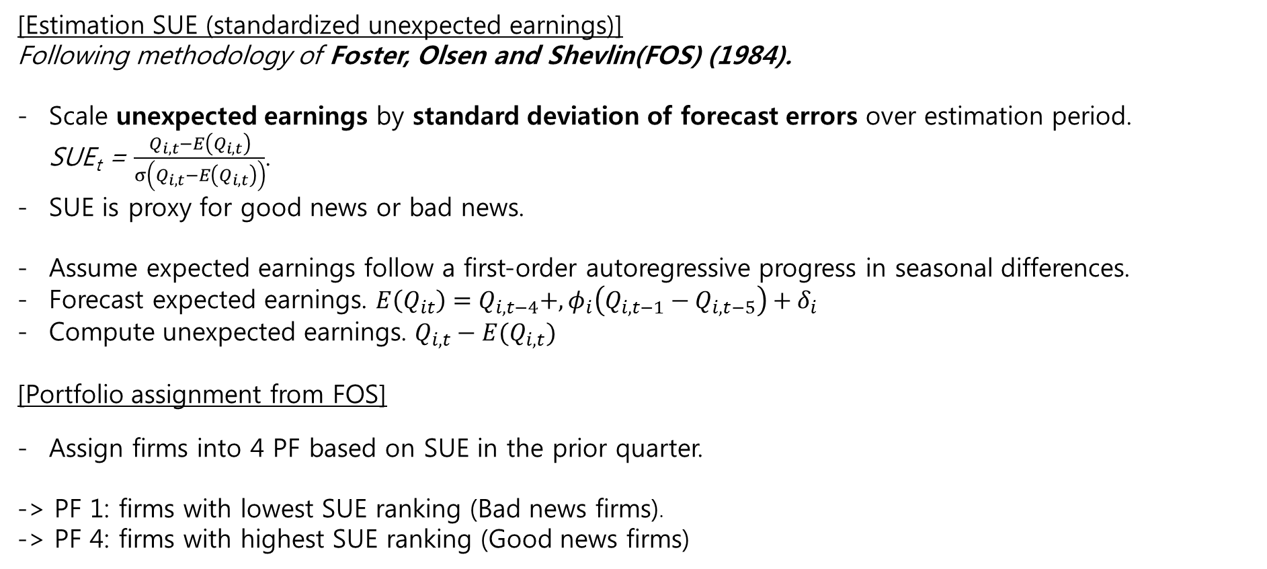
SUE Formation
[Estimation SUE (standardized unexpected earnings)]
Following methodology of Foster, Olsen and Shevlin(FOS) (1984).
Scale unexpected earnings by standard deviation of forecast errors over estimation period. SUE_{t} = $\frac{Q_{i,t}−E\left(Q_{i,t}\right)}{σ\left(Q_{i,t}−E\left(Q_{i,t}\right)\right)}$.
SUE is proxy for good news or bad news.
Assume expected earnings follow a first-order autoregressive progress in seasonal differences.
Forecast expected earnings. $E\left(Q_{it}\right)=Q_{i,t−4}+,φ_{i}\left(Q_{i,t−1}−Q_{i,t−5}\right)+δ_{i}$
Compute unexpected earnings. $Q_{i,t}−E(Q_{i,t})$
[Portfolio assignment from FOS]
Assign firms into 4 PF based on SUE in the prior quarter.
-> PF 1: firms with lowest SUE ranking (Bad news firms).
-> PF 4: firms with highest SUE ranking (Good news firms)

Slide 8
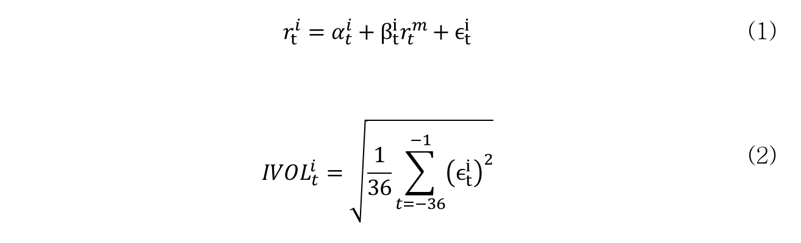
Limit to arbitrage proxy variables
Arbitrage risk
a. Idiosyncratic volatility
Pontiff (2006) demonstrates that arbitrageurs prefer to hold less of stocks with higher idiosyncratic stock return volatility.
In this paper, idiosyncratic volatility is used as a proxy for arbitrage costs.
Idiosyncratic volatility is obtained by regressing monthly return of individual stock on market(KOSPI) portfolio over 36 months, and then computing the standard deviation of the residuals.
$$r_{t}^{i}=α_{t}^{i}+β_{t}^{i}r_{t}^{m}+ϵ_{t}^{i}$$ | (1)
$$IVOL_{t}^{i}=\sqrt{\frac{1}{36}\sum_{t=−36}^{−1}{{\left(ϵ_{t}^{i}\right)}^{2}}}$$ | (2)

Slide 9
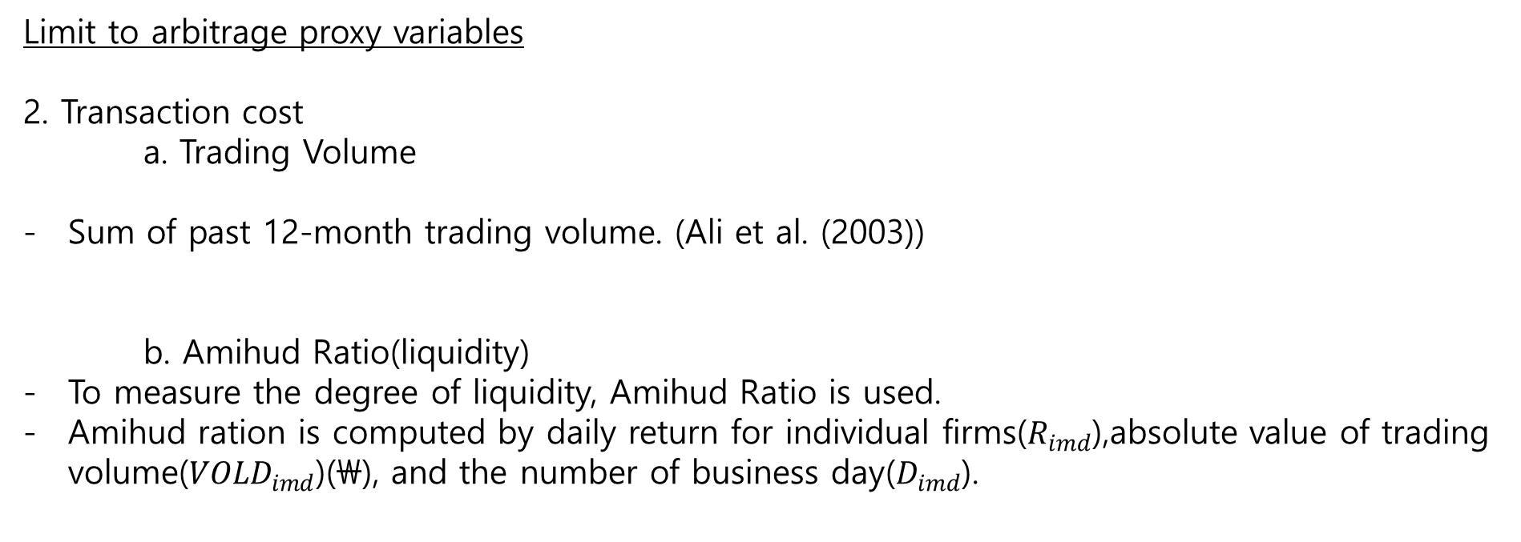
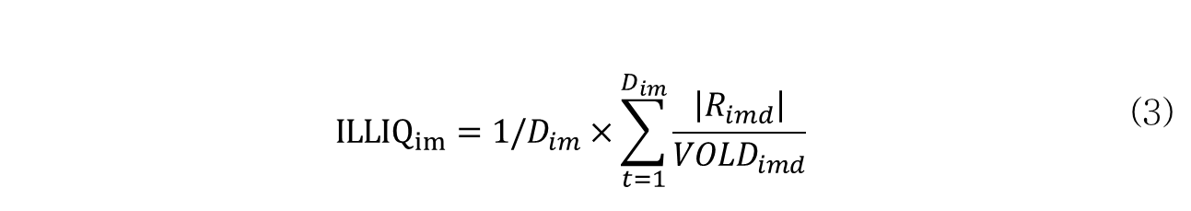
Limit to arbitrage proxy variables
Limit to arbitrage proxy variables
2. Transaction cost
a. Trading Volume
Sum of past 12-month trading volume. (Ali et al. (2003))
b. Amihud Ratio(liquidity)
To measure the degree of liquidity, Amihud Ratio is used.
Amihud ration is computed by daily return for individual firms($R_{imd}$),absolute value of trading volume(${VOLD}_{imd}$)(\), and the number of business day($D_{imd}$).
$${ILLIQ}_{im}=1/D_{im}×\sum_{t=1}^{D_{im}}{\frac{\left|R_{imd}\right|}{VOLD_{imd}}}$$ | (3)

Slide 10
Limit to arbitrage proxy variables
Limit to arbitrage proxy variables
c. Recent Price
- Mean of daily price in past 1month.
d. Zero frequency
- The number of firms whose daily return is zero(0%)

Slide 11
Limit to arbitrage proxy variables
Limit to arbitrage proxy variables
3. Information Uncertainty
a. Numbers of Analysts follow
The number of analysts’ coverage.
b. Cash-flow volatility
Cash flow volatility in past 4 years (using annual report).

Slide 12
Data Sample (KOSPI, 2001-2015)
Proxies for limit to arbitrage |  | Mean | Min | 1Q | Median | 3Q | Max
차익거래 위험(Arbitrage risk)
 | 기업고유 변동성(Idiosyncratic volatility) | 0.107 | 0.039 | 0.079 | 0.097 | 0.122 | 1.089
거래비용(Transaction costs)
 | 거래대금(Trading volume)(\1,000,000) | 5,177,072 | 3,930 | 475,284 | 1,730,149 | 5,430,824 | 102,438,680
 | 유동성(illiquidity) | 0.010 | 0.000 | 0.000 | 0.000 | 0.001 | 53.523
 | 가격(price) | 117,590 | 1,004 | 17,519 | 41,071 | 99,434 | 3,643,818
 | 영(0) 수익률(zero frequency) | 15.935 | 1 | 10 | 14 | 20 | 246
정보 불확실성(Information uncertainty)
 | 애널리스트 수(Number of Analysts Following) | 10.019 | 0 | 2 | 9 | 17 | 33
 | 현금흐름 변동성(Cash flow volatility) | 2.318 | 0.015 | 0.313 | 0.557 | 1.116 | 753.636
Pearson // Spearman | ivol | prc | amihud | trading | nfollow | zero | cfvol
ivol |  | -0.383 | 0.285 | -0.168 | -0.333 | -0.132 | -0.268
prc | -0.170 |  | -0.461 | 0.412 | 0.435 | -0.075 | 0.319
amihud | 0.007 | -0.008 |  | -0.959 | -0.751 | 0.333 | -0.487
trading | -0.065 | 0.226 | -0.012 |  | 0.714 | -0.372 | 0.455
nfollow | -0.290 | 0.137 | -0.030 | 0.481 |  | -0.234 | 0.526
zero | -0.069 | -0.089 | 0.080 | -0.197 | -0.244 |  | -0.131
cfvol | -0.126 | 0.255 | -0.005 | 0.604 | 0.302 | -0.077
Notes:
and with the total amount of long position = short positiion

Slide 13
Empirical test _ Single sorting(SUE)
Notes:
and with the total amount of long position = short positiion

Slide 14
Empirical test _ two way sorting (SUE and IVOL)
Notes:
and with the total amount of long position = short positiion

Slide 15
Empirical test _ two way sorting (SUE and Recent price)
Notes:
and with the total amount of long position = short positiion

Slide 16
Empirical test _ two way sorting (SUE and Amihud)
Notes:
and with the total amount of long position = short positiion

Slide 17
Empirical test _ two way sorting (SUE and Trading)
Notes:
and with the total amount of long position = short positiion

Slide 18
Empirical test _ two way sorting (SUE and Numbers of Analysts following)
Notes:
and with the total amount of long position = short positiion

Slide 19
Empirical test _ two way sorting (SUE and Zero Frequency)
Notes:
and with the total amount of long position = short positiion

Slide 20
Empirical test _ two way sorting (SUE and Cashflow Volatility)
Notes:
and with the total amount of long position = short positiion

Slide 21
Empirical Results _ sue
Risk adjusted returns (ex, CAPM, Fama-French 3 factor model, Fama-French 5 factor model) are statistically significant.
It means that CAPM, Fama-French 3 factor model, and Fama-French 5 factor model cannot explain the SUE anomaly.
Thus, this paper investigate whether the SUE effect is more stronger when the limit to arbitrage is most severe.

Slide 22
Momentum formation
Following Jegadeesh and Titman(1993), we form portfolios based on past monthly returns for 3, 6, 9, 12 months and hold the portfolio for 3, 6, 9, 12 months allowing overlaps
In order to lessen the bias of market micro structure we skip 1 month between formation and hodling periods.

Slide 23
Momentum Portfolio Returns (KOSPI, 1981-2015)
Formation Periods | prtf | Holding Periods |  |  |  | Formation Periods | prtf | Holding Periods
 |  | 3 | 6 | 9 | 12 |  |  | 3 | 6 | 9 | 12
3 | Loser | 1.357 | 1.298 | 1.149 | 1.235 | 9 | Loser | 1.155 | 1.216 | 1.261 | 1.431
 | 2 | 1.368 | 1.33 | 1.275 | 1.275 |  | 2 | 1.215 | 1.201 | 1.311 | 1.347
 | 3 | 0.998 | 1.201 | 1.231 | 1.246 |  | 3 | 1.098 | 1.267 | 1.313 | 1.281
 | 4 | 1.345 | 1.307 | 1.423 | 1.392 |  | 4 | 1.543 | 1.569 | 1.492 | 1.398
 | Winner | 1.491 | 1.399 | 1.403 | 1.31 |  | Winner | 1.401 | 1.34 | 1.268 | 1.198
 | WML | 0.134 | 0.101 | 0.254 | 0.075 |  | WML | 0.246 | 0.124 | 0.007 | -0.233
 | t-value | [0.39] | [0.38] | [1.14] | [0.39] |  | t-value | [0.62] | [0.35] | [0.02] | [-0.84]
6 | Loser | 1.431 | 1.144 | 1.165 | 1.335 | 12 | Loser | 1.195 | 1.295 | 1.388 | 1.485
 | 2 | 1.261 | 1.324 | 1.303 | 1.386 |  | 2 | 1.314 | 1.346 | 1.354 | 1.345
 | 3 | 1.026 | 1.077 | 1.195 | 1.187 |  | 3 | 1.344 | 1.456 | 1.467 | 1.415
 | 4 | 1.266 | 1.451 | 1.451 | 1.396 |  | 4 | 1.41 | 1.514 | 1.426 | 1.406
 | Winner | 1.367 | 1.416 | 1.355 | 1.256 |  | Winner | 1.436 | 1.251 | 1.14 | 1.074
 | WML | -0.064 | 0.272 | 0.19 | -0.078 |  | WML | 0.241 | -0.044 | -0.248 | -0.411
 | t-value | [-0.17] | [0.83] | [0.67] | [-0.32] |  | t-value | [0.6] | [-0.12] | [-0.76] | [-1.37]

Slide 24
Momentum Portfolio Returns (KOSPI, 2001-2015)
Formation Periods | prtf | Holding Periods |  |  |  | Formation Periods | prtf | Holding Periods
 |  | 3 | 6 | 9 | 12 |  |  | 3 | 6 | 9 | 12
3 | Loser | 1.455 | 1.182 | 0.957 | 1.007 | 9 | Loser | 0.732 | 0.764 | 0.885 | 1.043
 | 2 | 1.398 | 1.197 | 1.125 | 1.129 |  | 2 | 0.978 | 0.811 | 0.99 | 1.028
 | 3 | 0.981 | 1.066 | 1.036 | 1.024 |  | 3 | 0.82 | 1.039 | 1.056 | 1.023
 | 4 | 1.187 | 1.166 | 1.285 | 1.281 |  | 4 | 1.583 | 1.443 | 1.325 | 1.31
 | Winner | 1.404 | 1.558 | 1.648 | 1.596 |  | Winner | 1.885 | 1.925 | 1.826 | 1.746
 | WML | -0.051 | 0.376 | 0.691** | 0.589** |  | WML | 1.154** | 1.162** | 0.941** | 0.702*
 | t-value | [-0.14] | [1.15] | [2.37] | [2.21] |  | t-value | [2.17] | [2.35] | [2.09] | [1.78]
6 | Loser | 1.198 | 0.83 | 0.871 | 1.108 | 12 | Loser | 0.901 | 0.958 | 1.021 | 1.166
 | 2 | 1.036 | 0.962 | 0.891 | 0.945 |  | 2 | 0.791 | 0.827 | 0.875 | 0.87
 | 3 | 1.138 | 1.063 | 1.106 | 1.084 |  | 3 | 1.197 | 1.15 | 1.068 | 1.04
 | 4 | 1.147 | 1.291 | 1.319 | 1.27 |  | 4 | 1.43 | 1.396 | 1.408 | 1.423
 | Winner | 1.651 | 1.87 | 1.811 | 1.666 |  | Winner | 1.892 | 1.807 | 1.702 | 1.634
 | WML | 0.453 | 1.040** | 0.940** | 0.558 |  | WML | 0.991* | 0.849* | 0.681 | 0.468
 | t-value | [0.93] | [2.28] | [2.29] | [1.54] |  | t-value | [1.84] | [1.73] | [1.53] | [1.16]

Slide 25
Two way sort
 | Mom |  |  |  |  |  |  | Mom
Ivol | 1 | 2 | 3 | 4 | P4 - P1 |  | Prc | 1 | 2 | 3 | 4 | P4 - P1
1 | 0.653 | 0.764* | 0.898* | 1.502*** | 0.849* [1.775] |  | 1 | 0.581 | 0.521 | 0.725 | 1.379*** | 0.798* [1.726]
2 | 1.142** | 1.177** | 1.355** | 1.763*** | 0.621 [1.432] |  | 2 | 1.044 | 1.203** | 1.308** | 1.622** | 0.578 [1.158]
3 | 0.75 | 0.918 | 0.83 | 1.527** | 0.777* [1.666] |  | 3 | 0.607 | 1.227** | 1.655*** | 1.600** | 0.993** [2.164]
4 | -0.303 | 0.991 | 0.797 | 1.144 | 1.446** [2.260] |  | 4 | 0.376 | 1.654*** | 1.372** | 1.213* | 0.837** [2.016]
P4 - P1 | -0.956 | 0.227 | -0.101 | -0.358 | 0.597 [0.874] |  | P4 - P1 | -0.205 | 1.134** | 0.647 | -0.166 | 0.039 [0.072]
t-value | [-1.541] | [0.469] | [-0.225] | [-0.673] |  |  | t-value | [-0.401] | [2.413] | [1.414] | [-0.289]
 | Mom |  |  |  |  |  |  | Mom
Amihud | 1 | 2 | 3 | 4 | P4 - P1 |  | Trading | 1 | 2 | 3 | 4 | P4 - P1
1 | 0.362 | 0.484 | 0.805 | 1.310** | 0.948** [2.086] |  | 1 | 0.473 | 0.603 | 0.826* | 1.466*** | 0.993** [2.221]
2 | 0.964* | 1.229** | 1.460*** | 1.981*** | 1.017** [2.119] |  | 2 | 1.143* | 1.316** | 1.513*** | 1.789*** | 0.646 [1.308]
3 | 1.622*** | 1.470*** | 1.550*** | 2.050*** | 0.428 [0.936] |  | 3 | 1.362* | 1.421*** | 1.545*** | 1.866*** | 0.504 [1.045]
4 | 2.334*** | 1.872*** | 2.056*** | 2.443*** | 0.109 [0.144] |  | 4 | 0.967* | 1.608*** | 1.719*** | 1.993*** | 1.026*** [3.229]
P4 - P1 | 1.972** | 1.388*** | 1.251*** | 1.133** | -0.839 [-1.047] |  | P4 - P1 | 0.494 | 1.005*** | 0.894** | 0.527 | 0.033 [0.069]
t-value | [2.574] | [3.037] | [2.912] | [2.246] |  |  | t-value | [1.208] | [2.749] | [2.478] | [1.135]

Slide 26
Two way sort
 | Mom |  |  |  |  |  |  | Mom
Nfollow | 1 | 2 | 3 | 4 | P4 - P1 |  | Zero | 1 | 2 | 3 | 4 | P4 - P1
1 | 0.526 | 0.577 | 0.792* | 1.496*** | 0.970** [2.175] |  | 1 | 0.451 | 0.716 | 0.793 | 1.454** | 1.003** [2.063]
2 | 1.047 | 1.022* | 1.220** | 1.840*** | 0.792* [1.704] |  | 2 | 0.722 | 0.909* | 1.175** | 1.535*** | 0.812* [1.708]
3 | 0.879 | 1.188** | 1.455*** | 1.694*** | 0.815* [1.833] |  | 3 | 0.623 | 0.767* | 0.948** | 1.757*** | 1.134** [2.392]
4 | 0.266 | 1.156** | 1.157** | 0.731 | 0.465 [1.052] |  | 4 | 0.981 | 1.220*** | 1.106*** | 1.191** | 0.210 [0.387]
P4 - P1 | -0.261 | 0.58 | 0.365 | -0.765* | -0.504 [-0.928] |  | P4 - P1 | 0.53 | 0.504 | 0.312 | -0.263 | -0.793 [-1.240]
t-value | [-0.53] | [1.556] | [1.02] | [-1.696] |  |  | t-value | [0.929] | [1.424] | [0.785] | [-0.582]
 | Mom
Cfvol | 1 | 2 | 3 | 4 | P4 - P1
1 | 0.697 | 0.759 | 1.317** | 2.047*** | 1.350** [2.210]
2 | 1.156* | 1.516*** | 1.617*** | 1.754*** | 0.598 [1.143]
3 | 1.615** | 1.216** | 1.223** | 1.827*** | 0.213 [0.392]
4 | 0.553 | 0.554 | 0.861* | 1.377** | 0.824* [1.740]
P4 - P1 | -0.144 | -0.205 | -0.457 | -0.67 | -0.527 [-0.900]
t-value | [-0.347] | [-0.563] | [-1.135] | [-1.449]

Slide 27
Momentum Factor Loadings
Formation Periods |  | Holding Periods, WML |  |  |  | Formation Periods |  | Hodling Periods, WML
 |  | 3 | 6 | 9 | 12 |  |  | 3 | 6 | 9 | 12
3 | ExRet | -0.051 | 0.376 | 0.691** | 0.589** | 6 | ExRet | 0.453 | 1.040** | 0.940** | 0.558
 | t-value | [-0.14] | [1.15] | [2.37] | [2.21] |  | t-value | [0.93] | [2.28] | [2.29] | [1.54]
 | CAPM α | -0.005 | 0.403 | 0.692** | 0.592** |  | CAPM α | 0.483 | 1.037** | 0.941** | 0.562
 | t-value | [-0.01] | [1.22] | [2.36] | [2.21] |  | t-value | [0.98] | [2.25] | [2.27] | [1.54]
 | mkt | -0.074 | -0.042 | -0.001 | -0.005 |  | mkt | -0.047 | 0.005 | -0.002 | -0.007
 | FF3 α | -0.157 | 0.202 | 0.540* | 0.399 |  | FF3 α | 0.116 | 0.749 | 0.673 | 0.322
 | t-value | [-0.38] | [0.57] | [1.71] | [1.38] |  | t-value | [0.22] | [1.52] | [1.51] | [0.82]
 | mkt | -0.08 | -0.044 | -0.002 | -0.004 |  | mkt | -0.051 | 0.001 | -0.001 | -0.006
 | smb | -0.122 | -0.079 | -0.059 | -0.033 |  | smb | -0.142 | -0.126 | -0.062 | -0.047
 | hml | 0.092 | 0.123 | 0.093 | 0.119* |  | hml | 0.224* | 0.175 | 0.164 | 0.147
 | FF5 α | -0.28 | 0.073 | 0.443 | 0.262 |  | FF5 α | -0.076 | 0.624 | 0.533 | 0.182
 | t-value | [-0.67] | [0.2] | [1.38] | [0.9] |  | t-value | [-0.14] | [1.24] | [1.17] | [0.46]
 | mkt | -0.043 | -0.004 | 0.027 | 0.033 |  | mkt | 0.007 | 0.043 | 0.041 | 0.037
 | smb | -0.092 | -0.049 | -0.035 | 0.005 |  | smb | -0.095 | -0.1 | -0.028 | -0.013
 | hml | 0.069 | 0.094 | 0.076 | 0.108 |  | hml | 0.188 | 0.137 | 0.139 | 0.119
 | rmw | 0.286* | 0.310** | 0.222* | 0.285** |  | rmw | 0.447** | 0.323 | 0.325* | 0.330**
 | cma | 0.262* | 0.308** | 0.194* | 0.181* |  | cma | 0.410** | 0.370** | 0.292* | 0.308**

Slide 28
Momentum Factor Loadings
Formation Periods |  | Holding Periods, WML |  |  |  | Formation Periods |  | Holding Periods, WML
 |  | 3 | 6 | 9 | 12 |  |  | 3 | 6 | 9 | 12
9 | ExRet | 1.154** | 1.162** | 0.941** | 0.702* | 12 | ExRet | 0.991* | 0.849* | 0.681 | 0.468
 | t-value | [2.17] | [2.35] | [2.09] | [1.78] |  | t-value | [1.84] | [1.73] | [1.53] | [1.16]
 | CAPM α | 1.158** | 1.186** | 0.960** | 0.716* |  | CAPM α | 1.046* | 0.913* | 0.726 | 0.5
 | t-value | [2.16] | [2.38] | [2.12] | [1.8] |  | t-value | [1.93] | [1.86] | [1.63] | [1.23]
 | mkt | -0.007 | -0.038 | -0.03 | -0.021 |  | mkt | -0.088 | -0.103 | -0.072 | -0.051
 | FF3 α | 0.833 | 0.816 | 0.701 | 0.461 |  | FF3 α | 0.621 | 0.59 | 0.491 | 0.288
 | t-value | [1.45] | [1.53] | [1.43] | [1.08] |  | t-value | [1.07] | [1.11] | [1.02] | [0.65]
 | mkt | -0.015 | -0.038 | -0.031 | -0.022 |  | mkt | -0.091 | -0.103 | -0.072 | -0.052
 | smb | -0.188 | -0.094 | -0.076 | -0.074 |  | smb | -0.141 | -0.079 | -0.065 | -0.062
 | hml | 0.198 | 0.227* | 0.159 | 0.156 |  | hml | 0.260* | 0.198 | 0.144 | 0.13
 | FF5 α | 0.607 | 0.594 | 0.488 | 0.249 |  | FF5 α | 0.316 | 0.321 | 0.211 | -0.01
 | t-value | [1.04] | [1.1] | [0.98] | [0.58] |  | t-value | [0.54] | [0.6] | [0.43] | [-0.02]
 | mkt | 0.045 | 0.023 | 0.026 | 0.033 |  | mkt | -0.011 | -0.033 | -0.003 | 0.02
 | smb | -0.123 | -0.032 | -0.015 | -0.013 |  | smb | -0.052 | 0 | 0.021 | 0.032
 | hml | 0.187 | 0.209 | 0.148 | 0.148 |  | hml | 0.251* | 0.189 | 0.149 | 0.142
 | rmw | 0.457** | 0.465** | 0.433** | 0.423** |  | rmw | 0.605*** | 0.537** | 0.528*** | 0.545***
 | cma | 0.245 | 0.296 | 0.241 | 0.214 |  | cma | 0.295 | 0.268 | 0.176 | 0.135

Slide 29
Conclusions
SUE and Momentum effects are prominent in the Korean stock market for the period of 2001-2015
While momentum effects can be well explained by FF5 factor model, SUE effects are likely to be related to limit to arbitrage, especially trading costs.

