Slide 1
Proposal
박사과정 최경진

Slide 2
Overview
Motivation
Previous studies
Sample
Empirical result
Conclusion
Further studies
Q & A

Slide 3
Motivation
This paper investigate the two Anomalies such as Momentum and Post-earnings announcement drift.
Omitted risk factor ?
Limit to Arbitrage ?
차익거래제한때문에 underreaction과 overreaction을 (mis-pricing)을 arbitrage away(차익거래 기회가 즉각적으로 사라지는)할 수 없다.
이런 현상과 관련될 가능성이 높은 anomal가 Momentum과 Sue effect일 것으로 기대되었다.
- Efficient Market Hypothesis: An investment theory that states it is impossible to “beat the market” because stock market efficiency causes exiting share prices to always incorporate and reflect all relevant information.

Slide 4
Previous studies
Ball and Brown (1968), Foster et al. (1984), Bernard and Thomas (1989) finds that it takes a number of days for market prices to fully reflect the information provided in the earnings announcement which is refered to post earnings announcement drift (PEAD).

Slide 5
Previous studies
Jegadeesh and Titman (1993) 등은 자산의 과거수익률이 이후의 수익률에 영향을 준다는 모멘텀(Momentum) 효과를 제시하였다.
Hong and Stein (1999)의 정보지연반응 모형(Gradual-information-diffusion Model)에 의하면, 기업고유의 정보가 투자자들에게 동시에 전달되지 않기 때문에 모멘텀 현상이 발생할 수 있다고 해석한다. 특히 정보의 전달이 느려질수록 주식시장에서의 모멘텀 현상이 더 크게 나타날 것이라 예상할 수 있다. 모멘텀 현상은 미국 주식시장은 물론이고, 유럽 12개국의 주식시장(Rouwenhorst, 1998) 전세계 주식시장에서도(Griffin et al., 2003) 일반적인 현상으로 여겨지고 있다. 또한 미국시장의 다른 기간에서도 모멘텀 현상은 존재하며 (Jegadeesh and Titman, 2001), 산업별 포트폴리오 (Moskowitz and Grinblatt, 1999), 기업규모와 BE/ME를 기준으로 구성한 포트폴리오 (Lewellen, 2002), 주가지수, 통화, 상품, 채권 선물 시장에서 (Asness et al., 2013; Moskowitz et al., 2012) 모멘텀 현상이 관찰되었다.
그러나 Chui et al. (2010)은 선진국 시장에서 모멘텀 현상이 관찰됨에도 불구하고 몇몇 아시아 국가에서는 모멘텀 현상이 없거나 음의 모멘텀 현상(negative momentum profit)이 존재함을 밝혔다.

Slide 6
Research Question
[Research Question]
Which one is better explanation for post earnings announcement drift and Momentum?
A1) Risk factor
→ test using CAPM, FF3, FF5.
A2) Limit to arbitrage
→ test using two way sort.

Slide 7
Limit to arbitrage proxy variable
Limit to arbitrage proxy variables

Slide 8
Sample
Sample period: 2001. 01 ~ 2015. 12
Firms in KOSPI market except for financial firms.

Slide 9
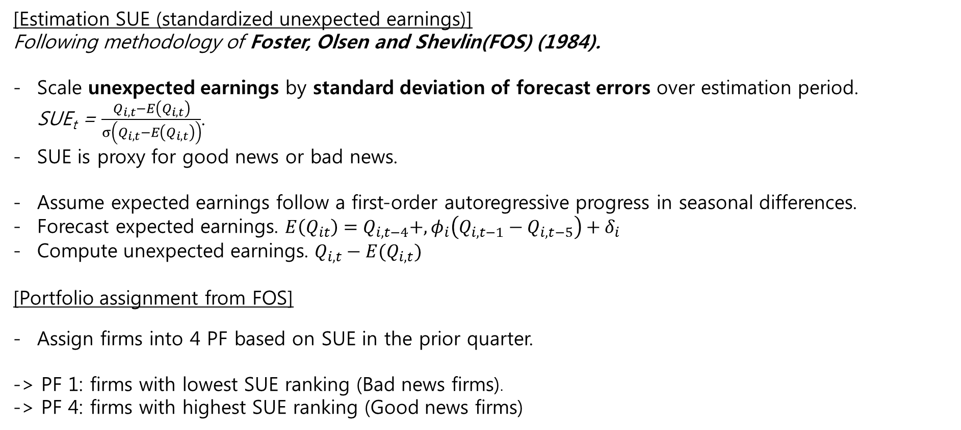
Sample
[Estimation SUE (standardized unexpected earnings)]
Following methodology of Foster, Olsen and Shevlin(FOS) (1984).
Scale unexpected earnings by standard deviation of forecast errors over estimation period. SUE_{t} = $\frac{Q_{i,t}−E\left(Q_{i,t}\right)}{σ\left(Q_{i,t}−E\left(Q_{i,t}\right)\right)}$.
SUE is proxy for good news or bad news.
Assume expected earnings follow a first-order autoregressive progress in seasonal differences.
Forecast expected earnings. $E\left(Q_{it}\right)=Q_{i,t−4}+,φ_{i}\left(Q_{i,t−1}−Q_{i,t−5}\right)+δ_{i}$
Compute unexpected earnings. $Q_{i,t}−E(Q_{i,t})$
[Portfolio assignment from FOS]
Assign firms into 4 PF based on SUE in the prior quarter.
-> PF 1: firms with lowest SUE ranking (Bad news firms).
-> PF 4: firms with highest SUE ranking (Good news firms)

Slide 10
Sample
Limit to arbitrage proxy variables
Arbitrage risk
a. Idiosyncratic volatility
2. Transaction cost
a. Trading Volume
b. Amihud illiquidity
c. Recent Price
d. Zero frequency
3. Information Uncertainty
a. Numbers of Analysts follow
b. Cash-flow volatility

Slide 11
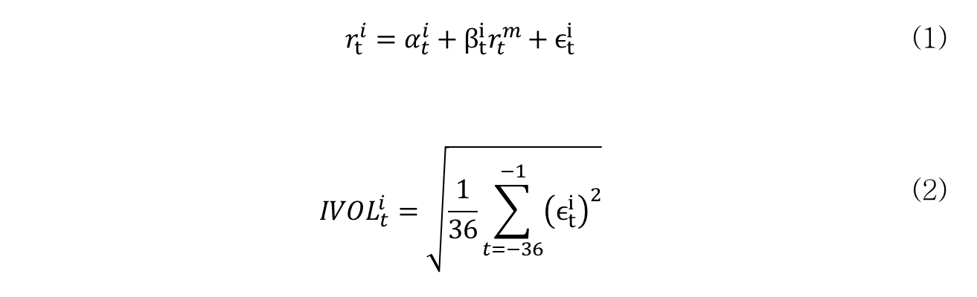
Sample
Limit to arbitrage proxy variables
Arbitrage risk
a. Idiosyncratic volatility
Pontiff (2006) demonstrates that arbitrageurs prefer to hold less of stocks with higher idiosyncratic stock return volatility.
In this paper, idiosyncratic volatility is used as a proxy for arbitrage costs.
Idiosyncratic volatility is obtained by regressing monthly return of individual stock on market(KOSPI) portfolio over 36 months, and then computing the standard deviation of the residuals.
$$r_{t}^{i}=α_{t}^{i}+β_{t}^{i}r_{t}^{m}+ϵ_{t}^{i}$$ | (1)
$$IVOL_{t}^{i}=\sqrt{\frac{1}{36}\sum_{t=−36}^{−1}{{\left(ϵ_{t}^{i}\right)}^{2}}}$$ | (2)

Slide 12
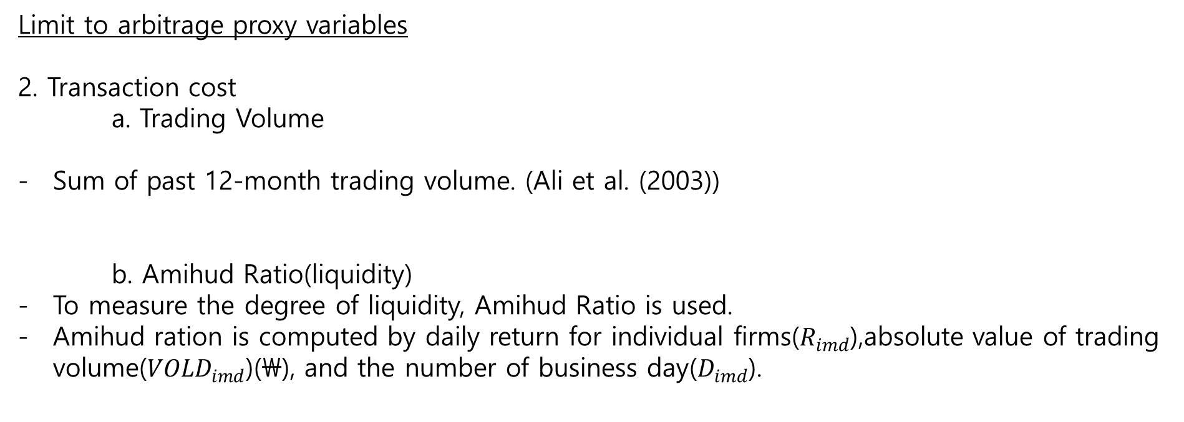
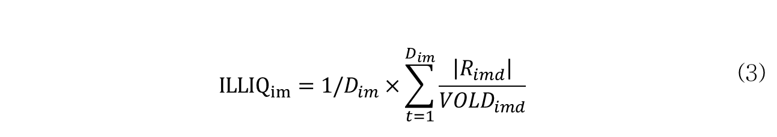
Sample
Limit to arbitrage proxy variables
2. Transaction cost
a. Trading Volume
Sum of past 12-month trading volume. (Ali et al. (2003))
b. Amihud Ratio(liquidity)
To measure the degree of liquidity, Amihud Ratio is used.
Amihud ration is computed by daily return for individual firms($R_{imd}$),absolute value of trading volume(${VOLD}_{imd}$)(\), and the number of business day($D_{imd}$).
$${ILLIQ}_{im}=1/D_{im}×\sum_{t=1}^{D_{im}}{\frac{\left|R_{imd}\right|}{VOLD_{imd}}}$$ | (3)

Slide 13
Sample
Limit to arbitrage proxy variables
c. Recent Price
- Mean of daily price in past 1month.
d. Zero frequency
- The number of firms whose daily return is zero(0%)

Slide 14
Sample
Limit to arbitrage proxy variables
3. Information Uncertainty
a. Numbers of Analysts follow
The number of analysts’ coverage.
b. Cash-flow volatility
Cash flow volatility in past 4 years (using annual report).

Slide 15
Empirical Test
SUE

Slide 16
Empirical test _ Single sorting(SUE)
차익거래제한 대용변수(proxy variables) |  | Mean | Min | 1Q | Median | 3Q | Max
차익거래 위험(Arbitrage risk)
 | 기업고유 변동성(Idiosyncratic volatility) | 0.107 | 0.039 | 0.079 | 0.097 | 0.122 | 1.089
거래비용(Transaction costs)
 | 거래대금(Trading volume)(M\) | 5,177,072 | 3,930 | 475,284 | 1,730,149 | 5,430,824 | 102,438,680
 | 유동성(illiquidity) | 0.010 | 0.000 | 0.000 | 0.000 | 0.001 | 53.523
 | 가격(price) | 117590 | 1004 | 17519 | 41071 | 99434 | 3643818
 | 영(0) 수익률(zerofreq) | 15.935 | 1 | 10 | 14 | 20 | 246
정보 불확실성(Information uncertainty)
 | 애널리스트 수(Number of Analyst Follow) | 10.019 | 0 | 2 | 9 | 17 | 33
 | 현금흐름 변동성(Cash flow volatility) | 2.318 | 0.015 | 0.313 | 0.557 | 1.116 | 753.636
Notes:
and with the total amount of long position = short positiion

Slide 17
Empirical test _ Single sorting(SUE)
Notes:
and with the total amount of long position = short positiion

Slide 18
Empirical test _ two way sorting (SUE and IVOL)
Notes:
and with the total amount of long position = short positiion

Slide 19
Empirical test _ two way sorting (SUE and Recent price)
Notes:
and with the total amount of long position = short positiion

Slide 20
Empirical test _ two way sorting (SUE and Amihud)
Notes:
and with the total amount of long position = short positiion

Slide 21
Empirical test _ two way sorting (SUE and Trading)
Notes:
and with the total amount of long position = short positiion

Slide 22
Empirical test _ two way sorting (SUE and Numbers of Analysts following)
Notes:
and with the total amount of long position = short positiion

Slide 23
Empirical test _ two way sorting (SUE and Zero Frequency)
Notes:
and with the total amount of long position = short positiion

Slide 24
Empirical test _ two way sorting (SUE and Cashflow Volatility)
Notes:
and with the total amount of long position = short positiion

Slide 25
Empirical Results _ sue
Risk adjusted returns (ex, CAPM, Fama-French 3 factor model, Fama-French 5 factor model) are statistically significant.
It means that CAPM, Fama-French 3 factor model, and Fama-French 5 factor model cannot explain the SUE anomaly.
Thus, this paper investigate whether the SUE effect is more stronger when the limit to arbitrage is most severe.

Slide 26
Conclusion
1. This paper find that zero investment portfolio using sue

Slide 27
Q & A
감사합니다

