Slide 1


Lab Section 2
Linux-GCC Primer (continued), Functions & Pointers
CS-202
Bashira A. Anima, Xinying Wang, Hemanta Sapkota, Yuchuan Liu
University of Nevada, Reno

Slide 2
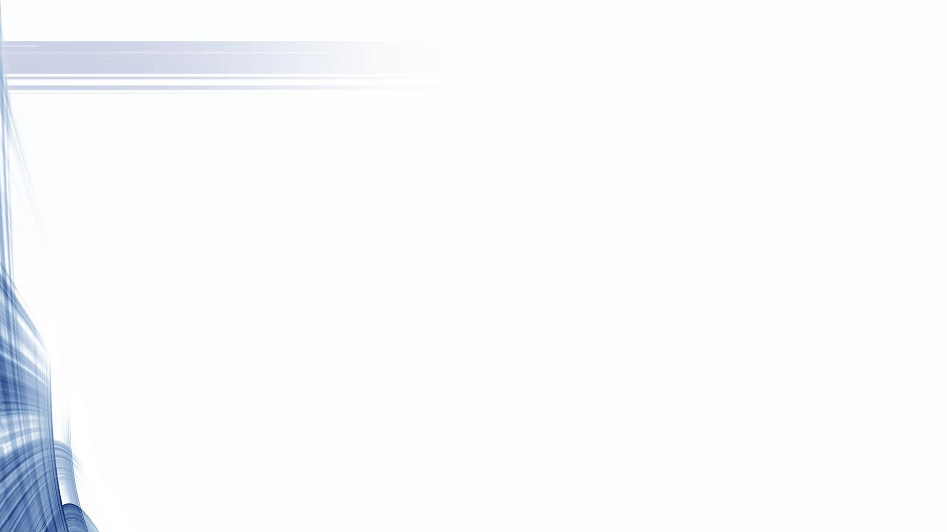

Your Teaching Assistants - Revised
Changed !
Bashira Akter Anima : Lab Section 5 – 9:00-9:50 am @ SEM 231C
banima@nevada.unr.edu Lab Section 1 – 10:00-10:50 am @ SEM 231C
Office Hrs: Mo 11 am - 1 pm @ ECC
Yuchuan Liu : Lab Section 2 – 11:00-11:50 am @ SEM 231C
ycliu@nevada.unr.edu Lab Section 3 – 12:00-12:50 pm @ SEM 231C
Office Hrs: We 9am - 11am @ SEM 207
Xinying Wang : Lab Section 8 – 1:00-1:50 pm @ SEM 231C
xinyingw@nevada.unr.edu Lab Section 7 – 2:00-2:50 pm @ SEM 231C
Office Hrs: Th 11 am - 1 pm @ SEM 207
Hemanta Sapkota : Lab Section 6 – 6:00-6:50 pm @ SEM 231C
hsapkota@nevada.unr.edu Lab Section 4 – 7:00-7:50 pm @ SEM 231C
Office Hrs: Th 11am - 12 pm @ SEM 342D
1:30 pm - 2:30 pm @ SEM 342D
CS-202 Lab Sections

Slide 3
Consulting / Asking for Assistance
Discussion Board first: You should always post your questions to the WebCampus Discussions section.
TAs and other students will answer your questions.
Email your primary TA : If you have a specific code question, or a question about your grades, then email your TAs.
Visit during Office Hours to get hands-on assistance.
If you still cannot handle your issue, then you may contact your PASS Leader / your Instructor via email.
CS-202 Lab Sections

Slide 4
Reminders
Code does not compile: ~0 Credit !
Code improperly formatted / unreadable: ~0 Credit !
Code has to be properly indented in matching Curly Braces “{}”
Variable names have to convey their utility
Code Organization (the components of a program in order):
Include statements importing Header Files.
Global Constants (avoid global variables at all costs).
Function Prototypes.
The program’s main() function.
Function Implementations.
CS-202 Lab Sections

Slide 5
Reminders
#include <iostream>
using namespace std;
const int MAX_STR_SIZE = 256;
void cStringPrint(const char * cstr);
int main(){
char my_cString[MAX_STR_SIZE] = "Hello World!";
cStringPrint ( my_cString );
cout << endl;
return 0;
}
void cStringPrint(const char * cstr){
while( *cstr ){
cout << *cstr++ ;
}
}
Headers
Global Constants
Prototypes
The main()
Implementations
CS-202 Lab Sections

Slide 6
Reminders
Turning in Projects
Specific instructions in respective Project Description file (pdf)
Archive file (.zip , .tar.gz , etc) with at least:
Source Code (.cpp) files and Documentation (.pdf , .txt , .doc(x) , etc.)
Named PA#_Lastname_Firstname.zip (e.g. PA2_Smith_John.zip)
Do not include the executable file
Using NoMachine Client program
Develop & compile your code as you were shown (g++) remotely
Instructions on WebCampus https://unr.canvaslms.com/files/2892775
Interface also accessible online via https://ubuntu.cse.unr.edu
CS-202 Lab Sections

Slide 7
Functions
All good programming should be modular:
Each part of a program that performs a distinct operation or task should be considered as a candidate separate function.
Functions make your code more readable:
Functions should have a descriptive name.
Comments with Pre/Post-conditions etc. help “inline” documentation.
Functions enable code re-use:
Eliminate the need to have repeated blocks of “copy-pasted” code.
CS-202 Lab Sections

Slide 8
Compilation Semantics
Compiling & Linking
A compiler – assembler – and linker form a toolchain of computer programs that take source code written in a specific programming language and transform it into a program that can be ran on a computer.
Executing
The process where a computer actually performs the instructions of the compiled/assembled/linked program.
Remember:
g++ -o my_program my_program_code.cpp
Remember:
./my_program
CS-202 Lab Sections

Slide 9
Remember: Pointers
Pointer
A Pointer is “Just a Variable”.
Its Value: an Address in memory (instead of storing an int/float/char/etc.)
Its Type: what type of variable resides in that memory Address.
int
int*
num
ptr
Addresses
0x1015
0x5286
Pointer Value: Where it points-to
in memory
18
0x5025
Values
CS-202 Lab Sections

Slide 10
Remember: Pointers
Pointer Assignment
Assignment means telling the pointer what memory Address to point to:
int num = 18;
int * ptr = &num;
int
int*
num
ptr
Addresses
0x1015
0x5286
Pointer Value: Where it points-to
in memory
18
0x1015
Values
CS-202 Lab Sections

Slide 11
Remember: Pointers
Dereference Operator (*) or “Value-Pointed-By”
To get the Value-Pointed-By a pointer, we pre-pend the star (*) operator to its name.
… = *ptr
*ptr = …;
int
int*
num
ptr
Addresses
0x1015
0x5286
18
0x1015
Values
CS-202 Lab Sections

Slide 12
Basic Pointer Arithmetic
Moving through an Array with Pointers
int num_array[10] = { 0 , 1 , 2 , 3 , 4 , 5 , 6 , 7 , 8 , 9 };
int* num_ptr;
num_ptr = num_array; //or equivalently, num_ptr = &num_array[0];
cout << *num_ptr;
0 Pointer points to Address of array 1st element.
CS-202 Lab Sections

Slide 13
Basic Pointer Arithmetic
Moving through an Array with Pointers
int num_array[10] = { 0 , 1 , 2 , 3 , 4 , 5 , 6 , 7 , 8 , 9 };
int* num_ptr;
num_ptr = num_array; //or equivalently, num_ptr = &num_array[0];
cout << *num_ptr;
num_ptr++;
cout << *num_ptr;
1 Pointer moves to point 1 position ahead (++) in memory,
therefore pointing to Address of array 2nd element.
CS-202 Lab Sections

Slide 14
Basic Pointer Arithmetic
Moving through an Array with Pointers
int num_array[10] = { 0 , 1 , 2 , 3 , 4 , 5 , 6 , 7 , 8 , 9 };
int* num_ptr;
num_ptr = num_array; //or equivalently, num_ptr = &num_array[0];
cout << *num_ptr;
num_ptr++;
cout << *num_ptr;
num_ptr += 8;
cout << *num_ptr;
9 Pointer moves to point 8 positions more ahead (+=8) in memory,
therefore pointing to Address of array 10th element.
CS-202 Lab Sections

Slide 15
Basic Pointer Arithmetic
Moving through an Array with Pointers
int num_array[10] = { 0 , 1 , 2 , 3 , 4 , 5 , 6 , 7 , 8 , 9 };
int* num_ptr;
num_ptr = num_array; //or equivalently, num_ptr = &num_array[0];
cout << *num_ptr;
num_ptr++;
cout << *num_ptr;
num_ptr += 8;
cout << *num_ptr;
num_ptr--;
cout << *num_ptr;
8 Pointer moves to point 1 position backwards (--) in memory,
therefore pointing to Address of array 9th element.
CS-202 Lab Sections

Slide 16
Basic Pointer Arithmetic
Moving through an Array with Pointers
int num_array[10] = { 0 , 1 , 2 , 3 , 4 , 5 , 6 , 7 , 8 , 9 };
int* num_ptr;
num_ptr = num_array; //or equivalently, num_ptr = &num_array[0];
cout << *num_ptr;
num_ptr++;
cout << *num_ptr;
num_ptr += 8;
cout << *num_ptr;
num_ptr--;
cout << *num_ptr;
num_ptr-=5;
cout << *num_ptr;
num_ptr = num_array;
cout << *num_ptr;
3 Pointer moves to point 4 positions more back (-=5) in memory,
therefore pointing to Address of array 4th element.
CS-202 Lab Sections

Slide 17
Basic Pointer Arithmetic
Moving through an Array with Pointers
int num_array[10] = { 0 , 1 , 2 , 3 , 4 , 5 , 6 , 7 , 8 , 9 };
int* num_ptr;
num_ptr = num_array; //or equivalently, num_ptr = &num_array[0];
cout << *num_ptr;
num_ptr++;
cout << *num_ptr;
num_ptr += 8;
cout << *num_ptr;
num_ptr--;
cout << *num_ptr;
num_ptr-=5;
cout << *num_ptr;
num_ptr = num_array;
cout << *num_ptr;
0 Pointer reassigned to points again to Address of array 1st element.
CS-202 Lab Sections

Slide 18
Remember: Parameters in Functions
i) Pass-by-Value
The “default” way.
Implies Data Copy operation.
void printVal (int x);
int x = 5;
int * xPtr = &x;
printVal(x);
printVal(*xPtr);
Valid Calls
CS-202 Lab Sections

Slide 19
Remember: Parameters in Functions
ii) Pass-by-Reference
Uses (&) operator once (function declaration).
Actual Argument passed, Data Copy unnecessary.
void changeByRef (int & x);
int x = 1;
int & xRef = x;
changeByRef(x);
changeByRef(xRef);
Note:
Variable might be changed.
Have to bear in mind the function prototype !
Valid Calls
CS-202 Lab Sections

Slide 20
Remember: Parameters in Functions
iii) Pass-by-Address
Uses pointers, and uses (*) and (&) operators.
Address passed (via Pointer value), Data Copy unnecessary.
void changeVal (int * x);
int x = 5;
int * xPtr = &x;
changeVal(&x);
changeVal(xPtr);
No guarantees pointer is valid.
Note:
Have to check for NULL pointer inside function calls !
Valid Calls
CS-202 Lab Sections

Slide 21
Remember: Functions and Arrays
Pass-by-Address
Arrays “Decay” into Pointers, they are always Passed-by-Address to functions.
Program does not make a copy of an array.
Changes made to an array inside a function will persist after the function exits.
Remember entire Arrays as Function Arguments:
double array[10] = {}; // braced initializer for zero-initialization
void arrayWholeFunction(double vals [], int num);
void arrayWholeFunction(double * vals, int num);
arrayWholeFunction(array, 10);
arrayWholeFunction(&array[0], 10);
or
Valid Definitions
by-Address (name)
by-Address-of (1st element)
or
CS-202 Lab Sections

Slide 22
A Comprehensive Example
#include <iostream>
using namespace std;
const int MAX_STR_SIZE = 255;
void cStringPrint(char * cstr);
int main(){
char my_cString[MAX_STR_SIZE] = "Hello World!";
cStringPrint ( my_cString );
return 0;
}
void cStringPrint(char * cstr){
while( *cstr ){
cout << *cstr++ ;
}
}
A C-string i.e. char array
A Function with a char * parameter
A Function that:
Iterates through an array by employing Pointer-Arithmetic (++)
Accesses elements of an array by employing Pointer-Dereferencing (*)
Equivalent to: cout << *cstr ;
cstr++;
CS-202 Lab Sections

Slide 23
Time for Questions !
CS-202
CS-202 Lab Sections

