Slide 1
BlingBank - SIRS Project
Group A39 - Diogo Melita, Nuno Alves, Tomás Esteves

Slide 2
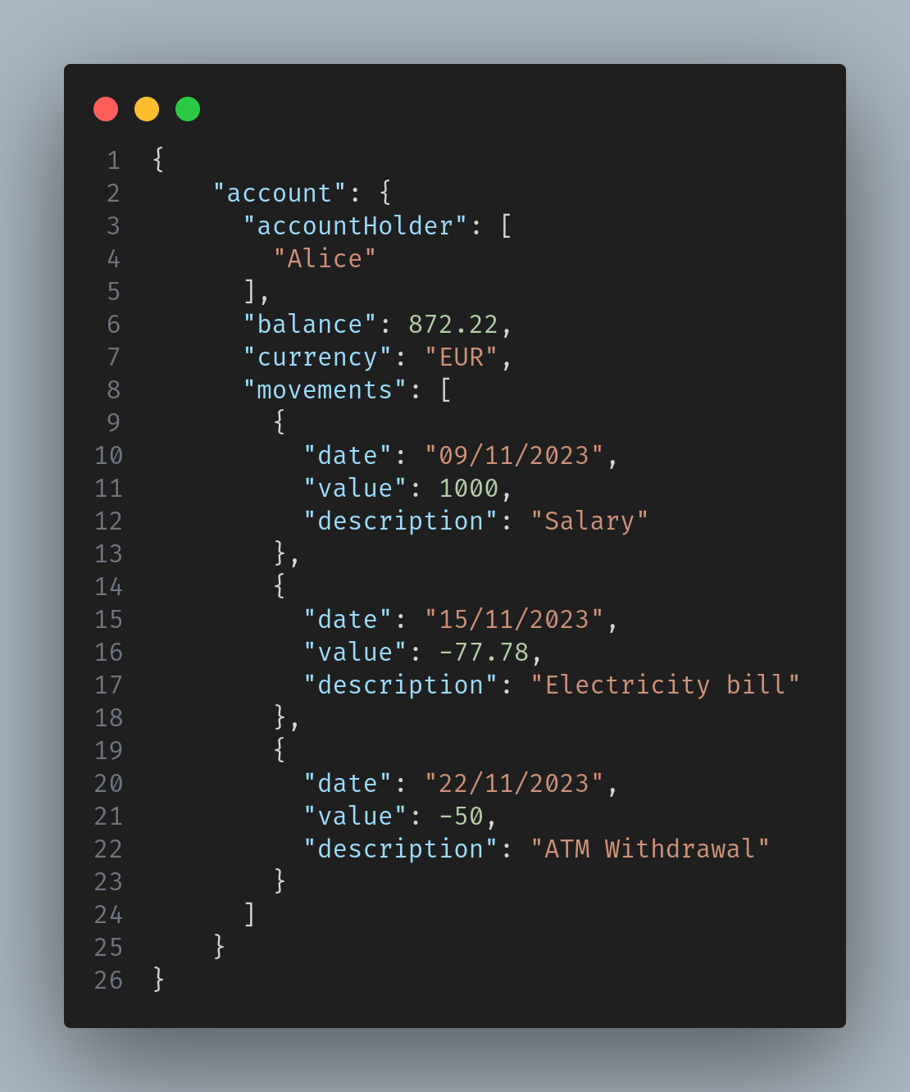

Secure Document

Slide 3
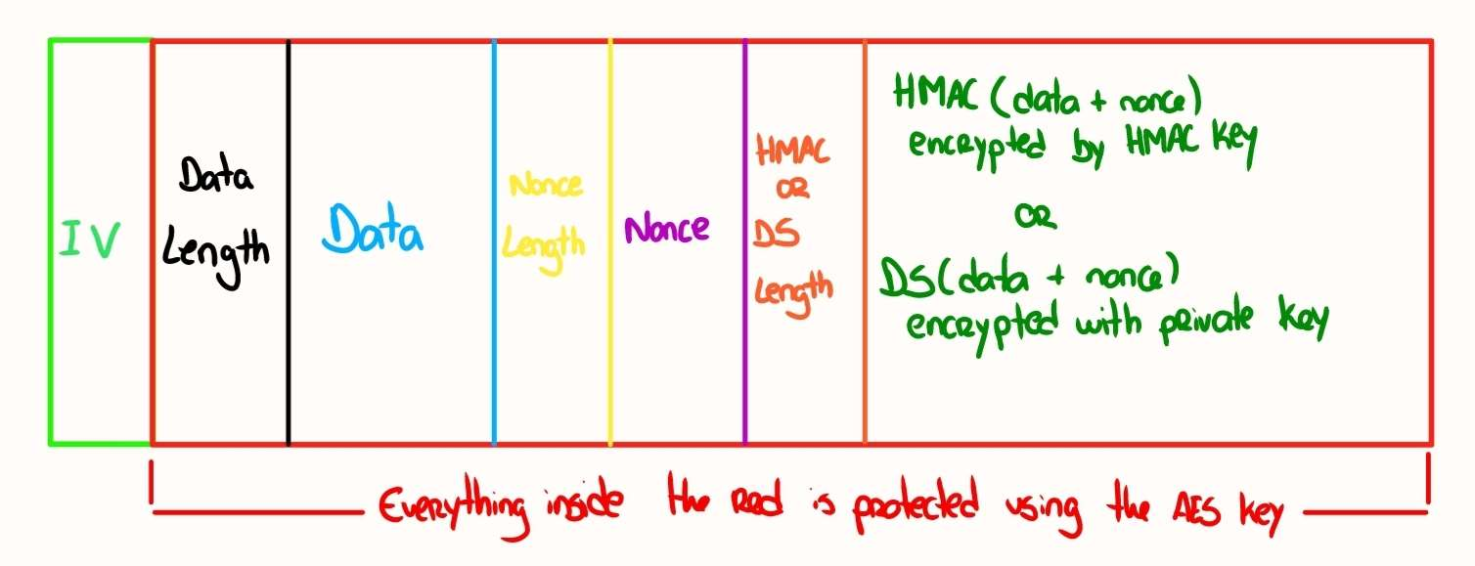
Secure Document Format

Slide 4
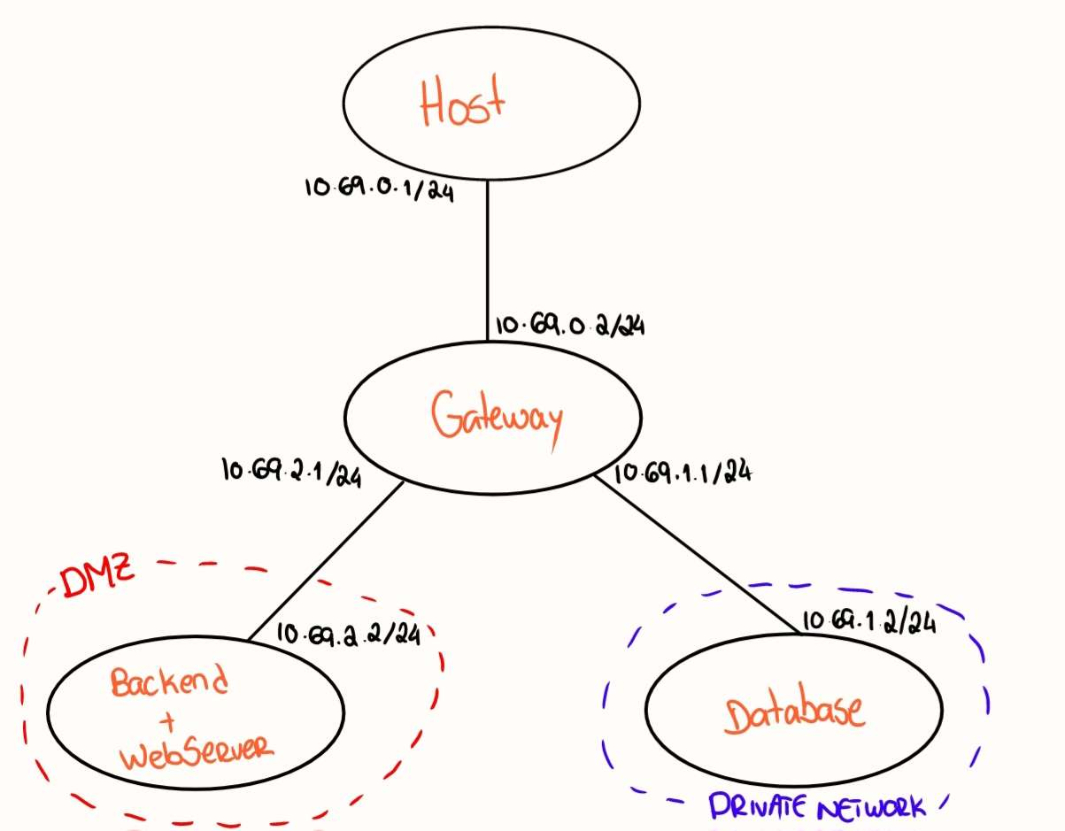

Infrastructure
WORLD

Slide 5



Registration and Login

Slide 6

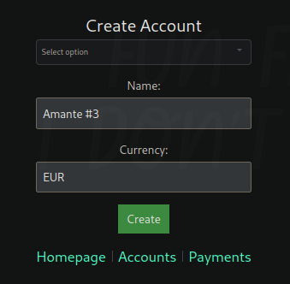

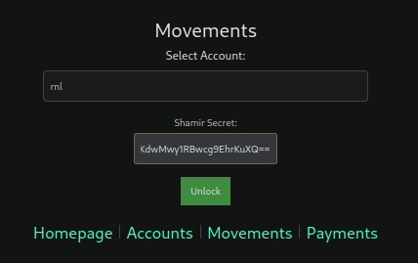
Account Management

Slide 7
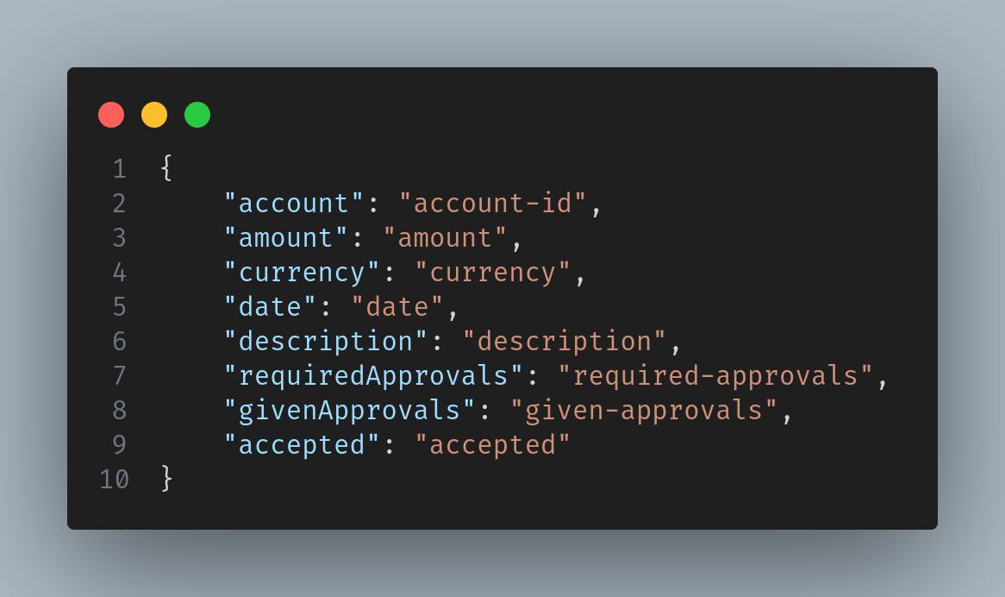
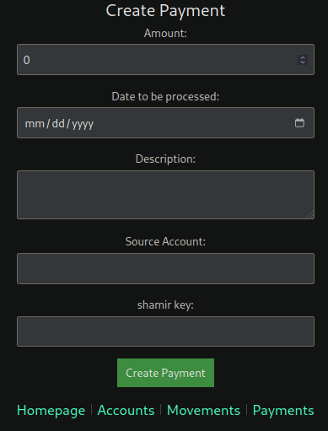
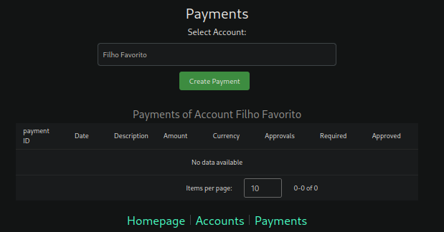

Security Challenge

Slide 8
Demonstration

