Slide 1
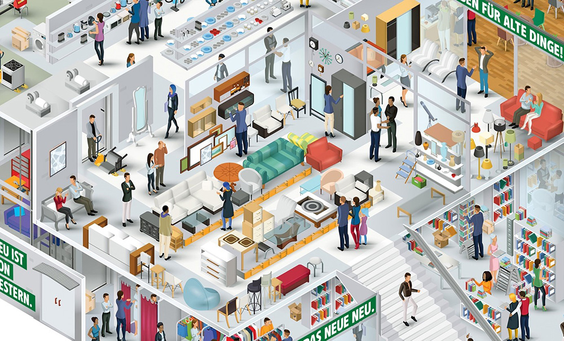
Data Visualization for Store 577

Slide 2
1. How did Store #577 perform against their individual monthly targets during the year 2019?

Slide 3
2. How are the store sales trending so far in 2020?

Slide 4
3. Do you expect the store to meet its annual 2020 target by the end of the year?

