Slide 1


Build a Chatbot with Rasa (Natural Language Processing)
This template is licensed under a Creative Commons Attribution-Share Alike 3.0 Unported License.
It makes use of the works of Mateus Machado Luna.
Presentation by Mr Namgyal BRISSON

Slide 2


Let’s take off
RASA Documentation
Chatito: Training & Testing Data Generation
Let’s dig in with an Example on Github

Slide 3
Minimal Airline Companies Database
The main idea is to imitate in a minimalist way a database of airline companies.
Insertion of a destination city with the associated airline ticket prices.
Following cities will be inserted:
  Taiwan
  Thaïlande
  California
  Paris
  Mauritius
  Mumbai
  Toulouse
  Lyon
  Berlin
  Rome
  Madrid
  Johannesburg
  Antananarivo
  New Delhi
  New-York
  Atlanta
  San Francisco
  Port Louis

Slide 4
Create Sample Flights
PK | DESTINATION | PRICE (€) | COMPANY
1 | taiwan | 500 | air taiwan
2 | thailand | 700 | air asia
3 | california | 600 | air america
4 | paris | 1200 | air france
5 | paris | 990 | air italia
6 | paris | 1080 | lufthansa
7 | mauritius | 1190 | air france
8 | mauritius | 1280 | air mauritius
9 | india | 599 | air india
… | … | … | ...

Slide 5
SQL CREATE script
create table if not exists flights
(
pk INTEGER not null
constraint flights_pk
primary key autoincrement,
destination TEXT not null,
price INTEGER not null,
company TEXT not null
);
create unique index if not exists flights_pk_uindex on flights (pk);

Slide 6
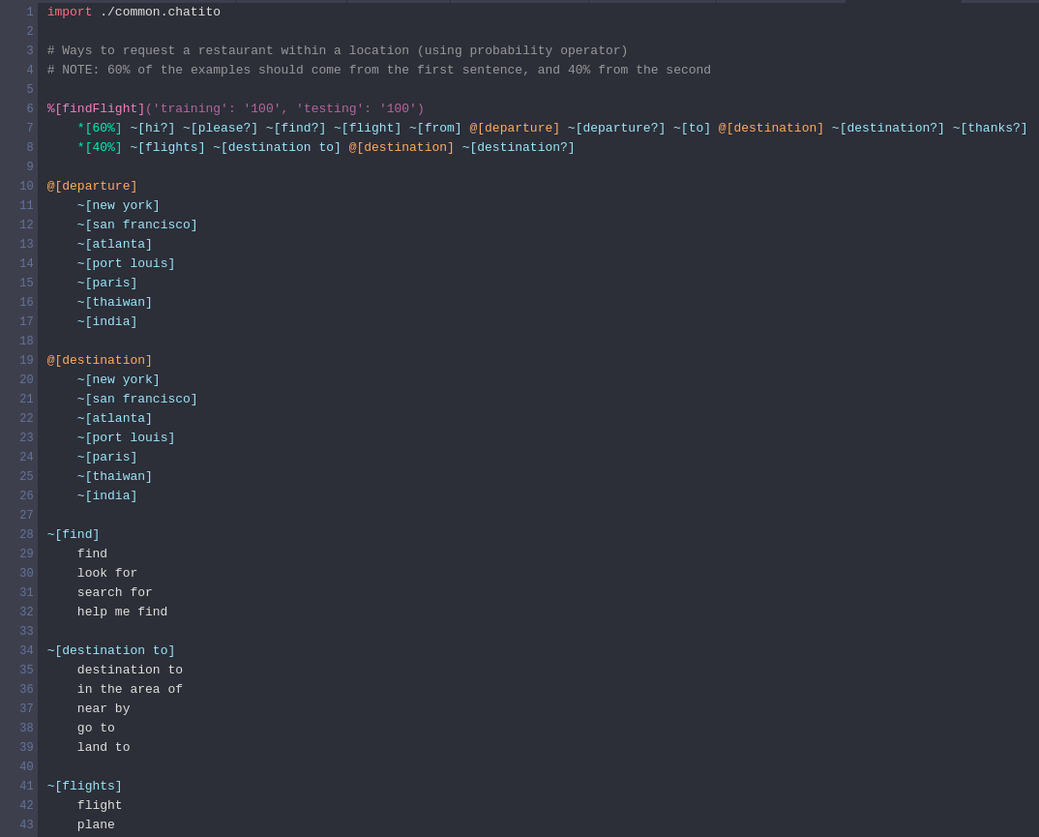
RASA Training Sets

Slide 7
Create the Bot
Create database using SQLite (sqlite3)
  Insert flights rows from fixture
Training NLP parser with Chatito training data set
Reply with database records matching NLP parser entities
Testing with samples

Slide 8
To go further
Create a multi-domain bot
  Create a training dataset for each domain you want to process (flight, restaurant, hotels, events, ...)
  Aggregate them all into a Chatbot
  Parralelize User’s question to each bot by implementing a multi-processes application
  Eventually, reply to the User for each domain from which you get replies

Slide 9

Time to Land...
Thanks for attending :)

