Slide 1
Build a Blog from scratch with Django
M. Namgyal BRISSON
Consultant in Software Development

Slide 2

Build a Blog from scratch
Django Framework
Session of today consists of following parts :
  Django in Brief
  Routing defined views to proper URLs
  Defining Data Models
  Defining Admin rendering
  Creating HTML View behaviors
  Creating associated HTML templates
  Deploy on Heroku
  To go further…

Slide 3
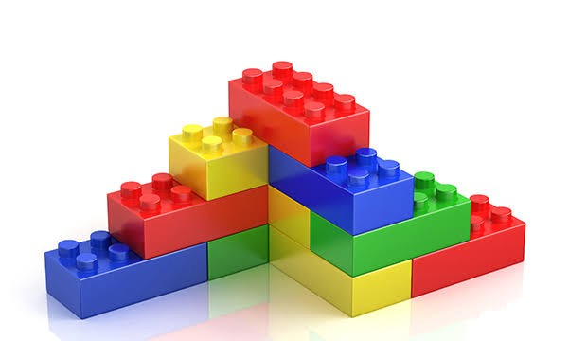
Django in Brief
« Django makes it easier to build better Web apps more quickly and with less code »
Django is a set of software pieces
Each piece address a problem (a set of features)
Each piece is pluggable & highly configurable

Slide 4
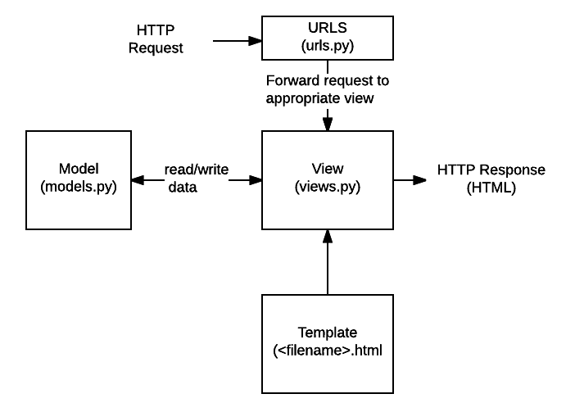
Django Routing
Defined in « urls.py » module
« To design URLs for an app, you create a Python module informally called a URLconf (URL configuration). This module is pure Python code and is a mapping between URL path expressions to Python functions (your views). »

Slide 5
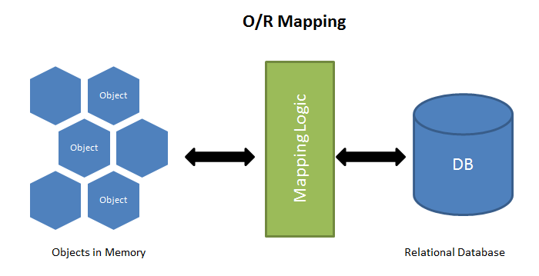
Django Models
Defined in « models.py » module
Use Object Relational Mapping (ORM)
Take in charge database synchronization with django command line tooling through « manage.py » script

Slide 6
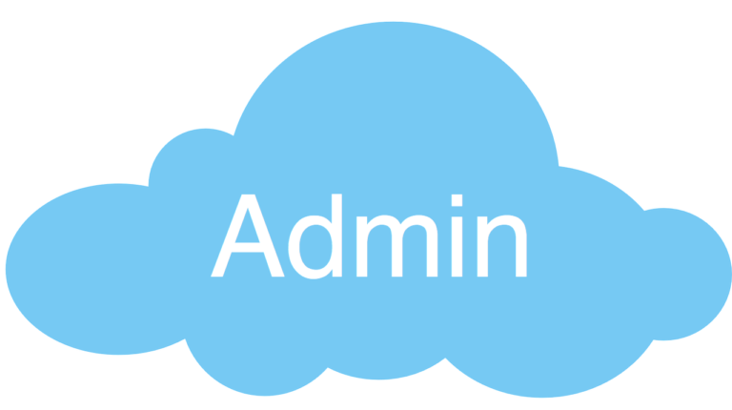
Django Admin
Defined in « admin.py » module
Automated Interface based on Data Models
Easy to customize & configure
To learn more, take a look at official Documentation

Slide 7

Django Views
Defined in « views.py » module
Place to write view logic & behavior
Several Generic piece of code brought by Django to speed up development of common use cases

Slide 8
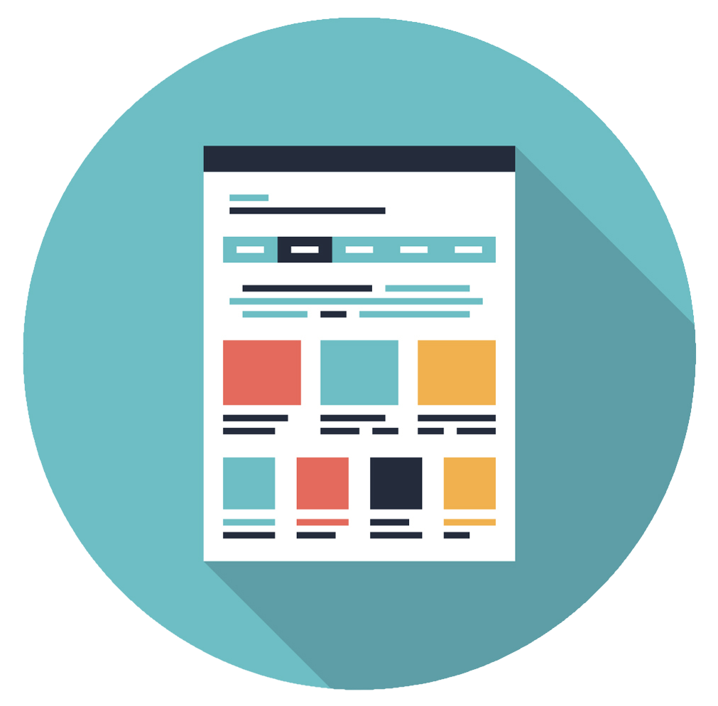
Django Templates
Stored in « templates » folder
Contains all HTML files to be bound to view’s logic (defined in views.py module)
Define the look & feel of the application

Slide 9

Deploy on Heroku
Install Heroku CLI
Follow Heroku’s instructions to deploy
Visualize your Blog

Slide 10

Thanks for Attending
To go further
  Django REST framework to build an API within minutes
  Find out tons of third-party contributions by digging into the Django’s community

