Slide 1
NLP in Engineering Fields
Authored by
M. Namgyal BRISSON
Independant Consultant for NXP
Python Mentor on OpenClassrooms

Slide 2
NLP in Engineering Fields
One-Hot Encoding
Basic Features Extraction
Readability Tests
  Flesch Reading Ease Score
  Gunning Fog Index Score
Tokenization & Lemmatization
Part-Of-Speech (POS) Tagging
Named Entity Recognition (NER)
Chatbot Example

Slide 3
One-Hot Encoding
https://colab.research.google.com/drive/13X5jeN3oY3CFJL3ok5rwP6tifiRhIiz-
... | Gender
... | male
... | female
... | female
... | male
... | Gender_male | Gender_female
... | 1 | 0
... | 0 | 1
... | 0 | 1
... | 1 | 0

Slide 4
Basic Features Extraction
Words count
Characters count
Words average length
Pattern specific count (for instance, [hash]tags)
Other Features Extraction
Sentences count
Paragraph count
Capitalized words
Uppercased words
Quantities (Numerical)
Etc.

Slide 5
Readability Tests
Flesch Reading Ease Score
  Greater the average sentence length, harder the text is to read
    « Quick & short example »
    « Pretty much longer sentence, therefore harder to read »
  Greater the number of syllables in a word, harder the text is to read
    « I feel good at home »
    « I’m positively affected by being at my domicile »
Higher the score is, greater the readability is!

Slide 6
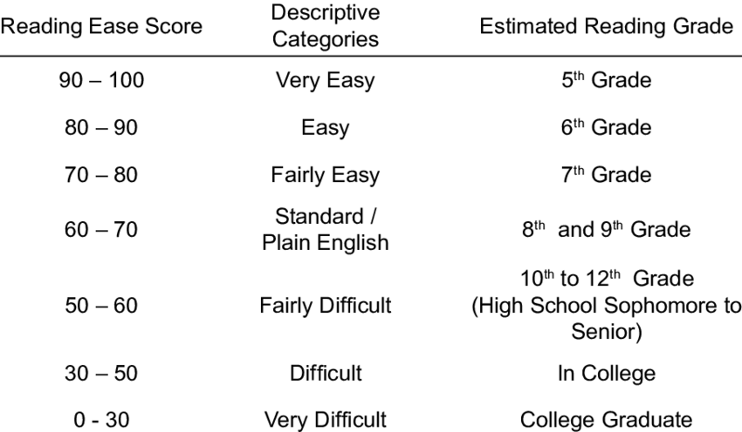
Readability Tests

Slide 7
Readability Tests
Gunning Fog Index Score
  Based on following principles:
    Average sentence length
    Percentage of complex words
Lesser the score is, greater the readability is!

Slide 8
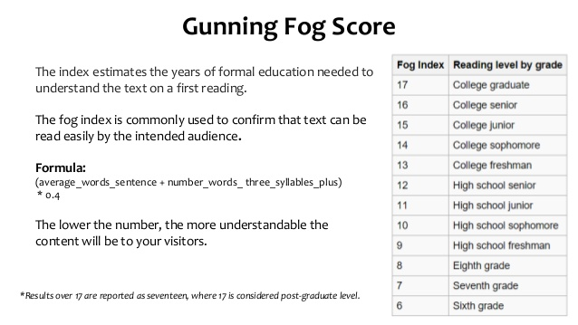
Readability Tests
https://colab.research.google.com/drive/1ZyIU1BZEP5WVS-EE1vghHJqMjgHWe1Uc

Slide 9
Tokenization & Lemmatization
Tokenization is splitting a sentence into its constituant parts
  « Hello, my name is Namgyal. »
  → [`Hello`, `,`, `my`, `name`, `is`, `Namgyal`, `.`]
Lemmatization is converting words into its base form
  « is », « am », « are » → « be »
  « deleting », « deletes », « deleted », « deletion » → « delete »
  « n’t » → « not »
  « ‘ve » → « have »
https://colab.research.google.com/drive/10HQ-OHeSSRHTcVkETPPaRkZqnQpm8mK4

Slide 10
Part-Of-Speach (POS) Tagging
Assigning every word, its corresponding part of speech.
Used for:
  Word-sense disambiguation
    « The bear is an animal »
    « Bear it up! »
  Sentiment analysis
  Question answering
  Opinion spam detection

Slide 11
Part-Of-Speach (POS) Tagging
WORD | POS
I | Pronoun
have | Verb
a | Article
cat | Noun
https://spacy.io/api/annotation#pos-universal
https://colab.research.google.com/drive/1i_Q-QNhCOUBtmNeE6_CmUdsB3nAvAVLo

Slide 12
Named Entity Recognition (NER)
Identifying & classifying named entities into predifined categories.
  Person
  Country
  Organization
  …
Can be used for:
  News article classification
  Efficient search algorithms
  Question answering
  Customer service
  …
  https://colab.research.google.com/drive/1Tyl_7tmz8j7ByUN_HjlQMRLIIKzilDiN

Slide 13
Chatbot Example
Minimalistic chatbot based on flight suggestions.
Libraries & techniques used:
  RASA NLU
  SQL database
  Chatito data generation
https://github.com/nam4dev/chatbot_rasa_nlu_presentation

Slide 14
Thanks for your attention :)

