Slide 1
Web-SCRaping
STRUCTURE UNSTRUCTURED DATA
Aggregating WEB DATA SOURCE to build a single one
Author: Namgyal BRISSON

Slide 2
INTRODUCTION
  WHAT IS WEB-SCRAPING
  LAW CONCERNS ABOUT WEB-SCRAPING
INTRODUCTION TO HTML
  HTML RENDERING EXAMPLE
  QUERY BY XPATH SELECTOR
  QUERY BY CSS SELECTOR
IDENTIFY DATA TO SCRAP
  PREPARE QUERIES
CREATE A SPIDER USING SCRAPY
PREPARE DATA COLLECTION USING DJANGO
  CREATE DJANGO MODELS
TRIGGER THE SPIDER & FILL THE DATA
TO GO FURTHER: DATA MANIPULATION & A.I
QUESTIONS & ANSWERS

Slide 3
INTROduction
This presentation will introduce a full overview of Web-Scraping techniques.
From data extraction to its representation.
Scrapy, BeautifuSoup & Django will be used to achieve it.

Slide 4
WHAT IS WEB-SCRAPING
Web-scraping is a technical approach which consists in extracting data from unstructured sources (websites, blogs, FTP, …) by parsing HTML pages.

Slide 5
LAW CONCERNS About web-scraping
Conduct a Legal Review
Assess your project against following criteria:
  Personal Data
  Copyrighted Data
  Database Data
  Data Behind A Login
  Sensitive Data

Slide 6
INTRODUCTION TO HTML
A web page is a Hyper Text Markup Language (HTML) tree
It is composed of HTML nodes
One can navigate the tree to reach content of interest

Slide 7
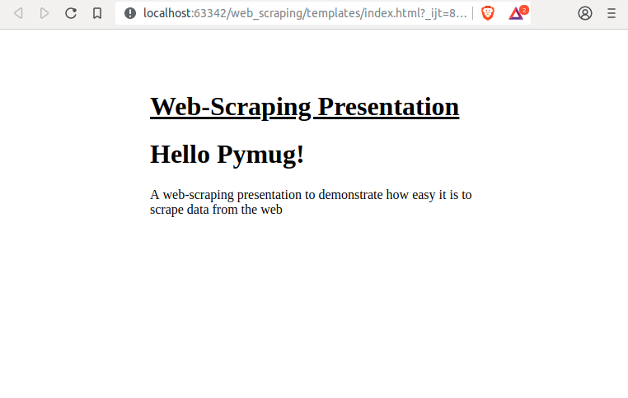
HTML RENDERING EXAMPLE
<!DOCTYPE html>
<html lang="en">
<head>
<meta charset="UTF-8">
<title>[Web-Scraping Presentation] Hello Pymug</title>
</head>
<style>
.container {
width: 100%;
position: relative;
}
.main {
width: 600px;
margin: 10% auto;
position: relative;
}
.main h1.title {
text-decoration: underline;
}
</style>
<body>
<div class="container">
<div class="main">
<h1 class="title">Web-Scraping Presentation</h1>
<div>
<h1>Hello Pymug!</h1>
<p>
A web-scraping presentation
to demonstrate how easy it is
to scrape data from the web
</p>
</div>
</div>
</div>
</body>
</html>

Slide 8
query by Xpath SELECTOR
//h1[contains(“title”, @class)]/text()
=> “Web-Scraping Presentation”

Slide 9
Query by Css selector
h1.title ::text
=> “Web-Scraping Presentation”

Slide 10
Identify DATA to scrap
GitHub Scrapy Official Repository
  https://github.com/scrapy/scrapy/pulls
  Data structure of a Pull Request Block:
    Id (need to be inferred from PR link)
    Title
    Link
    Status (need to follow the PR link)
    Author (need to follow the PR link)
    Scrapped URI (reference)

Slide 11
Prepare queries
Title:
xpath: //*[@data-hovercard-type="pull_request"]
→ css: a ::text
Link:
xpath: //*[@data-hovercard-type="pull_request"]
→ css: a::attr(href)

Slide 12
Prepare queries
Status:
xpath: //*[@id="partial-discussion-header"]/div[2]/div[1]/span
Author:
xpath: //*[@id="partial-discussion-header"]/div[2]/div[2]/a/text()
Pid:
Inferred from Link property
Scrapped URI:
Collected from the Response itself

Slide 13
Create a spider using scrapy
SCRAPY is a Python framework to scrape the web in an efficient & professional way.
Scraping service may periodically be triggered to fill a database to report concurrent prices on specific products, aggregate public data to build statistical views, etc.
Let’s get started!

Slide 14
Prepare data collection using django
Django is a famous python framework to build easy to highly complex website
We will take advantage of its “batteries included” to store and build quickly some views from scrapped data

Slide 15
CREATE DJANGO MODELS
What data do we need to store?
Pull Request Author:
  Name
  GitHub page link
Pull Request:
  Id
  Title
  Author (as foreign key)
  GitHub page link
  Status
  Scrapped URI

Slide 16
TRIGGER THE SPIDER & FILL THE DATA
https://scrapy.org/
Create the GitHub Spider which shall take in charge:
  GitHub scrapy pull requests page request
  Parsing data from the page
  Storing data into Django database

Slide 17
TO go further: DATA Manipulation & A.i
Today, Artificial Intelligence lies on data, a big amount of data (big data) to train models accurately.
Scraping is a way to get that amount of data without much effort.
It is therefore a really good start to collect statistical data on which on could apply A.I algorithms

Slide 18
Questions & answers
BEING CLEVER IS TO FAIL AND LEARN FROM IT :)
THEREFORE, DO NOT HESITATE TO ASK ANY QUESTION
KNOWING THAT THERE’S NO STUPID QUESTION!!!

