Slide 1

Image Classification
Group 7
Phạm Hồng Quang
Nguyễn Văn Nam
Ngô Minh Quang
Nguyễn Đức Nhật
Trần Tùng Dương

Slide 2
Problem
Object recognition in images using CIFAR-10 dataset

Slide 3
Investigation
CIFAR-10 is dataset used widely in machine learning research
Convolutional neural networks appear to be the best in classifying CIFAR-10 images

Slide 4
Investigation
Shallow neural networks can only learn basic levels of features in images.
Deep neural networks can help learn various levels of features in images.

Slide 5
Solution
Building and training a deep Convolution Neural Network model with multiple layers using keras
Libraries used:
Keras: support training and testing models
Matplotlib: for drawing graphs
Pandas: for data manipulation
Scipy: for image processing
Sklearn: support for model evalution
Cv2: for reading image
Numpy: for processing arrays

Slide 6
Data Description
CIFAR-10 dataset
Consists of 60,000 images divided into 10 classes: airplane, automobile, bird, cat, deer, dog, frog, horse, ship, truck
There are 50,000 images in training dataset and 10,000 images in test sets

Slide 7

Data Pre-processing
Import data: CIFAR-10 dataset is included in keras by default
Perform Z-score normalization:
CIFAR-10’s default input data type: uint => convert to float to perform normalization
Apply formula:

Slide 8
Data Pre-processing
Convert target array to one-hot encoding (binary matrices)
CIFAR-10’s default target data type is integer encoding
airplane: 0
automobile: 1
bird: 2
…
ship: 8
truck: 9
Needs to convert to one-hot encoding as there is no relationship between each class in CIFAR-10 dataset

Slide 9
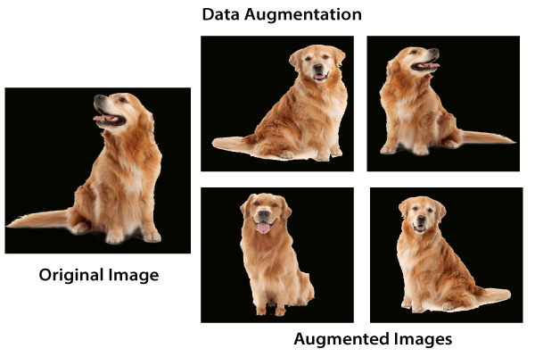
Data Augmentation
Enlarge the dataset for better generalization

Slide 10
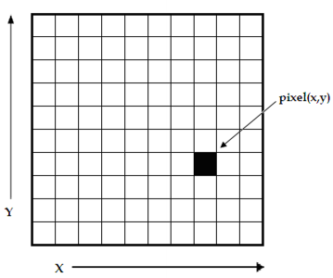
Building deep CNN model
Array of pixels
Classify as
CNN
X or Y or Z,…

Slide 11
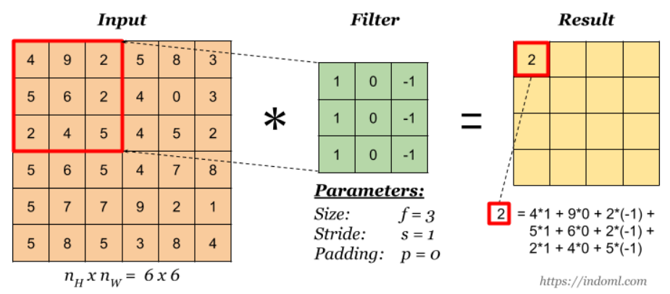
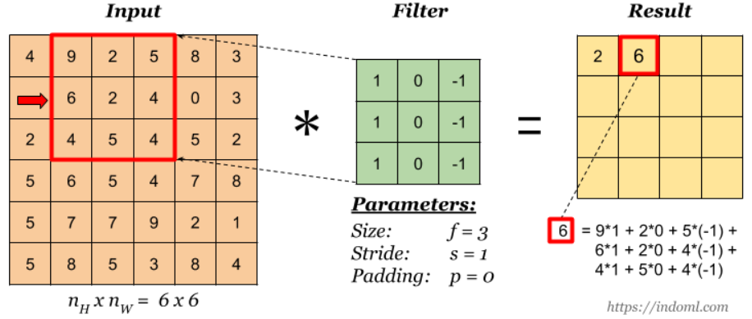
Building deep CNN model
Filters

Slide 12
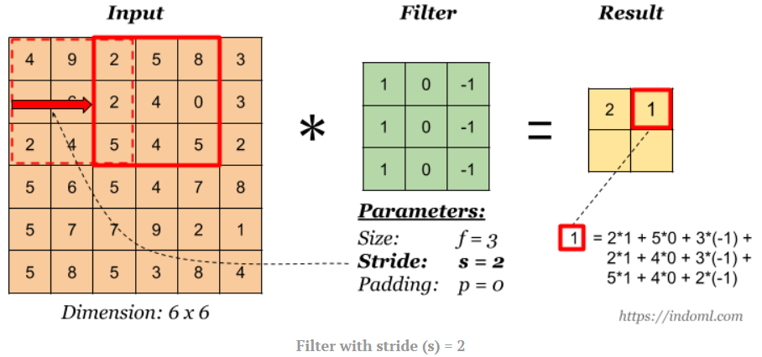
Building deep CNN model
Stride

Slide 13
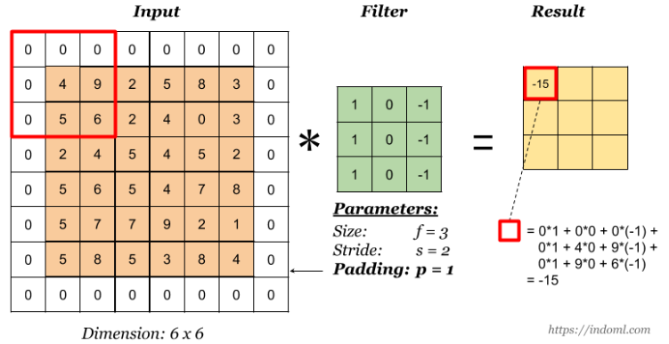
Building deep CNN model
Padding

Slide 14
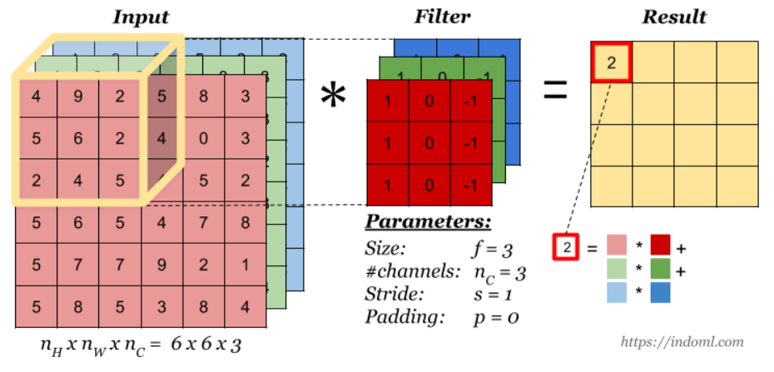
Building deep CNN model
Filter on RGB image with 3 channels

Slide 15
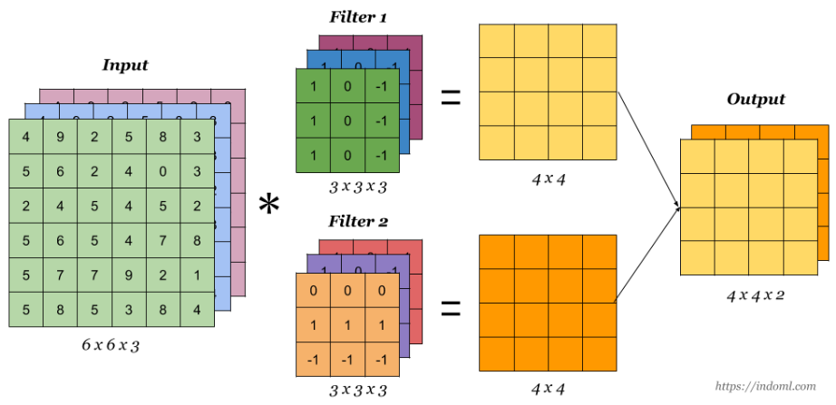
Building deep CNN model
Multiple Filters

Slide 16
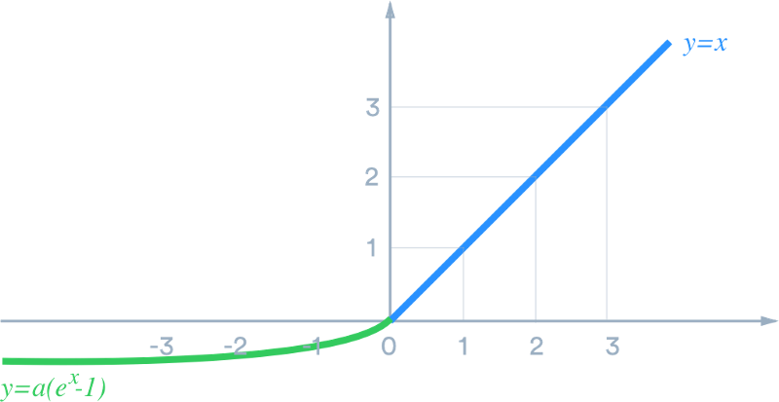
Building deep CNN model
Activation function: Exponential Linear Units (ELU)
x x>=0
α(e^x – 1) x<0

Slide 17
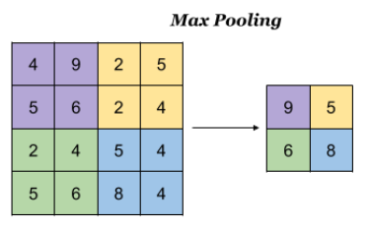
Building deep CNN model
Pooling layer: shrink image size, speed up calculation

Slide 18
Building deep CNN model
Batch normalization
Improving the speed, performance and stability
Used to normalize the input layer by adjusting and scaling the activations
Dropout
Works by randomly dropping out nodes during training
Computationally cheap and effective in reducing overfitting

Slide 19
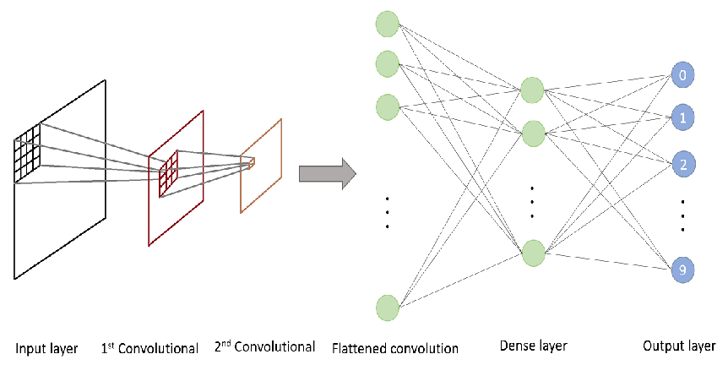
Building deep CNN model
Flatten and Dense layer

Slide 20
Building deep CNN model - optimizer
RMSProp optimizer: fast and popular optimizer
Learning rate = 0.001,
Weight Decay = e^-6

Slide 21
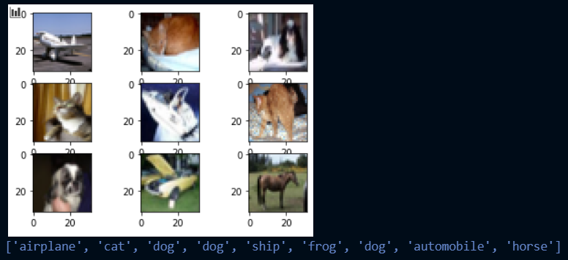
Prediction
Predict last 9 images in test dataset

Slide 22
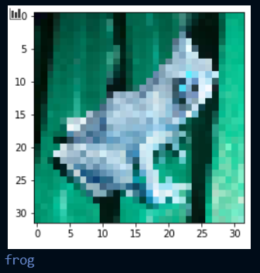
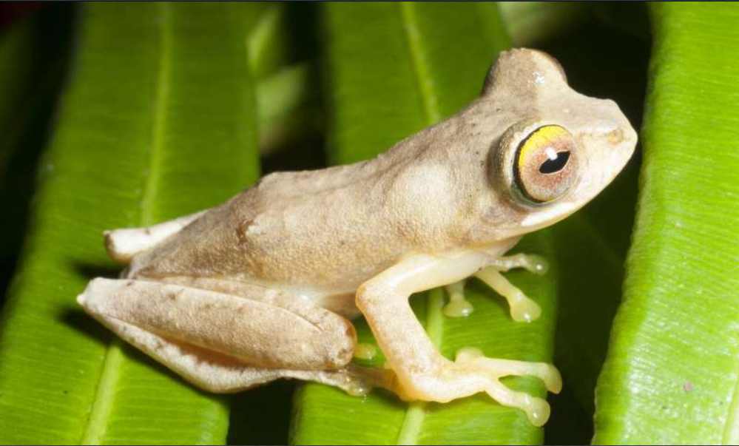
Prediction – custom image
Original image
After downscale to 32x32

Slide 23
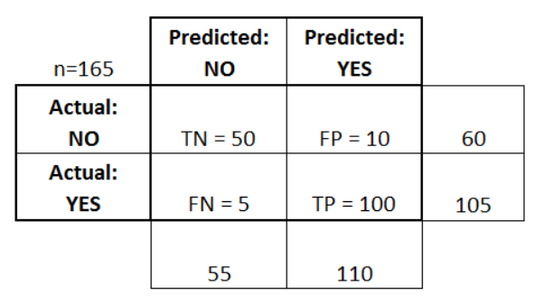

Evaluation
Confusion matrix
Accuracy $=\frac{\text{number} \text{of} \text{corrected} \text{predictions}}{total number of predictions}$

Slide 24


Evaluation
Cross-entropy loss:
C: number of classes
$t_{i}$: true output value
$s_{i}$: predicted output value

