Slide 1
Self-Evolving Multi-Agent DAGs from Pure Reflection
A pilot study on reflection-only graph evolution — no search, no RL
thyun.park · advisor talk · 2026-04-26

Slide 2
One-liner
TL;DR — what we tested
Can a multi-agent DAG (topology + personas + edges) be progressively edited by an LLM controller using ONLY in-context reflection over trajectory tapes — no search archive, no MCTS, no RL?
• Backbone: Qwen2.5-32B-Instruct (vLLM, single H200, bf16)
• Domains: FinanceBench / MEDIQ / AgentClinic (post-pivot from GSM8K)
• Methods compared: CoT · Planner-Executor · Evolved DAG (controller v2)
• Scoring: test accuracy + paired-accept rate (under streaming evolve)
– Controller v1 (n=30): at-or-below baselines on test, 'verifier-add' reflex (H1 weak fail)
– Controller v2 (n=30): qualitatively new behavior; test win not yet (noise dominates)
– Streaming evolve mode: 4 / 10 paired ACCEPTS in run #1 (vs 1 / 9 legacy)
§5.2 multi-seed sweep — running NOW

Slide 3
Setup
DAG formalism · baselines · pilot infrastructure

Slide 4
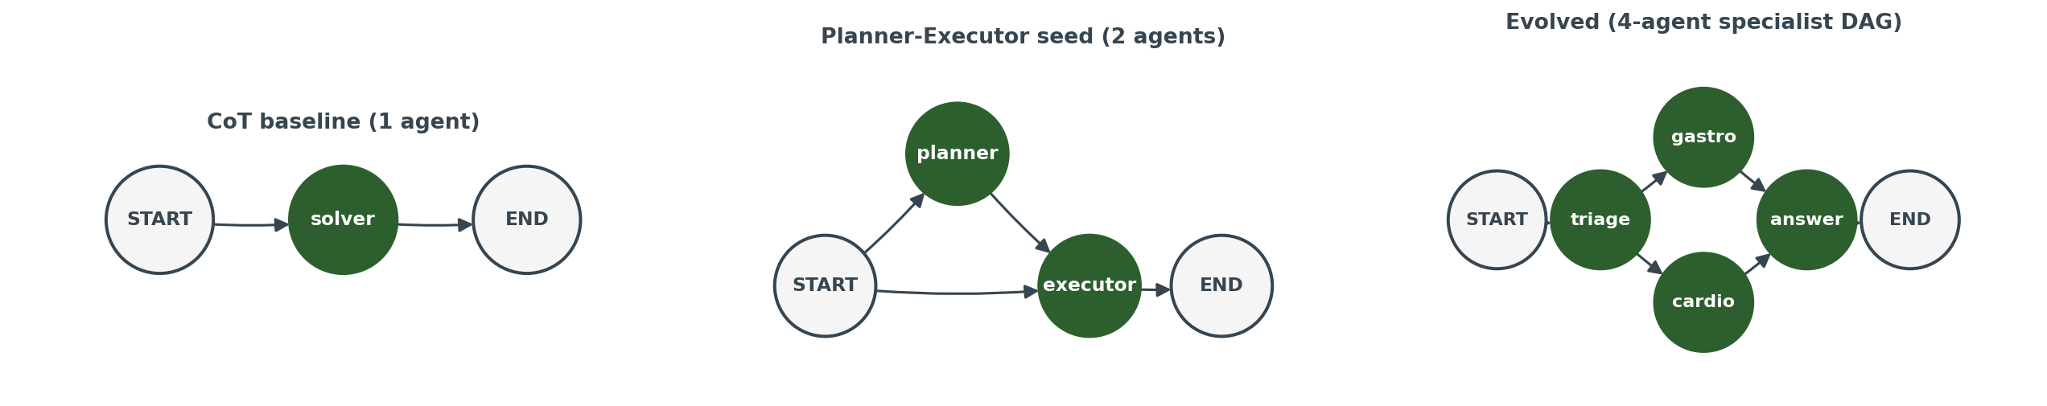
DAG formalism + the three graph shapes
• Graph G = (Agents A, Edges E ⊆ A × A) with reserved START / END nodes; orchestrator runs in topological order.
• An agent = (name, persona text). The persona is what the LLM is conditioned on at this node.
• Three shapes co-exist: CoT (1 agent), Planner-Executor seed (2 agents, baseline), Evolved (controller-edited).

Slide 5
Implementation
Pilot infrastructure (single repo, runnable end-to-end)
• src/llm.py · OpenAI-compatible chat client (vLLM at :8000)
• src/graph.py · Graph + edit ops (add/remove agent + edge, rewrite_persona)
• src/orchestrator.py · runs the graph on a Task → Tape
• src/controller.py · Reflection LLM that emits an EditBatch
• src/evolve.py · legacy + streaming evolve loops
• src/score.py · MCQ exact-match (MEDIQ) + LLM-judge (FB / AC)
• scripts/run_pilot.py · driver (baselines + evolve + test eval)
• uv-managed env, vLLM 0.19.1 patches, gcc auto-install in serve_vllm.sh
Backbone: Qwen2.5-32B-Instruct (bf16, single H200)
• vLLM with prefix caching
• EVO_GPU_UTIL=0.55 (shared GPU; ~78 GB)
• max_model_len = 16384 (controller prompts + tapes)
• EVO_MODEL / EVO_BASE_URL env-overridable
• Each run writes results/<run_id>/{evolve_log, results, plots/}
• Standard plots: accuracy_vs_iter / arch_size / edit_mix

Slide 6
Calibration on GSM8K (calib_01)
First end-to-end run · what it taught us · why we pivoted

Slide 7
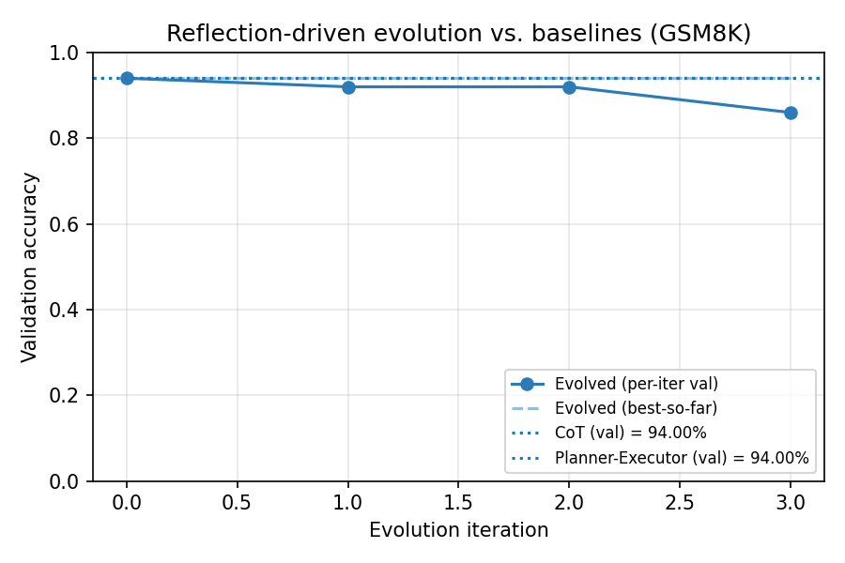
Stage 1 — Calibration
calib_01 — first calibrated run on GSM8K
• Setup: n_val = n_test = 50, seed = 0, max_iters = 3, B = ~66 min wall.
• Headline: Evolved 86 % test, CoT 92 %, P-E 90 %.
– Evolved underperforms BOTH baselines on test, at 2–3.7× more tokens.
• Val saturated (CoT = P-E = 94 %) → no discriminating signal at n = 50.
• Controller did emit hypothetical edits — graph mutates, but not towards a useful target.
• Pipeline finding: under old accept policy, best_graph and best_val_acc could disagree.

Slide 8
Stage 1 — Calibration
Insight 1 — Opt-2 strict accept rule
• Problem: under accept_slack > 0, best_graph could be replaced by a near-best graph while best_val_acc stayed at the original peak — the two fields disagreed.
• Fix (Opt-2 strict): both best_graph and best_val_acc advance only when val_acc > best_val_acc.
• Rejected candidates do NOT replace best_graph; ties also REJECT (default accept_slack = 0.0).
• Verified on results/smoke_opt2/: tied evolved iterations REJECTED; final best_graph == seed.
• Why it matters for the rest of the pilot: we need best_graph to be the graph that actually achieved the val score we report.

Slide 9
Stage 1 — Calibration
Insight 2 — GSM8K is the wrong testbed
• Single-model saturation: Qwen2.5-32B already hits ~94 % CoT — no headroom for multi-agent gain.
• Self-contained text: every problem is fully specified — no information asymmetry between agents.
• Linear arithmetic: planner / executor decomposition adds no leverage over a single CoT pass.
• → Multi-agent edits cannot exploit a structural advantage that does not exist in this benchmark.
• Decision (2026-04-24): pivot to information-asymmetric domains where multi-agent has a real lever.

Slide 10
Domain pivot — three new benchmarks
FinanceBench · MEDIQ · AgentClinic

Slide 11
Stage 2 — Domain pivot
FinanceBench / MEDIQ / AgentClinic
FinanceBench (LLM-judge)
MEDIQ (MCQ exact-match)
AgentClinic (LLM-judge)
• 10-K extraction QA
• GAAP / TTM / fiscal year
• Long-context retrieval
• Failure: hedging, period mix-up
• Clinical vignette → MCQ
• Differential diagnosis
• Base-rate reasoning
• Failure: demographic blindness
• Single-pass clinical case
• Specialty routing
• Decisive answer
• Failure: triage error, hedging
Sanity n=3 per benchmark passed (results/sanity_{financebench,mediq,agentclinic}/) — pipeline runs end-to-end on all three.

Slide 12
v1 controller @ n = 30
First domain-pivot measurement

Slide 13
Stage 3 — v1 controller
v1 controller @ n = 30 — three-domain measurement
Domain | CoT test | P-E test | Evolved test | Δ vs best baseline
FinanceBench | 70.0 % | 66.7 % | 70.0 % | 0 pp
MEDIQ | 43.3 % | 43.3 % | 50.0 % | +6.7 pp (within ±18 pp noise)
AgentClinic | 66.7 % | 70.0 % | 70.0 % | 0 pp
• Setup: --n-train 10 --n-val 30 --n-test 30 --max-iters 3 --seed 0.
• FinanceBench: same `add_verifier` edit emitted 3 rounds in a row — no domain vocabulary.
• MEDIQ: edits varied after iter 2 was ACCEPTED; some specialty mention.
• AgentClinic: alternated `summarizer ↔ verifier`.
• Read: H1 weakly falsified at this controller version. Headroom likely exists, but v1 is too thin to exploit it.

Slide 14
Stage 3 — v1 controller
Insight — the v1 'verifier-add' reflex
• Across all three domains, v1's most common edit was a generic `add_agent('verifier')`.
• Rationales were plausible-sounding but content-free — no GAAP, no differential diagnosis, no triage.
• v1 system prompt was only ~30 lines: 'edit the graph, here are the ops'. No notion of domain expertise, no persona-authoring rules, no anti-repeat.
• Hypothesis (drives H2): a thicker, domain-grounded controller can produce specialist personas that the v1 controller architecturally cannot.

Slide 15
Controller v2 — organization designer
System-prompt redesign · domain briefs · specialist personas

Slide 16
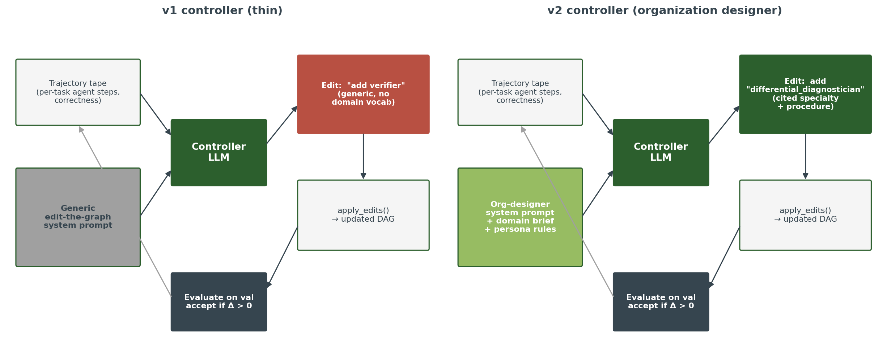
Stage 4 — v2 controller
v1 vs v2 — same loop, different conditioning
Same reflection loop — only the SYSTEM prompt and the side-channel domain brief differ. Output style flips from generic 'add verifier' to cited specialist personas.

Slide 17
Stage 4 — v2 controller
What's new in v2
• Org-designer framing: 'design an organization of domain experts that solves these tasks better than the seed P-E.'
• Mandatory persona-authoring rules: each new agent must cite specialty + concrete procedure; generic verifier/summarizer FORBIDDEN unless paired with specialty.
• Domain briefs (data/briefs/{financebench,mediq,agentclinic}.md, ~80–110 lines): task style, failure modes, useful expertise, anti-patterns.
• Active prune incentive: encourage `remove_agent` when an agent contributes nothing.
• Anti-repeat rule (string-level): 'do not repeat a rejected edit' (will be tightened to concept-level later).
• v2 sanity n=10 across 3 domains: specialist names appear (gaap_analyst, period_validator, differential_diagnostician, adolescent_specialist, …) — qualitative shift confirmed.

Slide 18
Stage 4 — v2 controller
v2 @ n = 30 — measurement noise dominates
Domain | CoT test | P-E test | Evolved test | Δ vs best baseline | best_graph
FinanceBench (16k) | 73.3 % | 70.0 % | 83.3 %* | +10 pp* | seed (all REJECT)
MEDIQ | 43.3 % | 46.7 % | 43.3 % | −3.4 pp | 3-agent (iter 2 ACCEPT)
AgentClinic | 60.0 % | 73.3 % | 66.7 % | −6.6 pp | seed (all REJECT)
• FinanceBench's +10 pp is SAME-GRAPH noise: best_graph == seed, yet test acc moved 13 pp from the simultaneous P-E run. Cannot be cited as a v2 win.
• AgentClinic iter-3 (REJECTED but notable): proposed triage → {gastro, cardio} → END. A literal specialty-department department; rejected on val tie under Opt-2 strict.
• Read: H2 BEHAVIOR satisfied (specialist personas, varied edits, prune); H2 TEST WIN not yet.

Slide 19
Stage 4 — v2 controller
Insight — same-graph cross-run noise is ±13 pp
• FinanceBench v2 evolved test = 83.3 %, but best_graph was the seed P-E.
• Yet a parallel P-E test run on the same split scored 70 %. Same graph, two different test draws.
• Difference 13 pp comes from: (a) vLLM batch-ordering, (b) KV-cache state non-determinism, (c) tqdm-driven scheduling differences, (d) sample selection at n = 30.
• → Architectural effect on test ≤ ±13 pp at n = 30 cannot be distinguished from re-run noise. The signal we want is BELOW the noise floor at this measurement scale.
• Practical consequence: under Opt-2 strict + per-iter wall budget, most architectural changes get rejected before they can be evaluated over multiple noise-averaged batches. Drives the streaming pivot.

Slide 20
Streaming evolve mode
Bootstrap-sampled mini-batches · paired comparison · run #1 on MEDIQ

Slide 21
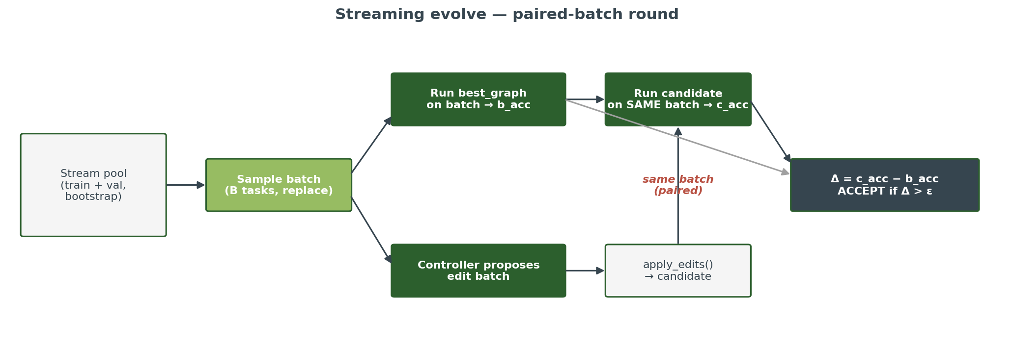
Stage 5 — Streaming evolve
Why streaming — paired-batch comparison kills cross-batch noise
• Each round draws a bootstrap mini-batch (B tasks) from train + val pool. Both best and candidate are evaluated on the SAME batch.
• Decision: ACCEPT iff c_acc > b_acc + ε. Δ is INSIDE-batch, so cross-batch difficulty drift cancels.
• Wall scales linearly with B: at B=100, ~52 min/round; at B=20, ~10 min/round.

Slide 22
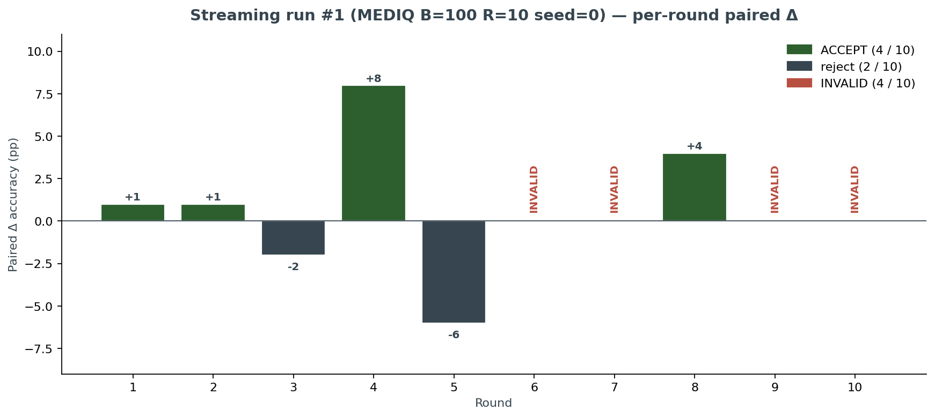
Stage 5 — Streaming evolve
Run #1 paired Δ — streaming fires
• MEDIQ B=100 R=10 seed=0
• wall ≈ 9 h 45 min
• 4 / 10 ACCEPTS
• 2 / 10 reject
• 4 / 10 INVALID
• INVALIDs all 'max_agents reached' at cap=6 (3 of 4) or orphaned-prune (1 of 4).
• Compare: v2 legacy across 3 domains × 3 iters = 1 ACCEPT total.

Slide 23
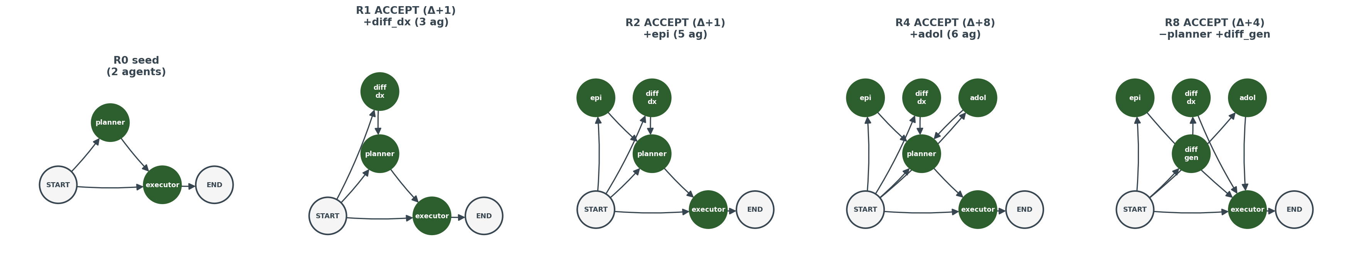
Stage 5 — Streaming evolve
Run #1 DAG evolution — five snapshots
Specialist personas accumulate through R4 (differential_diagnostician → epidemiology_consultant → adolescent_specialist). R5–R7 are reject / INVALID. R8 ACCEPTS a planner-prune + differential_generator — an organisational reorg, not just an addition.

Slide 24
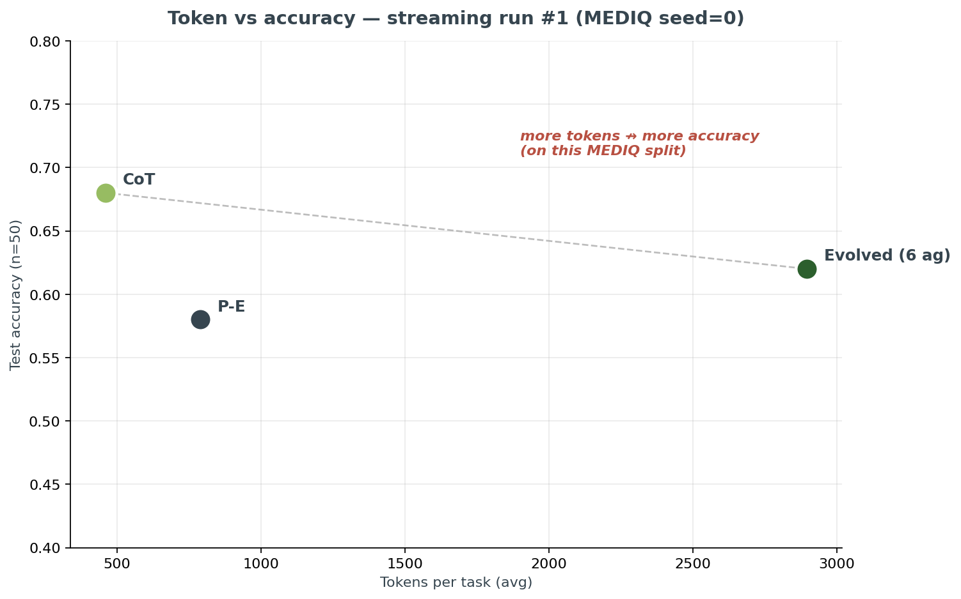
Stage 5 — Streaming evolve
Token cost vs test accuracy — streaming run #1
• CoT 68 % @ 0.46k tok
• P-E 58 % @ 0.79k tok
• Evolved 62 % @ 2.90k tok
• More tokens did NOT buy accuracy on this MEDIQ split.
– Evolved beats P-E by +4 pp at 6.3× tokens.
– Evolved loses to CoT by 6 pp at 6.3× tokens.
• Don't cite this number as a 'streaming wins' result. The publishable signal is paired ACCEPT activity.

Slide 25
Stage 5 — Streaming evolve
Three blockers identified before §5.2
(1) Pass criterion broken
(2) max_agents=6 binds
(3) Anti-repeat is string-level
• `best_val_acc > seed_batch_acc` compares MAX over independent bootstrap batches of varying difficulty — not a quality signal.
• Fix: drop it. Score on test acc + paired-accept rate.
• After R4 the graph has 6 agents; controller (which doesn't see the cap) keeps proposing add_agent → INVALID.
• 3 of 4 INVALID rounds are this exact pattern (~30 min/round burned).
• Fix: surface the cap in the prompt + raise default to 8.
• Controller renamed the same 'case feature extractor' role 5×: differential_generator → clinical_filter → pediatrician.
• Anti-repeat rule reads: 'don't repeat a REJECTED edit' — which the model interprets at the string level.
• Fix: add concept-level callout in the system prompt.

Slide 26
§5.1.5 patches + sanity
Mechanical fixes for the three blockers · sanity validated

Slide 27
Stage 6 — Pre-§5.2 patches
Patches landed (commit 8405c78)
• src/controller.py: `propose_edits` takes `max_agents` kwarg.
– `_build_user_prompt` opens with a `# Constraints` block (`max_agents = N, current n_agents = n. K agent slots remaining before the cap.`).
– When `n_agents == max_agents`, slack line becomes `AT CAP — only remove_agent / rewrite_persona / topology edits are allowed.`
• SYSTEM prompt adds a prune-DAG reminder ('removing X must not orphan any agent that depended on X').
• SYSTEM prompt adds a concept-level anti-repeat callout ('rename ≠ different idea').
• src/evolve.py: legacy + streaming loops both thread `max_agents` through to `propose_edits`.
• scripts/run_pilot.py: --max-agents default 6 → 8 (fits triage + 2-3 specialists + answer).
• Doc patch (4): `best_val_acc > seed_batch_acc` already replaced by test acc + paired-accept rate in §5.2 / pilot.md §8.4 — no further edits needed.

Slide 28
Stage 6 — Pre-§5.2 patches
sanity_streaming_v3_mediq_s0 — patches green for §5.2
Round | b_acc | c_acc | Δpp | Verdict | Edits (brief)
0 | 60.0 % | — | — | seed | (planner+executor, 2 ag 4 ed)
1 | 60.0 % | 60.0 % | 0.0 | reject | +differential_diagnostician (3 ag)
2 | 50.0 % | 55.0 % | +5.0 | ACCEPT | +differential_diagnostician (same as r1)
3 | 65.0 % | 65.0 % | 0.0 | reject | +base_rate_consultant (would be 4 ag)
• Wall ≈ 50 min total (B=20 R=3, baselines + n_test=30 eval). Per-round wall ~10 min — linear scale from B=100's 52 min.
• Direct `_build_user_prompt(max_agents=8, n_agents=2)` invocation confirms the `# Constraints` block renders.
• Test n=30: CoT 43.3 % / P-E 56.7 % / Evolved 43.3 %. Sanity is for *patches function*, not test win.
• Cap-binding (n_ag never reaches 8) and concept-level anti-repeat firing not exercised at R=3 — defer to §5.2.
• Round 2 ACCEPTED an exact-string-repeat of round 1's rejected edit on a different bootstrap batch — the soft-constraint anti-repeat did not inhibit. Will be re-examined at B=100 R=10.

Slide 29
Stage 7 — Live experiment
§5.2 — ongoing right now (MEDIQ seed=1)
Run started 2026-04-26 05:41 UTC
ETA ≈ 16:00 UTC (10 h wall)
r | b_acc | c_acc | Δpp | Verdict
1 | 54.0 % | 51.0 % | −3.0 | reject (big overhaul)
2 | 64.0 % | 66.0 % | +2.0 | ACCEPT
3 | 45.0 % | 40.0 % | −5.0 | reject
• Per-round wall: 45 / 50 / 73 min
• 1 ACCEPT in 3 rounds so far
• Pace consistent with run #1
• 7 rounds remaining
• Slides will be updated once the run completes.
Score on test acc + paired-accept rate (per pilot §8.4 option C). DO NOT re-introduce best_val_acc > seed_batch_acc.

Slide 30
Novelty & weaknesses (honest)
What's actually new · what's still soft

Slide 31
Honest self-assessment
Novelty — the three real differentiators
1. Reflection-only multi-agent evolution (no search archive, no MCTS, no RL)
• ADAS / AFlow / GPTSwarm / MaAS / Puppeteer all rely on search or RL.
• Our controller is purely an in-context reflector over trajectory tapes on a frozen backbone.
2. Controller v2 — organization-designer framing + per-domain briefs + specialist personas
• Persona-authoring rules force domain vocabulary (gaap_analyst, differential_diagnostician, …).
• Briefs let the same backbone behave like a specialist on each domain without retraining.
3. Streaming paired-batch evolve mode — accept rate jumps from 1 / 9 to 4 / 10
• Eliminates cross-batch difficulty noise that was rejecting most architectural changes under legacy.

Slide 32
Honest self-assessment
Weaknesses — what we should NOT claim yet
• v2 @ n=30 does NOT beat baselines on test in any of the three domains.
• ±13 pp same-graph cross-run noise dominates the architectural effect at this n. The signal is below the noise floor.
• LLM-judge is same-family Qwen → self-bias risk on FinanceBench / AgentClinic.
• Single backbone (Qwen2.5-32B) and single judge.
• Streaming wall is 9-10 h × seed × domain → 3 × 3 sweep is ~90 h on a shared GPU.
• ADAS / MaAS / Puppeteer direct comparison NOT done yet (reviewer question #0).
• Concept-level anti-repeat is a soft constraint and may not fire — sanity_v3 round 2 was an exact repeat.

Slide 33
Roadmap
What's next + timeline
Critical path → EMNLP 2026 ARR (D-31, 2026-05-25)
• §5.2 multi-seed v2 streaming sweep (3 domains × 3 seeds, MEDIQ seed=1 running now). ~90 h.
• §5.3 Random-persona ablation (replace v2 personas with random text of same count).
• §5.4 Harness ablation (controller on/off, random topo, fixed topo).
• §5.5 Add a second backbone (Qwen3-72B + one of Claude / GPT API).
• §5.6 Replace LLM-judge with a different family (Claude Haiku 4.5 or GPT-4.1-mini).
• §5.7 ADAS + (MaAS or Puppeteer or EvoMAC) direct baselines — non-negotiable for reviewer.
• Failure-mode taxonomy (MAST-style), cost Pareto pipeline, judge-calibration experiment.
Fallback venues: NeurIPS D&B (D-12, very aggressive) / EMNLP direct commitment (D-100) / NeurIPS workshops (summer).

Slide 34
Thank you — Q&A
Roadmap dashboard: references/roadmap.md · code: github.com/namam3gy (project repo)

