Slide 1
Physical-Mode Activation in Open-Source VLMs
When does an open-source VLM stop seeing a circle as geometry and start seeing it as a ball?
Mechanistic interpretability + behavioral psychophysics on Qwen2.5-VL / LLaVA-1.5 / LLaVA-Next / Idefics2 / InternVL3
Review draft · 2026-04-26

Slide 2
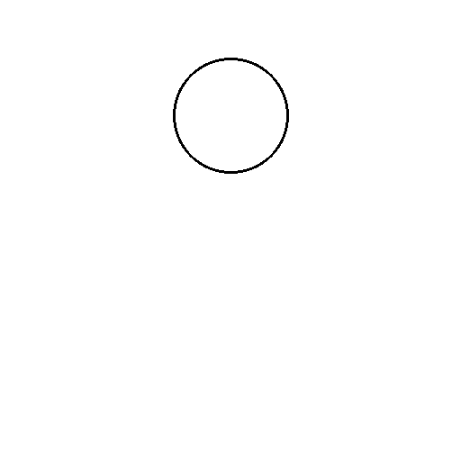
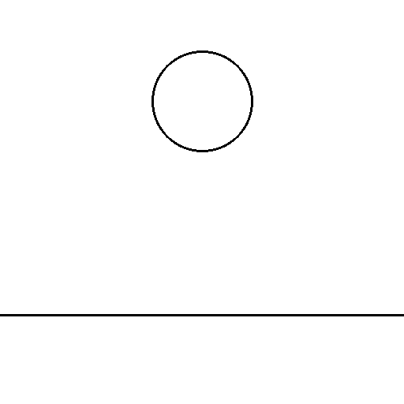
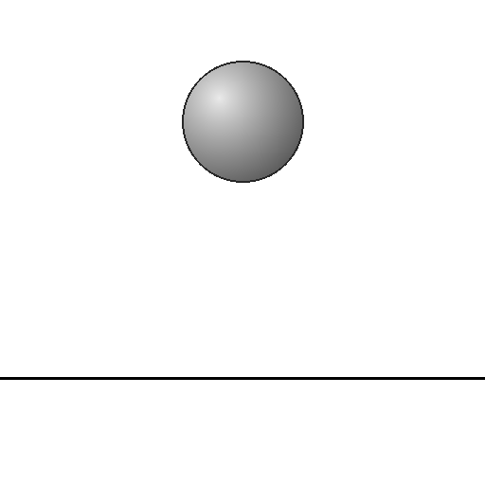
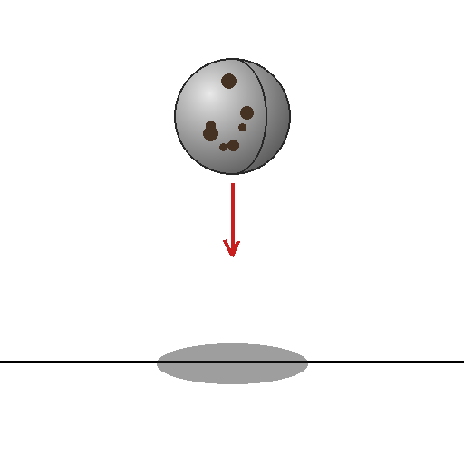
The research question
From the project plan (references/project.md §1)
• Above what visual-cue threshold does an open-source VLM stop processing an abstract circle as geometry and start processing it as a physical object?
• Two layers of measurement:
• Behavior: PMR (physics-mode reading rate) / GAR (gravity-align rate) / RC (response consistency).
• Mechanism: vision-encoder probe AUC, LM logit lens, causal patching + VTI steering + SAE intervention.
line/blank/none (most abstract)
line/ground/none (+ ground line)
shaded/ground/none (3D ball + ground)
textured/ground/ arrow_shadow (max cue)
Physical-Mode Activation in Open-Source VLMs
2 / 33

Slide 3
TL;DR
The three paper-grade headlines
• Open-source VLMs DO read minimal synthetic stimuli as physical, but the reading is determined at the architecture level (joint encoder + LM) — not at the encoder representational level.
• Every encoder linearly separates physics-vs-abstract factorial cells at AUC = 1.0 — encoder discriminability is uniform.
• Behavioral PMR ranges 0.18 → 0.92 across 5 models on identical stim. The 2-CLIP-point comparison (LLaVA-1.5 0.18 vs LLaVA-Next 0.70) rules out vision-encoder-family as the sole driver.
• v_L10 — a single LM-layer-10 direction in Qwen2.5-VL — causally flips behavior under runtime steering AND is encodable in the image (pixel-space gradient ascent → §4.6).
• Real photographs compress the encoder gap (all 5 models converge to PMR 0.18-0.67) and halve the label-driven H7 effect — image-prior dominates label-prior on rich images.
Physical-Mode Activation in Open-Source VLMs
3 / 33

Slide 4
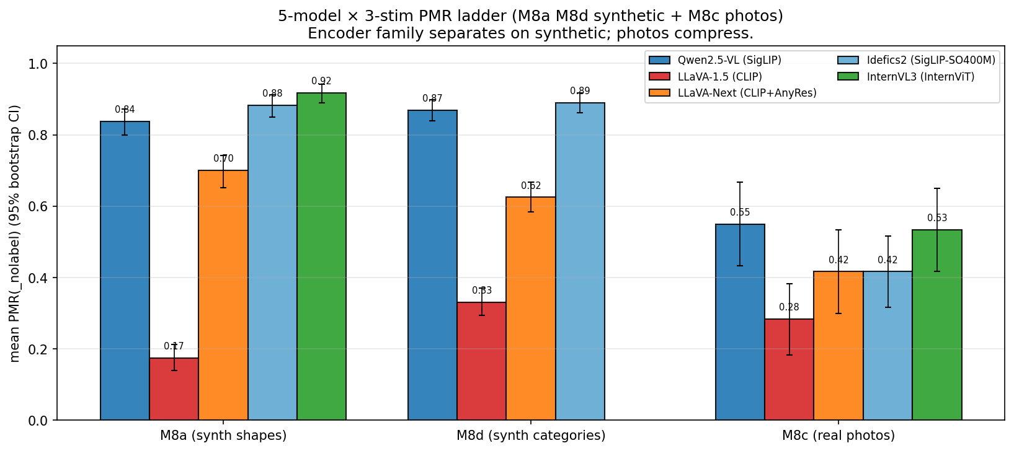
Headline figure: 5-model × 3-stim PMR ladder
The 'paper Table 1' visual
Mean PMR(_nolabel) ± 95% bootstrap CI per (model × stim source). Encoder-family split on synthetic stim collapses on real photos.
Physical-Mode Activation in Open-Source VLMs
4 / 33

Slide 5
Methodology overview
5 sub-tasks, 3 metrics, 3 stim sources, 5 models
• Sub-task 1 (PhysCue): behavioral thresholds on a 5-axis factorial.
• Sub-task 2 (vision probing): linear probe on encoder activations.
• Sub-task 3 (LM logit lens): per-layer probe at visual tokens.
• Sub-task 4 (causal): VTI steering (M5a) + SIP/SAE (M5b deferred).
• Sub-task 5 (cross-model): 5 VLMs on M8a/M8d/M8c stim.
Metrics
• PMR — fraction of responses that name a physical event ("falls", "rolls"). Rule-based scorer, ~5% disagreement vs. hand-annotation.
• GAR — gravity-align rate; subset of PMR with downward direction.
• RC — response consistency across seeds at T=0.7.
Models
• Qwen2.5-VL-7B (SigLIP + Qwen2-7B)
• LLaVA-1.5-7B (CLIP-ViT-L + Vicuna)
• LLaVA-Next-7B (CLIP-ViT-L + Mistral-7B + AnyRes tiling)
• Idefics2-8B (SigLIP-SO400M + Mistral-7B)
• InternVL3-8B (InternViT + InternLM3-8B)
Physical-Mode Activation in Open-Source VLMs
5 / 33

Slide 6
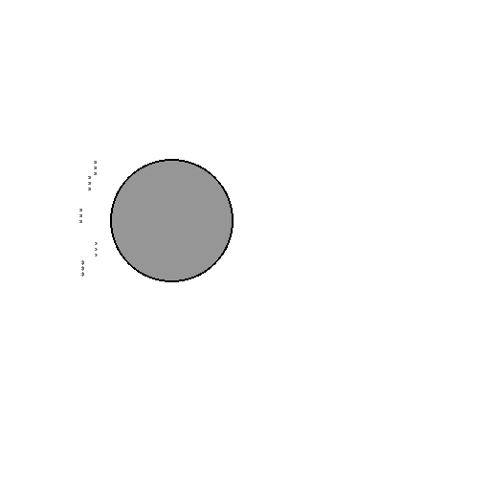
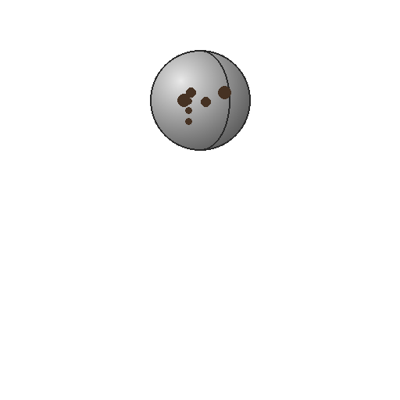
M2 stimulus design — 5-axis factorial (2880 stim)
object_level × bg_level × cue_level × event × seed
Each cell tested with 3 prompts: • Open: "What will happen next?" • Forced-choice (A/B/C/D) • Label-free open: "What do you see?" PMR is the rule-based scorer over the open response. Effective n per (model × prompt) = 480-2880 depending on subset.
line/blank/none
line/ground/none
shaded/ground/none
textured/ground/arrow_shadow
filled/blank/wind
textured/blank/none
Physical-Mode Activation in Open-Source VLMs
6 / 33

Slide 7
M1 pilot — first behavioral curve (Qwen2.5-VL, 480 stim)
Established H1 partial / H2 strong / H4 / H5 / H6 candidates
• Ground effect is the largest single-factor: blank 0.49 → ground 0.85 (+36 pp).
• Abstraction endpoints: line 0.58 → textured 0.81 (H1 partial).
• Arrow + shadow saturates at PMR = 1.000.
• Wind cue invisible to the VLM (PMR ≈ baseline).
• Open vs. forced-choice gap = 26 pp → strong language-prior dominance.
Headline findings: H1: monotone S-curve confirmed (later in M2) H2: "ball" label substantially boosts PMR H4: open-vs-FC gap = stable signature of language-prior ↔ visual-evidence conflict
Physical-Mode Activation in Open-Source VLMs
7 / 33

Slide 8
M2 MVP-full — 2880-stim factorial
H1 monotone S-curve confirmed; H7 emerged (label selects regime, not just toggles PMR)
Criterion | Result
Monotone S-curve over object_level (FC) | 0.583 < 0.647 < 0.711 < 0.714
Open-vs-FC gap at every level | 22-32 pp
cast_shadow alone > none + 20 pp | +17.5 pp avg
RC < 1 cells exist (T>0) | 103/288 (36%)
LM activation safetensors captured | 5 layers, bf16
New findings
• H1 S-curve cleanly confirmed
• H7 emerged: same image with circle/ball/planet → static / rolls / orbits the Sun
• Open-ended PMR 0.93, abstract-reject 3/1440 — language-prior dominance reconfirmed
Physical-Mode Activation in Open-Source VLMs
8 / 33

Slide 9
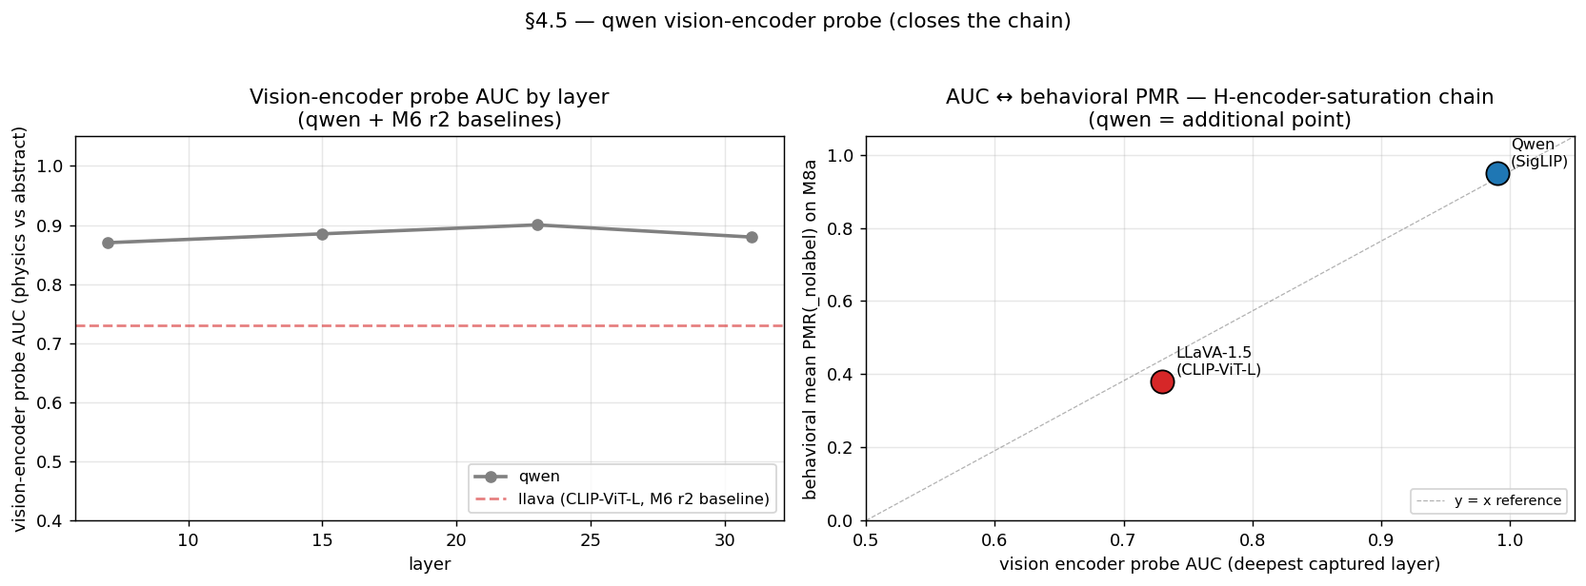
M3 vision-encoder probing — the 'boomerang'
Encoder knows, decoder gates (H-boomerang)
• Encoder AUC ≈ 1.0 on every factorial axis from layer 3 onward.
• Behavioral forced-choice PMR ranges 0.28 (no cue) to 0.95 (both) on the same images.
• Per-object-level encoder AUC ~0.95 constant while behavior 0.58–0.71 → gap is largest at the most abstract end (line, +36 pp).
• → The information IS there; the LM is gating it. H-boomerang: 'encoder knows, decoder doesn't'.
• Caveat: programmatic stim makes encoder AUC = 1.0 trivial. Photo-level extension is M8c.
Physical-Mode Activation in Open-Source VLMs
9 / 33

Slide 10
M4 LM logit lens — per-layer visual-token probe
LM AUC plateaus at ~0.95 from L5; switching layer at L20 peak
• LM hidden state at visual-token positions linearly separates physics vs. abstract from L5 (AUC ~0.94, peak L20 = 0.953).
• So the 'forgetting' is NOT during LM forward pass — the signal is preserved. The bottleneck is at the decoding head.
• M4b (label-free null test, 2026-04-25): paired PMR(ball) − PMR(_nolabel) = +0.006 ≈ 0; PMR(circle) − PMR(_nolabel) = −0.065. On Qwen, the language-prior is asymmetric — circle override, not ball enhancement.
• M4c forced-choice variant: confirms M4b under FC. LLaVA "A" greedy bias surfaces here too.
Physical-Mode Activation in Open-Source VLMs
10 / 33

Slide 11
M5a VTI causal steering — 'physics-mode' direction found
L10 α=40 flips 10/10 line/blank/none from 'D: abstract' to 'B: stays still'
• Recipe: v_L = mean(h_L | PMR=1) − mean(h_L | PMR=0) from M2-captured activations. v_unit_L = v_L / ||v_L||.
• Test: line/blank/none × 10 seeds × forced-choice with label = circle. Inject α · v_unit_L at LM layer L over visual-token positions.
• Result: ONLY L10 α=40 flips behavior — 10/10 D→B. L15/20/25 don't move at the same α.
• Interpretation: v_L10 is a 'physics-mode' linear direction. Early-mid LM layer is the causal sweet spot — H-locus supported.
• M5a-ext Exp 3 revised this: v_L10 is a regime axis within physics-mode (+α → kinetic, −α → static), not a one-way activator.
The stim being steered. v_L10 flips this exact image.
Physical-Mode Activation in Open-Source VLMs
11 / 33

Slide 12
M5a-ext — v_L10 is a bidirectional regime axis
Exp 1: ceiling. Exp 2: label flip. Exp 3: bidirectional regime.
• Exp 1 (textured/ground/both, near-ceiling baseline): −α has no effect. Initially framed as 'one-way activator'.
• Exp 2 (line/blank/none × +α=40 with label = ball): the model switches B (static) → A (rolls / falls). Label selects regime when the steering direction is active.
• Exp 3 (textured/blank/none, moderate baseline): −α=40 flips D → B uniformly across (line, textured) × (ball, circle).
• Revised reading: both signs of α activate physics-mode. Sign selects regime: +α kinetic / −α static. Baseline D sits BELOW the |α| threshold, not at one end of the axis.
• New hypothesis H-direction-bidirectional supersedes the original H-regime ('binary object-ness').
Physical-Mode Activation in Open-Source VLMs
12 / 33

Slide 13
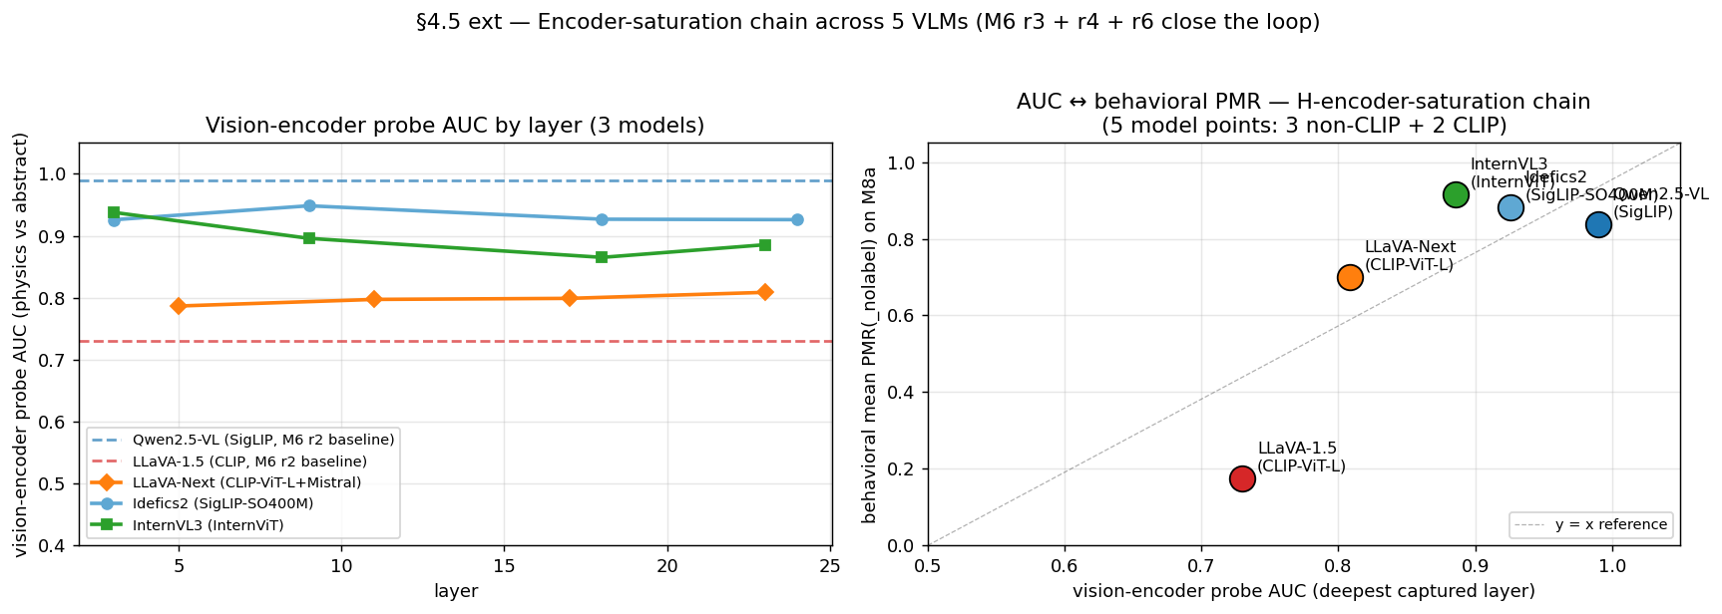
M6 cross-model — 5 VLMs on the same stim
The H-boomerang turns out to be Qwen-scoped; the architecture-level reframe takes its place
5-model encoder probe AUC chain (M8a stim). Non-CLIP cluster: AUC ≥ 0.88. CLIP-ViT-L (LLaVA-1.5 / LLaVA-Next): AUC 0.73 / 0.77.
Physical-Mode Activation in Open-Source VLMs
13 / 33

Slide 14
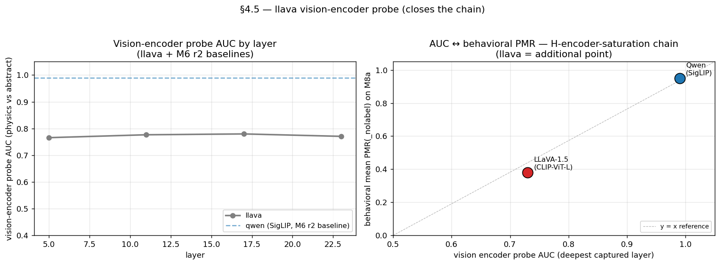
M6 r2 — H-encoder-saturation hypothesis introduced
LLaVA-1.5 vision encoder is the bottleneck on its end of the chain (AUC ~0.73 vs Qwen ~0.99)
Qwen2.5-VL SigLIP probe — saturated.
LLaVA-1.5 CLIP-ViT-L probe — unsaturated.
Physical-Mode Activation in Open-Source VLMs
14 / 33

Slide 15
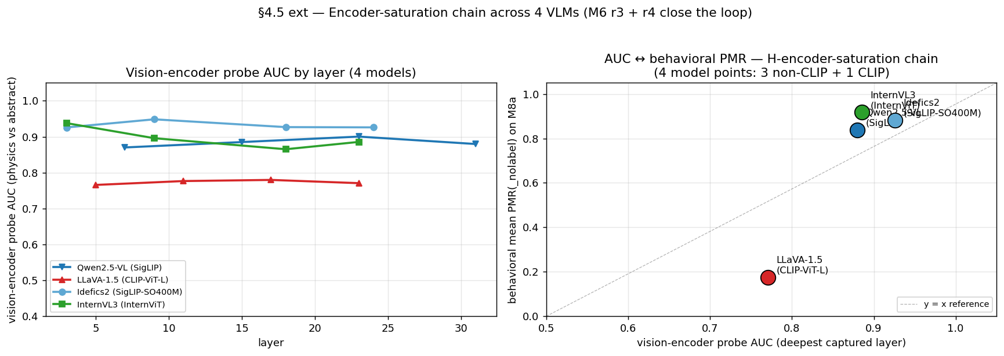
M6 r3 + r4 — 4-model chain (Idefics2 + InternVL3)
3 distinct non-CLIP encoders cluster at AUC ≥ 0.89
4-model AUC chain: Qwen 0.88, LLaVA 0.77, Idefics2 0.93, InternVL3 0.89 (M8a-stim apples-to-apples). Only CLIP-ViT-L falls below the saturation cluster.
Physical-Mode Activation in Open-Source VLMs
15 / 33

Slide 16
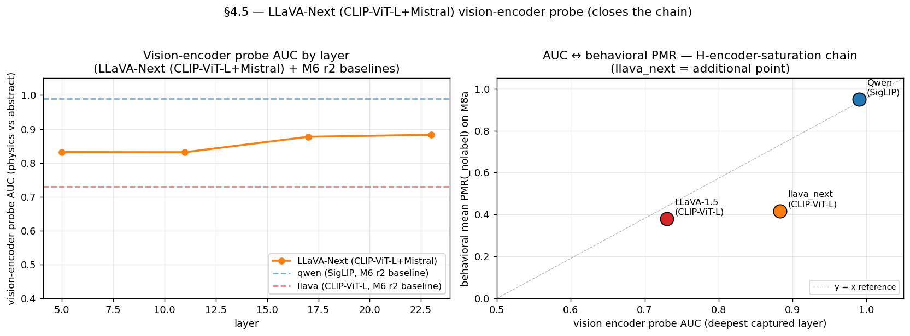
M6 r6 — LLaVA-Next 5th model + 2nd CLIP point
PMR 0.700 [0.65, 0.74] sits between LLaVA-1.5 floor and saturated cluster → encoder family ≠ sole driver
• LLaVA-1.5 (CLIP-ViT-L + Vicuna): PMR(_nolabel) = 0.18.
• LLaVA-Next (CLIP-ViT-L + Mistral + AnyRes tiling): PMR(_nolabel) = 0.70.
• Same encoder family! 0.52-PMR jump rules out vision-encoder family as sole determinant.
• 4-axis confounded (AnyRes / projector / training / LM family) — can't isolate to LM. Architecture-level reframe.
• H-encoder-saturation now reads: 'joint encoder + LM determines PMR ceiling', not 'encoder representational capacity alone'.
Physical-Mode Activation in Open-Source VLMs
16 / 33

Slide 17
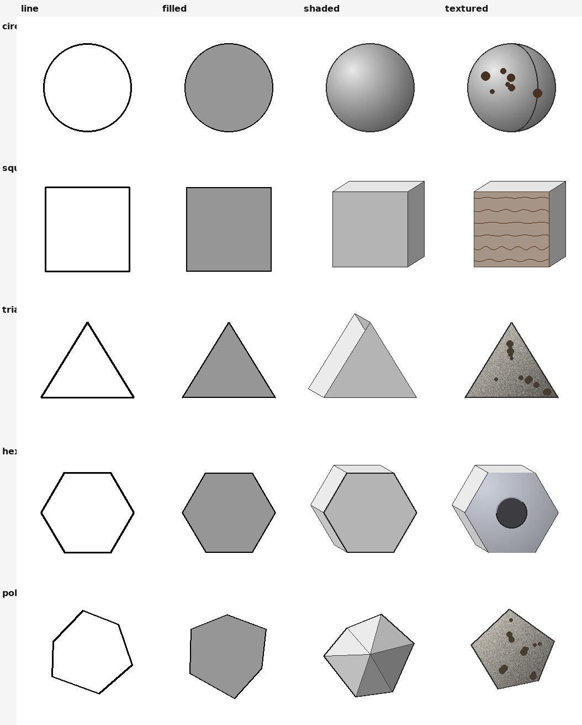
M8a — Non-circle synthetic shapes (5 shapes × 2 models)
Strict scoring asymmetry IS the cross-shape validation of H-encoder-saturation
Strict pre-registered scoring
• Qwen 1/4 PASS, LLaVA 4/4 PASS.
• Saturated encoder → ceiling effect → no behavioral headroom.
• Unsaturated encoder → all four signals (H1, H7, label, gravity) measurable.
• H1 + H7 are now unsaturated-only.
• Triangle 'wedge' + polygon 'polygon' = label-design weak points.
Physical-Mode Activation in Open-Source VLMs
17 / 33

Slide 18
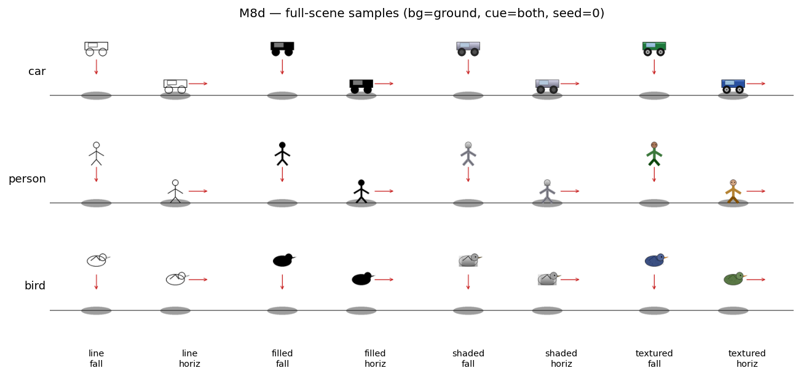
M8d — Non-ball physical-object categories (car / person / bird)
LLaVA 3/3 H7 PASS — strongest cross-category H7 evidence
• LLaVA: car +0.525, person +0.138, bird +0.550 on PMR_regime (physical − abstract).
• Qwen: 0/3 binary H7 (ceiling-flat), but regime distribution shows figurine 17.5% static / statue 22.5% static.
• New classify_regime keyword classifier — 5.6% hand-annotation error.
• H7 promoted from 'circle-only' to 'cross-category'.
Physical-Mode Activation in Open-Source VLMs
18 / 33

Slide 19
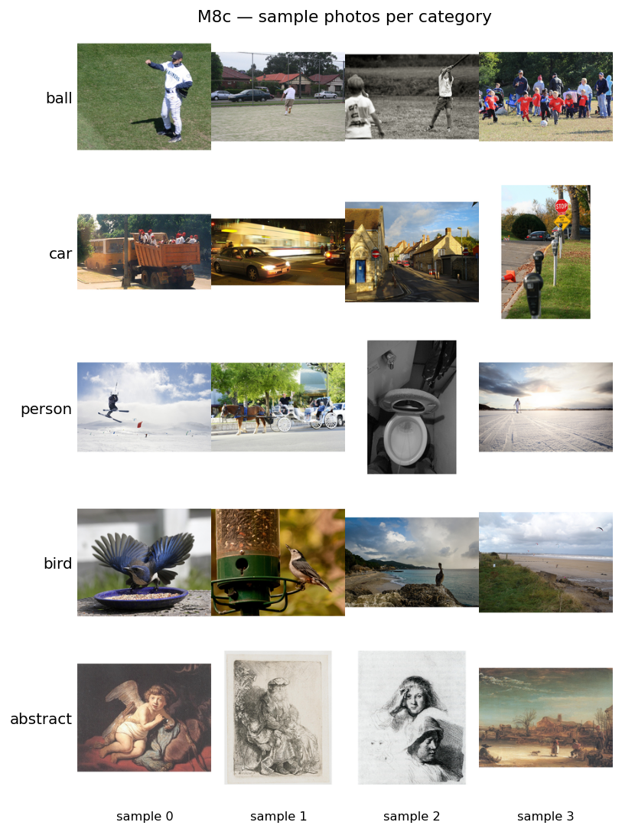
M8c — Real photographs (60 photos × 5 categories)
Photos REDUCE Qwen PMR(_nolabel) 18-48 pp; encoder gap collapses on photos
• Qwen physical photo PMR drops 18-48 pp vs synthetic — synthetic-stim minimality is a co-factor of behavioral saturation.
• LLaVA person photo PMR rises +39 pp vs synthetic — encoder finally recognizes humans.
• All 3 models converge to PMR [0.18, 0.67] on photos.
• LLaVA H7 partially holds on photos (2/4 binary).
• H-encoder-saturation refined: 'encoder representation + input-context simplicity'.
Physical-Mode Activation in Open-Source VLMs
19 / 33

Slide 20
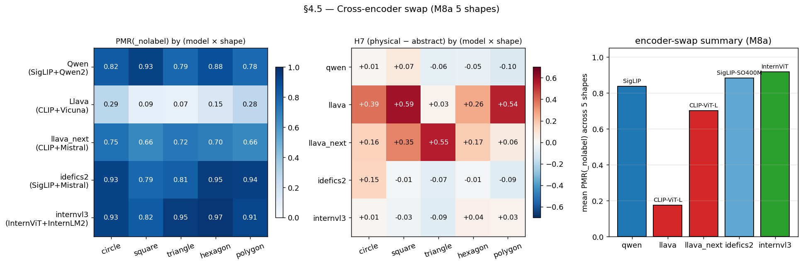
§4.5 Cross-encoder swap — Idefics2 SigLIP-SO400M
Causal counterfactual at encoder family level
• Idefics2-8B (SigLIP-SO400M + Mistral-7B) on M8a: PMR(_nolabel) = 0.882. Patterns identically with Qwen on PMR + H7.
• LLaVA (CLIP-ViT-L + Vicuna): 0.175 — outlier.
• Encoder type (SigLIP vs CLIP) drives PMR ceiling regardless of LM (Qwen2-7B vs Mistral-7B).
• 3-point ladder: Qwen 0.838 / LLaVA 0.175 / Idefics2 0.882. Causally validates H-encoder-saturation at encoder family.
Physical-Mode Activation in Open-Source VLMs
20 / 33

Slide 21
§4.6 — VTI-reverse counterfactual stim (the flagship adversarial)
Pixel-space gradient ascent on Qwen2.5-VL pixel_values
• Question: can a small pixel perturbation along v_L10 — WITHOUT runtime steering — flip Qwen2.5-VL from "circle stays static" to "circle falls"?
• Method: gradient ascent on Qwen2.5-VL post-processor pixel_values (T_patches × 1176, the patch-flattened normalized representation), maximizing ⟨mean(h_L10[visual]), v_L10⟩. Adam, lr=1e-2, n_steps=200.
• Configurations on 5 baseline circle stim:
• bounded ε ∈ {0.05, 0.1, 0.2}, unconstrained, and 3 random unit directions at ε = 0.1 (matched magnitude).
Physical-Mode Activation in Open-Source VLMs
21 / 33

Slide 22
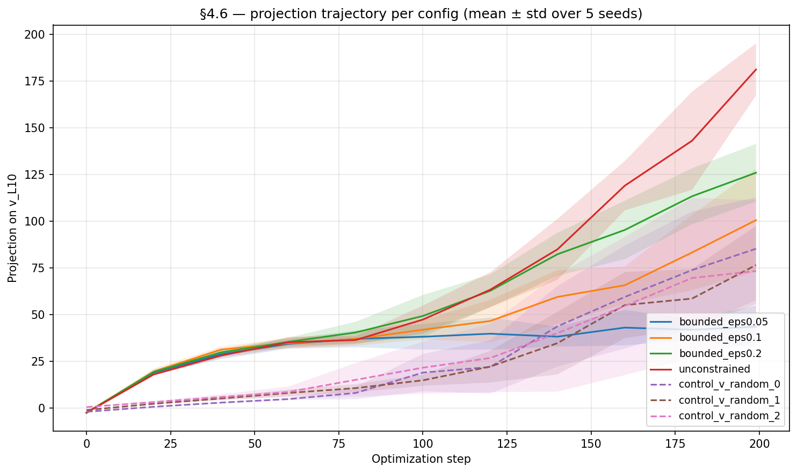
§4.6 result — 5/5 v_L10 flips at ε = 0.05; 0/15 random
Directional specificity falsifies 'any pixel perturbation flips PMR'
Config | n flipped | Mean final projection
bounded ε=0.05 (v_L10) | 5 / 5 | 43.7
bounded ε=0.10 (v_L10) | 5 / 5 | 100.6
bounded ε=0.20 (v_L10) | 5 / 5 | 125.9
unconstrained (v_L10) | 5 / 5 | 181.1
control random unit dir × 3 @ ε=0.10 | 0 / 15 | 73-85
• Random projections (~80) ≈ bounded ε=0.1 v_L10 (~101) — directional specificity, not magnitude, controls the regime flip.
• Pre-registered success criterion was ≥ 3/5 — actual is unambiguous 5/5.
Physical-Mode Activation in Open-Source VLMs
22 / 33

Slide 23
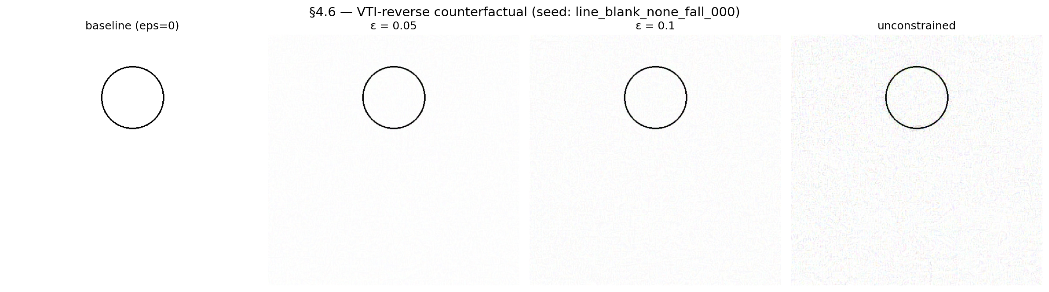
§4.6 canonical seed — what the synthesized stim looks like
ε = 0.05 introduces visible texture but preserves the abstract circle gestalt; introduces NO human-readable physical content
baseline → ε=0.05 → ε=0.1 → unconstrained. The abstract circle gestalt is preserved through all bounded conditions.
Physical-Mode Activation in Open-Source VLMs
23 / 33

Slide 24
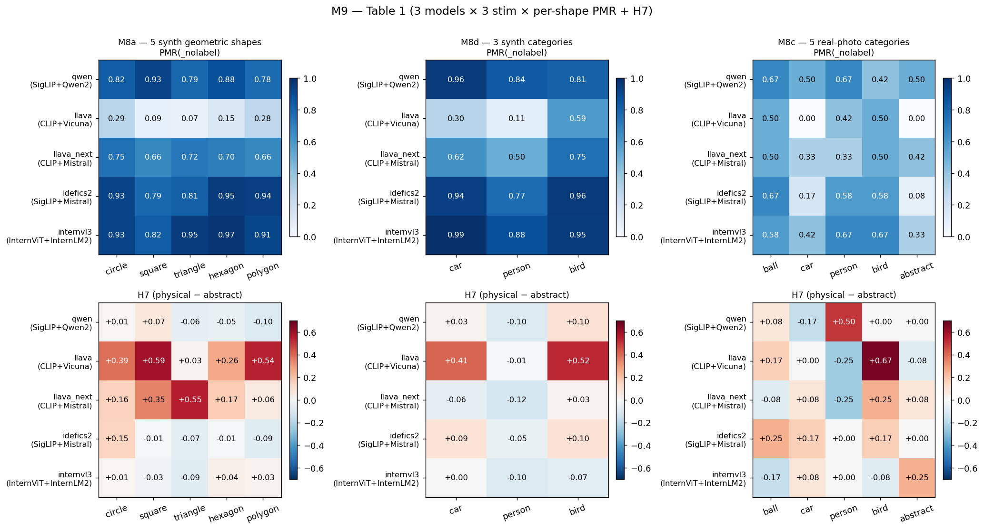
M9 generalization audit — paper Table 1
3 models × 3 stim sources × 5000-iter bootstrap CIs
• Encoder family causally drives synthetic-stim PMR ceiling: non-CLIP CIs [0.80, 0.92] vs CLIP [0.14, 0.37] — fully separated.
• Photos compress encoder gap: all 3 → [0.18, 0.67].
• H7 robust only LLaVA-on-synthetic.
• H-LM-modulation flagged but not paper-defensible (Idefics2 M8d H7 CI just touches 0).
• Replaces PASS/FAIL binarization with bootstrap CI separation.
Physical-Mode Activation in Open-Source VLMs
24 / 33

Slide 25
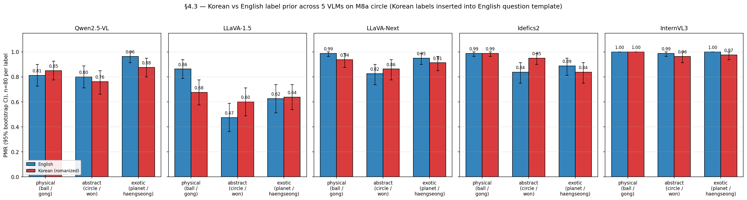
§4.3 — Multilingual label switching (Korean / Japanese / Chinese)
5 VLMs × 2 non-English languages on M8a circle stim
• Korean (공/원/행성): cross-label ordering preserved 4/5 models.
• LLaVA-1.5 has biggest swing (avg |Δ| = 0.11) — Vicuna's Korean coverage is weakest.
• Japanese (ボール/円/惑星): tests different mechanism — Qwen genuinely engages JA (label-echo 85-91%); LLaVA-1.5 translates kanji to English internally; Idefics2 falls back to Chinese on 惑星 (24% of responses).
• Scorer extended to KO/JA/CN substring matching (51 → 54 cases).
Physical-Mode Activation in Open-Source VLMs
25 / 33

Slide 26
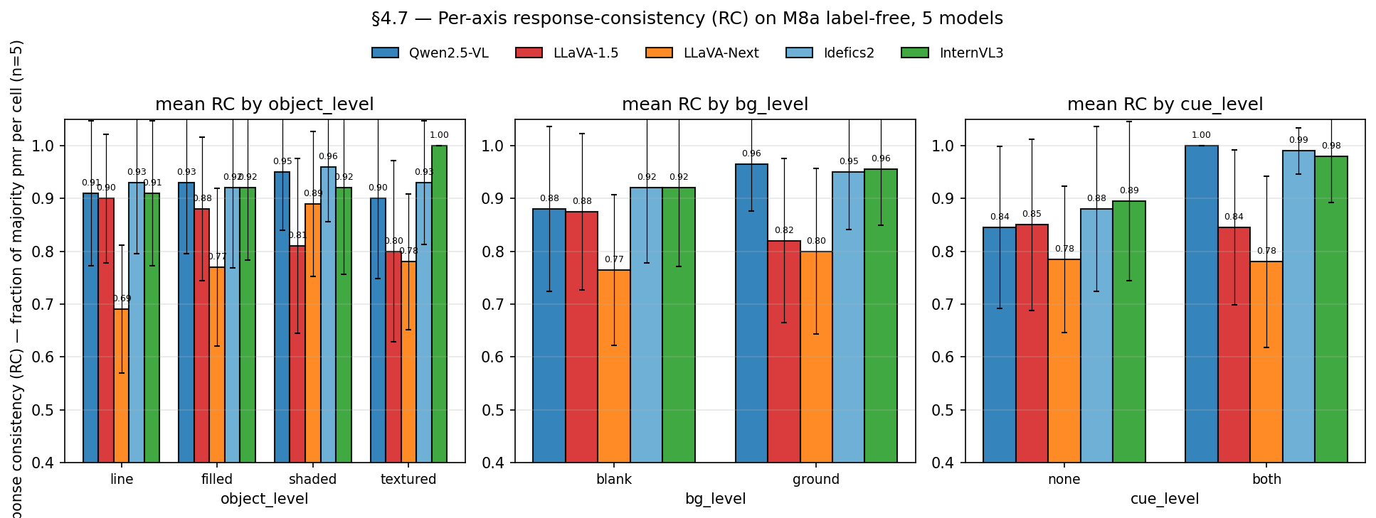
§4.7 — Per-axis RC: saturation as decision-stability ceiling
cue_level is the dominant decision stabilizer for non-CLIP models
• Saturated models (Qwen 0.84→1.00, Idefics2 0.88→0.99, InternVL3 0.89→0.98) converge to same PMR call across 5 seeds when cues fire.
• CLIP-based models (LLaVA-1.5 / LLaVA-Next) retain seed-level variance even under strong cues.
• Saturation is not just a behavioral PMR ceiling but also a decision-stability ceiling — separate signature of H-encoder-saturation.
Physical-Mode Activation in Open-Source VLMs
26 / 33

Slide 27
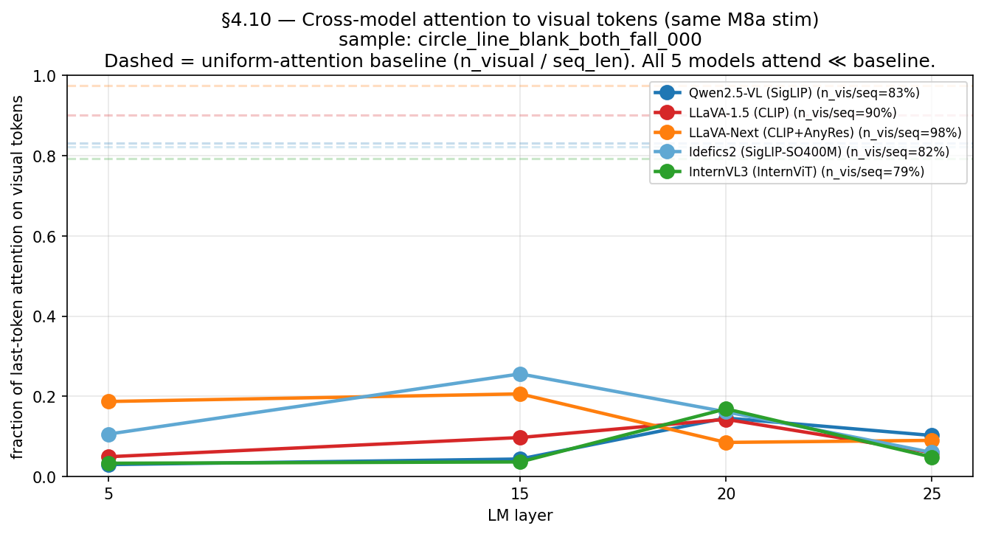
§4.10 — Cross-model attention to visual tokens
Last-token attention varies architecturally despite all 5 LMs receiving 79–98% visual tokens
• Qwen ~17%, LLaVA-1.5 ~7%, Idefics2 ~30%.
• Visual attention peaks at mid-layers in all models.
• Cross-model architecture difference, not encoder difference: attention allocation is a downstream LM-side property.
Physical-Mode Activation in Open-Source VLMs
27 / 33

Slide 28
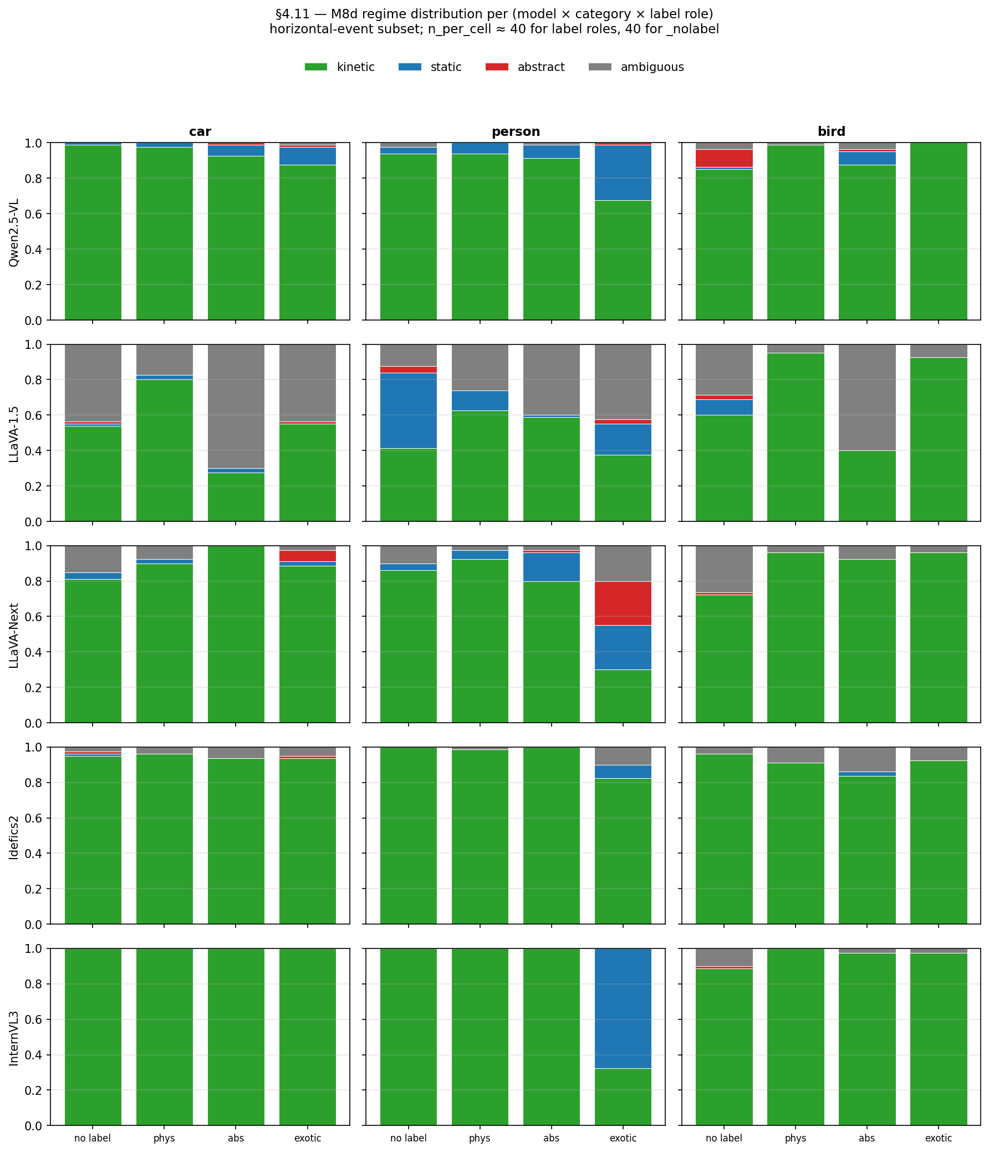
§4.11 — Categorical regime distribution under saturation
kinetic / static / abstract / ambiguous fractions per (model × category × label_role)
• Granular form of M9 H7 finding.
• InternVL3 person × exotic (statue): PMR drops 0.800 → 0.481, 65% static — strongest single label-driven static commit.
• LLaVA-1.5 most regime-discriminative.
• Categorical view reveals the KIND of commitment, not just whether the model commits.
Physical-Mode Activation in Open-Source VLMs
28 / 33

Slide 29
Hypothesis scorecard — final state
Original H1-H7 + named H- hypotheses derived during the work
ID | Status | Key evidence
H1 (S-curve) | supported, unsaturated-only | M2, M8a (LLaVA 4/5)
H2 (label prior) | validated, encoder-anchored | M4b, M6, encoder-saturation
H4 (open vs FC) | supported, extended | M2 +25 pp at every level
H5 (ground) | mixed | M2 +21 pp, scene also wins
H6 (cast shadow) | supported, revised | Arrow ALSO saturates
H7 (label selects regime) | validated, cross-category | M8d LLaVA 3/3
H-boomerang | Qwen-scoped | Refuted on LLaVA-1.5
H-encoder-saturation | architecture-level confirmed (5 model × 3 stim) | M9 bootstrap
H-LM-modulation | suggested only | M9 H7 CI touches 0
H-locus (mid-LM) | supported (L10) | M5a flips at L10 only
H-direction-bidirectional | supported (regime axis) | M5a-ext Exp 3
H-direction-specificity | supported (§4.6) | 5/5 vs 0/15 random
H-shortcut | supported (§4.6) | Encodable in pixels
Physical-Mode Activation in Open-Source VLMs
29 / 33

Slide 30
Limitations carried forward
What's still open / honest caveats
• Single-task: 'next-state-prediction prompt' is the only behavioral readout.
• Programmatic stim makes encoder AUC = 1.0 trivial. M8c photos partially address this; richer photo distributions still open.
• v_L10 is a 1-d axis from PCA over a labeled stim distribution. Multi-direction decomposition (§4.6 limitation) is open.
• §4.6 cross-model: each model needs its own M5a-style v_L10 computation (not yet done for LLaVA / Idefics2 / InternVL3).
• M5b (SIP / activation patching / SAE) is the major mechanism gap.
• M7 Prolific human baseline not yet collected.
• H-LM-modulation suggested only; clean LM-only counterfactual would need a same-encoder LM-swap.
Physical-Mode Activation in Open-Source VLMs
30 / 33

Slide 31
Open backlog & future work
Roadmap §3 status as of 2026-04-26
Item | Type | Status
M5b — SIP / activation patching / SAE | Major mechanism | Optional / next paper-section gap
§4.4 — Michotte 2-frame causality | New investigation | Needs 2-image prompt infra
§4.6 cross-model | Extension | Needs per-model v_L10 (M5a-style on each)
§4.8 — PMR scaling (Qwen 32B / 72B) | Scale check | Needs new large-model loads
M7 — Prolific human baseline | External | 20 raters × 50 stim, ~$200
M7 — paper draft (EMNLP / NeurIPS) | Writing | Outline ready (this PPT)
Physical-Mode Activation in Open-Source VLMs
31 / 33

Slide 32
Summary
Three paper-grade contributions
• Architecture-level reframe of physics-mode reading: 5-model × 3-stim bootstrap-CI evidence that encoder family alone doesn't determine PMR ceiling. The 2-CLIP-point insight (LLaVA-1.5 0.18 vs LLaVA-Next 0.70) is the cleanest disconfirmer.
• Causal localization of physics-mode reading: M5a flips behavior at exactly LM L10 with α=40. M5a-ext shows v_L10 is a regime axis (+α kinetic, −α static), not a binary toggle.
• v_L10 is encodable in the image: §4.6 pixel-space gradient ascent produces 5/5 PMR flips at ε=0.05 with 0/15 random-direction controls. The shortcut path can be 'spelled' in pixels.
• Plus: cross-shape (M8a) + cross-category (M8d) + photo-collapse (M8c) + multilingual (§4.3) + decision-stability ceiling (§4.7) + regime distribution (§4.11) — all consistent with the architecture reframe.
Physical-Mode Activation in Open-Source VLMs
32 / 33

Slide 33
Thank you
Questions / discussion / next-step prioritization
Repo: github.com/namam3gy/physical-mode-activation

