Slide 1
EMNLP 2026 Research Update
Cross-Modal Anchoring Bias in VLMs
Mechanism + Mitigation
Phase 1 (behavioural) → Phase A (data-mining) → E1/E1b/E1d (mechanism) → E2 (encoder pilot) → E4 (mitigation)
Park Taehyun · 2026-04-26

Slide 2
The phenomenon: cross-modal numerical anchoring
Does an irrelevant rendered-digit image bias a VLM's numeric answer?
• Setup: numerical VQAv2 question + target image
• We add a SECOND image — irrelevant to the question
• Two flavours of the second image:
— rendered digit ('the anchor')
— neutral texture (control for distraction)
• If the anchor pulls the prediction more than neutral, anchoring is real
• Closest neighbours: VLMBias (different setup), Typographic Attacks (classification flip not regression), LLM-anchoring (text-only)
• Novelty: rendered-number image as cross-modal anchor on open numerical VQA
target_only
Target image only
target + neutral
Target + neutral (no digits)
target + number
Target + anchor digit (e.g. '7')
Within-sample comparison: same model, same question, three image inputs.
2 / 16

Slide 3
Phase 1: H1 — anchoring exists across 7 VLMs
Standard prompt, VQAv2 number subset, 17,730 paired records per model
Model | acc(target) | adoption(num) | moved-closer | Δ moved-closer (W−C)
gemma4-e4b | 0.553 | 0.123 | 0.247 | +19.6 pp
gemma3-27b-it | 0.628 | 0.141 | 0.162 | +15.9 pp
qwen3-vl-30b-it | 0.759 | 0.120 | 0.163 | +12.2 pp
gemma4-31b-it | 0.749 | 0.116 | 0.081 | +8.4 pp
qwen3-vl-8b | 0.751 | 0.127 | 0.100 | +8.0 pp
llava-next-interleave-7b | 0.619 | 0.133 | 0.163 | +7.2 pp
qwen2.5-vl-7b | 0.736 | 0.110 | 0.089 | +6.9 pp
Headline
• adoption(num) ≈ 11–14 % across all models — anchor is occasionally copied
• BUT moved-closer is 8–25 % — most pairs move TOWARD the anchor without copying
• Bias is graded, not categorical capture
Insight: Anchoring in VLMs is a soft regression-style pull, exactly what cognitive-science models predict.
Counter-intuitive sub-finding: stronger models (qwen2.5-vl, qwen3-vl) anchor LESS on direction-follow than weaker ones (gemma4-e4b). Inverts Lou & Sun (2024) 'stronger LLMs anchor more' from text-only LLM literature.
3 / 16

Slide 4
Phase A insight A1 — uncertainty modulates graded pull
The strongest single hook for the paper. H2 refined.
Categorical adoption gap (wrong − correct)
Graded moved-closer gap (wrong − correct)
model | Δ adoption (W−C)
gemma3-27b-it | +2.4 pp
qwen3-vl-30b-it | +0.5 pp
qwen3-vl-8b | +0.4 pp
gemma4-31b-it | −0.4 pp
gemma4-e4b | −1.1 pp
qwen2.5-vl-7b | −1.6 pp
llava-next-interleave-7b | −1.8 pp
model | Δ moved-closer (W−C)
gemma4-e4b | +19.6 pp
gemma3-27b-it | +15.9 pp
qwen3-vl-30b-it | +12.2 pp
gemma4-31b-it | +8.4 pp
qwen3-vl-8b | +8.0 pp
llava-next-interleave-7b | +7.2 pp
qwen2.5-vl-7b | +6.9 pp
→ ALL within ±2 pp. Falsifies categorical-capture H2.
→ +6.9 to +19.6 pp on EVERY model. Holds 7/7.
Refined H2 (paper claim)
• When a VLM is uncertain (operationalised as 'originally wrong'), an irrelevant anchor digit drags the prediction TOWARD the anchor (+7 to +20 pp moved-closer rate), even though the rate of EXACTLY copying the anchor barely changes. The bias biases the search direction rather than replacing a confident estimate — Mussweiler-Strack selective-accessibility account.
4 / 16

Slide 5
Phase A insight A2 — anchor digits are not symmetric
Some digits are stickier; LLaVA × anchor=2 is a typographic-attack outlier
• Chance baseline (anchor == GT) ≈ 11 % per digit
• Universally STICKY: digits 1, 2, 4 above baseline on all models
• Universally INERT: digits 7, 8 below baseline
• Notable outliers:
— LLaVA × anchor=2: adoption = 30 % (~3× chance) — typographic-attack-style capture
— Gemma3 × anchor=2: 17.2 %
• Anti-anchoring (rare):
— Qwen3-VL-30B × anchor=3: mean_pull = −4.24 (predictions actively REPELLED from anchor)
— Qwen3-VL-8B × anchor=6: mean_pull = −2.89
• Confound: VQAv2 GT distribution is right-skewed (1, 2, 3 over-represented). Chance-corrected re-analysis on the to-do list.
Selected per-digit adoption (highlights)
model × anchor | adoption | tag
llava-interleave × anchor=2 | 0.300 | outlier
gemma3 × anchor=2 | 0.172 | high
llava-interleave × anchor=4 | 0.176 | high
qwen3-vl-30b × anchor=1 | 0.151 | high
gemma4-e4b × anchor=8 | 0.080 | low
qwen3-vl-8b × anchor=8 | 0.065 | low
gemma4-31b × anchor=8 | 0.065 | low
Open follow-up
Per-anchor pattern + anti-anchoring on Qwen3-VL is publication-worthy as a sub-finding but needs bootstrap CIs and chance-correction before the paper claim.
5 / 16

Slide 6
Phase A insight A7 — item susceptibility is partly content-driven
Spearman ρ (per-question moved-closer rate) across 7-model panel
• Per-question moved-closer rate, correlated across model pairs
• Cross-model Spearman ρ ranges 0.15 – 0.31
• Highest correlations:
— Qwen3-VL-30B ↔ Qwen3-VL-8B = 0.30 (same family)
— Gemma4-e4b ↔ Qwen3-VL-30B = 0.31
• Some questions are universally bias-susceptible; others are model-specific
• Mechanistic implication:
— Part of the bias lives in the visual encoder / content
— Part lives in the LLM head
— → predicts that an encoder ablation (E2) AND an attention analysis (E1) should both produce signal — schedule both
• A7 provides the bridge between Phase A (behaviour) and Phase B (mechanism)
Top cross-model correlations
pair | ρ
gemma4-e4b ↔ qwen3-vl-30b | 0.31
qwen3-vl-30b ↔ qwen3-vl-8b | 0.30
gemma3-27b ↔ qwen3-vl-30b | 0.27
llava ↔ qwen3-vl-8b | 0.25
gemma3-27b ↔ gemma4-31b | 0.20
qwen2.5-vl ↔ qwen3-vl-30b | 0.18
floor (model-resistant pairs) | 0.15
Reading
0.30 = same-family ceiling, NOT a perfect 1.0. So the encoder + training prior matters, but the question content also matters. Both are real, neither dominates. This refines the picture: anchoring is jointly determined by content susceptibility and model architecture.
6 / 16

Slide 7
E1 — anchor-image attention exceeds neutral on 4/4 models
Mean attention(anchor) − attention(neutral) at the answer step, n=200 each
Answer-step Δ attention (anchor − neutral)
Three claims tested
model | Δ attention | 95 % CI
gemma4-e4b (Gemma-SigLIP) | +0.00434 | [+0.0024, +0.0064]
qwen2.5-vl-7b (Qwen-ViT) | +0.00525 | [+0.0033, +0.0073]
llava-1.5-7b (CLIP-ViT) | +0.00559 | [+0.0035, +0.0078]
internvl3-8b (InternViT) | +0.00670 | [+0.0042, +0.0094]
• Claim 1: anchor > neutral attention (correlational)
— ✅ 4/4, every CI excludes 0
• Claim 2 (H2 mechanism): wrong > correct attention
— ❌ Null on 4/4 — uncertainty does NOT modulate mean anchor attention. Attention 'notice' is robust; behavioural pull is what's modulated.
• Claim 3 (A7 mechanism): susceptible > resistant attention
— ✅ 3/4 (Qwen, LLaVA-1.5, InternVL3); INVERTS on Gemma (early/SigLIP) which encodes anchor at step 0
Three-claim emerging structure for the paper: (a) anchor NOTICE (attention) is universal (b) anchor PULL (behaviour) is encoder-modulated (c) UNCERTAINTY modulates pull (Phase A) but not attention
7 / 16

Slide 8
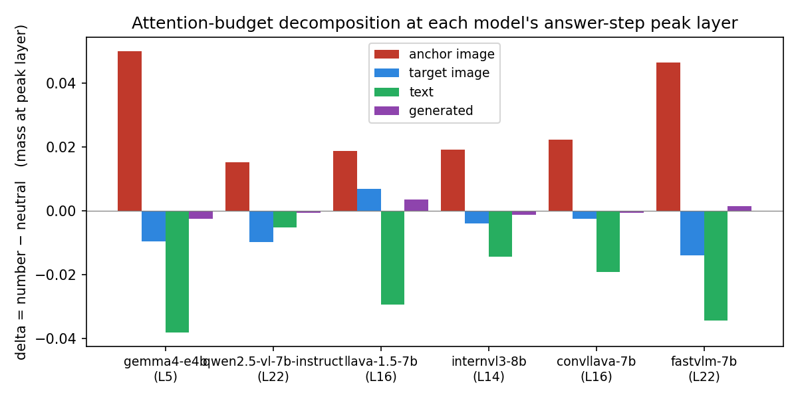
E1b — per-layer localisation: 4 archetypes by encoder family
Peak layer (where anchor attention concentrates) differs sharply by family
model (encoder) | peak layer | δ peak | budget source | archetype
Gemma-SigLIP (gemma4-e4b) | L5/42 (12 %) | +0.0501 | text | early + large
InternVL3-InternViT | L14/28 (52 %) | +0.0193 | text | mid-stack
LLaVA-1.5-CLIP-ViT | L16/32 (52 %) | +0.0188 | text | mid-stack
ConvLLaVA-ConvNeXt | L16/32 (52 %) | +0.0224 | text | mid-stack
Qwen2.5-VL-Qwen-ViT | L22/28 (82 %) | +0.0153 | target | late
FastVLM-FastViT | L22/28 (82 %) | +0.0467 | text | late + large
Budget decomposition at each peak
Two key takeaways
• Layer-averaged E1 numbers were HIDING a ~3× concentration at a single layer.
• Three encoder architectures (CLIP-ViT, InternViT, ConvNeXt) cluster at L14–16 with text-stealing budget — they form an architecture-blind MID-STACK CLUSTER. This is the highest-leverage E4 target.
• Two budget mechanisms exist: text-stealing (5/6) vs target-stealing (Qwen).
8 / 16

Slide 9
E1c — H3 falsified: ConvNeXt encoder ≠ less anchoring
ConvLLaVA replicates LLaVA-1.5's per-layer attention signature exactly
ConvLLaVA (ConvNeXt encoder) vs LLaVA-1.5 (CLIP-ViT encoder)
What this kills
measure | LLaVA-1.5 (CLIP-ViT) | ConvLLaVA (ConvNeXt) | verdict
Peak layer | L16 / 32 | L16 / 32 | match
Peak depth | 52 % | 52 % | match
Peak δ | +0.0188 | +0.0224 | within 19 %
Budget source | text | text | match
A7 susceptibility gap | +0.0097 | +0.0126 | within 30 %
Mechanism archetype | mid-stack text-stealing | mid-stack text-stealing | match
• H3 ("Conv < ViT") at adoption AND per-layer levels
• The originally-planned 'encoder ablation' paper subsection
• Frees compute for E5 / E7 instead
Replacement framing
Encoder ARCHITECTURE doesn't predict anchoring; post-projection LLM STACK DEPTH does. Three architecturally-distinct encoders converge to the same mid-stack text-stealing profile. Paper narrative shifts from "encoder modulates anchoring" to "depth-axis predicts the signature".
9 / 16

Slide 10
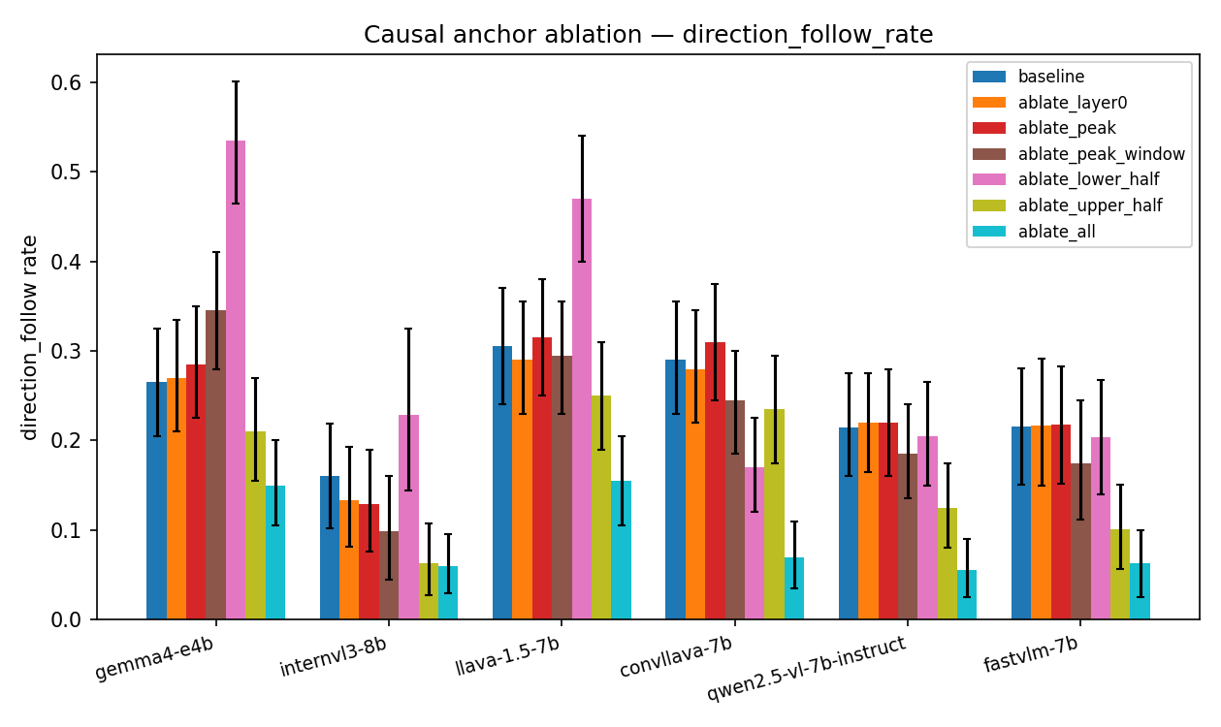
E1d — causal ablation: single-layer null, upper-half is the locus
7 ablation modes × 6 models, n=200 each. The peak is correlational, not causal.
Per-mode summary across 6-model panel
ablation mode | Δ direction_follow | verdict
Single-layer at E1b peak | ≤ ±3 pp | ✗ null on 6/6
Single-layer at L0 (control) | ≤ ±3 pp | ✗ null on 6/6
Stack-wide ablation | −11 to −22 pp | but fluency 4-6× on 3/6
Lower-half ablation | +27 to +17 pp on 3/6 | 🔥 BACKFIRES
Upper-half ablation | −5.5 to −11.5 pp on 6/6 | ✓ fluency clean on 4/6
Direction-follow Δ per ablation mode (6 models)
Causal evidence
• Per-layer peak from E1b is CORRELATIONAL — single-layer ablation does nothing.
• Multi-layer redundancy: anchor signal is encoded across many layers.
• Upper-half ablation = ARCHITECTURE-BLIND MITIGATION LOCUS — works on all 6 models, fluency-clean on the mid-stack cluster + Qwen.
• Caveat: ConvLLaVA & LLaVA-1.5 share peak/mechanism but respond OPPOSITE to lower-half (Δ = −0.12 vs +0.165). Same attention ≠ same causal structure.
10 / 16

Slide 11
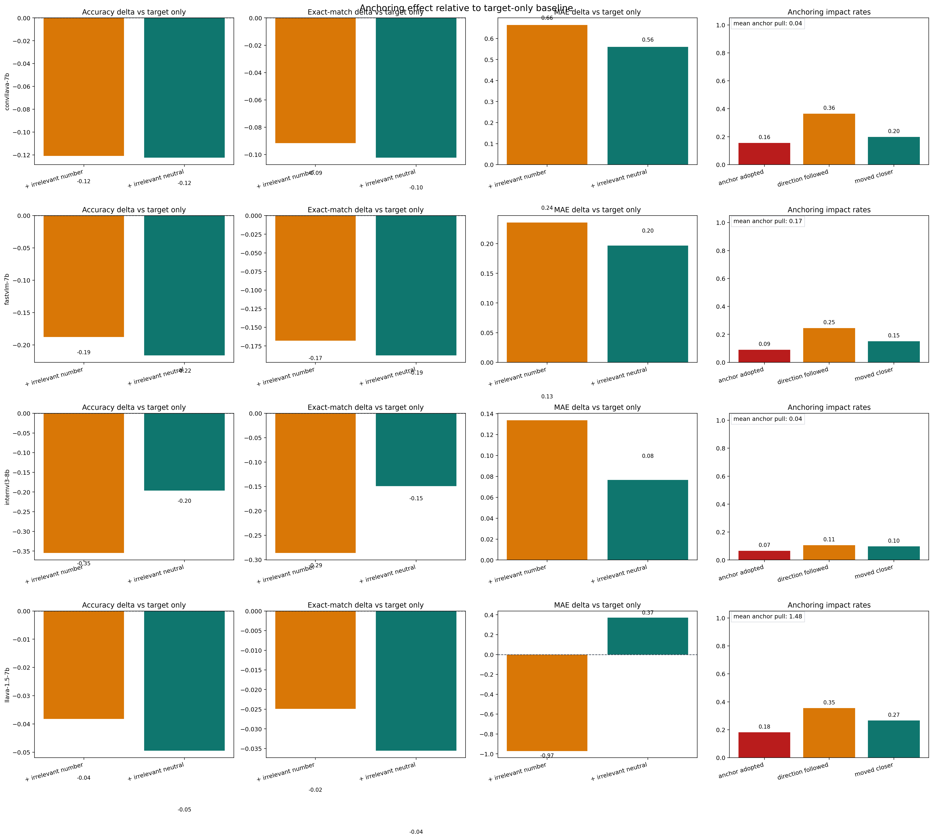
E2 pilot — two failure modes are orthogonal: anchoring vs distraction
11-model panel pilot (n=1,125 each); H6 hypothesis emerges
Two-axis bucketing
model | adoption | acc_drop(num) | axis
LLaVA-1.5-7b | 0.181 | 0.038 | anchoring (high adopt, low drop)
qwen3-vl-8b | 0.124 | 0.040 | anchoring
gemma3-27b-it | 0.141 | −0.004 | anchoring
ConvLLaVA-7b | 0.156 | 0.121 | BOTH
gemma4-e4b | 0.123 | 0.012 | anchoring
FastVLM-7b | 0.090 | 0.188 | distraction
InternVL3-8b | 0.066 | 0.355 | distraction (low adopt, high drop)
Per-model anchoring effects (E2 pilot)
New hypothesis H6
Cross-modal failures decompose into two ORTHOGONAL axes: anchor-pull (encoder-mediated) and multi-image distraction (architecture-mediated, hits accuracy without encoding the anchor). InternVL3 = pure distraction; LLaVA-1.5 = pure anchoring.
11 / 16

Slide 12
E4 — mitigation: soft attention re-weighting on upper-half layers
Combines E1b (where) + E1d (causal locus) + E4 (soft strength axis)
• E1d showed: only multi-layer upper-half intervention works
• E4 replaces hard mask with a soft strength axis:
— Forward pre-hook on each LLM decoder layer in [n/2, n)
— Adds `strength` to attention_mask columns at the anchor span
— Post-softmax: anchor attention multiplied by exp(strength)
— strength = 0 → multiplier 1 (no-op); strength = −∞ → 0 (E1d hard)
• Phase 1 sweep:
— n=200 stratified samples; 7 strengths × 3 conditions
— strength grid: [0, −0.5, −1, −2, −3, −5, −10⁴]
• Phase 2 full validation:
— n=17,730 × 5 anchors × 3 conds × 2 modes ≈ 88,650 records
— Resumable; runs on the chosen Phase-1 s* per model
Target
• ≥ 10 % reduction in direction_follow_rate
• ≤ 2 pp drop in standard VQA accuracy
• Hook should be no-op on target_only (sanity check)
• Mid-stack cluster: LLaVA-1.5, ConvLLaVA, InternVL3
Strength selection rule
Among strengths satisfying both targets, pick the smallest |s|. If none qualify → escalate to ablate_upper_quarter [3n/4, n). Per-model selection (NOT a single shared strength) — see Slide 13.
12 / 16

Slide 13
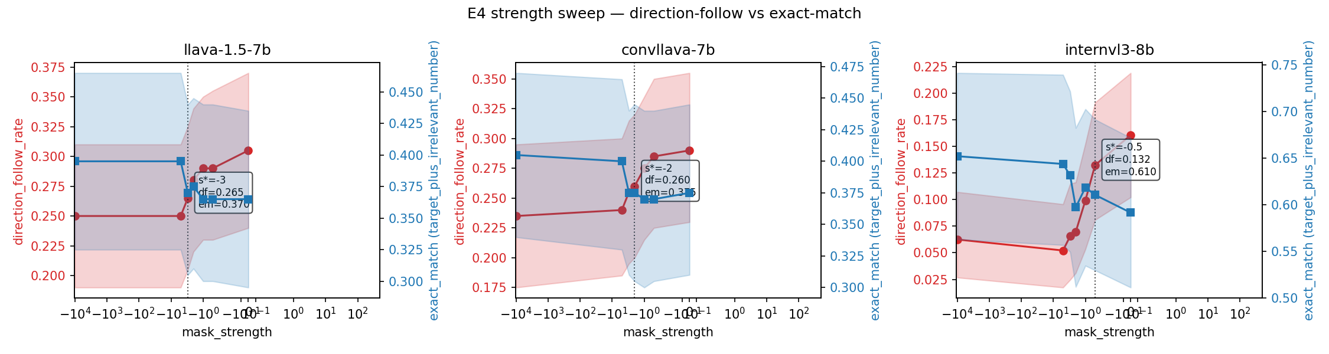
E4 Phase 1 sweep — all 3 mid-stack models meet target
n=200 stratified per model, 7 strengths × 3 conditions
Phase 1 cross-model summary
model | n_layers | upper-half | df₀ | s* | df at s* | Δ rel | Δ em
llava-1.5-7b | 32 | 16..31 | 0.305 | −3.0 | 0.265 | −13 % | +0.5 pp
convllava-7b | 32 | 16..31 | 0.290 | −2.0 | 0.260 | −10 % | +0.0 pp
internvl3-8b | 28 | 14..27 | 0.161 | −0.5 | 0.132 | −17.7 % | +1.9 pp
Strength-axis Pareto (df ↓ vs em →)
Three Phase-1 findings
• s* ranges from −0.5 (InternVL3) to −3.0 (LLaVA-1.5) — an order of magnitude apart. Single shared strength would over/under-mitigate.
• Mitigation effect ANTI-CORRELATED with baseline anchor-pull on df: InternVL3 (lowest df₀) shows LARGEST drop (−61 % at saturation).
• Strength-axis monotonicity is robust on all 3 models — no U-shape disasters where over-mitigation tips into hallucination.
• em(target_only) invariant on every model, every strength → hook is anchor-condition-specific by construction (sanity confirmed).
13 / 16

Slide 14
E4 Phase 2 — replication at full scale (88,650 records each)
Phase 1 prediction confirmed within 0.3 pp on relative df reduction
Phase 2 baseline vs treated comparison
model | s* | df₀ | df treated | Δ df | Δ rel | em (0 → s*) | Δ em | % complete
llava-1.5-7b | −3.0 | 0.2578 | 0.2122 | −4.55 pp | −17.7 % | 0.3340 → 0.3418 | +0.77 pp | 100 %
convllava-7b | −2.0 | 0.2283 | 0.2042 | −2.42 pp | −10.6 % | 0.3522 → 0.3652 | +1.30 pp | 100 %
internvl3-8b | −0.5 | (in flight) | — | — | — | — | — | ~50 %
Replication tightness
Caveats
• LLaVA: Phase 1 sweep predicted −17.7 %; Phase 2 measured −17.7 %
• ConvLLaVA: Phase 1 sweep predicted −10.3 %; Phase 2 measured −10.6 %
• Both within 0.3 pp on relative df; CIs ~10× narrower than Phase 1
• em rises on BOTH (+0.77 / +1.30 pp) — accuracy improved, not just preserved
• ConvLLaVA fluency tail at full scale: mean_dist 2.99 → 53.54 (small fraction of broken outputs; em still rises, df is per-pair and robust). For the paper: report MEDIAN distance + degraded fraction.
• InternVL3 Phase 2 will not finish in this session (rate 0.29 sample/s, ETA ~10 h remaining). Continues next session.
• InternVL3 needs the driver patch (max_new_tokens 8 → 32) BEFORE the run is reported — patch already applied to disk.
14 / 16

Slide 15
Reframing — anchor damages accuracy; mitigation partially recovers it
Paired analysis on intersection of valid samples; em(target_only) = ceiling
Phase 2 paired anchor-damage (full set)
model | n_paired | em(TO) | em(num@0) | anchor damage | em(num@s*) | recovery | % damage recovered
llava-1.5-7b | 17,724 | 0.3696 | 0.3340 | −3.55 pp | 0.3417 | +0.77 pp | 21.7 %
convllava-7b | 17,722 | 0.4454 | 0.3520 | −9.34 pp | 0.3651 | +1.31 pp | 14.0 %
Sharper paper claim
The anchor demonstrably DAMAGES accuracy (em drops 3.5–9.3 pp from the un-anchored ceiling). Upper-half attention re-weighting RECOVERS 14–22 % of that damage at the safe working point s*.
Why it's strong:
• Both df-axis (mechanism) AND em-axis (functional) signals agree on the locus
• Recovery ratio is similar across models (14–22 %) → not a single-model artefact
• The mitigation is causal (single-layer null in E1d rules out correlation alone)
15 / 16

Slide 16
Summary — current state of the paper
Single-claim arc: notice → modulate → mechanism → mitigate
Strong, paper-ready findings
• A1: anchoring is uncertainty-modulated GRADED PULL (+7 to +20 pp on 7/7 models)
• E1+E1b+E1c: anchor attention concentrates at family-specific peak; ConvNeXt = CLIP-ViT (H3 dead, depth-axis replaces it)
• E1d: single-layer null + upper-half is the architecture-blind causal locus
• E4 Phase 2: −17.7 % (LLaVA) and −10.6 % (ConvLLaVA) df reduction with em IMPROVED, replicates Phase 1 within 0.3 pp
• E2 pilot H6: anchoring vs distraction are orthogonal failure modes
Open questions / next session
• Finish InternVL3 Phase 2 with patched driver (max_new_tokens=32)
• Per-stratum: does mitigation concentrate on top-decile susceptible items?
• ConvLLaVA fluency tail decomposition (median + degraded-fraction)
• E5 multi-dataset (TallyQA, ChartQA) and E7 paraphrase robustness
• E6 closed-model subset (GPT-4o / Gemini-2.5) to defuse 'open-only' reviewer complaint

