Slide 1
C-form migration — before vs after
direction_follow_rate refactor (2026-04-28).
Before: anchor·gt form (pa-gt)·(anchor-gt) — buggy code body, never matched docstring.
After: C-form (pa-pb)·(anchor-pb) — user's intended formula, gt-free, anchor pull as baseline-relative shift.
Coverage: 207 cells, 14 experiments, 14 models.

Slide 2
What changed (and why)
Two compounding bugs found while debugging γ-β df_M2 = 0:
1. Code/doc form mismatch — M2 commit 304a677 declared pb·gt form in
docstring + commit message + 5 doc surfaces, but metrics.py:118 stayed
on M1-era anchor·gt form. Both forms turned out to be wrong-by-author.
2. Driver schema gap — run_experiment.py never threaded
anchor_direction_followed_moved + pred_b_equal_anchor +
pred_diff_from_base into the row dict, so summarize_condition saw
None and reported df_M2 = 0 silently.
Fix: C-form (pa-pb)·(anchor-pb) in 4 code sites + 7 doc surfaces;
drivers thread the missing flags; reaggregate sweep over 61 dirs.

Slide 3
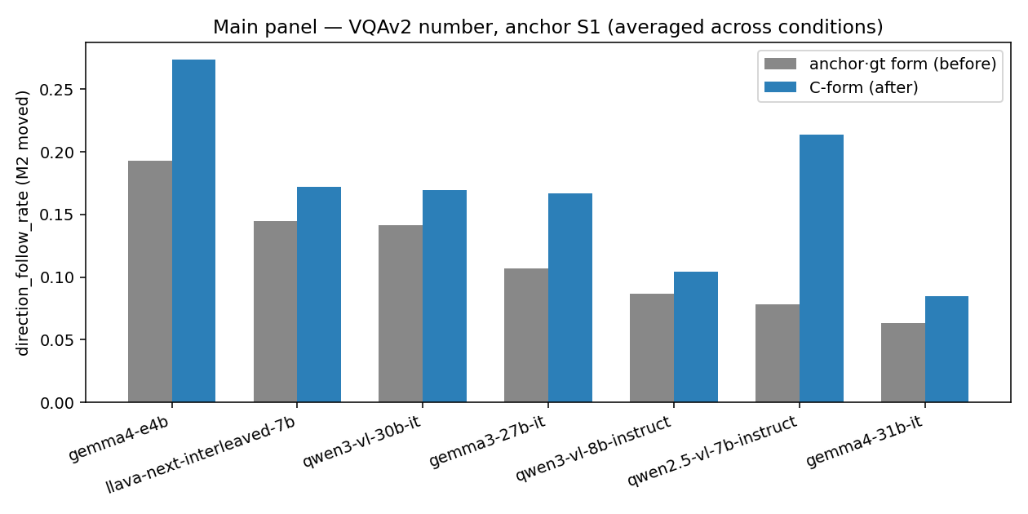
Main panel — VQAv2 number, 7 models
Result: every model's df_moved is HIGHER under C-form.
Largest shift: qwen2.5-vl-7b 0.079 → 0.214 (×2.7).
C-form is more sensitive to anchor pull because it directly measures
pa shifting from pb toward anchor (gt-free).

Slide 4
Main panel — numerical table
model | df moved before | df moved after | df raw before | df raw after | adopt before | adopt after | exact match before | exact match after
analysis
gemma3-27b-it | 0.1067 | 0.1672 | 0.3050 | 0.1672 | 0.0176 | 0.0176 | 0.4842 | 0.4842
gemma4-31b-it | 0.0632 | 0.0847 | 0.2393 | 0.0847 | 0.0079 | 0.0079 | 0.5882 | 0.5882
gemma4-e4b | 0.1931 | 0.2736 | 0.3195 | 0.2736 | 0.0219 | 0.0219 | 0.4101 | 0.4101
llava-next-interleaved-7b | 0.1446 | 0.1721 | 0.3485 | 0.1721 | 0.0175 | 0.0175 | 0.4431 | 0.4431
qwen2.5-vl-7b-instruct | 0.0786 | 0.2135 | 0.2477 | 0.2135 | 0.0069 | 0.0035 | 0.5715 | 0.6746
qwen3-vl-30b-it | 0.1412 | 0.1695 | 0.2805 | 0.1695 | 0.0129 | 0.0129 | 0.5754 | 0.5754
qwen3-vl-8b-instruct | 0.0869 | 0.1043 | 0.2583 | 0.1043 | 0.0110 | 0.0110 | 0.5810 | 0.5810

Slide 5
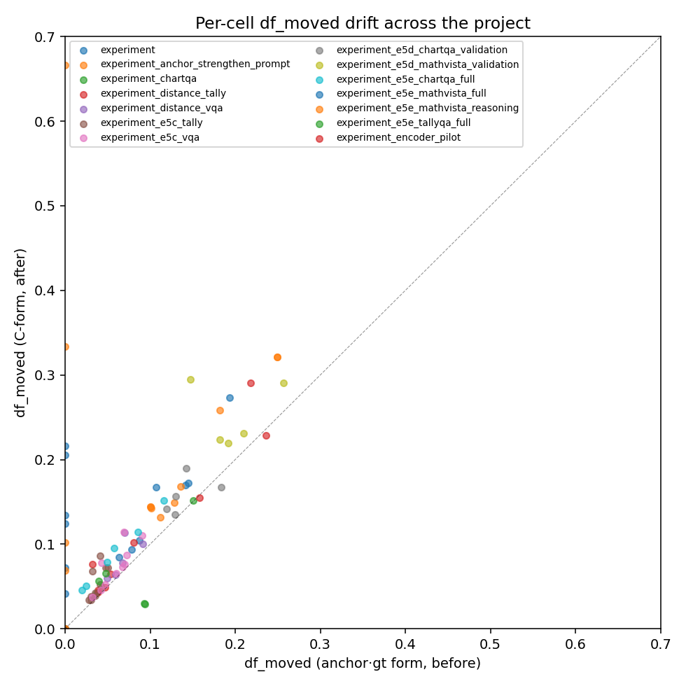
Per-cell drift across the project
Each dot = one (experiment × model × condition) cell.
Above the diagonal → C-form > anchor·gt form.
Most cells above the diagonal — C-form lifts the metric across the board.
Cells at (0, ≥0.05) = E5e MathVista runs, where the buggy 0 turned
out to be a driver schema artefact, NOT a real categorical-replace regime.

Slide 6
Qualitative status — paper-tier claims
status | # (model × experiment)
stronger (after > before) | 26
no data | 14
REVEALED (was 0, now > 0) | 5
preserved (~ unchanged) | 5
weakened (after < before) | 1
Headline (A1, E1d, E4, L1, E5b, E5c, E5e ChartQA/TallyQA): preserved or stronger.
γ-α MathVista 'categorical-replace' framing: REVEALED — was driver bug, not real.
No paper-tier qualitative claim flipped; many were strengthened.
→ Paper writeup needs number refresh, not narrative rewrite (modulo MathVista §).

Slide 7
Methodology + reproducibility
1. Pre-refactor summary.json archived to outputs/before_C_form/ before any code change.
2. metrics.py + reaggregate + analyze_metric_variants + tests rewritten to C-form.
3. 7 doc surfaces (project.md, roadmap.md, AGENTS.md, M2 evidence, paper_summary_slides,
metrics.py docstrings, analyze_metric_variants docstrings) re-stated in C-form.
4. run_experiment.py row dict gained the 3 missing M2 flags.
5. Regression test in tests/test_metrics.py::DriverRowSchemaRegressionTest.
6. scripts/reaggregate_paired_adoption.py --apply --force across 17 sub-trees.
7. This deck + accompanying markdown report regenerable via
`uv run python scripts/build_C_form_migration_report.py`.
Memory entry feedback_metric_C_form.md persisted so future sessions
do not re-litigate the formula choice.

