Slide 1
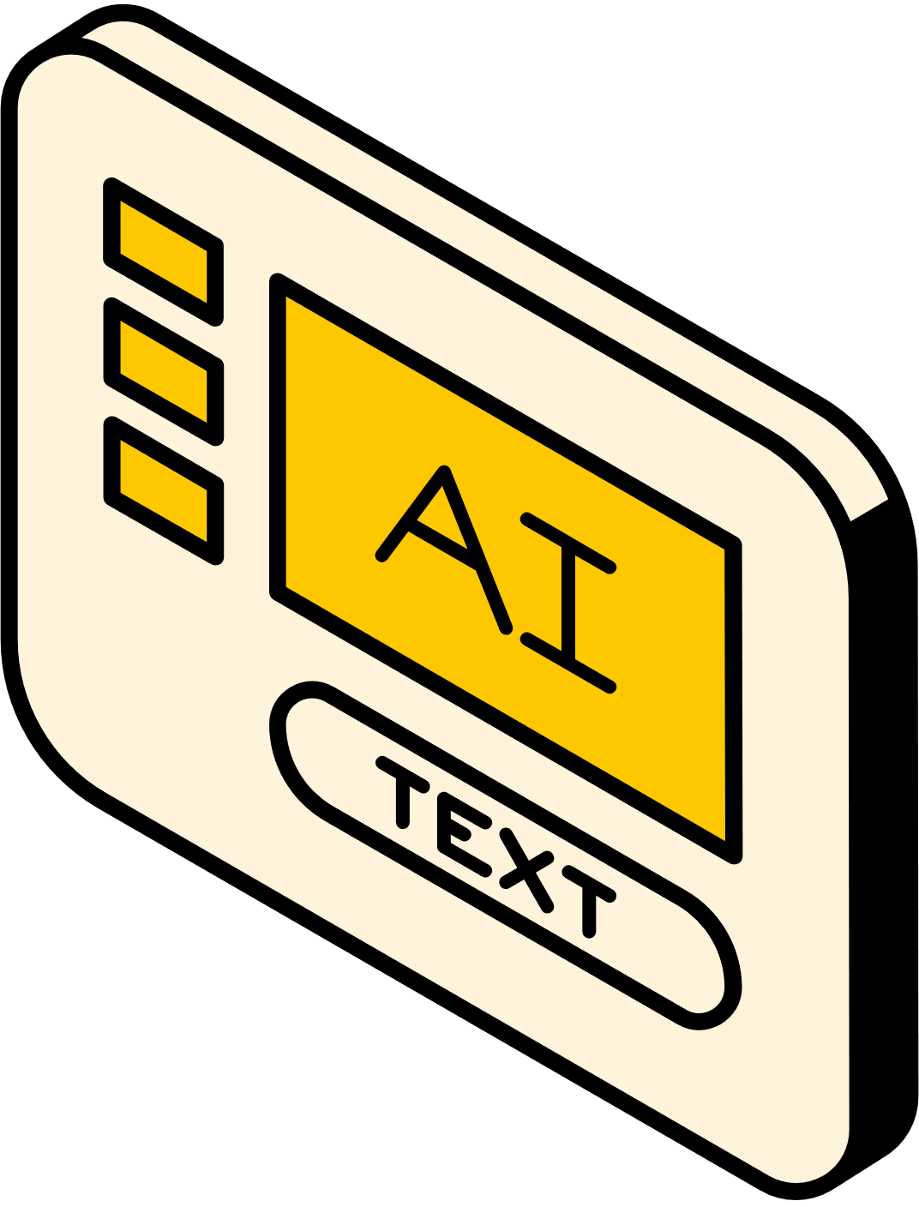
DOCBOT
A CHATBOT BASED
DOCUMENT ASSISTANCE SYSTEM
PRESENTED BY:
G-28A

Slide 2
PIPELINE
TExT PreprocessIng
Image preprocEssING
GenerAtIng Responses
Image captIONING
deployment on StreamlIT
Utilize the PyPDF2 module to extract page wise text content from PDF file and split extracted text into smaller chunks based on the defined parameters for further analysis.
Leverage custom-trained YOLO v5 model for efficient extraction of images along with corresponding captions located below each image.
Use the GPT 3.5 Turbo API to generate responses along with page numbers based on the query recieved from the user.
Use the Google Gemini Vision API to caption the images and use cosine similarity to match the images from the nearby pages with user prompt.
Use the user-friendly Streamlit interface to deploy the final model, which has a basic chatbot interface relevant to the problem statement.

Slide 3

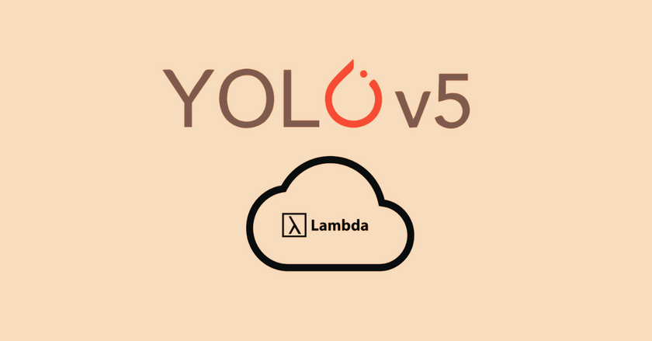
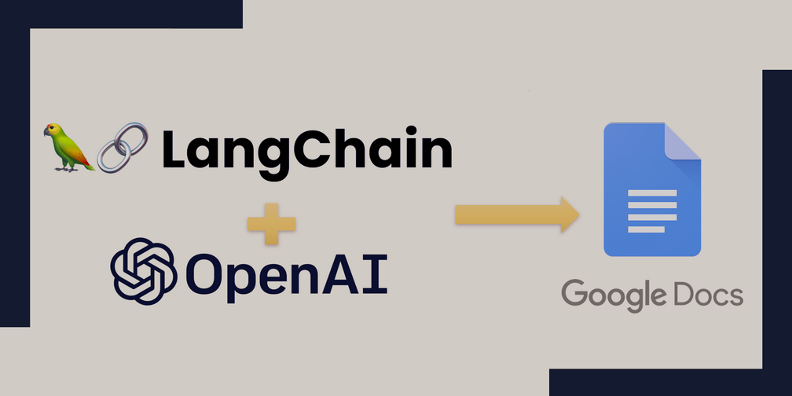

TECH STACK
STREAMLIT
YOLO V5
LANGCHAIN
GEMINI PRO VISION
To create a web-based interface for uploading PDF files, inputting queries, and displaying answers.
Custom trained to accurately detect images from the PDF along with the corresponding labels
Used to create embeddings, vector stores, and language model is deployed to process the text
To caption the images and use cosine similarity to find the image relevant to user prompt.
*Also used several other python libraries such as PIL, PyMuPDF(fitz), PyPDF2, IPython, RE(regular expression), NumPy

Slide 4
SUPPORT FOR JAPANESE
Leveraging the advanced language understanding provided by the GPT 3.5 Turbo LLM, our model is also able to comprehend and process Japanese text, ensuring high performance and accuracy across diverse linguistic contexts.​
日本語

Slide 5
FURTHER SCOPE FOR IMPROVEMENTS
MORE CUSTOMISED UI USING REACT JS
IMPROVING IMAGE RECOGNITION
IMPROVED IMAGE PROCESSING
We created a quite interactive and user friendly UI using React JS however were unable to integrate it.
Although YOLO is able to recognise the images quite well, there is a further scope for improved training or possibly using a more advanced framework.
Despite satisfying results by cloud vision, there is a scope to bring the images into a better format, which can be better processed by the model.

Slide 6
THANK YOU
Naman Singhania​
Aadi Chandra Modak​
Gagandeep Singh​
Rakeshkumar Honnalli​
Yasaswini Pagadala

