Slide 1
NAMAN ADEP
ANALYSIS OF COVID-19 CASES
USING PYTHON

Slide 2
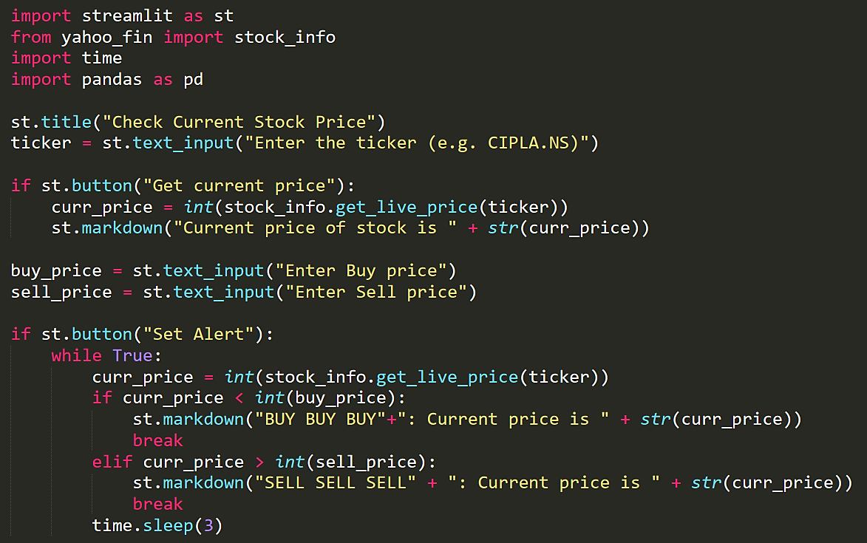
Follow these simple steps

Slide 3
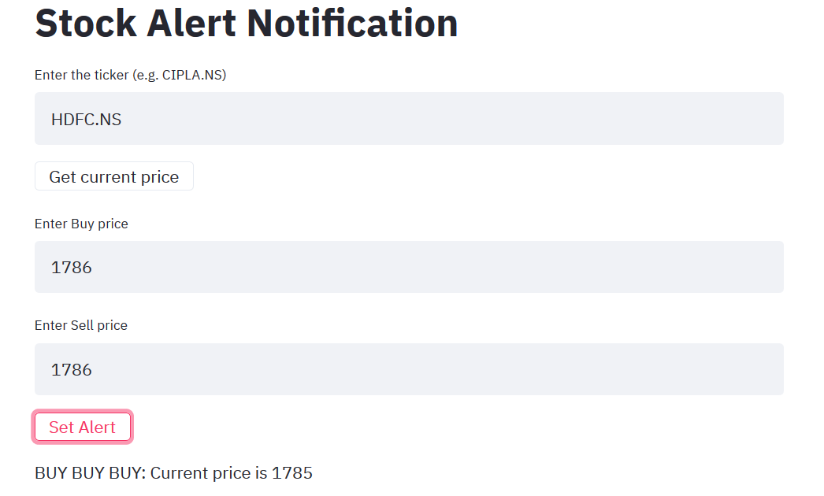

Slide 4
stock_alert.py
#Import package
import streamlit as st
from yahoo_fin import stock_info
import time
import pandas as pd
st.title("Stock Alert Notification")
ticker = st.text_input("Enter the ticker (e.g. CIPLA.NS)")
if st.button("Get current price"):
curr_price = int(stock_info.get_live_price(ticker))
st.markdown("Current price of stock is " + str(curr_price))
buy_price = st.text_input("Enter Buy price")
sell_price = st.text_input("Enter Sell price")
if st.button("Set Alert"):
while True:
curr_price = int(stock_info.get_live_price(ticker))
if curr_price < int(buy_price):
st.markdown("BUY BUY BUY"+": Current price is " + str(curr_price))
break
elif curr_price > int(sell_price):
st.markdown("SELL SELL SELL" + ": Current price is " + str(curr_price))
break
time.sleep(3)

