Slide 1

Mini Project Report on Library Management System
Submitted By :
Naman Gupta
A – 38
2018951
Under the mentorship of :
Meenakshi Maindola
(Assistant Professor)

Slide 2

Table of Contents 1. Introduction 2. Methodology 3. Result 4. Conclusion

Slide 3
Introduction
A library management system is a piece of software that aids in managing a library's catalogue
The programme can help with both the tracking of items that have been checked out and returned as well as the circulation of materials
The system could offer a basic set of features, such as adding and updating members and books, depending on the needs of users

Slide 4

Objective
The purpose of this Library Management System project is to monitor and regulate library transactions
It primarily focuses on the fundamental operations of a library, including the addition of new users, books, and information updates; searching for users and books; and offering the ability to borrow and return books
We can add new book records and retrieve information about books that are currently on hand at the library and display all books etc.

Slide 5

1.3 System Module
Recording of Book Information: Each book's information should be entered into the system to give potential borrowers or students the book references they need
Administrator Login: To have primary access to the system and secure all information and transactions carried out within it, the school librarian will need to provide their email address and password for the admin login
Information on Borrowing: The information on borrowing should include key facts about the borrowers and the books that each borrower has borrowed

Slide 6

Methodology
C++ programming was used to create this library management system
The system was made to be simple to use and comprehend
Data was stored and retrieved with the help of data structures like array and vectors
Logins for both admin(librarian) and user were created to ensure proper functionality

Slide 7
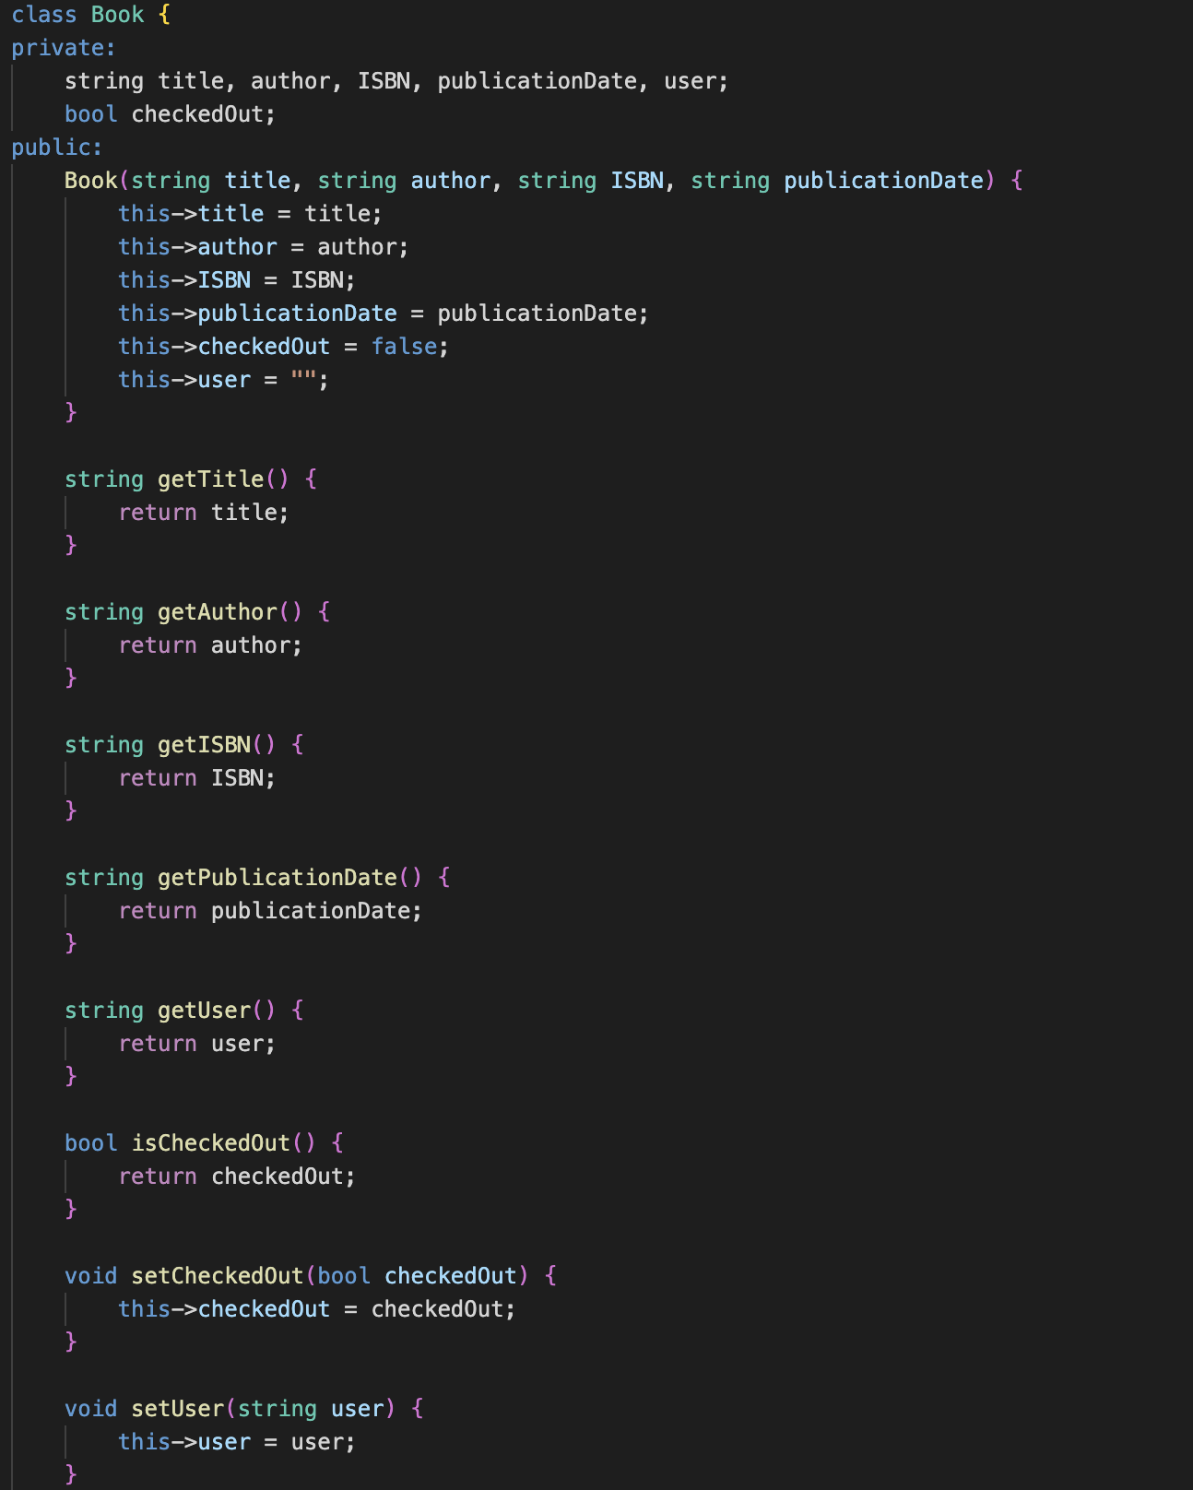
Code Snippet of Book Class in my Library Management System

Slide 8
4.1 Library Management System as an outcome/result
The system makes use of object-oriented programming principles and is developed using the C++ programming language
The system contains a validation system that makes sure the user enters the right data and is user-friendly and simple to use
Users can quickly issue books, find books using our program's many pre-defined categories, and return books they have already borrowed
It works for both the admin and the user

Slide 9
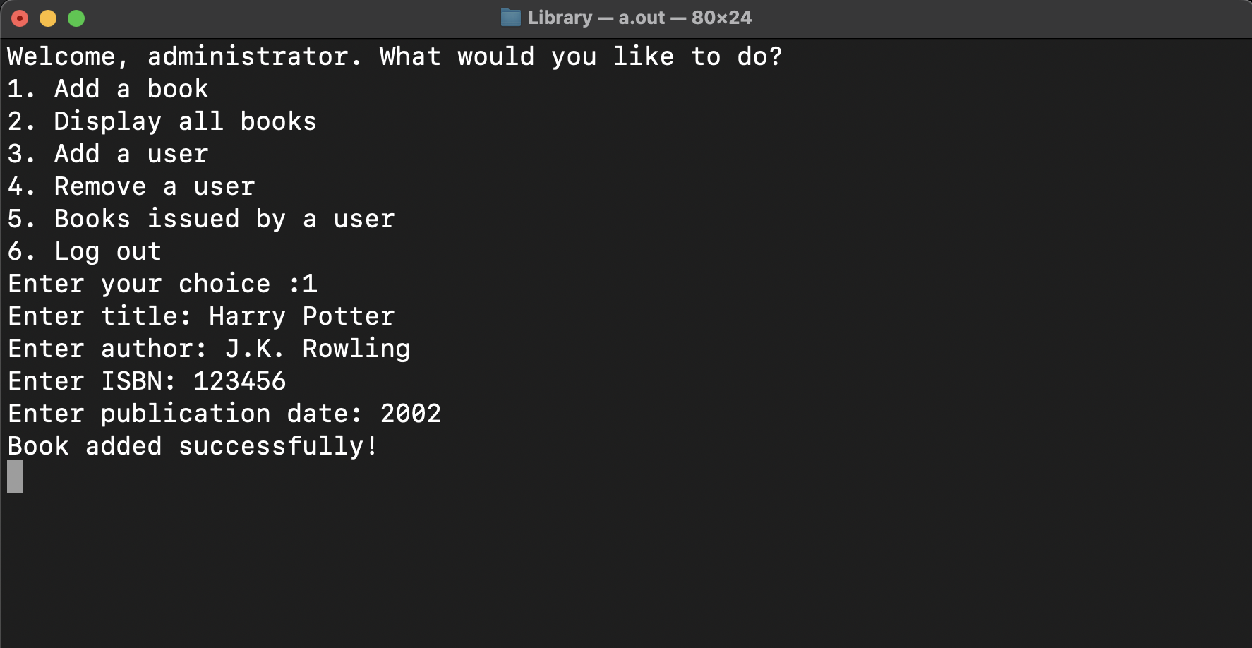
Output Screenshot while admin(librarian) adds a book

Slide 10

4.2 Skills Learned
C++ Programming: Writing code for this project required the usage of the popular, potent programming language C++, which is used to create a wide variety of software applications
File Handling: To store and retrieve data on books, authors, and users, the project included reading and writing data to files
System Development and Testing: The project involved planning and carrying out the project using software development, as well as testing the system to make sure it is functioning properly

Slide 11
Conclusion and Future Work
It has been observed that this method will aid in time management as well as informational productivity
The program was designed modular to facilitate future modifications i.e., afterwards one can add more functions to increase its functionality and remove some bugs.
Users can now participate in and experience brand-new search methods on upcoming library management systems that are helpful for fundamental tasks like categorization, novelty detection, summarization, similarity, and pertinent judgements

