Slide 1
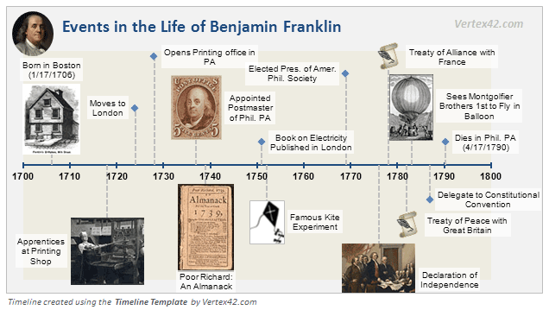
Event Ordering – Timeline Generation

Slide 2
Task Description
Aim : Build timelines from written news in English.
  Order on a timeline all the events in which a target entity is involved.
Input : Set of documents.
  Target Entity : People, Organization, Product
Output : Build an event TimeLine related to that entity.

Slide 3
Task Description
Aim : Build timelines from written news in English.
  Order on a timeline all the events in which a target entity is involved.
Input : Set of documents.
  Target Entity : People, Organization, Product
Output : Build an event TimeLine related to that entity.

Slide 4
Example
June 6, 2005 :
  Apple Computer CEO Steve Jobs gave his annual opening keynote to the World Wide Developers Conference (WWDC)
August 24, 2011:
  Yesterday, Steve Jobs unveiled iPhone 4.
August 24, 2011:
  Steve Jobs has been fighting pancreatic cancer since 2004.
TimeLine:
1 2004 fighting
2 2005-06-05 keynote
3 2011-08 unvieled

Slide 5
Events
Part­of­speech
  Verb : Except it is modified by modal words.
  Noun
Event Classes
  Speech_Cognitive : only events that describe the action of a person or an organization declaring something, narrating an event, informing about an event.
Factuality
  Only certain events (Factual or Non-factual)
    Apple Computer today launched a 3G version of its iPhone device.
    Apple might launch a 3G version of its iPhone device.

Slide 6
Event vs Non Event
1. POS
Verbs, Nouns | Other POS
2. Event Classes
Declaring, Narrating, Informing | Event describing mental states like : He plans to go to Rome.
3. Factuality - certainity
Certain Events | Possibilites, counter-factual
4. Causality
 | ENABLE­type verbs (e.g. enable, aid, allow, permit) and verbs in their complements
5. Other
 | Verbs modified by modal verbs except will

Slide 7
Time Anchors
He has been fighting pancreatic cancer since 2004.
  Time : 2004
Jobs, was born in San Francisco on February 24, 1955.
  Time : 24-02-1955
Apple launches new retail stores
  Time : Article Date
On May 23rd she said “Today I am moving”
  Time : 23-05-2005 (2005 is taken from Article Date).
In April 2010 he moved to Italy and three months later he bought a house
  04-2010 : moved
  07-2010 : bought

Slide 8
Example Contd...
He graduated in April 2010. He left Italy last month. (DCT: 2010­05­2010)
2010­04 graduated
2010­04 left

