Slide 1

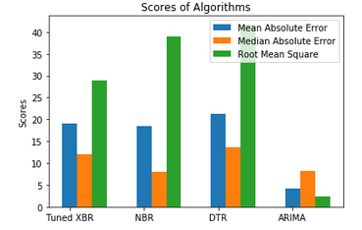
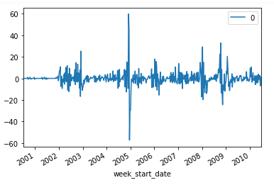
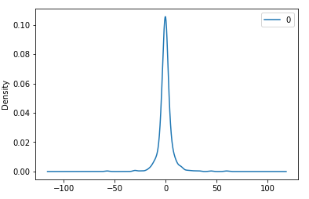
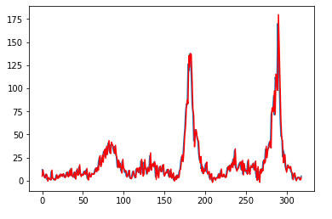
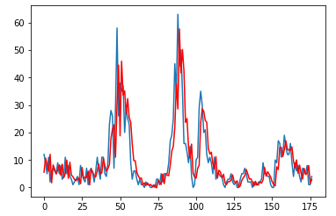
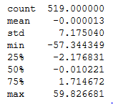
From the ARIMA Model results we can see very high AIC, BIC and HQIC values which says that the model is not powerful. Although the ARIMA model was found to have the lowest Mean Absolute Error which would mean that it should be the best performing model or algorithm but we chose to oversee it due it being unable to predict far into the future decades and which would give faulty predictions or forecast and cannot be used for future analysis. Therefore, taking into consideration the type of dataset and its distribution, the MAE values and the trade-offs. Negative Binomial Regressor is the best performing model.
Soft Computing Techniques for Dengue Detection
Naman Anand, Sambeet kumar Pradhan, Adweat Mishra | Dr. Dilip kumar Choubey| SCOPE
Introduction
Results
Dengue is a viral mosquito borne disease. The disease requires medical attention in these cases and may turn out to be fatal if not treated properly or a delay in treatment is reported. In this project, we will be using soft computing technique for predictive modelling dengue basis using four different algorithms and comparing them to find the best result.
From the statistics , we obtain a very low Mean Absolute Error and Median Absolute Error scores for the ARIMA model but unable to predict far into the future decades and which would give faulty predictions or forecast. Therefore, owing to this trade-off between the accuracy (Mean Absolute Error, Median Absolute Error) and time into which it can predict optimally, given it is a time series model, the ARIMA model was not the best performing algorithm. Therefore, taking into consideration the type of dataset and its distribution, the MAE values and the trade-offs Negative Binomial Regressor is the best performing model. This is majorly due the NBR model fitting perfectly to skewed distributions and during the exploratory data analysis we found that our labels in the dataset are a negatively skewed distribution.
Motivation
The incidences of Dengue have increased vastly recently and much more than the reported cases due to rise in asymptomatic cases. Therefore, looking at the gravity of situation it is extremely important that early detection of the Dengue disease is made possible given the amount of people at risk.
SCOPE of the Project
 | Mean Absolute Error | Median Absolute Error | Root Mean Square Error
Tuned XBR | 19.071 | 28.872 | 12.0
NBR | 18.452 | 38.942 | 8.0
DTR | 21.194 | 41.646 | 13.566
ARIMA | 4.272 | 2.3477 | 8.184
The soft computing techniques are hence forth used in the medical field so as to facilitate medical disease detection and medical diagnosis decision systems. We explore the various soft computing and machine learning tools used in the classification and detection of diseases. We will find the best prediction models among a set of models i.e XGBoost Model, Negative Binomial Regression Model, Decision Tree Regression Model and time series forecast ARIMA model on a dataset which consists of 24 features. The performances of the models are compared based on four metrics i.e Mean Absolute Error, Median Absolute Error and Root Mean Squared Error.
Methodology
The first step was to collect a reliable dataset. The dataset (DengAI dataset) is collected from drivendata.org. and contains climatic data instances for a week of two cities. The data in the dataset is time series. The work was carried out with implementing the different models on the dataset and then comparing the results based upon the metrics of Mean Absolute Error, Median Absolute Error, Root Mean Squared Error and some trade-offs were also done. Initially an exploratory data analysis was carried out on the dataset to study the relationships between the total cases and features in the dataset and among the features themselves. Correlation heat map was plotted to find out the relationships. The year with the maximum number of Dengue cases was identified. The important features were identified and those with high null values identified.
XGBoost Regressor Model (XBR) - Initial data pre-processing was done, Random Model was built, Then the XGBoost Regressor model was built, A tuned XGBoost Regressor Model was built by tuning the parameters. Cross Validation scores calculated. Mean Absolute Error, Median Absolute Error and Root Mean Squared. Error are calculated.
Negative Binomial Regressor Model (NBR)- K best features have been selected using the selectkbest feature selection technique.Hyperparameter tuning was done by tuning the alpha and link parameters,Negative Binomial Regressor Model was built,Mean Absolute Error, Median Absolute Error and Root Mean Squared Errors are calculated.
Decision Tree Regressor Model (DTR) - Initial data pre-processing was done, A grid search cross validation was carried to get the tuned the parameters. The importance of the features for the estimation was ranked. Features with low correlation are dropped. Features with high correlation are used. A grid search cross validation was carried to get the tuned the parameters. The importance of the features for the estimation was ranked.
ARIMA Model (ARIMA)- Initial data pre-processing for this model was done differently. The time series would be the total cases every week. We then convert the week start date feature into a date time dataframe. Then the week start date dataframe is converted into month dataframe and used as a feature. The missing values were handled by using the forward fill method. The stationarity of the time series was check using a function which contained: Rolling Statistics, Augmented Dicky Fuller Test . For eliminating the trend in data a log transformation was used. Again, the above function was run. Next the moving average of the log transformed data was calculated. This was then subtracted from the log transformed data which gave the log transformed data moving average. Again, the above function was run. Differencing was used to shift the data. This (shift=1) gave us the value of d in the ARIMA parameters. Then the stationary time series data was decomposed i.e the trend and seasonality were removed and we got the residual. Next, for forecasting data ARIMA model parameters are defined. We plot the partial autocorrelation graph, which when shuts-off gives us the value of p. We plot the autocorrelation graph, which when tapers, gives us the value of q. Then the ARIMA Model is built and its statistics which are the AIC, BIC, HIQC are also printed. Now for prediction, the originally log transformed data is again transformed into its original form. Forecast using the model is found. Mean Absolute Error, Median Absolute Error and Root Mean Squared Error are calculated.
 | ARIMA Model for SJ City | ARIMA Model for Iq City
Length up until it can predict | 260 | 156
 | ARIMA Model for SJ City | ARIMA Model for Iq City
MAE | 6.083042954949091 | 4.587205933745022
Conclusion
We have been able to find the algorithm which predicts the dengue disease with best accuracy. We used XGBoost because now most of the times in predictive analysis, this algorithm has been used very widely. Then we used Decision tree Regressor but it was soon found that it is not suitable for the predictive analysis as its doesnot adapt itself according to time. The Negative binomial regressor was used to predict the disease but it was not upto the expectaions. Finally, we used ARIMA algorithm and it was found out to be the best among all as it’s a time series and was best in terms of accuracy. But the AIC values were very large and cannot be applicable for the long period series. It only predicted accurately till 250 weeks. So may be in the future, we have develop a better form of ARIMA algorithm which can predict more efficiently.
References
Faisal, T.F. & Taib, M.N., (2008) “Analysis of significant factors for dengue infection prognosis using the self organizing map”, 2008 30th Annual International Conference of the IEEE Engineering in Medicine and Biology Society , IEEE 2008 , pp: 5140-5143.
Bakar, A.A., Kefli, Z., Abdullah, S. & Sahani, M., (2011) “Predictive Models for Dengue Outbreak Using Multiple Rulebase Classifiers,” Proceedings of the International Conference on Electrical Engineering and Informatics.

