Slide 1

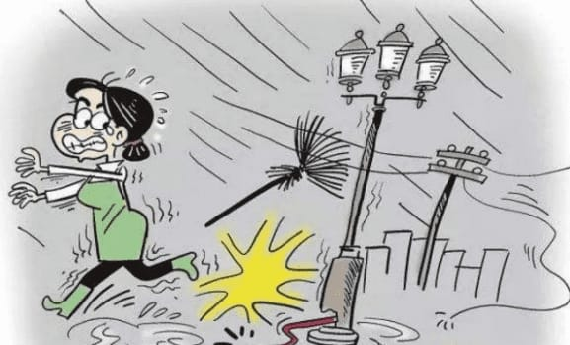
Smart India Hackthon 2024
Problem Statement ID – 1582
Problem Statement Title- System to check the healthiness of earthing system and alert staff in case of any malfunction.
Theme- Miscellaneous
Problem Statement Category- Hardware
Team Name – Tech Titans1

Slide 2
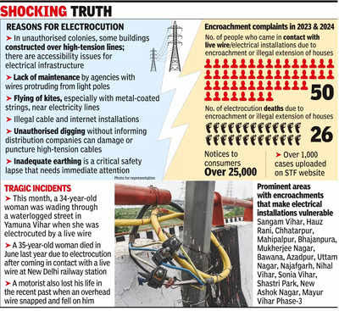
Earth Leakage Monitoring and Alert System
Tech
Titans1
Proposed Solution:
Real-time earth leakage monitoring system:
Sensors and low-power network.
Detects malfunctions, transmits data.
Location, alerts, messages.
Addressing the Problem:
Additional Safety Layer: Sensors provide real-time alerts by communicating with the nearest base station during faults.
Real-time Monitoring: Data is sent to a central system, reducing manpower and improving reliability and safety.

Slide 3


Technical Approach
Tech
Titans1
Continuous Monitoring System
Information Transmited to Parent Pole
Parent Pole
Sensors: Earth Leakage Current sensor, Earth Resistance Sensor, Humidity sensor, Temp. sensor, smoke detector and others.
Via wired cables by mesh network.
Transit data via wired cable.
Microcontroller: Arduino Uno.
Alert System Generation
Informing Electrical Department :)
DC Power Supply: Rechargeable battery.
Sound System-ultrasonic electronic repelent for animals and message for humans.
LED Light
Monitoring Software
Data Collection
Transmission

Slide 4
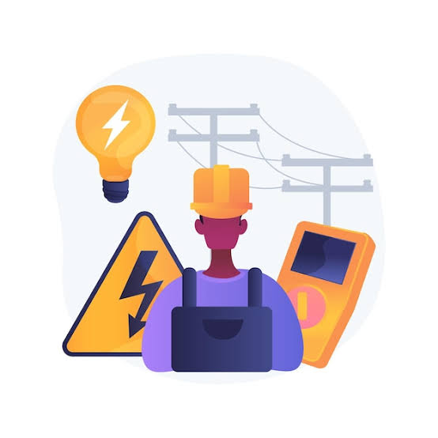
Impact & Benefits
Tech
Titans1
Impact:
Societal: Saves lives of humans and animals from electrical hazards.
Financial: Reduces repair costs and extends equipment life.
Technical: Early detection and diagnosis.
Benefits:
Improves power quality and reduces energy loss.
Early warning system for potential hazards.
Environmental monitoring with sensors (humidity, temperature).
Detects illegal energy consumption.
Ensures reliable earthing system for overall stability.

Slide 5
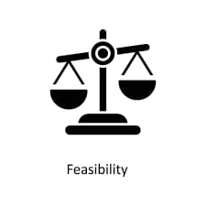
Feasibility & Viability
Tech
Titans1
Feasibility And Viability:
Technical: Wide and cheap components.
Financial: Prevents big losses.
Operational: Saves time and work.
Maintenance: Simple upkeep.
Compliance: Follows safety rules.
Reliability: Keeps systems working longer.
Challenges:
Interference: Sensors conflict.
Environment: Affects sensors reliability.
Costs: Manage expenses.
Noise: Impacts sensors functionality.
Strategies:
Separate sensors: Avoid interference.
Isolation: Separate sensors.
Optimize components: Balance cost and performance.
Filter noise: Reduce noise problems.
Uniqueness:
Reduces financial losses after faults.
Rapid response: Low-latency system.
Long-term safety: Proactive protection.

Slide 6

Research & Reference
Tech
Titans1
Websites
http://www.electroschematics.com
http://tinkercad.com
http://robokits.co.in
Images
http://timesofindia.indiatimes.com
http://www.canva.com
Youtube Channel
https://m.youtube.com/@robojax
Articles
“IEC 60364-7-714", 1996-04 1st Ed. Electrical Installations of Buildings Part 7. Requirements for Special Installations or Locations Section 714: External Lighting Installations, 1996
“IEC 60364-4-41", Low-Voltage Electrical Installations Part 4-41: Protection for Safety Protection Against Electric Shock 2005 Ed.5, 2005.

