Slide 1
MUSIC RECOMMENDATION SYSTEM
EXECUTIVE SUMMARY
What are the key takeaways?
After a thorough comparison of a variety of models, we can safely conclude that the user-user similarity-based collaborative filtering model had the best performance. The second-best performance was yielded from the optimised model-based collaborative filtering.
The evaluation number, which was the F_1 score in this instance, was 0.504 for the user-user similarity-based collaborative filtering model and 0.502 for the model-based collaborative filtering.
The popularity model yields the same results for every user. Only the content-based technique uses the item characteristics to give recommendations.
For the user interface, I suggest a hybrid of an optimized user-user similarity-based collaborative filtering model (via grid search) and a content-based recommendation system accompanied by a popularity model.
Computations like grid search are computationally expensive.
What are the next key steps?
We want to improve the user-user model by tuning its hyperparameters.
For hyperparameter tuning, one approach is, of course, testing a wider range of parameters with cross-validation.
Another approach is to use domain knowledge or prior experience with similar problems to guide the selection of parameters to test. For example, if you have experience with KNN and know that certain parameter values tend to work well in similar scenarios, you can use this knowledge to inform your choice of parameters to test.
Use the optimized model to build the hybrid model.

Slide 2
PROBLEM SOLUTION AND SUMMARY
Here is a description of the problem from the ground up to maximize clarity.
What problem was being solved?
Streaming platforms like Spotify, Soundcloud, and YouTube use different recommendation models to provide personalized suggestions to each user. For example, Spotify uses a machine learning tool called the approximate nearest-neighbour search algorithm to group songs and users together based on shared attributes or qualities. Our aim is to build a recommendation system to propose the top 5 songs for a user based on the likelihood of listening to those songs.
The dataset comes in the files. The first file, song_df, has a million entries and has five columns: song id, title, release (name of the released album), artist name, and year of release. The second file, count data, has two million entries and has three columns: user _id, song id, and play count.
We want to solve this problem to maximize user-platform interaction and user satisfaction and hence generate more revenue.
What are the key points that describe the final solution design?
Load the data. To make the data suitable for analyses, left merge the count_df and song_df data on "song_id” and drop the duplicates from the song_df data simultaneously.
User ids and song ids are encrypted, so encode them to numeric features using label encoding.
Filter the data to make the computations less expensive and have our recommendation backed by enough data. I recommend using the following filter: users who have listened to at least 90 songs, songs that at least 120 users have played, and songs with a play count of less than or equal to 5. Note that there should be 117876 rows and 7 columns in the filtered data set.
4. After a brief exploration of the original data, the following observations can be observed.
The total number of unique users is 3156.
The total number of unique songs is 9999.
The total number of unique artists is 3374.
The top 5 songs in the filtered data set are Dog Days Are Over (Radio Edit), Sehr Kosmisch, Use Somebody, Secrets, and Fireflies.
The top 5 interacted users in the filtered data are 3237, 15733, 62759, 43041 and 27401.
The distribution of play counts against the year is given on the next page. We notice that songs released in recent years are played more.

Slide 3
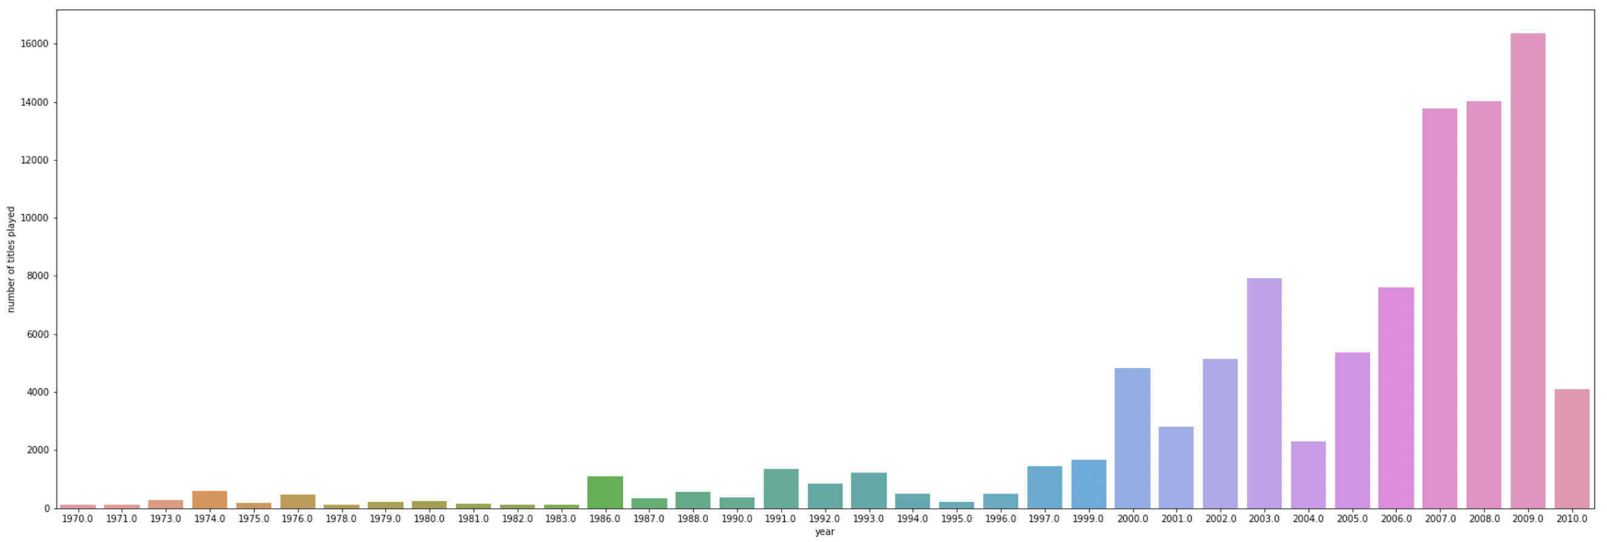

Slide 4
5. Create the popularity based recommendation system on the filtered data by creating a song_id data frame with average counts and play frequency for each song. Create a function to find the top n songs for a recommendation based on the average play count of song. We can also add a threshold for a minimum number of play counts for a song to be considered for recommendation. This results in the following top 10 songs with no minimum play count: 7224, 8324, 6450, 9942, 5531, 5653, 8483, 2220, 657, 614.
6. For performance assessment, create the function precision_recall_at_k to calulate the RMSE, precision@k, recall@k, and F_1 score of a model.
7. We build the models listed below and the following metrics can be observed.
 | RMSE | PRECISION | RECALL | F_1
Baseline User-User Similarity Based Collaborative Filtering | 1.0878 | 0.396 | 0.692 | 0.504
Optimized User-User Similarity Based Collaborative Filtering | 1.0928 | 0.394 | 0.676 | 0.498
Baseline Item-Item Similarity Based Collaborative Filtering | 1.0394 | 0.307 | 0.562 | 0.397
Optimized Item-Item Similarity Based Collaborative Filtering | 1.0931 | 0.394 | 0.675 | 0.498
Baseline Model-Based Collaborative Filtering (Matrix Factorization) | 1.0252 | 0.41 | 0.633 | 0.498
Optimized Model-Based Collaborative Filtering (Matrix Factorization) | 1.0141 | 0.415 | 0.635 | 0.502
Baseline Cluster-Based Recommendation System | 1.0487 | 0.397 | 0.582 | 0.472
Optimized Cluster-Based Recommendation System | 1.0696 | 0.393 | 0.559 | 0.462

Slide 5
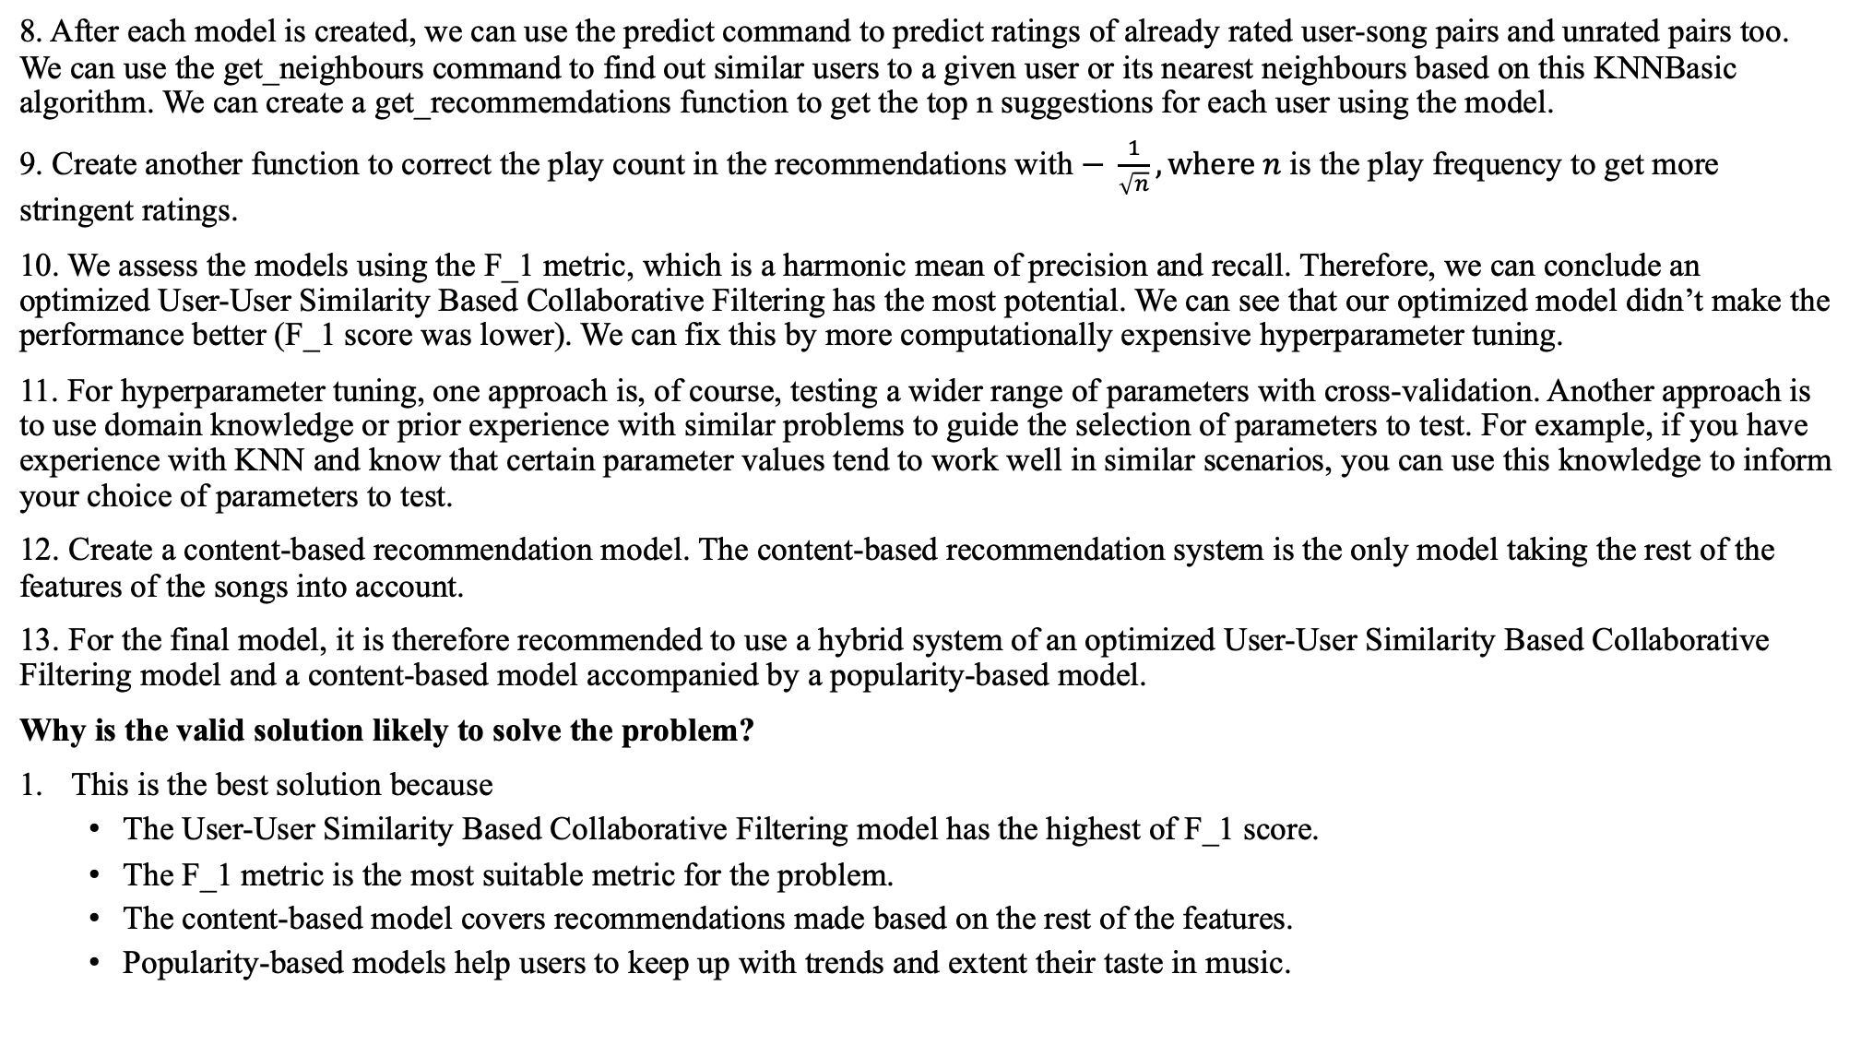
8. After each model is created, we can use the predict command to predict ratings of already rated user-song pairs and unrated pairs too. We can use the get_neighbours command to find out similar users to a given user or its nearest neighbours based on this KNNBasic algorithm. We can create a get_recommemdations function to get the top n suggestions for each user using the model.
9. Create another function to correct the play count in the recommendations with $− \frac{1}{\sqrt{n}}, where n$ is the play frequency to get more stringent ratings.
10. We assess the models using the F_1 metric, which is a harmonic mean of precision and recall. Therefore, we can conclude an optimized User-User Similarity Based Collaborative Filtering has the most potential. We can see that our optimized model didn’t make the performance better (F_1 score was lower). We can fix this by more computationally expensive hyperparameter tuning.
11. For hyperparameter tuning, one approach is, of course, testing a wider range of parameters with cross-validation. Another approach is to use domain knowledge or prior experience with similar problems to guide the selection of parameters to test. For example, if you have experience with KNN and know that certain parameter values tend to work well in similar scenarios, you can use this knowledge to inform your choice of parameters to test.
12. Create a content-based recommendation model. The content-based recommendation system is the only model taking the rest of the features of the songs into account.
13. For the final model, it is therefore recommended to use a hybrid system of an optimized User-User Similarity Based Collaborative Filtering model and a content-based model accompanied by a popularity-based model.
Why is the valid solution likely to solve the problem?
This is the best solution because
The User-User Similarity Based Collaborative Filtering model has the highest of F_1 score.
The F_1 metric is the most suitable metric for the problem.
The content-based model covers recommendations made based on the rest of the features.
Popularity-based models help users to keep up with trends and extent their taste in music.

Slide 6
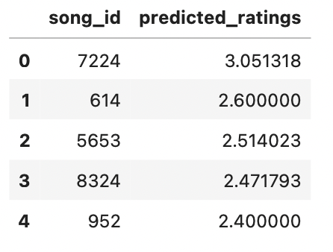
2. An example of some recommendations made by the optimized user-user algorithm for user 6958.
3. These are the pros of using a User-User Similarity Based Collaborative Filtering model
Personalization: User-user collaborative filtering models can make highly personalized recommendations based on the specific tastes and preferences of individual users.
No need for explicit ratings: These models do not require users to provide explicit ratings or feedback on the items they consume, which can be time-consuming and inconvenient for users.
Scalability: User-user collaborative filtering models can scale to large datasets and handle a large number of users and items efficiently.
Robustness: These models can handle sparse data and missing values well, as they rely on the relationships between users rather than on the specific ratings or feedback provided by individual users.
Cold start problem: User-user collaborative filtering models can handle the "cold start" problem, where there is little or no information available about a new user or item, by making recommendations based on the preferences of similar users.
4. There are also some potential drawbacks to using a user-user collaborative filtering model for music recommendation:
User overlap: These models rely on the assumption that users with similar tastes will have overlaps in their item consumption patterns. However, this may not always be the case, particularly for users with very diverse or niche tastes.
Shilling attack: User-user collaborative filtering models can be vulnerable to "shilling attacks," where malicious users manipulate the system by artificially inflating the ratings or feedback for certain items.
Privacy concerns: These models require the sharing of user data in order to make recommendations, which can raise privacy concerns for some users.
Limited to existing users: User-user collaborative filtering models can only make recommendations based on the preferences of existing users, which can limit the variety and novelty of the recommendations.

Slide 7
RECOMMENDATIONS FOR IMPLEMENTATION
What are the key actions?
Tune the hyperparameters of the user-user algorithm and deploy.
Create the hybrid with the based system.
Have the popularity-based recommendation and the hybrid model recommendation on the home page of the interface.
To make the interface computationally efficient, batch mode processing is recommended.
This is how you can bring in new data.
Identify the data sources: The first step in bringing data into a recommendation system is to identify the sources of the data. The source will the new user-song interactions.
Extract the data: Once the data sources have been identified, the next step is to extract the data from these sources. This may involve using tools such as web scraping or API calls to access and download the data. We can add the user-song interactions to the unfiltered data set.
Transform the data: The extracted data is typically raw and unstructured and will need to be transformed into a usable format. This may involve cleaning the data, removing duplicates or missing values, and normalising or scaling the data. So we process the data as we did before (data frame structuring, encoding, filtering)
Load the data into the recommendation system: Once the data has been transformed, the next step is to load it into the recommendation system. This may involve storing the data in a database or data warehouse or directly importing it into the recommendation system.
Update the data: Recommendation systems typically rely on dynamic data, and the data will need to be regularly updated in order to ensure that the recommendations are accurate and up to date. This may involve scheduling regular data updates or using real-time data streams.

Slide 8
What are the key risks/challenges?
The hybrid system will be computationally expensive.
If the number of items is less, we may eventually run out of recommendations.
What other problems need to be explored in what priority order?
To make the content-based recommendations better, we can include lyrics, genre, mood, and country of origin of songs in our data set.
We can tailor recommendations by considering whether if the user is approaching a special event, for example, a birthday party or a wedding.
One may observe that the model-based collaborative filtering system was quicker to optimise. Its optimized model’s F_1 score is a close second to that of the user-user algorithm. Therefore, to save computation time, should one wish to, a hybrid of content based system and model-based collaborative filtering system can implement.

