Slide 1
YTL Summer Internship
Interns
Mentors
Naman Jain
Aniket Kamboj
Achint Satsangi
Ravi Maharshi
Bhupendra Niranjan

Slide 2
LEARNING Journey (Tech-Stack)

Slide 3
Backend
Making REST APIs with Spring Boot
Spring Data JPA , JPQL
API integration
Using Redis as Cache Layer
Following coding standards

Slide 4
Databases
MongoDB
PostgreSQL
Redis

Slide 5
Front-End
Basics of HTML, CSS, JavaScript
AJAX requests in JavaScript
ReactJS
React Hooks
Material – UI
Axios to send asynchronous HTTP request to REST endpoints
API Integrations with backend application

Slide 6
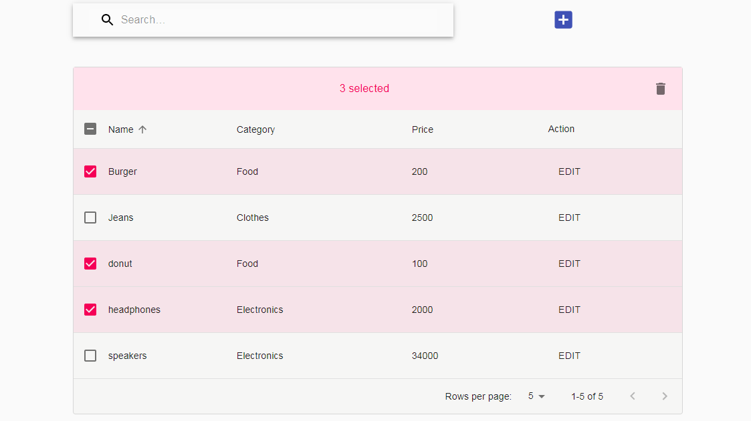
Sample learning projects were build to fortify technical concepts

Slide 7
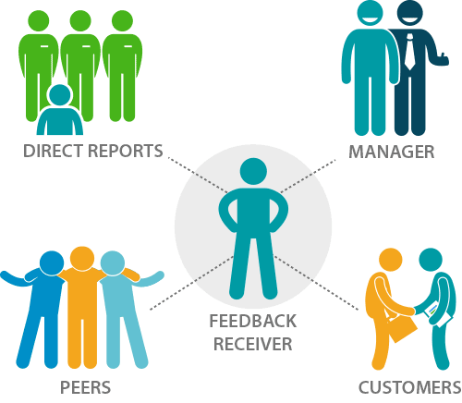
Generic Survey Platform (InsightPlus 2.0)
The objective is to create a generic survey platform where you can create a new survey, add questions to it, select participants & respondents and then send it out. The respondents fill these survey form which is then used to generate reports for each participant, while also providing views around response status from multiple perspectives.

Slide 8
Features Of This Project
Create new generic survey templates with 4 variety of question types
Empowers “Quarterly Employee 360 Feedback Survey" templates as well
Powerful filters to select participants and respondents with an option to upload from excel file as well
Selecting a template and launching the survey
Real time survey status views and reporting
Send reminders notification through email from the application itself
Add more participants and respondents, as well as extend due date of an ongoing survey
Generate survey reports
Filling out survey responses

Slide 9
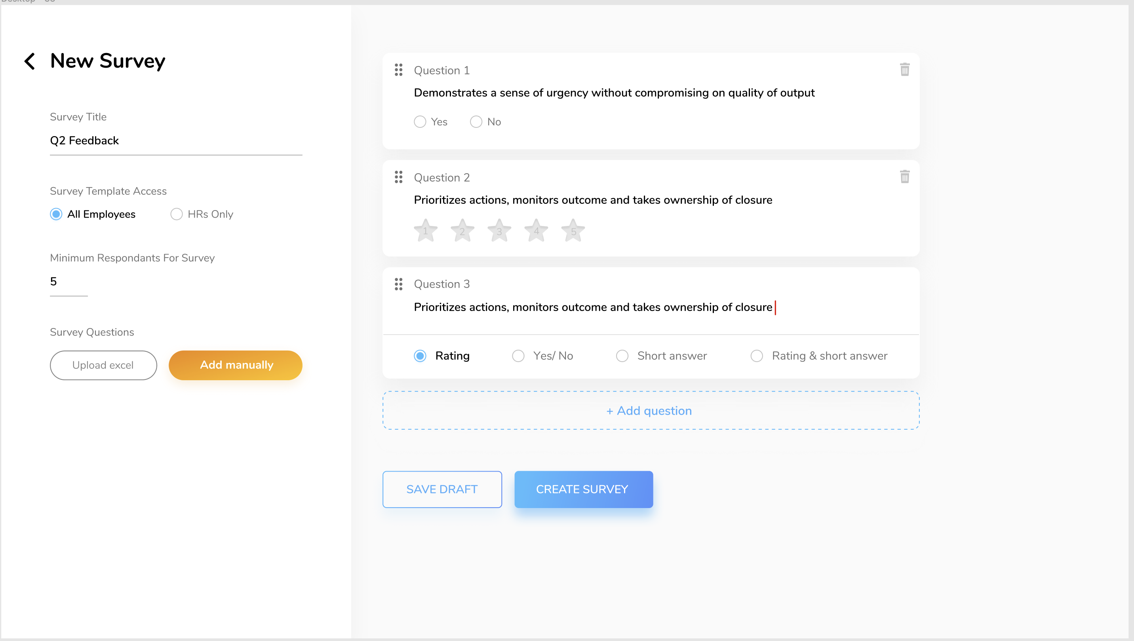
Create new survey template

Slide 10
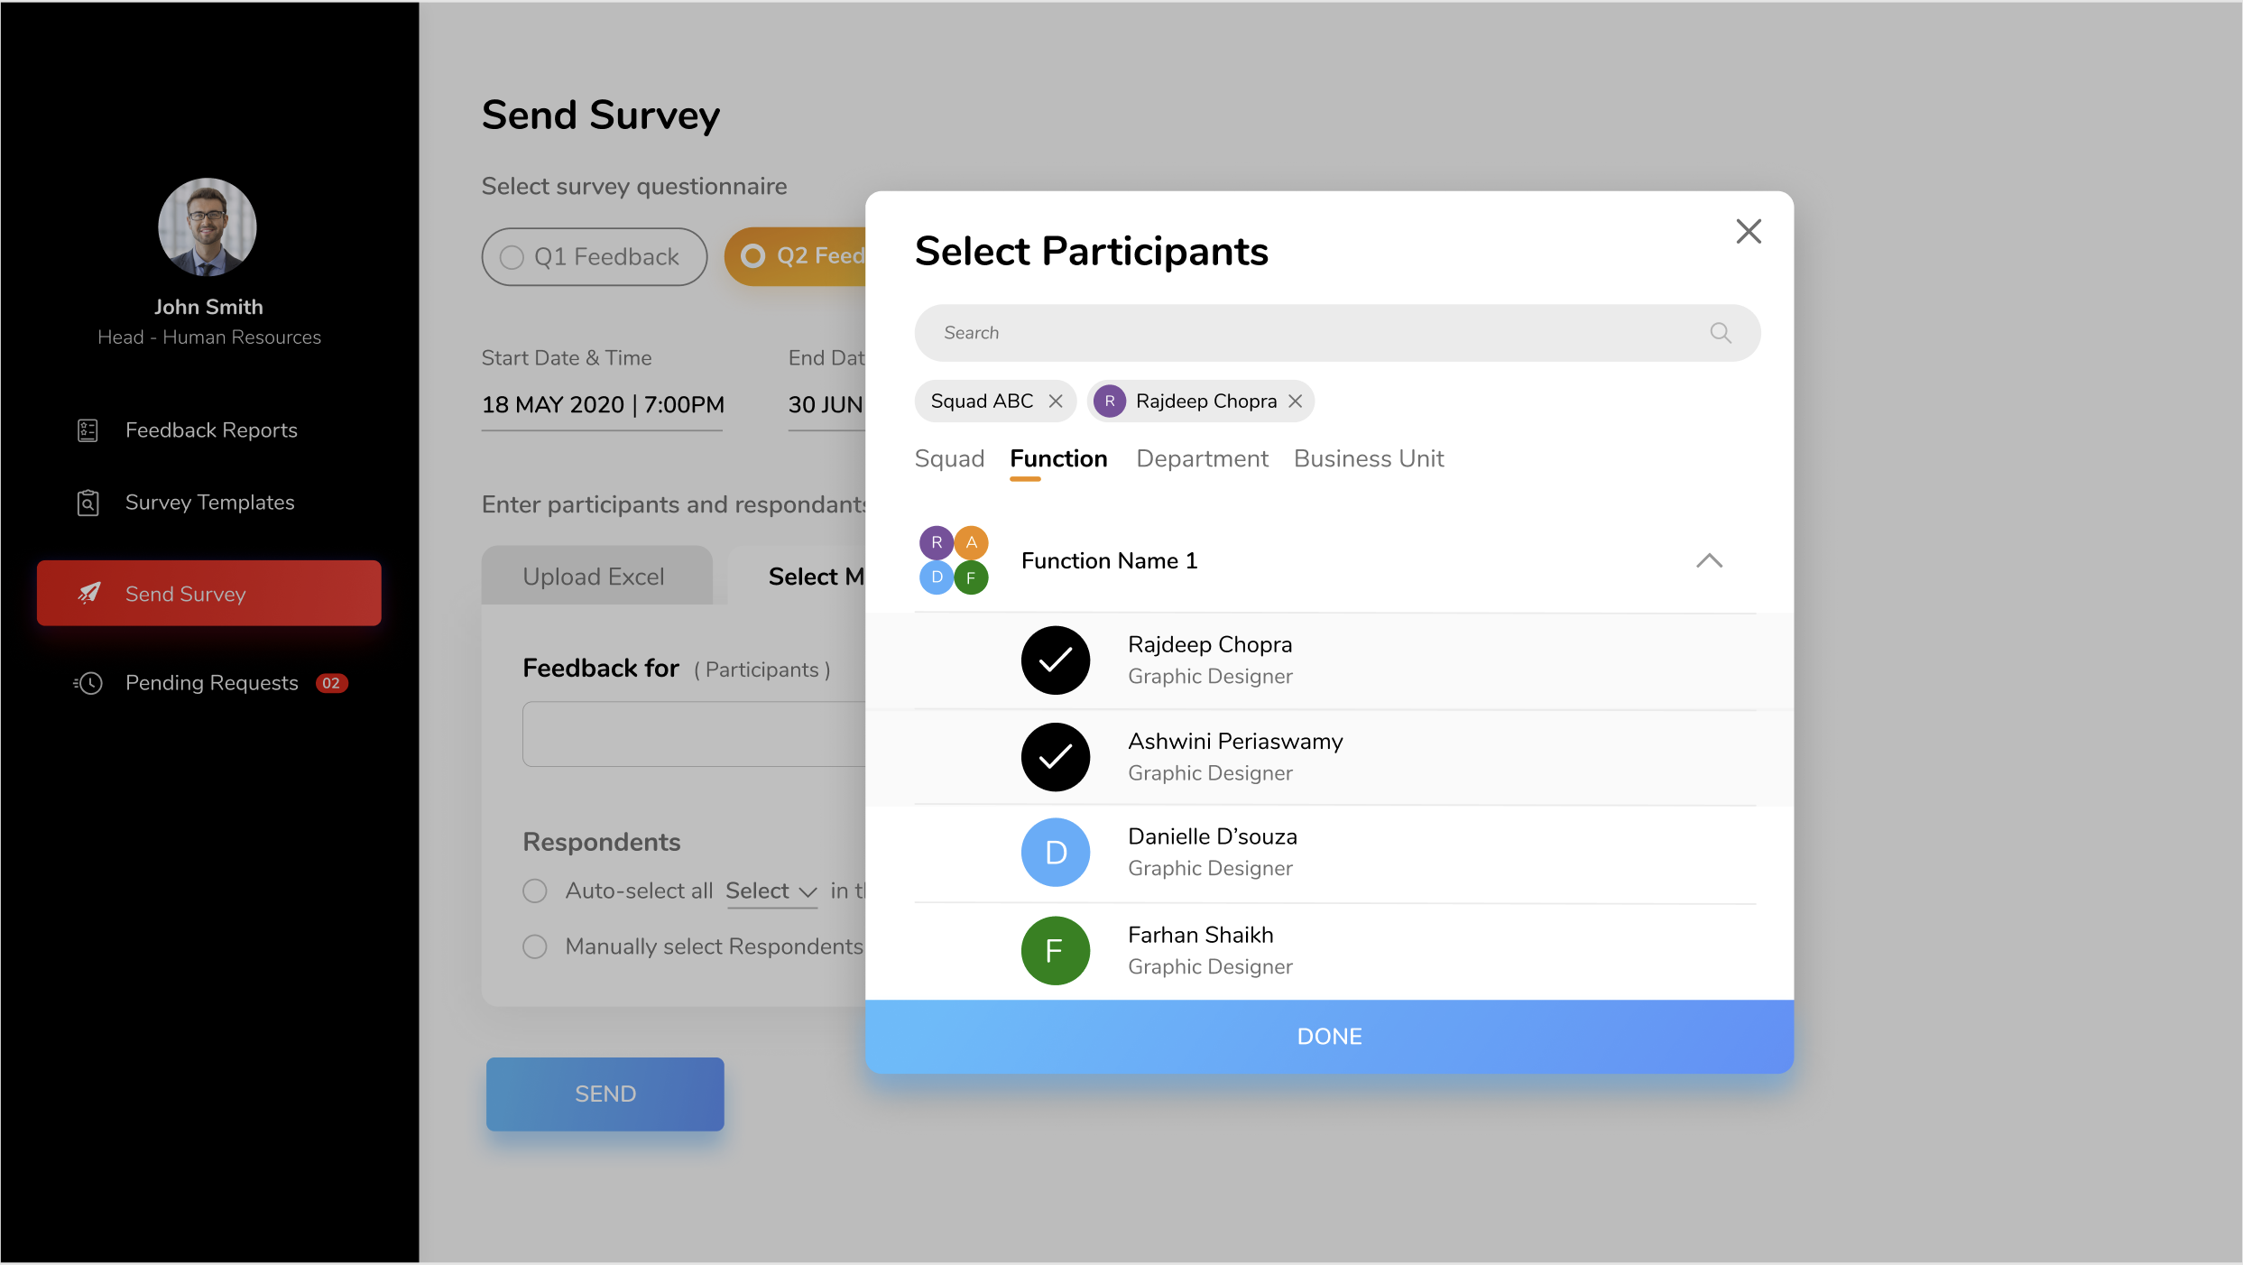
Sending survey

Slide 11
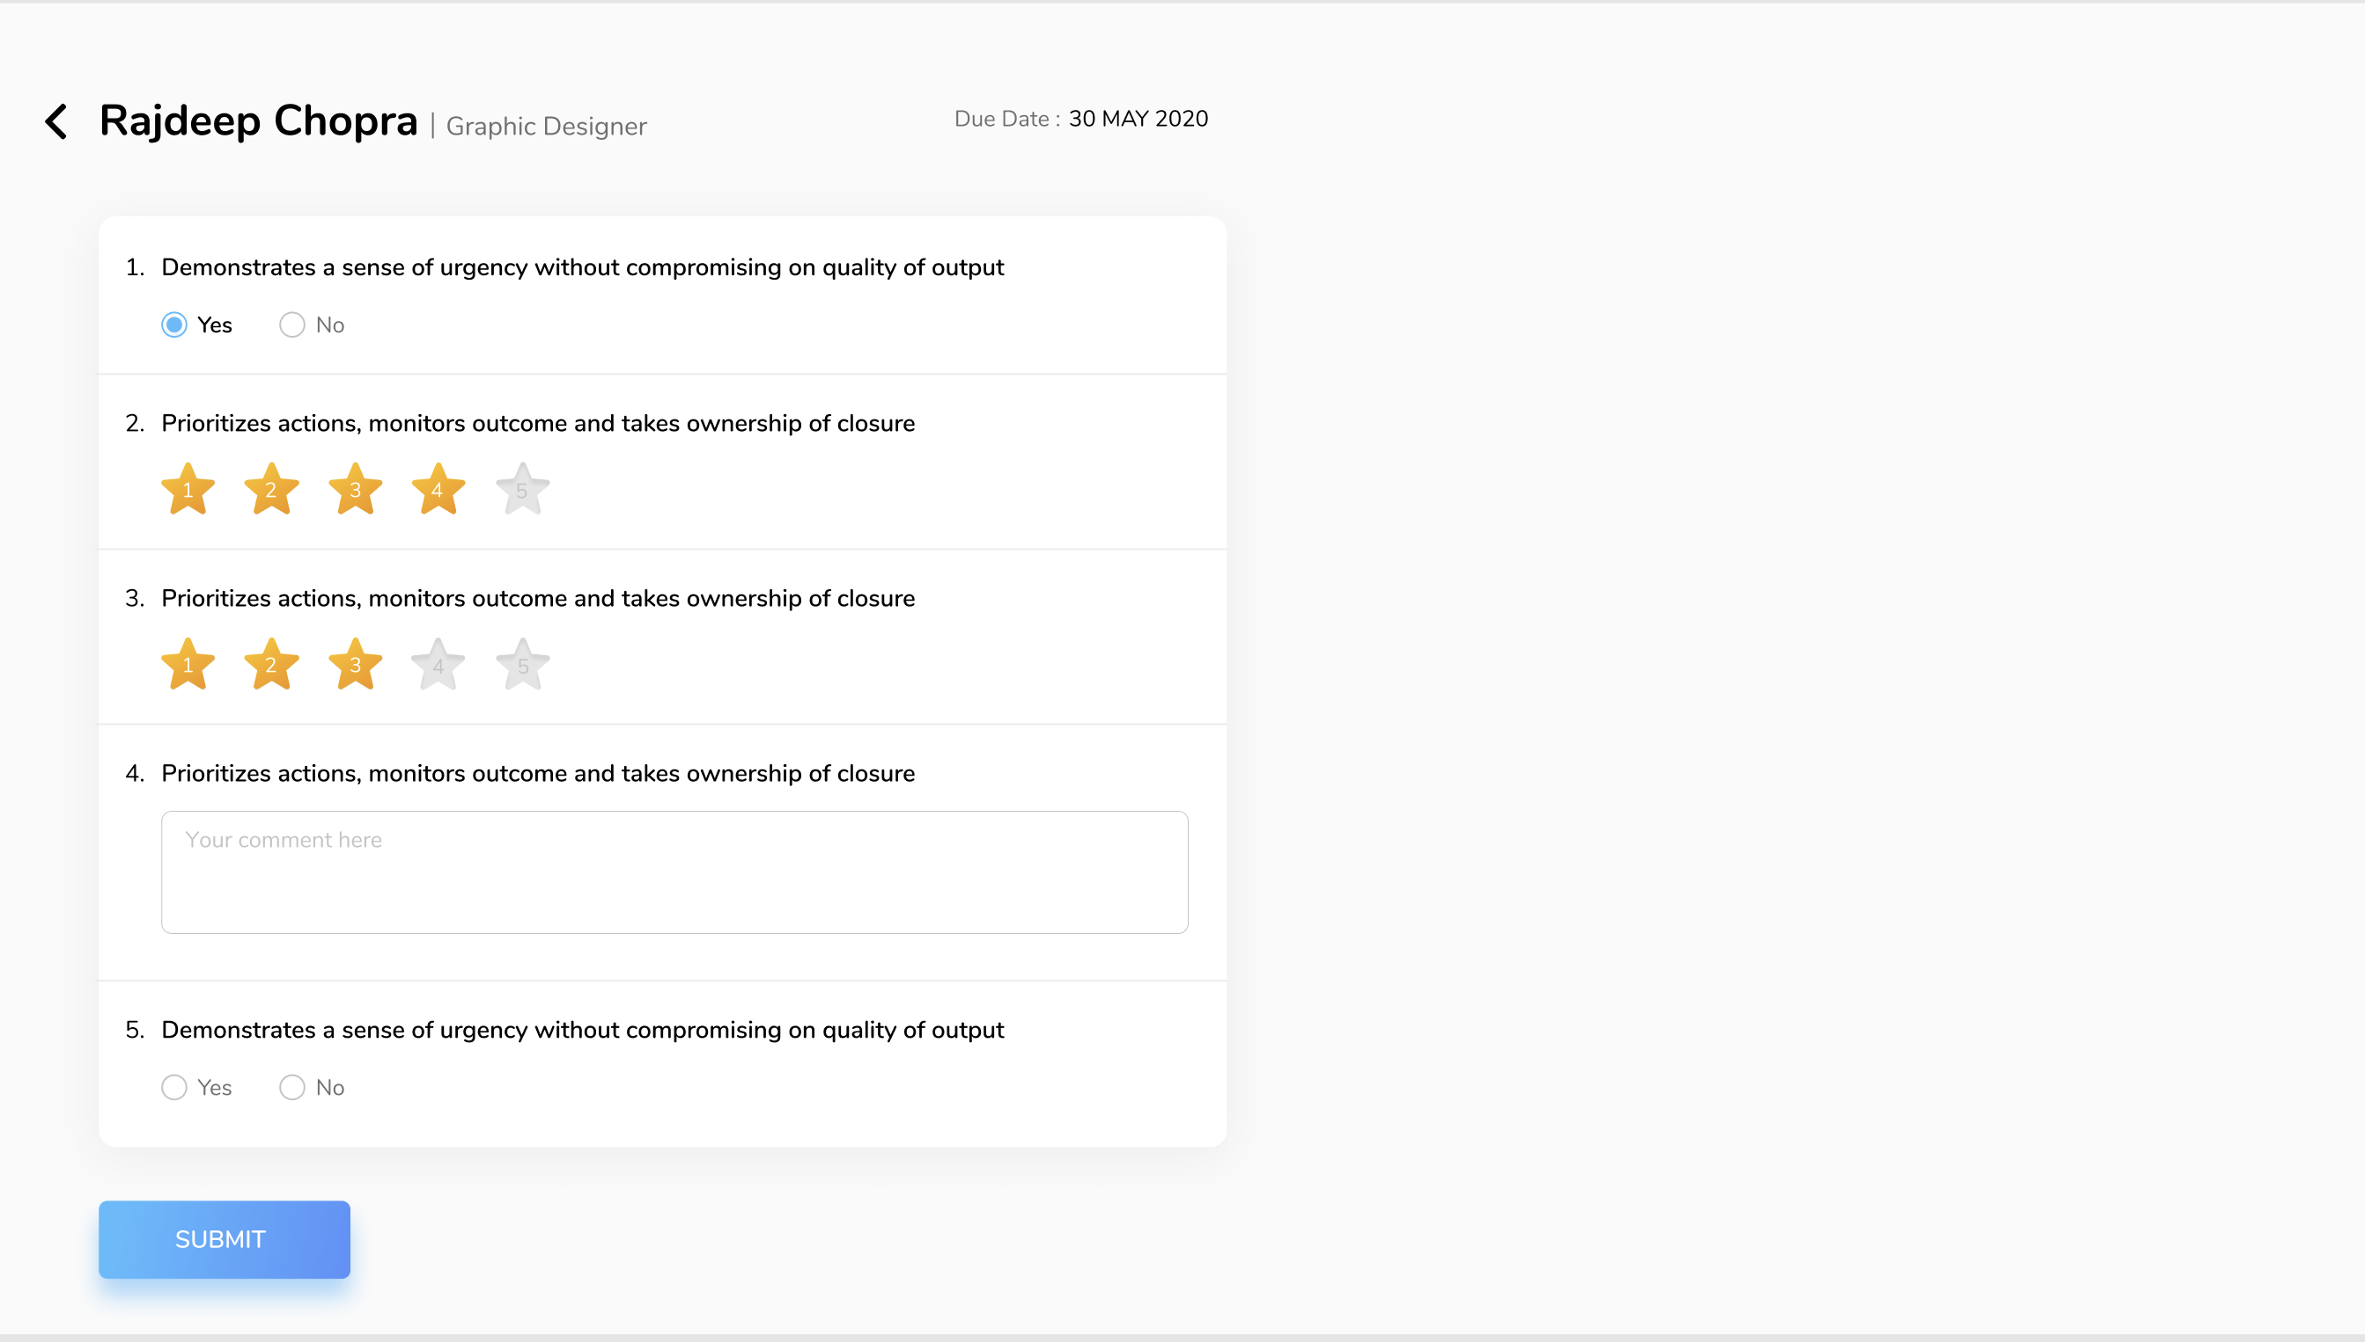
Responding to Survey/ feedback form

Slide 12
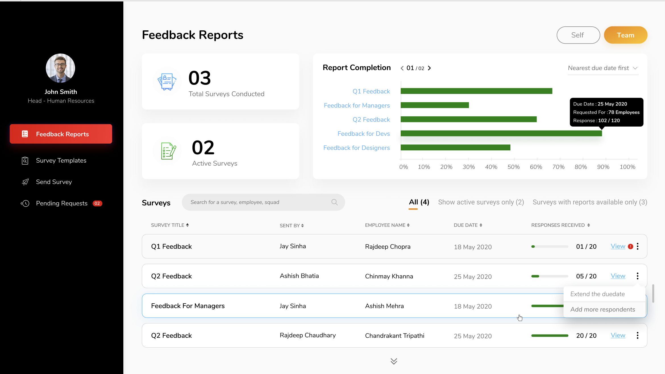
Survey reporting

Slide 13
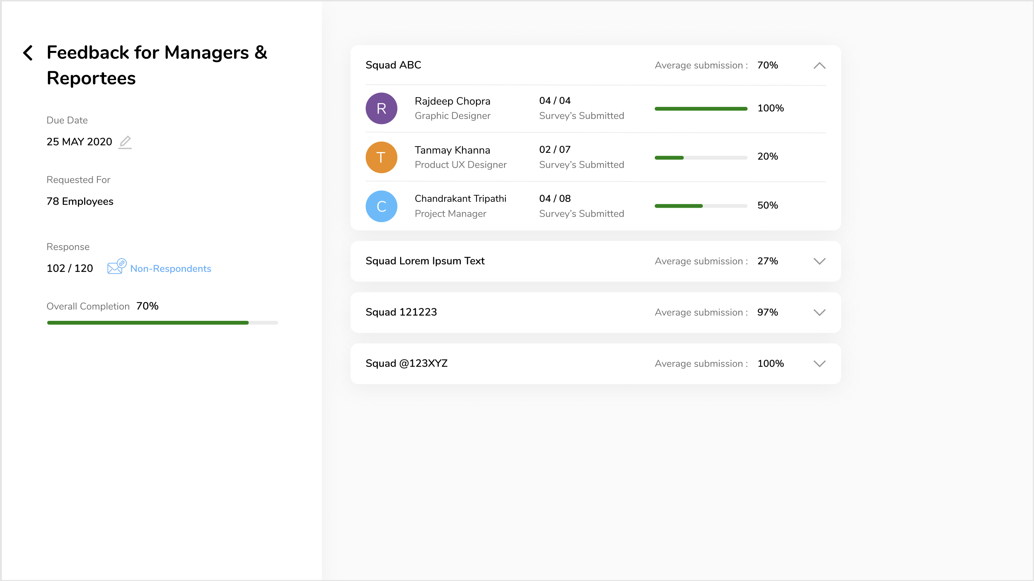
Survey status Views

Slide 14
Work done (API/ functionalities)
Send Survey with requestor-respondent-role mapping- Simple version - (manual select)
Send Survey with requestor-respondent-role mapping- excel version - (excel file upload)
Sending individual reminders to respondents through mail notifications
Sending consolidated lists email reminders to the non-respondents

Slide 15
Work in progress
Listing survey templates
Create Survey Template with Questions
Upload Questions : manually and through excel
Duplicate Survey Template with Questions
Show list of surveys pending response
Edit survey - extend expiry/ due date API
Edit survey - add more people

Slide 16
THANK YOU

