Slide 1

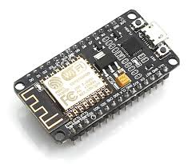

NodeMcu Server Client Application
Presented By : Naman Gupta

Slide 2
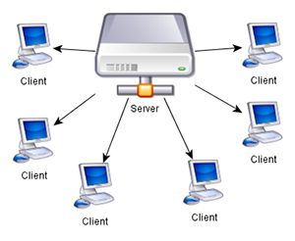
SerVER
A Server is a computer program or a machine that accept and process requests generated by another program or machine and respond to them.
client
A client is a piece of computer hardware or software that accesses a service made available by a server.

Slide 3
Client / Server Model
Client/server is a program relationship in which one program (the client) requests a service or resource from another program (the server).
The client/server model can be used by programs within a single computer, it is a more important concept for networking.
The client establishes a connection to the server over a local area network (LAN) or wide-area network (WAN), such as the Internet.
Once the server has fulfilled the client's request, the connection is terminated.
Your Web browser is a client program that has requested a service from a server; in fact, the service and resource the server provided is the delivery of this Web page.

Slide 4
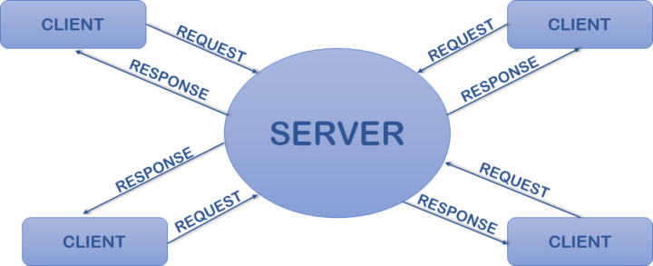
Connectivity

Slide 5
Connectivity with node-mcu
/ * This sketch demonstrates how to set up a simple HTTP-like server.
* The server will set a GPIO pin depending on the request
* http://server_ip/gpio/0 will set the GPIO2 low,
* http://server_ip/gpio/1 will set the GPIO2 high
* server_ip is the IP address of the ESP8266 module, will be
* printed to Serial when the module is connected.
*/
#include <ESP8266WiFi.h>
const char* ssid = "RobuByte";
const char* password = "esp@8265";
// Create an instance of the server
// specify the port to listen on as an argument
WiFiServer server(80);
void setup() {
Serial.begin(115200);
delay(10);
// prepare GPIO2
pinMode(D4, OUTPUT);
digitalWrite(D4, 0);
// Connect to WiFi network
Serial.println();
Serial.println();
Serial.print("Connecting to ");
Serial.println(ssid);
WiFi.begin(ssid, password);
while (WiFi.status() != WL_CONNECTED) {
delay(500);
Serial.print(".");
}
Serial.println("");
Serial.println("WiFi connected");
// Start the server
server.begin();
Serial.println("Server started");
// Print the IP address
Serial.println(WiFi.localIP());
}

Slide 6
Connectivity with node-mcu…
else {
Serial.println("invalid request");
client.stop();
return;
}
// Set GPIO2 according to the request
digitalWrite(D4, val);
client.flush();
// Prepare the response
String s = "HTTP/1.1 200 OK\r\nContent-Type: text/html\r\n\r\n<!DOCTYPE HTML>\r\n<html>\r\nGPIO is now ";
s += (val)?"high":"low";
s += "</html>\n";
// Send the response to the client
client.print(s);
delay(1);
Serial.println("Client disonnected");
// The client will actually be disconnected
// when the function returns and 'client' object is detroyed
}
void loop() {
// Check if a client has connected
WiFiClient client = server.available();
if (!client) {
return;
}
// Wait until the client sends some data
Serial.println("new client");
while(!client.available()){
delay(1);
}
// Read the first line of the request
String req = client.readStringUntil('\r');
Serial.println(req);
client.flush();
// Match the request
int val;
if (req.indexOf("/gpio/0") != -1)
val = 0;
else if (req.indexOf("/gpio/1") != -1)
val = 1;

Slide 7
Thank You

