Slide 1
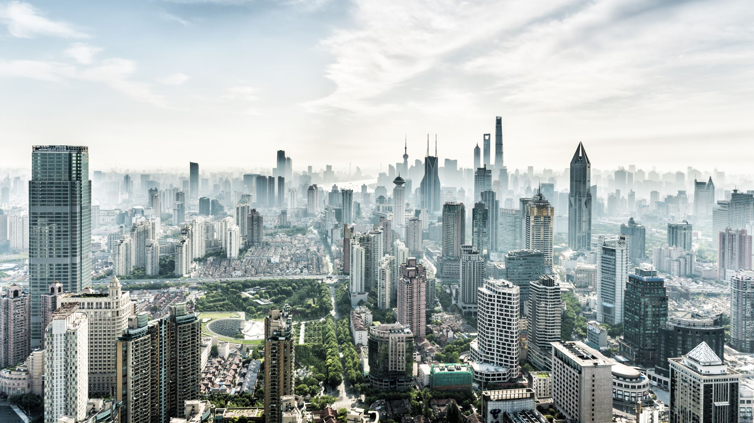
Light the heavy traffic using light
THEME: TRAFFIC MANAGEMENT
IDEA: Our aim is to help the commuters , traffic police to reduce the traffic by developing an adaptive traffic light . Our idea is to modify the traffic light’s timer according to the traffic intensity.

Slide 2
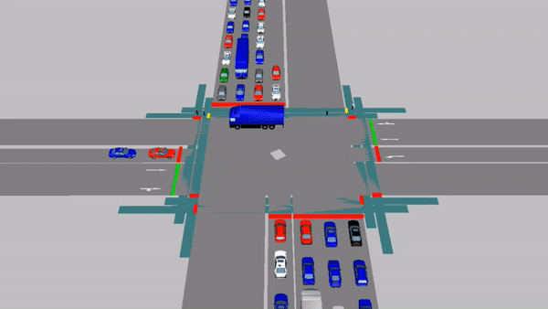

Slide 3
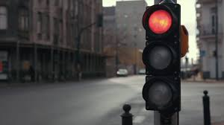
features
Traffic monitoring on single click
Reliability and accuracy
Feasible
Low cost

Slide 4
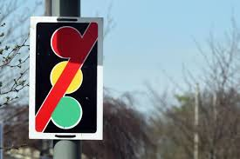
CONSTRAINTS
Environmental factors
Wi-Fi connectivity
Cyber security

Slide 5
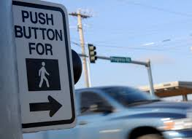
Future aspects
Identify the emergency vehicles
More secure database
Better sensors
Enhanced algorithm
Centralised traffic monitoring databas

Slide 6
Technology stack
TECH STACK
HARDWARE
NODE MCU
ULTRASONIC SENSOR
SOFTWARE
FLUTTER FRAMEWORK
ANDROID APPLICATION

Slide 7
USE CASE
Food management in grand weddings
Polling booths
School safety
Multiplex

