Slide 1
Team : Go Karuna Karuna Go
Team Members:
Naman Shankhydhar
Neeraj Maurya
Ayush Paharia
Akshit Awasthi

Slide 2
About
This web application is made using front-end technologies like –
HTML
CSS
Bootstrap
Vanilla JS
Certain Libraries of JavaScript like ChartJS and BotUI Framework

Slide 3
Motive
We made this app as many people would be unaware about Corona virus pandemic and its symptoms. So our app tells you about it , its symptoms. It shows you real-time statistics and charts of number of increasing cases and active cases and most importantly it predicts whether there is a chance of you being corona positive using a chatbot. You just need to select the option provided by the chatbot and it will tell you about the result.

Slide 4
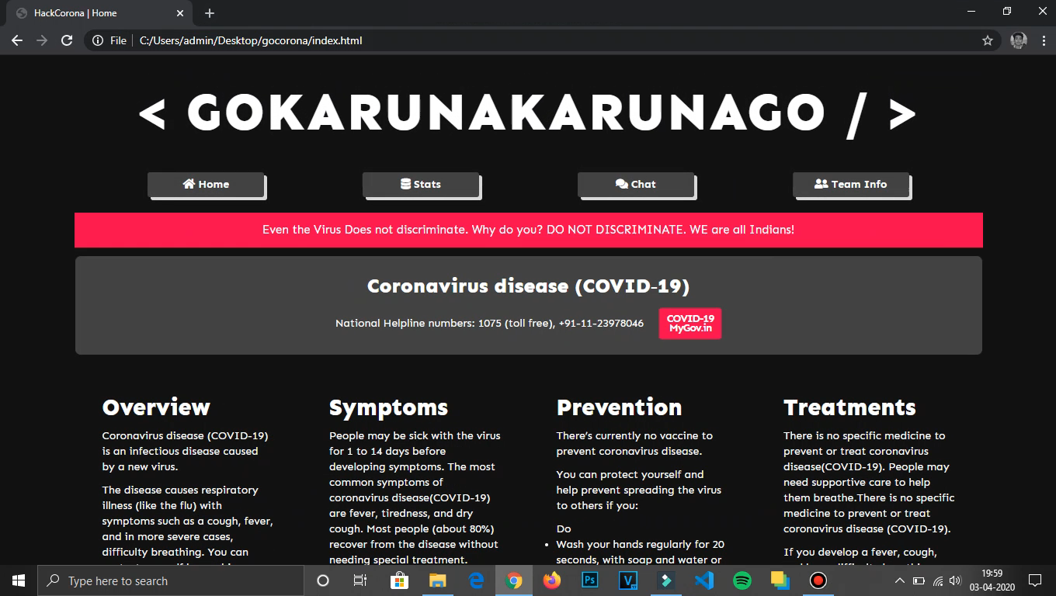
Our Website
Our website have user friendly interface and very easy navigation to flow through.
Our Goal is to spread awareness about the
deadly virus COVID-19 and how to prevent it through our website

Slide 5
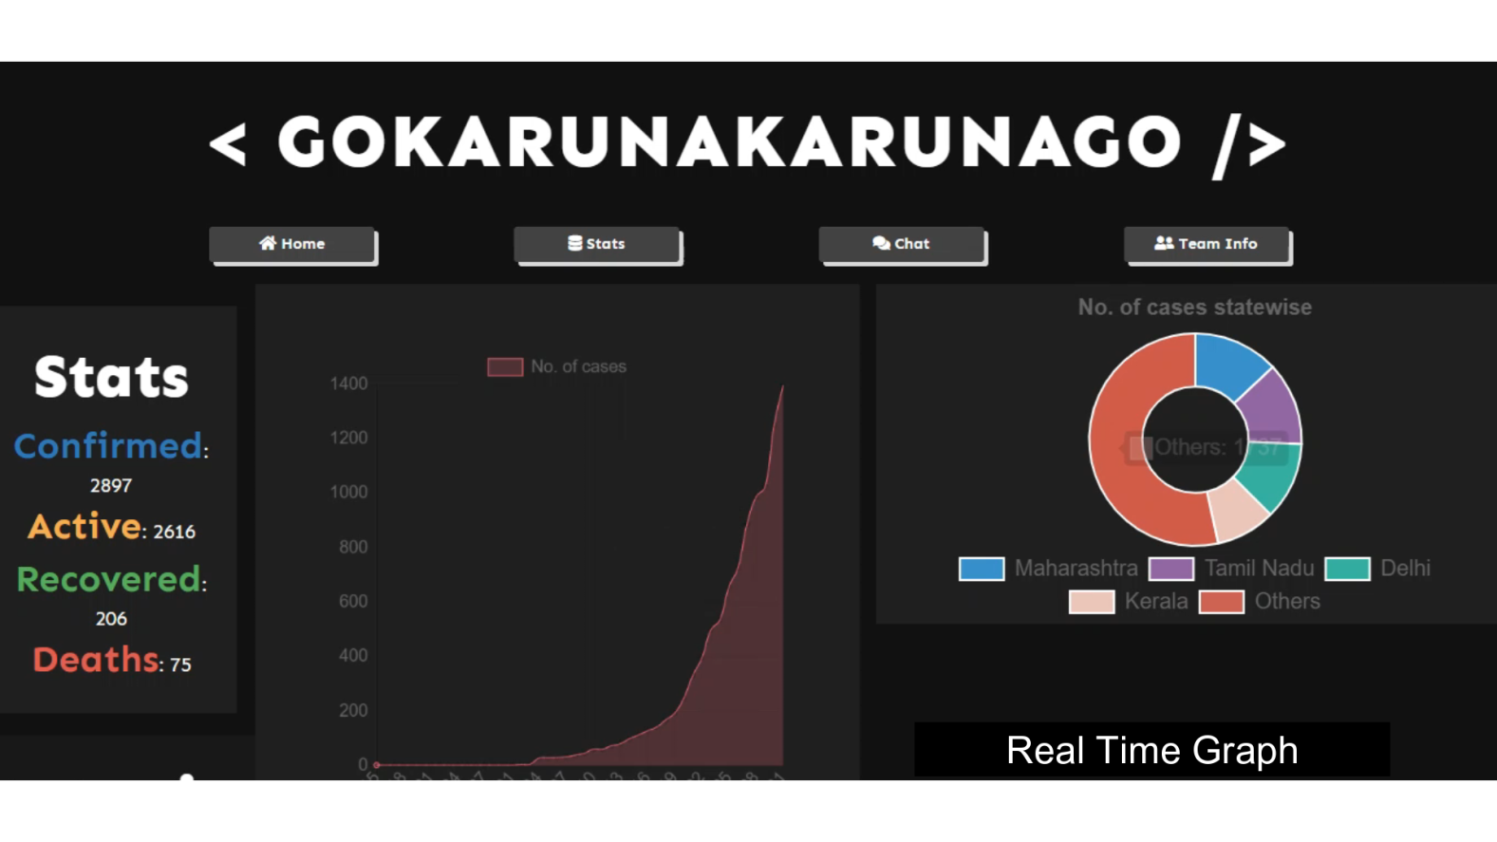
Real Time Data and Stats
We have a real-time graph and stats section which show
the number of infected and recovered persons in India.

Slide 6
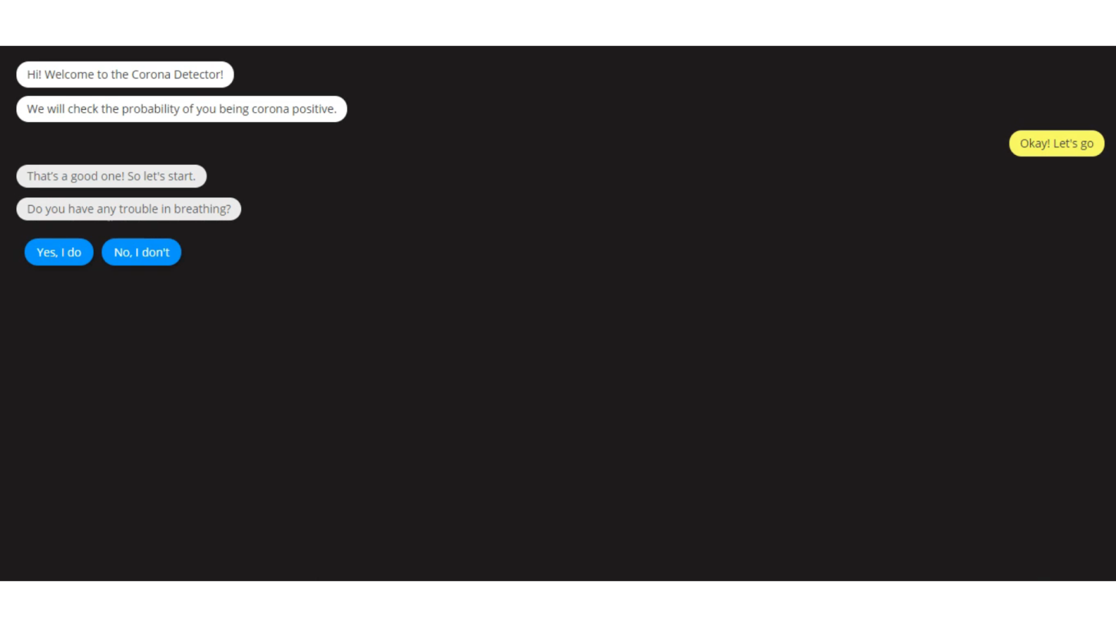
ChatBOT
We have a ChatBOT to detects the chances of you being
corona positive.

Slide 7
Usage
1). Clone the repo using "git clone https://github.com/naman360/hackcorona.git".
2). Open "index.html" to view the application.

