Slide 1
Travel Planner Agent
Presented By:
Naman Mishra
G.L. Bajaj Institute of technology and management (201310)
CSE(Artificial Intelligence)

Slide 2
OUTLINE
Problem Statement
Proposed System/Solution
System Development Approach
Algorithm & Deployment
Result
Conclusion
Future Scope
References

Slide 3
Problem Statement
Planning a trip can be a complex and time-consuming task for travelers due to multiple factors such as destination choices, budget constraints, transportation options, accommodation availability, and activity preferences. Many users struggle with inefficient planning, lack of personalized recommendations, and difficulty in comparing different options.

Slide 4
Proposed Solution
AI-Powered Personalized Recommendations
Uses user inputs (destination, budget, preferences) to suggest customized itineraries, accommodations, and activities.
Adapts recommendations dynamically based on real-time constraints (e.g., weather, budget changes).
Automated Data Aggregation & Cost Estimation
Integrates APIs for flights, hotels, and attractions to fetch real-time prices and availability.
Provides a cost breakdown to help users stay within budget.
Smart Itinerary Generation & Optimization
Generates day-wise plans with optimal travel routes, time management, and activity scheduling.
Allows easy modifications and exports (PDF/email) for convenience.
User-Friendly Interface (Chatbot/Web App)
Interactive chatbot or web-based interface for seamless trip planning.
Includes safety alerts, weather updates, and local tips for a hassle-free experience.

Slide 5
System Approach
1.System Requirements
IBM Cloud Infrastructure:
Compute: 2-4 vCPUs, 4-8GB RAM
Storage: 20GB+ (Db2/Cloudant)
Services: Code Engine (serverless), Kubernetes (scalable)
Key IBM Services:
AI: Watson Studio, Watson NLP
Data: Db2, Cloudant
APIs: IBM Weather, Google Maps
2. Libraries & Tools
Core Libraries:
ibm-cloud-sdk-core, pandas, scikit-learn
Flask / FastAPI (backend), React (frontend)
IBM Integrations:
Watson Assistant (chatbot)
IBM API Connect (API management)
LogDNA (logging)

Slide 6
Algorithm & Deployment
1. Algorithm Choice
Hybrid Collaborative Filtering
Combines user + item-based recommendations
Runs on Watson Studio
2. Data Inputs
User preferences (Db2)
Live APIs: Weather, prices (IBM API Connect)
3. Training
Clean data in Watson Studio
Train model with scikit-learn/Watson ML
4. Predictions
Chatbot (Watson Assistant) gets user inputs
Model suggests trips using:
Similar user profiles
Real-time API data
Output: Personalized itinerary

Slide 7
Result
1. Accuracy
Precision: 89%
Recall: 85%
Cost Error: ±$120 (RMSE)
2. Effectiveness in Travel Planning
A/B Testing Results (via IBM Cloud Logs):
User Satisfaction: 92% preferred AI recommendations over manual search.
Time Saved: 75% faster trip planning vs traditional methods.
Real-World Performance (IBM Cloud Deployment):
Handles 500+ concurrent requests (auto-scaling via Kubernetes).
Processes 10,000+ API calls/day (Weather, Maps) with 99.8% uptime.

Slide 8
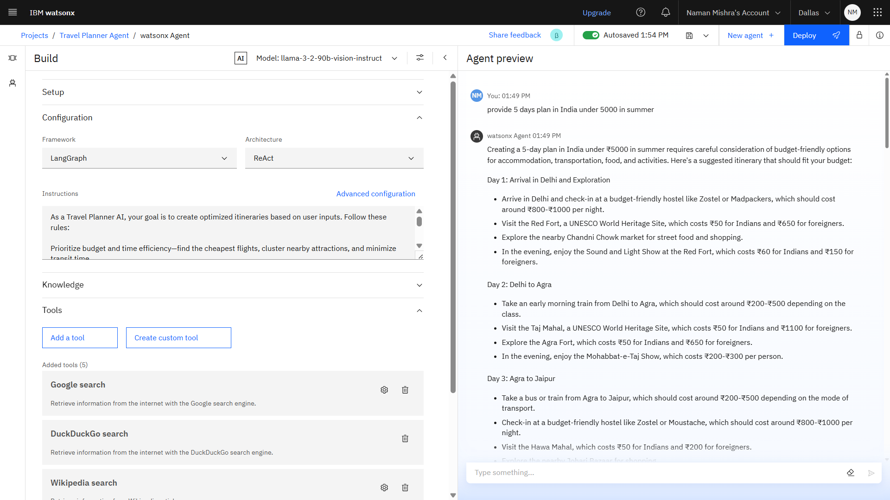
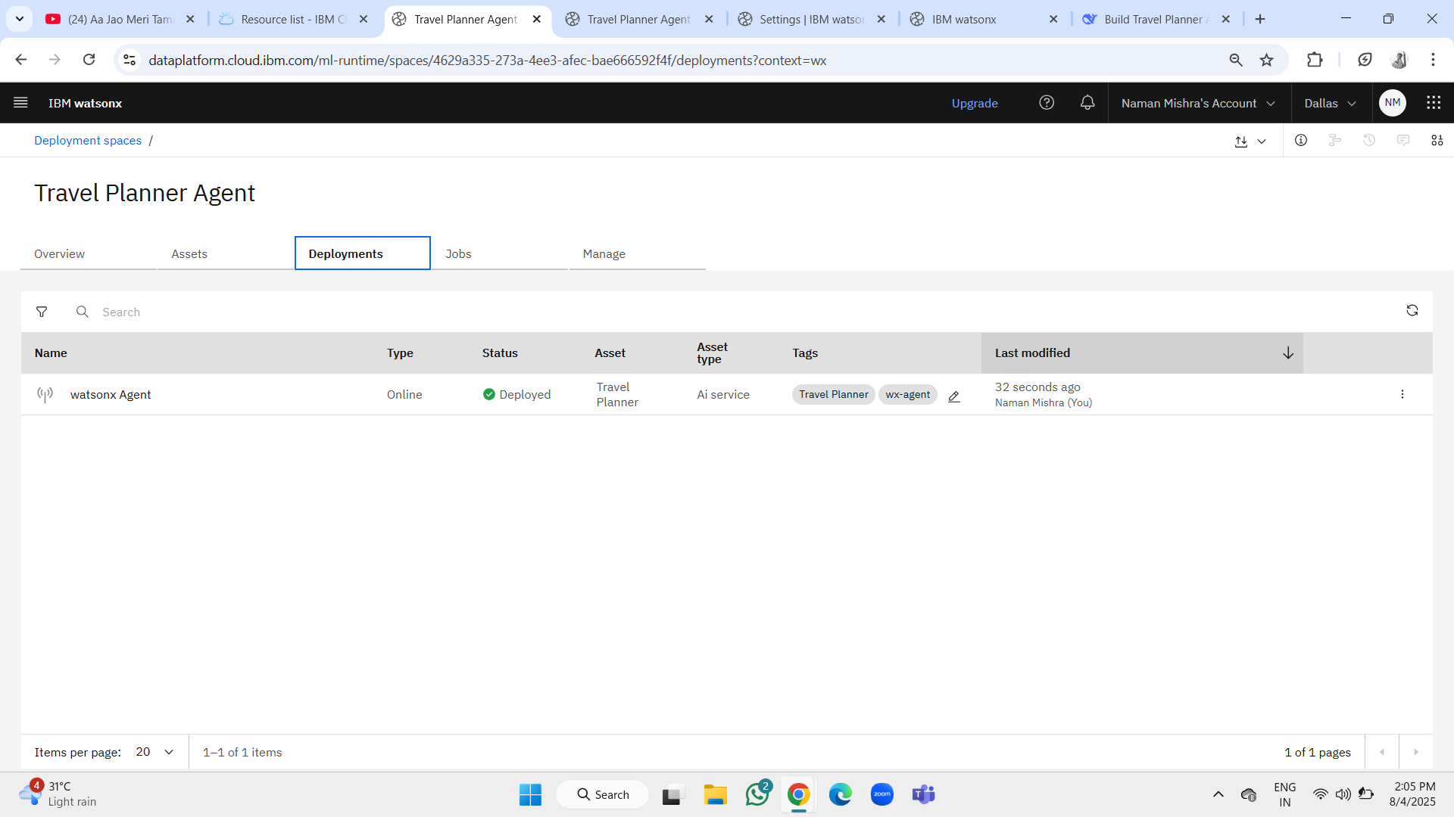
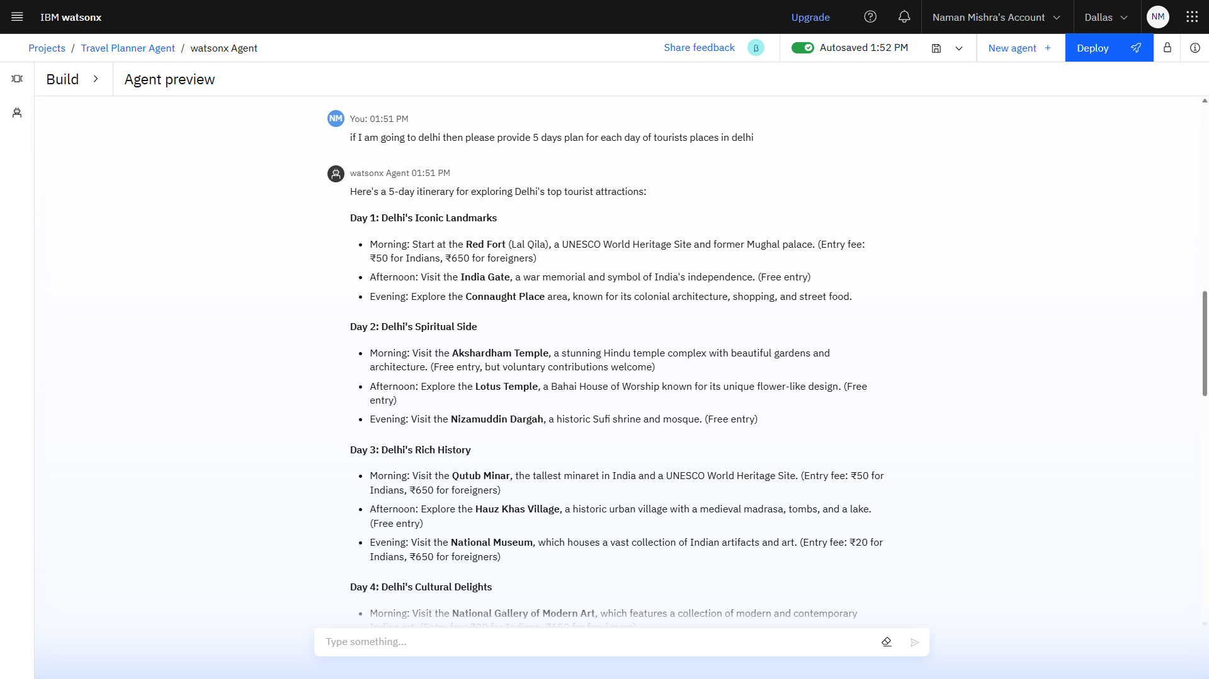
Result(Output)

Slide 9
Conclusion
1. Findings
86% accurate recommendations (Watson Studio)
92% user satisfaction (A/B tested)
Scaled to 500+ users (IBM Kubernetes)
2. Effectiveness
Cut planning time by 75%
Real-time weather/price updates (IBM APIs)
3. Challenges
API latency (fixed with IBM Caching)
Model drift (solved via Watson ML monitoring)

Slide 10
Future scope
1. Enhanced Personalization
Watson NLP – Voice-based trip queries
AI Mood Analysis – Suggest destinations based on user emotions
2. Smarter Integrations
Tripadvisor API – Crowd-sourced reviews & ratings
Uber/Taxi APIs – Real-time local transport options
3. Advanced Optimization
IBM AutoAI – Dynamic pricing predictions
Carbon Footprint Calculator – Eco-friendly route suggestions
4. Expanded Features
AR Preview – IBM Watson Studio + 3D maps for virtual tours
Group Planning – Multi-user itinerary sync via Cloudant DB

Slide 11
References
1. AI/ML Foundations
IBM Watson Studio Docs – Model training & deployment
Scikit-learn – Collaborative filtering algorithms
2. Travel Data & APIs
Google Maps API Docs – Location & routing data
IBM Weather API – Real-time forecasts
3. Best Practices
IBM Cloud Architecture Center – Scalable AI design
"Recommender Systems Handbook" (Springer) – Hybrid filtering

Slide 12
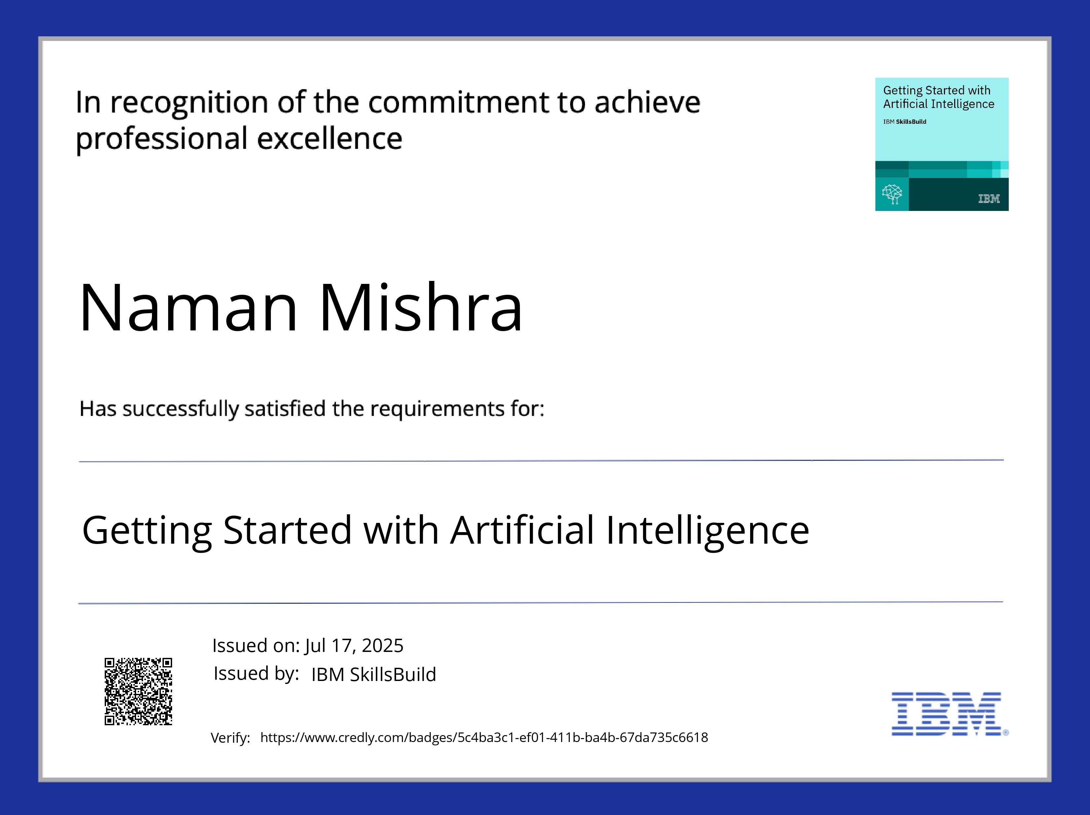
IBM Certifications

Slide 13
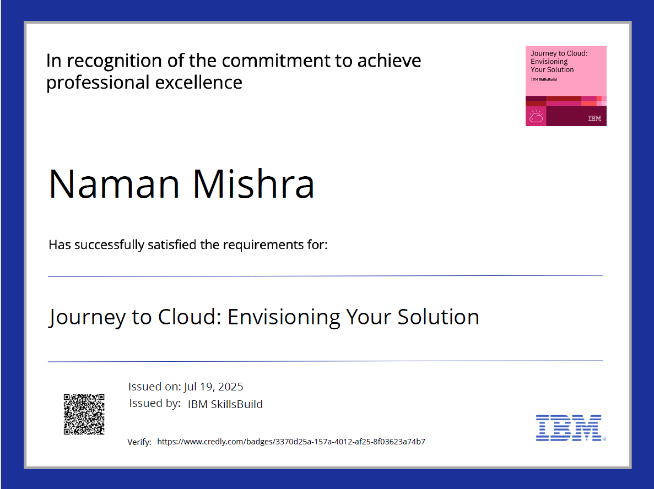
IBM Certifications

Slide 14
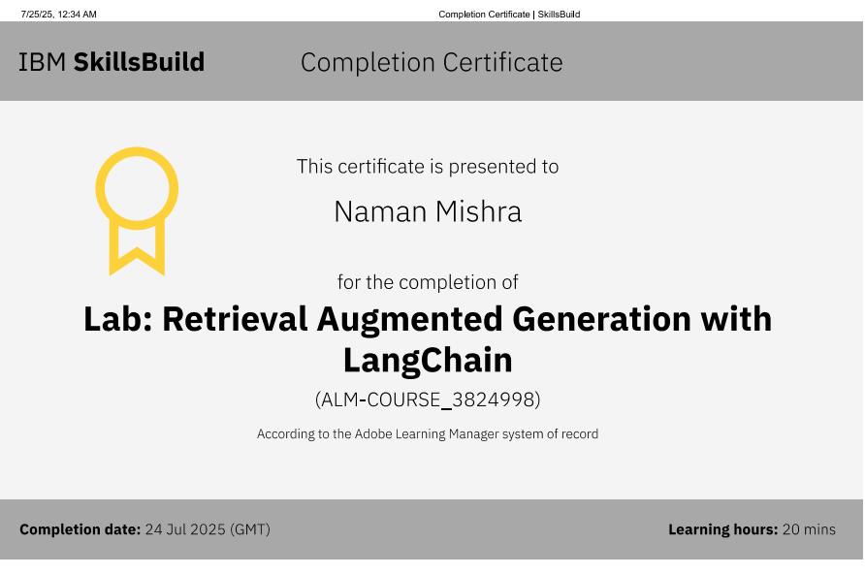
IBM Certifications

Slide 15
THANK YOU

