Slide 1

AIR PIANO ANAMATIK
Naman Sharma (W1598814)

Slide 2
PROBLEM STATEMENT
Start a new era of keyless pianos that play musical notes upon hovering over a sensor
Enable recording a new melody and learning a new song through the Web/Mobile App by triggering a series of LEDs
PURPOSE
Combining learning with entertainment
New way to learn the basics of music and musical notes
Cost efficient and easy to repair device made with affordable hardware
User friendly device meant to be enjoyed by all age groups!

Slide 3
FEATURES
Hover over the sensors to play the seven notes on C scale
Three modes available: Play, Record and Learn
Play/Record: Play the notes at your leisure or choose to store the melody played
Learn: Select a song/melody and follow the notes shown on the screen
Accessible using the Web and Mobile Apps

Slide 4
DEVELOPMENT

Slide 5
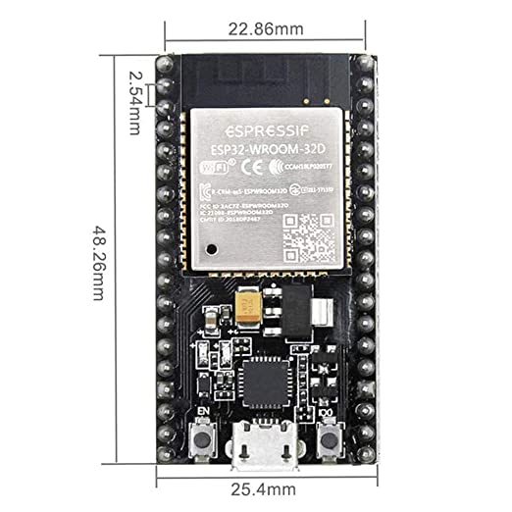
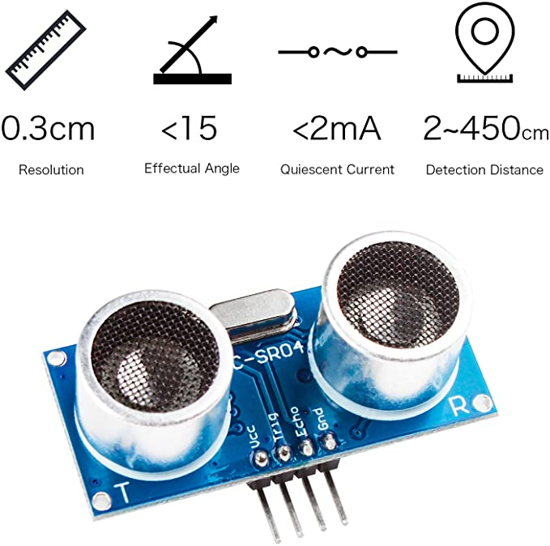
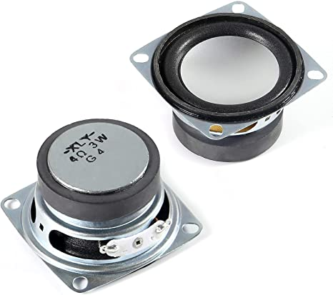
HARDWARE INVENTORY
HiLetgo ESP32 Development Board 2.4GHz Dual-Mode WiFi + Bluetooth Dual Cores Microcontroller Processor Integrated with Antenna RF AMP Filter AP STA for Arduino IDE
Smraza Ultrasonic Module HC-SR04 Distance Sensor for Arduino
ALMOCN 2PCS 2" 4Ohm 3W Small Full Range Audio Speaker Stereo Woofer Loudspeaker for Arduino

Slide 6
TECHNOLOGY STACK
Arduino IDE for ESP32
Web and Mobile Front End
HTML/CSS
JavaScript
Bootstrap
jQuery
AJAX
Backend
PHP
Cloud Service for hosting
AWS
Database
MySQL

Slide 7
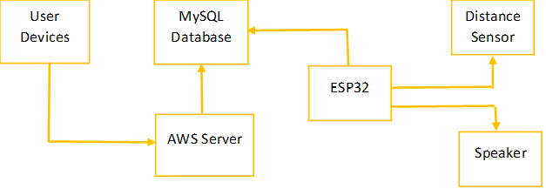
ARCHITECTURE

Slide 8
CONCLUSION AND FUTURE DIRECTIONS
Successfully completed initial goals
Trigger LEDs for assistance in Learn mode
Allow user to play the audio of the recorded songs
WebSocket to sync with other players
Compact design
Toy for babies and toddlers to enhance motor skills and hand-eye coordination

Slide 9
THANK YOU ANAMATIK
Naman Sharma (W1598814)

