Slide 1
USING NATURe INSPIRED ALGORITHM
TEST CASEs OPTIMISATION

Slide 2

IMPORTANT ?
What is TESting & why is it SO

Slide 3
WHY IS TESTING SO IMPORTANT ?
Testing should be introduce in the early stage of the SDLC, The cost of fixing the bug is larger if testing is not done in early stage & bugs found in later stages.
In the today’s competitive market only the quality product stays longtime firmly, so to make sure they produce the good quality products, the testing of application is key factor in SDLC.
As it not possible makes it software application is defect free but testing will be necessary.
Most important thing of testing is the development environment is different than the Testing environment and the testing done on testing environment is similar to the Production environment.

Slide 4
WE ARE AIMING TO REDUCE THIS PERCENTAGE WITH OPTIMISED TEST CASES !!
TIME

Slide 5
WHAT are TEST CASEs ?
testing & TEST CASE(s) optimisation
Usually are the set of conditions under which a tester will determine whether the application, software system or one of its features is working as it was originally intended.
WHAT is TEST CASE optimisation ?
Usually implies ordering execution time such that
Rate of Fault Detection is increased
Amount of time to perform regression is reduced as well as elimination of unnecessary test cases.
Use of test cases that have maximum path coverage.

Slide 6
NATURE INSPIRED ALGORITHMs
HOW CAN TEST CASES BE OPTIMISED ?
Algorithms imitating processes in nature/inspired from nature – Nature Inspired Algorithms
Nature provide some of the efficient ways to solve problems.

Slide 7
WHY NATURE INSPIRED ALGORITHM ?
TEST CASE OPTIMISATION USING NATURE INSPIRED ALGORITHM
Convergence Speed
Computational Complexity
Accuracy (near the optimal solution)
Stability.

Slide 8
OPTIMISATION
NATURE INSPIRED ALGORITHM
An act, process, or methodology of making something (as a design, system, or decision) as fully perfect, functional, or effective as possible
NATURE AS AN OPTIMISER
BIRDS: Minimize drag.
HUMPBACK WHALE: Maximise manoeuvrability.
BOXFISH: Minimise drag and maximise rigidity of exoskeleton.

Slide 9
NATURE INSPIRED ALGORITHM
EVOLUTIONARY ALGORITHMS
SWARM OPTIMISATION
Bacteriologic Algorithm
PARTICAL SWARM OPTIMISATION
DIFFERENTIAL EVOLUTION
ANT COLONY OPTIMISATION
.
.
.
.
.
.
.
OUR FOCUS
.

Slide 10
EVOLUTIONARY ALGORITHM
NATURE INSPIRED ALGORITHM

Slide 11
ON WHAT TERMINOLOGIES IT IS BASED ON ?
EVOLUTIONARY ALGORITHM
INDIVIDUAL :- CARRIER OF THE GENETIC INFORMATION , IT IS CHARACTERISED BY ITS STATE IN SEARCH SPACE, ITS FITNESS.
POPULATION :- POOL OF INDIVIDUAL WHICH ALLOWS THE APPLICATION OF GENETIC OPERATORS.
FITNESS FUNCTION :- THE OBJECTIVE FUNCTION.
GENERATION :- AN ITERATION STEP.

Slide 12

MAJOR STEPS INVOLVED
EVOLUTIONARY ALGORITHM
SELECTION
Mutation
Crossover
INITIALISATION
MUTATION
RECOMBINATION
SELECTION

Slide 13
DIFFERENTIAL EVOLUTION
EVOLUTIONARY ALGORITHM

Slide 14
ALGORITHM (BASIC STEPS)
Initialise
Termination condition
YES
Result
NO
Divide population into groups
Select mutation operator for each population
General Feature Selection
Mutation
Crossover
Selection

Slide 15
Bacteriologic Algorithm

Slide 16
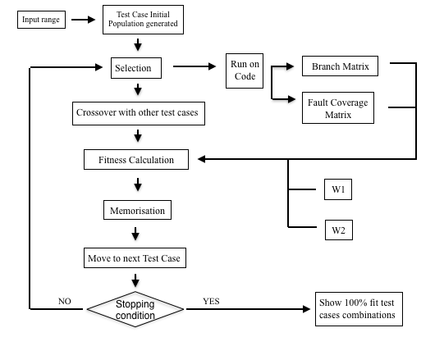

Slide 17
SOME basic concepts we are following
what we are doing in the project !
Branch Coverage - It is a testing method, in which the intention is to assure that every one of the possible branch from every decision point is executed at least once and because of that it assures that all reachable code is executed.
Fault Detection- Its a method for discovering a failure in software. Faults usually occur when we are handling variables and doing some move or arithmetic operations on them .It helps to see how well a test suite is as if a test suite covers all areas where a fault can occur then chances are we could catch the problem while testing.

Slide 18
SOME basic concepts we are following
FITNESS FUNCTION :-
FIT = W1*BC + W2*FDA
GENERAL FEATURE SELECTION :- It is a defined technique to select the important or useful subsets out of the various subsets present.
The method we used here had N test cases and we made a P x N matrix .
Each index of the matrix was given a random value between 0 to 1 .
When traversing only those columns were given 1 which had the value greater than the respective row value the conditions here are:-
No two same columns can be 1 again in different rows.
Exactly two columns are to be made one.

Slide 19
GENERAL FEATURE SELECTION EXAMPLE
0.3195145613401611 | 0.9816107371507137 | 0.07842108918201818 | 0.5796994138629581 | 0.0124664778098552
0.7564077516575008 | 0.4441955113580993 | 0.589594899723035 | 0.7263080415531624 | 0.14128961010870367
0.6526835466581318 | 0.32826832661517513 | 0.02377581625746561 | 0.9329759939407378 | 0.3188718295881934
0.3510491056741064 | 0.5069054487671629 | 0.9315185036615858 | 0.4432007828906608 | 0.6629542824086172
0.2948543062795658 | 0.025590355906243034 | 0.39623920425822257 | 0.9636871798390512 | 0.6327449950891065
0 | 1 | 0 | 1 | 0
1 | 0 | 1 | 0 | 0
1 | 0 | 0 | 1 | 0
0 | 1 | 1 | 0 | 0
0 | 0 | 0 | 1 | 1

Slide 20
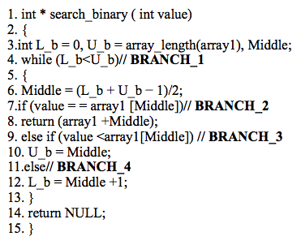
WHAT WE Are doing in the project !
Binary Search Program

Slide 21
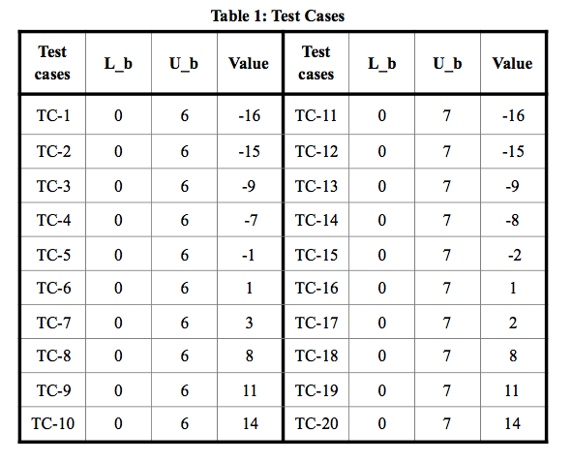
TEST CASES WE HAVE TAKEN MANUally

Slide 22
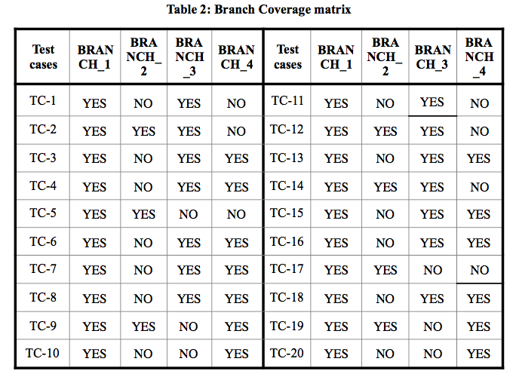
BRANCH COVERAGE MATRIX

Slide 23
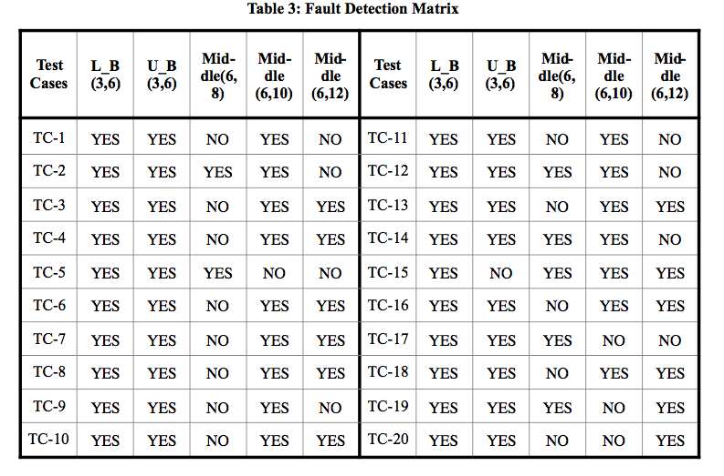
FAULT coverage matrix

Slide 24
Differential evolution algorithm vs bacteriologic algorithm
Take 4 test cases 1 being the parent others being the child.
Now form a mutant vector with formula
where F=0.5
New Mutated vector = | 0 | 6 | 3 |
Since we have 3 chromosomes we need to generate 3 random numbers between 0 & 1 let say the numbers generated are :-
0.4,0.8,0.5 we compare them with a random number CR let say 0.7 if random number greater than CR take the chromosome from parent else from child. New child test case :-
Fitness value of new child test case is
FIT=((0.5 * 3/4)+ (0.5*4/5)) *100= 77.5%
Take any two test cases and form a test suite. Lets say for example these two are selected
Now find the branch coverage and fault coverage of this test suite from already computed tables.
Branch coverage
BC=(3/4)*100 = 75%
FAULT DETECTION
FC =(4/5)*100 = 80%
FITNESS VALUE (FIT)
= ((0.5 * 75) + (0.5*80))*100 = 77.5
TC-5 | 0 | 6 | -1
TC-8 | 0 | 6 | 8
TC-13 | 0 | 7 | -9
TC-16 | 0 | 7 | 1
TC-5 | 0 | 6 | -1
TC-9 | 0 | 6 | 11
(TC-8)+F*((TC-13)-(TC-16))
TC-5 | YES | YES | NO | NO
TC-9 | YES | YES | NO | YES
TC-5 | YES | YES | YES | NO | NO
TC-9 | YES | YES | NO | YES | NO
Child test case | 0 | 6 | 3

Slide 25
Differential evolution algorithm vs bacteriologic algorithm
Now compare the fitness value of parent test case and child test case . If child’s test case FIT value is greater than that of parent replace the parent test case with child test case.
Parent Fitness Value :- ((0.5*2/4) + (0.5*3/5))*100 = 55%
Therefore
Repeat this procedure with different test cases and form test suites and take those test suits that are optimal.
New test case | 0 | 6 | 3

Slide 26
RESULTS WITH DIFFERENT PROGRAMS
result

Slide 27
TIME COMPARISON (IN SECONDS)
Programs | Differential Evolution | Bacteriologic Algorithm
Leap Year | 0.09099 | 0.11807
Maximum of three | 0.07788 | 0.07906
Minimum of two | 0.07181 | 0.12891
Point Circle | 0.11112 | 0.096137
Remainder | 0.05966 | 0.11210
Quadretic Eqn. | 0.04116 | 0.08010
Even Odd | 0.04732 | 0.05836
Marks | 0.07820 | 0.08265
Triangle clas. | 0.08925 | 0.10104

Slide 28
result
both algorithm’s have performed well in test case prioritisation and optimisation but in the examples taken by us differential was superior in terms of time complexity.
FINAL RESULT

