Slide 1
Mosaicing Demo

Slide 2
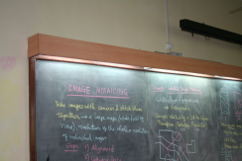
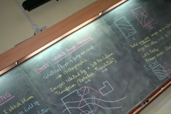
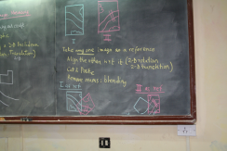
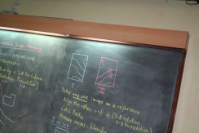
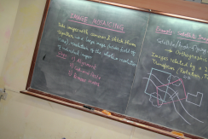
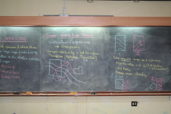
THE PROBLEM
Stitching 6 distorted images of a Blackboard into one complete image of Blackboard

Slide 3
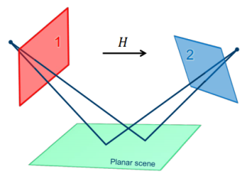
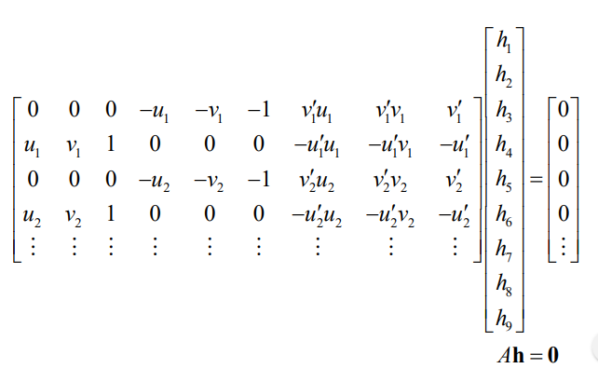
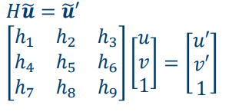
THEORY

Slide 4
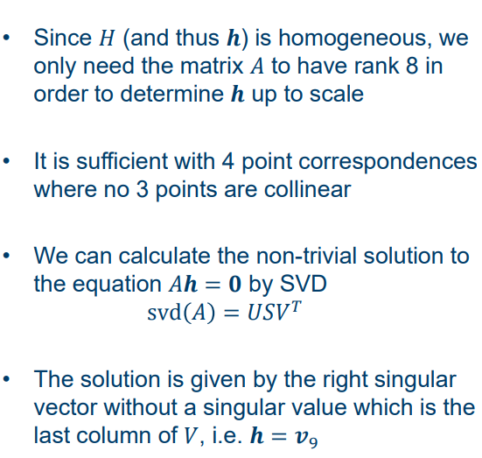

Slide 5
Image on Left is taken as base Image i.e. the base plane
Image on Right is the Image to be projected on the base Image

Slide 6
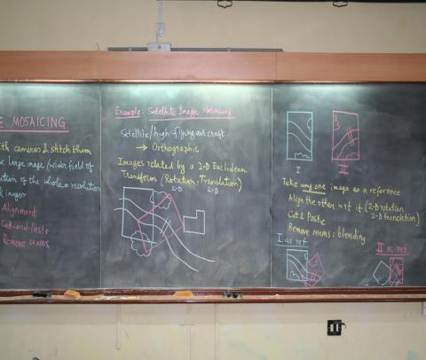

Base Image(m4)
Distorted Image(m1)

Slide 7
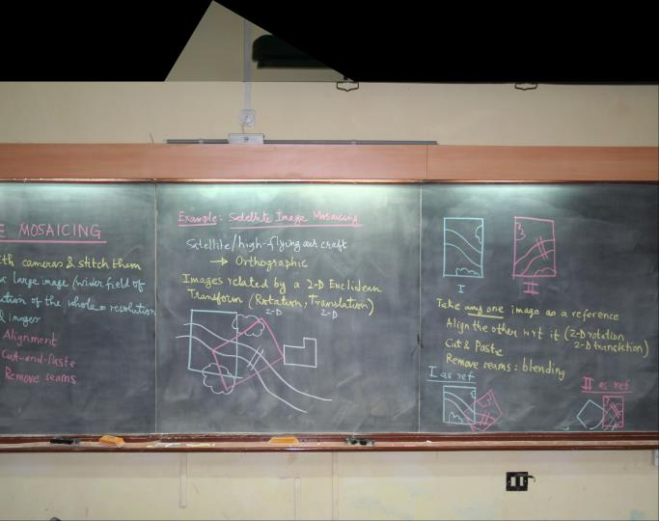
First
Result

Slide 8
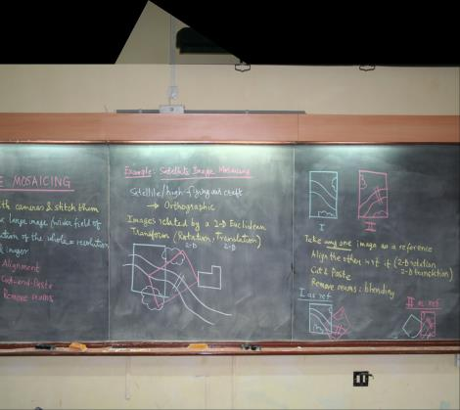

First Result
Distorted Image(m2)

Slide 9
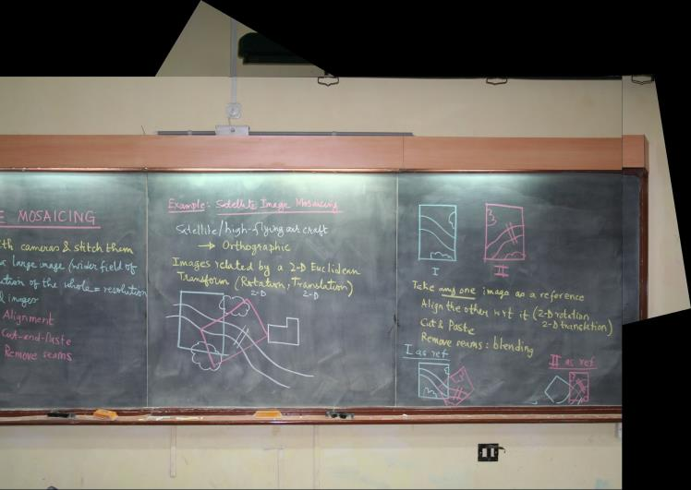
Second
Result

Slide 10


Second Result
Distorted Image(m3)

Slide 11
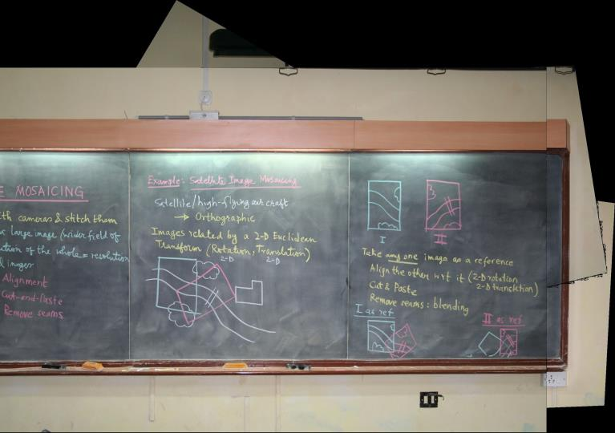
Third
Result

Slide 12

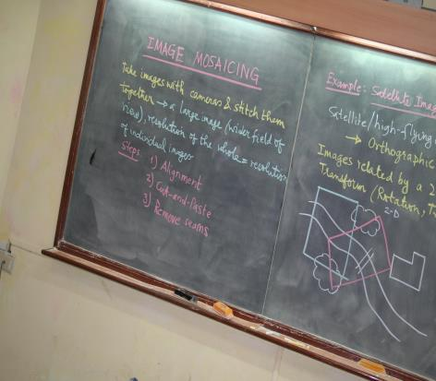
Third Result
Distorted Image(m5)

Slide 13
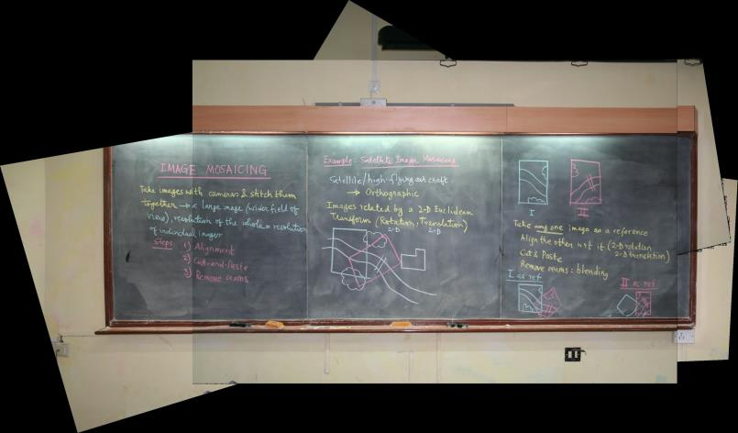
Fourth
Result

Slide 14
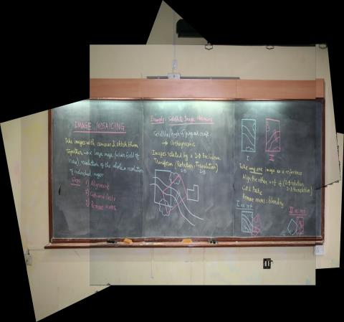

Fourth Result
Distorted Image(m0)

Slide 15
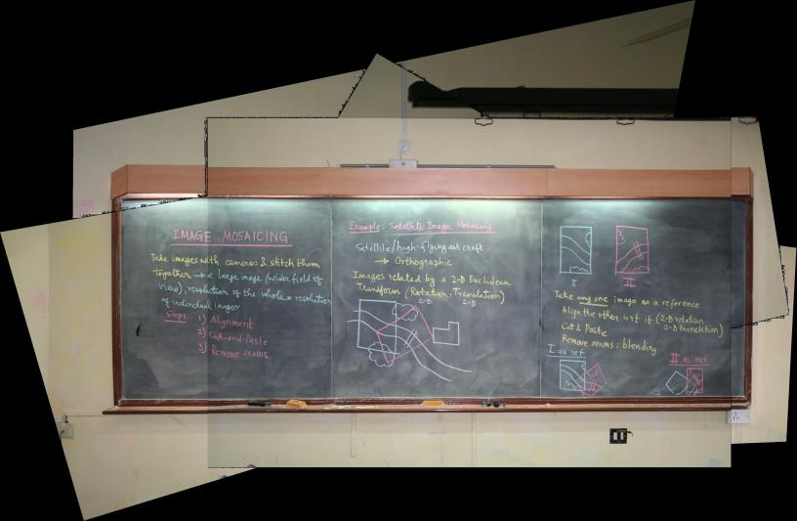
Final
Result

