Slide 1

ASSIGNMENT GUIDELINES
Make the changes in the PPT as you solve the parts
This file contains the template for all the parts of the project.
Check the instructions added in the note section of every slide for clarity.
Don’t move around any image or text box
If you require more/lesser elements, be careful when you copy/delete the existing ones.

Slide 2
ASSIGNMENT Name: Naman Agarwal
Problem Statement The sales pipeline conversion percentage at TechnoServe (a tech SaaS startup) has dropped from 35% at the end of last fiscal (FY 2017-18) to 25% at present.
Assignment Objective
Understand the problem, come up with a hypothesis for low conversions faced by TechnoServe, and analyse the dataset provided to arrive at possible solutions to increase it.
Notes:
Problem Statement

Slide 3
PART I : 1. Understanding the Problem Sales Pipeline Conversion at a SaaS Startup
Who?
TechnoServe, a SaaS based company located in Pune.
What?
The pipeline conversion rate dropped from 35% to 25%.
When?
During the last fiscal year, i.e. 2017-2018.
Where?
Among the clients of the SaaS Pipeline.
How?
Sales and customer related issues
.
Technology related issues.

Slide 4
PART I : 2. Understanding the Problem Sales Pipeline Conversion at a SaaS Startup
Situation
What sales methods you’re currently using?
What is your product like?
What is the strength of your sales team?
Which social channels are you using for sales?
What is the current technology you are using?
Problem
Is your sale team’s strength sufficient?
Are your social channels optimal?
Is your current technology meets the customer demands?
Is your product delivery on time?
Implication
How will change in the current product offering impact the company?
Will upscaling sales team going to impact the company?
How will increasing marketing cost going to impact the company?
Have customers provided negative feedbacks after receiving the products?
Need-Payoff
Would adding new sales person to the team would be valuable?
Would investing in new product and technology be useful?
Will higher conversion rate achieve by upscaling sales team?
Will conversion rate improve by optimizing sales channels?
Notes:
Provide at least three questions under each branch.

Slide 5
PART II : Formulating Hypotheses Sales Pipeline Conversion at a SaaS Startup
Framework Used
The Framework used is the BANT Framework.
Reason for using the selected framework
As the Business problem that the TechnoServe is facing, revolves around the sales they are making so BANT is a good option as it mainly deals with identifying good leads from the customer pool. BANT stands for:
Budget, Authority, Need, Timeframe.
The framework helps you measure the quality of sales prospects and analyze their likelihood of converting into successful customers.
How you have used the framework here
After interviewing with several personnel, and with different departments such as product management, sales and marketing and a few of the customers to decide the possible reason or identify the possible causes behind the drop in the pipe conversions. BANT framework is used to find the several hypothesis that helps in finding the possible causes behind the drop and other factors, that might be responsible directly or indirectly.
Notes:
All the frameworks that are used should be mentioned.
A suitable reason is a must to provide here

Slide 6
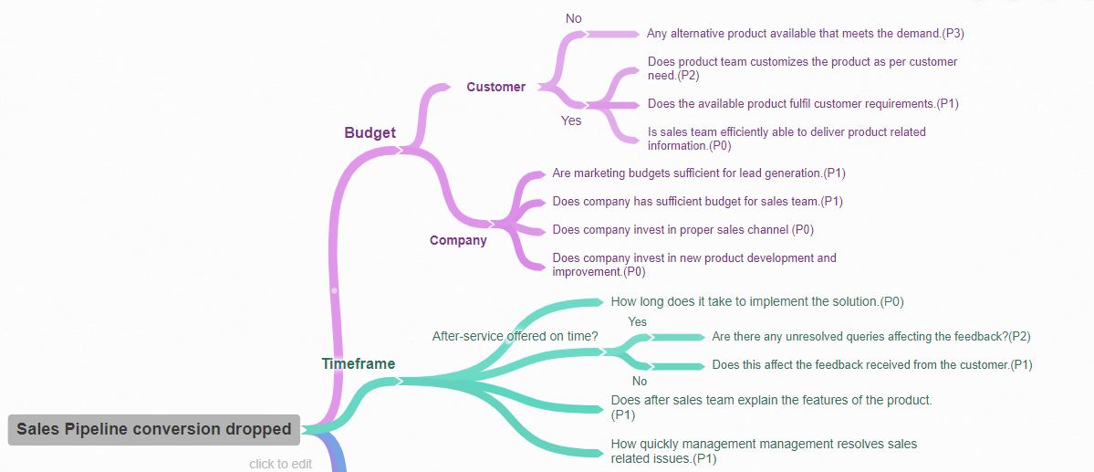
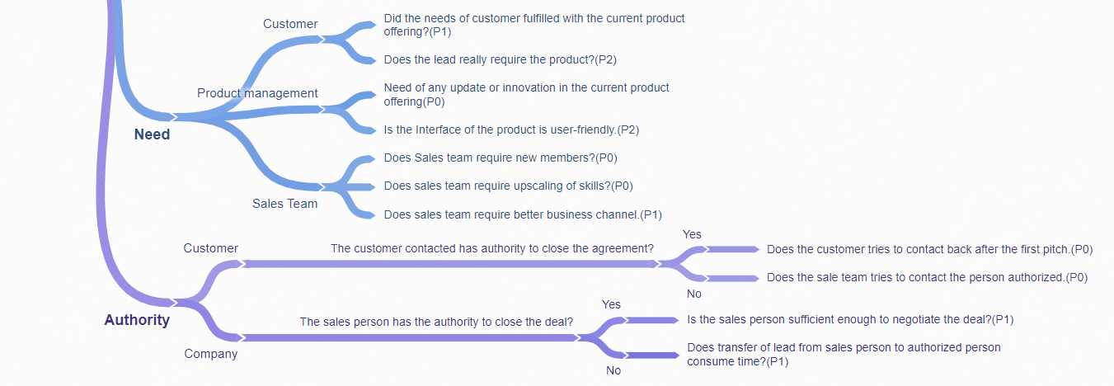
PART II : Formulating Hypotheses Sales Pipeline Conversion at a SaaS Startup
Notes:
Use the “download as” feature of Coggle if you are using the tool.
Provide one image with complete tree along with separate elements where the text is readable.
Copy the slide if you require more space

Slide 7
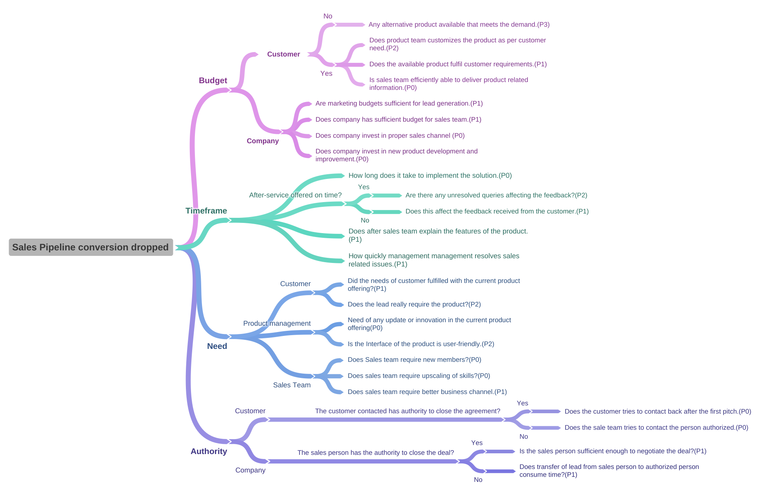

Slide 8
PART II : Formulating Hypotheses Sales Pipeline Conversion at a SaaS Startup
Branch 1-
Is sales team efficiently able to deliver product related information.(P0)
Branch 2
Does company invest in new product development and improvement.(P0)
Notes:
Each branch must follow this naming pattern: Problem – Branch 1 – Sub-branch 1 – Sub-branch 2 – …… – Hypotheses
There must be minimum 10 hypotheses in total and at least 1 in each branch.

Slide 9
PART II : Formulating Hypotheses Sales Pipeline Conversion at a SaaS Startup
Branch 3
Need of any update or innovation in the current product offering.(P0)
Branch 4
Does sales team require upscaling of skills?(P0)
Notes:
Each branch must follow this naming pattern: Problem – Branch 1 – Sub-branch 1 – Sub-branch 2 – …… – Hypotheses
There must be minimum 10 hypotheses in total and at least 1 in each branch.

Slide 10
PART II : Formulating Hypotheses Sales Pipeline Conversion at a SaaS Startup
Branch 5
Are marketing budgets sufficient for lead generation.(P1)
Branch 6
Does Sales team require new members?(P0)
Notes:
Each branch must follow this naming pattern: Problem – Branch 1 – Sub-branch 1 – Sub-branch 2 – …… – Hypotheses
There must be minimum 10 hypotheses in total and at least 1 in each branch.

Slide 11
PART II : Formulating Hypotheses Sales Pipeline Conversion at a SaaS Startup
Branch 7
How quickly management resolves sales related issues.(P1)
Branch 8
Does sales team require better business channel.(P1)
Notes:
Each branch must follow this naming pattern: Problem – Branch 1 – Sub-branch 1 – Sub-branch 2 – …… – Hypotheses
There must be minimum 10 hypotheses in total and at least 1 in each branch.

Slide 12
PART II : Formulating Hypotheses Sales Pipeline Conversion at a SaaS Startup
Branch 9
Does the customer tries to contact back after the first pitch.(P0)
Branch 10
Does after sales team explain the features of the product. (P1)
Notes:
Each branch must follow this naming pattern: Problem – Branch 1 – Sub-branch 1 – Sub-branch 2 – …… – Hypotheses
There must be minimum 10 hypotheses in total and at least 1 in each branch.

Slide 13
PART III A : Generating Insights Sales Pipeline Conversion at a SaaS Startup
Variable
Technology Primary
B2B Sales Medium
City
Sales Velocity
Client Revenue Sizing
Client Employee Sizing
Business from Client Last Year
Opportunity Sizing
Insights if any
ERP Implementation and Technical Business Solutions are the major offerings by the company covering 99% of their revenue.
Marketing and sellers are the major lead generators for the company.
Mumbai has maximum positive conversion rate.
The conversion rate for the company is 22.6%. I.e. most of the opportunities are getting wasted.
Average days spent in the sales stage would be around 20 to 40 days.
Last Year (F.Y.- 2016-17) 88% of clients did not give any business.
Pattern of Insight
Out of 78025 opportunities only 17627 turned into business.
76% of business is optioned from the clients with revenue between 100k or less. I.e. small scale businesses.
76% of business is optioned from the clients with employee sizing 1k or less. I.e. small scale businesses.
Thus, 76% of the business is obtained from small scale business
Notes:
Analyse the variables in the dataset, find the insights and mention the pattern of insights in the data. Make more copies of this slide if needed.

Slide 14
PART III A : Generating Insights Sales Pipeline Conversion at a SaaS Startup
Variable under consideration:
Technology Primary
ERP Implementation contributes to 66% of the opportunity win.
I.e. 11629 out of 17627 are for it.
ERP Implementation and Technical Business Solutions covers 99% of the business
Notes:
For each variable that produced an interesting insight, explain you analysis bit here – the results you got from excel and the necessary visualisations. Note: it is compulsory for you to mention the results of the analysis on these variables - 'Technology Primary', 'B2B Sales Medium', 'Client Revenue Sizing', 'Opportunity Sizing' and 'Business from Client last year’.

Slide 15
PART III A : Generating Insights Sales Pipeline Conversion at a SaaS Startup
Variable under consideration:
B2B Sales Medium
Enterprise sellers are the major source of business generation followed up by the marketing.
Enterprise seller contribute of the 54% of the total opportunity rate conversion.
I.e. out of 17627 leads converted 9584 were due to enterprise sellers.
Notes:
For each variable that produced an interesting insight, explain you analysis bit here – the results you got from excel and the necessary visualisations. Note: it is compulsory for you to mention the results of the analysis on these variables - 'Technology Primary', 'B2B Sales Medium', 'Client Revenue Sizing', 'Opportunity Sizing' and 'Business from Client last year’.

Slide 16
PART III A : Generating Insights Sales Pipeline Conversion at a SaaS Startup
Variable under consideration:
Client Revenue Sizing
Clients whose revenue is lesser than 100k contributes to 77% of the pipeline conversion. I.e. 13611 out of 17627 are by 100k or lesser
Small scale business clients are the ones who utilize our products.
Notes:
For each variable that produced an interesting insight, explain you analysis bit here – the results you got from excel and the necessary visualisations. Note: it is compulsory for you to mention the results of the analysis on these variables - 'Technology Primary', 'B2B Sales Medium', 'Client Revenue Sizing', 'Opportunity Sizing' and 'Business from Client last year’.

Slide 17
PART III A : Generating Insights Sales Pipeline Conversion at a SaaS Startup
Variable under consideration:
Opportunity Sizing
It shows a gradual decline in the pipeline conversion as the revenue size increases.
As the revenue size increases from 10k to 60k, the pipeline conversion decreases.
10k or lesser has maximum number of conversion from 27%. I.e. out of 17627; 4831 were from 10k or lesser.
Notes:
For each variable that produced an interesting insight, explain you analysis bit here – the results you got from excel and the necessary visualisations. Note: it is compulsory for you to mention the results of the analysis on these variables - 'Technology Primary', 'B2B Sales Medium', 'Client Revenue Sizing', 'Opportunity Sizing' and 'Business from Client last year’.

Slide 18
PART III A : Generating Insights Sales Pipeline Conversion at a SaaS Startup
Variable under consideration:
Business from Client Last Year
68% of existing clients have not provided any business this year.
8.7% of the existing clients provided business around 25000 to 50000
Notes:
For each variable that produced an interesting insight, explain you analysis bit here – the results you got from excel and the necessary visualisations. Note: it is compulsory for you to mention the results of the analysis on these variables - 'Technology Primary', 'B2B Sales Medium', 'Client Revenue Sizing', 'Opportunity Sizing' and 'Business from Client last year’. Make more copies of this slide if needed.

Slide 19
PART III A : Generating Insights Sales Pipeline Conversion at a SaaS Startup
Recommendations
Company should more on ERP Implementation and Technical Business Solutions products.
Invest more in Enterprise sellers and marketing than in social marketing leads.
Company should focus more on small scale companies whose revenue is in between 100k or lesser.
The major revenue company generating from leads lies between 0 to 30k
Company should try to sustain old clients. Should work on connections, proper feedback system, queries resolving, and client engagement.
Corresponding Insights
These two technology together contribute to 99% of the business offering. Thus, enhancing these two technology is significant.
93% of conversion rate is by the sellers and marketing combined together, and thus, investing in these two is curtail, as they affect the business directly. The, Social channels are not effective.
77% of the business is generated from this sector, i.e. 100k or lesser are more interested in the offering products. So the products should be optimized according to them for better business growth.
67% of the companies revenue is coming in the range till 30k. SO, company should try to work towards increasing this segment.
68% of the existing clients have not given business this fiscal year. Working on client engagement will help in sustaining the existing clients.
Notes:
For each recommendation explain the insights that form the reasoning for giving that recommendation. Make more copies of this slide if necessary.

Slide 20
PART III B : Presenting Findings Sales Pipeline Conversion at a SaaS Startup
The conversion rate will increase by investing more in sales and marketing.
Sales and marketing contribute to 99% of pipeline conversion.
Investing in B2B online channels lead to drop in conversion rate.
Enterprise sellers are generating conversion of 54%.
Marketing contributes to 39% of conversion rate.
Online leads are producing only 0.23%.
Cost cutting in marketing and sales resulted in pipeline conversion drop.
Invest more in upscaling and skilling sales team.
Notes:
You are free to use the elements and boxes mentioned previously. Make sure you’re using the pyramid principle, data visualization, visual design principle and storyboarding concepts to design these slides.

Slide 21
PART III B : Presenting Findings Sales Pipeline Conversion at a SaaS Startup
Notes:
You are free to use the elements and boxes mentioned previously. Make sure you’re using the pyramid principle, data visualization, visual design principle and storyboarding concepts to design these slides.

Slide 22
PART III B : Presenting Findings Sales Pipeline Conversion at a SaaS Startup
Notes:
You are free to use the elements and boxes mentioned previously. Make sure you’re using the pyramid principle, data visualization, visual design principle and storyboarding concepts to design these slides.

